Slide 1
Collect all the things
Justin Walsh

Slide 2
Let us blueprint
Collect all the things
Wires, Pins, and Nodes
Actor Blueprint vs Level Blueprint
Remember Things - Programmers Call it a Variable
Communicate with Others aka Events
Q & A

Slide 3
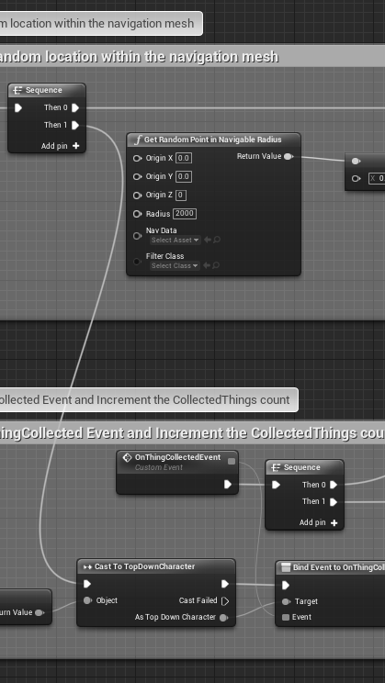
project is on github
https://github.com/UnrealPhx/CollectAllTheThings

