Slide 1
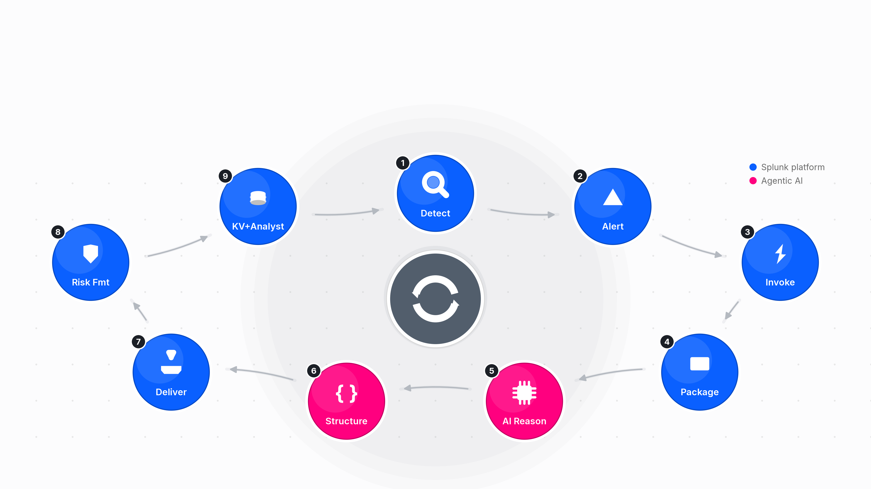
The Agentic Detection Loop
Notes:
Detect → Decide → Act → Record — one continuous loop, closed without a human in the middle of it, and now closed inside a single process instead of handed off between two.
This is the single architecture diagram the whole rest of the talk hangs off — full version lives in ARCHITECTURE.md. Walk it top to bottom exactly once here, slowly, then tell the room "we're now going to walk each of these three phases in detail" — this sets up slides 6–10.
Name the phases explicitly since you'll refer back to them by number for the rest of the deck — and flag up front that Phase 2 and Phase 3 used to be two separate hops, not one:
Phase 1 — ES alert-action output feeds the agentic AI (shipped, TA_ResponseActions).
Phase 2 — the AI answers, in-line, before delivery (shipped, v1.3.3, inside the same process as Phase 1).
Phase 3 — that answer lands via Splunk's own existing APIs, with zero human intervention (shipped, v1.3.3, same call as Phase 2 — no second component).
Tell the room honestly, right here, that this diagram is the second version of this architecture, not the first: the first shipped design (v1.3.1–v1.3.2) split Phase 2/3 out into a separate asynchronous bridge component that polled Slack for a reply. It worked. It's still worth seeing — slides 8–9 walk through it, because building it and retiring it is where Takeaway 3 actually comes from. What's on screen now is what replaced it, once the cost of running a second component became obvious and the fix turned out to be simpler than the original design: trust the Perplexity API's own structured-output feature and trust that the alert action already had everything it needed synchronously, with no hand-off required.
Emphasise the closing line — this is the "retaining the principles of being agentic" test this whole pipeline has to pass: detect (correlation search) → decide (agentic AI against the standing perplexity_ask checks) → act (Slack + notable comment + KV store write-back) → record (native Adaptive Response panel, Incident Review) — one continuous loop, closed without a human in the middle of it, and now closed synchronously in one request/response rather than an async poll. This exact phrase and diagram are from ARCHITECTURE.md § The loop at a glance.
Everything here is already shipped — this is not a roadmap slide. Status detail, including the retired first version, comes back on slide 14.

