Slide 1

The other AI:
Assets and Identity.
Using Splunk to keep in check
SEC1053
David Pollard
Unshakeable Salt Ltd, @UnshakeableSalt
Notes:
Credit: Image
Source: Photo of myself, taken by myself

Slide 2
The other AI: Assets and Identity. Using Splunk to keep in check
Compliance doesn’t have to be a checkbox chase. Splunk can transform governance into a living, automated process—mapping assets, identities, and risks in real time.
Learn how to align with the UK Government’s Cyber Assessment Framework & the NIST Cyber Security Framework while leveraging AI‑driven, agentic workflows to detect anomalies, trigger automated responses, and sustain a continuously monitored, audit‑ready environment powered by Splunk Enterprise and Splunk Enterprise Security.
Takeaway #1
Takeaway #2
Takeaway #3
Learn how to use Splunk for continuous asset discovery and risk tracking across secure infrastructures.
How Splunk's automated governance workflows simplify meeting regulatory mandates such as the Cyber Assessment Framework / NIST Cyber Security Framework
Understand how to turn compliance reports into proactive, automated security actions inside Splunk.

Slide 3
You can’t protect what you don’t know you have.
Dave DeWalt
Former CEO, McAfee & FireEye · Founder, NightDragon
Notes:
Why open SEC1053 on this quote
Dave DeWalt — former CEO of McAfee and FireEye, and founder of the cyber investment firm NightDragon — has made this point repeatedly across interviews and industry whitepapers: security teams cannot protect, or even scope the risk of, an asset they don’t know exists. It is a deliberately simple line for a deliberately hard problem: asset visibility is the foundation every other control sits on top of.
Sources for the quote: CyberDefense Magazine whitepaper with Dr. David G. DeWalt and a BankInfoSecurity interview with FireEye’s Dave DeWalt.
Link to the UK NCSC Cyber Assessment Framework (CAF)
CAF Objective A — “Managing security risk” — opens with Principle A3, Asset Management: “Everything required to deliver, maintain or support networks and information systems necessary for essential functions is determined and understood.” Contributing outcome A3.a expects a maintained, accurate inventory covering hardware, software, data and supporting infrastructure, with ownership, prioritisation and lifecycle status — the exact capability the quote is describing. Every downstream CAF objective, especially A2 Risk Management and the technical/monitoring outcomes in Objectives B and C, assumes this inventory already exists; you cannot risk-assess or defend what you have not first identified. This maps directly across CAF versions, including the current CAF 4.0 used for NIS Regulations/GovAssure audits.
ncsc.gov.uk/collection/cyber-assessment-framework
Link to NIST CSF
NIST CSF places the same idea at the very start of the framework, under the Identify function, category ID.AM (Asset Management) — inventorying and managing physical devices, software platforms, data flows and their business context so risk can be assessed accurately. CSF 2.0 strengthens this further by tying ID.AM explicitly to organisational context and governance, reinforcing that asset visibility is the prerequisite for every later Protect, Detect, Respond and Recover activity.
nist.gov/cyberframework/identify
Transition line: this is exactly the gap Splunk Enterprise Security’s asset and identity framework closes — which is what the rest of SEC1053 covers.

Slide 4

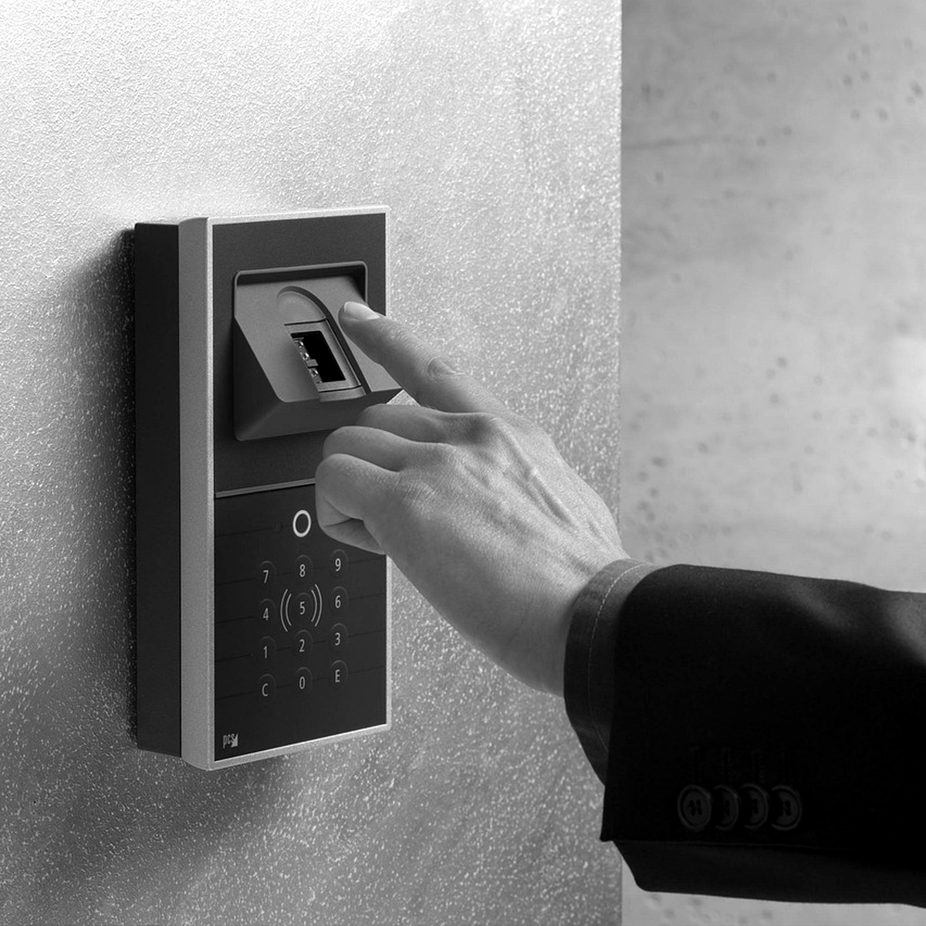
Defining Terms
…because you really guess how much is debated
Asset
Identity
any component of the technical estate that must be identified, tracked, and secured - physical hardware, VMs, cloud instances, containers, code repositories, SaaS/third-party services. Not just servers and laptops.
any entity - human or non-human - that authenticates and is granted access: users, service accounts, API keys, workload identities, certificates.
Notes:
assets and identities are two axes of the same risk. An asset is compromised *through* an identity; an identity's blast radius is defined by *which assets it can reach*. You can't reason about risk with only one half of the picture.
Anchor this to the frameworks early: NIST CSF's ID.AM category already spans both physical/software assets *and* personnel, and CAF Principle A3 (Asset Management) expects you to know what you have before you can protect it.
Credit: Photo by Schäferle on Pixabay
https://pixabay.com/photos/server-space-the-server-room-dark-2160321/
Credit: Photo by u_h0yvbj97 on Pixabay
https://pixabay.com/photos/fingerprint-sensor-4703841/

Slide 5
Most orgs don't have a CMDB. The ones that do don't trust it.
Reality Check
Notes:
Set the stakes: without asset visibility, ES notable events have no risk context, no ownership, no priority — every alert is just noise with a hostname attached.

Slide 6
Why CMDBs Fail (Even When They Exist)
Manual entry drift,
M&A sprawl
shadow IT
ephemeral cloud instances
ownership silos.
The CMDB is a snapshot; your environment is a stream.

Slide 7
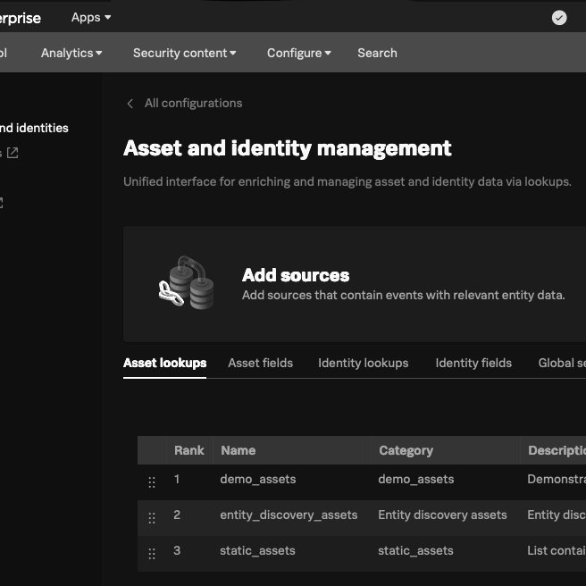
Reframe: ES Isn't a CMDB Replacement, It's an Enrichment Layer
Notes:
Credit: Image
Source: Own ES Instance at Unshakeable Salt.

Slide 8
“The SOC Missed the Alert”
Everyone always, without mentioning;
there was no telemetry source
the forgotten storage bucket
the still-routable decommissioned VPN concentrator
the admin account nobody remembered existed

Slide 9
The Data You Don't Have
(And Why That's Why Enterprise Security Fails)
unmanaged BYOD
shadow IT
SaaS nobody provisioned through IT
decommissioned-but-still-live cloud resources nobody tore down
OT/IoT devices with no agent capability
contractor/third-party laptops
orphaned service accounts
undocumented API integrations
pre-EDR-rollout assets
M&A-inherited environments never fully onboarded
An unmonitored asset isn't a "known unknown" on a risk register — it's genuinely invisible. Your SIEM, EDR, and vulnerability scanner are only as good as their coverage; nothing analyses telemetry that was never generated
Notes:
- **Classic blind spots:** unmanaged BYOD, shadow IT/SaaS nobody provisioned through IT, decommissioned-but-still-live cloud resources nobody tore down, OT/IoT devices with no agent capability, contractor/third-party laptops, orphaned service accounts, undocumented API integrations, pre-EDR-rollout assets, and M&A-inherited environments never fully onboarded.
- **The core point:** an unmonitored asset isn't a "known unknown" on a risk register — it's genuinely invisible. Your SIEM, EDR, and vulnerability scanner are only as good as their coverage; nothing analyzes telemetry that was never generated.
- **Reframe the failure mode:** security incidents are rarely "the SOC missed the alert." They're far more often "there was no telemetry source there at all" — the forgotten storage bucket, the still-routable decommissioned VPN concentrator, the admin account nobody remembered existed.
- **Bridge to Takeaway 1:** this is exactly why *continuous* discovery matters more than a one-off inventory project — the goal isn't to close the gap once, it's to keep noticing when something new and unmonitored appears.
- **Possible callback (see cross-session note above):** when Splunk detects something and genuinely can't classify it, that's a candidate use case for the agentic AI pattern from SEC1215 — an LLM reasoning over the raw signal to propose what it might be and writing that back into the asset/identity KV Store, rather than the gap just sitting there until a human investigates.

Slide 10
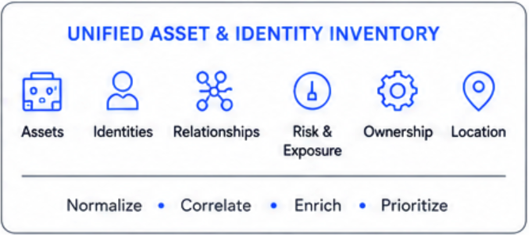
The Hard Part: Identity Correlation, Not Collection
| inputlookup asset_inventory_lookup
| eval asset_id=asset_id
| join type=left asset_id
[ | inputlookup identity_inventory_lookup
| rename primary_asset_id as asset_id ]
| eval last_correlated=strftime(now(),
"%Y-%m-%d %H:%M:%S")
| eval correlation_status=case(
isnull(identity_id), "orphaned_asset",
isnull(asset_id), "orphaned_identity",
identity_status!="active",
"stale_identity_on_active_asset",
1=1, "correlated")
| table asset_id, asset_owner, asset_criticality, identity_id, identity_owner,
identity_status,
identity_mfa_enrolled,
correlation_status,
last_correlated
| outputlookup asset_identity_correlated_lookup
Notes:
The real challenge with the data you *do* have isn't gathering it, it's correlating hostname/IP/MAC/cloud-instance-ID into one canonical asset identity over time — through DHCP churn, VPN NAT, ephemeral instances. Introduce the need for a normalization schema here.
Credit: Image
Source: Created by myself using Visio, merged and collated into larger view using Perplexity AI

Slide 11
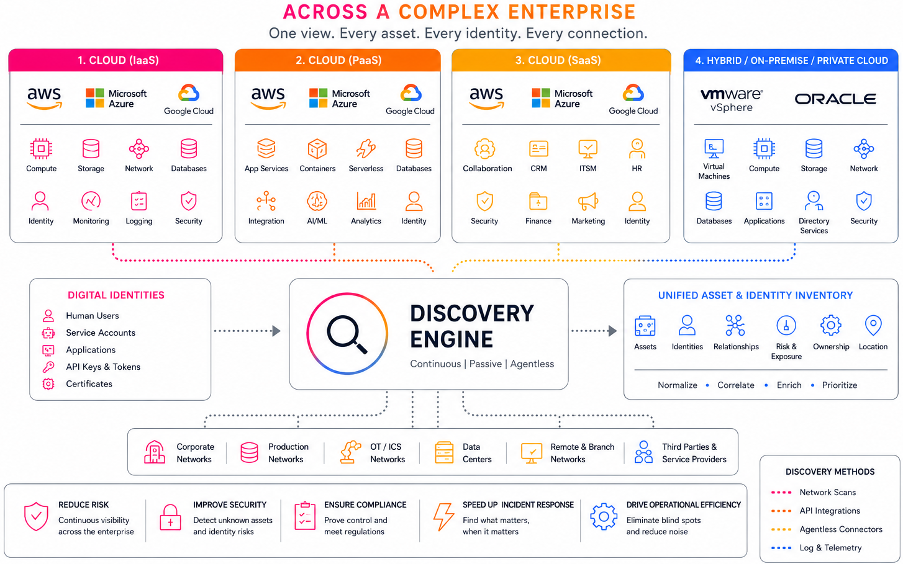
Notes:
Discovering Assets and Digital Identities
Credit: Image
Source: Created by myself using Visio, merged and collated into larger view using Perplexity AI

Slide 12
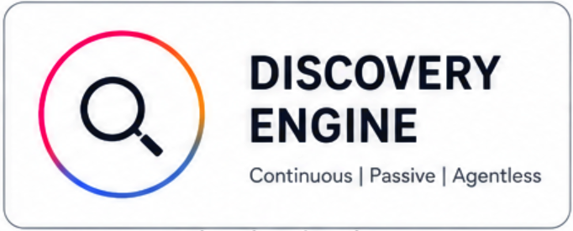
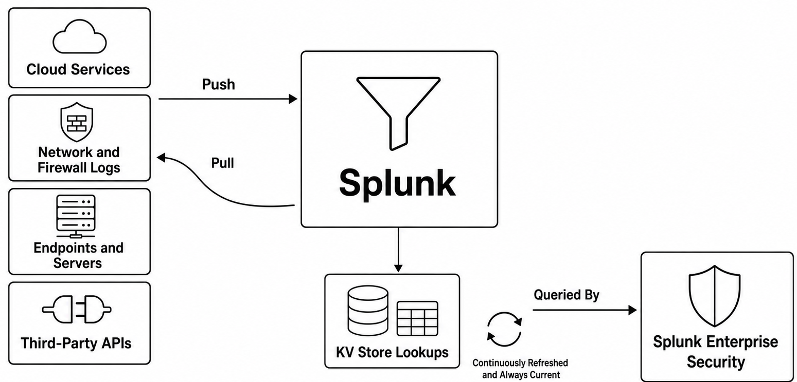
Building the "Poor Man's CMDB" in Splunk
`` Correlate network/auth activity against Asset and Identity inventories ``
index=network_traffic OR index=auth OR index=osquery
| eval asset_id=coalesce(dest_asset_id, dvc, dest)
| eval identity_id=coalesce(user, service_account, workload_identity)
`` Enrich with Asset inventory (KV Store-backed lookup, refreshed every 15m) ``
| lookup asset_inventory_lookup asset_id
OUTPUT asset_owner, asset_type, asset_environment, asset_criticality, asset_last_seen
`` Enrich with Identity inventory (KV Store-backed lookup, refreshed every 15m) ``
| lookup identity_inventory_lookup identity_id
OUTPUT identity_type, identity_owner, identity_status, identity_mfa_enrolled, identity_risk_sc
Notes:
Scheduled searches normalize and push identity data into KV Store lookups — continuously refreshed, always current. Reference Asset and Risk Intelligence (ARI) as Splunk's productized version of this exact pattern.
Credit: Image
Source: Created by myself using Visio, merged and collated into larger view using Perplexity AI

Slide 13
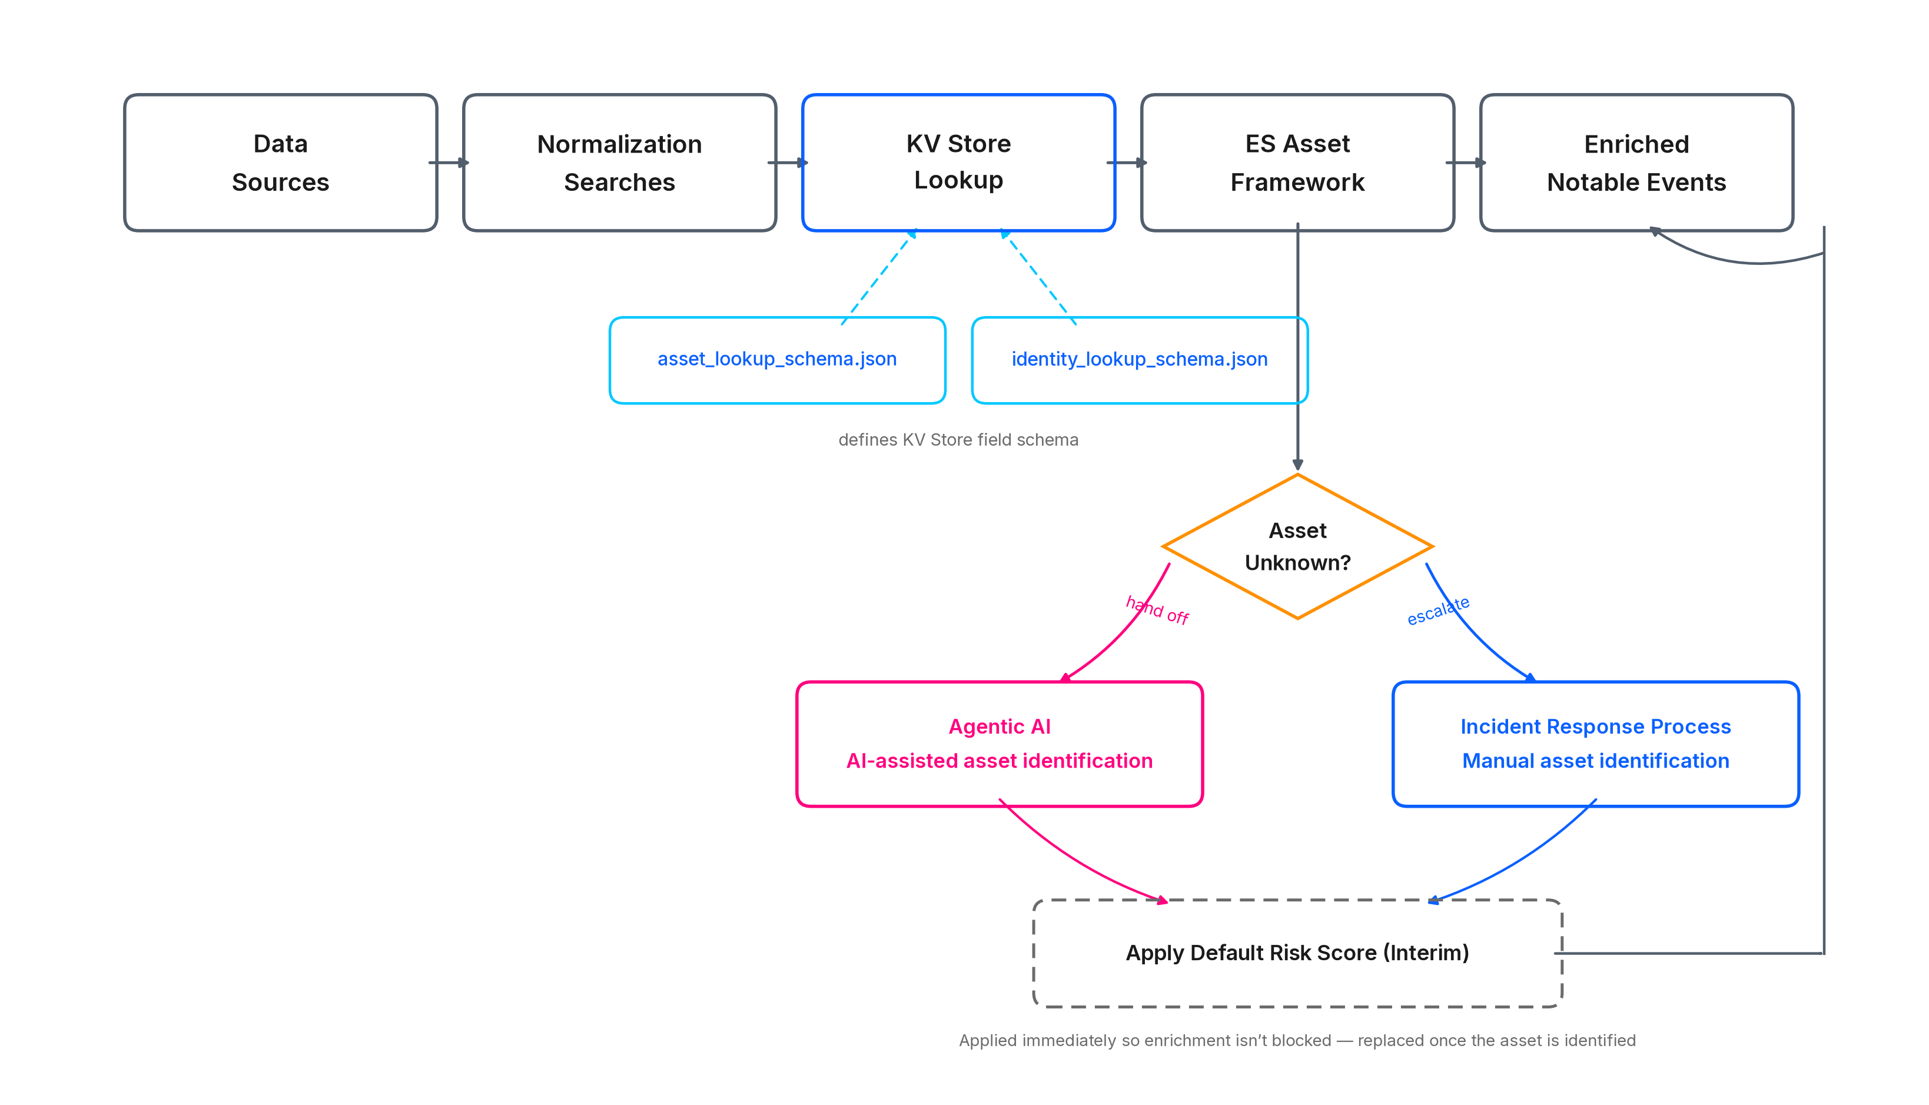
Architecture Walkthrough
Notes:
Data flow diagram: sources → normalization searches → KV Store lookup → ES Asset framework → enriched notable events. Show the actual lookup schemas here — `asset_lookup_schema.json` / `identity_lookup_schema.json` and the ES 8.5.1 YAML templates already in `conf26/SEC1053/Proof_of_concept/`.
Credit: Image
Source: Created by myself using Visio, merged and collated into larger view using Perplexity AI

Slide 14
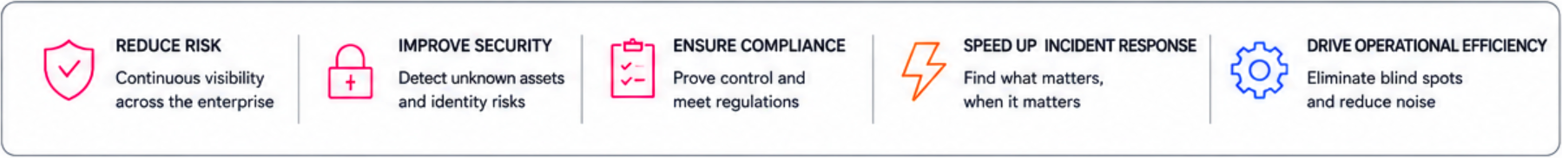
Governance Gets Measurable
All assets relevant to the secure operation of essential function(s) are identified and inventoried (at a suitable level of detail).The inventory is kept up-to-date.
You have prioritised your assets according to their importance to the operation of the essential function(s). [Threat and Risk Scoring]
You have assigned responsibility for managing all assets, including physical assets, relevant to the operation of the essential function(s). [Process: Incident Management]
Assets relevant to the essential function(s) are managed with cyber security in mind throughout their lifecycle, from creation through to eventual decommissioning or disposal. [Process: Onboarding to Splunk]
Notes:
Once you have continuous coverage, map it directly to CAF Principle A3 (Asset Management) and NIST CSF ID.AM. Completeness, freshness, and ownership become auditable KPIs instead of a point-in-time spreadsheet an auditor has to take on faith.
CAF Principle A3 — Asset Management has one contributing outcome, A3.a: “All assets relevant to the secure operation of essential function(s) are identified and inventoried… the inventory is kept up-to-date”.
NIST CSF 2.0 ID.AM (Asset Management) subcategories most relevant here are ID.AM-01 (hardware inventories maintained) and ID.AM-02 (software/services/systems inventories maintained).
Every correlation search is tagged at creation — compliance mapping isn't a spreadsheet, it's metadata that runs.
Credit: Image
Source: Created by myself using Visio, merged and collated into larger view using Perplexity AI

Slide 15
From Visibility to Automated Action
Keeping the Inventory up to date:
(Did you attend my talk yesterday?)
Alert Actions firing AI Agents:
Perform a basic refresh of temporal assets
Use a LLM to fingerprint and ID
Rebalance risk scores dynamically before a human gets involved
Notes:
Tagged, risk-scored assets let you automate: rogue-asset detection when something unmanaged appears on the network, automatic ticket creation, dynamic risk re-scoring. The compliance report stops being a PDF and becomes a live trigger.

Slide 16
The other AI: Assets and Identity. Using Splunk to keep in check
You don't need a CMDB: you need continuous, correlated identity.
Takeaway #1
Takeaway #2
Takeaway #3
Splunk is a consumer of A&I data, not ‘the’ source
Continuous Coverage
CAF Principle A3 (Asset Management)
NIST CSF ID.AM
Auditable KPIs of real time data, no longer using point in time spreadsheets
Rogue Asset Detection
Automatic Ticket Creation
Dynamic Risk re-scoring
Compliance Report is a live trigger, not a PDF
Notes:
Structure: one real architecture, built twice — what we shipped first, what it taught us, and
the simpler version running today → a live look at each phase → the pitfalls that drove the
rebuild, so you don't have to hit them yourself.
## Speakers Notes
These three takeaways come directly from the session abstract and are the spine of the
whole talk — every section maps back to one of them, and slide 14 closes by revisiting all
three explicitly.
Set expectations here: this isn't a roadmap or a vision talk.
Credit: Image
Source: Created by myself using Visio, merged and collated into larger view using Perplexity AI

Slide 17

From Zero to Agentic:
Building Your First AI-Driven Threat Investigation in Splunk Enterprise Security
SEC1215
David Pollard
Unshakeable Salt Ltd, @UnshakeableSalt
Resources:
https://github.com/UnshakeableSaltLtd/SplunkConf
Notes:
Credit: Image
Source: Standard QR Generation within Adobe

Slide 18
Thank you

