Slide 1

From Zero to Agentic:
Building Your First AI-Driven Threat Investigation in Splunk Enterprise Security
SEC1215
David Pollard
Unshakeable Salt Ltd, @UnshakeableSalt
Notes:
Welcome in, introduce yourself briefly: David Pollard, Unshakeable Salt Ltd.
20-minute Theater Session (Tuesday, Sep 15, 1:30–1:50 PM MDT),
Security track,
Novice skill level,
so the framing throughout is deliberately practical and not academic — this is what
actually happened building one bespoke agentic use case inside Splunk Enterprise Security,
not a vendor pitch.

Slide 2
From Zero to Agentic: Building Your First AI-Driven Threat Investigation in Splunk Enterprise Security
Agentic AI promises autonomous security operations — but where do you actually start?
This session cuts through the hype with hard-won lessons from building a bespoke agentic use case inside Splunk Enterprise Security from scratch.
We cover LLM selection on a real-world budget, native Splunk integration patterns, and the critical pitfalls that cost time before delivering value. Practical, honest, and immediately applicable.
Takeaway #1
Takeaway #2
Takeaway #3
Choose the right LLM for SecOps — balancing cost, latency, privacy, and capability without defaulting to the biggest name.
A repeatable pattern to integrate agentic workflows into Splunk ES — what to build yourself vs. what Splunk gives you for free.
Avoid the top pitfalls — a prioritised starting framework for teams with limited time and budget to reach value fast.
Notes:
Structure:
one real architecture, built twice — what we shipped first, what it taught us, and
the simpler version running today → a live look at each phase → the pitfalls that drove the
rebuild, so you don't have to hit them yourself.
These three takeaways come directly from the session abstract and are the spine of the
whole talk

Slide 3
01
The Agentic Promise
02
Choosing the LLM
Agenda
03
A three-phase loop
04
Phase 1 – The “Alert Action”
05
Phase 2 – Bridge Mechanics & CIM
06
Phase 3 – Zero Touch
07
Demo
08
Recap & Pitfalls

Slide 4
‘Agentic AI’ is Easy to Say,
- Hard to Ship
Every vendor keynote: autonomous SOC, self-healing detections, AI analysts.
The gap nobody shows you: what connects an LLM's opinion to a field Splunk can score, correlate, and dashboard.
An LLM's reply is prose, or loose JSON at best — Enterprise Security's Risk Analysis framework and Incident Review don't care what the AI said. They care about fields.
Start with Smart LLM's and tune down to specific API addressing.
The plumbing between "the AI had a thought" and "the SOC analyst sees a risk score, with zero copy/paste."
Notes:
This is the hook / problem statement before we show any architecture.
The core tension to land here:
agentic AI demos always show the LLM reasoning about a security event, but they
skip the unglamorous part — getting that reasoning back into the platform in a form the
platform's own automation (Risk-Based Alerting, Incident Review) can actually use.
Land the specific technical claim early, because it's the thesis of Phase 2 later: a risk
modifier in the risk index is only usable by the Risk Analysis and Incident Review
dashboards once it carries, at minimum, `risk_object`, `risk_object_type`, and `risk_score`
— because the Risk data model (`All_Risk`) accelerates exactly those fields, and an object's
overall risk score is the sum of every risk modifier's `risk_score` for it.
Don't over-explain yet — this slide is intentionally a teaser for slide 8, where we walk
through the design we built *first* to chase exactly this bar (mapping the AI's verdict onto
`risk_object`/`risk_object_type`/`risk_score`). Small honest caveat to set up now so it isn't
a surprise later: what ships today (v1.3.3, slide 5) deliberately does not push the AI's
answer into the risk index — that trade-off, and why it was still the right call, is Takeaway
3's whole arc. The point right now is just: "posted to Slack" is not the same thing as
"usable by Splunk."

Slide 5
We have no SOAR, we have no AI
Take a finding we see in Enterprise Security, where we normally have to rely on a person performing an action, manually gathering some enrichment data, rekeying it into our platform and waiting for the next decision point.
‘Apply some Agentic AI magic'
Proof of Concept

Slide 6
Enterprise Security
Package it up
Finding
Append to the original Finding
Better audit this
Do some
‘AI Stuff’
with it
Send it back to Splunk
Package it up again

Slide 7
Other LLM and AI Providers are available…
Is in fact Takeaway #1

Slide 8
Choosing the Right LLM for SecOps
Takeaway #1
Four axes that actually matter - not "which model tops the leaderboard":
Cost
Priced per notable/investigation, not per demo. A SOC generates volume; the biggest frontier model on every single notable gets expensive fast. Learning as we did this, treat the same as developing detections.
Latency
The call happens synchronously, in-line, inside the alert action itself. The correlation search's adaptive response doesn't finish until the model replies, so round-trip time is part of the alert pipeline's own latency budget, not a footnote.
Privacy
The payload is a full CIM/risk notable export. Where does that data go, and under what retention/training terms?
Capability
Does it need to reason over a full raw event, or just answer three standing yes/no/score questions well?
Notes:
Design decision that follows from this: keep the **payload full and complete**, so a
smaller/cheaper model still gets the whole picture to reason over — don't compensate for a
weaker model by hand-crafting a bigger prompt.
Concretely, the agentic AI actor in this build is called directly: `notable_to_perplexity_json.py`
makes a synchronous request to the Perplexity Chat Completions API, passing the JSON payload
plus the standing `perplexity_ask` checks you'll see in Phase 1, and the model is named by a
plain config value, `param.perplexity_model`. Emphasise this is a *contract*, not a lock-in:
because the interface between Splunk and the AI is a plain JSON payload in, and a JSON Schema
`response_format` out (see Phase 2), the model behind that call is swappable by editing one
config field — the integration doesn't care which model answers, only that it can honour a
structured schema. Worth naming explicitly: this is simpler than the first version of this
build, which invoked the AI in-thread via a Slack mention and had to parse whatever came back
as a reply — swapping models there meant hoping the new model kept following the same
free-text convention. That's gone now; the schema does the enforcing, not the model's good
behaviour.
Practical guidance to leave the audience with: start the cost/latency/privacy/capability
conversation with "what's the smallest model that reliably returns our JSON shape," not
"which model is smartest" — capability requirements here are narrow and specific (score a
notable against three standing checks, reply in strict JSON), not general reasoning.

Slide 9
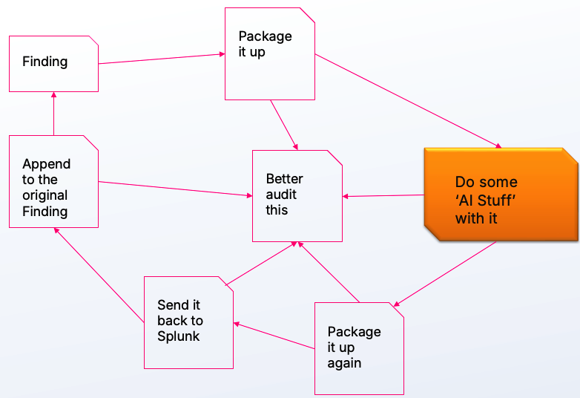
The Agentic Loop, One Synchronous Step
ES Correlation Search
  Triggers Notable/Risk event
    Adaptive Response Action: TA_ResponseActions
      Builds the full CIM/Risk notable as JSON
      Answers an “AI Prompt” block of standing checks via Synchronous Call to AI API
Receives answer back as an “AI Response”
One payload back
  Slack for Visual Audit
  Originating notables audit trail
  Notable enrichment KV Store record
Notes:
This is the single architecture diagram the whole rest of the talk hangs off — full version
lives in
Walk it top to bottom exactly once here, slowly, then tell the room "we're now going to walk
each of these three phases in detail" — this sets up slides 6–10.
Name the phases explicitly since you'll refer back to them by number for the rest of the
deck — and flag up front that Phase 2 and Phase 3 used to be two separate hops, not one:
- **Phase 1** — ES alert-action output feeds the agentic AI (shipped, `TA_ResponseActions`).
- **Phase 2** — the AI answers, in-line, before delivery (shipped, v1.3.3, inside the same
process as Phase 1).
- **Phase 3** — that answer lands via Splunk's own existing APIs, with zero human
intervention (shipped, v1.3.3, same call as Phase 2 — no second component).
Tell the room honestly, right here, that this diagram is the *second* version of this
architecture, not the first: the first shipped design (v1.3.1–v1.3.2) split Phase 2/3 out
into a separate asynchronous bridge component that polled Slack for a reply. It worked. It's
still worth seeing — slides 8–9 walk through it, because building it and retiring it is where
Takeaway 3 actually comes from. What's on screen now is what replaced it, once the cost of
running a second component became obvious and the fix turned out to be simpler than the
original design: trust the Perplexity API's own structured-output feature and trust that the
alert action already had everything it needed synchronously, with no hand-off required.
Emphasise the closing line — this is the "retaining the principles of being agentic" test
this whole pipeline has to pass: detect (correlation search) → decide (agentic AI against
the standing `perplexity_ask` checks) → act (Slack + notable comment + KV store write-back)
→ record (native Adaptive Response panel, Incident Review) — one continuous loop, closed
without a human in the middle of it, and now closed synchronously in one request/response
rather than an async poll.
Everything here is already shipped — this is not a roadmap slide.

Slide 10
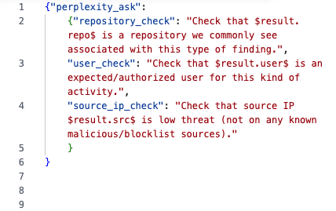
Phase 1: ES Alert Action Feeds the Agentic AI
Takes the triggering notable/finding and delivers it to Slack as a complete JSON payload every CIM/risk/notable field, noise fields stripped, no size-limited summary.
Ships a standing `perplexity_ask` block by default in `param.additional_fields`:
  three checks that travel with every notable
    Is `$result.repo$` a repo we commonly see for this finding type?
    Is `$result.user$` an expected/authorised user?
    Is `$result.src$` a low-threat source IP?
  Two delivery modes:
    file_upload (bot token, no size limit)
    webhook (quick setup, truncates large payloads).
Notes:
This is Phase 1 of the loop, detailed.
Key point to land: this isn't a lossy summary sent to the LLM — it's the *entire* CIM/risk
event, denylist-scrubbed only for noise
The `perplexity_ask` block is the "standing question" pattern worth calling out: every
notable gets the *same* structured question, so the agentic AI's job is narrow and
repeatable (three checks, one structured answer) rather than open-ended free-form analysis
— this is what keeps a smaller/cheaper model (Takeaway 1, slide 4) viable. This block hasn't
changed shape since v1.3.0; what changed underneath it (slide 8 onward) is *how* it gets
answered and *how quickly* that answer gets back into Splunk.

Slide 11
What Splunk Gives You for Free vs. What You Build
Takeaway #2
Splunk gives you for free | You build
Adaptive Response framework | The delivery shaping (JSON payload, denylist)
`cim_actions.py`'s `ModularAction` - native panel reporting | The standing-question payload (`perplexity_ask` block)
The Perplexity Chat Completions API's `response_format` (JSON Schema) | The synchronous in-line call + the schema shape itself
The Notable Event API + KV store | The KV-store enrichment + custom drilldown dashboard
The pattern, once built, is reusable per correlation search - you only write the glue once.
Notes:
This is Takeaway 2 stated as a direct comparison table — the "repeatable pattern" the
abstract promises.
"Takeaway 2 (repeatable pattern, build-vs-free)... Adaptive Response + CIM + the Notable
Event API + KV store are Splunk's own primitives; the JSON shaping, the standing checks, and
the synchronous Perplexity call are the glue you write once and reuse per correlation
search." Worth a callback here: the "you build" column used to have a fourth thing in it —
an async bridge process. It's not a column entry anymore, and that's the point: the
reusable pattern got *simpler* between v1.3.2 and v1.3.3, not more capable-looking. Slides
8–9 show what that bridge used to do and why removing it was the right trade.
Use this slide as the pivot point in the talk: slides 6–10 (Phases 1–3) are the detailed
walkthrough of exactly what sits in each column of this table. Tell the room: "keep this
table in mind — every component we show next is either something Splunk ships, or
something in this specific app that fills a gap."
Good ad-lib: `cim_actions.py`'s `ModularAction` class is what makes the notable's native
"Adaptive Responses" panel / "View Adaptive Response Invocations" audit trail work
automatically the moment you call `self.message(..., status=...)` — most people writing a
custom alert action skip this and lose that free integration point.

Slide 12
Phase 2, Take 1:
What We Thought We Needed
AI verdict concept | CIM Risk field it becomes
Which user/host/IP is this about | `risk_object` `risk_object_type`
How risky is this, on our scale | `risk_score`
Why — the AI's reasoning, in one line | `risk_message`
Which notable this ties back to | `orig_sid` `orig_rid` `event_id`
The fix, at the time: pin the required JSON shape into the prompt itself
(`perplexity_ask.reply_format` in `alert_actions.conf`), so the reply is deterministic, not scraped from free text. It worked and it's not what ships today.
Here's why we built it, and exactly how it worked.
Notes:
This is the flashback slide: the *first* version of Phase 2, shipped as v1.3.1, and the
moment "the AI said something" was supposed to become "Splunk can correlate, score, and
dashboard what the AI said" by treating the verdict as a new CIM Risk modifier. It's a real,
worked design — not a straw man — which is exactly why it's worth walking through before
showing what replaced it.
Repeat the field-minimum claim from slide 3, now with the "why" fully spelled out: a risk
modifier in the risk index is only usable by Risk Analysis and Incident Review once it
carries, at minimum, `risk_object`, `risk_object_type`, and `risk_score`, because the Risk
data model (`All_Risk`) accelerates exactly those fields, and an object's overall risk score
is the sum of every risk modifier's `risk_score` for it — reference:
Bridge slide into "how does it actually read that reply back"

Slide 13
Phase 3, Take 2: One Payload, Three Existing Write-Back Paths
No bespoke store, and no second process either.
The same envelope that carried `perplexity_ask` now also carries `perplexity_response`, straight into the three paths that our Splunk App already had:
Slack
The Notable Event API → the originating notable
The `notable_enrichment’ KV store & custom drilldown
Still useful for visually auditing exactly what was asked and what came back, per notable, as it happens.
`POST /services/notable_update` comment summarising what was sent, now including the Perplexity answer - visible directly in that notable's own Activity timeline in Incident Review.
The full ask-and-response JSON as a structured record, reached from the notable's Adaptive Responses panel.
No analyst forwards, tags, or re-keys anything. All three writes happen inside the same alert-action invocation — no waiting on a reply, no second component to trigger them.
Notes:
his is Phase 3 — the payoff of Phases 1 and 2, and the clearest evidence that removing the
bridge cost nothing structurally. Source:
Emphasise "not a bespoke store, and no second process" — this is the point where the
"build vs. free" framing (slide 7) pays off most visibly: the same three write-back paths
v1.2.0 already had now just also carry `perplexity_response`. Nothing new was invented to
replace the bridge's writes — they were already there, waiting to be fed synchronously
instead of asynchronously. Contrast explicitly with slide 8's take: the bridge *did* also
feed the risk index via HEC, which this design deliberately doesn't do — that's the one
real capability gap, named honestly rather than glossed over (see slide 3's caveat and
Close this slide with the full "retaining the principles of being agentic" loop, repeated
from slide 5 but now every step has been shown concretely: **detect** (correlation search)
→ **decide** (agentic AI against the standing `perplexity_ask` checks, in-line) → **act**
(Slack + notable comment + KV store write-back, same call) → **record** (native Adaptive
Response panel, Incident Review) — one continuous loop, closed without a human in the
middle of it, closed synchronously.
Transition line into the demo: "so let's actually see this fire, end to end — and notice how
few steps that actually is now."

Slide 14
Live DEMO

Slide 15
LIVE DEMO SCRIPT
TRIGGER: fire a correlation search in Splunk ES; a notable lands in Incident Review.
FIRE THE ACTION: `TA_ResponseActions` builds the full CIM/risk JSON, including the `perplexity_ask` standing checks.
The AI answers, in-line: before anything is sent anywhere, a single synchronous call to the Perplexity API returns a structured `perplexity_response`, merged straight into the same payload.
One payload, three deliveries: Slack, the notable's comment trail, and the KV store record all get written in the same action invocation. No polling, no wait.
Payoff: show the same notable in Incident Review: Adaptive Responses panel, notable comment, and the KV-store drilldown dashboard, all populated
Notes:
This is the live demo slide — talk through the five numbered steps as you drive the actual
Splunk instance, Slack workspace, and dashboards. Supporting demo scripts/config live in
Suggested pacing for a 20-minute session: this demo now runs noticeably faster than the
version of this talk that would have run against v1.3.1–v1.3.2 — there's no 60-second poll
interval to wait out anymore, because there's no poll at all. Say that out loud: "the old
version of this demo had a built-in coffee-break while we waited for a bridge to notice a
Slack reply — watch how long this takes now." Have a fallback screenshot ready regardless,
in case the live Perplexity API call is slow or the network is uncooperative on the day, but
you should no longer need it purely to skip a polling delay.
Things to physically point at on screen for maximum impact:
- The Adaptive Responses panel entry (backed by `cim_actions.py`'s `ModularAction` — see
slide 7) — proves the native panel integration works without any custom UI code.
- The KV-store drilldown dashboard
(`default/data/ui/views/notable_slack_enrichment_drilldown.xml`) — shows the full
`perplexity_ask`/`perplexity_response` pair, ask and answer side by side, next to the
rest of the enrichment record.
- The notable comment itself in Incident Review's Activity timeline — this is the moment to
say "this landed the moment the alert action ran, not sixty seconds and a Slack reply
later." (Skip the `All_Risk`/risk-index datamodel search that would have been here in an
earlier version of this demo — v1.3.3 deliberately doesn't write to the risk index; see
slide 8's honest scope note if anyone asks why.)

Slide 16
{ "source": "splunk_es_adaptive_response",
"action": "notable_to_perplexity_json",
"sent_at": "2026-08-03T10:31:36Z",
"search_name": "Test Harness Sample Finding",
"sid": "test-harness-notable_to_perplexity_json-1785753096",
"app": "search",
"owner": "admin",
"results_link": "",
"server_host": "localhost",
"notable": {
"event_id": "5B2F1B0A-0000-0000-0000-TESTHARNESS01",
"rule_name": "Test Harness Sample Finding",
"search_name": "Test Harness Sample Finding",
"repo": "UnshakeableSaltLtd/SplunkConf",
"user": "dpollard",
"src": "203.0.113.42",
"dest": "10.0.0.5",
"signature": "Sample Finding (test_harness.py)",
"urgency": "medium"
},
"additional_fields": {
"perplexity_ask": {
"repository_check": "Check that UnshakeableSaltLtd/SplunkConf is a repository we commonly see associated with this type of finding.",
"user_check": "Check that dpollard is an expected/authorized user for this kind of activity.",
"source_ip_check": "Check that source IP 203.0.113.42 is low threat (not on any known malicious/blocklist sources)."
},
"perplexity_response": {
"repository_check": "UnshakeableSaltLtd/SplunkConf is a private internal repo owned by the organization, not a public/third-party repo commonly linked to this finding type; no reputation concerns found.",
"user_check": "dpollard is a recognized internal user with prior legitimate activity against this repository; no anomaly detected for this action type.",
"source_ip_check": "203.0.113.42 falls in the TEST-NET-3 documentation range (RFC 5737) and is not a real routable/malicious address; treat as low threat only because it is a non-production placeholder IP.",
"overall": "No indicators of compromise: the repo and user are both expected/authorized, and the source IP is a benign documentation-range placeholder rather than a real threat source. Low risk overall; no analyst follow-up required beyond routine review."
}
}
}

Slide 17
Pitfalls We Hit
Takeaway #3
Pitfall 1: Notable fields
Pitfall 2: Silent Failures
`/services/notable_update`
only accepts `comment` / `status` / `urgency` / `newOwner` / `disposition`.
There is no REST call that attaches a new indexed field to an existing notable after the fact — "notable enrichment" has to fall back to a KV-store + custom-drilldown pattern, plus a plain-text comment for anything visible directly in Incident Review.
Our first designs had to read a reply back out of Slack, and Incoming Webhooks carry no bot token to do that with — a correlation search wired to `delivery_method=webhook` still delivered fine, it just never got a verdict, and nothing errored to tell you.
Current designs don’t read anything back out of Slack at all, so this entire failure class is gone (not fixed, but removed), by trusting the alert action's own synchronous context instead of a second read path.
Notes:
**Pitfall 1 detail:** cite the actual API reference so the audience can verify this
themselves —
[Notable Event API reference](https://help.splunk.com/en/splunk-enterprise-security-7/api-reference/7.3/notable-event-endpoints/notable-event-api-reference).
The lesson: don't assume "notable enrichment" means a new indexed field appears on the
notable itself — in practice it means "a comment, plus a structured record surfaced via a
custom drilldown," which is exactly what `TA_ResponseActions` v1.2.0 already built before
Phase 2/3 existed. This is worth saying plainly to the room: the talk's narrative can make
this sound like a new REST write capability; it isn't one.
**Pitfall 2 detail:** frame this one differently from Pitfall 1 — it's not "here's a
constraint you still have to live with," it's "here's a whole category of bug the team
doesn't have anymore, and here's exactly why." This was the "silent failure" pitfall — the
most dangerous kind, because there was no exception, no log error, nothing; the only
symptom was that `awaiting_ai_response` never flipped to `1` on that KV-store record, so
the bridge never picked it up. The reaction, once this was understood: don't add a check
for it, don't add a warning log for it, remove the thing that made it possible — the
synchronous call in v1.3.3 has no delivery-method dependency because it never reads
anything back out of Slack at all. That's the "trusted the platform" move in concrete
form: trusting that the alert action already had every byte it needed, in-process, meant
not needing a second read path in the first place.

Slide 18
Takeaway #3
Pitfalls We Hit
Pitfall 3: Solved once, then solved properly: LLM reply-format drift.
Free-text answers to the original standing checks were unparseable.
The first fix: pin the required JSON shape into the prompt itself (`perplexity_ask.reply_format`) and have the bridge log-and-skip, not crash, on anything that still didn't parse.
It worked, but it was still prose the model chose to format correctly.
Later fixes go one layer deeper: the Perplexity API's own `response_format` (JSON Schema) constrains the output structurally - there's no prose to parse, and no reply-format instruction competing for prompt space with the actual questions.
Notes:
**Pitfall 3 detail:** this is the direct payback for slide 8's design — tell the story as
"we tried it the naive way first" (just ask the AI to answer the checks, parse whatever
comes back) "and it didn't work reliably enough to trust." The interim fix that shipped in
v1.3.1: `reply_format` pinned into `alert_actions.conf`'s `perplexity_ask.additional_fields`
block, instructing the AI to "Reply in this thread with ONLY a single JSON object, no prose
before or after it." Reinforce the resilience point from slide 9 as a real, credited
engineering decision at the time: a parse failure never crashed the poller, it just left
`awaiting_ai_response=1` so nothing silently vanished. Then land the actual pivot: once the
team was already deep in "how do we make an LLM reliably emit JSON," someone noticed
Perplexity's own API already solves exactly that problem as a first-class feature —
`response_format` — and trusting that feature made the prompt-pinning workaround
unnecessary entirely. That's the react-fast beat: don't keep polishing the workaround once
you've spotted the platform already had the answer.

Slide 19
Takeaway #3
Pitfalls We Hit
Pitfall 4: Scripted Input overheads
Our initial build used a plain classic scripted input,
Not a full `splunklib.modularinput` scheme
No auto-generated Splunk Web settings page for its custom keys
Required a hand-edited `local/inputs.conf`
That trade-off didn't get fixed with a better input scheme; the team looked at the whole component and decided the poller itself wasn’t earning its keep.
This is the single clearest "we reacted fast once we saw the operational cost" moment in the whole build. Go back to Takeaway #2 and see what Splunk provides for you ‘out of the box’.
Notes:
**Pitfall 4 detail:**
be honest that the original scripted-input choice was a deliberate,
considered trade-off, not a shortcut taken by accident — flag it as a decision point every
team building something similar will face. Classic scripted inputs are faster to ship for a
single internal component with one maintainer; full modular inputs pay off once you need
Splunk Web's config UI, validation, and multi-instance/clustering-aware input management for
something other people will configure. What actually happened here, though, is a step
further than "we'd pick modular input next time": once Phase 2/3 collapsed into a
synchronous in-process call, there was no poller left to configure at all — the entire
class of problem ("how do we expose this scripted input's settings nicely") disappeared
along with the component. Emphasise this as the clearest example in the whole talk of
reacting to a pitfall by removing its cause rather than mitigating it.

Slide 20
From Zero to Agentic: Building Your First AI-Driven Threat Investigation in Splunk Enterprise Security
Takeaway #1
Takeaway #2
Takeaway #3
Theres no such thing as being capable, quick, private and cheap.
Leverage what you have and what you know.
Splunk provides so much integration for free.
Keep it simple, supported, safe
Keep it extensible and expandable.
Make mistakes, learn fast and use your existing development pipelines to grow
Notes:
Structure: one real architecture, built twice — what we shipped first, what it taught us, and
the simpler version running today → a live look at each phase → the pitfalls that drove the
rebuild, so you don't have to hit them yourself.
## Speakers Notes
These three takeaways come directly from the session abstract and are the spine of the
whole talk — every section maps back to one of them, and slide 14 closes by revisiting all
three explicitly.
Set expectations here: this isn't a roadmap or a vision talk.

Slide 21
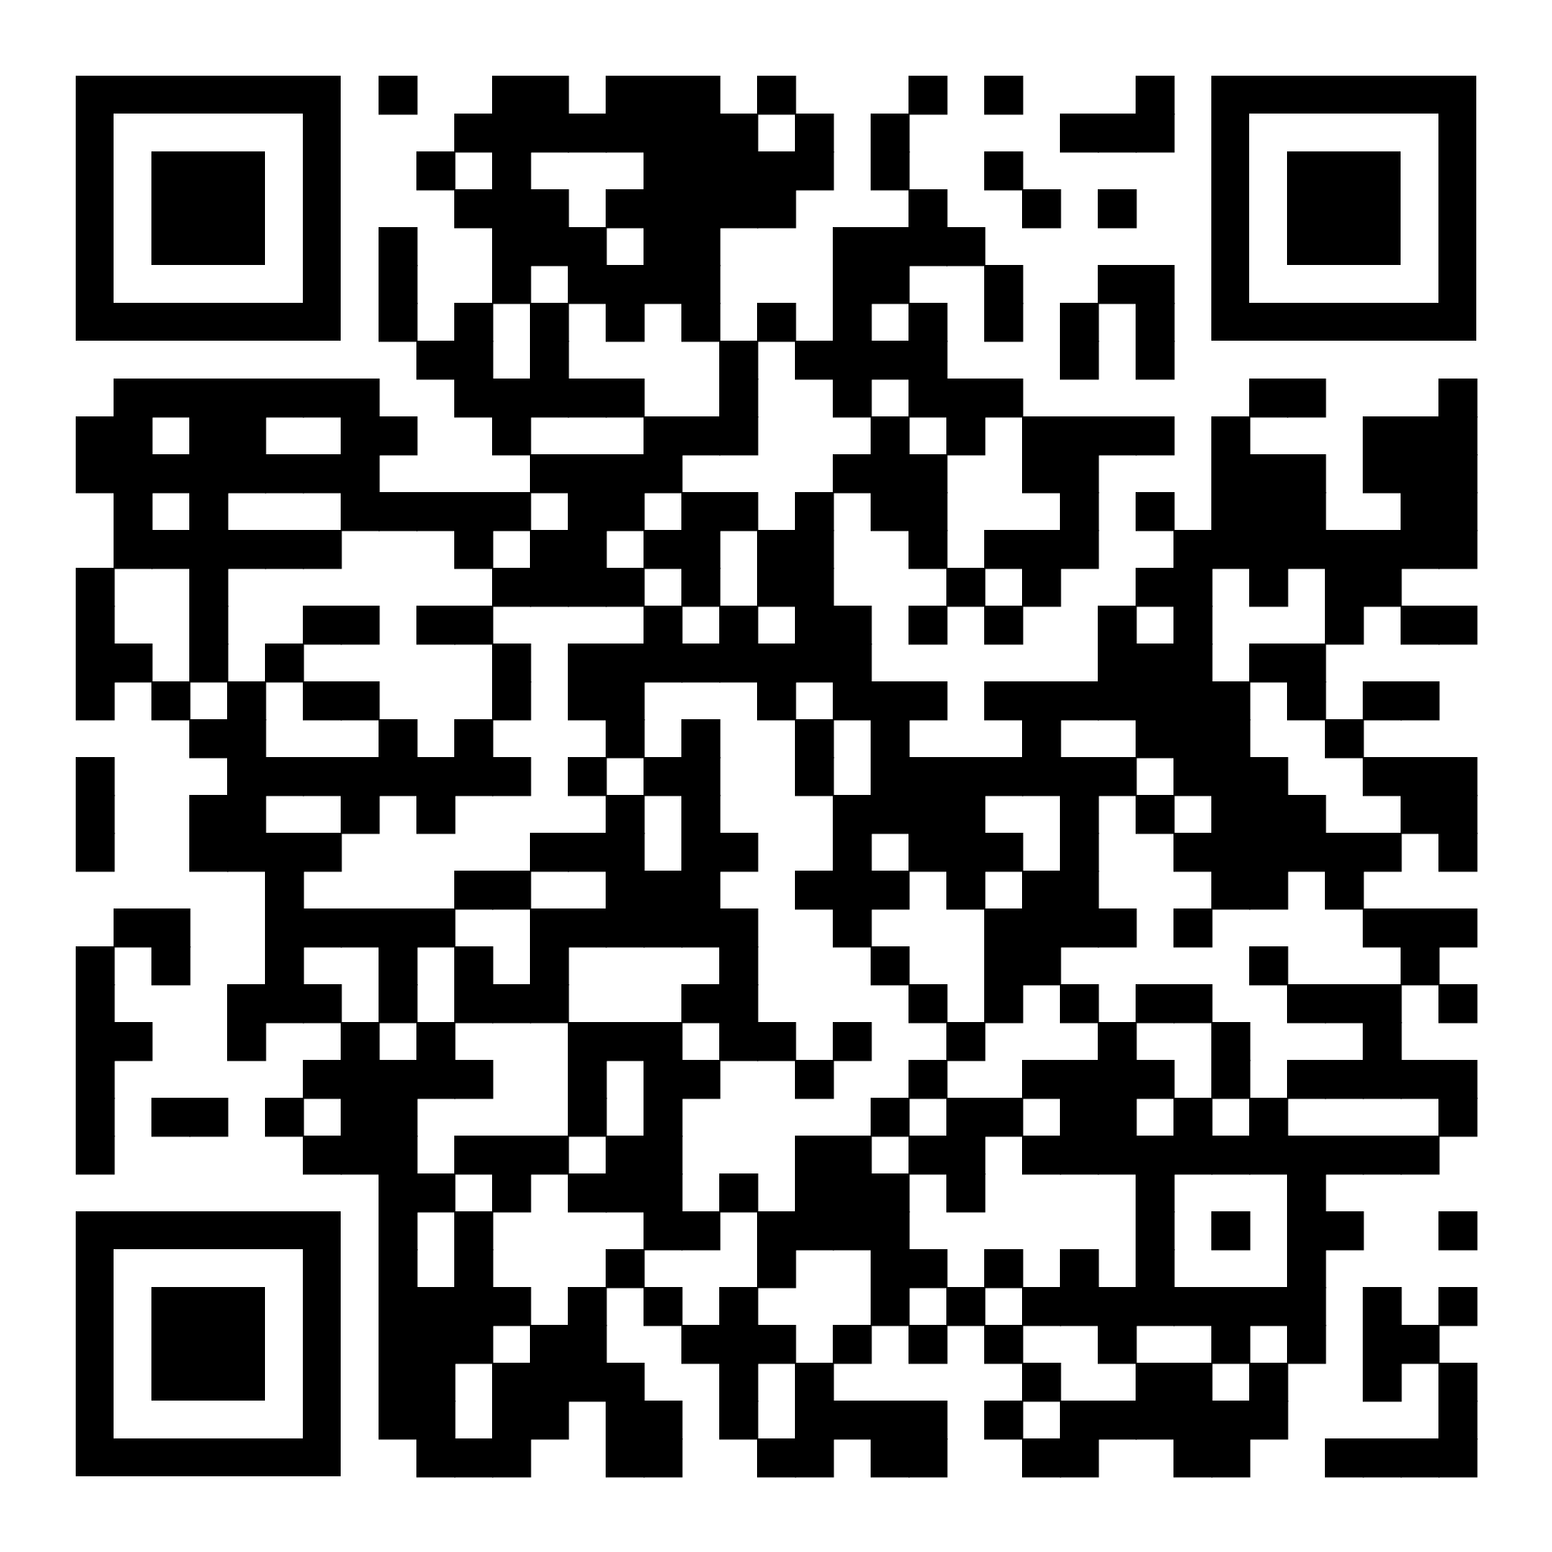
From Zero to Agentic:
Building Your First AI-Driven Threat Investigation in Splunk Enterprise Security
SEC1215
David Pollard
Unshakeable Salt Ltd, @UnshakeableSalt
Resources:
https://github.com/UnshakeableSaltLtd/SplunkConf

Slide 22
Thank you

