Slide 1
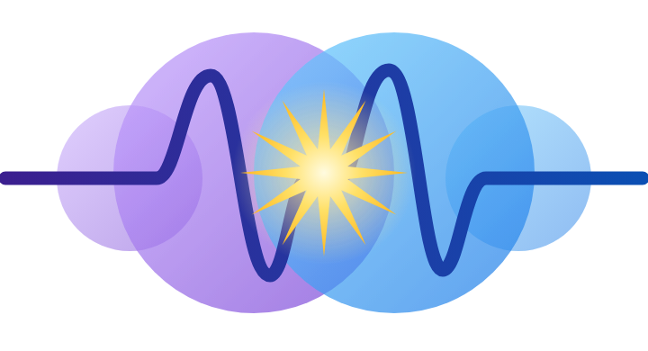
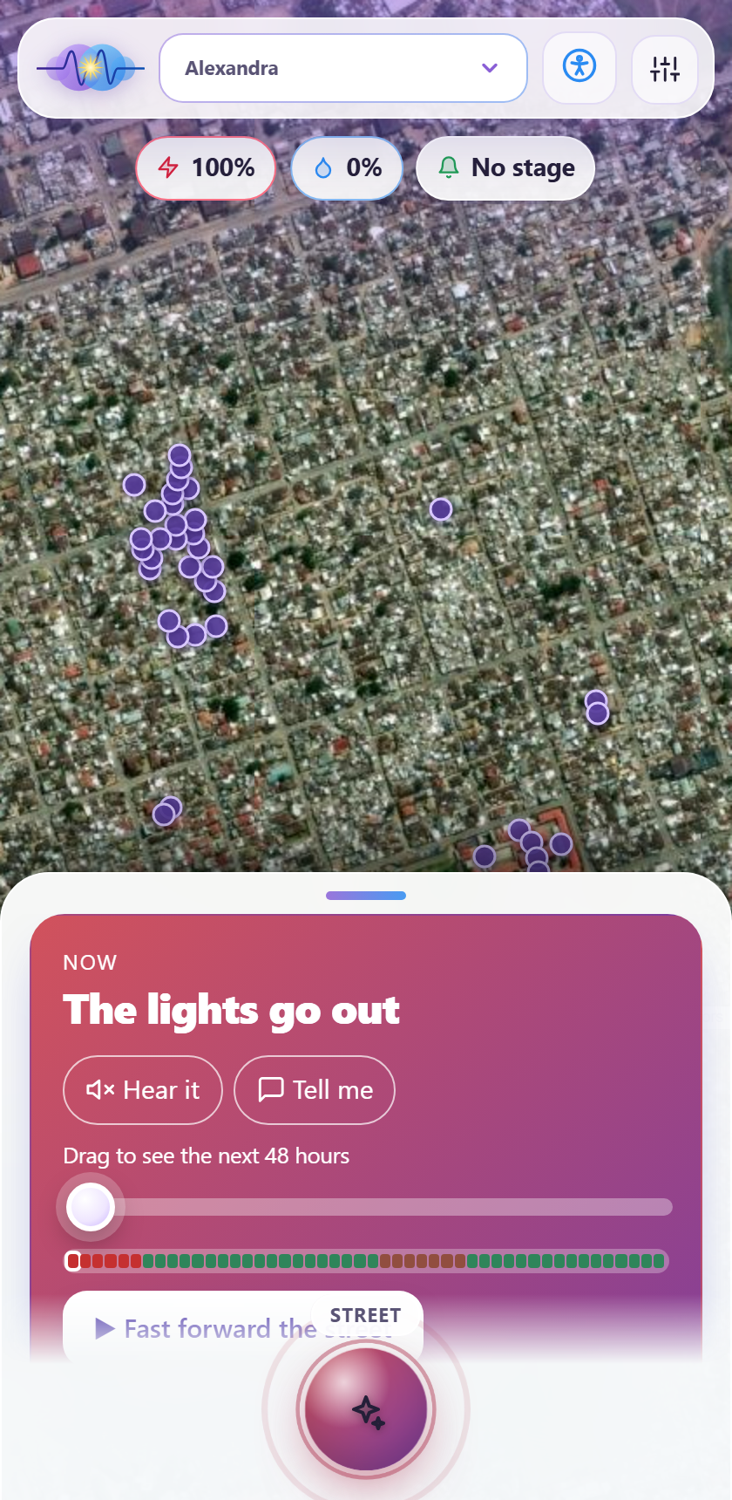
Kasi Grid
Know before it goes dark.
Neighbours verify power and water outages anywhere in South Africa, the app learns when and how long they last, and families that depend on power for health get help in time.
FNB App of the Year Hackathon 2026 | Climate resilience and essential services
Team Amethyst & Azure: Tshedza Tshikovhi and Mulanga Munaka
Source code: https://github.com/Unsolvedstar/Kasi-Grid

Slide 2
The grid is better. Kasi still goes dark.
500+ days
Still dark
22
without loadshedding (Eskom, October 2026). There is no stage or schedule left to check.
Townships lose power to load reduction, cable theft and substation faults, with no schedule and no warning.
major water outages in two weeks in Johannesburg, January 2026.
What a family sees
The power or water goes off on one street. Nobody says why or for how long, so a WhatsApp rumour decides whether the fridge stays shut. A spaza loses a day of stock. And a household on an oxygen concentrator cannot tell how long its battery will last against an outage.
Sources: Eskom statements and SAnews (Oct 2026); Daily Maverick (Jan 2026); allAfrica (Aug 2026).
Kasi Grid | Amethyst & Azure
https://github.com/Unsolvedstar/Kasi-Grid

Slide 3
Kasi Grid in one slide
Live satellite street
Verified by neighbours
Thinks ahead
Every home is a glowing dot. Drag through the next 48 hours and watch the street dim and relight.
3 different devices must agree before an outage is verified. Anonymous. Anywhere in South Africa.
Learns when outages cluster and how long they last. Says "expected back around 09:30".
When minutes matter
Money and help
For everyone
Live battery countdown for medical devices, staged alerts, a one-tap ambulance call.
What an outage costs a shop, pooled restock orders, a board for neighbours to help each other.
Works for deaf and blind users, offline, in four languages, on a basic phone.
Kasi Grid | Amethyst & Azure
https://github.com/Unsolvedstar/Kasi-Grid

Slide 4
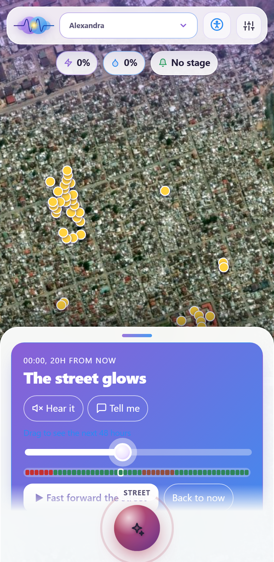
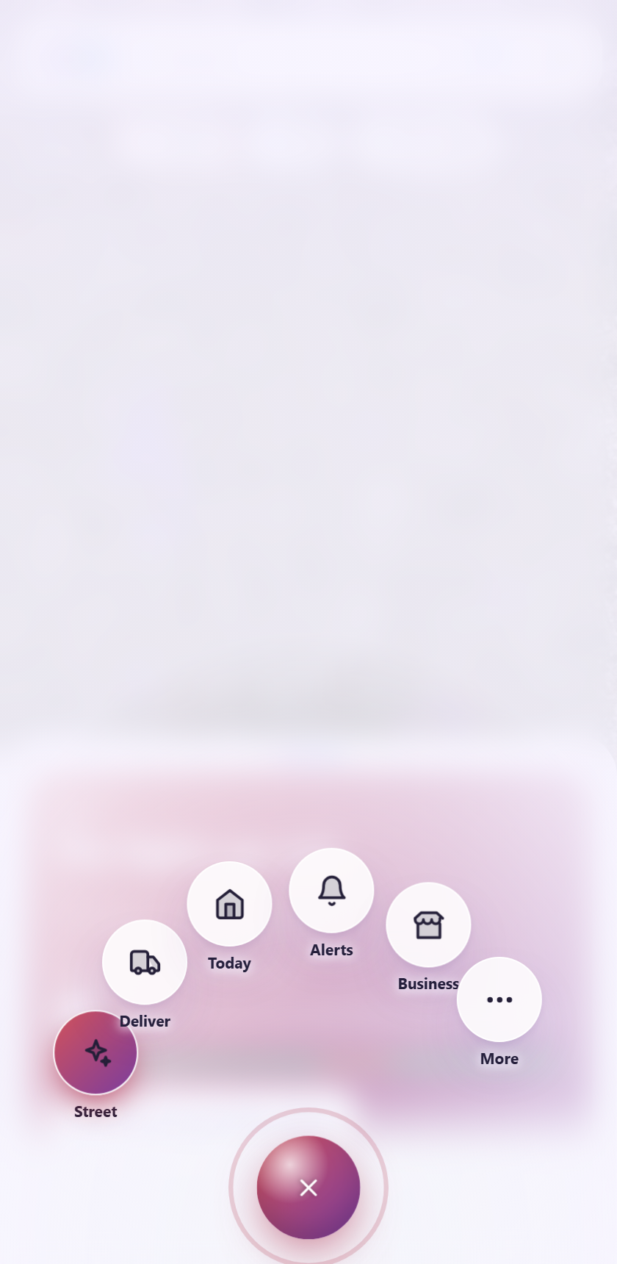
The street, felt: scrub through the night
Real satellite imagery; every mapped home is a dot. 40% outage risk darkens about 40% of them, so the odds are visible
Drag through 48 hours; tap the map to explore it full screen
Hear it, Tell me and a heartbeat buzz make it felt as well as seen
One orb for navigation
Kasi Grid | Amethyst & Azure
https://github.com/Unsolvedstar/Kasi-Grid

Slide 5
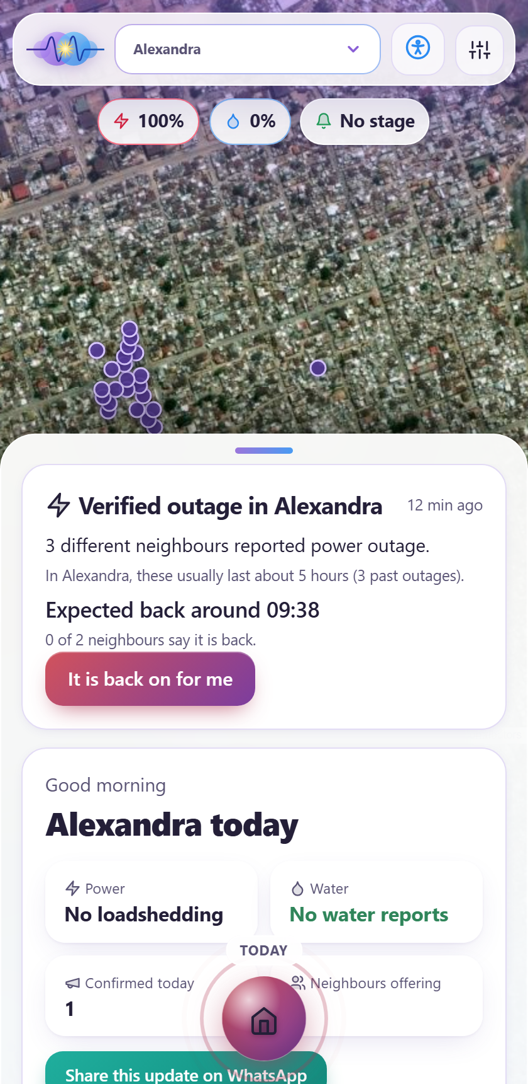
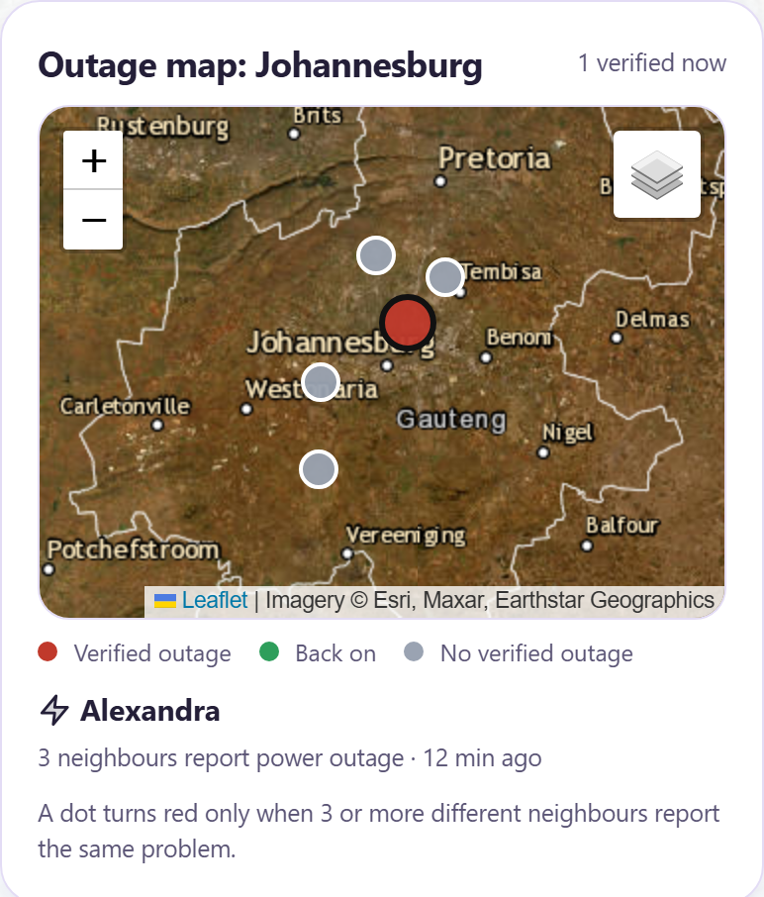
Neighbours make it real: verified, local, on a map
3 or more different devices report the same problem and it becomes a verified outage
The map shows every community: red verified, green back on, grey quiet
Neighbours vote "back on for me" and the alert closes itself
Anonymous by default: no account needed. One vote per device
Kasi Grid | Amethyst & Azure
https://github.com/Unsolvedstar/Kasi-Grid

Slide 6
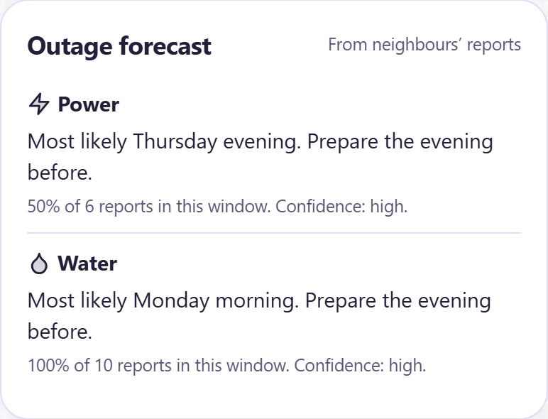
It thinks ahead: when, and for how long
Learns each community's own pattern: the weekday and time of day outages cluster
Learns how long they last, from the "back on" votes, and shows "expected back around 09:30"
Warns a household with a medical device before its high-risk window
Transparent: shows its confidence and says when there is not enough data
From our demo data: "Outages here are most likely Thursday evening. Past outages usually last about 5 hours." Rule-based on purpose: a small community does not have the data for a black box.
Kasi Grid | Amethyst & Azure
https://github.com/Unsolvedstar/Kasi-Grid

Slide 7
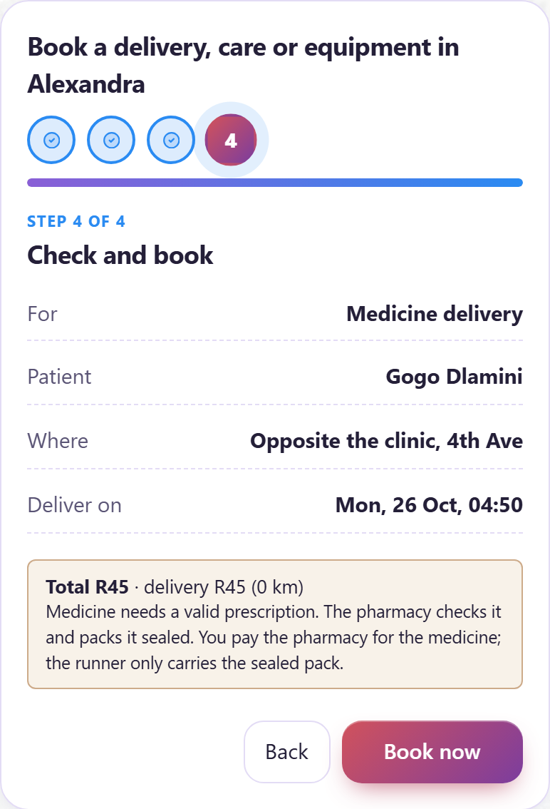
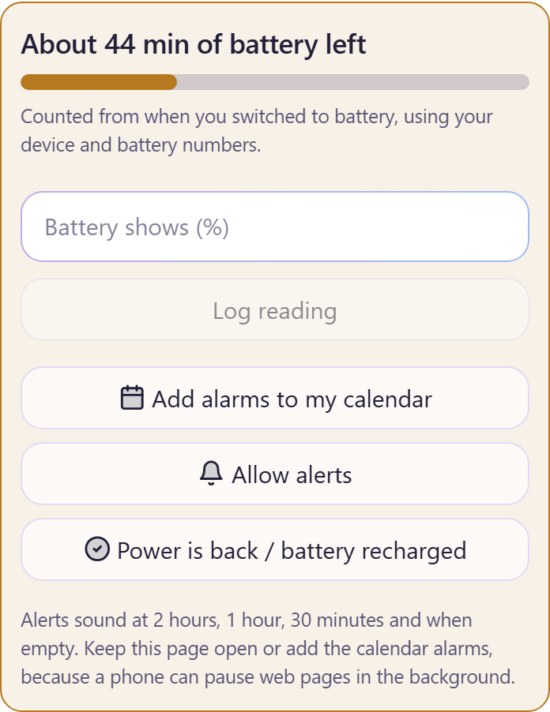
When power is a medical need: a live battery plan
Enter the device (watts) and the battery (watt-hours, charge, age, type): the plan counts the honest hours, not the label
Tap when you switch to battery: a live countdown, corrected by readings from the battery display
Compared with how long outages usually last here. Too short? Book a backup in four short steps
Carers and equipment: fixed price, the 3 nearest are asked, a prescription check for oxygen
Kasi Grid | Amethyst & Azure
https://github.com/Unsolvedstar/Kasi-Grid

Slide 8
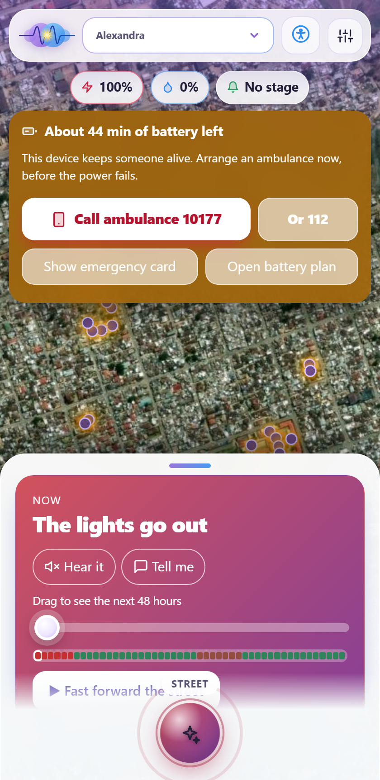
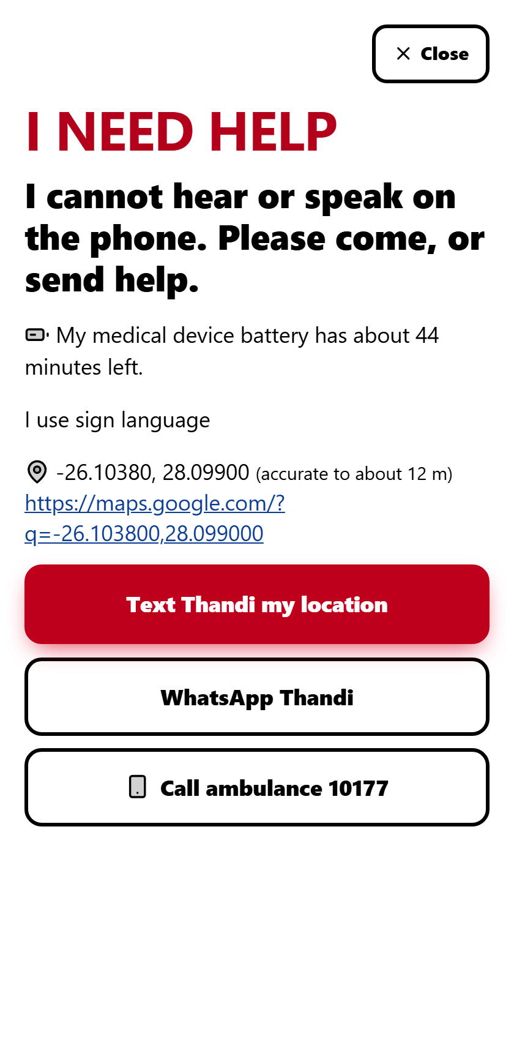
When minutes matter: alerts and the ambulance
Alerts at 2 hours, 1 hour, 30 minutes and empty: sound, vibration, screen flash, spoken words and large text, whatever the person can perceive
Life-support devices get the ambulance prompt a stage earlier
Call ambulance 10177 or 112 in one tap
Cannot speak on the phone? The emergency card texts or WhatsApps your exact location to a contact, with nothing to say
Kasi Grid | Amethyst & Azure
https://github.com/Unsolvedstar/Kasi-Grid

Slide 9
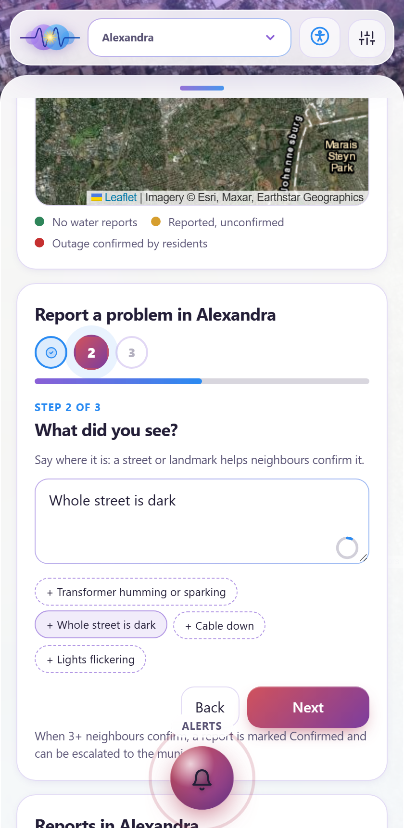
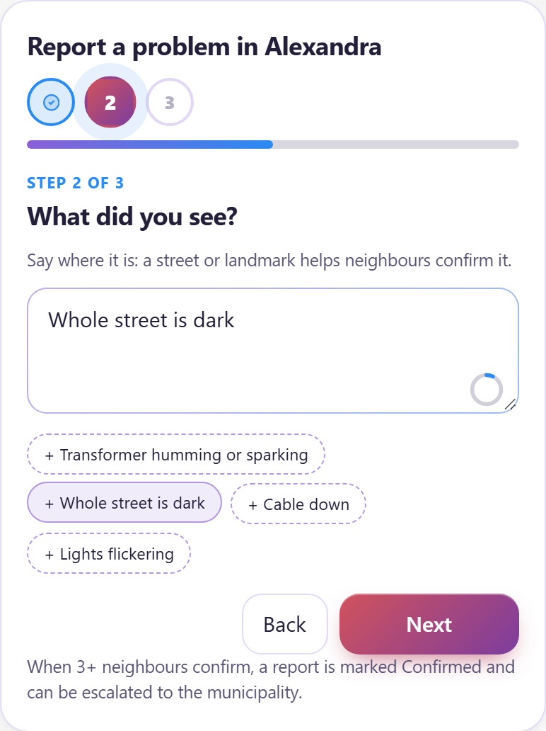
Anywhere in South Africa, down to the exact spot
Every place is a community of about 2 km: find any town, suburb or street, or use your location
A precise GPS fix that settles on the best reading, shown on the map as "you are here"
Reports and posts take an optional exact pin. Board posts are shown only to about 100 m, so no home is given away
Long forms are short steps: one question at a time
Kasi Grid | Amethyst & Azure
https://github.com/Unsolvedstar/Kasi-Grid

Slide 10
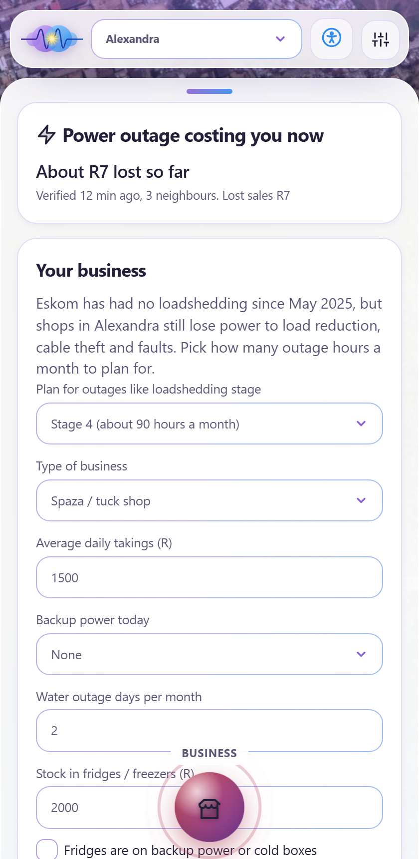
Outages cost money: see how much
During a verified outage the shop owner sees what it has cost so far: lost sales and stock at risk
Fridges hold cold about 4 hours shut; the app counts stock at risk after that
Ranked fixes by payback: inverter, cold box, water tank
Spazas order together for lower prices (pooled restock)
An opening for a bank: an outage savings pot, stock insurance or finance for backup power
Kasi Grid | Amethyst & Azure
https://github.com/Unsolvedstar/Kasi-Grid

Slide 11
One outage, one household: Gogo's family in Alexandra
1
2
3
4
5
Set up once
Power fails
Knows what to do
Time runs low
Help arrives
Her grandson enters the concentrator (300 W) and battery (1000 Wh): about 2.4 hours.
Three neighbours report it. It is verified in minutes, and the street goes dark on the map.
"Past outages here last about 5 hours. Your battery is shorter. Get a backup."
The countdown alerts at 1 hour and 30 minutes, and the ambulance is one tap away.
A neighbour with a generator, a runner with a cylinder, or the ambulance.
Kasi Grid | Amethyst & Azure
https://github.com/Unsolvedstar/Kasi-Grid

Slide 12
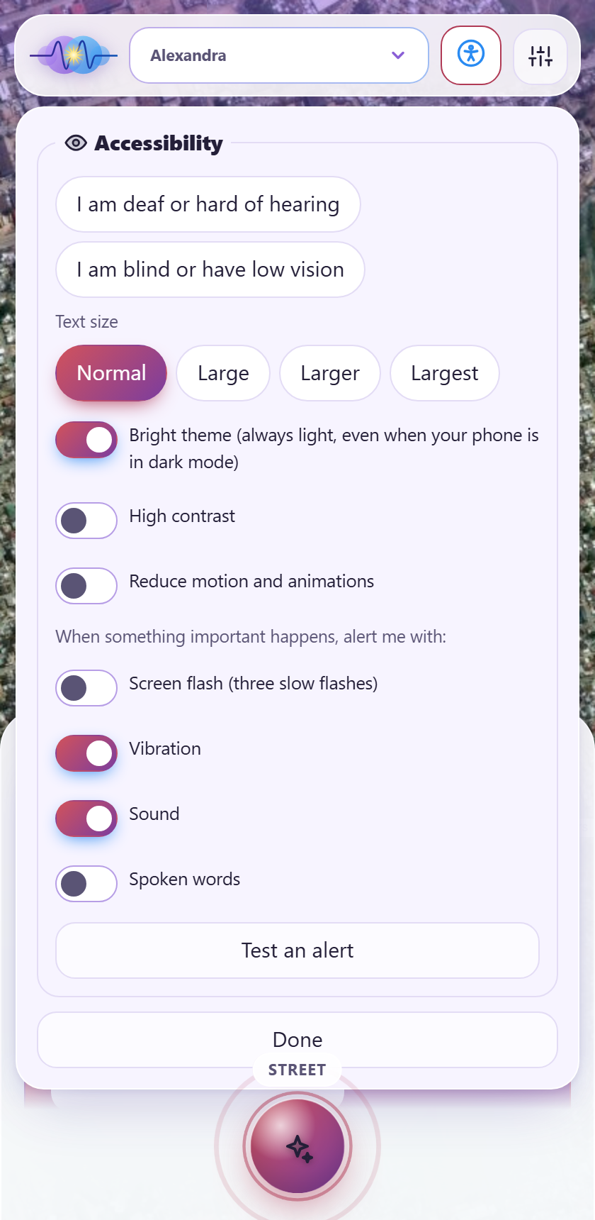
For everyone: deaf, blind, offline
Deaf or hard of hearing: every alert can flash the screen (slow, safe flashes), vibrate and show as large text
Blind or low vision: screen-reader announcements, spoken alerts, text up to 200%, high contrast, full-height panels
Reduce motion; a bright theme on every phone; touch targets sized for thumbs
English, isiZulu, Sesotho, Afrikaans (drafts, native review planned). Installable, works offline, posts queue and send later
Kasi Grid | Amethyst & Azure
https://github.com/Unsolvedstar/Kasi-Grid

Slide 13
How it is built, and kept safe
Installable web app
React + Vite, offline queue, service worker
API
Node + Express as a serverless function, rate limits, validation
Database
Hosted libSQL (Turso)
Eskom + EskomSePush
Stage and official slots
OpenStreetMap + Esri
Homes, shops, clinics, satellite imagery
Open-Meteo + NAMC
Weather, food prices
Privacy
Safety
No account needed; an optional one is hashed and deletable. Location is optional. Board posts only to about 100 m. The medical plan stays on the phone.
111 automated tests. Production dependency scan: 0 vulnerabilities. Parameterised SQL, input limits, rate limits, token-protected admin.
Kasi Grid | Amethyst & Azure
https://github.com/Unsolvedstar/Kasi-Grid

Slide 14
Who pays, and why
Households pay nothing: reporting, alerts, forecasts and the medical plan stay free
Spaza Pro: advanced outage-cost reports, about R49 a month
Commission: 4% on pooled restock orders, 10% on care and equipment bookings
Partner listings for suppliers, carers and clinics: about R299 a month
A municipal dashboard or sponsor: about R3,000 a month
~R9,800
a month to run a 3,000-user pilot
~R17,000
a month by month 6 (projection)
R0
for residents, always
Estimates and hypotheses to validate in the pilot, not measured results.
Kasi Grid | Amethyst & Azure
https://github.com/Unsolvedstar/Kasi-Grid

Slide 15
Built, tested, ready to pilot
111
0
4
0
automated tests passing
known vulnerabilities in production dependencies
languages, offline-capable
accounts required to use it
What is real today
What is demo data, and said so
A working app on a phone: verified outages, forecast, duration estimate, live medical battery plan, care booking, outage cost, accessibility. Live Eskom status, real tariffs, real maps and buildings. Checked in a browser.
Outage history, carers, equipment prices and bookings are samples and labelled in the app. Next: a one-week pilot in one community, then real suppliers and payments.
Kasi Grid | Amethyst & Azure
https://github.com/Unsolvedstar/Kasi-Grid

Slide 16
Next six months
Months 1-2: prove it
Months 3-4: make it real
Months 5-6: scale it
Run the pilot in one community. Native-speaker review of all four languages. Get real supplier prices. First conversation with a bank about an outage savings pot. An independent security check.
Payments through a provider. Carer vetting through a background-check partner. Equipment from licensed suppliers. POPIA review before handling health or booking data.
More communities from the same code. A dashboard for municipalities and utilities. Pro plan for small businesses. A pilot with a bank or insurer.
Kasi Grid | Amethyst & Azure
https://github.com/Unsolvedstar/Kasi-Grid

Slide 17
Team Amethyst & Azure, and where to find the code
Team
Why us
Tshedza Tshikovhi (22): software developer, leads a small team at Shudu Connections (Innovation Hub). Built CashCram, Top-13 in the NWU 2026 pitch competition.
Mulanga Munaka (22): biomedical engineering student at Wits, who shaped the medical power plan.
A developer who ships and a biomedical engineer who knows how people depend on power for health. Built, tested and checked on a phone.
Source code and demo
Git repository: https://github.com/Unsolvedstar/Kasi-Grid
Live app: https://kasi-grid.vercel.app
Try: the street slider, Today, Deliver (300 W, 1000 Wh, "Switched to battery"), and the accessibility button.
Kasi Grid | Amethyst & Azure
https://github.com/Unsolvedstar/Kasi-Grid

