Slide 1
Recursion
Ritesh Ranjan

Slide 2

What is recursion ??

Slide 3
What is recursion?
Sometimes, the best way to solve a problem is by solving a smaller version of the exact same problem first
Recursion is a technique that solves a problem by solving a smaller problem of the same type

Slide 4
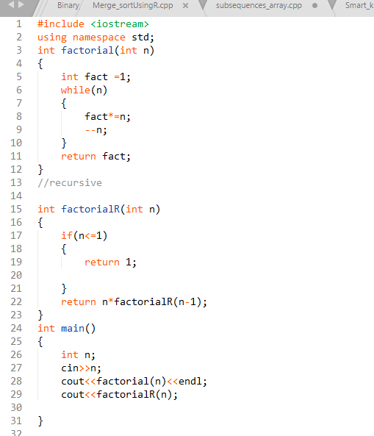
Lets do a program ( factorial of no )

Slide 5
Recursion
Recursive fun{
Base call
Base call
{
Recursive call !
}
}

Slide 6
For now assume recursion is magic!
It will be bring whatever you ask it to !

Slide 7
Lets see some famous problem !
Linear Search
Binary search
Max/Min of n number
For you to try
Fibonacci number !
Substrings/subarray !

Slide 8
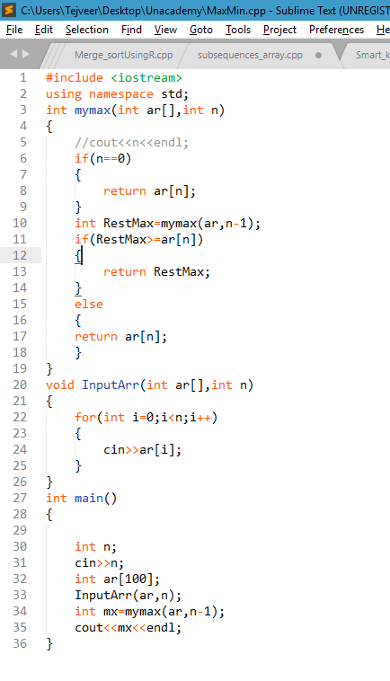
Max/Min of n numbers !

Slide 9
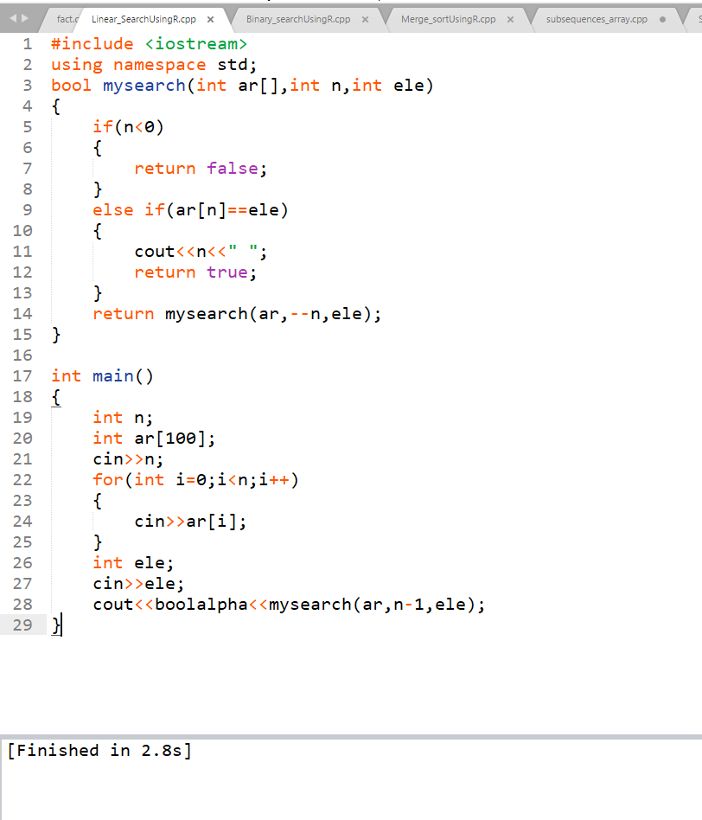
Linear Search

Slide 10
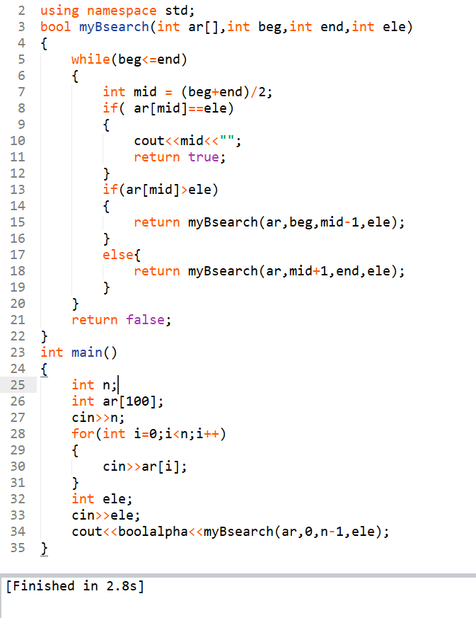
Binary Search !

Slide 11
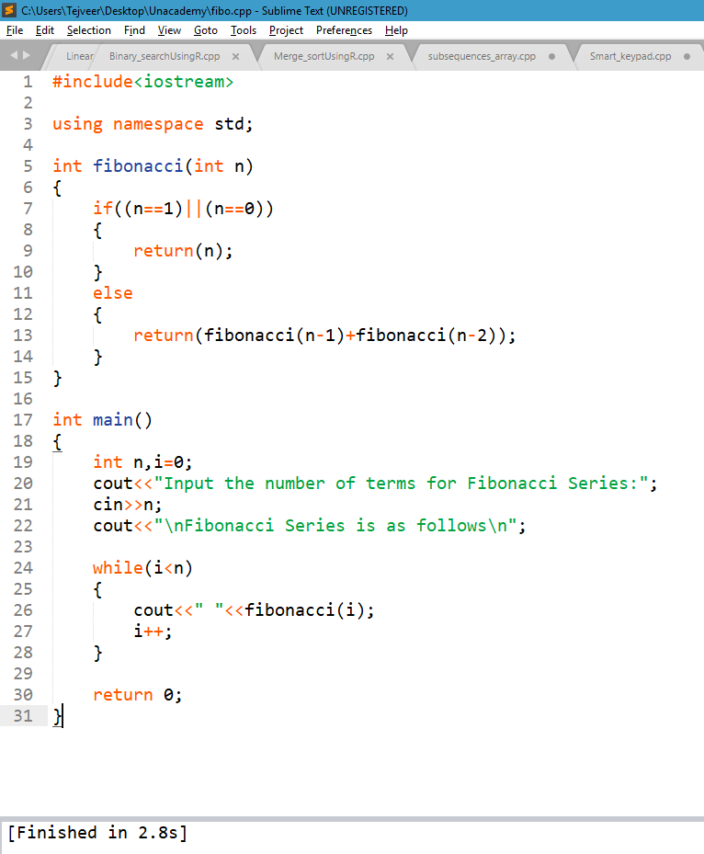
Fibonacci Number

Slide 12
Substring !
A substring of a string is a string S than occurs in S in order !
For example “ the best of” is substring of “It was the best of times”
For example “Apple”
Apple ,appl ,pple ,app, ppl ………………so on

Slide 13
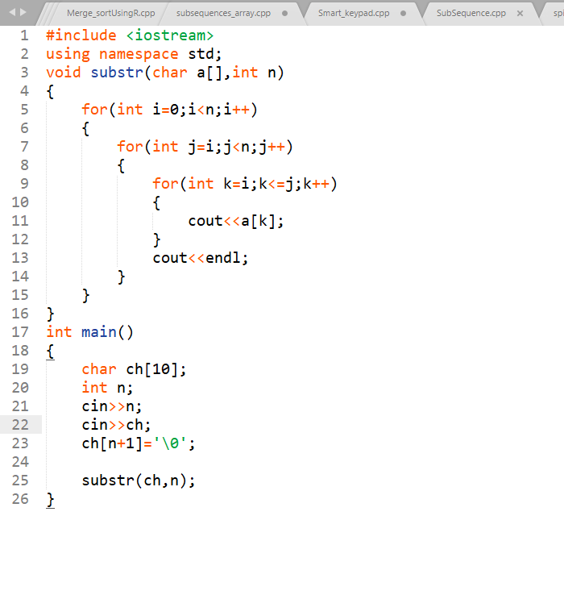
Substring/subarray

Slide 14
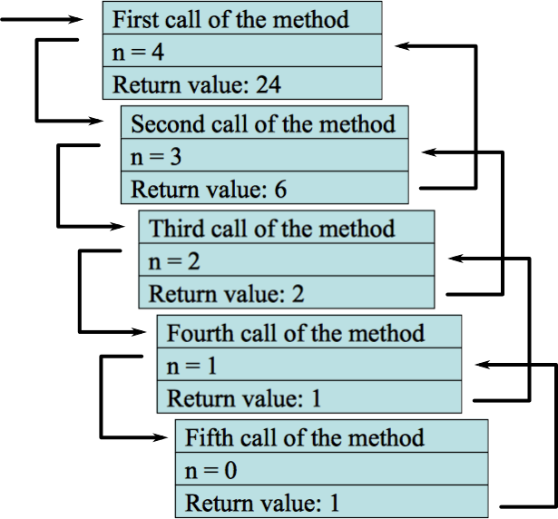
Analysis of Recursion (CallStack)

Slide 15
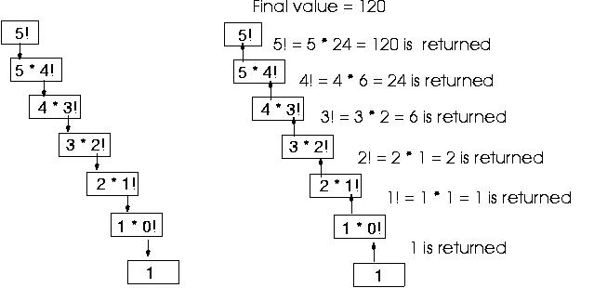
Another view !

Slide 16
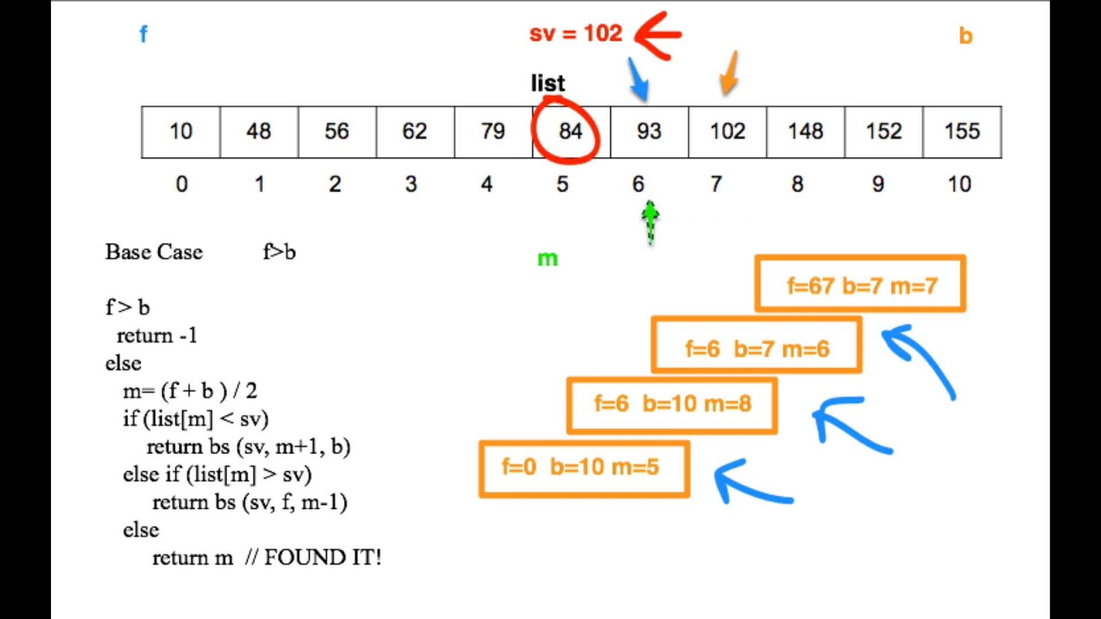
Analysis of Binary Search

Slide 17
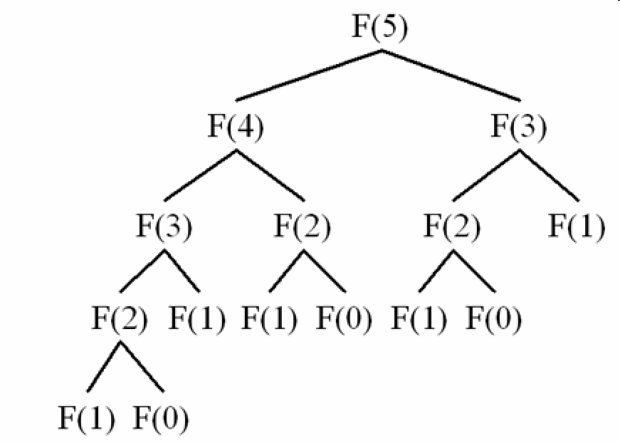
Analysis of Fibonacci series

Slide 18
A very famous problem ! (subsequence problem)
A subsequence is a sequence that can be derived from another sequence by zero or more elements, without changing the order of the remaining elements. For the same example, there are 15 sub-sequences. They are (1), (2), (3), (4), (1,2), (1,3),(1,4), (2,3), (2,4), (3,4), (1,2,3), (1,2,4), (1,3,4), (2,3,4), (1,2,3,4). More generally, we can say that for a sequence of size n, we can have (2n-1) non-empty sub-sequences in total.

Slide 19
abc
bc
C
C
bc
C
C
0
0
0
0
Include a
Include a
not b
Include b
not b
Include b
Not c
c
not c
not c
Not c
c
c
c

Slide 20
