Slide 1
Introduction
Welcome
Overview of scrum-agile approach
Agile Development: Agile is an iterative and incremental approach to software development that emphasizes collaboration, flexibility, and customer satisfaction.
Scrum Framework: Scrum is a popular Agile framework that provides a structured approach to project management. It includes roles (Product Owner, Scrum Master, Development Team), events (Sprint Planning, Daily Standups, Sprint Review), and artifacts (Product Backlog, Sprint Backlog).
Waterfall development is a sequential and rigid software development approach where each phase is completed before moving to the next, while Agile development is an iterative and flexible approach that emphasizes collaboration, adaptability, and delivering working software in short cycles.

Slide 2
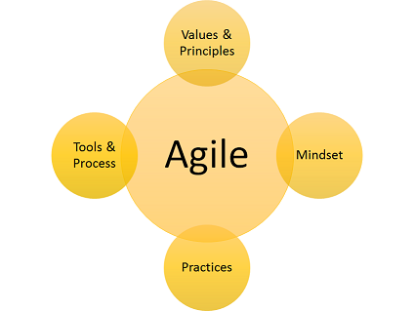
Pro: Iterative Development - The iterative nature of Agile development allows for frequent feedback and early detection of issues, resulting in faster delivery of valuable software increments and increased customer satisfaction.
Con: Scalability Challenges - Scaling Agile practices to larger projects or organizations can be challenging. Coordinating multiple Agile teams, aligning priorities, and maintaining consistency across teams can become complex and require additional management effort.
Pro: Collaboration and Transparency - Agile promotes close collaboration among team members and stakeholders, fostering a transparent and open work environment. This facilitates effective communication, shared understanding, and collective ownership of the project.
Con: Lack of Predictability - Agile's adaptive nature can make it difficult to accurately predict project timelines and outcomes, especially when dealing with evolving requirements or changing priorities. This can pose challenges in terms of project planning and meeting strict deadlines.

Slide 3
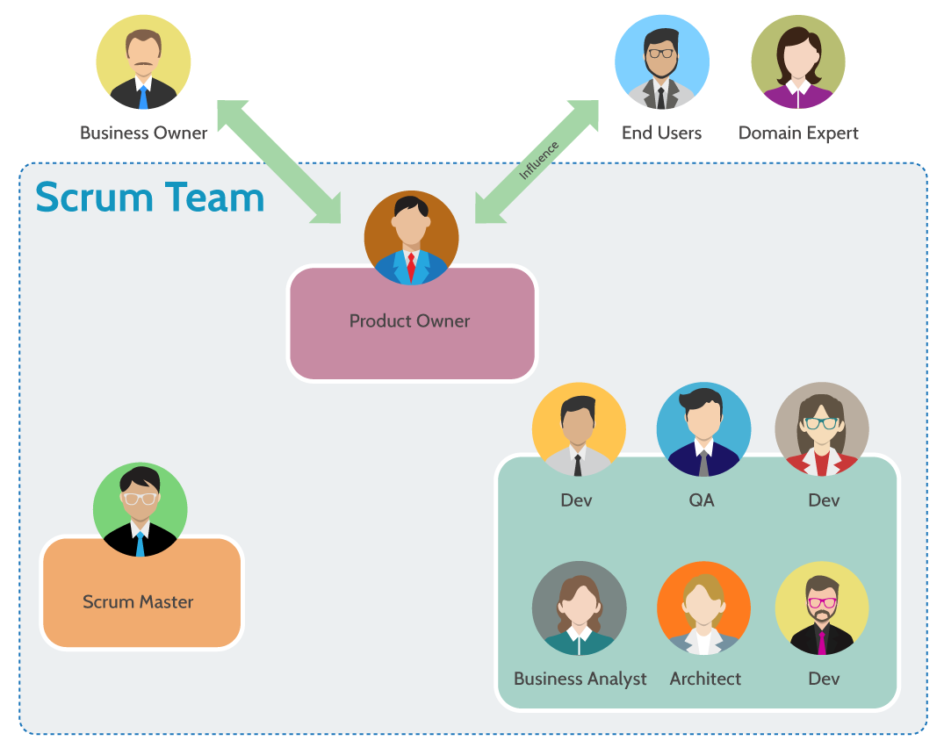
Development Team:
- Self-organizing and cross-functional
- Collaboratively delivers increments of product functionality
Scrum Master:
- Facilitates the Scrum process
- Removes impediments and ensures team productivity
Product Owner:
- Responsible for product vision and prioritization
- Ensures value delivery to stakeholders

Slide 4
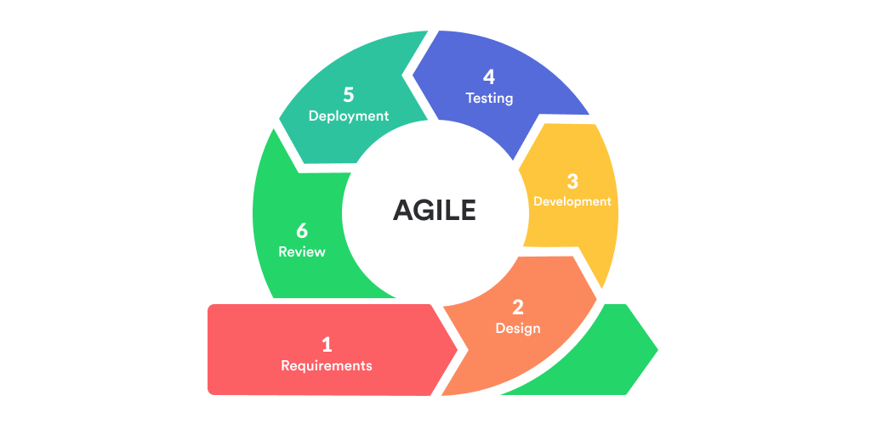
Release:
Integrating and testing product increments
Delivering potentially shippable increments
Development:
Iteratively developing product increments
Conducting daily Scrum meetings
Planning:
Detailed release and iteration planning
Creating a prioritized product backlog
Envisioning:
Defining project goals and product vision
Establishing high-level requirements

Slide 5
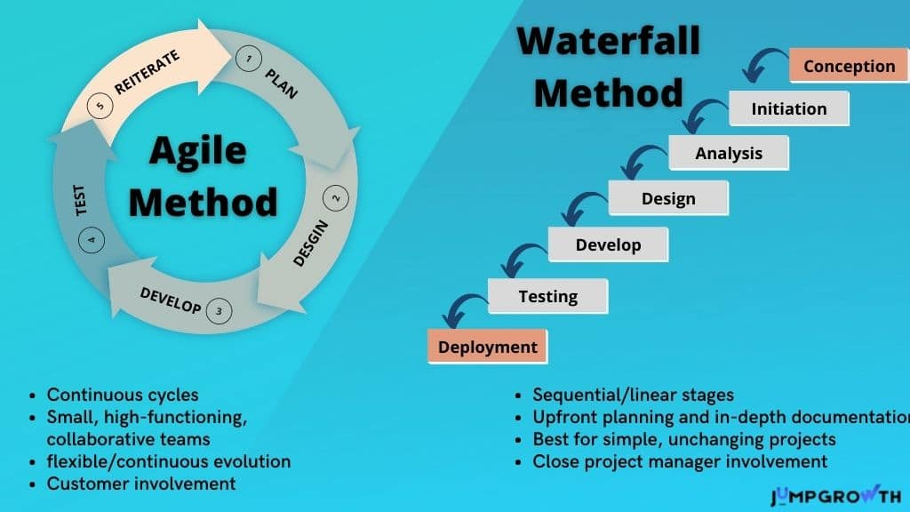

Slide 6
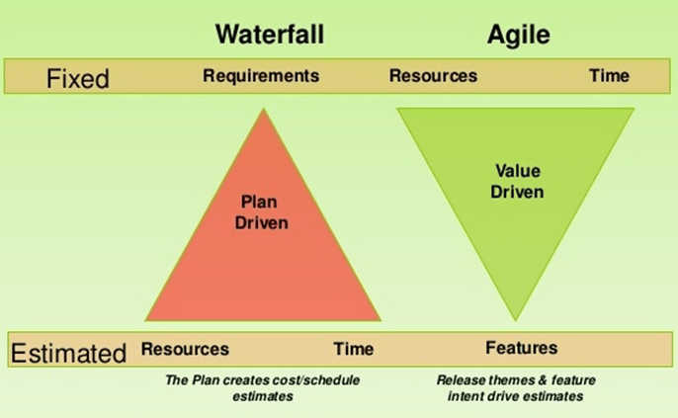
Project Complexity:
Agile: Suitable for complex and evolving projects
Waterfall: Suitable for straightforward and stable projects
Customer Collaboration:
Agile: Emphasizes active involvement and continuous feedback
Waterfall: Less customer involvement during development
Predictability and Control:
Agile: Provides flexibility but may require more frequent monitoring
Waterfall: Offers a structured and controlled environment

Slide 7
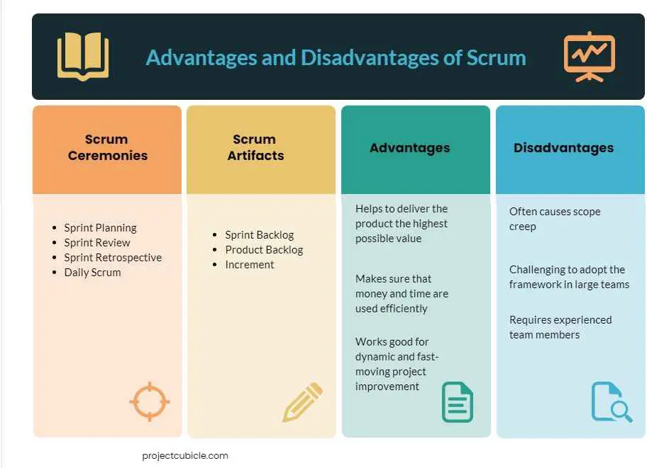

Slide 8
Last, First. (2023) agile_versus_waterfall-min.png (PNG Image, 686 × 423 pixels). Retrieved June 18, 2023, from https://abstracta.us/wp-content/uploads/2019/08/agile_versus_waterfall-min.png
Last, First. (2023) Agile-vs-Waterfall-review.jpg (JPEG Image, 3000 × 1800 pixels). Retrieved June 18, 2023, from https://hygger.io/wp-content/uploads/2019/08/Agile-vs-Waterfall-review.jpg
Last, First. (2023) Agile-vs-Waterfall-comparison-table.jpg (JPEG Image, 1024 × 576 pixels). Retrieved June 18, 2023, from https://jumpgrowth.com/wp-content/uploads/2020/10/Agile-vs-Waterfall-comparison-table.jpg
Last, First. (2023) 925d76d668dc5bf47d44a8fc0907f30d1d9c8b1f.png (PNG Image, 1024 × 505 pixels). Retrieved June 18, 2023, from https://d32myzxfxyl12w.cloudfront.net/assets/images/article_images/925d76d668dc5bf47d44a8fc0907f30d1d9c8b1f.png?1557486197
Last, First. (2023) da041607cc793ff1529f1012dbeccffa.png (PNG Image, 424 × 319 pixels). Retrieved June 18, 2023, from https://i.pinimg.com/originals/da/04/16/da041607cc793ff1529f1012dbeccffa.png
Last, First. (2023) scrum-team.png (PNG Image, 1075 × 860 pixels). Retrieved June 18, 2023, from https://www.tutorialscampus.com/agile/img/scrum-team.png

