Slide 1
Introduction
Welcome
Overview of scrum-agile approach
  Agile Development: Agile is an iterative and incremental approach to software development that emphasizes collaboration, flexibility, and customer satisfaction.
  Scrum Framework: Scrum is a popular Agile framework that provides a structured approach to project management. It includes roles (Product Owner, Scrum Master, Development Team), events (Sprint Planning, Daily Standups, Sprint Review), and artifacts (Product Backlog, Sprint Backlog).
Waterfall development is a sequential and rigid software development approach where each phase is completed before moving to the next, while Agile development is an iterative and flexible approach that emphasizes collaboration, adaptability, and delivering working software in short cycles.

Slide 2
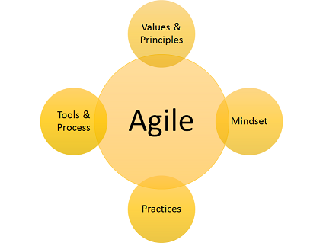
Pro: Iterative Development - The iterative nature of Agile development allows for frequent feedback and early detection of issues, resulting in faster delivery of valuable software increments and increased customer satisfaction.
Con: Scalability Challenges - Scaling Agile practices to larger projects or organizations can be challenging. Coordinating multiple Agile teams, aligning priorities, and maintaining consistency across teams can become complex and require additional management effort.
Pro: Collaboration and Transparency - Agile promotes close collaboration among team members and stakeholders, fostering a transparent and open work environment. This facilitates effective communication, shared understanding, and collective ownership of the project.
Con: Lack of Predictability - Agile's adaptive nature can make it difficult to accurately predict project timelines and outcomes, especially when dealing with evolving requirements or changing priorities. This can pose challenges in terms of project planning and meeting strict deadlines.

Slide 3
