Slide 1

Code Review of Banking System Application

Slide 2
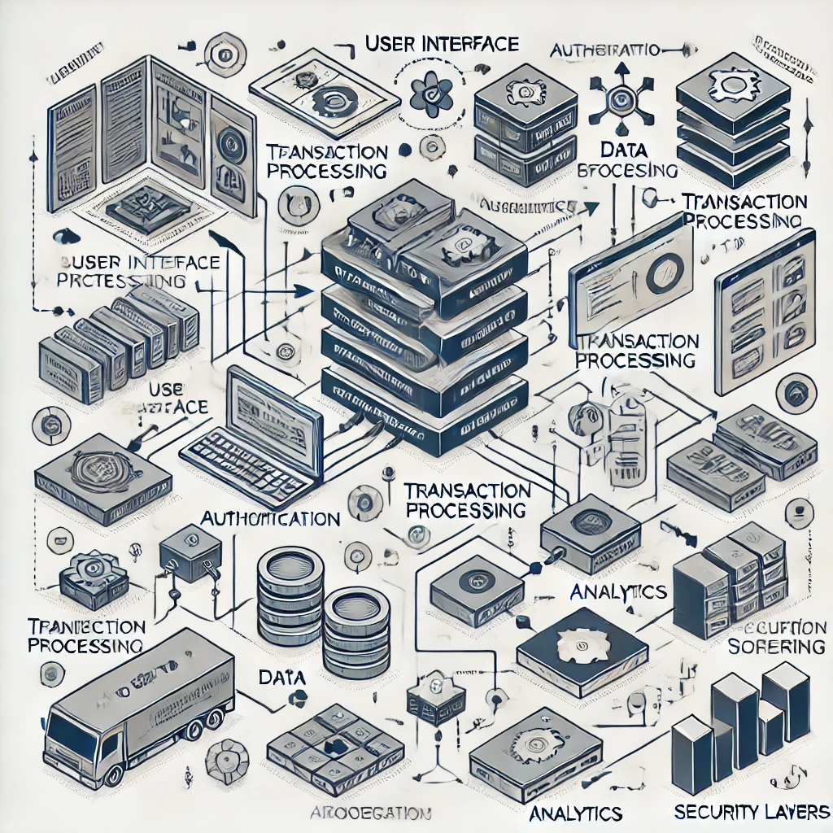
Category One - Software Design and Engineering
Existing Code Functionality:
Implements a simple banking system in C++.
Features client management, password security, and main application flow.
Handles adding new clients, loading, and saving client data.

Slide 3

Code Analysis and Findings
Error Handling: Lacks comprehensive error handling.
Input Validation: User inputs are not validated.
Security Practices: Passwords are hashed but not salted.
Incomplete Functionality: Key functions are declared but not implemented.
Documentation: Minimal comments and documentation.

Slide 4

Practical Enhancements
Implement Comprehensive Error Handling
Enhance Security Measures
Complete Transaction Functions
Add Input Validation
Improve Documentation
Implement Testing

Slide 5

Category Two - Algorithms and Data Structures
Existing Code Functionality:
Uses standard data structures: unordered_map, Client struct.
Password hashing with SHA256.
Manages balances with dollars and cents.

Slide 6

Code Analysis and Findings
Data Type Limitations: uint8_t for cents limits value to 255.
Precision Issues: Separation of dollars and cents can cause errors.
Password Hashing Algorithm: Lacks salting, vulnerable to attacks.
Inefficient Balance Handling: Carry-over logic can be optimized.

Slide 7

Practical Enhancements
Use Appropriate Data Types
Improve Password Security
Optimize Algorithms
Implement Data Validation

Slide 8
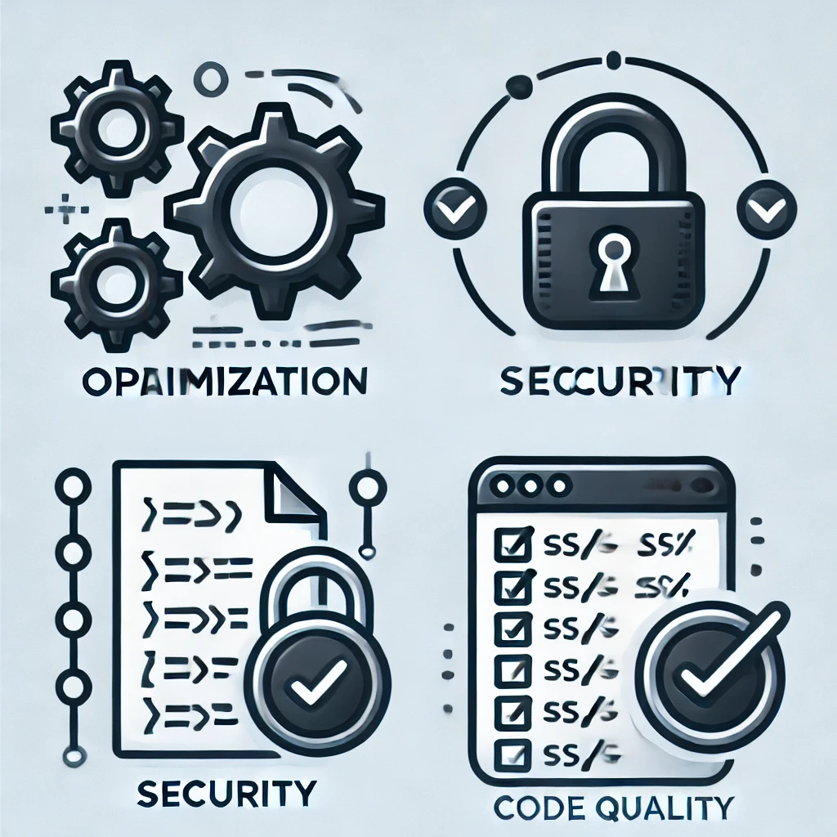
Category Three - Databases
Existing Code Functionality
Uses a JSON file for data storage.
Reads and writes client data for persistence.

Slide 9
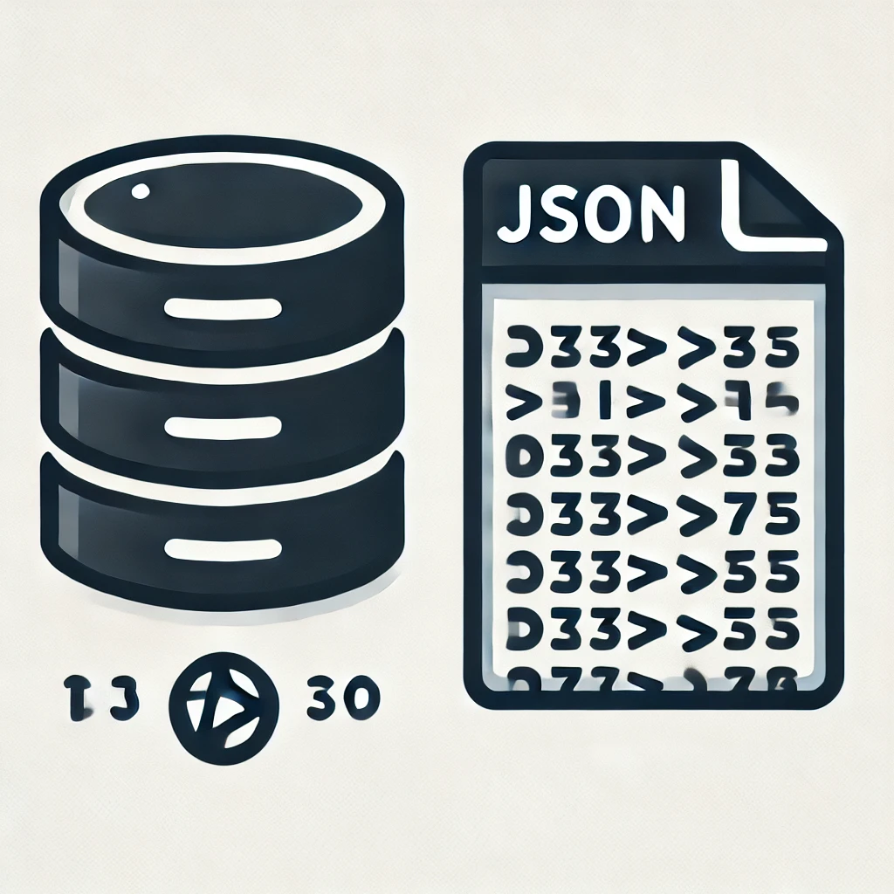
Code Analysis and Findings
Scalability Issues: JSON file isn't scalable for many clients.
Data Integrity and Concurrency: No concurrency control.
Security Concerns: Sensitive data stored in plain text.
Error Handling: Insufficient for file operations.

Slide 10

Practical Enhancements
Integrate a Database System
Implement ORM
Enhance Security
Add Transaction Support

Slide 11

Conclusion
Summarized Findings and Enhancements
Alignment with Course Outcomes
Skills Demonstrated:
Secure Coding Practices
Error Handling
Software Engineering Principles
Algorithms and Data Structures
Database Design and Management

Slide 12

Q&A
Thank you for your attention. Any questions?

