Slide 1
SOFTWARE ENGINEERING
#Project_No :- 02

Slide 2
OCCUPANCY MONITORING SYSTEM
Android Application

Slide 3
Introduction
‘Project Class’ is a real-time occupancy monitoring system android application, which will display regular updates information about the occupancy of the buildings.It will automatically not allow anybody after the building has reached its safety capacity.This system is mainly made keeping focus of auditorium buildings and will also be able to manage events.

Slide 4
Goal and Motivation
In this era of modern technology, monitoring the occupancy of the rooms of a building of our institute or any other place by a single person counting will be like of a fool.
So, our main goal of this project is monitor by digital method like in our case through an android application.

Slide 5
Challenges
The most challenging we have faced was connecting database to the app
We have faced issues related to real-time counting data of the users.

Slide 6
Potential Customer
Since our main purpose is to monitor the occupancy of a building. So, we mainly can say that it’s effective use will be in
In Institutes, where administrations can monitor through the app.
In hotels, auditoriums and all the places where user gather and admin need control over the occupancy situation.

Slide 7
REQUIREMENTS
The devices should always be connected to the internet.
There should be enough database space for storing the information.
Application should be able to render it’s layout to different screen sizes.
Minimum 2 GB of ram is needed for smooth running of application
Minimum SDK version Android 4.0.3

Slide 8
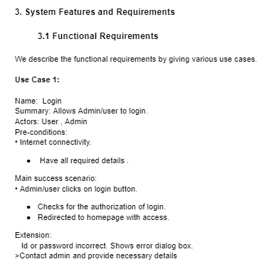
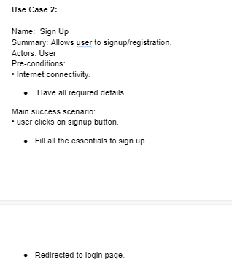
SRS

Slide 9
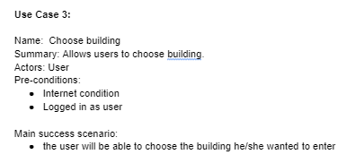
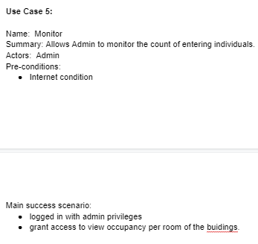
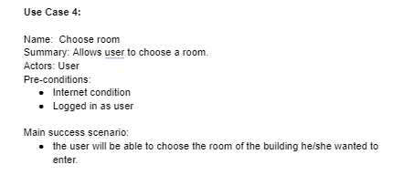

Slide 10
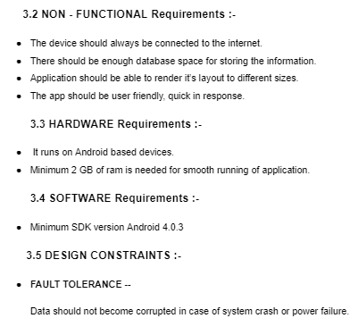
NON-FUNCTIONAL Requirements

Slide 11
TEST PLAN
Link for test plan:
https://drive.google.com/file/d/1EFSpuGe6ucvVdJqNfKDuVx_8IBfK_mJW/view?usp=sharing
Traceability matrix
https://drive.google.com/file/d/1ZZmWjrIglwtgKURYAOtXtEmLv-RMe5pw/view?usp=sharing

Slide 12
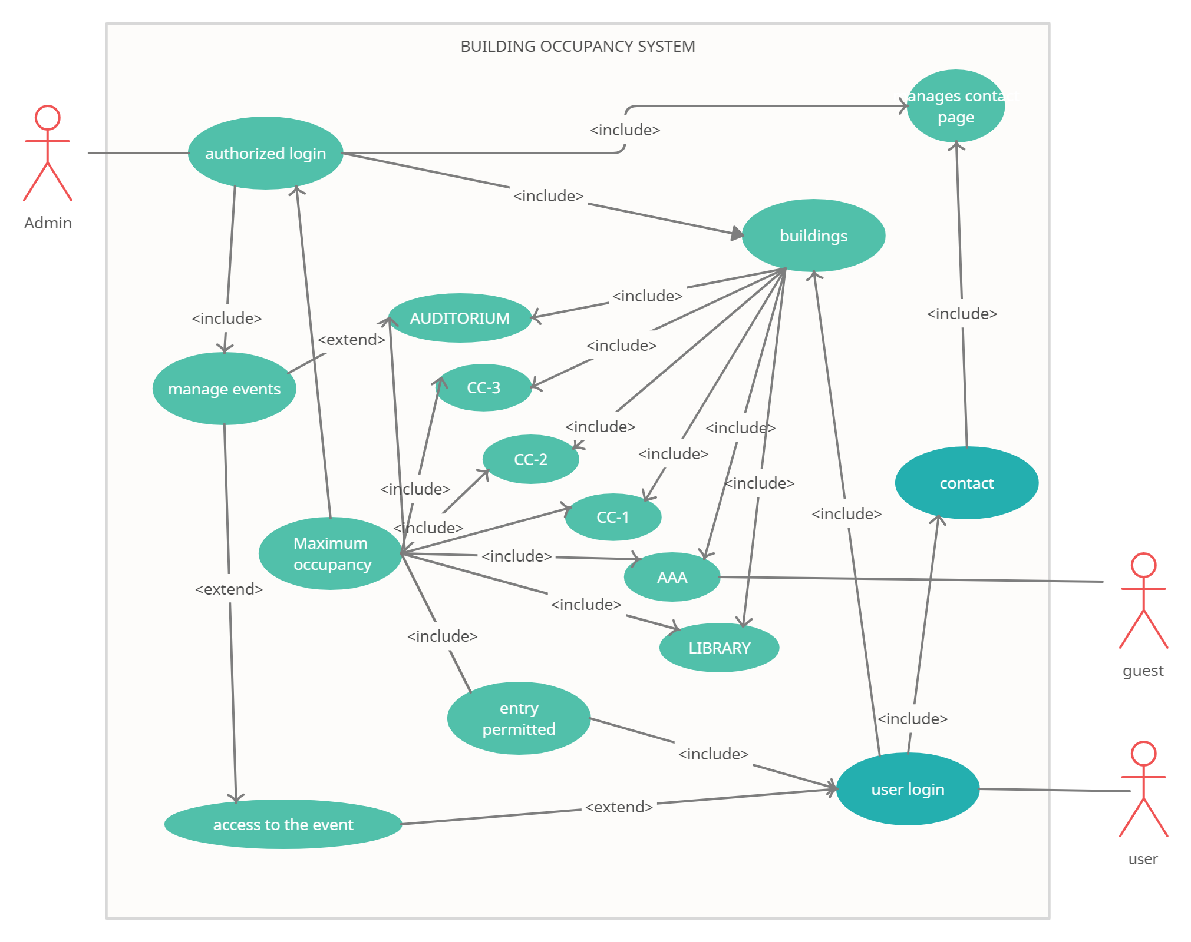
USE CASE DIAGRAM

Slide 13
USE CASES
USE CASES | Description Of Use Cases
Login | Allow the user/admin to login
Sign Up | Allow the user to Sign Up
Choose Building | Allow the user to choose his building
Choose Room | Allow the user to choose his room
Monitor | Allow the admin to monitor the count of users

Slide 14



TECH USED
FRONT END DEVELOPMENT

Slide 15


TECH USED
BACK END DEVELOPMENT

Slide 16
Group Member
CHETAN PATIDAR IIT2019193
AAMIN CHOUDHURI IIT2019206
ABHISHEK BITHU IIT2019199
DEBASISH DAS IIB2019031

Slide 17
THANK YOU

