Slide 1
Everything Basketball Website progress
By: Austin Guzzetti-Ouellette, Kyle Stewart, Eduardo Carey

Slide 2
What it is
A Basketball Website
Made entirely with HTML and CSS
Addition to Portfolio
Informational Website

Slide 3
What it does
Presents in-depth information about basketball
Incorporates mix of images and videos to present information
Uses grids, tables, and columns to organize information

Slide 4
Why
To add to portfolio
To show my in-depth knowledge of the topic
To apply web skills learned to produce final product
To learn more CSS
To gain more teamwork experience

Slide 5
How it is being built
Design -
Microsoft word
Trello Chart -
project

Slide 6
How it is being built (pt 2)
Code -
HTML
CSS
Windows

Slide 7
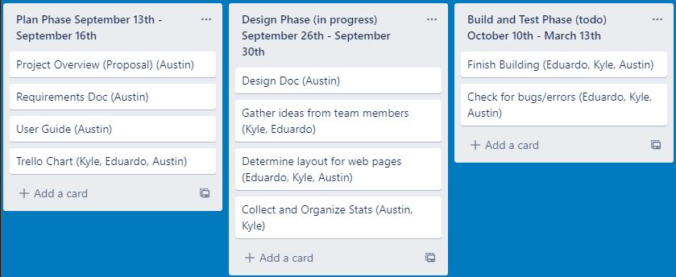
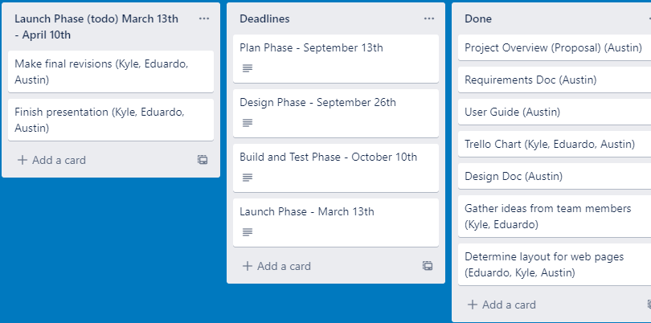
Trello Chart
Currently slightly behind schedule
Have the work for 9/13 done
Have most work for 9/26 done
Began to start code on 10/14

Slide 8
Research
Studying sports statistics
Studying sport history
Making stat sheets
Organizing player statistics
https://docs.google.com/spreadsheets/d/162p5LRyuFKWWTpriXEHySnbwn4NsX7-vgKCax2GQb1I/edit#gid=50211667 - Link to spreadsheet (40s, 50s, 60s, 70s decades are complete)

Slide 9
Design
Spent most time on so far
Thought it was done
Was wrong, went back and revised it
Currently completed
https://docs.google.com/document/d/11sIhpqoaipMYXH0eS_5dfsNjWPXOIcDc/edit - Link to Design document

Slide 10
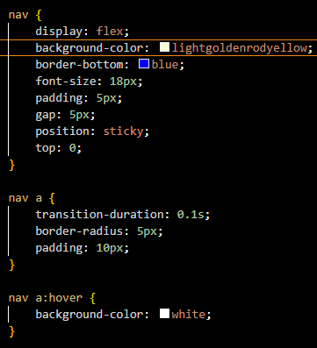
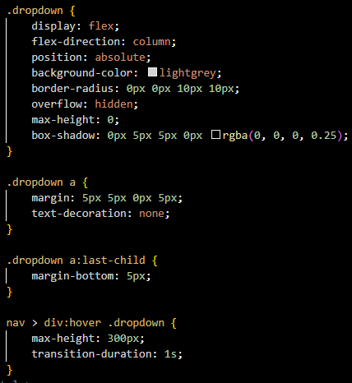
Code
Drop Down menus are incorporated
Navigation has been incorporated

Slide 11
What it looks like (so far)
Navigation:
Dropdown menu:

Slide 12
Current Status
Stat Sheets (40s - 70s are all completed)!
Navigation is complete
Drop Down menus have been incorporated
Stat Sheet (40% complete)
Research is complete

Slide 13
What is left to do
Finish Stat Sheets
Fill in homepage information
Code rest of decade web pages
Code franchise history web pages
Code all time lineups web pages

Slide 14
Plan
Look up statistics for remaining decades
Finish recording those stats in sheets ASAP
Code layouts for other pages
Implement decade information into code
Implement franchise history information into code
Implement all time lineup information into code

