Slide 1
Everything Basketball Website progress
By: Austin Guzzetti-Ouellette, Kyle Stewart, Eduardo Carey

Slide 2
What it is
A Basketball Website
Made entirely with HTML and CSS
Addition to Portfolio
Informational Website

Slide 3
What it does
Presents in-depth information about basketball
Incorporates mix of images and videos to present information
Uses grids, tables, and columns to organize information

Slide 4
Why
To add to portfolio
To show my in-depth knowledge of the topic
To apply web skills learned to produce final product
To learn more CSS
To gain more teamwork experience

Slide 5
How it is being built
(Part 1)
Design - Microsoft word
Trello Chart - Project

Slide 6
How it is being built
(Part 2)
Code - HTML and CSS
(All code is written within Visual Studio Code)

Slide 7
Research
Studying sports statistics
Studying sport history
Making stat sheets
Organizing player statistics
Basketball_Stats - Link to spreadsheet (40s, 50s, 60s, 70s, and 80s decades are complete)

Slide 8
Design
Thought it was done
Was wrong, went back and revised it
Currently completed
Austin_swDesTemplate.docx - Link to Design document

Slide 9
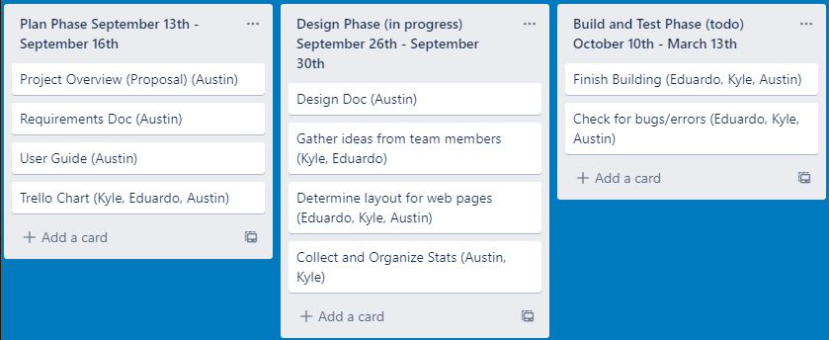
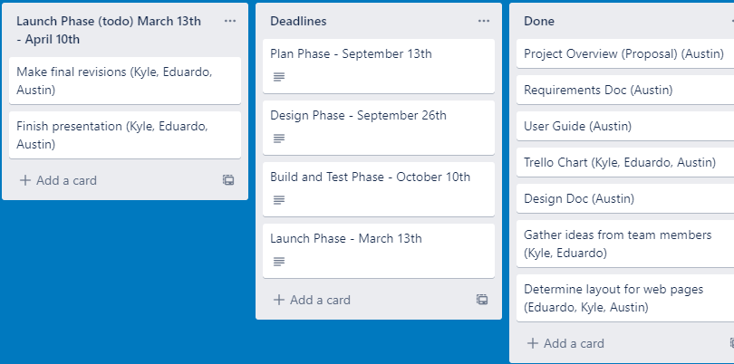
Trello Chart
Have the work for 9/13 done
Have most work for 9/26 done
Began to start code on 10/14
Still in Coding phase (1/27)

Slide 10
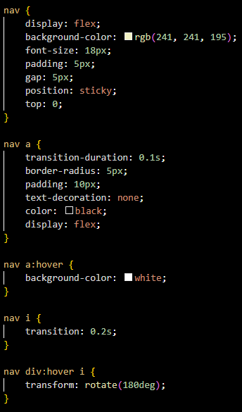
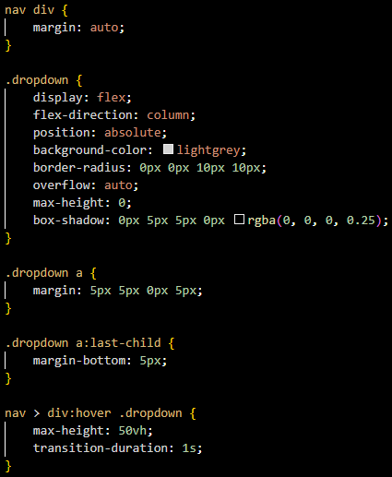
Code
Drop Down menus are incorporated
Navigation has been incorporated
CSS File has been revised
Took out unnecessary code
Decades that have multiple pages only have dropdowns

Slide 11
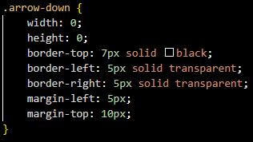
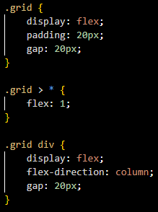
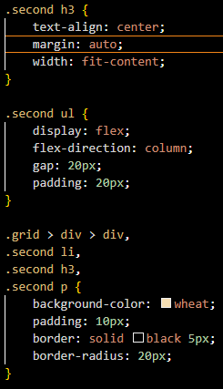
Code (Continued)
Grid code is complete
Dropdown Arrows are now incorporated
Added a class titled “second”
The second class displays information under the grid
For example, the original rules on the homepage

Slide 12

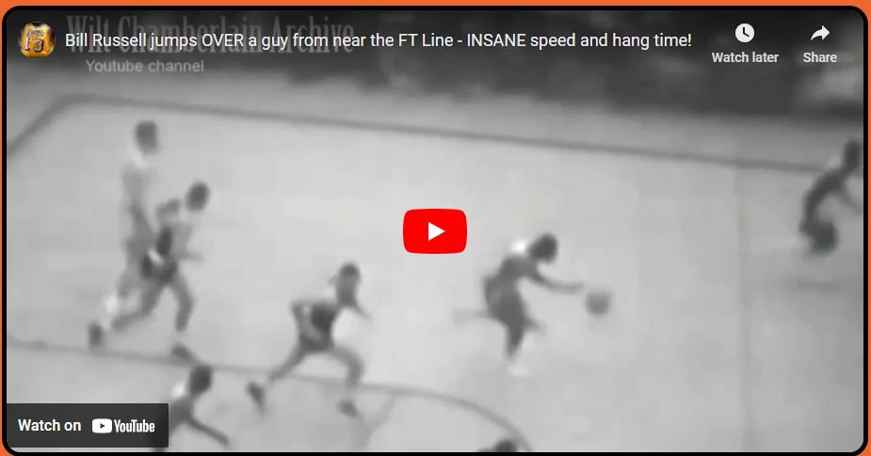
Code (continued)
Iframe Styles have been implemented
Every Iframe inside a grid will apply styles

Slide 13
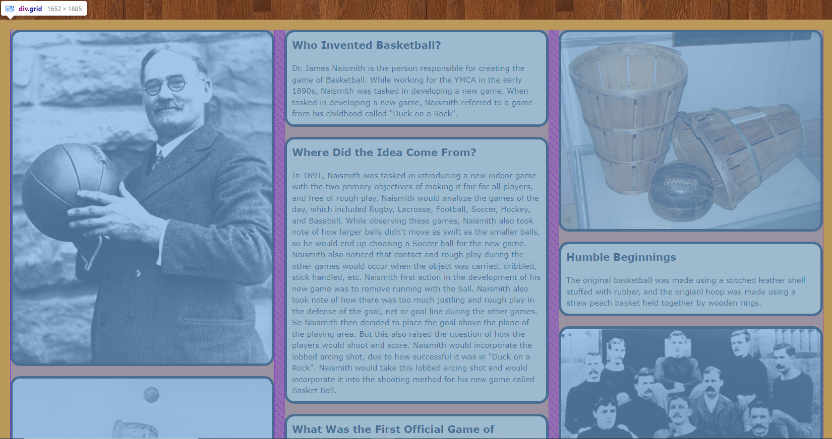
What the Grid looks like

Slide 14
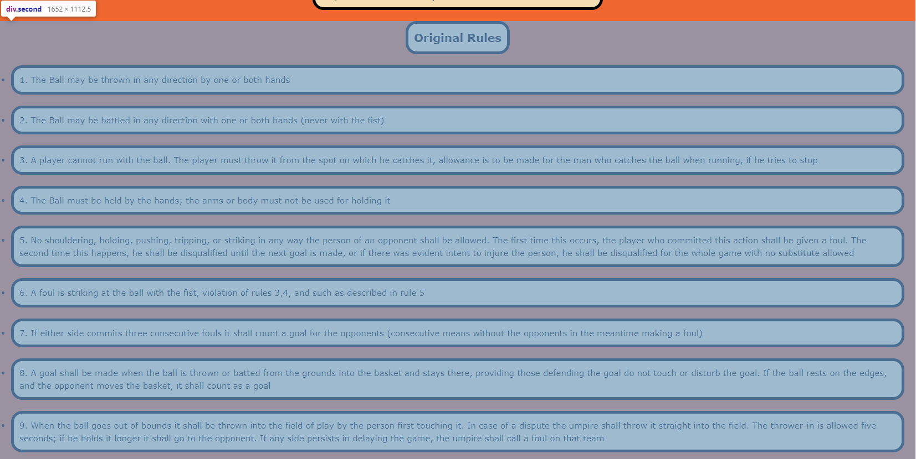
What the second class looks like

Slide 15
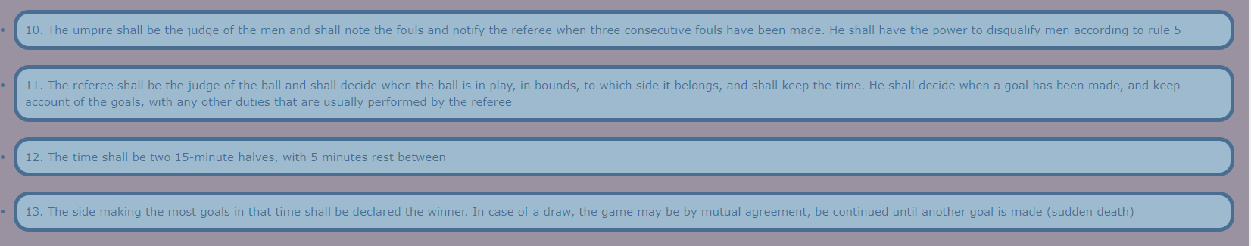
What the second class looks like (pt2)

Slide 16
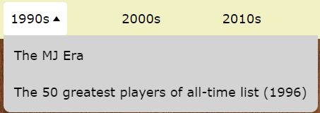
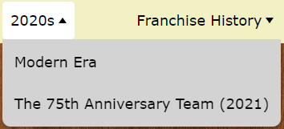
What it looks like (so far)
Navigation:
Drop Down menu/arrows:

Slide 17
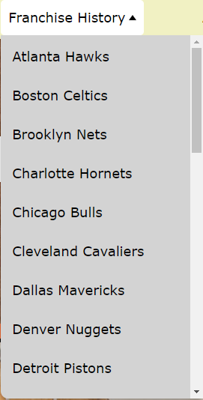
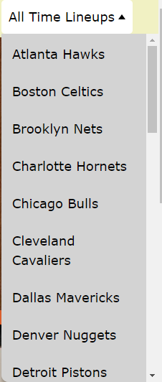
More Drop Down Menus/Arrows

Slide 18
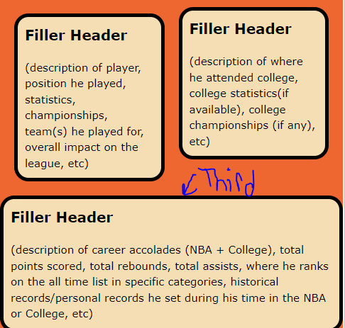
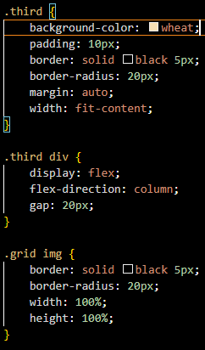
Code (Continued)
Added a class titled “third”
Displays information below the second class

Slide 19
Current Status
Stat Sheets (40s - 80s are all completed)!
Navigation is complete
Drop Down menus have been incorporated
Stat Sheet (50% complete)
Research is complete
Homepage is complete
40s and 50s pages mostly complete
Code Layouts for decades pages are complete
Iframe Styles have been incorporated

Slide 20
What is left to do
Finish Stat Sheets
Implement information into (60s - 2020s) decade web pages
Code layout franchise history web pages
Code layout all time lineups web pages

Slide 21
Plan
Look up statistics for remaining decades
Finish recording those stats in sheets ASAP
Code layouts for other pages
Implement decade information into code
Implement franchise history information into code
Implement all time lineup information into code

