Slide 1
Simple DevOps project
Hordiienko Roman

Slide 2

Agenda
Create website;
Post it on GitHub;
Deploy Web-project

Slide 3






Project structure
webhook
push
ssh slave plugin

Slide 4
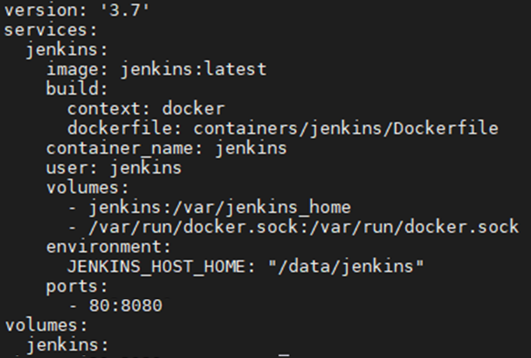
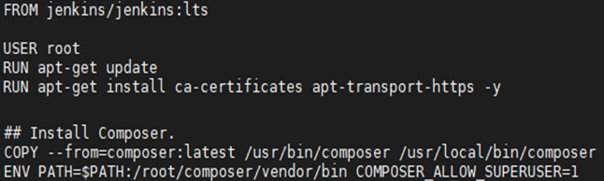
Configure and build docker file
Docker-compose.yml
Dockerfile

Slide 5
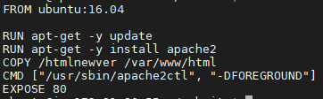
Docker build file

Slide 6
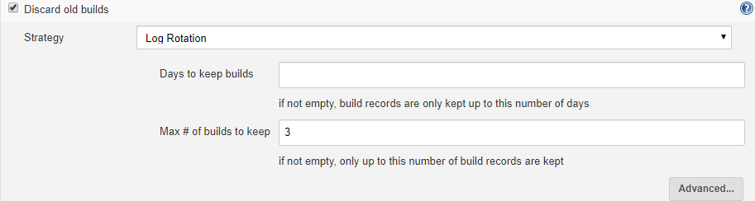
Jenkins: Project configure

Slide 7
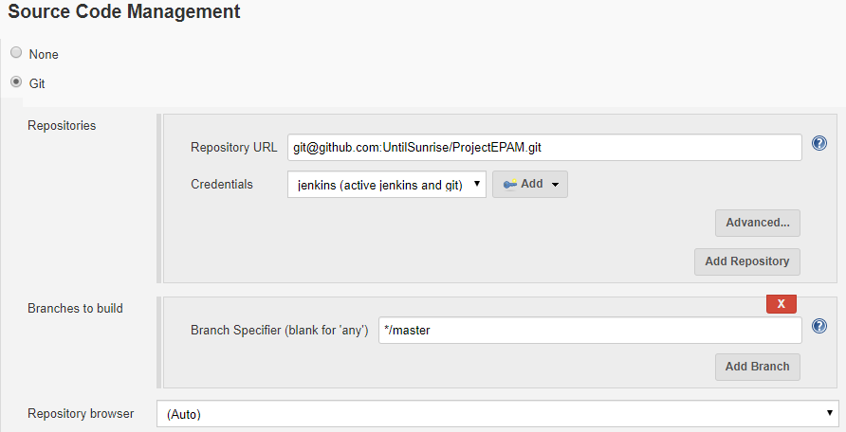
Jenkins: Project configure

Slide 8
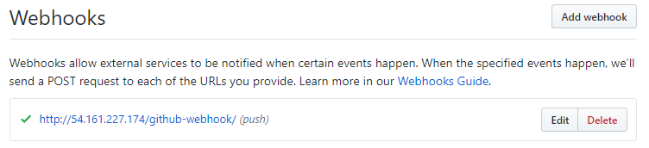
Webhook setup

Slide 9
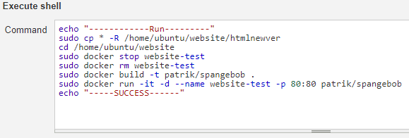
Execute shell: Command

Slide 10
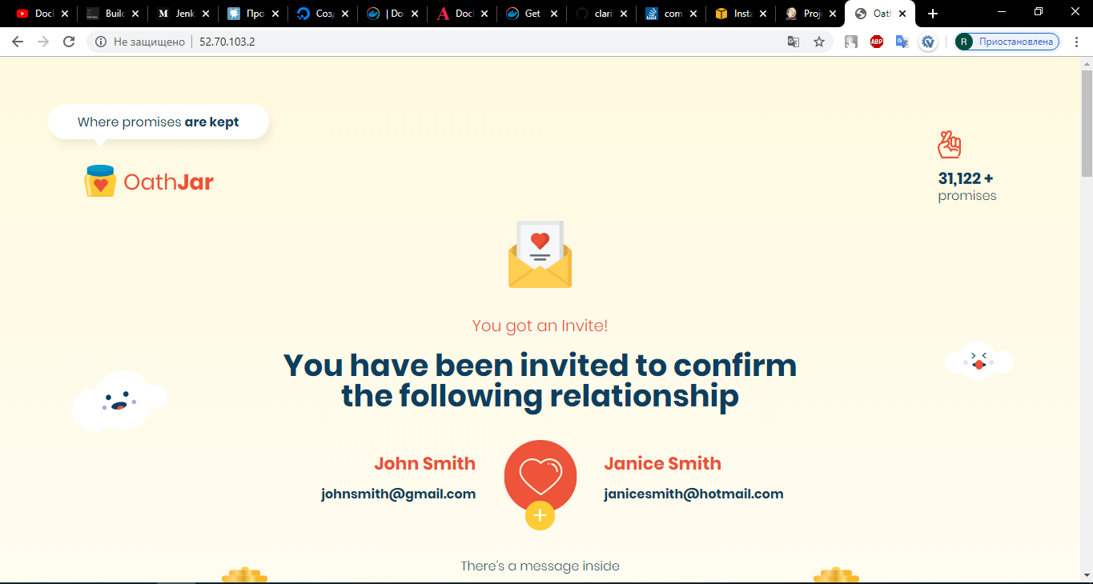
Deploy Result

Slide 11
Q & A ?

