Slide 1
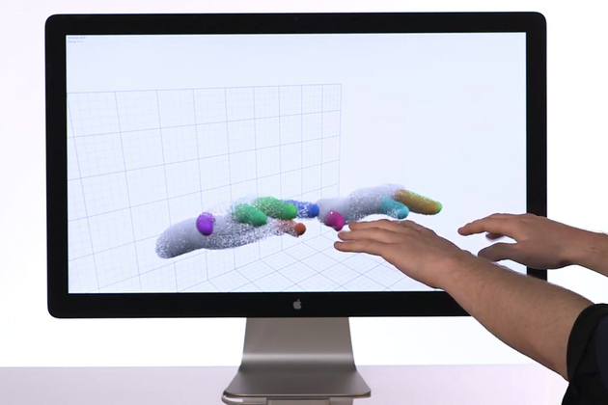
LeapIT
Client: Samuel Mann
Project Team: Sammy Wong
Matt Seaton
Notes:
Introduce the ourselves, and what we hope to achieve using leap motion: Explore its capability's in a variety of areas (DJ and learning)

Slide 2
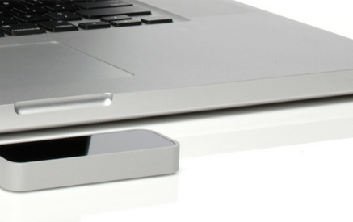
LeapIT
What is Leap Motion??
“Advanced motion sensing technology for human–computer interaction. Originally inspired by frustration surrounding 3D modeling using a mouse and keyboard, Leap Motion asserts that molding virtual clay should be as easy as molding clay in the real world.”
http://en.wikipedia.org/wiki/Leap_Motion
Notes:
What is Leap Motion?

Slide 3
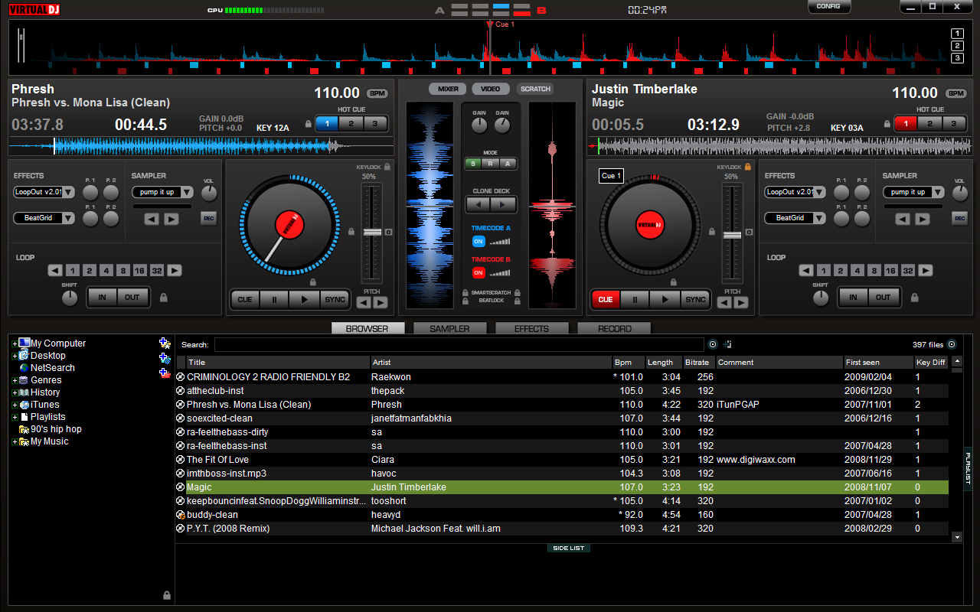
LeapIT
Why combining Leap motion and Virtual DJ?
Retains the element of touch
Provides a clean interface
Provide a base for future development

Slide 4
LeapIT
What are our end goals?
To create an efficient easy to use way for the digital DJ of today.
What next?
We would like to continue to work with the leap motion tool into the second semester, working with the Otago Polytechnics Occupational Therapy Department to develop a learning tool for disabled children.

