Slide 1
Center

Slide 2
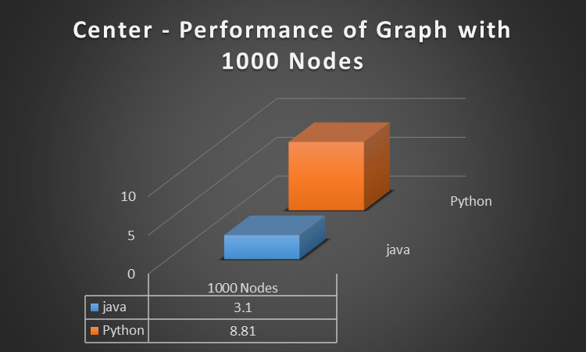
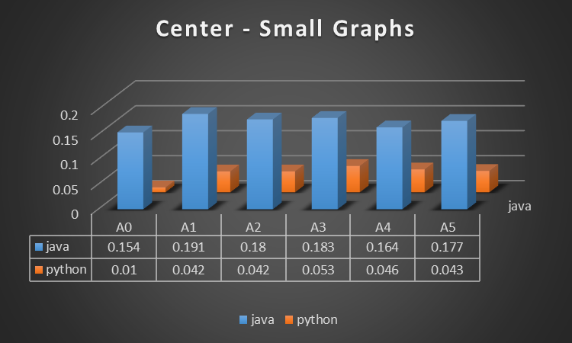
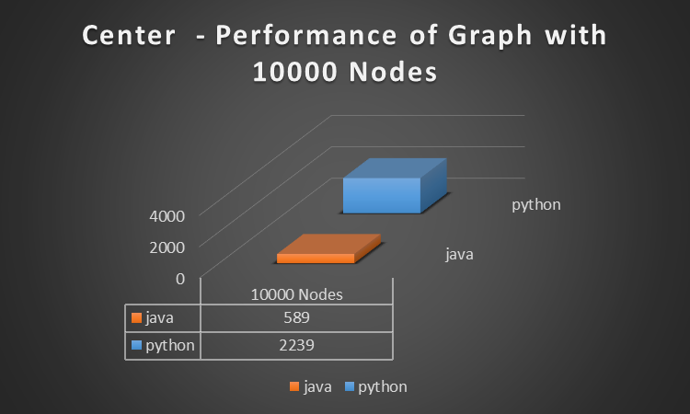

Slide 3
TSP

Slide 4
Performance

Slide 6
Results

Slide 7
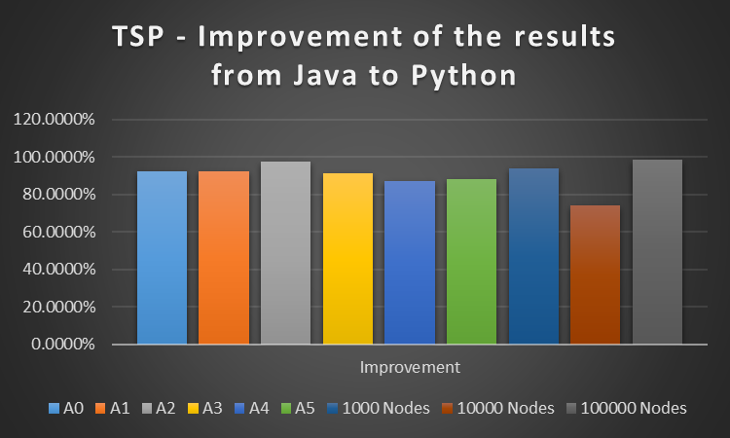

Slide 8
Graph | Java | Python | Improvement
A0 | 42.5016425 | 39.1438787 | 92.0997%
A1 | 71.7423095 | 66.1427492 | 92.1949%
A2 | 89.8960676 | 87.4496905 | 97.2787%
A3 | 140.288911 | 128.038889 | 91.2680%
A4 | 160.602965 | 139.792561 | 87.0423%
A5 | 143.661432 | 126.19094 | 87.8391%
1000 Nodes | 45610.8178 | 42839.4683 | 93.9239%
10000 Nodes | 98544.085 | 72750.1051 | 73.8249%
100000 Nodes | 44572.958 | 43826.646 | 98.3256%
For each graph we create 4 random sequences which will suit the number of nodes in the graph and then we run out Java and Python TSP algorithms on the same inputs, then we sum the results of all of the sequences of each graph in order to see the difference in the results.
As we can see in the table, the change in the algorithms was very effective, the results improved by at least 1% for each graph in python. The most surprising improvement is that for graphs with 10,000 nodes, the results was better by almost 30%.

Slide 9
Shortest Path

Slide 10
