Slide 1

BACHELOR THESIS II · CSAITHE02 · BSc APPLIED COMPUTER SCIENCE
Fair, Reproducible Benchmarking and Visualization of Optimizers when Fine-Tuning Language Models
Maksim Seliuk
Student ID 1220715469
Supervisor: Dr. Dimitris Karampatzakis
School of Economics, Business and Computer Science · Academic year 2025–2026
Notes:
0:00–0:15. Good morning. My name is Maksim Seliuk. My supervisor is Dr. Karampatzakis, and the thesis is on fair, reproducible benchmarking and visualization of optimizers when fine-tuning language models.

Slide 2
MOTIVATION
“Which optimizer is best?” is the wrong question
New optimizers keep arriving. Lion, Sophia and Muon were each launched with evidence that they beat AdamW.
But the comparisons are rarely fair. Choi et al. (2019) showed that the ranking of optimizers can be inverted simply by changing the hyperparameter-search protocol.
Schmidt et al. (2021) benchmarked fifteen optimizers and found no single winner: the tuning budget matters as much as the update rule.
So much of the reported progress measures the experimenter’s effort, not the algorithm.
Visualization is just as unreliable: naive loss-landscape plots can be made to show almost any degree of sharpness (Dinh et al., 2017; Li et al., 2018).
The question this thesis asks instead
How can optimizers be compared and visualised fairly, and what changes once the comparison is made fair?
Maksim Seliuk · Neapolis University Pafos · BSc Applied Computer Science
2 / 10
Notes:
0:15–0:45. Start with the problem. Every year new optimizers arrive claiming to beat AdamW. But Choi and colleagues showed the ranking can be inverted just by changing the search protocol, and Schmidt’s fifteen-optimizer benchmark found no single winner: the tuning budget matters as much as the algorithm. So a lot of the reported progress is really measuring how hard the experimenter tuned. The same unreliability affects visualization. That is why I reframed the question.

Slide 3
AIM AND RESEARCH QUESTIONS
Three questions, one protocol
Establish, implement and demonstrate a fair, reproducible methodology for benchmarking and visualising optimizers when fine-tuning a language model, then use it to characterise four representative optimizers (five under full fine-tuning).
RQ1 · Benchmark
Under an equal tuning budget, is there a statistically detectable difference between AdamW, Lion, Sophia and SGD + momentum?
Measured by final validation quality and by steps to a fixed quality target.
RQ2 · Tunability
How sensitive is that conclusion to the tuning protocol? What does quality versus learning rate look like for each optimizer?
Which optimizers forgive a badly chosen learning rate, and which demand a precise one.
RQ3 · Geometry
What does a correct loss-landscape visualization reveal, and how does a naive one mislead?
Also a cheap curvature measure, validated against the exact Hessian.
The deliverable is the comparison protocol itself, rather than a verdict on which optimizer wins.
Maksim Seliuk · Neapolis University Pafos · BSc Applied Computer Science
3 / 10
Notes:
0:45–1:15. The aim is to establish and demonstrate a fair, reproducible methodology. Three research questions. RQ1: is there a real difference under an equal budget. RQ2: how do the optimizers respond to the tuning protocol itself. RQ3: what does a correct loss-landscape visualization show. The deliverable is the protocol rather than a verdict on which optimizer wins.

Slide 4
METHODOLOGY
The fairness invariant, encoded in software
Identical model, data order, initialization and compute budget for every optimizer; only the hyperparameter search space may vary.
Compared: SGD + momentum, AdamW, Lion and Sophia (plus Muon under full fine-tuning)
Workload
GPT-2 (124M) + LoRA r=8 on WikiText-2, packed into 256-token blocks. Second model: SmolLM2-360M (Llama-style).
Shared budget
800 steps, batch 8 × 256, 5% warm-up + cosine decay, gradient clip 1.0, fp32 weights with bf16 autocast.
Pre-registered search
18 log-spaced learning rates per optimizer, declared before the sweep, with no post-hoc widening of a losing range.
Final evaluation
Best configuration re-trained on 5 seeds; bootstrap 95% CI; Mann–Whitney U with Cliff’s δ and Hedges’ g.
Extensions
Full fine-tuning of all 124M weights (+ Muon), 2-D tuning grids, second model, filter-normalized slices, Hessian curvature.
Reproducibility
One declarative YAML config, fixed seeds, logged environment and per-trial JSON, so every number is regenerable without retraining.
Maksim Seliuk · Neapolis University Pafos · BSc Applied Computer Science
4 / 10
Notes:
1:15–1:55. The whole method rests on one invariant, encoded in software: same model, same data order, same initialization, same compute budget, with only the search space varying. GPT-2 with LoRA on WikiText-2, 800 steps for everyone, eighteen pre-registered learning rates each. Then the best configuration is re-run on five seeds with bootstrap intervals and effect sizes. Everything is driven from one YAML config.

Slide 5
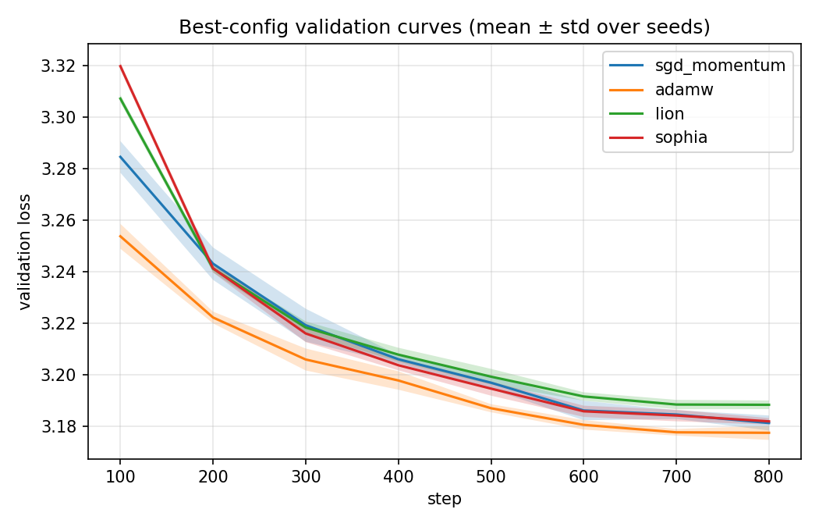
RQ1 · RESULTS
Under a fair budget the four optimizers finish level
Optimizer | Best LR | Val loss (mean ± std) | Steps → 3.20 | Seconds → target | Opt. state (MB) | Step time (ms)
AdamW | 3.0e-3 | 3.1763 ± 0.0021 | 400 | 98 | 2.36 | 241
SGD + momentum | 4.4e-1 | 3.1813 ± 0.0032 | 520 | 91 | 1.18 | 176
Sophia | 5.8e-4 | 3.1819 ± 0.0013 | 500 | 191 | 2.36 | 383
Lion | 6.7e-4 | 3.1881 ± 0.0019 | 540 | 54 | 1.18 | 100
Spread of only 0.012 nats (≈ 0.3 perplexity), the same order as one optimizer’s seed-to-seed noise.
Reliable but trivial. Cliff’s δ = 1.0 against Lion and Sophia, yet against SGD the gap is borderline (p ≈ 0.056).
Cost breaks the tie. AdamW and Sophia carry two state buffers, SGD and Lion one; step time spans 4× (100 to 383 ms).
Speed has no single answer. AdamW is fastest per step (400), Lion fastest per second (54 s), so the verdict depends on how the budget is counted.
Maksim Seliuk · Neapolis University Pafos · BSc Applied Computer Science
5 / 10
Notes:
1:55–2:35. This is the headline result. Under a fair budget the four optimizers finish inside 0.012 validation loss, about 0.3 perplexity, which is the same order as one optimizer’s own seed noise. AdamW is reliably ahead of Lion and Sophia, but the margin is trivial, and against SGD it is borderline. What actually separates them is cost: two state buffers versus one, and a four-fold spread in step time. Note the inversion: AdamW is fastest per step, Lion is fastest per second.

Slide 6
RQ1 · ROBUSTNESS
The near-tie belongs to the regime, not the algorithms
Full fine-tuning (124M) | Best LR | Val loss | Steps → 3.26 | Step (ms)
SGD + momentum | 1.2e-1 | 3.1794 ± 0.0027 | 200 | 128
Sophia | 1.0e-5 | 3.2053 ± 0.0018 | 200 | 142
Lion | 6.5e-6 | 3.2135 ± 0.0021 | 200 | 136
AdamW | 2.2e-5 | 3.2202 ± 0.0036 | 200 | 141
Muon | 2.2e-3 | 3.2535 ± 0.0074 | 100 (4/5) | 266
Spread widens 6× (0.012 to 0.072) and the ranking inverts.
Well-tuned SGD is now clearly first , with every seed below every seed of every other optimizer; AdamW drops to fourth.
Muon reaches the target in half the steps, but its Newton–Schulz step costs 2×, so the advantage cancels in wall-clock, and it ends last on quality.
Second model: SmolLM2-360M (LoRA, 3 seeds)
What transfers: AdamW is again first (2.4370) and the tunability fragilities recur on a different architecture.
What does not: SGD falls from a near-tie to clearly last (2.4767), trailing the adaptive trio by 0.03–0.04.
“Best optimizer” is a property of the (optimizer, regime) pair. A single-regime study would have reported either result as the ranking.
Maksim Seliuk · Neapolis University Pafos · BSc Applied Computer Science
6 / 10
Notes:
2:35–3:15. Then I asked whether that near-tie is a property of the optimizers or of the regime. Repeating the identical protocol on full fine-tuning of all 124 million weights, the spread widens sixfold and the ranking inverts. Well-tuned SGD is now clearly first and AdamW drops to fourth. Muon is fastest to the target in steps, but its step costs twice as much, so the advantage cancels. On the second model AdamW’s edge transfers, but SGD’s competitiveness does not. So best optimizer is a property of the optimizer-and-regime pair.

Slide 7
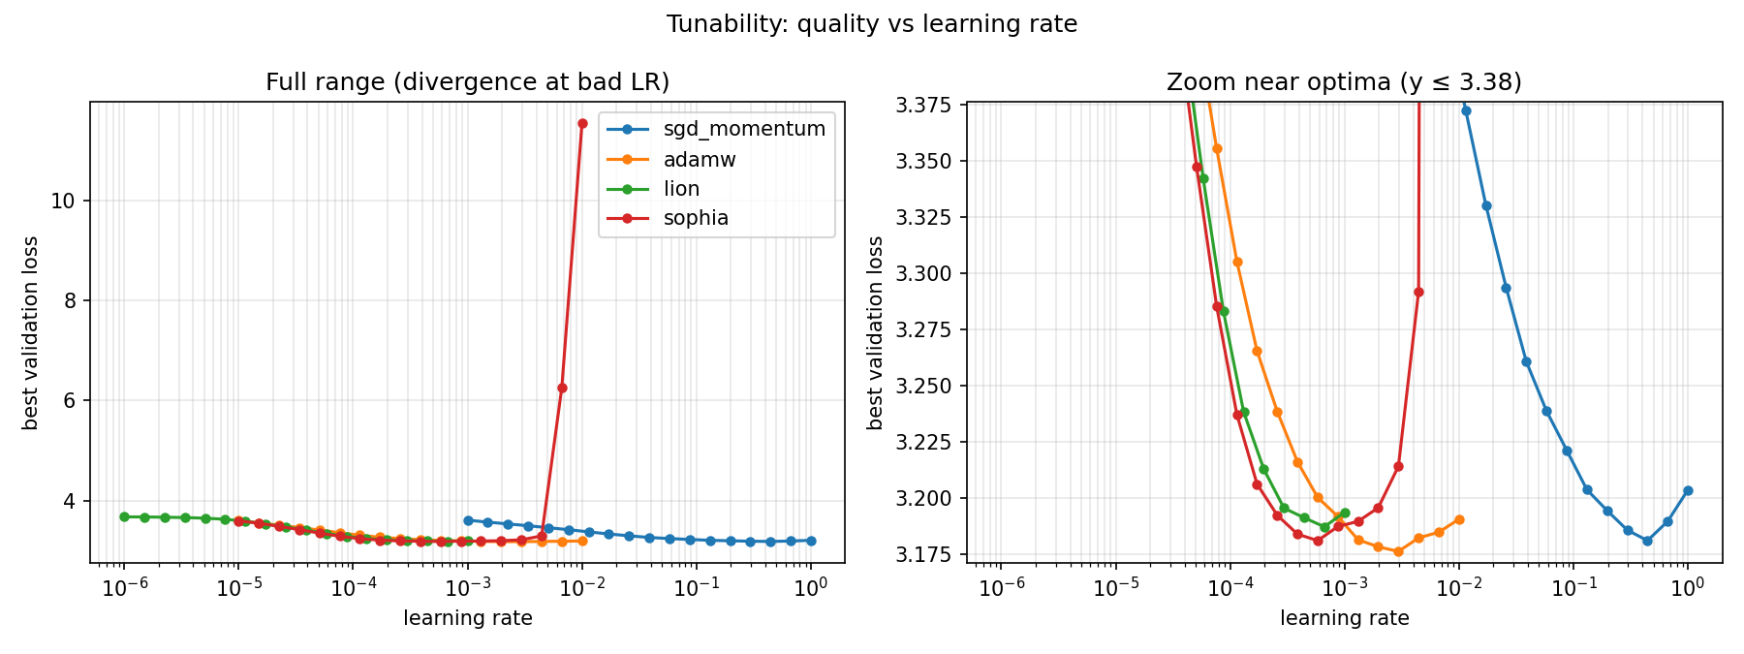
RQ2 · TUNABILITY
Where the optimizers genuinely differ
Best validation loss vs learning rate (GPT-2 + LoRA, 18 points per optimizer). Right: zoom near the optima.
Optima span three orders of magnitude : 0.44 for SGD against 6e-4 to 3e-3 for the Adam family, which is why per-optimizer ranges are the fair choice.
AdamW is the most forgiving (within 0.01 of optimal across the whole decade 1e-3 to 1e-2); Lion’s basin is narrower; Sophia is the most fragile, jumping from 3.18 to 11.55 above its threshold.
Two-dimensional check: AdamW’s valley is essentially 1-D in the learning rate, but SGD’s learning rate and momentum form a diagonal ridge, so whether one axis suffices is itself optimizer-specific.
Maksim Seliuk · Neapolis University Pafos · BSc Applied Computer Science
7 / 10
Notes:
3:15–3:55. RQ2 is tunability, and this is where the optimizers genuinely differ. Their optima span three orders of magnitude in learning rate, which is why per-optimizer ranges are the fair choice. AdamW has a broad, flat valley, so it forgives a bad learning rate. Sophia does not: past a threshold it diverges catastrophically. And the two-dimensional grids show that whether one tuning axis is enough is itself optimizer-specific. It is for AdamW, it is not for SGD.

Slide 8
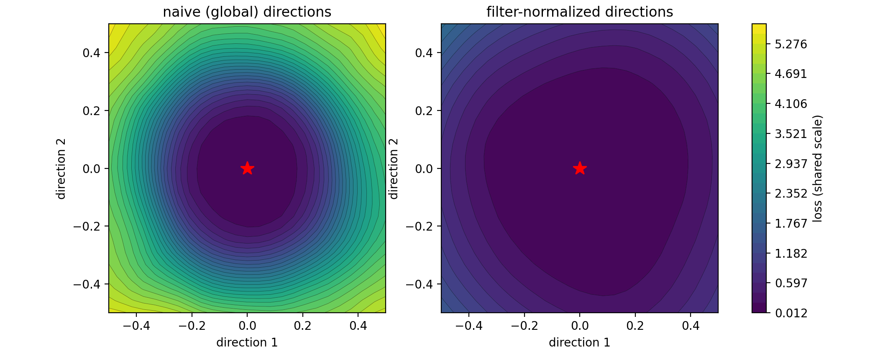
RQ3 · GEOMETRY
Naive visualization misleads; curvature explains part of it
Visualization: the same minimum, twice
Curvature: top Hessian eigenvalue λₘₐₓ
Optimizer | λₘₐₓ | Tunability (RQ2)
AdamW | 1.41 | broadest, most forgiving
SGD + momentum | 1.48 | broad, never destabilises
Sophia | 1.81 | diverges at high LR
Lion | 5.58 | narrowest basin
The proxy is validated: power iteration on Hessian–vector products gives 19.046 against an exact 19.052 on a toy MLP, an error of 0.03%.
Geometry explains Lion. Its minimum is ≈ 4× sharper than the others, which matches its narrow tunability basin.
Geometry does not explain Sophia. It sits at moderate curvature yet diverges most violently, which points to an update-dynamics failure (empirical-Fisher preconditioning driven into clip saturation) rather than a landscape one.
Across regimes: under full fine-tuning the winning SGD and Muon reach minima 50–90× flatter than the adaptive methods, pinned near the sharp pretrained basin.
Same solution, same step size. Naive global normalization drives the edge loss to ≈ 5.3 where filter normalization reaches ≈ 1.9, so apparent sharpness is an artefact of direction scaling.
Interpolating AdamW → SGD shows a loss barrier (0.011 at both ends, 0.027 at the midpoint): different basins, not linearly connected.
Maksim Seliuk · Neapolis University Pafos · BSc Applied Computer Science
8 / 10
Notes:
3:55–4:35. RQ3. These two panels are the same AdamW solution at the same step size. Only the direction normalization differs, and the minimum looks three times sharper on the left. So sharpness read off a naive slice is an artefact. Quantitatively, I validated a Hessian-vector-product estimate of the top eigenvalue against the exact Hessian to 0.03 percent. It explains Lion’s narrow basin, a four-times sharper minimum, but it explicitly does not explain Sophia. That isolates Sophia’s fragility as an update-dynamics effect rather than a landscape one.

Slide 9
CONCLUSION
What changes once the comparison is made fair
RQ1. Under an equal, pre-declared budget the optimizers converge to within 0.012 validation loss on GPT-2 + LoRA, but full fine-tuning widens the spread sixfold and inverts the ranking.
RQ2. They differ far more in how they must be tuned than in best-case quality; whether a second hyperparameter matters is itself optimizer-specific.
RQ3. Filter normalization is necessary rather than optional, and a validated curvature probe separates a landscape fragility (Lion) from a dynamics fragility (Sophia).
Practical takeaway
For LoRA, AdamW remains a sound default, mainly because it is the easiest to tune rather than because it is decisively better. Lion when memory or step time binds; well-tuned SGD under full fine-tuning.
Limitations
Two language-modelling models, a mostly single-axis search, small seed counts (5 and 3), a fixed 500–800 step budget, and a simplified Sophia variant.
Contribution
A reproducible, config-driven harness that encodes the fairness invariant, an equal-budget tuning and multi-seed evaluation procedure, and an honestly scoped visualization component.
Equalising the tuning budget shrinks optimizer differences on accuracy and relocates them to robustness, tunability and cost.
Maksim Seliuk · Neapolis University Pafos · BSc Applied Computer Science
9 / 10
Notes:
4:35–4:55. To conclude: equalising the tuning budget shrinks the accuracy differences to noise and relocates them to tunability, cost and adaptation regime. Practically, AdamW stays a sound LoRA default because it is easiest to tune, Lion when memory binds, and SGD under full fine-tuning. The contribution is the protocol and the harness that enforces it.

Slide 10
Thank you — questions?
Maksim Seliuk · Student ID 1220715469
Supervisor: Dr. Dimitris Karampatzakis
Fair, Reproducible Benchmarking and Visualization of Optimizers when Fine-Tuning Language Models
Neapolis University Pafos · School of Economics, Business and Computer Science · 2025–2026
Notes:
4:55–5:00. Thank you. I am happy to take questions.

