Slide 1
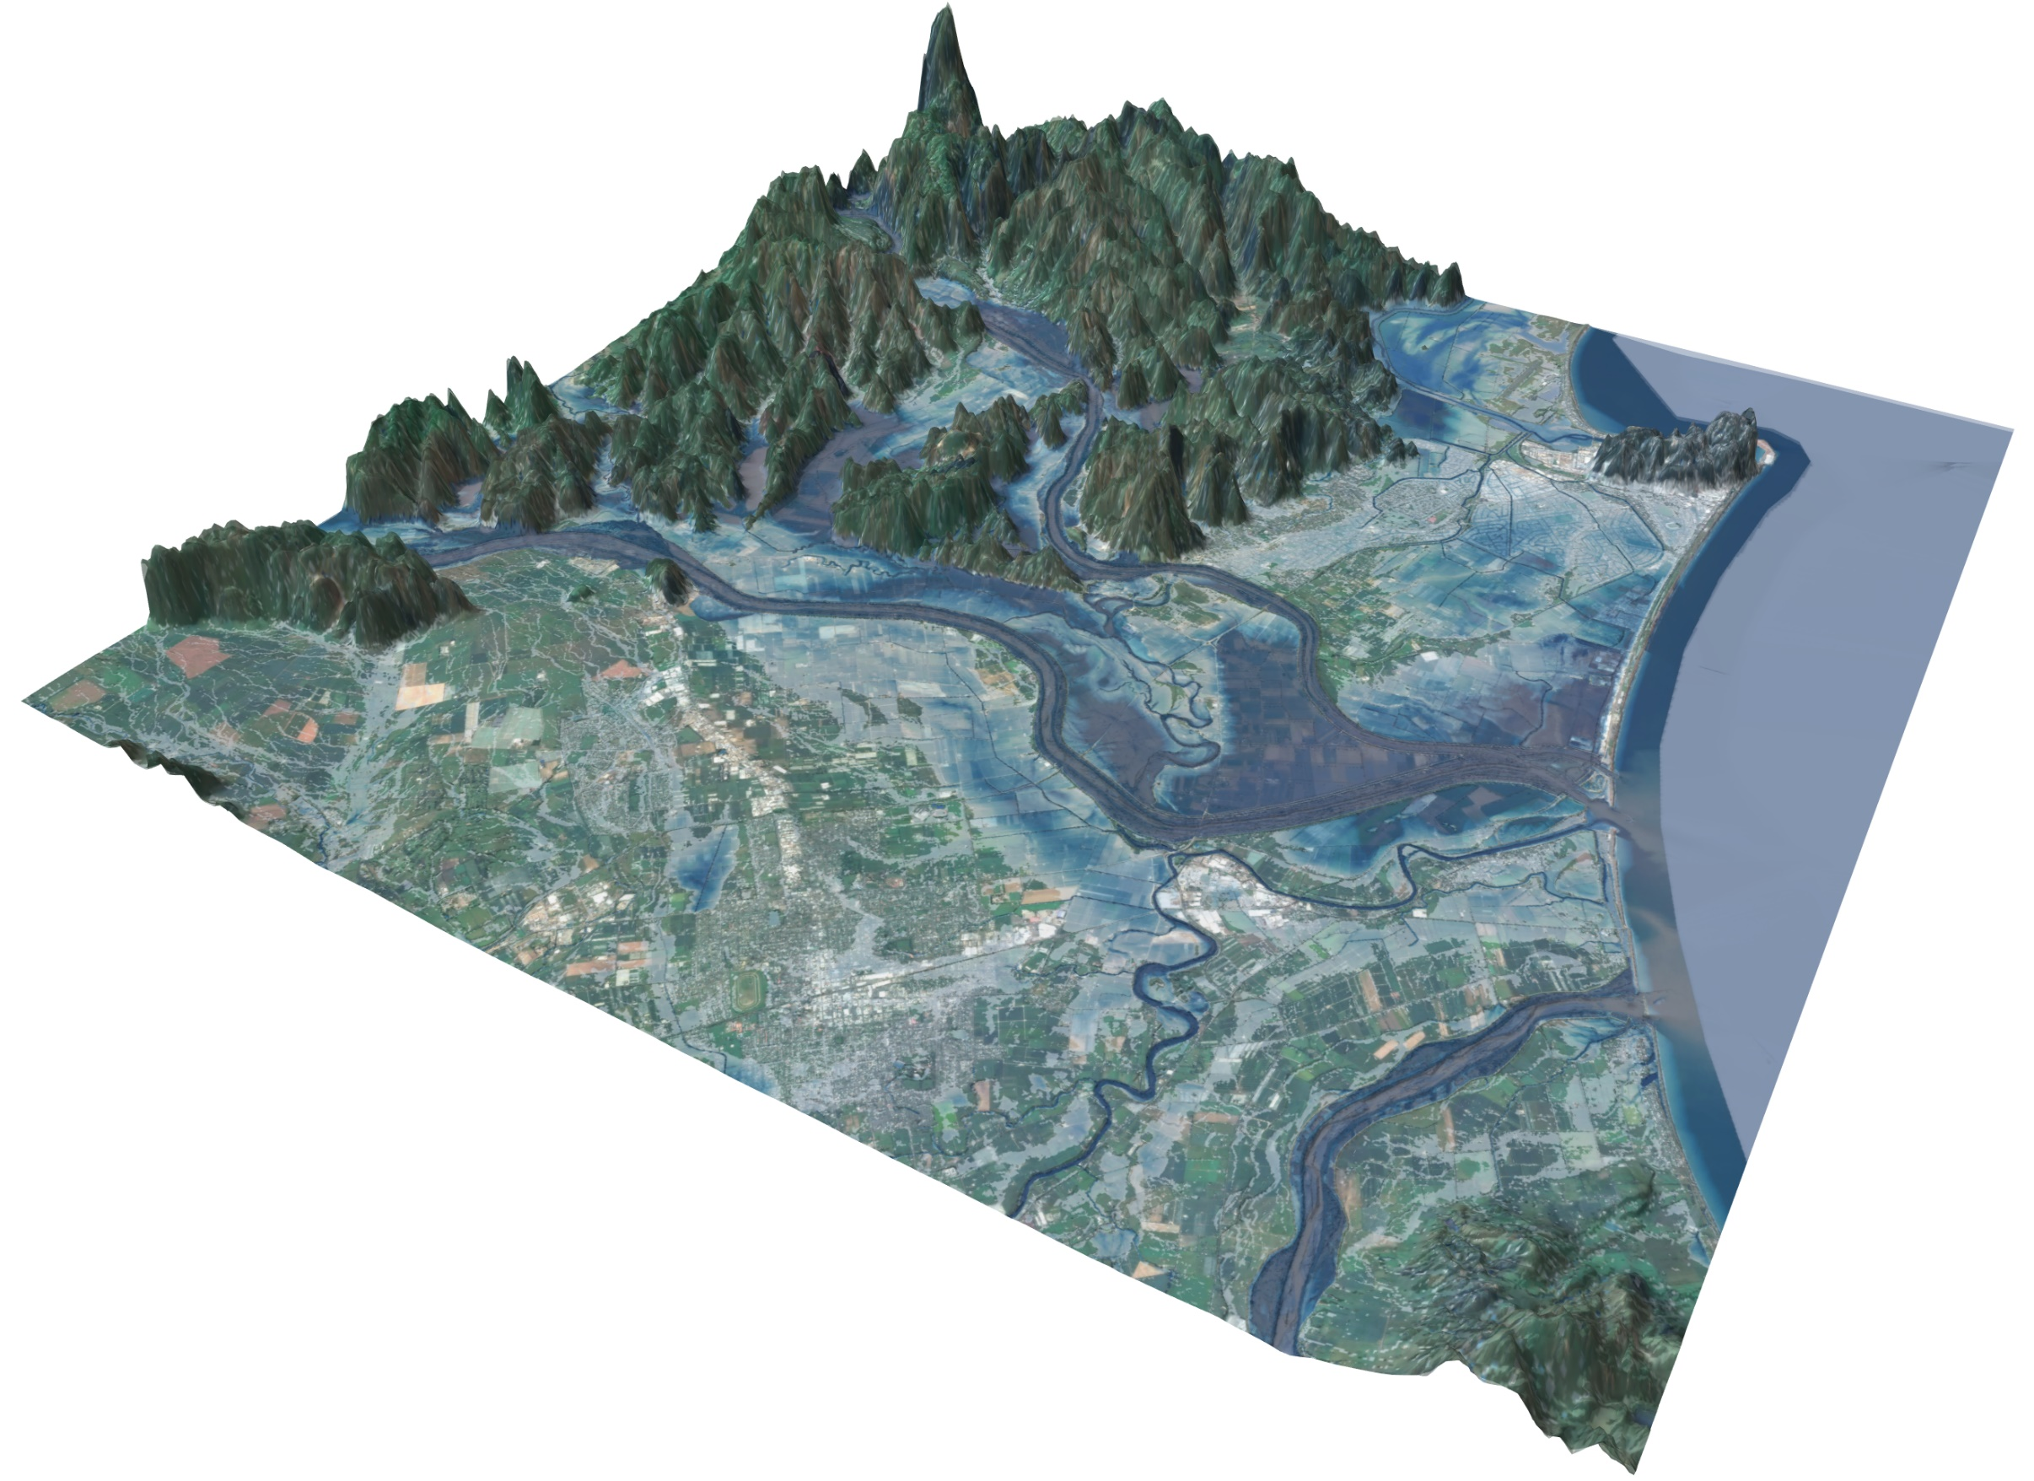
BG-Flood Workshop
Rainfall and fluvial flooding
Joë Pelmard¹, Alice Harang²
¹ University of Auckland, New Zealand
² Earth ational Institute of Water and Atmospheric Research, New Zealand

Slide 2
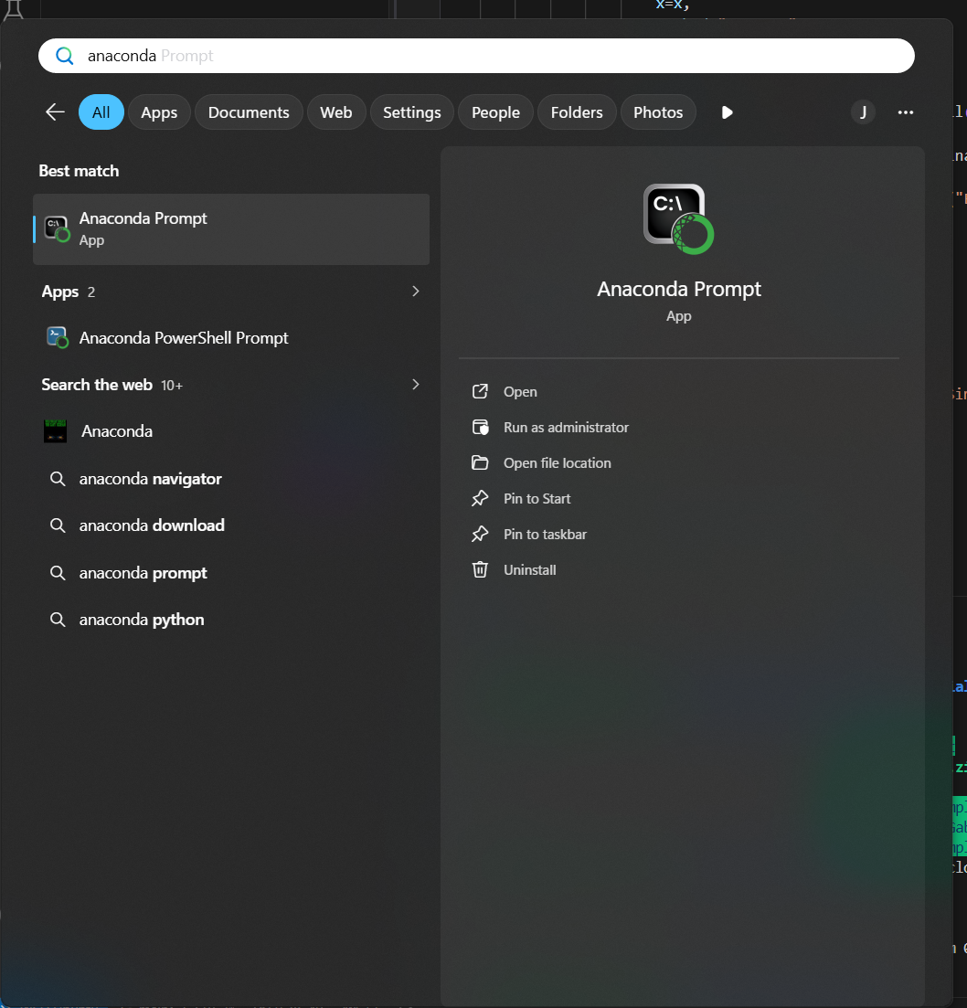
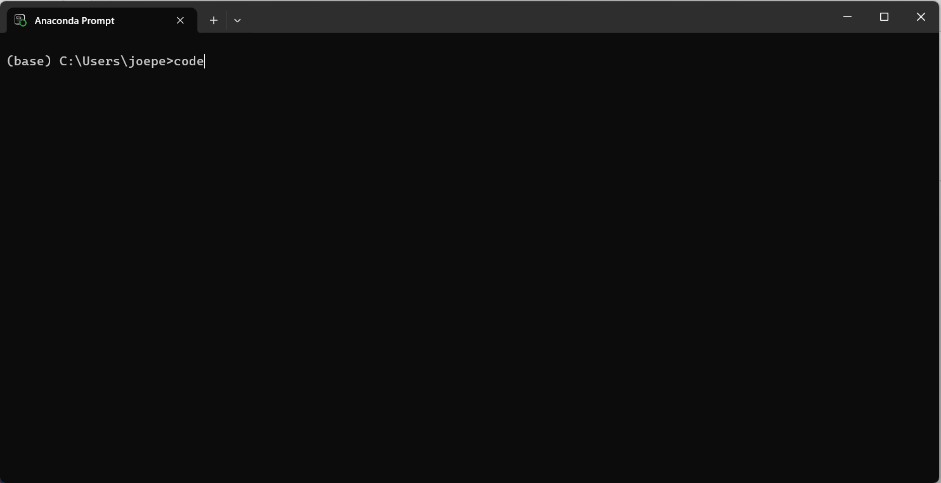
Clone/download the tutorial repository
Open Anaconda Prompt → Open Visual Studio code from the prompt

Slide 3
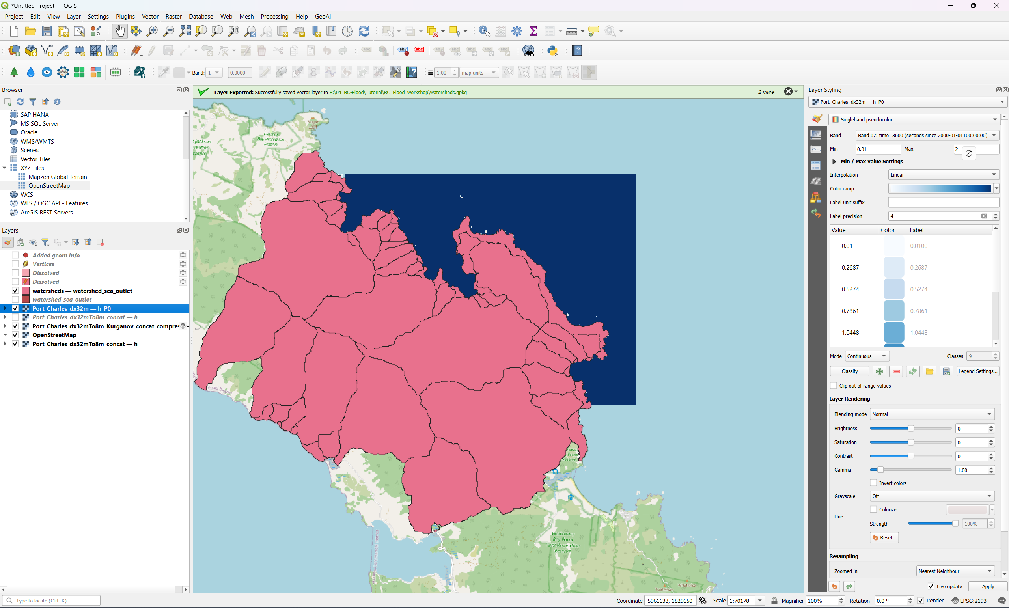
Style
Timestep
Colormap features
Layer Styling
CRS

Slide 4
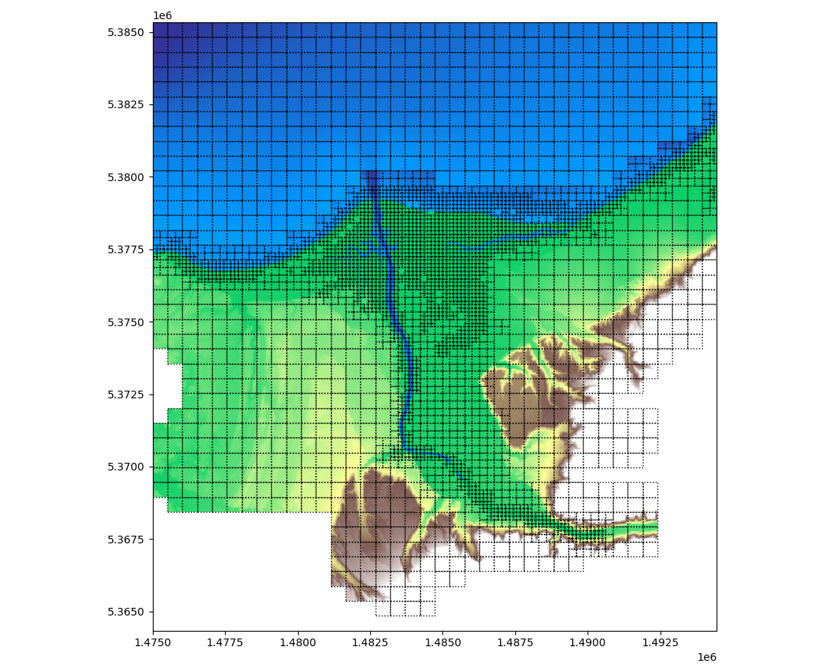
Example of final refinement

