Slide 1

Using AI to Extract and Curate Research Data
Dr Kyle Hemming
30 June 2026
Centre for eResearch

Slide 2
Today’s plan
Intro + framing
15 min
Block 1
Data Cleaning
30 min
Block 2
Data transformation (feature extraction)
40 min
Wrap up
20 min

Slide 3
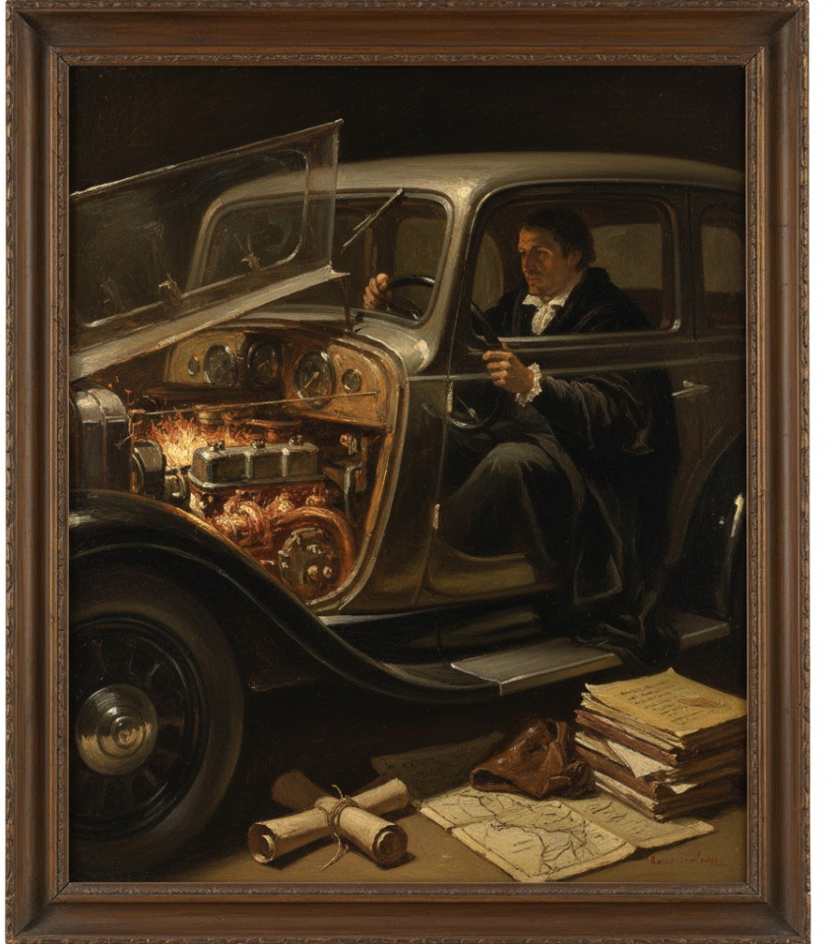
Generative artificial intelligence (GenAI)
AI mimics human intelligence
Figures out complex patterns, makes decisions
GenAI = new, language-based answers
Uses large language models (LLMs)

Slide 4
Data prep is a marathon
Research → Results
Effort + time in getting the data ready
Analysis is the finish line.
Real work is before it.
Raw data is almost never analysis-ready
Outliers, typos, inconsistent formats, free text, missing values
Manual cleaning is slow and hard to audit
Steps don't appear in Methods & take the most time
AI changes pace, not problem
Today is about speeding up that process, reliably

Slide 5
Set up checklist (5 min)
Before we start — setup checklist (5 min)
Create your workshop folder
1
Name it exactly: data curation workshop resources 30 June 2026
Download the data
2
Save plants_site_A.csv from the Zoom chat into your folder
3
Make a working copy
Open the CSV in Excel → Save As → plants_site_A_cleaned → save to folder, close the original
Open Copilot
4
Go to copilot.microsoft.com — log in with your university or personal Microsoft account
Open Word
5
New document → title: Prompt log — data curation workshop — 30 June 2026 → save to folder

Slide 6
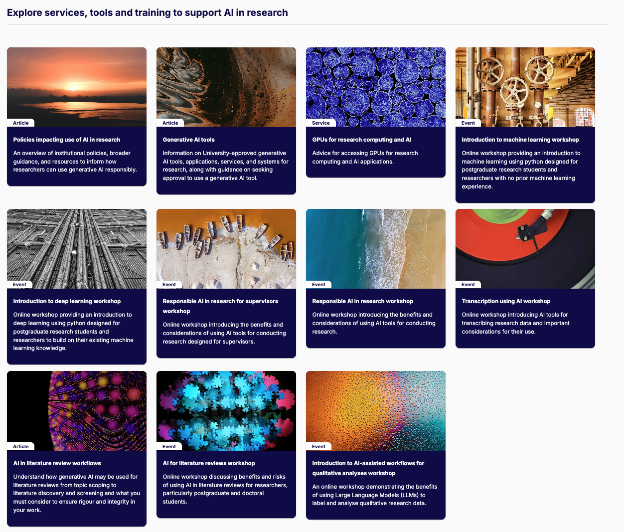

Access AI training, tools, services
Research software and computing / Research AI

Slide 7
Access AI training, tools, services
Research software and computing / Research AI

Slide 8
Access AI training, tools, services
Research software and computing / Research AI

Slide 9
Access AI training, tools, services
Research software and computing / Research AI

Slide 10
Access AI training, tools, services
Research software and computing / Research AI

Slide 11
Access AI training, tools, services
Research software and computing / Research AI

Slide 12
Access AI training, tools, services
Research software and computing / Research AI

Slide 13
Access AI training, tools, services
Research software and computing / Research AI

Slide 14
Access AI training, tools, services
Research software and computing / Research AI

Slide 15
Thank you for attending
Dr Kyle Hemming Dr Toby Johnson
3 March 2025
Centre for eResearch

