Slide 1



Managing References with Zotero
Tom Saunders
tom.saunders@auckland.ac.nz
@TomSaundersNZ

Slide 2
Housekeeping
Please stay muted, feel free to turn camera on/off
Helper: James Love
Questions: Enter in chat at any time
Slides will be available
Gold underlined text in slides are links to more information

Slide 3
Session Plan
What is Zotero?
Adding items and moving from a different reference manager
Interface
Organising items with collections, tags, searches
Break
Citing in word processors
Group libraries
Tips & tricks

Slide 4
Zotero
Free open source reference manager
Powerful ways to add, manage, and cite references
Supports all major operating systems and word processors
Unlimited reference syncing, paid plans allow file syncing:
Free = 300MB 2GB = US$20/year 6GB = US$60/year Unlimited = US$120/year
One device
2+ devices
Paid plan isn’t needed. Manually backup your storage folder regularly.
Paid plan means attachment files (PDFs etc) are available on all devices and Zotero web.

Slide 5
Start Demo

Slide 6


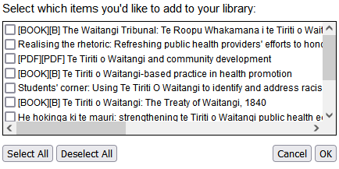
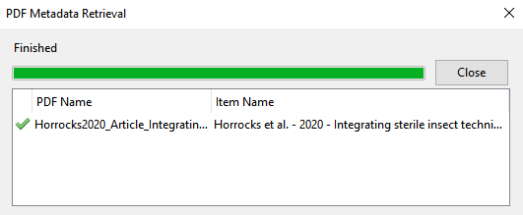
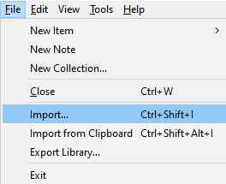
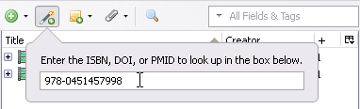
Adding Items
1. From web browser Look for one of these icons
2. Multiple items detected
3. Drop a pdf into zotero
5. Import RIS, XML, BibTeX, etc
4. Add via identifier

Slide 7
Importing from other managers
Back up your libraries first, and disable automatic sync in Zotero in case there are problems with import
1. Endnote (Preserves attachment files)
Export XML to endnote.data\PDF folder. Import to Zotero.
2. Mendeley (Preserves attachment files)
File > Import > Mendeley Reference Manager (online import)
3. Refworks/Papers/etc
Export RIS or BibTeX (won’t bring attachment files)
OR Drag n drop all your PDFs into Zotero and it will create parent items

Slide 8
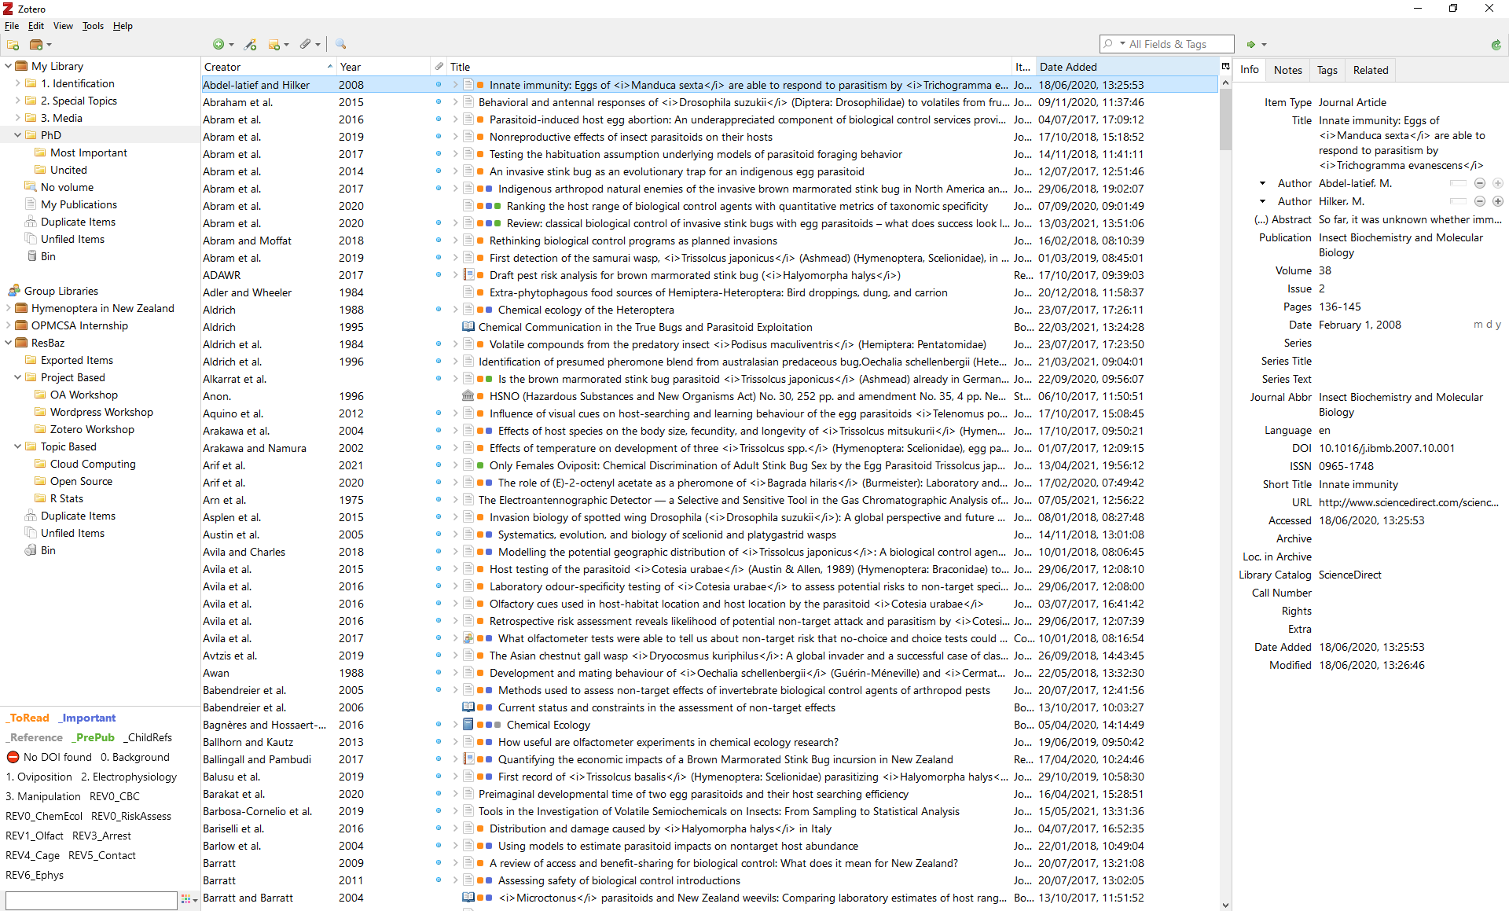
Interface
Reference list
Shows items in currently selected collection or library.
Double click item to open pdf.
Click here to change columns or add secondary sort.
Library and collections
Right click to add, rename, or delete.
Drag n drop refs between collections.
Item metadata
Shows metadata of selected item.
Auto detected but may need tweaking.
Fields change based on item type.
Click fields to edit.
Tags

Slide 9

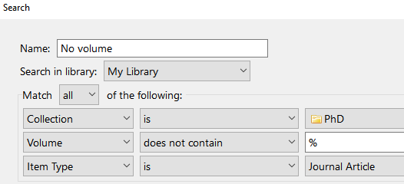
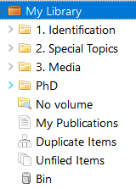
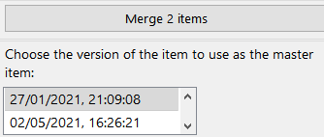
Organising
Tip: Select an item and hold Ctrl to highlight collections containing the item.
1. Collections: Hierarchical, same item can be in multiple
2. Tags Status: Actions (to-read, important, etc) Content: Subjects (cats, predation, mice), where it fits with your work (chapter-1)
3. Searching Multiple conditions, includes text in pdfs/notes Boolean (AND OR) and wildcard (% = ‘something’) Saved searches will add new items that fit criteria
4. Duplicates
Advanced
Basic
Select master version, other version will be merged in.

Slide 10
“Write what should not be forgotten.” —Isabel Allende
Break

Slide 11
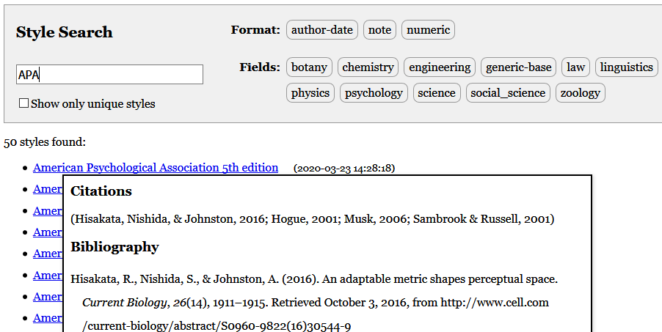
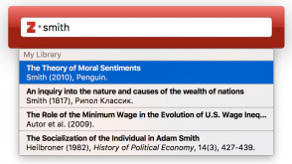
Citing
Edit > Preferences > Cite > Get additional styles
Styles: Install from the style manager
Word Processors: Plugin installed with Zotero, adds toolbar - Add citation, Add/edit bibliography, Change citation style, Refresh - Edit item data in zotero then refresh to update in doc.
Google Docs: Requires zotero running Use as you would with a word processor (see limitations)
Inside Zotero Use quick copy to copy in-text citations or references to clipboard/HTML/RIS
For LaTeX users: Install ‘Better BibTeX’ plugin for Zotero
Right click item(s) > Create bibliography from items > Select style > Select citations or bibliography

Slide 12
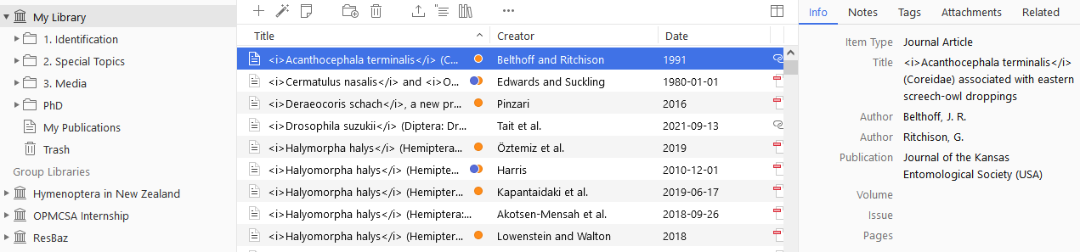
Collaboration
Select ‘New Library’ > New Group
Group Libraries: Ideal for group projects, lab groups, tutorials etc Private or public, share files, uses owners storage quota Separate library
My publications Drag your pubs here, choose whether file is public
Zotero web Profile, groups, my pubs, forum Web library: Add/manage citations, view synced pdfs
https://www.zotero.org/[username]/library

Slide 13

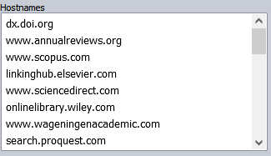
Tips & Tricks 1
Browser addon settings > Zotero Connector Options > Proxies
For UoA:
Proxies: Detects institutional proxy and remembers
Notes: Right click item > Add note Searchable, useful for summarising or coding Insert into documents with live citations
Annotations: Open item in Zotero pdf reader, add comments etc Add annotations to notes: ‘Add Note from Annotation’ Click extracted annotation > ‘Show on page’ to open item to that page

Slide 14
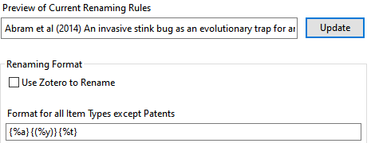
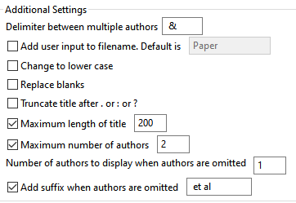
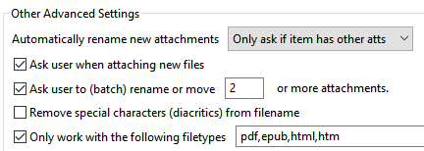
Tips & Tricks 2
Item metadata Right click title > sentence case, then capitalise as needed Initials for author names (avoids Thomas Tom T. problem) Italicise species names <i>Homo sapiens</i> Confirm metadata is accurate, check URL, add tags now
File naming (Zotfile) Tools > Zotfile Preferences > Renaming rules
My settings
Advanced tab

Slide 15
Tips & Tricks 3
Shortcuts New item: Ctrl+Shift+N New note: Ctrl+Shift+O Quick search: Ctrl+Shift+K Copy citations to clipboard: Ctrl+Shift+A Copy refs to clipboard: Ctrl+Shift+C Expand/collapse all: +/- keys next to numpad
Add another author manually: While cursor is in author field press shift+enter

Slide 16
End Demo

Slide 17
Resources & Support
Zotero documentation
Zotero forums for basic support questions
Transferring your library from EndNote or Mendeley

