Slide 1
Introduction to Python
Dr Toby Johnson
Dr Chris Seal
March 2026

Slide 2


Learning Objectives
Firsthand experience using Python
Awareness of programming fundamentals Knowledge about ways of ingesting existing data and visualising it
Confidence with common programming workflows (trial and error; debugging, etc.)
Not a full introduction to programming course
Hacky Hour
researchdata@auckland.ac.nz
Notes:
You will get a hands-on introduction to the Python programming language
You are not expected to have experience with any programming language
If you do, please continue to ask questions once you spot differences/similarities
You will learn how to run Python on the Google Colab platform
We will provide you with links to tutorials on
How to use Python/Jupyter Notebooks on your local machine or how to create scripts
The main learning outcome should be: Get comfortable with a commonly used programming language. Everyone makes mistakes. Embrace them and we show you how to work with them (in 2024, we do not only have a great community, but also AI)

Slide 3
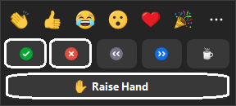
Housekeeping
Zoom: Stay muted
Change Zoom name to your name (not UPI, etc.)
Introduce yourself over Zoom chat (name, research area, institution, what you hope to get from this workshop)
Questions are good - use Zoom chat or Zoom Reactions - ‘raise hand’ to ask questions.
We’ll aim for a 5 min break on the hour

Slide 4
Workshop overview
This lesson is based on The Carpentries Programming with Python
It follows the Carpentries style of teaching (live-coding, embracing mistakes - - just to name a few)
Usually an 8 hour course over 2 days! We will not be covering everything!
You made a great choice with Python 🐍
Python is a rather abstract programming language.
It is very popular, the most searched for programming language
there are tons of great libraries that can be used for data analysis
We use Google Colab
If you want to learn some intermediate python, attend Chris’ talk on Thursday @ 2pm.
https://carpentries.org/
Notes:
Teaching style
Our research programming skills workshops follow the ‘Carpentries’ teaching style.
We’ll focus on practical/ hands-on coding – watch > do, no copy-paste-magic.
We will embrace mistakes as teachable moments.
Instructors will check in with learners and helpers frequently to ask “How do you find that?” “Can anyone explain why we have this result?” “Did anyone get a different result?” - this formative assessment helps us all get the most from the workshop.
Use the Zoom Reactions - green tick/thumbs up or red cross/thumbs down – to get a sense of how you’re going with the material.
We will seek your feedback at the end of the workshop and discuss next steps or learning opportunities to support you to apply what you learn this week.
Teaching environment
Local installation of Python is not encouraged for the lesson as it can take too long to support all the different OSs present today.
We use Google Colab to avoid set-up delays and to standardize your experience in the workshop.
Schedule
The workshop is about 8h in length – two sessions of roughly 4 hours covering a few lessons each day.
Day 1 will be run by Mike and Day 2 will be run by Jens – the Instructors.
We have Helpers – Ben, Nelis, Shamim that may differ across the days.
We’ll aim for a 5 min break every hour or so and a slightly longer break in the middle. These will tend to be at natural break points in the lessons.
Best experience for all
Please stay on camera and muted, this allows the teaching team to visually check that you are following and to minimize disruption of any noise.
Use welcoming and inclusive language
Be respectful of different viewpoints and experiences
Gracefully accept constructive criticism
Focus on what is best for the community
Show courtesy and respect towards other community members
https://docs.carpentries.org/topic_folders/policies/code-of-conduct.html
Slides and lesson materials are available and will be provided at the end.
Asking questions or getting help
Questions are good - use Zoom chat or Zoom Reactions - ‘raise hand’ to ask questions.
Helpers are familiar with using Python and will monitor the Zoom chat to support learners and communicate with the instructors as needed.
If they spot questions that seem relevant to more people, the helper will raise this with the instructor.
The instructor may suggest a helper take a question posed to the group or postpone answering until a suitable point.
We are about to start the lesson. Any questions?

Slide 5



Slide 6
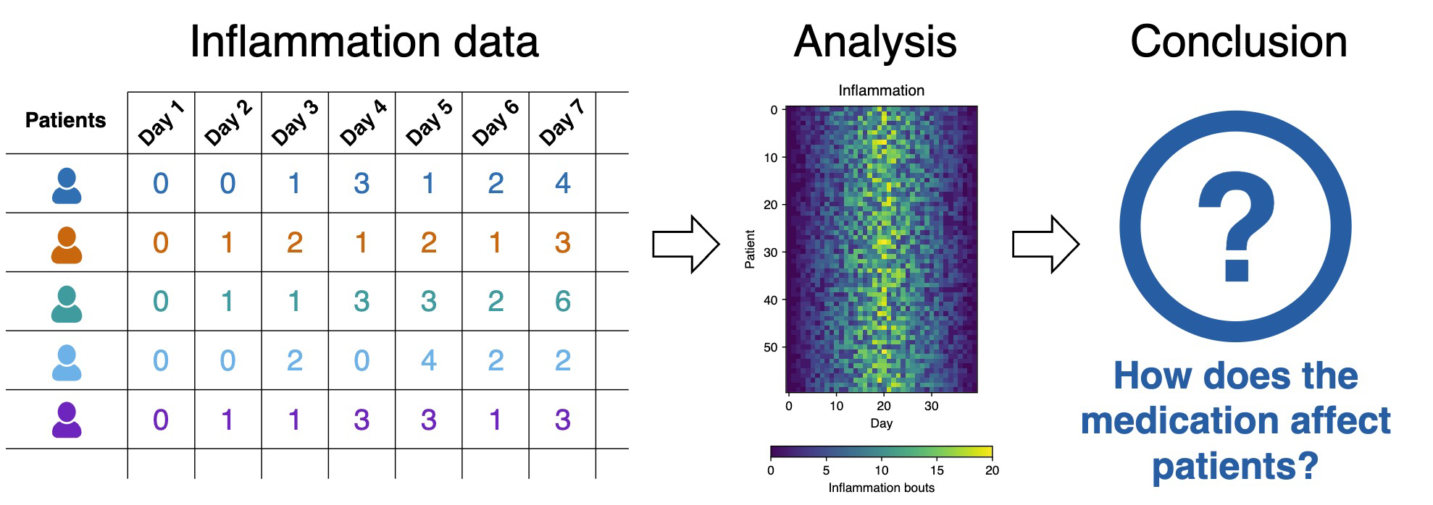
Learning Python through data analysis
Investigating Dr. Maverick's miracle arthritis inflammation cure!
We have some files (csv) containing inflammation data that we're going to explore using Python.
60 patients
40 days

Slide 7
Workshop outline
Content | Instructor
0) Colab introduction Python Fundamentals Visualising Data | Toby
5 min break
Analysing data from multiple files Making choices Creating functions (if we have time) | Chris
Wrap up and questions | Chris

Slide 8
Go Python!
Notes:
About 10 mins for f

