Slide 1

Upgrading Your R Scripts with Software Development Principles
Dr Tom Saunders & Dr Toby Johnson
ResBaz 2026
Notes:
[Presenter 1]
Welcome to our Managing Research Data workshop.
After this session you will
Understand University policies, and services and support available
Learn best practices to apply to your research data to enable FAIR and CARE
Identify issues to pursue and document
Describe why effective data management is central to good research practice
Identify the benefits of effective data management and data sharing
Explain what a Data Management Plan is
Give reasons why it is important to create a data management plan
Presenters come from the University's Centre for eResearch – a research capability platform that supports researchers across the university, and from the research Services team within Libraries and Learning Services. [presenters to introduce themselves – Presenter 1, Presenter 2, Presenter 3 and person responding to chat (as required).

Slide 2
Today:
You can write R code to analyse some data, but where to next?
We think these skills have a big pay off:
Managing your work in projects
Using version control
Writing functions
Managing dependencies
Publishing your code

Slide 3
Why?
Most R users are not software developers
Opens up popular ways to collaborate on research projects
Gives you skills that are in demand
Allows recognition and citing of additional research outputs
Make using R more fun

Slide 4
Projects
setwd("Users/tjoh144/Documents/project_folder")
data <- read_csv("Users/tjoh144/Documents/project_folder/data/experiment1.csv)
write.csv(data, "Users/tjoh144/Documents/project_folder/data/processed_data.csv)
Notes:
Need to change the reading in data bit to experiment-1_data.csv.
Also, change write.csv to write_csv

Slide 5
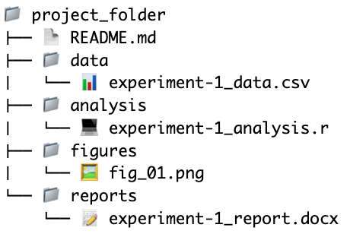
Projects
Notes:
Maybe edit this slide so that the folders and files are not in the 'project_folder' root directory, and are simply a collection of different directories and files. Then when we introduce r studio projects they can all become neatly arranged together.

Slide 6
Projects

Slide 7
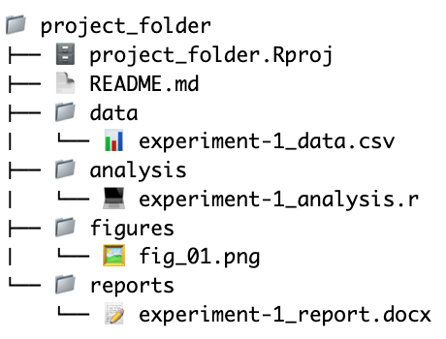
Projects
Keep all the files in a project together in one directory.
Set your working directory automatically so you no longer need to write a full path.
Allow you to package the entire directory and send to a colleague (or collaborate using version control).

Slide 8
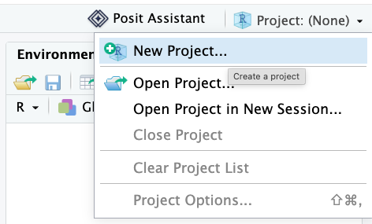
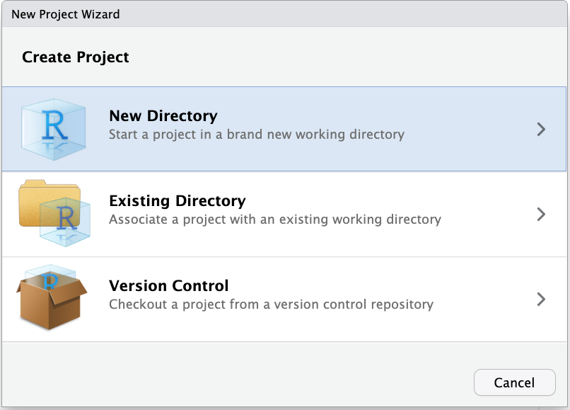
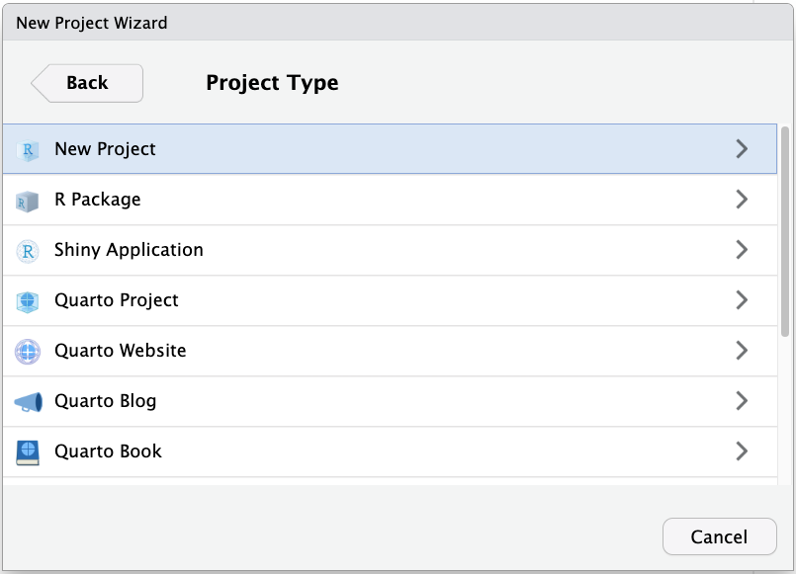
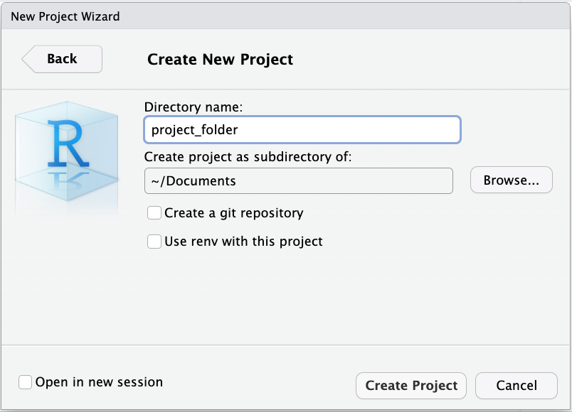
Projects

Slide 9
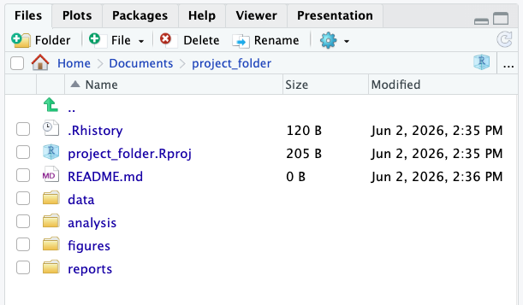
Projects

Slide 10
Projects
>getwd()
[1] "/Users/tjoh144/Documents/project_folder
data <- read_csv("data/experiment-1_data.csv")
write_csv(data, "data/processed-data.csv")
More: https://support.posit.co/hc/en-us/articles/200526207-Using-RStudio-Projects

Slide 11
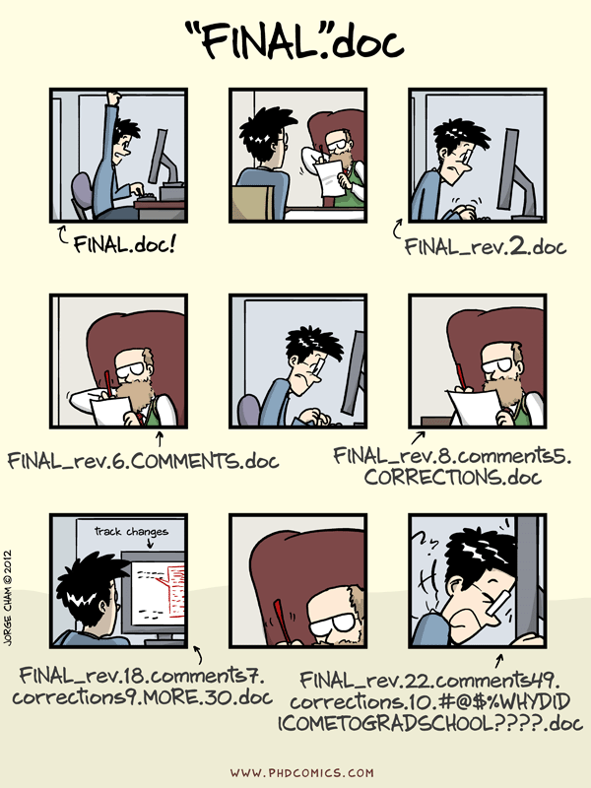
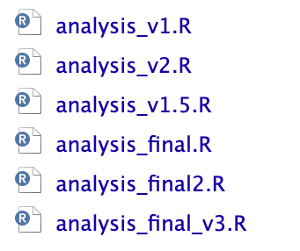
Version Control

Slide 12
Version Control
This is fine when you have few versions, but:
Results in large folders with lots of files
Hard to keep consistent naming
Makes collaboration hard
Hard to revert changes
Instead of making a new copy each time, we could record the changes we have made to each file

Slide 13
Version Control - Git
Tracks changes to plain text files locally to preserve versions and allow easy roll back.
Works on a branching model – files can be branched, with changes being merged back in.
Used by most software developers, and increasingly researchers.

Slide 14
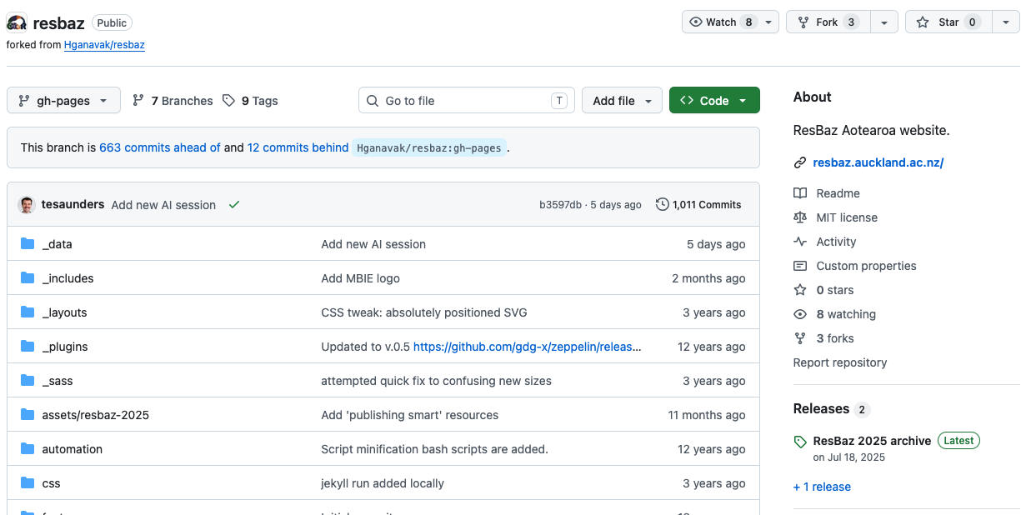
Version Control - Github
A remote hosting service for your Git 'repositories'.
Good for additional backups
Powerful collaboration tool
Handles conflicts when multiple people change the same file.

Slide 15
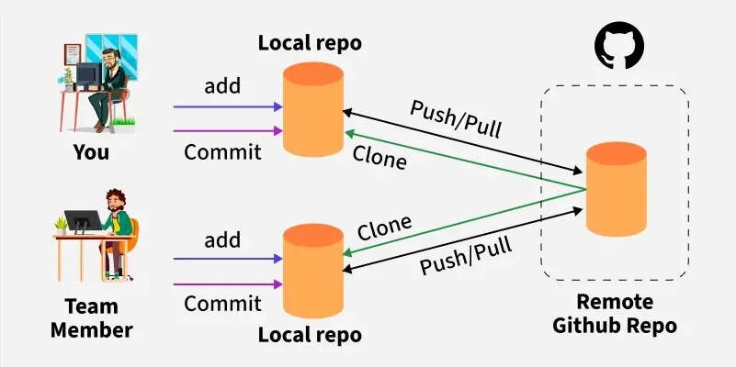
Version Control – Git & Github

Slide 16
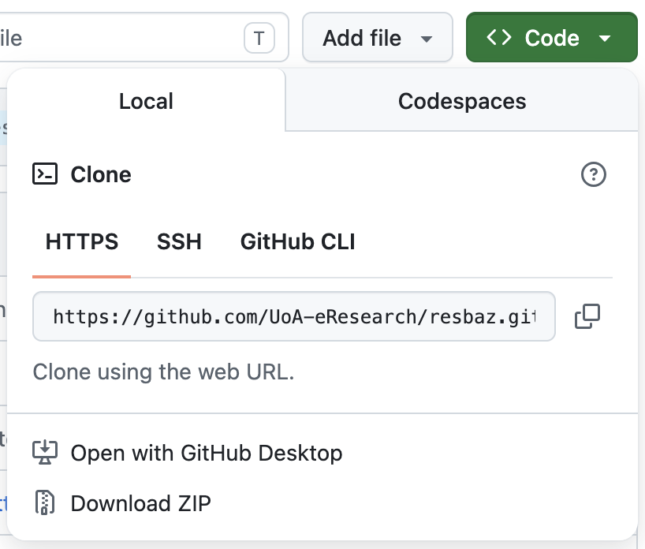
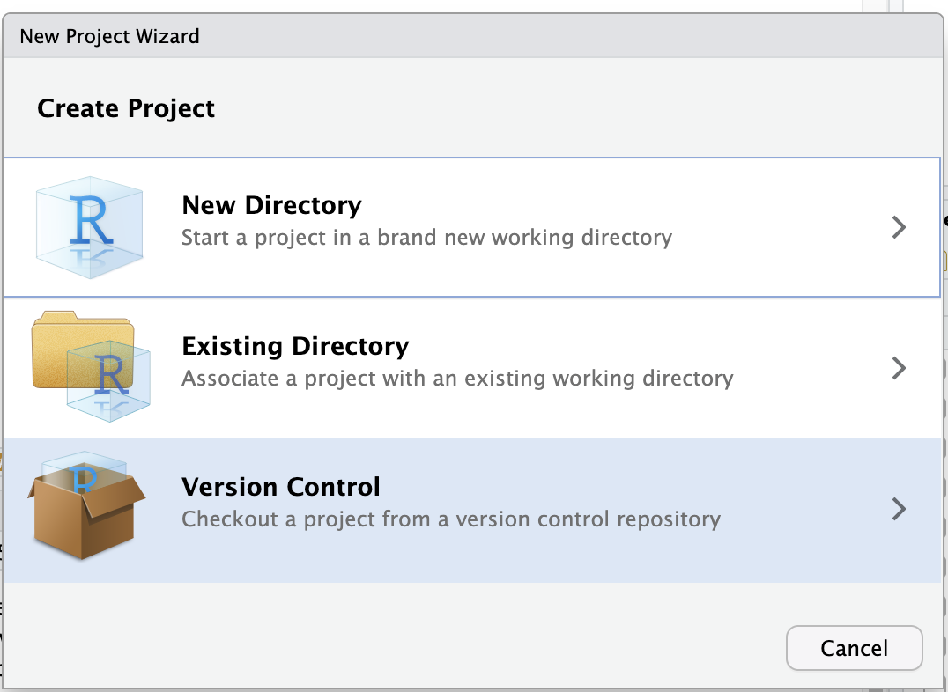
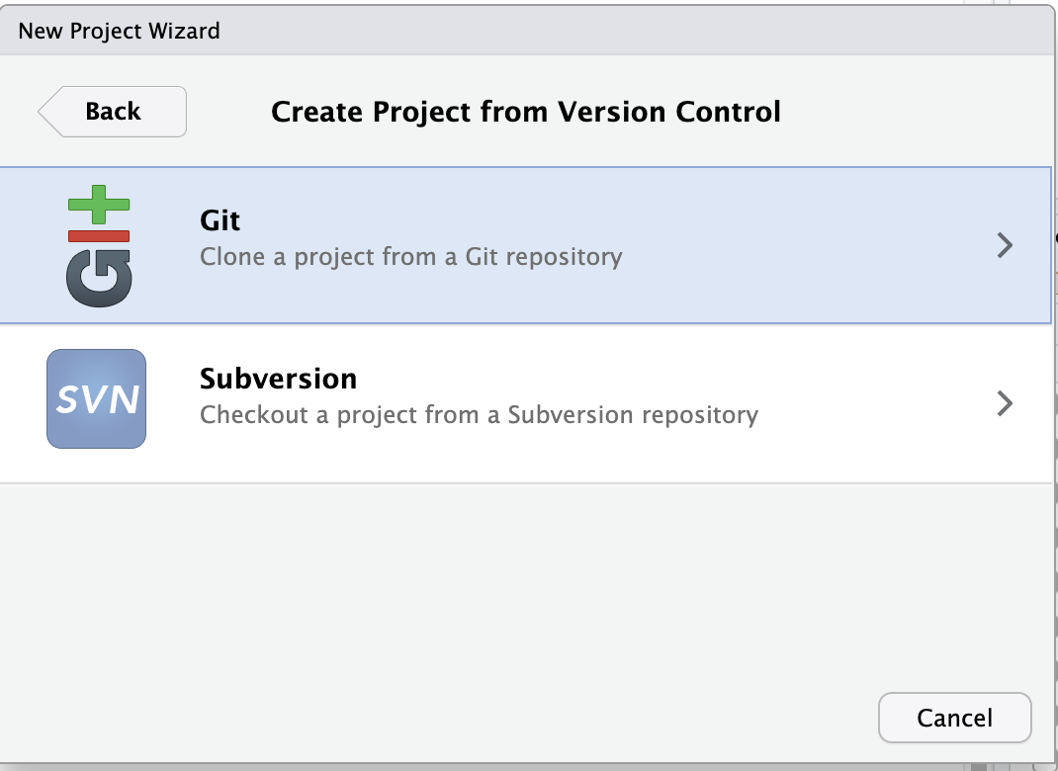
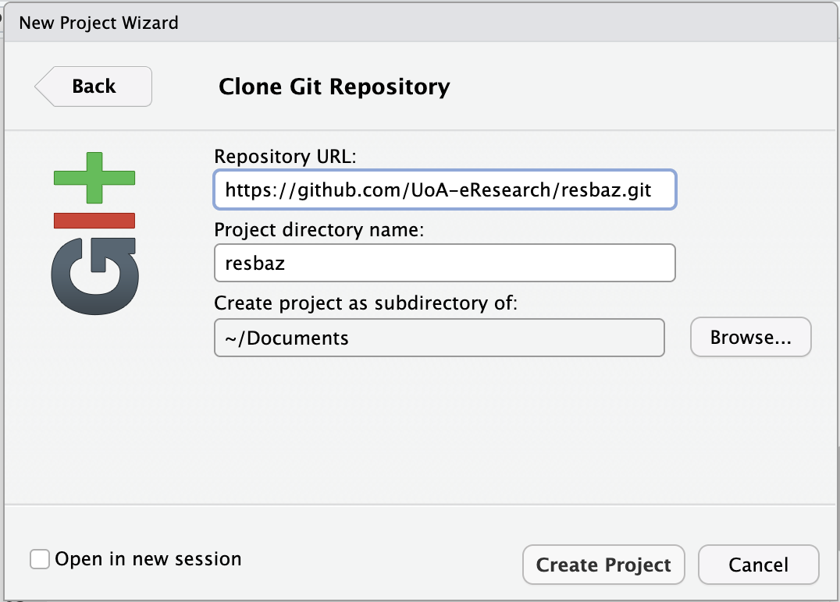
Version Control – Git & Github

Slide 17
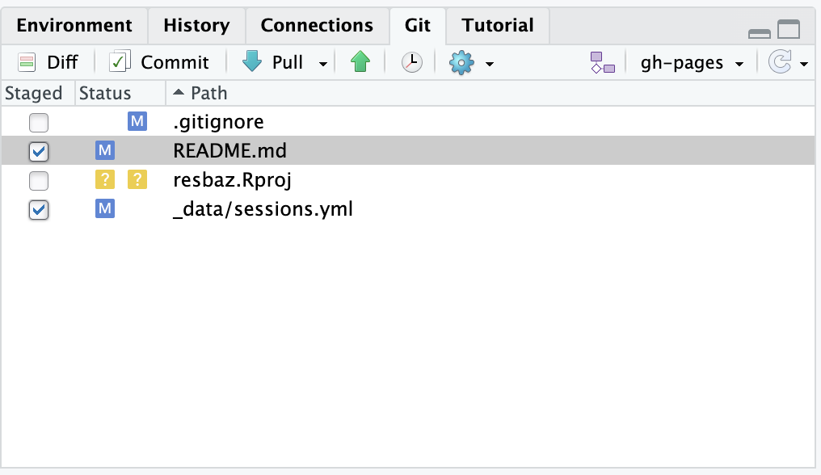
Version Control – Git & Github
Introduction to Git: https://uoa-eresearch.github.io/git-novice/
Setting up Git and GitHub with R: https://happygitwithr.com/

Slide 18
Functions
Sometimes we need to repeat code, but repetitive code can be:
Hard to read, understand, and collaborate on
Difficult to debug or spot mistakes in
Very long
When you have three copies of the same code, you should write a function

Slide 19
Functions
function_name <- function(arguments) {
# Code block to execute
return(output_value)
}
Pick a name
Identify the inputs
Wrap the code in a function

Slide 20
Example: Convert F to C
f_to_c <- function(fahrenheit) {
celsius <- (fahrenheit - 32) * 5 / 9
return(celsius)
}
f_to_c(32) # Returns 0
f_to_c(212) # Returns 100

Slide 21
Functions
Functions can have multiple arguments, and arguments can have default values:
calculate_power <- function(base, exp = 2) {
result <- base ^ exp
return(result)
}
# Example usage
calculate_power(4) # Uses default exponent=2. Returns 16 calculate_power(4, exp = 3) # Overrides default. Returns 64

Slide 22
Functions
Functions can evaluate code conditionally with if, else_if, and else:
check_sign <- function(number) {
if (number > 0) { return("Positive")
} else if (number < 0) { return("Negative")
} else { return("Zero")
}
}

Slide 23
Dependencies
We develop our code in a specific environment.
Operating System
R version
R Package versions
If we or others can't reproduce that environment in future, the code may no longer run.
Managing dependencies means ensuring the code can always be run with the same packages (and package versions) used to create it.

Slide 24
renv
Works at the project level and adds the following:
Project library: Collection of all packages currently used by project
.Rprofile: Runs when you open the project to force use of project library
Lockfile: Records metadata about each package so it can be reinstalled

Slide 25
renv
Two important functions:
renv::snapshot(): updates the lockfile with metadata about the currently-used packages in the project library. This file can then be shared with other people so they can reproduce the current environment by running...
renv::restore(), which uses the metadata from the lockfile to install exactly the same version of every package.
The package environment is now recreated on another machine.

Slide 26
renv
Open the project you would like to use renv on and:
Capture packages currently in use
A collaborator can clone the project and get the same packages
renv::init()
renv::snapshot()
renv::restore()
https://rstudio.github.io/renv/articles/renv.html

Slide 27
Publishing Code
Creates a permanent record to preserve the work
Allows others to view your workflow and immediately re-use it
Promotes transparency and reproducibility
Gives you a DOI so your code becomes citable
Use a service such as Zenodo or Figshare – they integrate with GitHub to make publishing your code easy.
https://docs.github.com/en/repositories/archiving-a-github-repository/referencing-and-citing-content
https://info.figshare.com/user-guide/how-to-connect-figshare-with-your-github-account/

Slide 28
End
You don't need to do everything at once
Try one out in the order we've covered them
Reproducibility is a journey, not a destination

