Slide 1

Navigating New Zealand’s Trusted-Research Protective Security Requirements Benjamin Turley – University of Auckland
ResBaz 2025

Slide 2

Introduction
Notes:
Nick

Slide 3

New Zealand Threat Environment
Foreign Interference in New Zealand academia can include when states or state-affiliate individuals:
Attempt to cancel academic events on 'sensitive' topics;
Monitor university lectures on 'sensitive' topics.
Harass students and lecturers; and
Monitor and secretly influence student groups
These activities can lead to self-censorship or the exclusion of diverse voices within academic spaces
1 https://www.stuff.co.nz/nz-news/350342963/security-agencies-admit-failures-over-parliamentary-cyberattack

Slide 4
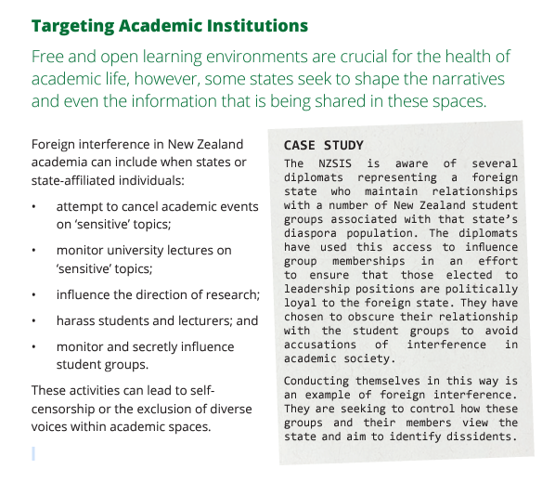

Slide 5
Identified Risks
Undisclosed Foreign Funding: Researchers may receive grants, payments, or other forms of support from foreign entities without disclosing these sources, which can lead to conflicts of interest
Parallel Laboratories: Some researchers might operate "shadow laboratories" in foreign countries, conducting the same research funded domestically, which can lead to intellectual property theft
Recruitment of Staff and Students: Foreign actors may target and recruit university staff and students to further their interests, sometimes through financial incentives or other means
Influencing Research Agendas: There can be efforts to subtly influence the direction of research to align with foreign political, social, or economic agendas. This might involve funding specific projects or exerting pressure on researchers
Theft of Intellectual Property: Sensitive research data and intellectual property can be stolen through cyber-attacks or by individuals with access to the information
Manipulating Academic Programs: Foreign entities might attempt to alter academic programs or curricula to promote their own ideologies or suppress certain topics

Slide 6
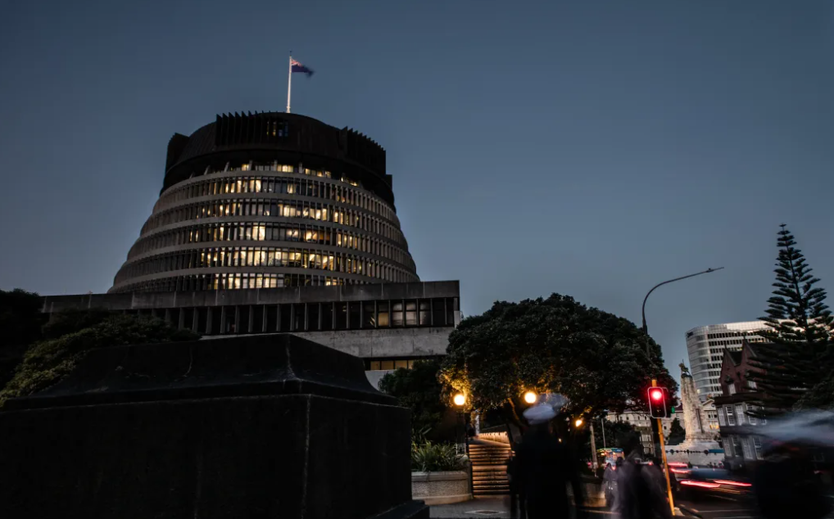
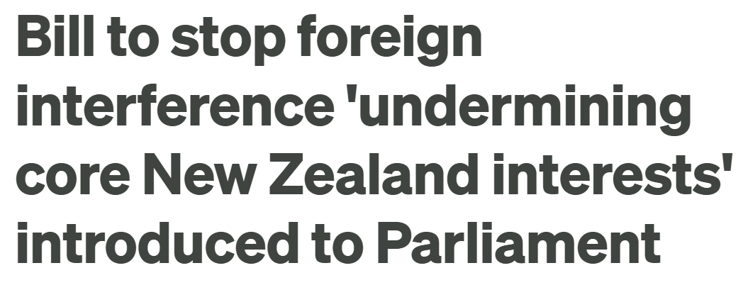
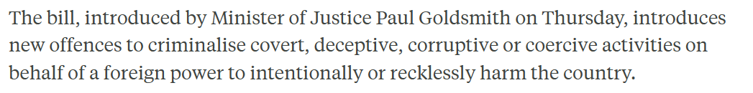

Slide 7

Targeting of New Zealand Academic
Break-ins:
February 2018: Academic's home and office were broken into. Important documents and electronic devices were targeted
Repeated Incidents: Multiple break-ins occurred over a short period, suggesting a coordinated effort
Tampering:
Car Sabotage: Academic's car was tampered with, including the discovery of cut brake lines and loosened wheel nuts
Safety Concerns: These actions posed significant risks to her personal safety and highlighted the severity of the intimidation campaign
Cyber Attacks:
Hacking Attempts: Academic experienced numerous hacking attempts on her email and electronic devices
Data Breaches: Sensitive research data was targeted, indicating an effort to disrupt her work and access confidential information

Slide 8
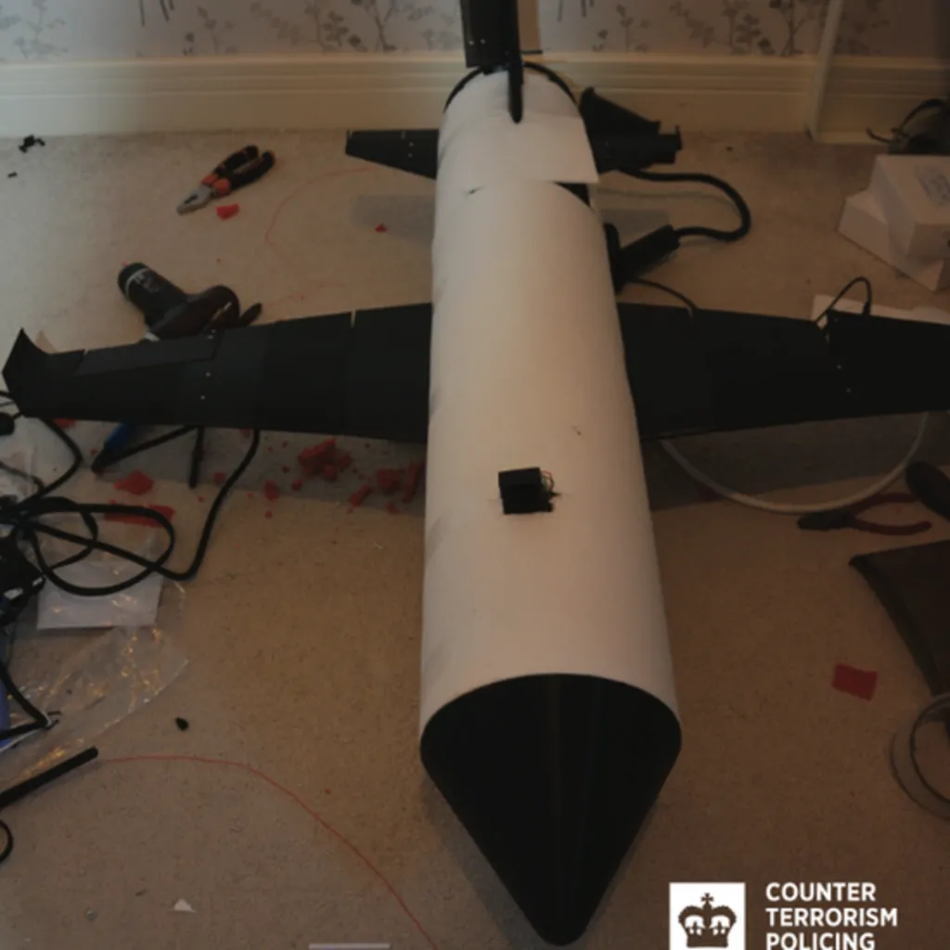

Dual Use Tech
Birmingham University Student charged with counter-terrorism offences after creating a weaponized drone in Support of Islamic State.
11 British Universities unwittingly contributed to Iranian military drone development.

Slide 9

Cyber Threats
University of Michigan: 230,000 Personal Records Stolen.
Eindhoven University of Technology: suffered major ransomware attack that disrupted critical campus services including email and Wi-Fi
University of Auckland and University of Otago: data compromised when third party software supplier was hacked

Slide 10


Slide 11


New Zealand Response
Trusted Research – Protective Security Requirements (2021):
National policy framework focused on reducing risks associated with foreign interference, espionage, and export controls, particularly for sensitive research and technologies.
TR-PSR Guide for Senior University Leaders (2022):
Guidance on how universities should respond
Emphasises a proportionate values-based approach that promotes international collaboration, academic freedom and freedom from discrimination
"Light Touch Approach"
Notes:
Universities in New Zealand are taking steps to protect themselves from foreign interference and espionage following the rollout of a national policy and increasingly prevalent requirements of external funding agencies.

Slide 12
What does it involve?
TR-PSR requires the proactive identification and management of risks across three domains:
Due Diligence - organisations and individuals, and their affiliations
Research Security - physical and digital security environments
Export Controls – research on munitions and ‘dual use goods’:
‘Strategic goods’ (as listed on the New Zealand Strategic Goods List (NZSGL))
‘Catch all goods’ (not listed, but have a military end use)
‘Controlled chemicals’ (as incorporated into NZSGL)
Export controls compliance and obligations
Notes:
Focussing in on due diligence as this is most relevant to external engagements.

Slide 13
Focus to date
Our approach at the University of Auckland
An enabling approach that includes a balanced consideration of risks and opportunities, and with processes and controls that are proportionate to the risks involved
Training
(TR-PSR 101, TR-PSR 201)
Better information on the ResearchHub
General Consents to export controlled goods
‘Funded research proposals’
(as detailed on next slide)
Notes:
At first impression much of the rhetoric and materials imply we are all to take an inward-looking approach to improving and/or developing processes, so we bristle with outward-facing security.

Slide 14

Pre-Award Research Security Screening Questionnaire

Slide 15
About the questionnaire
To be completed for all funded research proposals
Up to five questions (intuitive, self-contained)
Responses determine need for:
Pre-submission escalation
Post-award risk assessment
Will be embedded in new Research Management System (RMS) from late-2025
Post award assessment documented in Data Management Plan (DMP)
Subject to change pending MFAT legislation updates.

Slide 16
First question
Does the work involve 'Sensitive research technologies' and/or 'Sensitive' or 'Restricted' research data?
If Yes, then a Post Award Security Risk Assessment (SRA) is required
Does not trigger Pre-Award escalation
Note – A list of Sensitive Research Technologies drawn from Canadian, Australian and US documents is currently in the process of being published.

Slide 17
Second question
Is the work exempt from the New Zealand export controls regime?
Exemptions include:
Fundamental research
Information already in the public domain
Minimum necessary information required for patent applications
Medical equipment specifically designed for medical end-use
Clinical trials.
For more details on these exemptions and to access an AI Assistant to help you understand whether an export permit is likely to be required
If Yes, then the activity is exempt from Export Controls Assessment
Does not trigger Pre-Award escalation

Slide 18
Third question
Does the work involve collaborators based in or affiliated with countries other than New Zealand?
If No, then the activity is exempt from Export Controls Assessment
If Yes, then proceed to Question 4

Slide 19
Fourth question
Does the research involve collaborators based in or affiliated with countries other than OECD countries of Pacific Island Nations?
If Yes, then a Due Diligence Assessment is required
Does not trigger Pre-Award escalation

Slide 20
Fifth question
Does the work involve any collaborators based in or affiliated with FATF 'High-Risk Jurisdictions subject to a call for action" or New Zealand's Independent sanctions?
(i.e., Myanmar, North Korea, Iran, Russia)
If Yes, then a Pre-Submission escalation is required

Slide 21

Post-Award Risk Management

Slide 22
Post-Award Risk Management
Projects conduct ongoing risk management (inclusive of other risk considerations such as Health & Safety, handling of dangerous goods, ethics, etc).
External funders may have additional research risk management requirements, particularly where projects involve certain technologies.

Slide 23
What is a DMP?
Data management plans (DMPs) are used to describe and document important decisions relating to the data generated or gathered by a research project.
A DMP is required for any research project involving sensitive or restricted research data, but is recommended for all projects.

Slide 24
Benefits of a DMP
Prompts data management considerations and captures decisions to support ethics, security, data sovereignty, funder requirements, open research, etc.
Aligns with University policies and processes, including Research Data Management Policy guidance and the Research data classification standard.
Clarifies roles and responsibilities for project members and collaborators regarding stewardship and governance during and after the project.
Supports project members and collaborators to follow agreed practices.

Slide 25

Questions?

