Slide 1
COMSM0166 · SOFTWARE ENGINEERING DISCIPLINE & PRACTICE · v2.1
Quantum Drop
no idle seconds in a tower-defence — Plinko is the economy
GROUP 23
Yu Chengyin Minigame physics · Audio
Zhu Qihao Minigame gates · Economy balancing
Zhang Zhenyu Tower combat · Performance profiling
Zhang Xun Monsters & waves · Boss AI
Liu Bowen Map & placement · Cache layers
Li Zhuolun UI & state · Refactor lead · i18n / tests
github.com/UoB-COMSM0166/2026-group-23 · live build: docs/Game_v2.1/

Slide 2
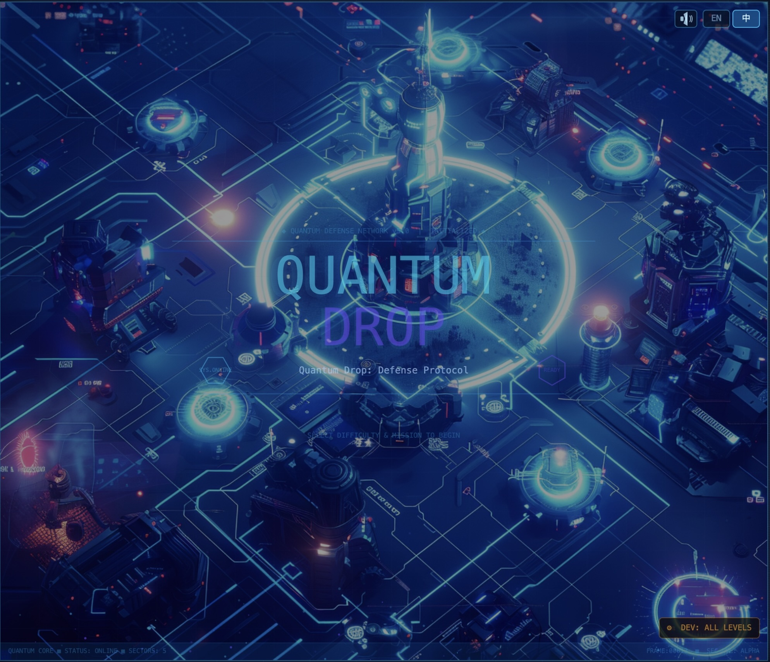
CHAPTER 1 / PRESENTATION
Meet Quantum Drop
Presenter: Yu Chengyin
WHAT IS IT?
A zero-build p5.js browser game that fuses two genres:
the slow strategy of a tower-defence with the fast, tactile feel of a Plinko ball-drop — the player aims a launcher between waves and the falling ball count becomes their coin budget.
5
8
10
48
Sectors
Tower types
Enemies (3 bosses)
Unit tests
STACK
p5.js · zero build
EN / 中文 i18n
GitHub Pages
node:test (no install)
Launch screen — bilingual, sci-fi map, dev shortcut to all levels
Quantum Drop · Group 23 · COMSM0166 Software Engineering
2 / 11

Slide 3
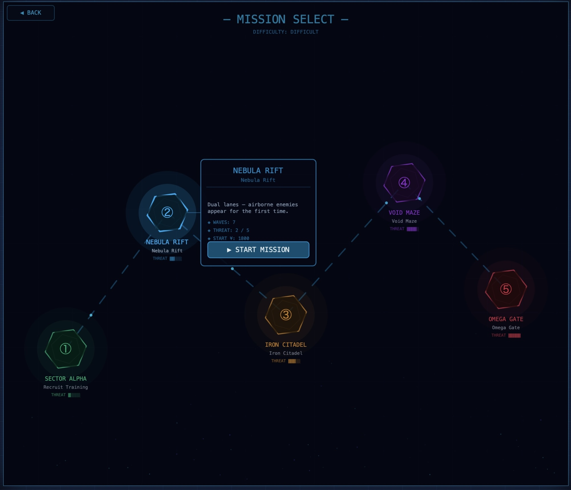
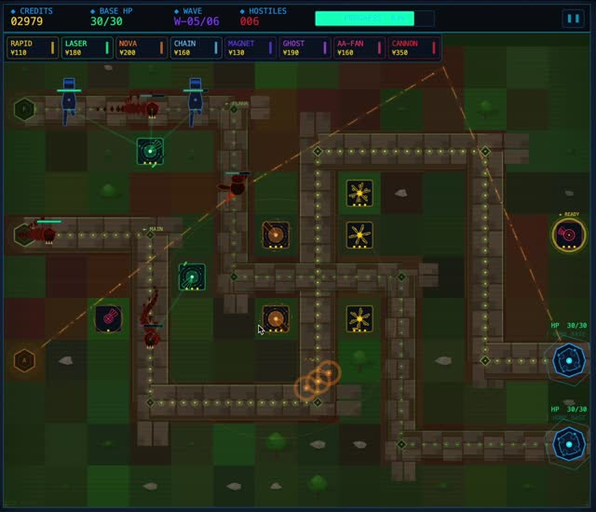
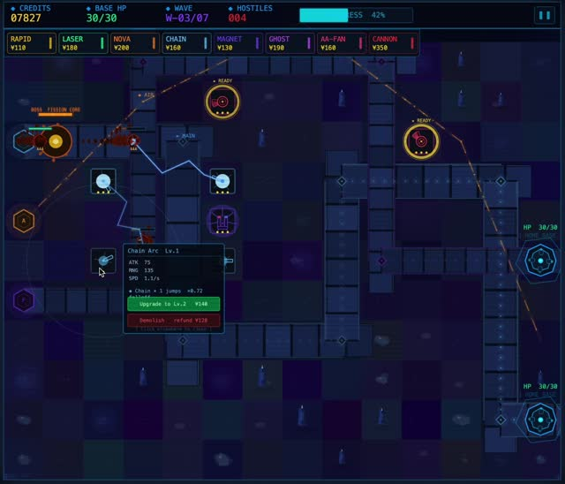
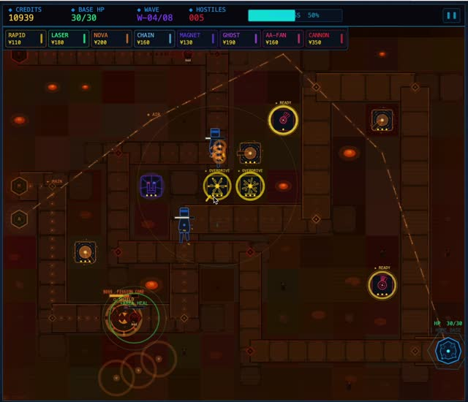
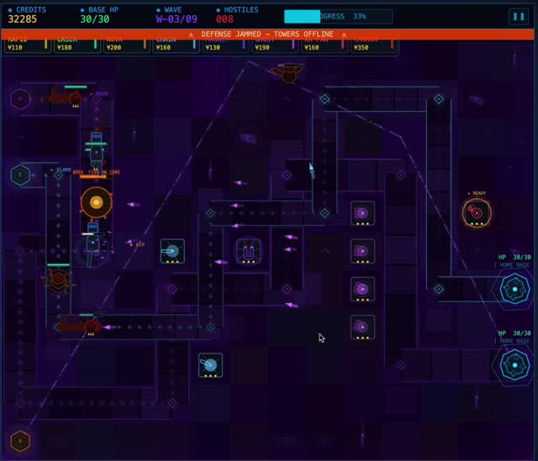
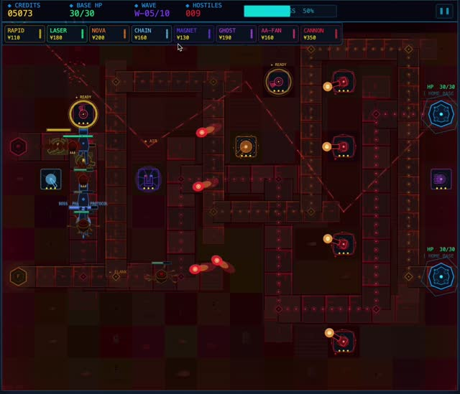
CHAPTER 2 / VISUAL MATERIAL
Procedural cyberpunk, six contributors
Presenter: Liu Bowen
All visuals are code
Five themed sectors
No sprite sheets — every monster, tower, beam and particle is drawn from primitives + trig. One unified aesthetic across six contributors.
Sector Alpha · Nebula Rift · Iron Citadel · Void Maze · Omega Gate. Each level has its own palette, path and BGM track.
Bilingual UI (EN / 中)
Responsive canvas
Runtime t(key) toggle on the launch screen, persisted in localStorage. Caches include currentLang in their signature.
windowResized() + CSS letterbox so the 980×840 sketch fills any viewport while preserving aspect ratio.
Sector Alpha
Nebula Rift
Iron Citadel
Void Maze
Omega Gate
Quantum Drop · Group 23 · COMSM0166 Software Engineering
3 / 11

Slide 4
CHAPTER 3 / CLARITY OF IDEA
No idle seconds — Plinko is the economy
Presenter: Zhu Qihao
1
2
3
AIM & DROP
SETTLE → COINS
BUILD & DEFEND
Click to launch. Balls fall through +N, −N, ×N gates — luck × skill decides the haul.
Final ball count → coin payout, one-to-one. The card prints BALLS → COINS so the link is unmistakable.
Pick from 8 tower variants × 3 tiers; survive the wave; leftover coins carry into the next drop.
…and back. Coins persist across the loop, tying both halves together.
WHY IT WORKS
Most tower-defences make you wait between waves; we replaced that dead time with a skill-based economy. A great drop genuinely changes your tower composition — and a bad drop forces a creative defence with what you can afford.
Quantum Drop · Group 23 · COMSM0166 Software Engineering
4 / 11

Slide 5
LIVE
DEMO
Quantum Drop · Group 23 · COMSM0166 Software Engineering
5 / 11

Slide 6
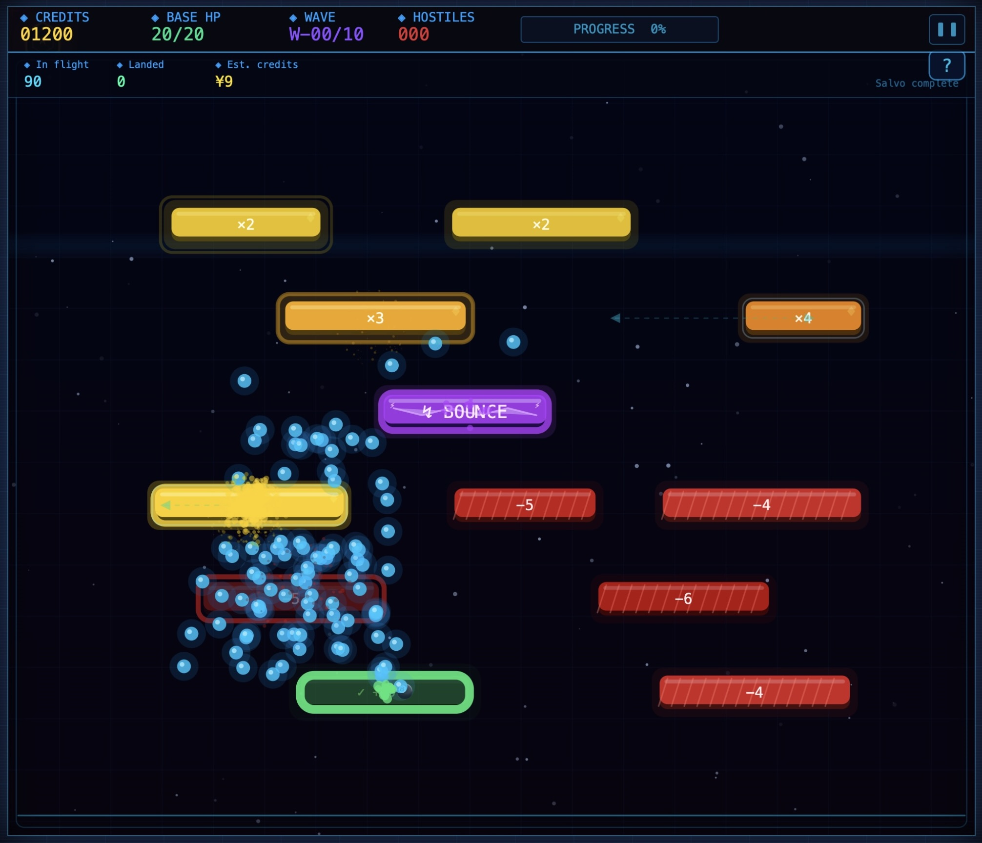
CHAPTER 4 / CHALLENGE 1
Fair economy, real variance
Presenter: Zhang Xun
THE PROBLEM
HOW WE GOT IT TO FEEL RIGHT
The minigame is the entire economy — it has to feel physical and fair while producing a designer-tunable payout.
State machine + spawn-queue + balanced lattice
• Up to ~80 balls on screen with object pooling — alive=false then a single per-frame filter, never splice in the loop.
• Gate effects push into a spawnQueue — we never mutate mgBalls mid-iteration.
• Per-level data/levels.js tunes ball count + gate density so payouts land within ±25 % of the design target — wide enough for variance, narrow enough for tuning.
• Settlement card prints BALLS → COINS: Round-1 testers couldn't see the causal chain; Round-2 testers got it by wave 2.
Mid-salvo: gravity-driven balls cascade through +N / −N / ×N gates
Quantum Drop · Group 23 · COMSM0166 Software Engineering
6 / 11

Slide 7
CHAPTER 5 / CHALLENGE 2
v1.4 → v2.0: three god-files, one sprint
Presenter: Zhang Zhenyu
THE PROBLEM
HOW WE FIXED IT
By v1.4, three files attracted every new feature. Parallel PRs colliding every week.
Top-down extraction, prototype-injected variants
monsters.js
2,082 L
1. Pure data into data/ — TOWER_DEFS, WAVE_CONFIGS, LEVEL_INFO. Removed ~400 mixed lines.
2. Every mutable global into state.js — declarations only, callers untouched.
3. Concern-oriented split: monsters/ towers/ ui/ screens/.
4. Towers via Tower.prototype injection — eight tiny variant files, zero call-site changes.
✓ Verified by playing all 5 levels before & after; gameplay identical. Week-9 payoff: sound + perf HUD + responsive CSS landed in parallel with zero merge conflicts.
10 entities + Boss AI + particles
towers.js
1,281 L
8 tower types via if/else
ui.js
934 L
HUD + pause + build menu + …
≈ 4 300 lines in three files, any change blocked everyone else.
v2.0 →
data/
monsters/
towers/
ui/
screens/
Constraint: no behaviour change · no caller rewrites · one sprint.
Quantum Drop · Group 23 · COMSM0166 Software Engineering
7 / 11

Slide 8

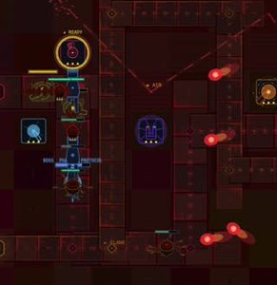
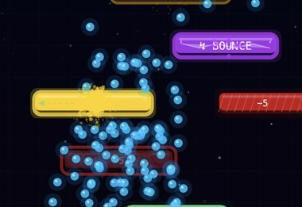
CHAPTER 6 / CHALLENGE 3
Drawing with code, not pixels
Presenter: Liu Bowen
THE PROBLEM · WEEK 4
HOW WE PIVOTED · v2.1
The original sprite plan stalled.
All visuals from primitives + trig.
Original v0.3 sprites — pixel art, three different hands.
Glow, beams, particles — all from polar coords + trig.
• Styles diverged across contributors.
• No versioning — every iteration cost a day.
• Gameplay code was waiting on art that wasn't coming.
• Every entity drawn from JS — one primitive per type → one shared aesthetic across six contributors.
✓ Cost: one ugly week. Payoff: the cyberpunk look held the rest of the term.
Quantum Drop · Group 23 · COMSM0166 Software Engineering
8 / 11

Slide 9
CHAPTER 7 / PROCESS & TEAMWORK
Owners, retros, playtesters
Presenter: Li Zhuolun
Wk 2-3
Wk 4
Wk 5-7
Wk 8
Wk 9-10
Ideation
MoSCoW + stories
Module sprints
v1.4 → v2.0
Polish & QA
Dot-vote across 6 pitches; fused TD + Plinko on the tie-break.
5 levels, 18 stories, 5 stakeholder roles. Strict scope.
One owner per module + a cross-cutting secondary.
God-file refactor sprint; data/, state.js, prototype towers.
Tutorial, i18n, sound, perf HUD, 48 unit tests, 2 playtest rounds.
TOOLS & RITUALS
GitHub + Pages
One owner / module
Wed workshop
Playtests × 2
trunk-based · preview URL per merge
+ a cross-cutting secondary
demo · pair-debug · sprint plan · retro
rounds with strangers — drove the tutorial
Quantum Drop · Group 23 · COMSM0166 Software Engineering
9 / 11

Slide 10
CHAPTER 8 / FUTURE WORK
What we'd ship next
Presenter: Li Zhuolun
1
Per-level star ratings
2
Scripted tutorial
3
Accessibility audit
localStorage key already reserved; UI not yet built. Cheap to add, big retention impact.
Today the overlay is informational. A forced-first-build flow would land the loop even faster.
Colour-blind palettes for range rings; keyboard-only play; larger-font option.
→ promotes a Could-Have from the MoSCoW list
→ closes the Round-1 onboarding gap (Process slide)
→ new stakeholder row, not yet covered
4
Mobile / touch
5
Visual regression tests
6
Sequel: meta + co-op
mouseX/Y already maps to taps; bottleneck is build-menu sizing on narrow screens.
Canvas-hash per fixed frame to catch rendering regressions automatically.
Roguelite unlocks across runs; authored boards paired to wave threats; two-player shared economy.
→ Won't-Have promoted; CSS work small
→ extends our 48-case node:test suite
→ builds on the loop from Ch.3 + the economy from Ch.4
Quantum Drop · Group 23 · COMSM0166 Software Engineering
10 / 11

Slide 11
Thank you.
Drop the balls. Build the towers. Tell us what to fix.
REPO
github.com/UoB-COMSM0166/2026-group-23
LIVE
uob-comsm0166.github.io/2026-group-23/Game_v2.1/
VIDEO
linked from the repo README — tag: video/v2.1
TEAM
Yu Chengyin · Zhu Qihao · Zhang Zhenyu · Zhang Xun · Liu Bowen · Li Zhuolun
COMSM0166 · Group 23 · v2.1 · 2026

