Slide 1


Transactional Data Analysis
Presentation by : Group 38
Team Members : Don Joseph
Rajasree Rajan Unnithan
Isarapon Prasertstid
Xinyue Zheng

Slide 2
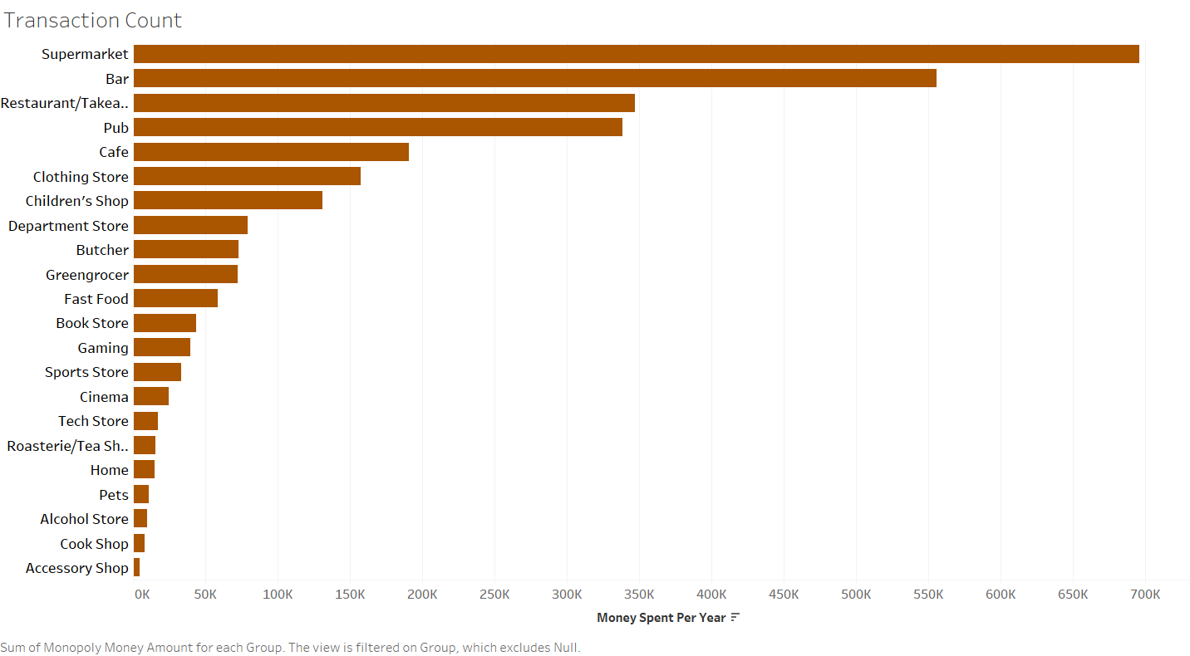
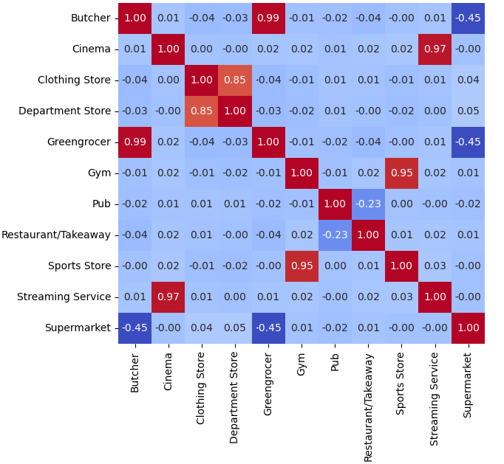
Category-wise spending trends

Slide 3
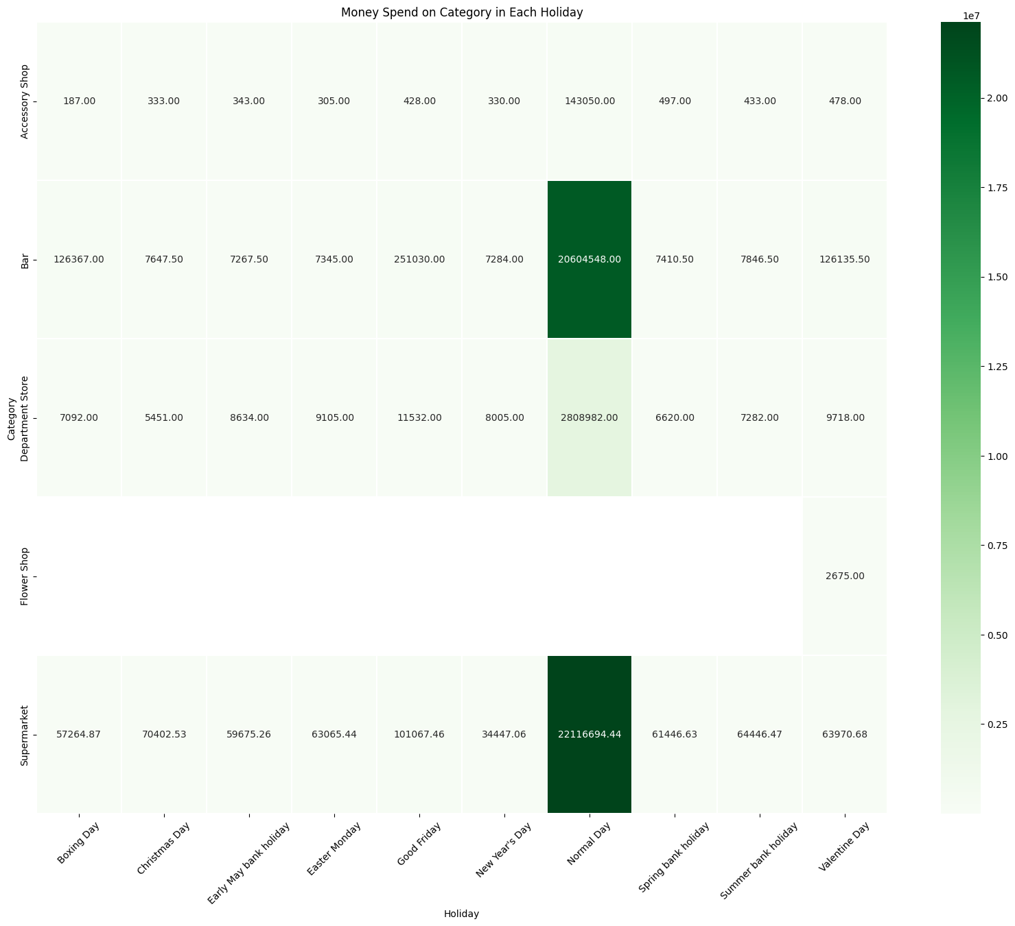
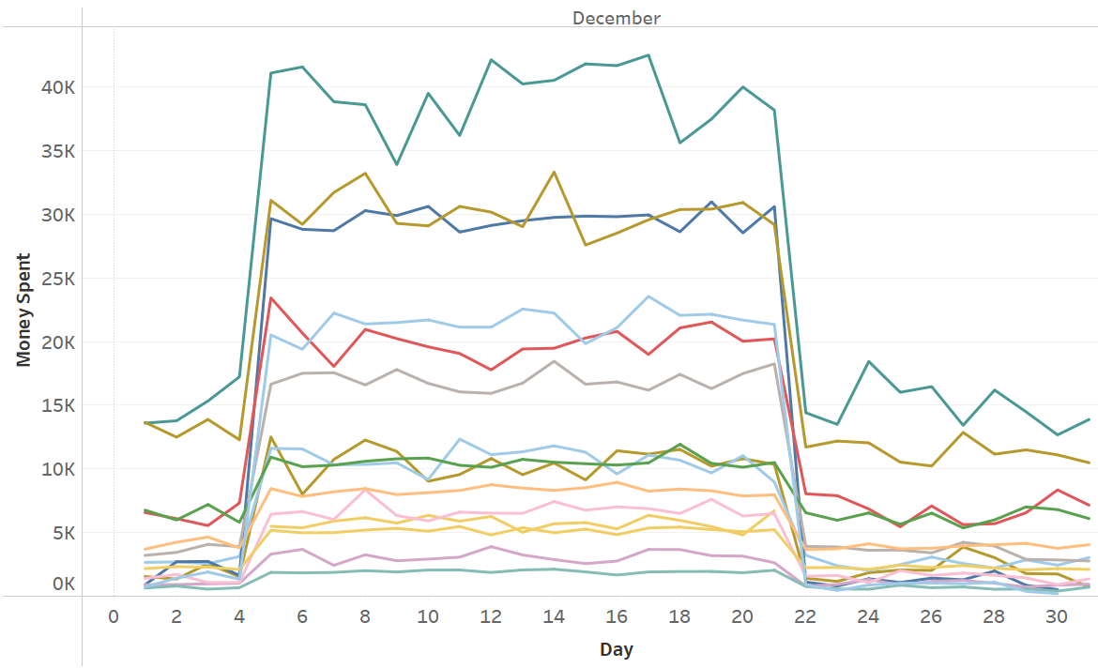
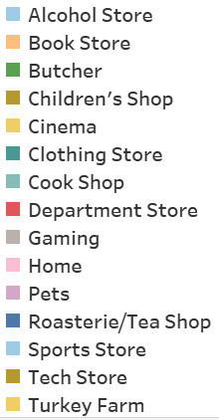
Category-wise spending trends

Slide 4
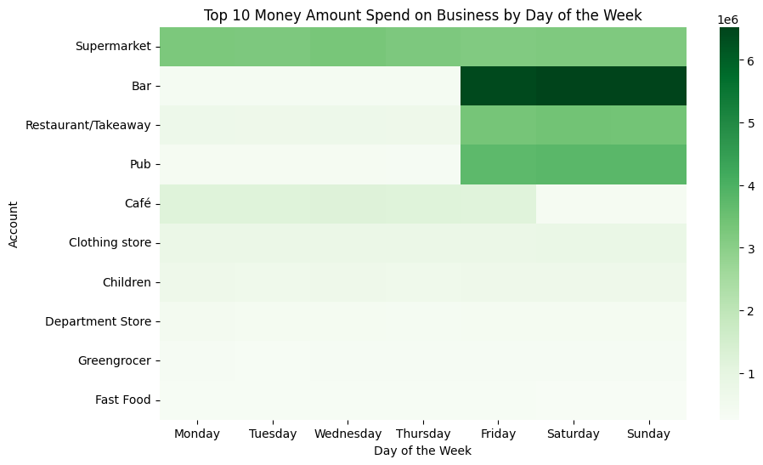
Understanding Customer behavior and market trend
Notes:
This heatmap shows the top five businesses in each holiday, people tend to spend money on PUB and BAR on Good Friday and Boxing Day. This finding suggests that there is a cultural association between celebration and parties with alcoholic beverages.
Clearly, people allocate a portion of their expenditure toward these specific businesses. Recognizing alcohol-related spending throughout the year can make us market suitable strategies for customer preference.
Not only holiday but alcohol-related businesses also still gain a lot of money from people in weekend followed by restaurant/takeaway and supermarket, suggest distinct consumer behaviors based on day of the week. On weekends, people tend to socialize, leading to increased spending on alcohol-related establishment and dining out.
In contrast, weekdays a shift towards practical spending, notably at supermarkets, as individuals prioritize routine purchases and necessities.
To understand more on customer, let's see the RFM score in the next slide.
TO DO: Add valentines day spending to first figure + plot merchant categories on y-axis.

Slide 5
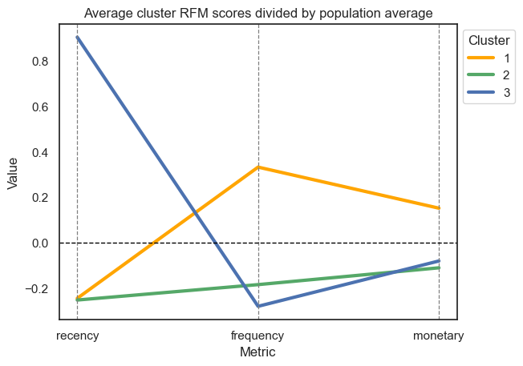
Customer Segmentation - RFM Score Distribution Across Clusters
Clustering methodology
Dataset: Binned recency, frequency and monetary scores into quartiles per account ID.
Algorithm: K-Means, tuned via elbow method.
Key Insights
Only one segment has above-average frequency and monetary scores.
The remaining two segments are differentiated only by recency scores.

Slide 6
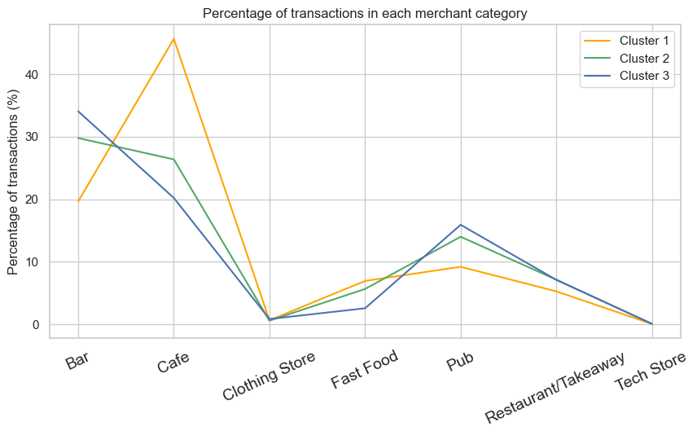
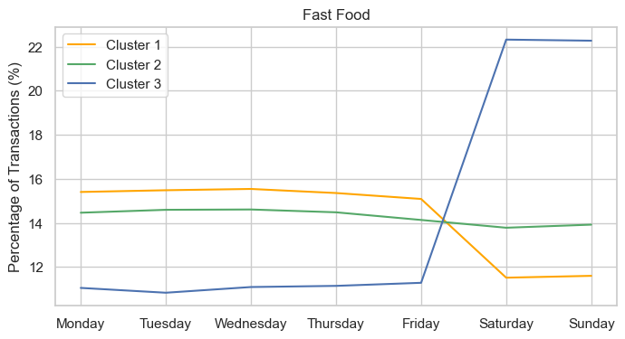
Customer Segmentation – Which merchants are they visiting?
Key Insights
Peak in spending at merchants such as cafes and fast-food restaurants during the weekdays.
This is a common consumer spending pattern amongst (relatively young) white-collar workers.
Credit-card cashback schemes focused on weekday deals

Slide 7
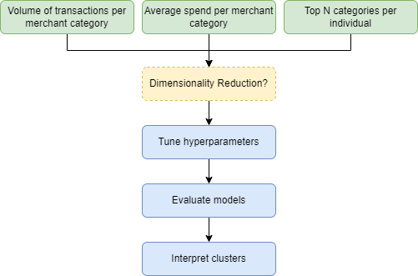
Can we identify these segments in a more direct way?
Feature engineering
Aggregating volume of transactions or normalized spend per merchant category for each Account ID.
Investigated PCA to improve clustering performance.
Model selection
Centroid-based methods: K-Means.
Density-based methods: DBSCAN, OPTICS, HDBSCAN.
Evaluation metrics
Grid-searching hyperparameters with silhouette score.
Interpreting the differences between clusters – and whether these are useful.
Notes:
In customer segmentation, we start with Feature engineering method
From the given 4 column, we have two method to create more feature
The first one is that we span each unique value in the 'to_randomly_generated_account' column into unique category column
The second we use the top N category column
After we find the appropriate feature, then we aggregate volume of transactions by using summation, average and also normalized spend for each account. However I found that normalized data give the less score compared to normal data, and there is a better result when we used summation rather than average
Moreover, we also try to use PCA to reduce the dimension in our feature and the result do no different between using and not using PCA to reduce feature
After, we finished the Feature engineering method we then select 4 model to clustering the transaction data which are K-Means, DBSCAN, OPTICS, HDBSCAN. Most of the result shows that HDBSCAN can do better when we are tuning the best fit parameter to that model by using Grid-searching
For Evaluation metrics, we use silhouette score. The best score that we have for now is 0.52 in HDBSCAN with the top n category column per customer feature

Slide 8
Current progress with segmentation work
Unsupervised Learning techniques
Business
How do we generate feature ?
Group by category
K-mean
HDBSCAN
DBSCAN
How do we combine the row?
Average
Summation
Feature | Aggregation
Businesses | Average
Business with PCA
Category
Businesses | Summation
Business with PCA
Category
Use only money spend on Top 3 with encode business as numerical value | Summation
There is no different between using and not using PCA to reduce feature
Summation is better than Average
Kprototypes for different kind of variable types.

Slide 9
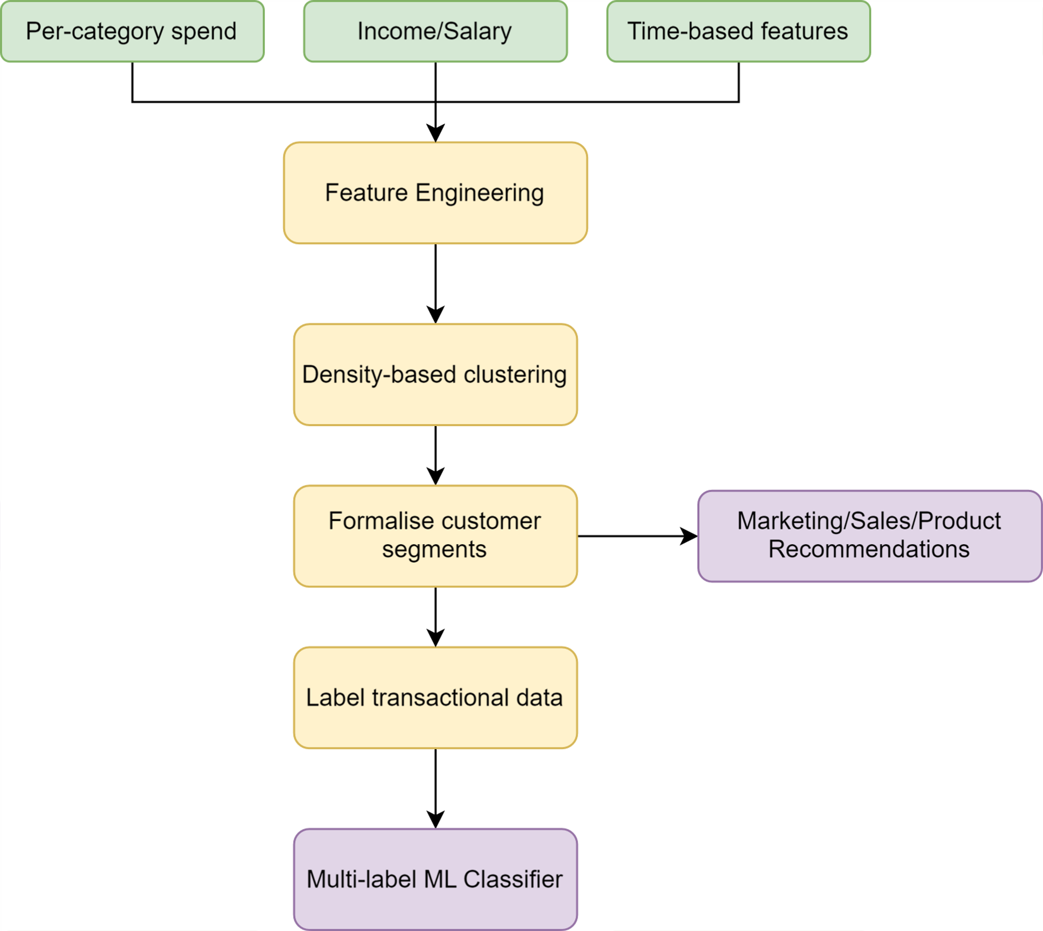
Next Steps/Challenges
Key objectives in the remaining time
Identify explainable customer segments.
Create tailored product marketing/sales strategy based on analysis of identified segments.
Create a predictive model, to infer which consumer segment an individual may belong to.
Key risks/challenges
Unifying insights from both datasets + missing day of transactions
Creating new features based on an individual's income.
Creating new time-based features that measure frequency of purchase utilizing more granular timestamps.
Appropriately tuning hyperparameters of HDBSCAN/DBSCAN algorithms and evaluating them correctly.
Further investigating dimensionality reduction techniques to reduce feature space.
We are here!

Slide 10
Questions ???

Slide 11
Thank You

