Slide 1
Predicting T-Cell Receptor Specificity
--Group 3

Slide 2
Introduction
Inspiration Sources
Framework

Slide 3
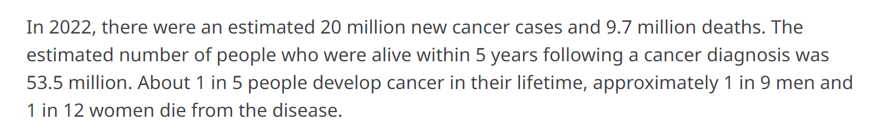
Presenter:Wei Zeng
Introduction
Cancer is the leading cause of death worldwide
immunotherapy that can harness the immune system to fight cancer has firmly established itself as a novel pillar of cancer care
The specificity of T cell receptor (TCR) plays a crucial role in immunotherapy.

Slide 4
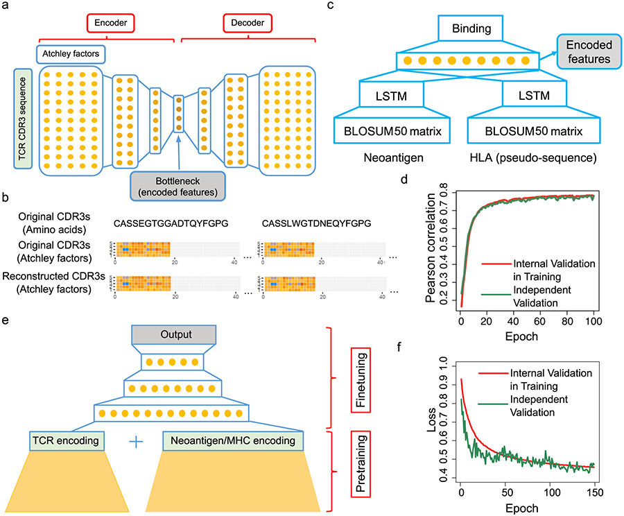
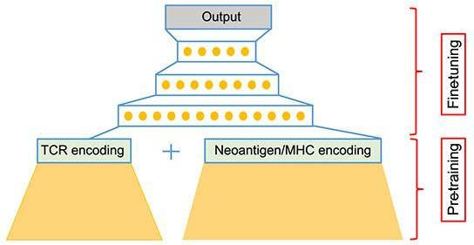
Presenter:Wei Zeng
Inspiration Sources
The structure of the re-implemented netMHCpan model
The structure of the stacked auto-encoder for learning TCR embeddings
Structure of the final pMTnet model
input
output
input: TCR sequence
input: MHC sequence (class I only) and the antigen protein sequence
+
a continuous variable that reflects the percentile ranking of predicted binding strength between TCR and pMHC, relative to a pool of 10,000 randomly sampled TCRs of the same pMHC.
output: numerical TCR embedding vector
output: whether the antigens bind to the MHC molecule or not

Slide 5
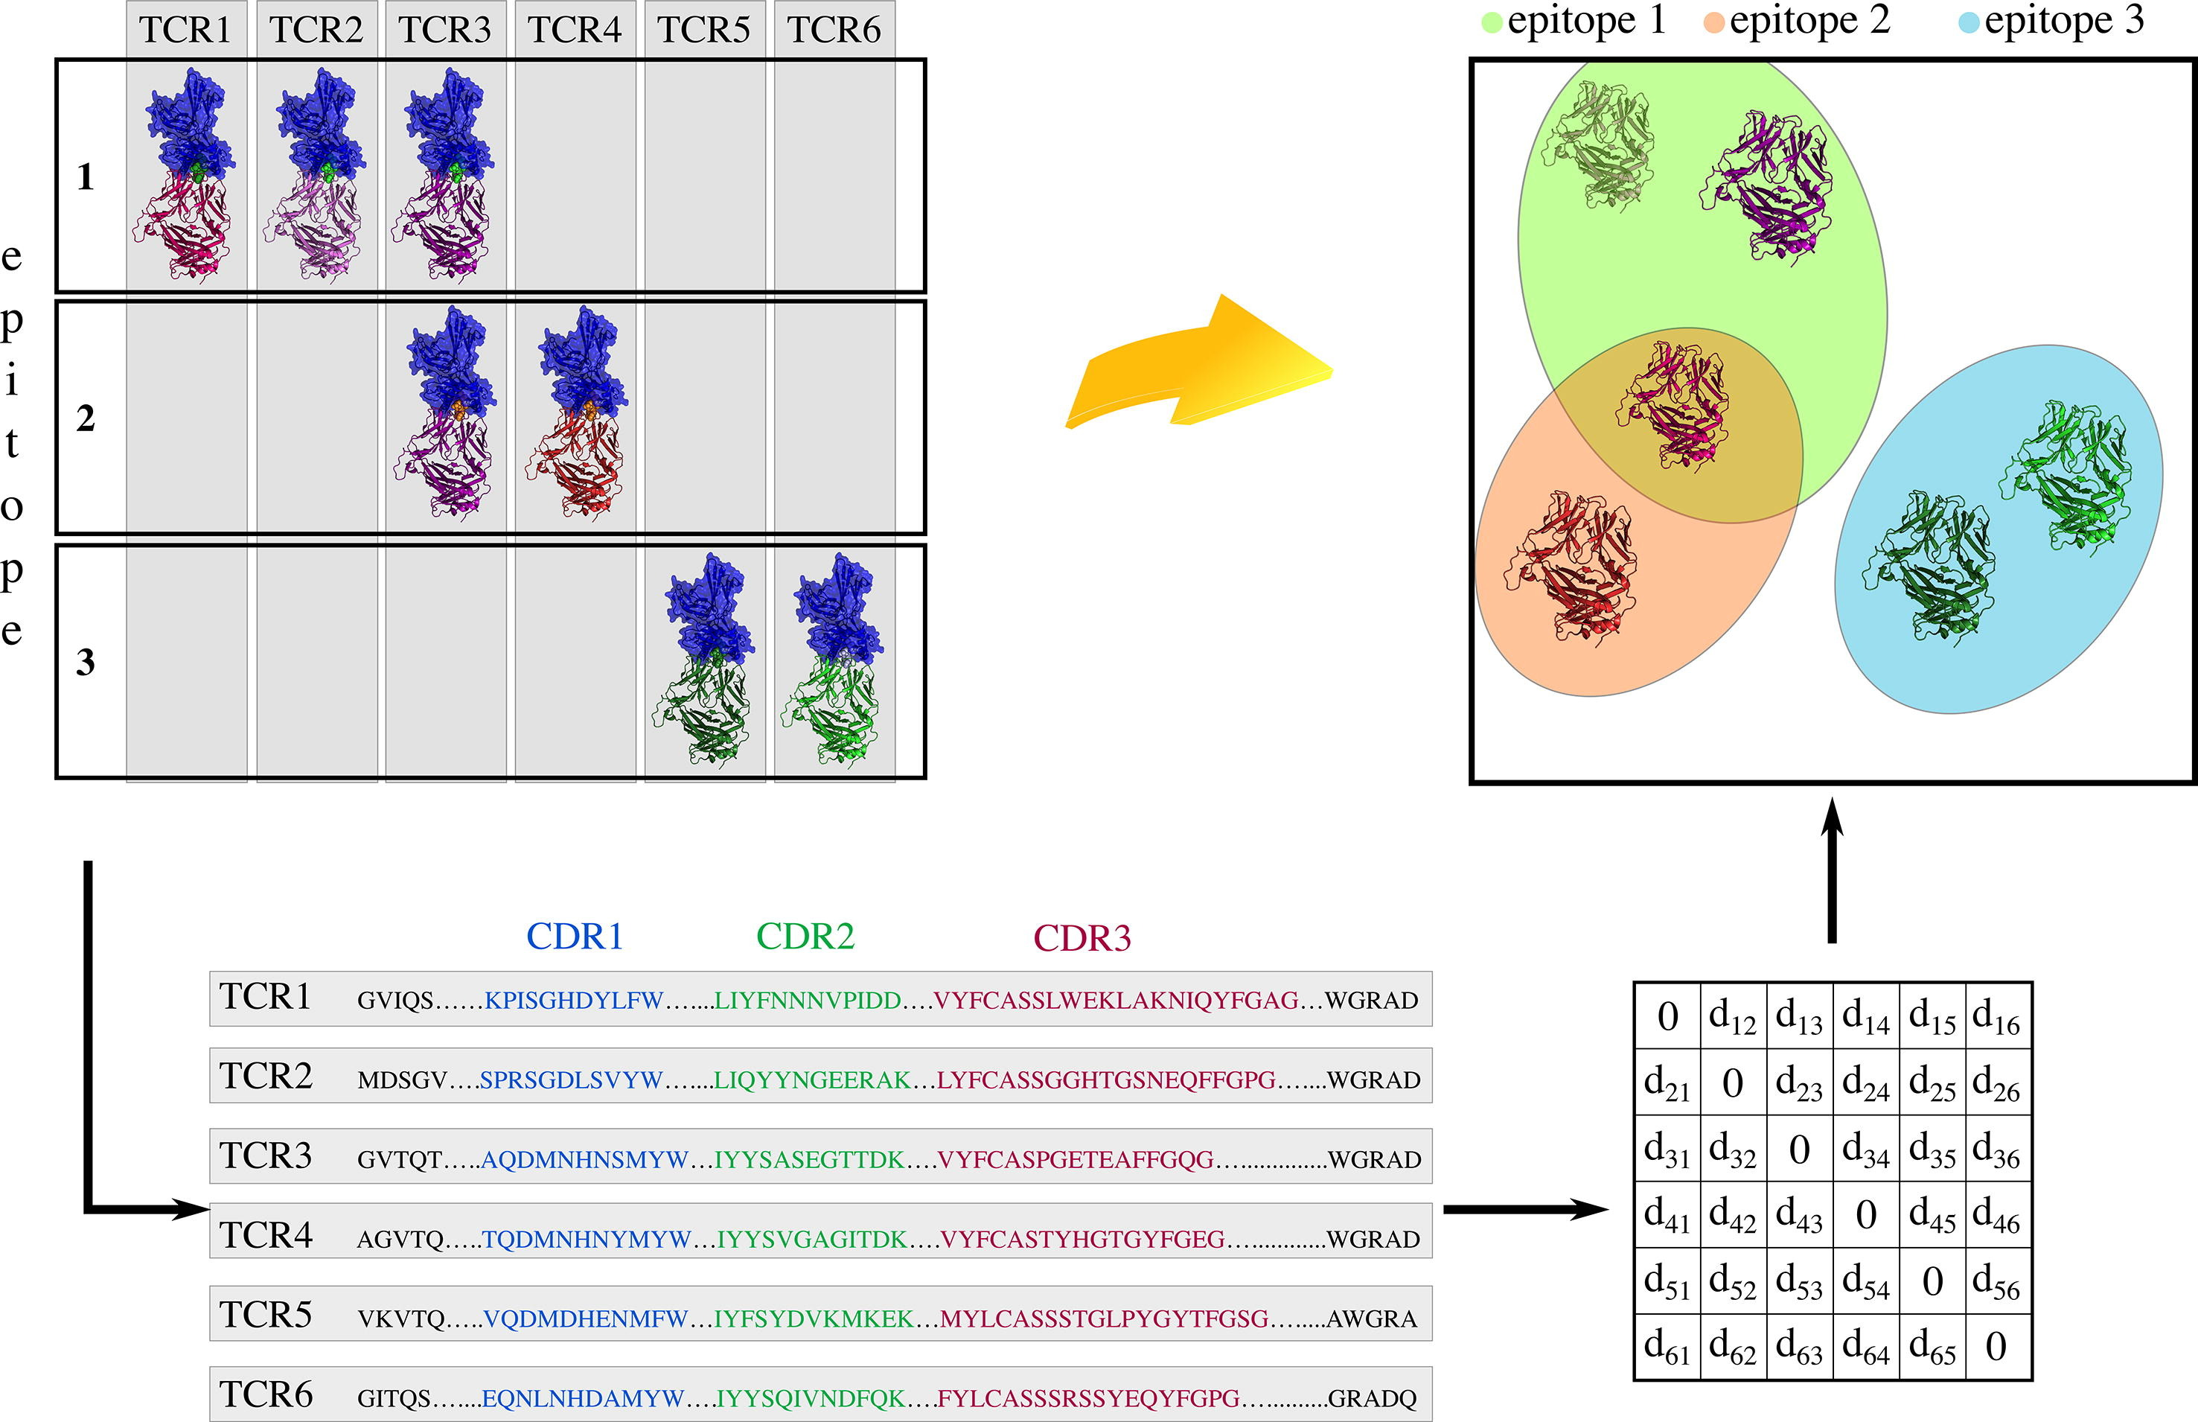
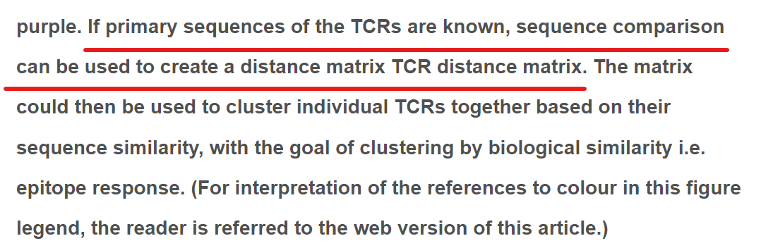
Presenter:Wei Zeng
Inspiration Sources

Slide 6
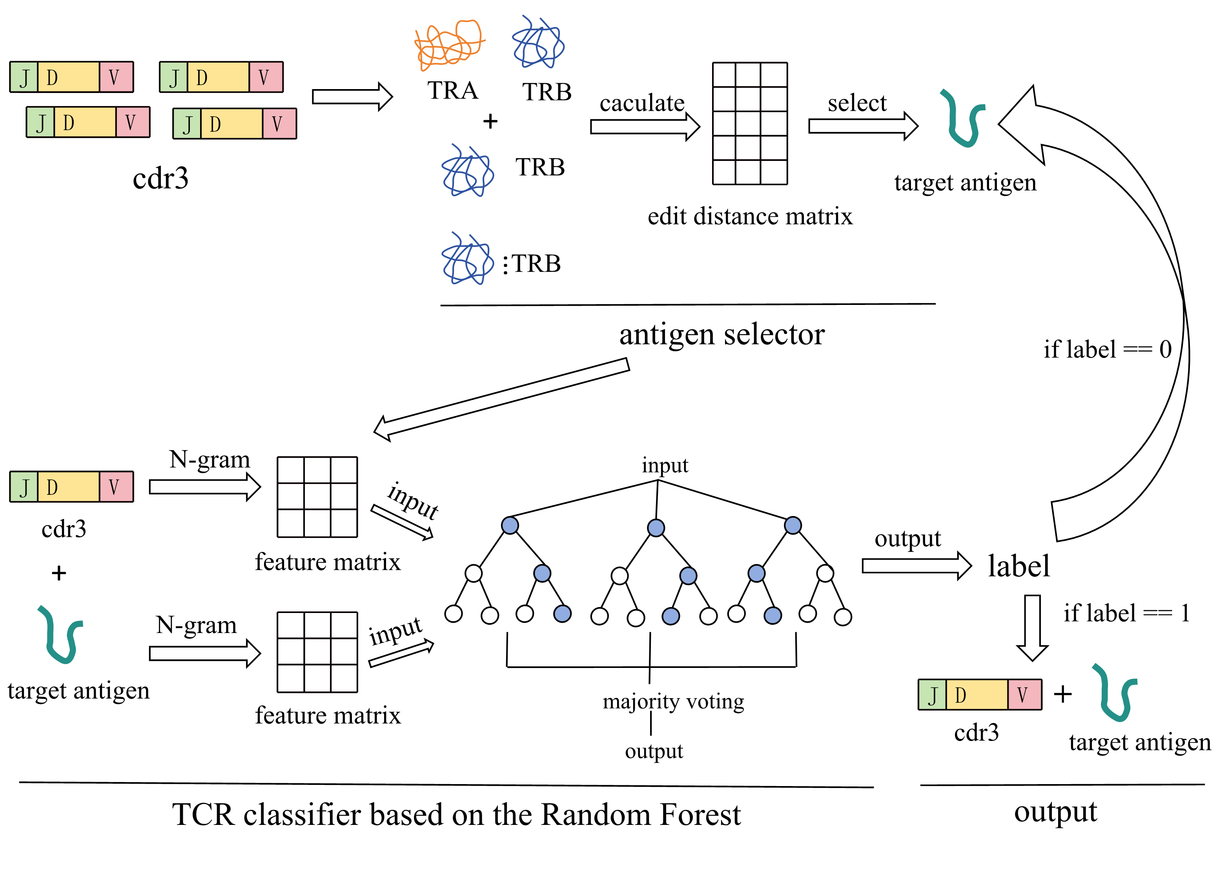
Presenter:Wei Zeng
Framework
Antigen selector
Edit distance
TCR classifier
N-gram
Random Forest
K-fold validation

