Slide 1
Predicting T-Cell Receptor Specificity
-Group 3
KELVIN ZHAO, TENGYAO TU, ZHENYU ZHANG, WEI ZENG

Slide 2
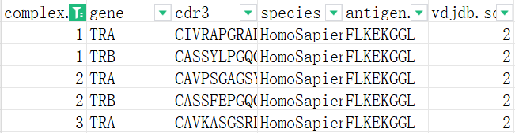
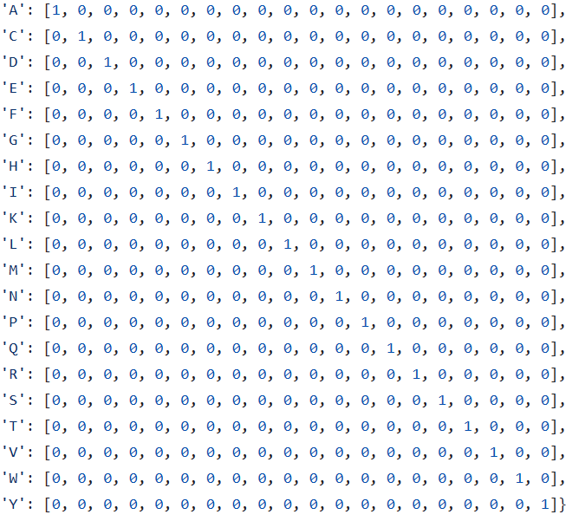
Data Source
complex.id: The same id indicates that the TRA and TRB chains are from the same TCR;
0 indicates that the TRA or TRB chain data is missing
cdr3: Each TCR is made up of a pair of proteins, they are TRA and TRB in this table.
so cdr3 is a sequence of TRA or TRB
antigen.epitope: The sequence of antigenic epitope
vdjdb.score: Effectiveness of the TCR against antigen
species*: TCR parent species
mhc. class*: The classes of MHC
TRA+TRB : 'C': { [0, 1, 0, 0, 0, 0, 0, 0, 0, 0, 0, 0, 0, 0, 0, 0, 0, 0, 0, 0],
‘ ’ : [0, 0, 0, 0, 0, 0, 0, 0, 0, 0, 0, 0, 0, 0, 0, 0, 0, 0, 0, 0] }
matrix: 39×20
Antigen : 'F': { [0, 0, 0, 0, 1, 0, 0, 0, 0, 0, 0, 0, 0, 0, 0, 0, 0, 0, 0, 0],
‘ ’ : [0, 0, 0, 0, 0, 0, 0, 0, 0, 0, 0, 0, 0, 0, 0, 0, 0, 0, 0, 0] }
One-Hot Encoding
matrix: 24×20

Slide 3
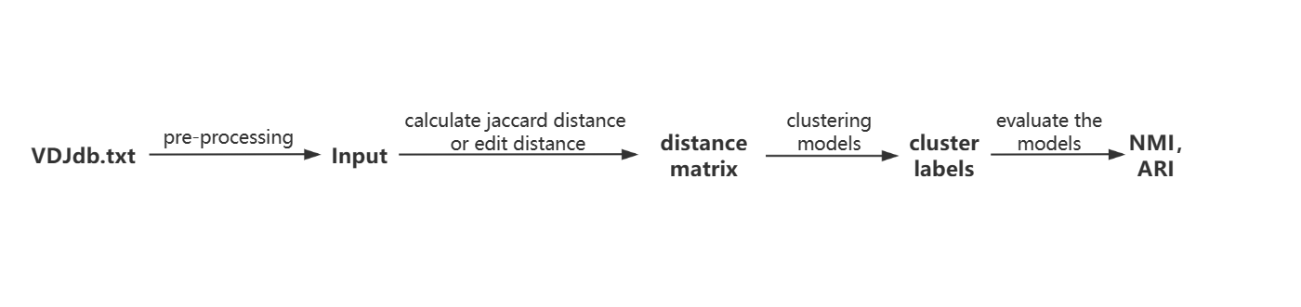
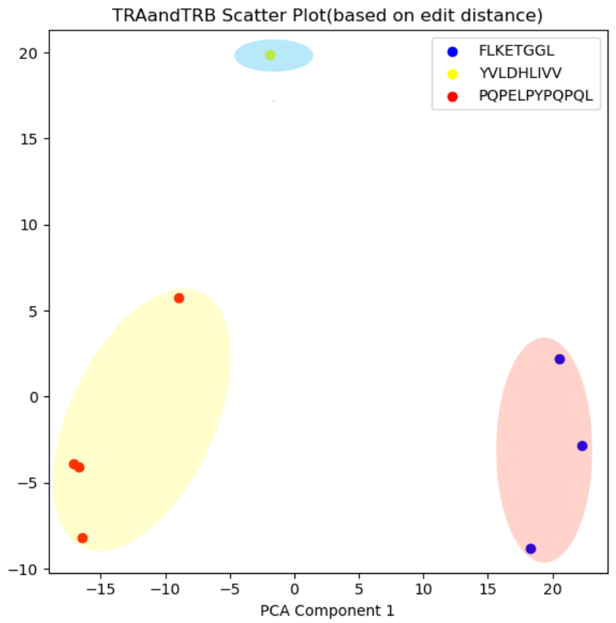
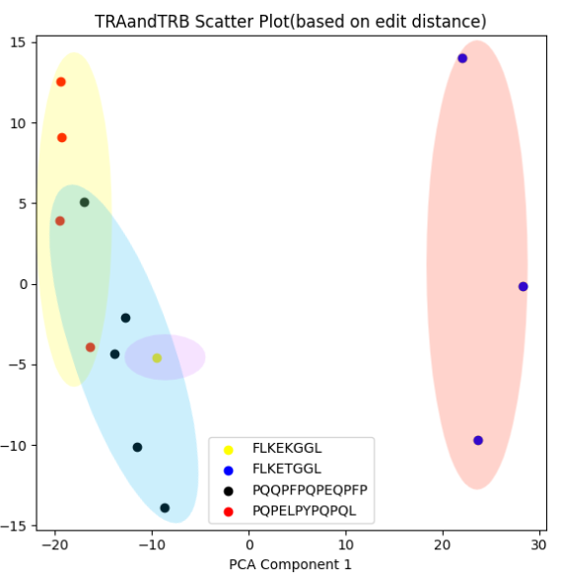
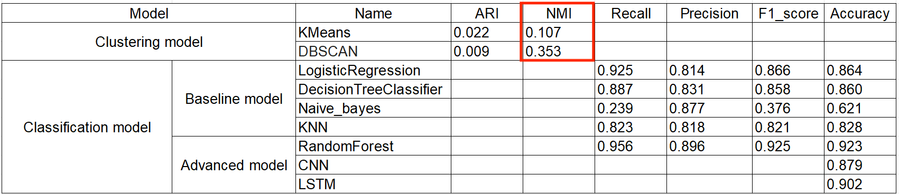
Progress so far
Clustering model

Slide 4
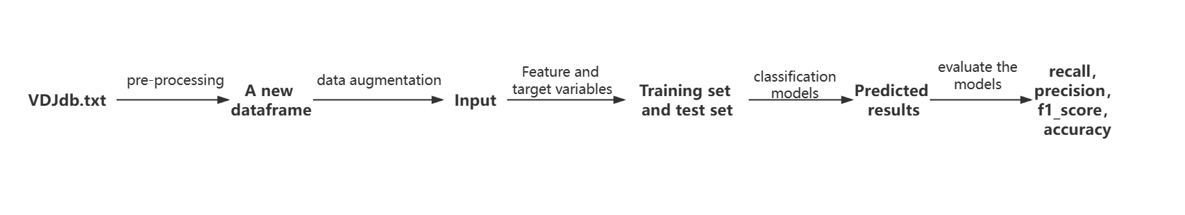
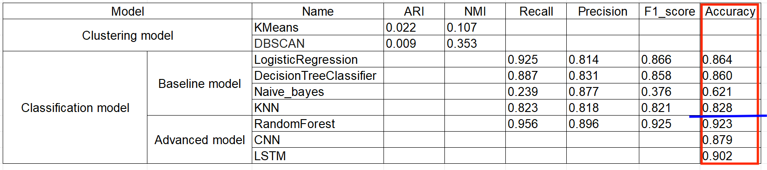
Progress so far
Classification model

Slide 5
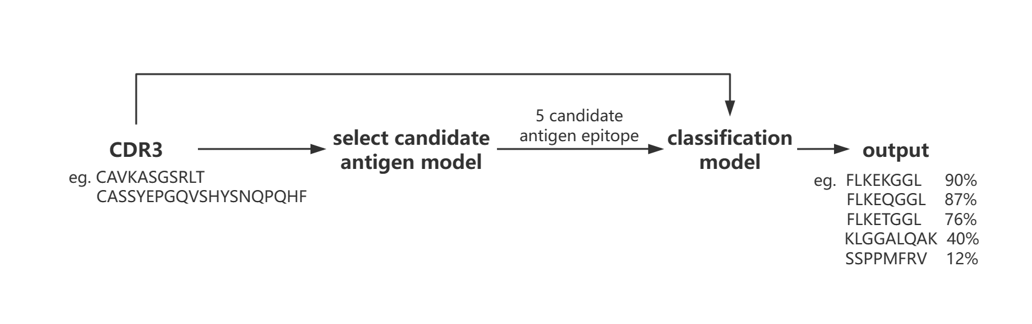
Next planned steps and Challenges

Slide 6
Further Challenges
- Data reliability
- Candidate antigen choices
- Improving deep learning efficiency

