Slide 1
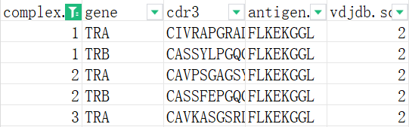
Data cleansing and pre-processing
cdr3: Each TCR is made up of a pair of proteins, they are TRA and TRB in this table. so cdr3 is a sequence of TRA or TRB
complex.id: The same id indicates that the TRA and TRB chains are from the same TCR; 0 indicates that the TRA or TRB chain data is missing
antigen.epitope: The sequence of antigenic epitope
vdjdb.score: Effectiveness of the TCR against antigen

Slide 2
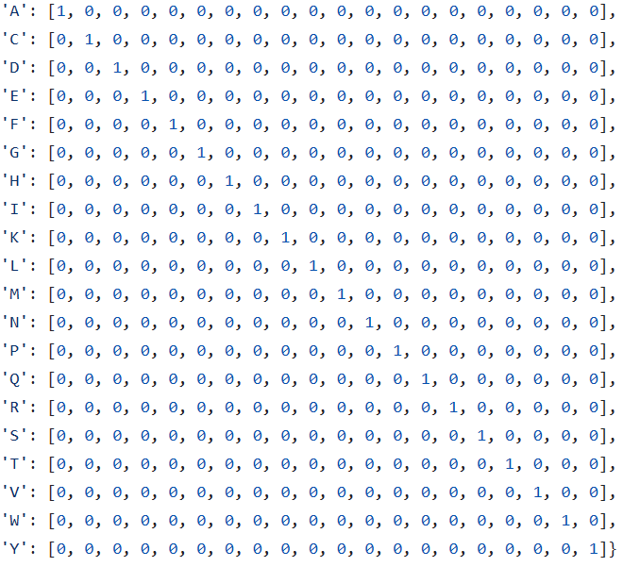

One-Hot Encoding
Input
Output
TRA : 'C': { [0, 1, 0, 0, 0, 0, 0, 0, 0, 0, 0, 0, 0, 0, 0, 0, 0, 0, 0, 0],
·
·
‘ ’ : [0, 0, 0, 0, 0, 0, 0, 0, 0, 0, 0, 0, 0, 0, 0, 0, 0, 0, 0, 0] }
Antigen : 'F': { [0, 0, 0, 0, 1, 0, 0, 0, 0, 0, 0, 0, 0, 0, 0, 0, 0, 0, 0, 0],
·
·
‘ ’ : [0, 0, 0, 0, 0, 0, 0, 0, 0, 0, 0, 0, 0, 0, 0, 0, 0, 0, 0, 0] }
f(x)
score (0) → 0 (negative)
+
TRB : 'C': { [0, 1, 0, 0, 0, 0, 0, 0, 0, 0, 0, 0, 0, 0, 0, 0, 0, 0, 0, 0],
·
·
‘ ’ : [0, 0, 0, 0, 0, 0, 0, 0, 0, 0, 0, 0, 0, 0, 0, 0, 0, 0, 0, 0] }
score (1, 2, 3) → 1 (positive)
matrix: 24×20
matrix: 21×20

