Slide 1



Predicting T-Cell Receptor Specificity
--Group 3

Slide 2

Presenter:Wei Zeng
Introduction
Background
Framework

Slide 3
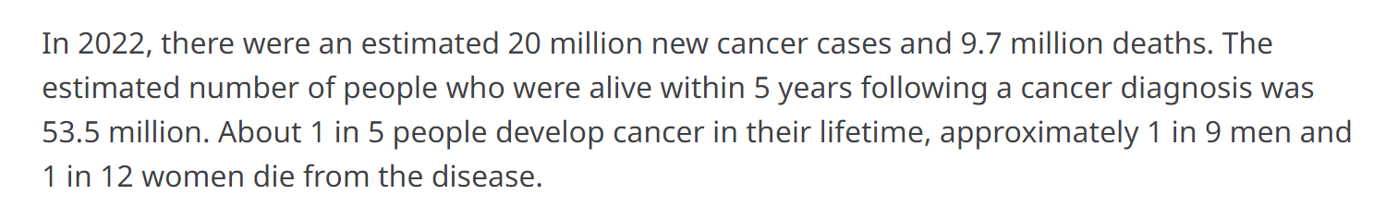
Presenter:Wei Zeng
Introduction
Cancer is the leading cause of death worldwide
immunotherapy that can harness the immune system to fight cancer has firmly established itself as a novel pillar of cancer care
The specificity of T cell receptor (TCR) plays a crucial role in immunotherapy.
[1]Global cancer burden growing, amidst mounting need for services (World Health Organization: WHO, 2024b)
[2]A review of cancer immunotherapy: From the past, to the present, to the future (Esfahani et al., 2020b)

Slide 4
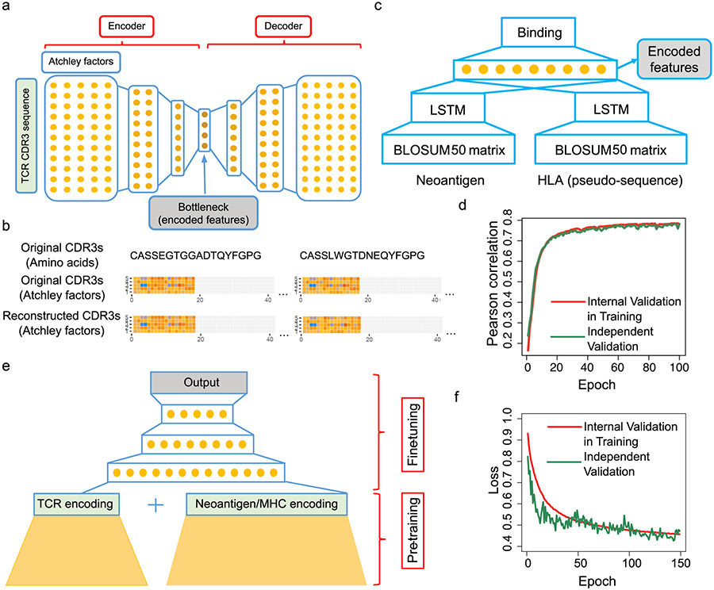
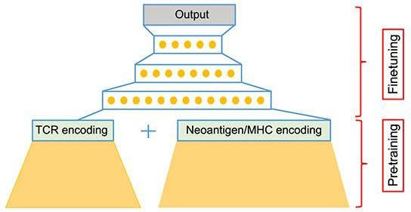
Presenter:Wei Zeng
Background
The structure of the re-implemented netMHCpan model
The structure of the stacked auto-encoder for learning TCR embeddings
Structure of the final pMTnet model
input
output
input: MHC sequence (class I only) and the antigen protein sequence
input: TCR sequence
a continuous variable that reflects the percentile ranking of predicted binding strength between TCR and pMHC, relative to a pool of 10,000 randomly sampled TCRs of the same pMHC.
output: whether the antigens bind to the MHC molecule or not
output: numerical TCR embedding vector
Deep learning-based prediction of the T cell receptor-antigen binding specificity (Lu et al., 2021b)

Slide 5
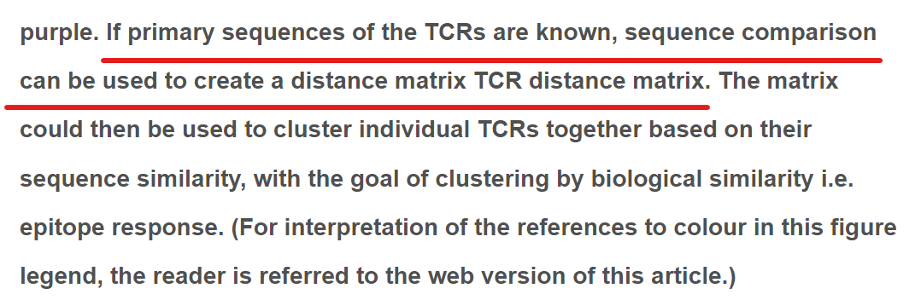
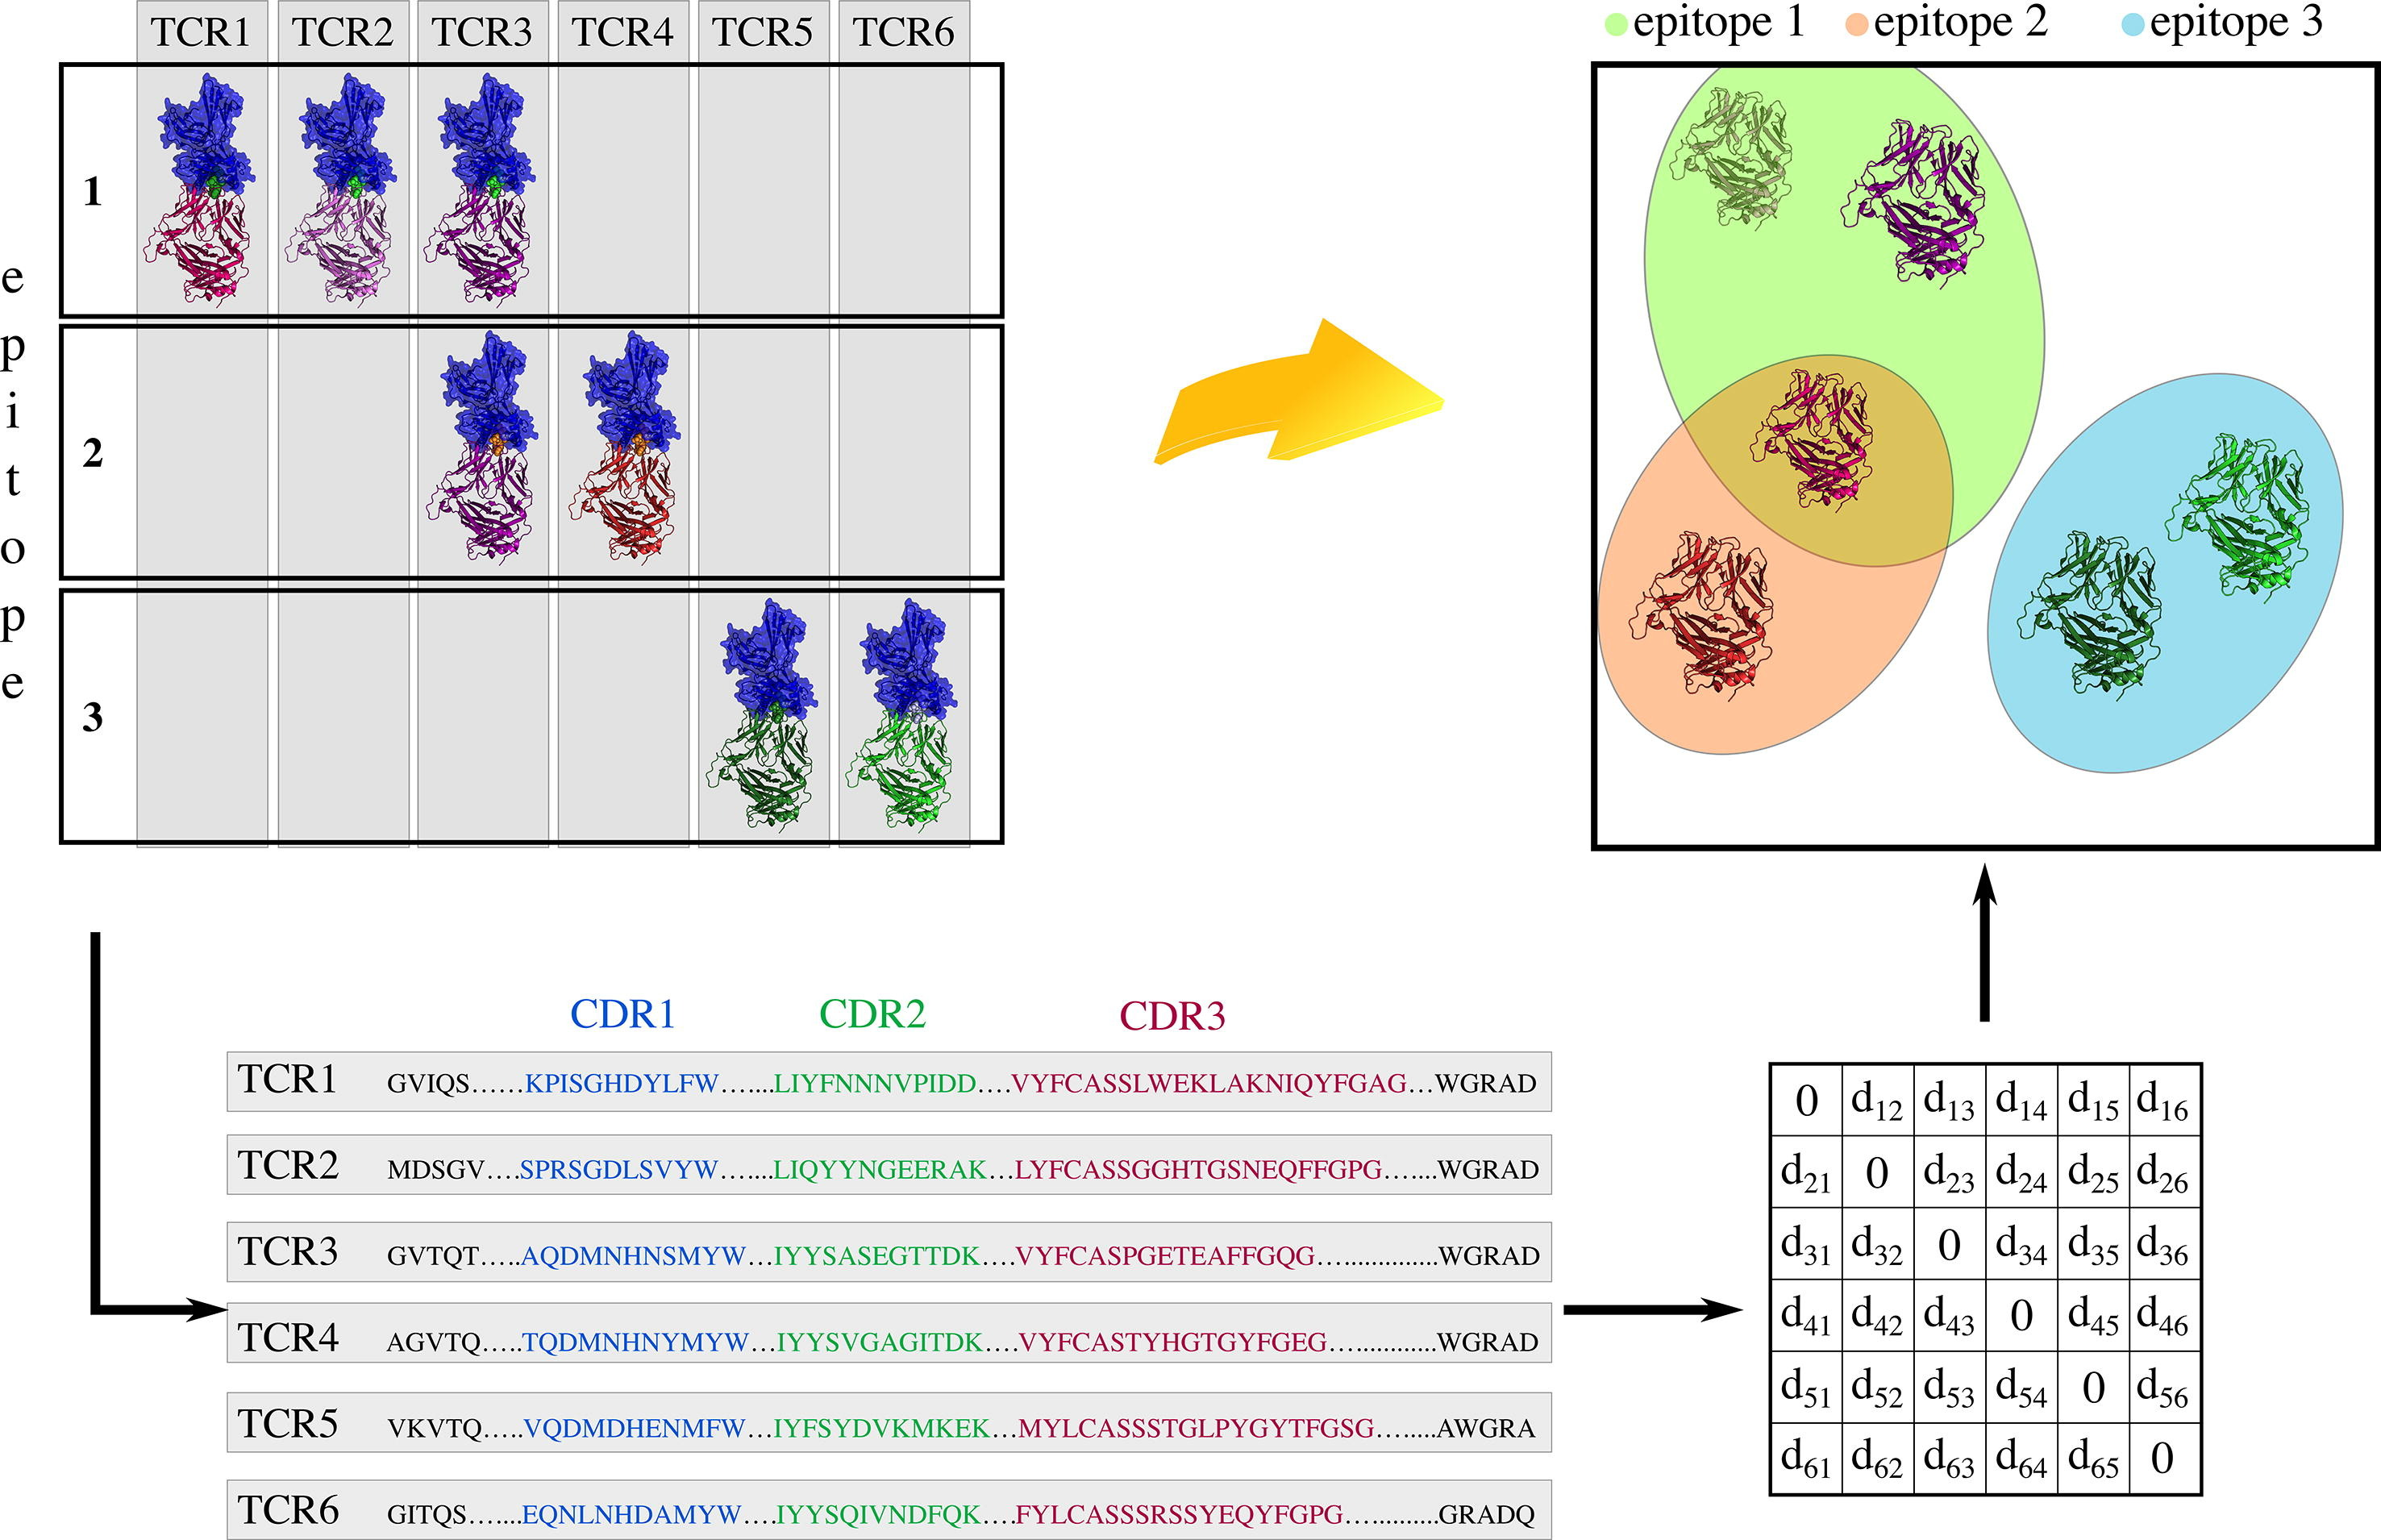
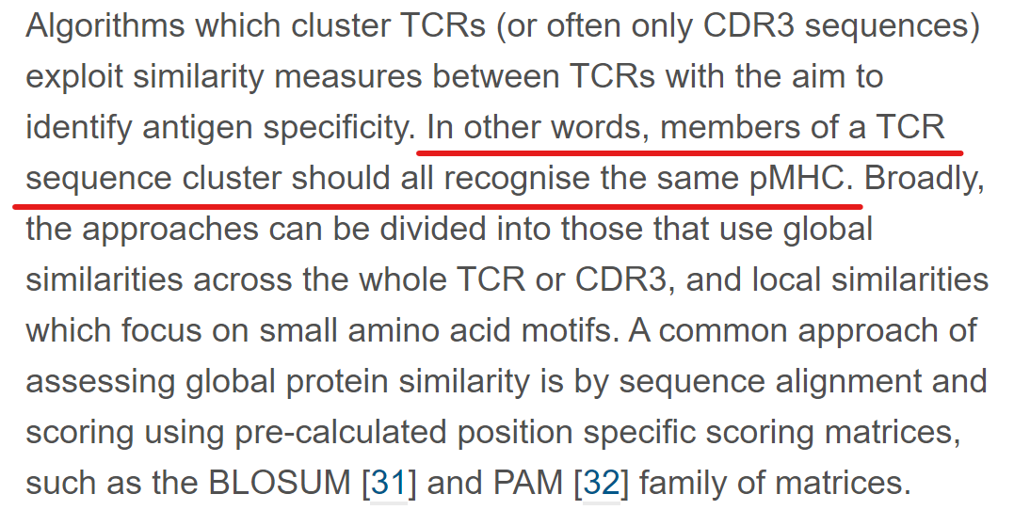
Presenter:Wei Zeng
Background
T cell receptor sequence clustering and antigen specificity (Vujović et al., 2020b)

Slide 6
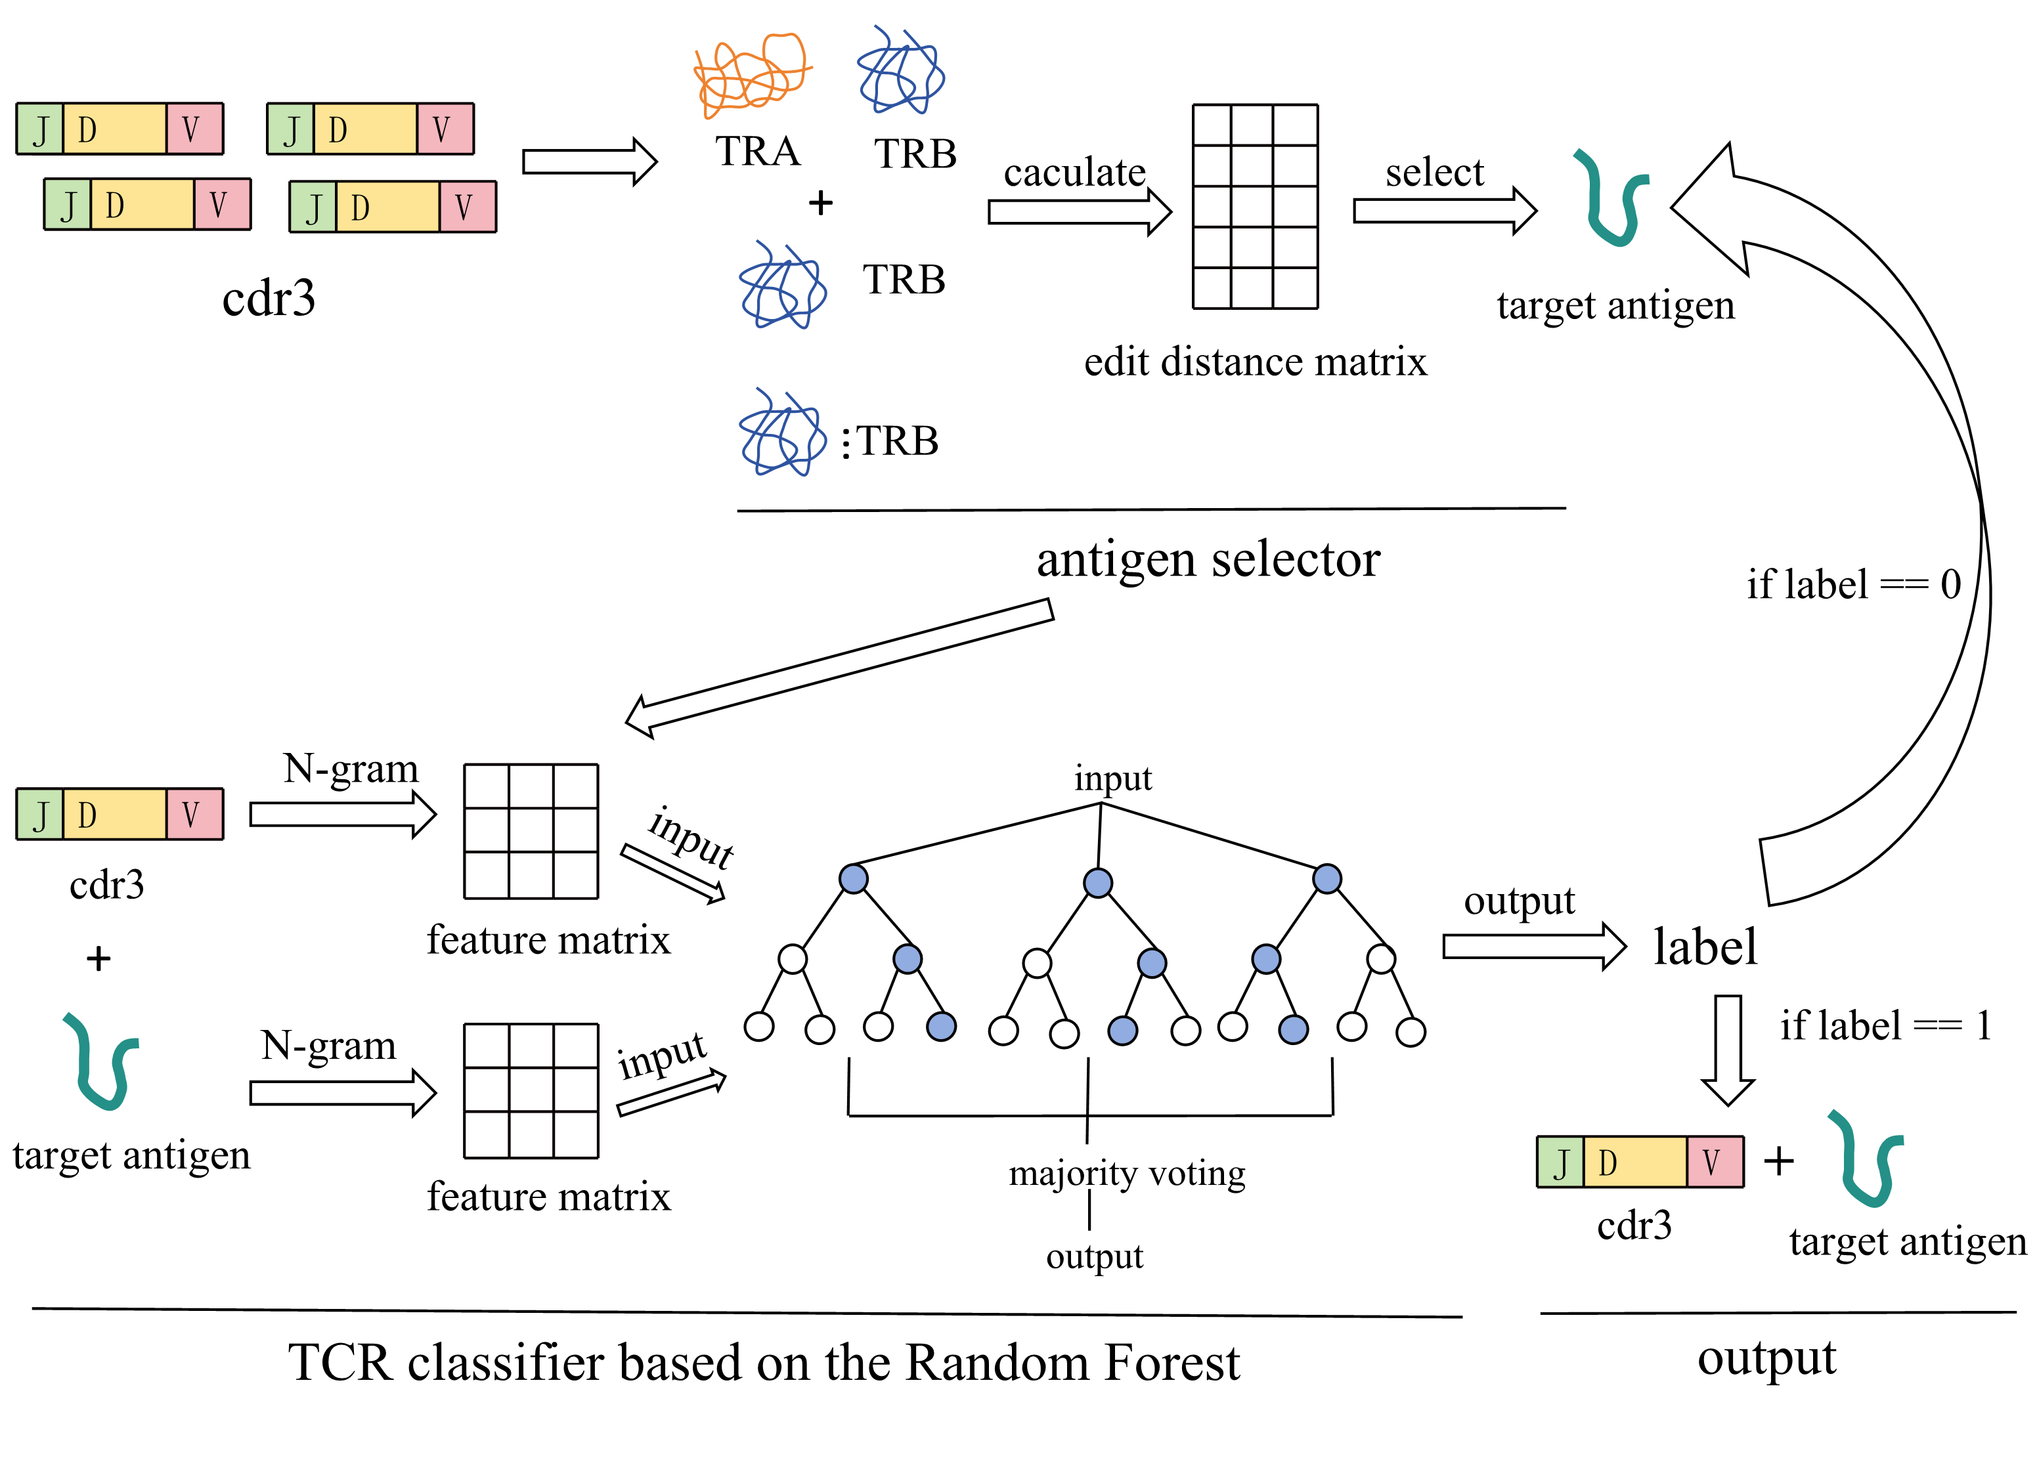
Presenter:Wei Zeng
Framework
Antigen selector
Edit distance
TCR classifier
N-gram
Random Forest
K-fold validation

Slide 7
Presenter:

Slide 8
Presenter:

Slide 9
Presenter:

Slide 10
Presenter:

Slide 11
Presenter:

