Slide 1

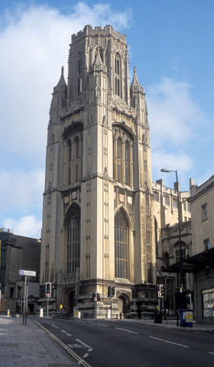
BUDE a General Purpose Molecular Docking Program with Implicit Data Resiliency
Amaurys Ávila Ibarra
James Price
Simon McIntosh-Smith
Richard Sessions

Slide 2
What is BUDE?
BUDE (Bristol University Docking Engine)
General purpose molecular docking program.
Uses an empirical free energy forcefield to predict ligand-receptor interactions.
Genetic algorithm for searching poses.
OpenCL/OpenMP/OmpSs accelerated.
C/C++

Slide 3
BUDE docking modes
Virtual screening by docking.
Binding site specification.
Protein-protein docking.

Slide 4
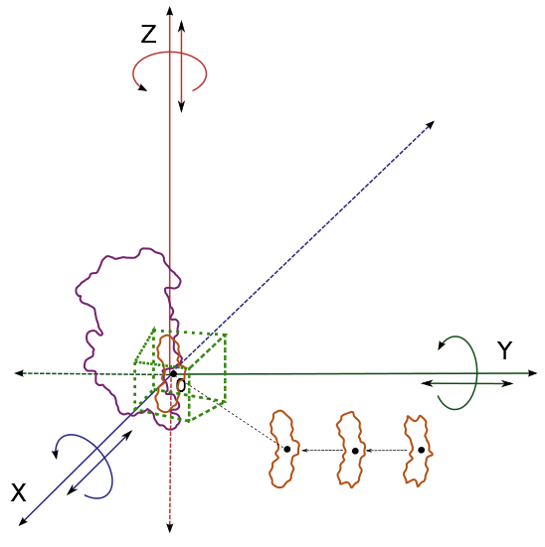
Virtual screening by docking

Slide 5
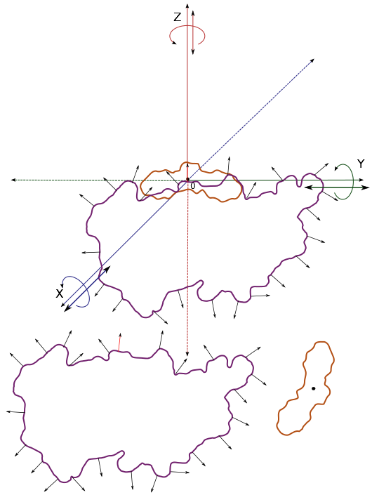
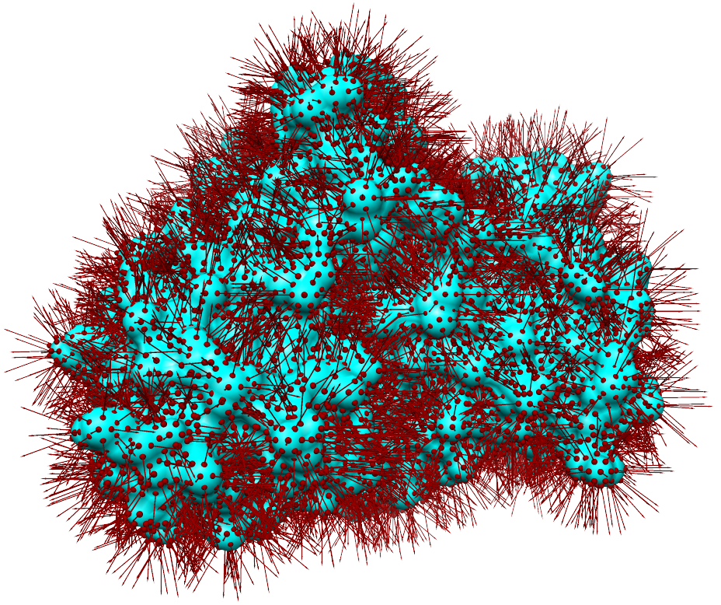

Binding site identification
Full rotation and limited translation of the ligand at each receptor surface vector

Slide 6
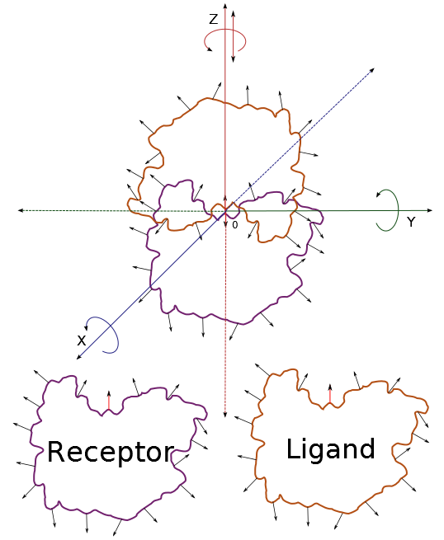
Protein-protein docking
Each point on ligand offered to
each point on receptor with a local
mini-dock: complete rotation in Z ,
rock in X & Y, small translations in
X, Y & Z

Slide 7
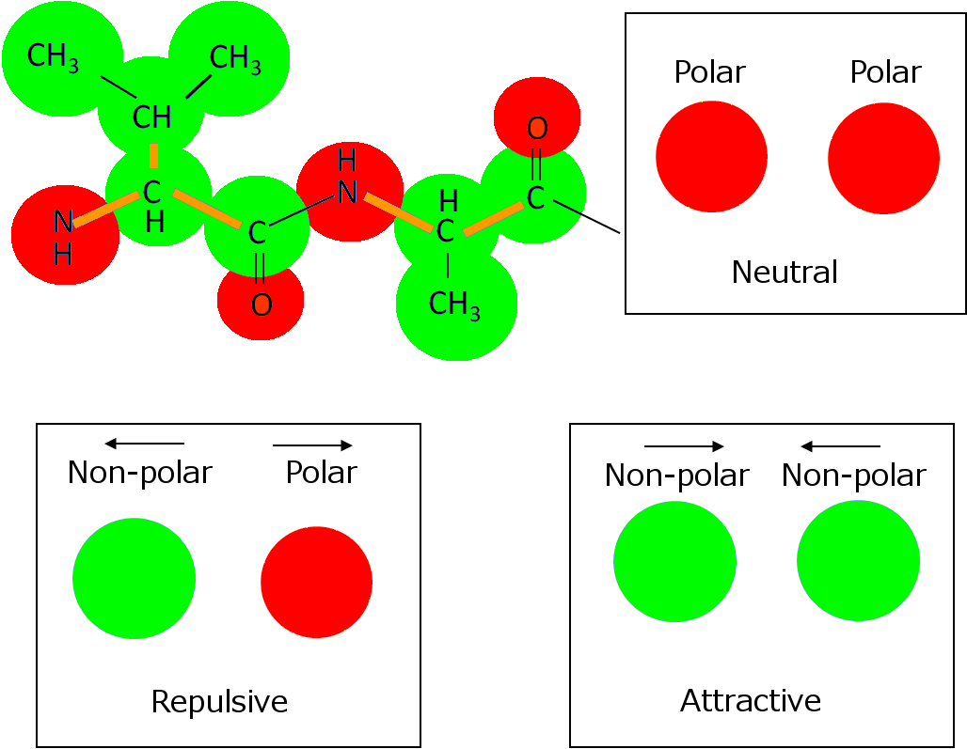
Atom-atom based forcefield
parameterised according to atom type,
analogous to standard molecular mechanics

Slide 8
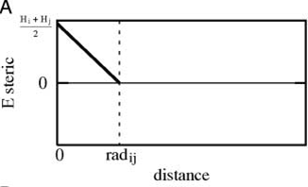
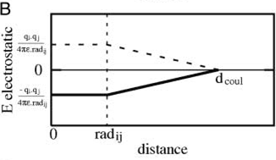
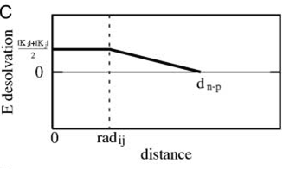
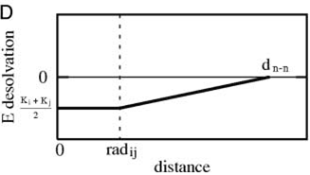
Empirical free energy forcefield
McIntosh-Smith, S., et al., Benchmarking Energy Efficiency,
Power Costs and Carbon Emissions on Heterogeneous Systems.
Computer Journal, 2012. 55(2): p. 192-205.
soft core

Slide 9
BUDE’s molecule
Residues
Atoms
Molecule
R₁
R₂
A₂
A_{N}
A₁
R_{N}
A_{i}
= [ X, Y, Z , FF ]
Pose = [ D_{X}, D_{Y}, D_{Z} , A_{X}, A_{Y}, A_{Z} ] = TD

Slide 10
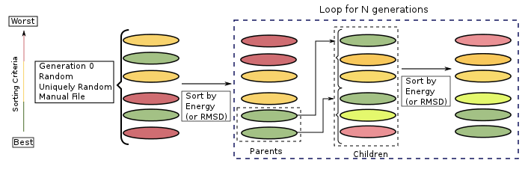
EMC genetic algorithm
Seed | Parents | Selected By | Flag | Generation Size | Output Descriptors | Output Coordinates | Mutation Method | Max Mutable states | Parameter | Parameter
N | M | R* | True | X | Y | Z | U | K | R* | R*

Slide 11
EMC minimiser
Parent TD
State | A | B | C | D | E | F
Index | 1 | 2 | 3 | 4 | 5 | 6
Random T
1 < T= 3 < K
Select T random States
B, D, E
Base TD
State | A | B | C | D | E | F
Index | 1 | x | 3 | y | z | 6
Generate random indexes
If x = 2 -> new x
If y = 4 -> new y
If z = 5 -> new z
Child TD
State | A | B | C | D | E | F
Index | 1 | 7 | 3 | 8 | 9 | 6

Slide 12
BUDE’s algorithm
readData(){
Molecule receptor;
Molecule ligand;
Forcefield parameters;
TDs generation_0;
}
doEMC(){
energies[poses] = computeEnergies(gen[0]);
for(i = 1 upto N generations){
select best parents TDs by energy;
generate children TDs;
energies[childrenTDs] = computeEnergies(gen[i]);
}
output best N results;
}

Slide 13
BUDE’s algorithm
computeEnergies(N TDs){
pose_energy[N];
for(i = 0 upto N poses){
transform ligand;
for(each ligand atom){
for(each receptor atom){
pose_energy[i] = sum(F(receptor.atom, ligand.atom));
}
}
}
sort(pose_energy[]);
}

Slide 14
Critical data
Receptor data.
Ligand data.
Forcefield parameters.
Data that need verification, corruption of these data will lead to unreliable results.

Slide 15
Data that tolerate errors
Poses for Generation 0.
Poses within EMC generations.
Data with errors should be discarded by the algorithm.

Slide 16
Error detection
Cyclic redundancy checks CRC.
Checksums.
Parity bits

Slide 17

Error correction
Automatic repeat request.
Redundancy copies.
BUDE’s case.

Slide 18
Error checking exercise
Using the miniBUDE and CRC32 code provided check that the critical data has not been corrupted.
Calculate CRC before and after docking.
If error detected warn user.

