Slide 1
Advanced Hands On OpenCLTM
Simon McIntosh-Smith
James Price
Tom Deakin
Mike O'Connor
Includes contributions from: Timothy G. Mattson (Intel), Benedict Gaster (UWE),
Dan Curran and Mike Boulton (all University of Bristol)

Slide 2
Course materials
http://www.cs.bris.ac.uk/~simonm/OpenCL/
intro_to_OpenCL_Feb_2015_part1.{pptx|pdf}
Intro-Exercises.zip

Slide 3
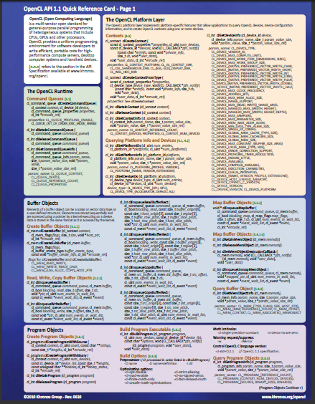
Course materials
In addition to these slides, C++ API header files, a set of exercises, and solutions, it is useful to have:
OpenCL Reference Cards
These cards will help you keep track of the API as you do the exercises:
https://www.khronos.org/registry/cl/
The spec is also very readable and recommended to have on-hand

Slide 4
A quick recap of OpenCL
Lecture 2

Slide 5
It’s a Heterogeneous world
A modern computing platform includes:
One or more CPUs
One of more GPUs
DSP processors
Accelerators
… other?
From integrated CPUs in smartphones, tablets and laptops through high-end desktops and servers with discrete GPUs
OpenCL lets Programmers write a single portable program that uses ALL resources in the heterogeneous platform

Slide 6
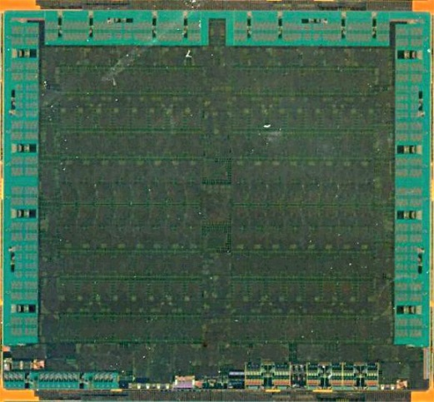
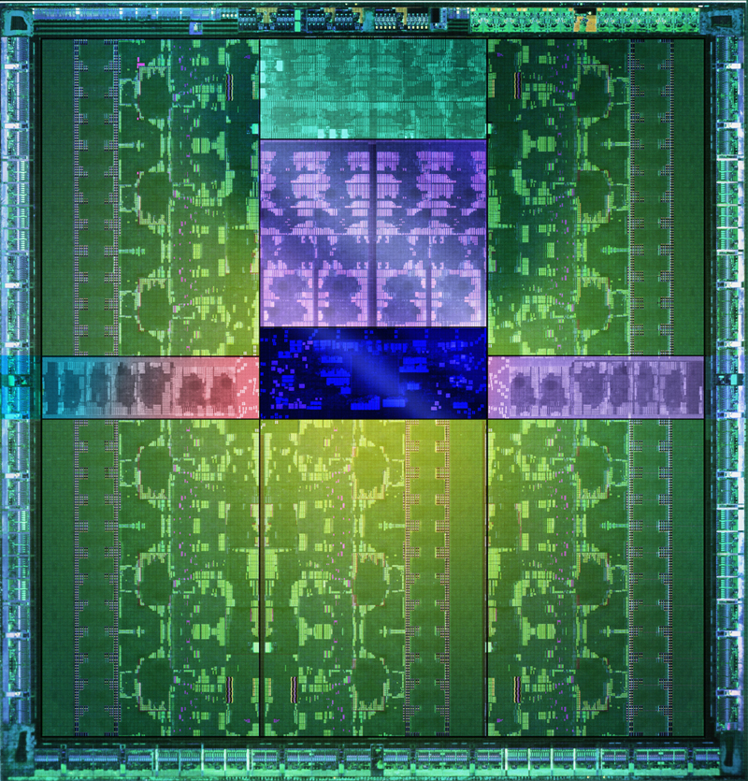
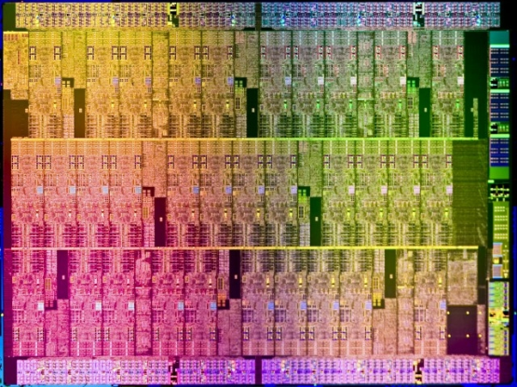
Microprocessor trends
Individual processors have many (possibly heterogeneous) cores.
32 cores
16 wide SIMD
10 cores
16 wide SIMD
61 cores
16 wide SIMD
15 cores
192 wide SIMD
AMD® Tahiti
Intel® Xeon Phi™ coprocessor
NVIDIA® Tesla® K40
The Heterogeneous many-core challenge:
How are we to build a software ecosystem for the Heterogeneous many core platform?
Third party names are the property of their owners.

Slide 7
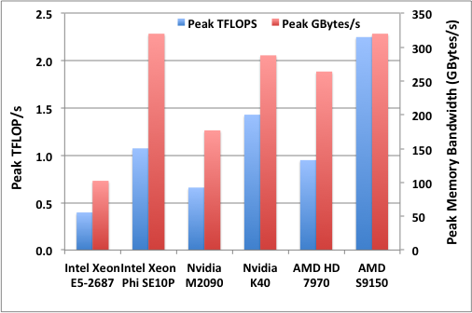
Many-core performance potential
5.7X FLOP/s speedup
3.1X memory bandwidth
16 cores of Sandy Bridge at 3.1 GHz

Slide 8
Unlocking this potential
Need efficient, expressive, parallel programming languages
Also need cross-platform standards
Ideally not just for HPC so that they have sufficient momentum for the long term
OpenCL is the only parallel programming language that meets all these many-core requirements today

Slide 9

Industry Standards for Programming Heterogeneous Platforms
GPUs
Increasingly general purpose data-parallel computing
CPUs
Multiple cores driving performance increases
Emerging Intersection
Graphics APIs and Shading Languages
Multi-processor programming – e.g. OpenMP
Heterogeneous Computing
OpenCL – Open Computing Language
Open, royalty-free standard for portable, parallel programming of heterogeneous parallel computing CPUs, GPUs, and other processors

Slide 10




























OpenCL Working Group within Khronos
Diverse industry participation
Processor vendors, system OEMs, middleware vendors, application developers.
OpenCL became an important standard upon release by virtue of the market coverage of the companies behind it.
Third party names are the property of their owners.

Slide 11
OpenCL progress
New OpenCL C++ kernel language based on a subset of C++14
Significantly enhanced programmer productivity and code performance
OpenCL C still supported to preserve kernel code investment
Support for the new Khronos SPIR-V intermediate language in core
SPIR-V now used by both OpenCL 2.1 and the new Vulkan graphics API
Runs on any OpenCL 2.0-capable hardware
Only driver update required
OpenCL C++ Shading language
SPIR-V in Core
Subgroups into core
Subgroup query operations
clCloneKernel
Low-latency device timer queries
Shared Virtual Memory
On-device dispatch
Generic Address Space
Enhanced Image Support
C11 Atomics
Pipes
Android ICD
3-component vectors
Additional image formats
Multiple hosts and devices
Buffer region operations
Enhanced event-driven execution
Additional OpenCL C built-ins
Improved OpenGL data/event interop
Device partitioning
Separate compilation and linking
Enhanced image support
Built-in kernels / custom devices
Enhanced DX and OpenGL Interop
Dec08
18 months
Jun10
18 months
Nov11
24 months
Nov13
16 months
Mar15
OpenCL 1.0 Specification
OpenCL 1.1 Specification
OpenCL 1.2 Specification
OpenCL 2.0 Specification
OpenCL 2.1 Specification (Provisional)

Slide 12
Important OpenCL concepts
Lecture 3

Slide 13
OpenCL Platform Model
…
…
…
…
…
…
…
Processing Element
…
…
Host
…
…
…
…
…
…
Compute Unit
OpenCL Device
One Host and one or more OpenCL Devices
Each OpenCL Device is composed of one or more Compute Units
Each Compute Unit is divided into one or more Processing Elements
Memory divided into host memory and device memory

Slide 14

An N-dimensional domain of work-items
Global Dimensions:
1024x1024 (whole problem space)
Local Dimensions:
128x128 (work-group, executes together)
1024
Synchronization between work-items possible only within work-groups:
barriers and memory fences
1024
Cannot synchronize between work-groups within a kernel
Choose the dimensions that are “best” for your algorithm

Slide 15
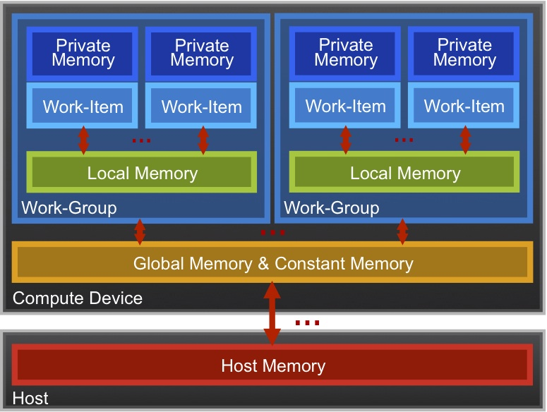
OpenCL Memory model
Private Memory
Per work-item
Local Memory
Shared within a
work-group
Global Memory /Constant Memory
Visible to all
work-groups
Host memory
On the CPU
Memory management is explicit: You are responsible for moving data from
host → global → local and back

Slide 16
The basic platform and runtime APIs in OpenCL (using C)
CPU
GPU
Context
Programs
Kernels
Memory Objects
Command Queues
Programs
dp_mul
Buffers
Images
__kernel void
dp_mul(global const float *a,
global const float *b,
global float *c)
{
int id = get_global_id(0);
c[id] = a[id] * b[id]; }
dp_mul
CPU program binary
arg [0] value
In Order
Queue
Out of Order
Queue
arg [0] value
In Order
Queue
Out of Order
Queue
arg[0] value
arg [1] value
arg [1] value
dp_mul
GPU program binary
arg[1] value
arg [2] value
arg [2] value
arg[2] value
GPU
Compute Device

Slide 17
Host programs
The host program is the code that runs on the host to:
Setup the environment for the OpenCL program
Create and manage kernels
5 main steps in all host programs:
Define the platform … platform = devices+context+queues
Create and Build the program (dynamic library for kernels)
Setup memory objects
Define the kernel (attach arguments to kernel functions)
Submit commands … transfer memory objects and execute kernels

Slide 18
The C++ Interface
Khronos has defined a common C++ header file containing a high level interface to OpenCL, cl.hpp
This interface is dramatically easier to work with¹
Key features:
Uses common defaults for the platform and command-queue, saving the programmer from extra coding for the most common use cases
Simplifies the basic API by bundling key parameters with the objects rather than requiring verbose and repetitive argument lists
Ability to “call” a kernel from the host, like a regular function
Error checking can be performed with C++ exceptions
¹ especially for C++ programmers…

Slide 19
C++ interface example
#define N 1024
int main(void) {
vector<float> h_a(N), h_b(N), h_c(N);
// initialize these host vectors…
Buffer d_a, d_b, d_c;
Context context(CL_DEVICE_TYPE_DEFAULT);
CommandQueue queue(context);
Program program(context,
loadprogram(“vadd.cl”), true);
// Create the kernel functor
make_kernel<Buffer, Buffer, Buffer>
vadd(program, “vadd”);
// Create buffers
// True indicates CL_MEM_READ_ONLY
// False indicates CL_MEM_READ_WRITE
d_a = Buffer(context, h_a.begin(), h_a.end(), true);
d_b = Buffer(context, h_b.begin(), h_b.end(), true);
d_c = Buffer(context, CL_MEM_WRITE_ONLY,
sizeof(float) * N);
// Enqueue the kernel
vadd(EnqueueArgs(queue, NDRange(N)),
d_a, d_b, d_c);
copy(queue, d_c, hc.begin(), hc.end());
}
Note: The default context and command queue are used when we do not specify one in the function calls. The code here also uses the default device, so these cases are the same.

