Slide 1
Advanced OpenCL Topics: The OPENCL ECOSYSTEM

Slide 2



OpenCL progress v2.2 - Top to Bottom C++
Single Source C++ Programming
Full support for features in C++14-based Kernel Language
API and Language Specs
Brings C++14-based Kernel Language into core specification
OpenCL C++ Kernel Language
SPIR-V 1.2 with C++ support
SYCL 2.2 for single source C++
Portable Kernel Intermediate Language
Support for C++14-based kernel language e.g. constructors/destructors
SPIR-V in Core
Subgroups into core
Subgroup query operations
clCloneKernel
Low-latency device timer queries
Device partitioning
Separate compilation & linking
Enhanced image support
Built-in kernels / custom devices
Enhanced DX & GL Interop
Shared Virtual Memory
On-device dispatch
Generic Address Space
Enhanced Image Support
C11 Atomics
Pipes
Android ICD
3-component vectors
Additional image formats
Multiple hosts and devices
Buffer region operations
Enhanced event-driven execution
Additional OpenCL C built-ins
Improved OpenGL data/event interop
Dec08
18 months
Jun10
18 months
Nov11
24 months
Nov13
24 months
Nov15
18 months
May17
OpenCL 1.0 Specification
OpenCL 1.1 Specification
OpenCL 1.2 Specification
OpenCL 2.0 Specification
OpenCL 2.1 Specification
OpenCL 2.2 Specification

Slide 3
OpenCL 2.2
Released at IWOCL 2017
Maintenance release at IWOCL 2018
Big changes:
OpenCL C++ Kernel Language
SPIR-V 1.2 with C++ support
SYCL 2.2 for single source C++
Specification and conformance tests available on GitHub

Slide 4
OpenCL 2.x talks
Tutorial: Heterogeneous Computing Using Modern C++ with OpenCL Devices (Wednesday 9am)
Keynote: OpenCL – A State of the Union (Wednesday 2pm)
Panel: What Next for OpenCL? A session with the Khronos OpenCL WG (Wednesday 5pm)

Slide 5

SPIR
Standard Portable Intermediate Representation
Defines an IR for OpenCL programs
Means that developers can ship portable binaries instead of their OpenCL source
Also intended to be a target for other languages/programming models (C++ AMP, SYCL, OpenACC, DSLs)
SPIR-V ratified March 2016
Open source SPIR-V tools on Khronos website

Slide 6
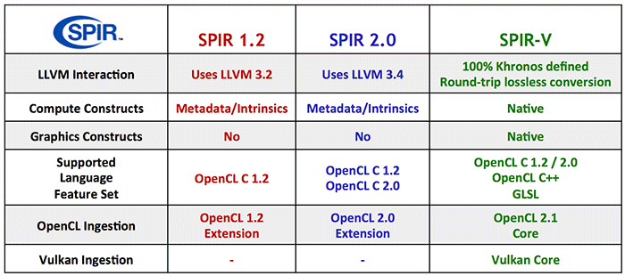
SPIR

Slide 7

SYCL
Single source C++ abstraction layer for OpenCL
Goal is to enable the creation of C++ libraries and frameworks that utilize OpenCL
Can utilize SPIR to target OpenCL platform
Supports ‘host-fallback’ (CPU) when no OpenCL devices available
Provisional specification released Mar’14, v1.2 final released at IWOCL 2015
Implementations:
Codeplay ComputeCpp Community Edition (free)
triSYCL (open source on GitHub)
More info: http://sycl.tech

Slide 8
SYCL talks at IWOCL
Heterogeneous Computing Using Modern C++ with OpenCL Devices (Wednesday at 9am)
Developer Feedback Session on OpenCL 2.x, SYCL and SPIR with the Khronos OpenCL working group (Wednesday 5.30pm)
Accelerated Machine Learning Using TensorFlow and SYCL on OpenCL Devices (Thursday 4.30pm)

Slide 9
Libraries
clFFT/clBLAS/clRNG (all on GitHub)
Arrayfire (on GitHub)
Boost compute with VexCL
ViennaCL (PETSc), PARALUTION
Lots more - see the Khronos OpenCL pages:
https://www.khronos.org/opencl/resources
Notes:
libraries

Slide 10
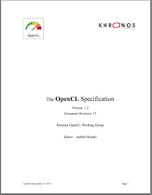
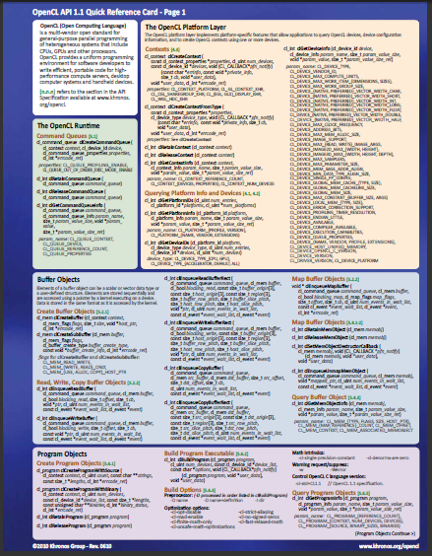


Resources: https://www.khronos.org/opencl/
The OpenCL specification
Surprisingly approachable for a spec!
https://www.khronos.org/registry/cl/
OpenCL reference card
Useful to have on your desk(top)
Available on the same page as the spec.
OpenCL Programming Guide:
Aaftab Munshi, Benedict Gaster, Timothy G. Mattson and James Fung, 2011
Heterogeneous Computing with OpenCL
Benedict Gaster, Lee Howes, David R. Kaeli, Perhaad Mistry and Dana Schaa, 2011

Slide 11
Hands On OpenCL
http://handsonopencl.github.io
One of the most popular OpenCL training courses on the web
Completely open source (creative commons attribution CC BY license)
Downloaded over 11,000 times so far!
Lots of training material, examples and solutions, source code etc.
Works on Linux, Windows, OSX etc.

Slide 12
Other useful resources
Lots of OpenCL examples in the SDKs from the vendors:
AMD, Intel, Nvidia, …
The BabelStream benchmark:
http://uob-hpc.github.io/BabelStream/
The SHOC OpenCL/CUDA benchmark suite (available as source code):
https://github.com/vetter/shoc/wiki

Slide 13
Other useful resources
IWOCL webpage & newsletter:
http://www.iwocl.org
http://www.iwocl.org/signup-for-updates/
IWOCL annual conference
May each year

Slide 14
Some Concluding remarks

Slide 15
Conclusion
OpenCL has increasingly widespread industrial support
OpenCL defines a platform-API/framework for heterogeneous parallel computing, not just GPGPU or CPU-offload programming
OpenCL has the potential to deliver portably performant code; but it has to be used correctly
The latest APIs such as C++ and Python make developing OpenCL programs much simpler than before
OpenCL is the only parallel programming standard that enables mixing task parallel and data parallel code in a single program while load balancing across ALL of the platform’s available resources.

Slide 16
Versions of opencl

Slide 17
OpenCL 1.0
First public release, December 2008

Slide 18
OpenCL 1.1
Released June 2010
Major new features:
Sub buffers
User events
More built-in functions
32-bit atomics become core features

Slide 19
OpenCL 1.2
Released November 2011
Major new features:
Custom devices and built-in kernels
Device partitioning
Support separate compilation and linking of programs
Greater support for OpenCL libraries

Slide 20
OpenCL 2.0
Released November 2013
Major new features:
Shared virtual memory (SVM)
Dynamic parallelism
Pipes
Built-in reductions/broadcasts
Sub-groups
"generic" address space
C11 atomics
More image support

Slide 21
OpenCL 2.1
OpenCL 2.1 was released in Nov’15
Brings several important new features:
SPIR-V in core
Subgroups in core
clCloneKernel
Low-latency device timers
Specification and headers available here
Drivers starting to appear, with more expected to follow

Slide 22
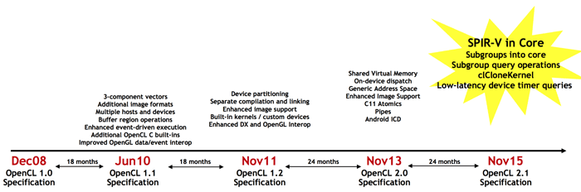
OpenCL progression

