Slide 1
Advanced OpenCL Topics: OpenCL on FPGAs

Slide 2
OpenCL on FPGAs
FPGA architectures are very different from GPUs and CPUs
Requires a completely different approach to achieve good performance
On CPUs/GPUs, you want lots of parallelism: i.e. lots of work-items and work-groups
For FPGAs, you want just a few work-items, each representing a long pipeline

Slide 3
What are FPGAs?
Reprogrammable hardware
Integrate huge numbers of lookup tables (LUTs), registers, on-chip memories, and arithmetic hardware (e.g. DSP blocks)
These on-chip resources are connected through a reconfigurable network
Traditionally programmed through a very low-level hardware description language
VHDL or Verilog

Slide 4
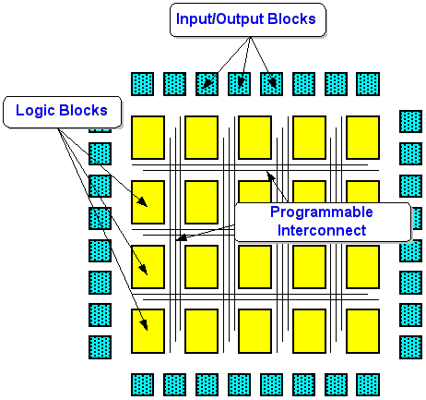
FPGA architecture
Source: http://www.fpga-site.com/faq.html

Slide 5
Compiling OpenCL into hardware
size_t index = get_global_id(0);
C[index] = (A[index] >> 5) + B[index];
F[index] = (D[index] – E[index]) << 3;
G[index] = C[index] + F[index];
The Altera Offline Compiler (AOC) provides a custom pipeline structure that speeds up computation by allowing operations within a large number of work-items to occur concurrently. The AOC can create a custom pipeline that calculates the values for variables C, F and G every clock cycle, as shown below. After a ramp-up phase, the pipeline sustains a throughput of one work-item per cycle.
Source: Altera SDK for OpenCL: Best practices guide

Slide 6
FPGA optimisation tips
Create single work-item kernels if:
You cannot break down an algorithm into separate work-items easily because of data dependencies that arise when multiple work-items are in flight.
You organize your OpenCL application in multiple kernels, you use channels to transfer data among the kernels, and the data processing sequence is critical to your application.
Equivalent to an NDRange size of (1, 1, 1)

Slide 7
Single work-item kernels
In this approach, the FPGA OpenCL compiler will attempt to pipeline the work-item
Special care needed to ensure the compiler can pipeline loops

Slide 8
More tips for FPGA optimisation
Optimize each kernel to target a single compute unit first
Then scale the number of compute units up until you've filled the FPGA
Compiling with fewer compute units takes much less FPGA compilation time
Consider moving data between kernels using OpenCL pipes or vendor extensions such as channels
Unrolling loops can help FPGA OCL compilers
e.g. #pragma unroll 8
Optimise floating point operations
Avoid expensive operations
Allocate memory aligned to at least 64 bytes
Use restrict to avoid pointer aliasing
Avoid work-item ID-dependent backward branching

Slide 9
Using pipes and channels
Source: Altera SDK for OpenCL: Best practices guide

Slide 10
Optimising floating point
Giving the FPGA OpenCL compiler more freedom regarding IEEE compliance can make a huge difference in performance
Key compiler flags include:
--fp-relaxed : compiler can change order of ops
--fpc : minimise type conversions and combine multiple rounding operations into one. Results in use of FMAC type instructions
Fixed point even better than floating point on FPGAs, can pack in more execution units
OpenCL supports 8, 16, 32 and 64-bit fixed point

Slide 11
Operation costs on FPGAs
Expensive operations include:
Integer division and modulo (remainder) operators
Most floating-point operators except addition, multiplication, absolute value, and comparison
Atomic functions
In contrast, cheap operations include:
Binary logic operations such as AND, NAND, OR, NOR, XOR, and XNOR
Logical operations with one constant argument
Shift by constant
Integer multiplication and division by a constant that is a power of two
Source: Altera SDK for OpenCL: Best practices guide

Slide 12
Other FPGA kernel tips
Use well-formed loops
These have an exit condition that compares against an integer bound, and have a simple induction increment of one per iteration
Avoid pointer arithmetic, use simple array indexing instead
Avoid complex loop exit conditions
Convert nested loops into a single loop
Declare variables in the deepest scope possible

Slide 13
OpenCL on FPGA summary
You'll probably need completely different kernels for optimal performance on an FPGA
Still uses the same overall OpenCL host infrastructure though
In theory, OpenCL supports using CPUs, GPUs, DSPs and FPGAs all at the same time…

Slide 14
Useful resources
Altera:
https://www.altera.com/products/design-software/embedded-software-developers/opencl/documentation.html#Guides
https://www.altera.com/en_US/pdfs/literature/hb/opencl-sdk/aocl-best-practices-guide.pdf
Xilinx:
http://www.xilinx.com/products/design-tools/software-zone/sdaccel.html#documentation

