Slide 1
Advanced OpenCL Topics - Host-DEVICE Interactions
Lecture 8

Slide 2
Platform discovery
A machine may have any number of OpenCL platforms
Each with their own devices
Some devices may even be aliases across platforms (CPU, usually)
How can you reliably pick your devices?

Slide 3
Hard coding
Only good if you know what machine your code will always run on
Simplest to implement
Often this simple approach is good enough
//get platforms
cl_platform_id platforms[2];
clGetPlatformIDs(1,platforms,NULL);
//get devices from the first platform
cl_device_id devices[3];
clGetDeviceIDs(platforms[0], CL_DEVICE_TYPE_ALL,3,devices,NULL);
//create context from the last device
return clCreateContext(NULL, 1, &devices[2], NULL, NULL, NULL);

Slide 4
Selection
Pass platform & device numbers in command line (with sane defaults)
Much more flexible
Needs more code..
Also beware – cl_uint is used for device cardinality
cl_context getDevice
(int plat_num, int dev_num)
{
//get number of platforms, devices
cl_uint num_platforms;
clGetPlatformIDs(0, NULL, &num_platforms);
cl_platform_id platforms[num_platforms];
clGetPlatformIDs(num_platforms, platforms, NULL);
cl_uint num_devices;
clGetDeviceIDs(platforms[plat_num], CL_DEVICE_TYPE_ALL, 0, NULL, &num_devices);
cl_device_id devices[num_devices];
clGetDeviceIDs(platforms[plat_num], CL_DEVICE_TYPE_ALL, num_devices, devices,NULL);
//remember: check ids are in range..
return clCreateContext(NULL,1,&devices[dev_num], NULL, NULL, NULL);
}

Slide 5
Selection
Give each platform/device a unique number
Pass a single argument
Much cleaner
But requires quite a bit more code
# alternatively, in python, this
# triggers interactive device
# selection (no C required!)
pyopencl.create_some_context(True)

Slide 6
Pinned Memory
In general, the fewer transfers you can do between host and device, the better
But some are unavoidable
It is possible to speed up these transfers, by using pinned memory (also called page-locked memory)
If supported, can enable much faster host <-> device communications

Slide 7
Pinned Memory
A regular enqueueRead/enqueueWrite command might manage ~6GB/s
But PCI-E Gen 3.0 can sustain transfer rates of up to 16GB/s
So, where has our bandwidth gone?
The operating system
Why? Let's consider when memory is actually allocated…

Slide 8
Malloc Recap
Consider a laptop which has 16GB of RAM.
What is the output of the code on the right if run on this laptop?
Bonus Question: if compiled with –m32, what will the output be?
#include <stdlib.h>
#include <stdio.h>
int
main
(int argc, char **argv)
{
//64 billion floats
size_t len = 64 * 1024*1024*1024;
//256GB allocation
float *buffer = malloc(len*sizeof(float));
if (NULL == buffer)
{
fprintf(stderr, "malloc failed\n");
return 1;
}
printf("got ptr %p\n", buffer);
return 0;
}

Slide 9
% gcc test.c -o test
% ./test
got ptr 0x7f84b0c03350

Slide 10
Malloc Recap
A non-NULL pointer was returned
Both OS X and Linux will oversubscribe memory
When will this memory actually get allocated?
Checking the return value of malloc/calloc is useless – malloc never* returns NULL!
#include <stdlib.h>
#include <stdio.h>
int
main
(int argc, char **argv)
{
//64 billion floats
size_t len = 64 * 1024*1024*1024;
//256GB allocation
float *buffer = malloc(len*sizeof(float));
if (NULL == buffer)
{
fprintf(stderr, "malloc failed\n");
return 1;
}
printf("got ptr %p\n", buffer);
return 0;
}
* This might not be true for an embedded system

Slide 11
Malloc Recap
This program does not actually allocate any memory
We call malloc, but we never use it!
#include <stdlib.h>
#include <stdio.h>
int
main
(int argc, char **argv)
{
size_t len = 16 * 1024*1024;
float *buffer = malloc(len*sizeof(float));
return 0;
}

Slide 12
Malloc Recap
So what happens here?
The pointer we got back, when accessed, will trigger a page fault in the kernel.
The kernel will then allocate us some memory, and allow us to write to it.
But how much was allocated in this code? Only 4096 bytes (one page)
#include <stdlib.h>
#include <stdio.h>
int
main
(int argc, char **argv)
{
size_t len = 16 * 1024*1024;
float *buffer = malloc(len*sizeof(float));
buffer[0] = 10.0f;
return 0;
}

Slide 13
Malloc Recap
4KB pages will be allocated at a time, and can also be swapped to disk dynamically
In fact, an allocation may not even be contiguous
So, enqueueRead/enqueueWrite must incur an additional host memory to host memory copy, wasting bandwidth and costing performance

Slide 14
EnqueueWrite:
Allocate contiguous portion of DRAM
Copy host data into this contiguous memory
Signal the DMA engines to start the transfer
EnqueueRead:
Allocate contiguous portion of DRAM
Signal DMA engine to start transfer
Wait for interrupt to signal that the transfer has finished
Copy transferred data from the contiguous memory into memory in the host code’s address space

Slide 15
Pinned memory side-steps this issue by giving the host process direct access to the portions of host memory that the DMA engines read and write to.
This results in much less time spent waiting for transfers!
Disclaimer: Not all drivers support it, and it makes allocations much more expensive (so it would be slow to continually allocate and free pinned memory)

Slide 16
Using Pinned Memory
// create device buffer
cl::Buffer d_buffer(
context,
CL_MEM_READ_WRITE | CL_MEM_ALLOC_HOST_PTR,
bufferSize);
// map buffer
float *h_ptr =
(float *) queue.enqueueMapBuffer(
d_buffer, // device buffer
CL_TRUE, // blocking map
CL_MAP_READ, // read data*
0, // offset of region
bufferSize, // amount of data to be mapped
);
// use buffer
// unmap buffer
queue.enqueueUnmapMemObject(d_buffer, h_ptr);
OpenCL has no official support for pinned memory
But e.g. NVIDIA supports pinned memory allocations (CL_MEM_ALLOC_HOST_PTR flag)
When you allocate a cl_mem object, you also allocate page-locked host memory of the same size
But this does not return the host pointer
Reading and writing data is handled by enqueueMapBuffer, which does return the host pointer
Eventually call clEnqueueUnmapMemObject when you're done
*Can be CL_MAP_READ, CL_MAP_WRITE or CL_MAP_WRITE_INVALIDATE_REGION (OpenCL 1.2).
Notes:
Also relevant for zero copy etc in presence of shared memory

Slide 17
Caveats
Again, allocating pinned memory is much more expensive (about 100x slower) than regular memory, so frequent allocations will be bad for performance.
However, frequent reads and writes will be much faster!
Not all platforms support pinned memory. But, the above method will still work, and at least will not be any slower than regular use

Slide 18
Multiple Devices
Running across multiple devices can deliver better performance (if your problem scales well)
Remember, the cost of moving data to/from a device are much greater than normal memcpys, so avoid where possible
There are several options for using multiple devices

Slide 19
Multiple Contexts
The simplest method – just call clCreateContext multiple times, with a different device id.
This is only useful if you don’t need to move data between devices – clEnqueueCopyBuffer can’t work with memory objects created in different contexts

Slide 20
Multiple Command Queues
clCreateContext can support more than one device, although only within the same platform.
This allows copies between devices.
However, there must be a separate command queue for each device in the context.

Slide 21
OpenCL & MPI
Using MPI, it is possible to use multiple devices.
Typically, each MPI process gets a single device.
This allows any number of OpenCL devices.
However, moving memory between them can be very expensive.

Slide 22
Halo Exchange
If you can split your problem up into regions, then the edges must be synchronized across devices
OpenCL allows for copying rectangular regions of a 3D buffer with clEnqueueReadBufferRect/writeBufferRect
This is good approach to get something working; however, in practice this method is usually quite slow
A much better alternative is to write kernels that will pack/unpack buffer regions into contiguous chunks that can be read directly, although this is much more complicated

Slide 23
Exercise 9: Fast host-device data transfers
Start with the HostDevTransfer project
Improve the performance of the host-to-device data transfers by using mapped memory
Experiment with different sized buffers
Experiment with different devices
An example solution will be provided

Slide 24
Profiling OpenCL Code
Lecture 9

Slide 25
Profiling
It’s hard to tell whether code will run fast just by looking at it, especially with low level OpenCL/CUDA
Bad performance is a bug
Problems might not be in kernels:
Enqueueing clFinish after kernel calls
Inappropriate work group size for architecture
Slow memory copying between device and host
How do we tell where the bottlenecks are?
Notes:
Hard to tell how good performance is going to be even if you know the kernel is relatively well optimised

Slide 26
OpenCL events
Every enqueued command returns an event object, which can be used to gather basic profiling information
Need to enable profiling in the command queue:
cl::CommandQueue(context, CL_QUEUE_PROFILING_ENABLE);
Capture the event from the command
cl::Event event = kernel(cl::EnqueueArgs(queue, global), …);
or
queue.enqueueReadBuffer(d_data, CL_FALSE,
0, sz, h_data, NULL, &event);
Query the start and end times from the event
// Ensure command has finished
event.wait();
// Get start and end timestamps (in nanoseconds)
cl_ulong start, end;
event.getProfilingInfo(CL_PROFILING_COMMAND_START, &start);
event.getProfilingInfo(CL_PROFILING_COMMAND_END, &end);
// Compute time taken (in milliseconds)
double time_taken = (end-start)*1.0e-6;
Notes:
Simple example, most people might already know. Should work everywhere

Slide 27
Profiling tools
Intel's offline compiler shows whether your kernel is being vectorised for the target device – if it can’t vectorise it, then it won’t run well!
Intel's VTune shows memory use, parallelism, instructions taken etc. for OpenCL kernels, and has source level profiling
Old versions of NVIDIA's nvvp show memory bandwidth, occupancy, etc.
AMD's CodeXL provides similar functionality for AMD hardware
ARM's DS-5 is another similar tool
Notes:
Mention lots of tools for profiling, ecosystem is better than it was. Nvvp might be able to be coerced to provide profiling information, codexl/ds-5 I’m not sure

Slide 28
Extrae and Paraver
From Barcelona Supercomputing Center
http://www.bsc.es/computer-sciences/performance-tools/trace-generation
http://www.bsc.es/computer-sciences/performance-tools/paraver
Create and analyze traces of OpenCL programs
Also MPI, OpenMP
Required versions:
Extrae v2.3.5rc
Paraver 4.4.5

Slide 29
Extrae and Paraver
Extrae instruments your application and produces “timestamped events of runtime calls, performance counters and source code references”
Allows you to measure the run times of your API and kernel calls
Paraver provides a way to view and analyze these traces in a graphical way

Slide 30
Important!
At the moment NVIDIA® GPUs support up to OpenCL v1.1 and AMD® and Intel® support v1.2 or later
If you want to profile on NVIDIA® devices you must compile Extrae against the NVIDIA headers and runtime otherwise v1.2 code will be used by Extrae internally which will cause the trace step to segfault

Slide 31
Installing Extrae and Paraver
Paraver is easy to install on Linux
Just download and unpack the binary
Extrae has some dependencies, some of which you’ll have to build from source
libxml2
binutils-dev
libunwind
PAPI
MPI (optional)
Use something like the following command line to configure before “make && make install”:
./configure –-prefix=$HOME/extrae --with-binutils=$HOME --with-papi=$HOME --with-mpi=$HOME --without-dyninst --with-unwind=$HOME --with-opencl=/usr/local/ --with-opencl-libs=/usr/lib64

Slide 32
Step 1 – tracing your code
Copy the trace.sh script from extrae/share/example/OPENCL to your project directory
This sets up a few environment variables and then runs your compiled binary
Copy the extrae.xml file from the same location to your project directory
This gives some instructions to Extrae as to how to profile your code
Lots of options here – see their user guide
The default they provide is fine to use to begin with
Trace!
./trace.sh ./a.out

Slide 33
Step 2 – visualize the trace
Extrae produces a number of files
.prv, .pcf, .row, etc…
Run Paraver
./wxparaver-<version>/bin/wxparaver
Load in the trace
File –> Load Trace -> Select the .prv file
Load in the provided OpenCL view config file
File -> Load configuration -> wxparaver-<version>/cfgs/OpenCL/views/opencl_call.cfg
The traces appear as three windows
OpenCL call in host - timings of API calls
Kernel Name – run times of kernel executions
OpenCL call in accelerator – information about total compute vs memory transfer times

Slide 34
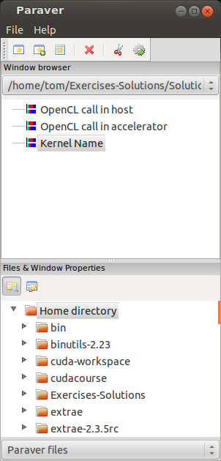
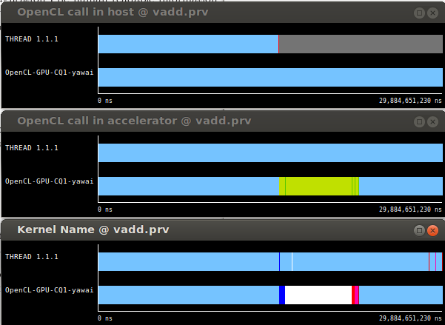
Paraver

Slide 35
Usage Tips
Show what the colours represent
Right click -> Info Panel
Zoom in to examine specific areas of interest
Highlight a section of the trace to populate the timeline window
Tabulate the data – numerical timings of API calls
Select a timeline in the Paraver main window, click on the ‘New Histogram’ icon and select OK
Powerful software – can also pick up your MPI communications
Perform calculations with the data – see the Paraver user guide

Slide 36
Platform specific profilers
More information can be obtained about your OpenCL program by profiling it using the hardware vendors dedicated profilers
OpenCL profiling can be done with Events in the API itself for specific profiling of queues and kernel calls

Slide 37
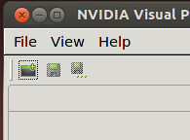
NVIDIA Visual Profiler®
This gives us information about:
Device occupancy
Memory bandwidth(between host and device)
Number of registers uses
Timeline of kernel executions and memory copies
Etc…
Start a new session:
Follow the wizard, selecting the compiled binary in the File box (you do not need to make any code or compiler modifications). You can leave the other options as the default.
The binary is then run and profiled and the results displayed.
Third party names are the property of their owners.

Slide 38
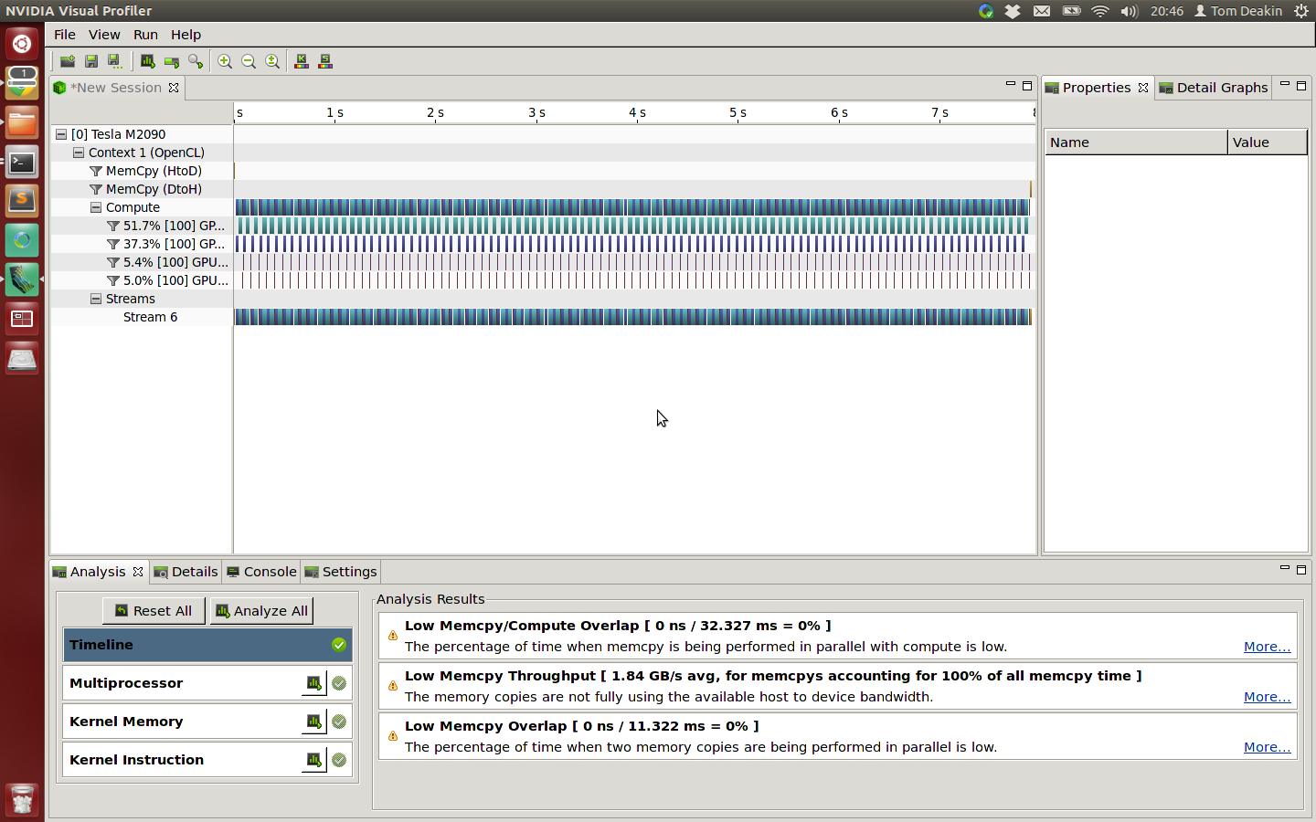
Profiling using nvvp
The timeline says what happened during the program execution:
Some things to think about optimising are displayed in the Analysis tab:
Each invocation of the kernel is pictured as a box
Kernels

Slide 39
Profiling using nvvp
The Details tab shows information for each kernel invocation and memory copy
number of registers used
work group sizes
memory throughput
amount of memory transferred
No information about which parts of the kernel are running slowly, but the figures here might give us a clue as to where to look
Best way to learn: experiment with an application yourself

Slide 40
NVIDIA® Nsight™
Visual Studio plugin
Simple tracing of API calls and enqueued commands
Visual timeline
Works with non-NVIDIA devices!
Can also profile OpenGL commands
Download here (registration required)

Slide 41
Profiling from the command line
NVIDIA® also have nvprof and 'Command Line Profiler’
nvprof available with CUDA™ 5.0 onwards, but currently lacks driver support for OpenCL profiling
The legacy command-line profiler can be invoked using environment variables:
$ export COMPUTE_PROFILE=1
$ export COMPUTE_PROFILE_LOG=<output file>
$ export COMPUTE_PROFILE_CONFIG=<config file>
Config file controls which events to collect (run nvprof --query-events for a comprehensive list)
Run your application to collect event information and then inspect output file with text editor
Can also output CSV information (COMPUTE_PROFILE_CSV=1) for inspection with a spreadsheet or import into nvvp (limited support)
Third party names are the property of their owners.

Slide 42
AMD® CodeXL
AMD provide a graphical Profiler and Debugger for AMD Radeon™ GPUs
Available for download
Can give information on:
API and kernel timings
Memory transfer information
Register use
Local memory use
Wavefront usage
Hints at limiting performance factors
Third party names are the property of their owners.

Slide 43
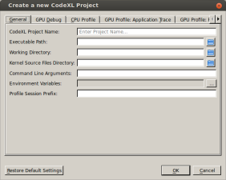
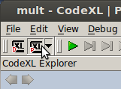
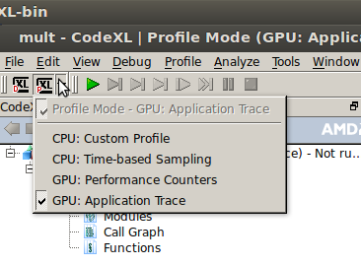
CodeXL
Create a new project, inserting the binary location in the window
Click on the Profiling button, and hit the green arrow to run your program
Select the different traces to view associated information

Slide 44
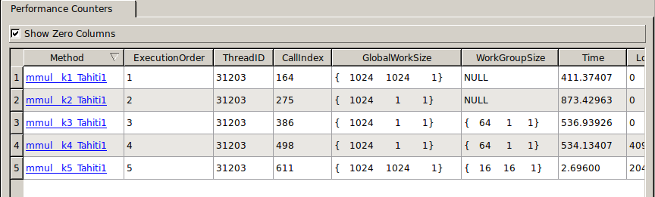
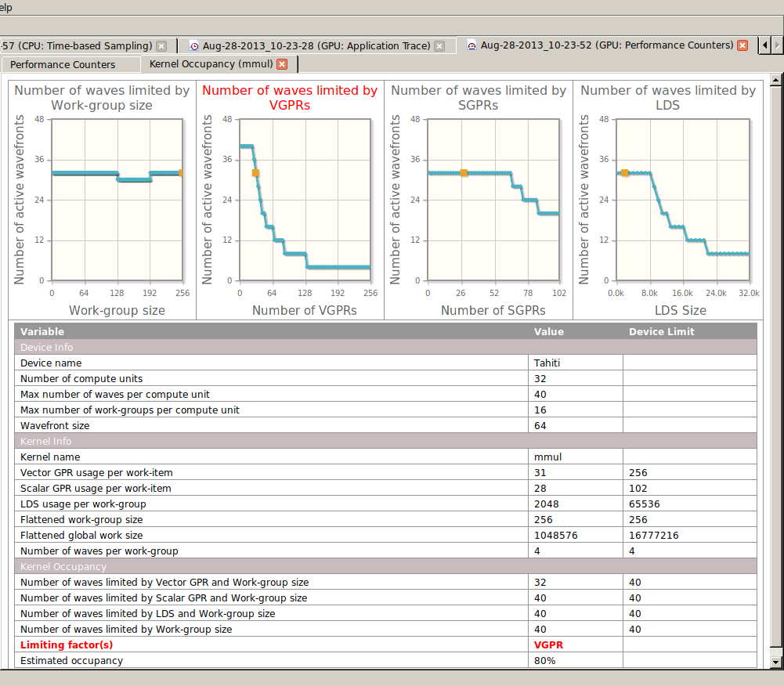
CodeXL
GPU: Performance Counters
Information on kernels including work group sizes, registers, etc.
View the kernel instruction code
Click on the kernel name in the left most column
View some graphs and hints about the kernel
Click on the Occupancy result

Slide 45
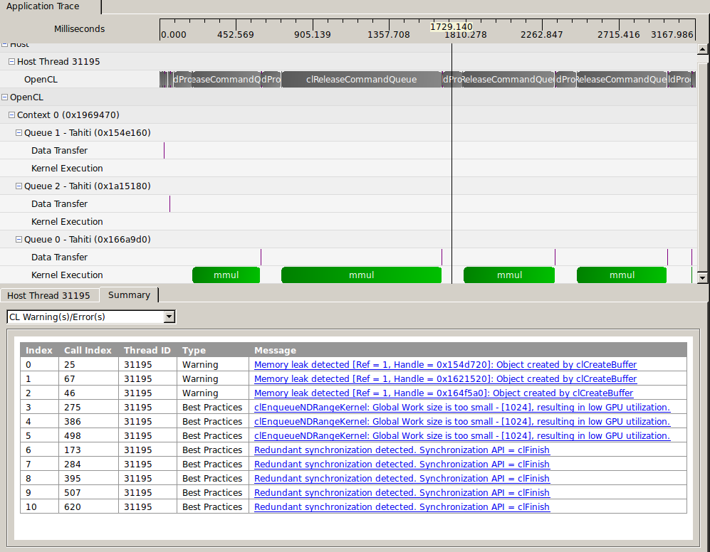
CodeXL
GPU: Application Trace
See timing information about API calls
Timings of memory movements
Timings of kernel executions

Slide 46
Intel vTune
https://software.intel.com/en-us/intel-vtune-amplifier-xe
Commercial product (30-day free trial)
Detailed analysis of OpenCL kernels running on CPUs, GPUs and Xeon Phi
Visual timelines
Hotspot analysis
Hardware counters
Lots more!
More details about profiling Intel GPUs

Slide 47
Debugging OpenCL
Lecture 10

Slide 48
Debugging OpenCL 1.1
Top tip:
Write data to a global buffer from within the kernel
result[ get_global_id(0) ] = … ;
Copy back to the host and print out from there or debug as a normal serial application
Works with any OpenCL device and platform

Slide 49
Debugging OpenCL – more tips
Check your error messages!
If you enable Exceptions in C++ as we have here, make sure you print out the errors.
Don’t forget, use the err_code.h from the tutorial to print out errors as strings (instead of numbers), or check in the cl.h file in the include directory of your OpenCL provider for error messages

Slide 50
printf
OpenCL 1.2* defines printf as a built-in function available within kernels
Useful to perform quick sanity checks about intermediate values
Remember that the kernel is potentially being executed by lots of work-items
Output order is undefined
Guard with if(get_global_id(0) == …) to inspect a specific work-item (adjust for 2D/3D )
* printf is also available as an extension for some 1.1 or earlier implementations

Slide 51
Debugging with GDB
GDB works with OpenCL running on the CPU with AMD® or Intel® runtimes
Useful for stepping through kernel execution, and catching some illegal memory accesses
Can be a bit fiddly to get working, and requires different setup instructions for each platform

Slide 52
Using GDB with Intel®
Ensure you select the CPU device from the Intel® platform
Enable debugging symbols and add the absolute path to the kernel source code when building the kernels:
clBuildProgram(… "–g –s /path/to/kernel.cl" …);
The symbolic name of a kernel function ‘kernel void foo(args)’ will just be foo
To set a breakpoint on kernel entry enter at the GDB prompt:
break foo
This can only be done after the kernels have been built
On Windows, this functionality is provided via a graphical user interface inside Visual Studio
Third party names are the property of their owners.

Slide 53
Using GDB with AMD®
Ensure you select the CPU device from the AMD® platform
Enable debugging symbols and turn off all optimizations when building the kernels:
clBuildProgram(… "–g –O0" …);
The symbolic name of a kernel function ‘kernel void foo(args)’ will be __OpenCL_foo_kernel
To set a breakpoint on kernel entry enter at the GDB prompt:
break __OpenCL_foo_kernel
This can only be done after the kernels have been built
AMD® recommend setting the environment variable CPU_MAX_COMPUTE_UNITS=1 to ensure deterministic kernel behaviour
Third party names are the property of their owners.

Slide 54
CodeXL
Provides the ability to debug OpenCL kernels running on the GPU
Step through kernel source
Inspect variables across work-items and work-groups
Display contents of buffers and images
Allows applications to be debugged on remote machines

Slide 55
Intel® INDE
Starter Edition is free to download
Contains OpenCL Code Builder (SDK)
Visual Studio plugin for debugging
Offline compiler for analysis
Usage information

Slide 56
GPUVerify
A useful tool for detecting data-races in OpenCL programs
Developed at Imperial College as part of the CARP project
Uses static analysis to try to prove that kernels are free from races
Can also detect issues with work-group divergence
More information on the GPUVerify Website
gpuverify --local_size=64,64 --num_groups=256,256 kernel.cl

Slide 57
Oclgrind
A SPIR interpreter and OpenCL simulator
Developed at the University of Bristol
Runs OpenCL kernels in a simulated environment to catch various bugs:
oclgrind ./application
Invalid memory accesses
Data-races (--data-races)
Work-group divergence
Runtime API errors (--check-api)
Also has a GDB-style interactive debugger
oclgrind –i ./application
More information on the Oclgrind Website

Slide 58
Exercise 10: Profiling and Debugging OpenCL programs
Goal:
To experiment with profiling and debugging tools
Procedure:
Take one of your OpenCL programs, such as matrix multiply or host<->device transfer
Run the program in the profiler and explore the results
Modify the program to change the performance in some way and observe the effect with the profiler
Repeat with other programs if you have time, such as a debugger, GPUverify, Oclgrind etc.

Slide 59
Advanced Topics in OpenCL – Kernel Issues
Lecture 10

Slide 60
Shipping OpenCL Kernels
OpenCL applications rely on just-in-time (JIT) compilation in order to achieve portability
Shipping source code with applications can be an issue for commercial users of OpenCL
There are a few ways to try and hide your OpenCL kernels from end users

Slide 61

Encrypting OpenCL Source
One approach is to encrypt the OpenCL source, and decrypt it at runtime just before passing it to the OpenCL driver
This could achieved with a standard encryption library, or by applying a simple transformation such as Base64 encoding
This prevents the source from being easily read, but it can still be retrieved by intercepting the call to clCreateProgramWithSource()
Obfuscation could also be used to make it more difficult to extract useful information from the plain OpenCL kernel source

Slide 62
Precompiling OpenCL Kernels
OpenCL allows you to retrieve a binary from the runtime after it is compiled, and use this instead of loading a program from source
This means that we can precompile our OpenCL kernels and ship the binaries with our application (instead of the source code)

Slide 63
Precompiling OpenCL Kernels
Retrieving the binary (single device):
// Create and compile program
program = clCreateProgramWithSource(context, 1, &kernel_source, NULL, &err);
clBuildProgram(program, 1, &device, "", NULL, NULL);
// Get compiled binary from runtime
size_t size;
clGetProgramInfo(program, CL_PROGRAM_BINARY_SIZES, sizeof(size), &size, NULL);
unsigned char *binary = malloc(size);
clGetProgramInfo(program, CL_PROGRAM_BINARIES, size, binary, NULL);
// Then write binary to file
…
Loading the binary
// Load compiled program binary from file
…
// Create program using binary
program = clCreateProgramWithBinary(context, 1, &device,
&size, &binary, NULL, &err);
err = clBuildProgram(prog, 1, &device, "", NULL, NULL);

Slide 64
Precompiling OpenCL Kernels
These binaries are only valid on the devices for which they are compiled, so we potentially have to perform this compilation for every device we wish to target
A vendor might change the binary definition at any time, potentially breaking our shipped application
If a binary isn’t compatible with the target device, an error will be returned either during clCreateProgramWithBinary() or clBuildProgram()

Slide 65
Portable Binaries (SPIR)
Khronos have produced a specification for a Standard Portable Intermediate Representation
This defines an LLVM-based binary format that is designed to be portable, allowing us to use the same binary across many platforms
Not yet supported by all vendors

Slide 66
Stringifying Kernel Source
We usually load our OpenCL kernel source code from file(s) at runtime
We can make things easier by using a script to convert OpenCL source files into string literals defined inside header files
This script then becomes part of the build process:
foo.h: foo.cl
./stringify_ocl foo.cl

Slide 67
Stringifying Kernel Source
This script makes use of SED to escape special characters and wrap lines in quotation marks
#!/bin/bash
IN=$1
NAME=${IN%.cl}
OUT=$NAME.h
echo "const char *"$NAME"_ocl =" >$OUT
sed -e 's/\\/\\\\/g;s/"/\\"/g;s/^/"/;s/$/\\n"/' \
$IN >>$OUT
echo ";" >>$OUT

Slide 68
Stringifying Kernel Source
Before stringification:
After stringification:
kernel void vecadd(
global float *a,
global float *b,
global float *c)
{
int i =
get_global_id(0);
c[i] = a[i] + b[i];
}
const char *vecadd_ocl =
"kernel void vecadd(\n"
" global float *a,\n"
" global float *b,\n"
" global float *c)\n"
"{\n"
" int i =\n"
" get_global_id(0);\n"
" c[i] = a[i] + b[i];\n"
"}\n"
;

Slide 69
Generating Assembly Code
Can be useful to inspect compiler output to see if the compiler is doing what you think it’s doing
On NVIDIA platforms the ‘binary’ retrieved from clGetProgramInfo() is actually PTX, their abstract assembly language
On AMD platforms you can add –save-temps to the build options to generate .il and .isa files containing the intermediate representation and native assembly code
Intel provide an offline compiler which can generate LLVM/SPIR or x86 assembly

Slide 70
Kernel Introspection
We can query a program object for the names of all the kernels that it contains:
clGetProgramInfo(…,
CL_PROGRAM_NUM_KERNELS, …);
clGetProgramInfo(…,
CL_PROGRAM_KERNEL_NAMES, …);
We can also query information about kernel arguments (OpenCL 1.2):
clGetKernelInfo(…, CL_KERNEL_NUM_ARGS, …);
clGetKernelArgInfo(…, CL_KERNEL_ARG_*, …);
(the program should be compiled using the
-cl-kernel-arg-info option)

Slide 71
Kernel Introspection
This provides a mechanism for automatically discovering and using new kernels, without having to write any new host code
Can make it much easier to add new kernels to an existing application
Provides a means for libraries and frameworks to accept additional kernels from third parties

Slide 72
Separate Compilation and Linking
OpenCL 1.2 gives more control over the build process by adding two new functions:
clCompileProgram()
clLinkProgram()
This enables the creation of libraries of compiled OpenCL functions, that can be linked to multiple program objects

Slide 73
Compiler Options
OpenCL compilers accept a number of flags that affect how kernels are compiled:
-cl-opt-disable
-cl-single-precision-constant
-cl-denorms-are-zero
-cl-fp32-correctly-rounded-divide-sqrt
-cl-mad-enable
-cl-no-signed-zeros
-cl-unsafe-math-optimizations
-cl-finite-math-only
-cl-fast-relaxed-math
implies

Slide 74
Compiler Flags
Vendors may expose additional flags to give further control over program compilation, but these will not be portable between different OpenCL platforms
For example, NVIDIA provide –cl-nv-arch to control which GPU architecture to target, and –cl-nv-maxrregcount to limit the number of registers used
Some vendors support –On flags to control the optimization level
AMD allow additional build options to be dynamically added using an environment variable: AMD_OCL_BUILD_OPTIONS_APPEND

Slide 75
Metaprogramming
We can exploit JIT compilation to embed values that are only know at runtime into kernels as compile-time constants
In some cases this can significantly improve performance
OpenCL compilers support the same preprocessor definition flags as GCC/Clang:
–Dname
–Dname=value

Slide 76
Example: Multiply a vector by a constant value
Passing the value as an argument
Defining the value as a preprocessor macro
Not known at application build time (e.g. passed as command-line argument)
kernel void vecmul(
global float *data,
const float factor)
{
int i = get_global_id(0);
data[i] *= factor; }
program.build("");
kernel void vecmul(
global float *data)
{
int i = get_global_id(0);
data[i] *= factor; }
std::stringstream options; options.setf(
std::ios::fixed,
std::ios::floatfield);
options << "-Dfactor=”
<< factor; program.build(options.str().c_str());

Slide 77
Metaprogramming
Can be used to dynamically change the precision of a kernel
Use REAL instead of float/double, then define REAL at runtime using OpenCL build options: –DREAL=type
Can make runtime decisions that change the functionality of the kernel, or change the way that it is implemented to improve performance portability
Switching between scalar and vector types
Changing whether data is stored in buffers or images
Toggling use of local memory
All of this requires that we are compiling our OpenCL sources at runtime – this doesn’t work if we are precompiling our kernels or using SPIR

Slide 78
Exercise 11: optimisations
The example is a simple N-Body code
At each timestep, each body experiences a gravitational force from every other body in the system
Each work-item computes the forces acting on a single body, and updates its velocity and position
A fully working (naïve) implementation of this code is provided as a starting point

Slide 79
Exercise 11: optimisations
Experiment with some OpenCL compiler options to improve performance
Try embedding some simulation parameters into the kernel as compile-time constants using OpenCL build options
This won’t help for every parameter
This won’t help on every device – try it on a few!
An example solution will be provided
Extras:
Add a command-line argument (e.g. --unroll) to dynamically control the amount of unrolling inside the kernel (replacing the static UNROLL_FACTOR definition)
Get the compiler to generate the assembly code and look through this, correlating it to your source code

Slide 80
Advanced OpenCL Topics - OPTIMISATION
Lecture 12

Slide 81
Fast Kernels
There's a tendency to overcomplicate OpenCL code
“GPUs are hard, therefore my code must be hard!”
Adding too many levels of indirection at the start is doomed to failure
Starting off with using local memory, trying to cache data yourself etc.
Modern runtimes and compilers are pretty smart!
Start simple. But once you have something working…

Slide 82
Performance portability
Obviously a very large field, but some basic concepts to keep in mind:
Don’t (over-) optimise specifically for one piece of hardware
Test on various platforms during development to make sure it actually works on different hardware
Profile (events should work everywhere!)
Notes:
Quick notes about it – mention paper?

Slide 83
OpenCL Memory Hierarchy
OpenCL has 4 address spaces
Kernels are “dumb” – data movement between address spaces will not happen automatically*
However, manual use can sometimes improve performance (if you know something the compiler or runtime does not!)

Slide 84
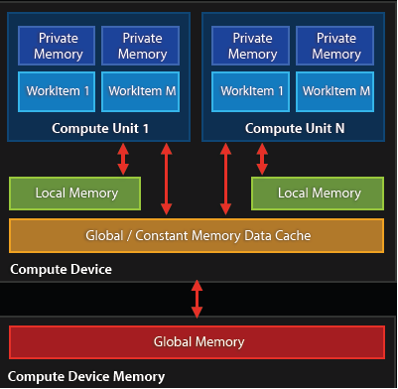
Private Memory
This is the default address space for variables defined in your kernel
Memory access time is the fastest at O(1) cycles.
But they are limited in numbers!

Slide 85
Private Memory
This is the default address space for variables defined in your kernel
Memory access time is the fastest at O(1) cycles
But they are limited in numbers!
Each variable maps to a register on the device of execution
But variables are not limited, they will be spilled into memory “somewhere” (usually global memory)
“Occupancy” must also be considered…
kernel void
calc_diff
(
global float *a,
global float *b,
global float *c
)
{
//”id” is in private memory
const int id = get_global_id(0);
c[id] = fabs(a[id] - b[id]);
}

Slide 86
Occupancy
E.g. NVIDIA’s K40 has 128 words of memory per processor element (PE), i.e. 128 registers per core
But, multiple work-items (threads) will be scheduled on a single PE (similar to hyperthreading)
In fact, global memory latency is so high that multiple work-items per PE are a requirement for achieving a good proportion of peak performance!
Probably want to aim for at least 4 work-items per PE, possibly more to achieve good performance

Slide 87
Local Memory
Local memory is the next level up from private
Still reasonably fast to access at O(10) cycles
Local memory is shared between work-items inside a local work-group
Ideal use-case is when there is lots of data that gets reused amongst threads within a work-group
It can be allocated either in the host, or inline in the kernel*
When used well, can result in significant performance increases
kernel void
calc_something
(
global float *a,
global float *b,
global float *c,
//this local memory is set by the host
local float *t
)
{
//kernels can also declare local memory
local float tmp[128];
//etc.
}

Slide 88
Global Memory
This is where data you want processed will be resident, and where output data will be written to
Global memory has long access latency, but high bandwidth (> 300GB/s on high-end GPUs!)
Latency can be mitigated via coalesced accesses
It’s often better to re-compute data than store it!
size_t len = 1024*1024 * sizeof(float);
float *hostPtrA = malloc(len);
//create device buffer
cl_mem devPtrA = clCreateBuffer(
context, //pointer to context
CL_MEM_READ_WRITE,//memory flags
len, //size of buffer (bytes)
NULL, //host pointer
NULL //error code pointer
);
clEnqueueWriteBuffer(
queue, //pointer to queue
devPtrA, //host pointer
CL_FALSE, //blocking write
0, //offset into device ptr
len, //number of bytes to write
hostPtrA, //host pointer
0, NULL, NULL //event list data
);

Slide 89
Coalesced Access
Coalesced memory accesses are key for high performance code
In principle, it’s very simple, but frequently requires transposing/transforming data on the host before sending it to the GPU
Sometimes this is an issue of AoS vs. SoA
Using sub buffers can help in this regard

Slide 90
Memory layout is critical to performance
“Structure of Arrays vs. Array of Structures” problem:
struct { float x, y, z, a; } Point;
Structure of Arrays (SoA) suits memory coalescence on GPUs
Array of Structures (AoS) may suit cache hierarchies on CPUs
Adjacent work-items like to access adjacent memory
x | x | x | x | … | y | y | y | y | … | z | z | z | z | … | a | a | a | a | …
Individual work-items like to access adjacent memory
x | y | z | a | … | x | y | z | a | … | x | y | z | a | … | x | y | z | a | …

Slide 91
Optimizations
Coalesce - to combine into one
Coalesced memory accesses are key for high bandwidth
Simply, it means, if thread i accesses memory location n then thread i+1 accesses memory location n+1
In practice, it’s not quite as strict…
__kernel func( __global float *memA, __global float *memB)
{
int g_id = get_global_id(0);
// ideal
float val1 = memA[g_id];
// still pretty good
const int c = 3;
float val2 = memA[g_id + c];
// stride size is not so good
float val3 = memA[c*g_id];
const int loc =
some_strange_func(g_id);
// terrible!
float val4 = memA[loc];
}

Slide 92
Memory access patterns
0
1
2
3
4
5
6
7
GPU Threads
0x0f4
0x0f8
0x0fc
0x100
0x104
0x108
0x10c
0x110
0x114
0x118
0x11c
0x120
0x124
0x128
64 Byte Boundary
GPU Memory
64 Byte Boundary

Slide 93
Memory access patterns
float val1 = memA[g_id];
0
1
2
3
4
5
6
7
0x0f4
0x0f8
0x0fc
0x100
0x104
0x108
0x10c
0x110
0x114
0x118
0x11c
0x120
0x124
0x128
64 Byte Boundary

Slide 94

Memory access patterns
const int c = 3;
float val2 = memA[g_id + c];
0
1
2
3
4
5
6
7
0x114
0x118
0x11c
0x120
0x124
0x128
0x12c
0x130
0x134
0x138
0x13c
0x140
0x144
0x148
64 Byte Boundary

Slide 95
Memory access patterns
float val3 = memA[3*g_id];
0
1
2
3
4
5
6
7
0x0f4
0x0f8
0x0fc
0x100
0x104
0x108
0x10c
0x110
0x114
0x118
0x11c
0x120
0x124
0x128
Strided access results in multiple
memory transactions (and
kills throughput)
64 Byte Boundary

Slide 96
Memory access patterns
const int loc =
some_strange_func(g_id);
float val4 = memA[loc];
0
1
2
3
4
5
6
7
0x0f4
0x0f8
0x0fc
0x100
0x104
0x108
0x10c
0x110
0x114
0x118
0x11c
0x120
0x124
0x128
64 Byte Boundary

Slide 97
Sub Buffers
If you have positional data, you may be tempted to create a structure with x,y,z coordinates
But when it comes to running on a GPU, this strided (AoS) access will be slower than contiguous (SoA) access
clCreateSubBuffer allows you to create a region within a pre-existing buffer, which could ease the process of converting data from AoS to SoA format

Slide 98
Constant Memory
Constant memory can be considered a store for variables that never change
Setting and updating constants in memory uses the same interface as global memory, with enqueueRead/enqueueWrite commands
The difference is how it is declared in the kernel
If a device has constant memory, upon kernel execution the data will be copied once from global
GPUs typically have ~64kB of constant memory
Can declare OpenCL program scope constant data, but this has to be initialized at OpenCL program compile time
kernel void
calc_something
(
global float *a,
global float *b,
global float *c,
//constant memory is set by the host
constant float *params
)
{
//code here
}

Slide 99
Work-groups
Work-group sizes being a power of 2 helps on most architectures. At a minimum:
8 for AVX CPUs
16 for Xeon Phi
32 for Nvidia
64 for AMD
May be different on different hardware
On most systems aim to run lots of work-groups. For example, on Xeon Phi, multiples of the number of threads available (e.g. 240 on a 5110P) is optimal, but as many as possible is good (1000+)
NULL work-group size (cl::NullRange) might be good!
Notes:
Work group sizes – maybe obvious. Mention opencl 2 padded work group sizes

Slide 100
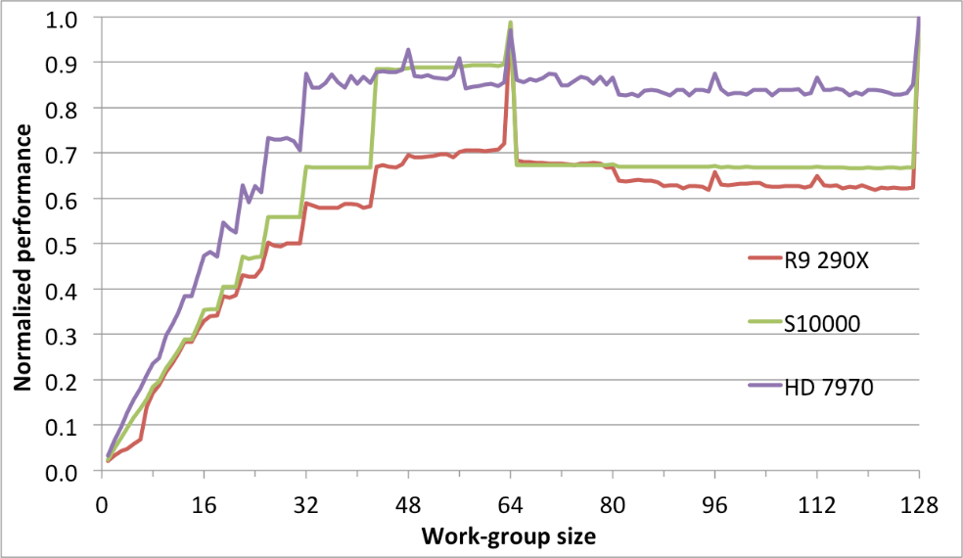
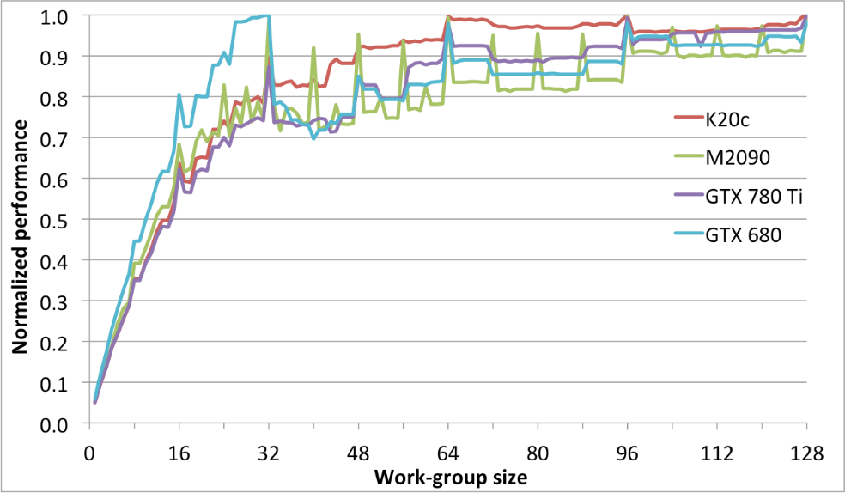
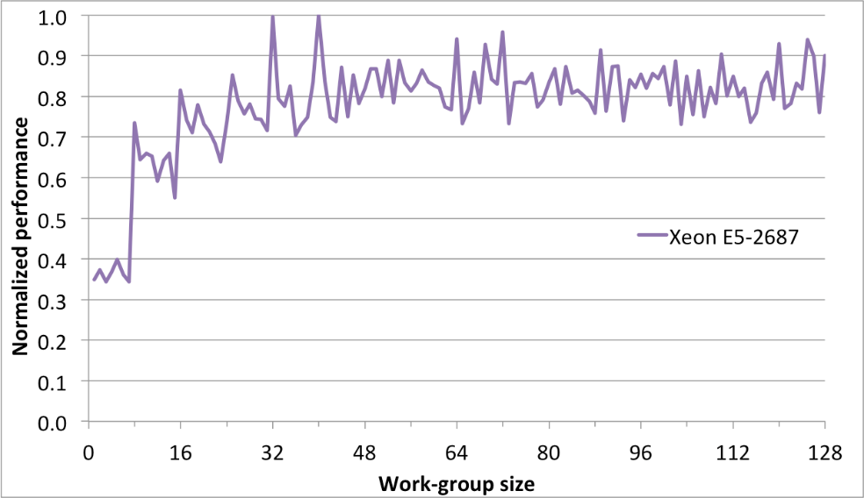
Effect of work-group sizes
Notes:
Results from our 2D lattice Boltzmann code, results from the ISC paper.
Top left is AMD, top right is Nvidia, bottom is Intel CPU.

Slide 101
Tuning Knobs some general issues to think about
Tiling size (work-group sizes, dimensionality etc.)
For block-based algorithms (e.g. matrix multiplication)
Different devices might run faster on different block sizes
Data layout
Array of Structures or Structure of Arrays (AoS vs. SoA)
Column or Row major
Caching and prefetching
Use of local memory or not
Extra loads and stores assist hardware cache?
Work-item / work-group data mapping
Related to data layout
Also how you parallelize the work
Operation-specific tuning
Specific hardware differences
Built-in trig / special function hardware
Double vs. float (vs. half)
From Zhang, Sinclair II and Chien: Improving Performance Portability in OpenCL Programs – ISC13

Slide 102
Auto tuning
Q: How do you know what the best parameter values for your program are?
What is the best work-group size, for example
A: Try them all! (Or a well chosen subset)
This is where auto tuning comes in
Run through different combinations of parameter values and optimize the runtime (or another measure) of your program.

Slide 103
Auto tuning example - Flamingo
http://mistymountain.co.uk/flamingo/
Python program which compiles your code with different parameter values, and calculates the “best” combination to use
Write a simple config file, and Flamingo will run your program with different values, and returns the best combination
Remember: scale down your problem so you don’t have to wait for “bad” values (less iterations, etc.)

Slide 104
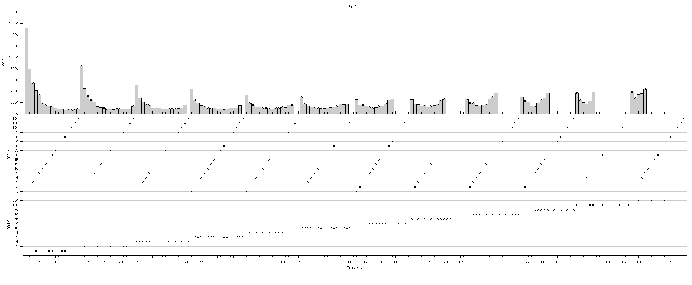
Auto tuning - Example
D2Q9 Lattice-Boltzmann
What is the best work-group size for a specific problem size (3000x2000) on a specific device (NVIDIA Tesla M2050)?
Best: 60x1
Runtimes – lower is better
X values
Y values

Slide 105
Thread throttling
Barriers between memory access-heavy kernel code sections might actually speed it up by helping the caches
Helps temporal locality of data
Architecture dependent
Notes:
Barriers between code for better cache use etc

Slide 106
Barrier example
left_flux = (xarea[THARR2D(0, 0, 1)]
* (xvel0[THARR2D(0, 0, 1)] + xvel0[THARR2D(0, 1, 1)]
+ xvel0[THARR2D(0, 0, 1)] + xvel0[THARR2D(0, 1, 1)]))
* 0.25 * dt * 0.5;
barrier(CLK_LOCAL_MEM_FENCE);
right_flux = (xarea[THARR2D(1, 0, 1)]
* (xvel0[THARR2D(1, 0, 1)] + xvel0[THARR2D(1, 1, 1)]
+ xvel0[THARR2D(1, 0, 1)] + xvel0[THARR2D(1, 1, 1)]))
* 0.25 * dt * 0.5;
barrier(CLK_LOCAL_MEM_FENCE);
bottom_flux = (yarea[THARR2D(0, 0, 0)]
* (yvel0[THARR2D(0, 0, 1)] + yvel0[THARR2D(1, 0, 1)]
+ yvel0[THARR2D(0, 0, 1)] + yvel0[THARR2D(1, 0, 1)]))
* 0.25 * dt * 0.5;
barrier(CLK_LOCAL_MEM_FENCE);
top_flux = (yarea[THARR2D(0, 1, 0)]
* (yvel0[THARR2D(0, 1, 1)] + yvel0[THARR2D(1, 1, 1)]
+ yvel0[THARR2D(0, 1, 1)] + yvel0[THARR2D(1, 1, 1)]))
* 0.25 * dt * 0.5;
Notes:
Example of the barriers which can speed up code by making a barrier between accessing different bits of memory.
From the CloverLeaf benchmark (2D structured grid code for Hydrodynamics).

Slide 107
Compilation hints
When using 2 or 3 dimensional work group sizes with a local size of 1 in some dimension, consider using get_group_id() instead of get_global_id()
Can specify the reqd_work_group_size attribute to hint to the compiler what you’re going to launch it with
As with C/C++, use the const/restrict keywords for the inputs where appropriate to make sure the compiler can optimise memory accesses (-cl-strict-aliasing in 1.0/1.1 as well)
Try to use unsigned types for indexing and branching
Notes:
Hints to compiler to make it go faster.

Slide 108
Vectorisation
OpenCL C provides a set of vector types:
type2, type3, type4, type8 and type16
Where type is any primitive data type
Than can be convenient for representing multi-component data:
Pixels in an image (RGBA)
Atoms or points (x, y, z, mass/type)
All the standard arithmetic operators and built-in math functions can be used on these types (and are applied component-wise)
There are also a set of built-in geometric functions for operating on these types (dot, cross, distance, length, normalize)

Slide 109
Vectorisation
In the past, several platforms required the use of these types in order to make use of their vector ALUs (e.g. AMD’s pre-GCN architectures and Intel’s initial CPU implementation)
This isn’t ideal: we are already exposing the data-parallelism in our code via OpenCL’s NDRange construct – we shouldn’t have to do it again!
These days, most OpenCL implementations target SIMD execution units by packing work-items into SIMD lanes – so we get the benefits of these vector ALUs for free (Intel calls this ‘implicit vectorisation’)

Slide 110
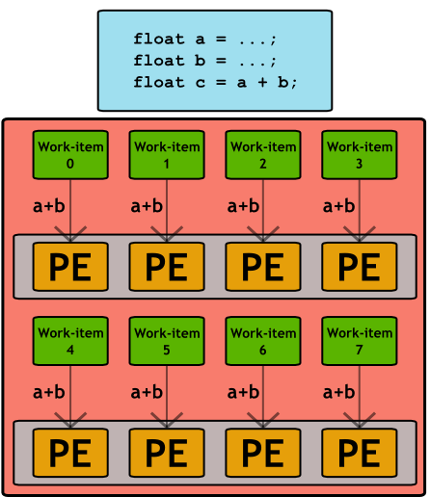
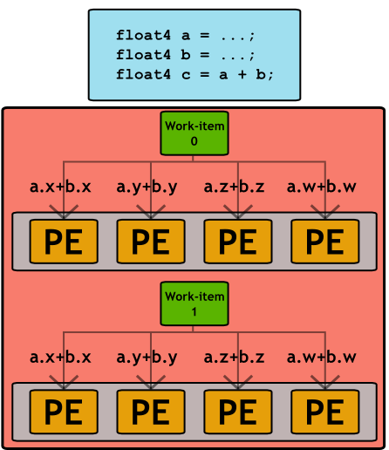
Vectorisation
Implicit vectorisation
Explicit vectorisation

Slide 111
Vectorisation
Unfortunately, some platforms still require explicit vectorisation, e.g.
ARM Mali GPUs
Qualcomm Adreno GPUs
As the architectures and compilers mature, we expect to see a continued shift towards simple, scalar work-items
You can query an OpenCL device to determine whether it prefers scalar or vector data types:
clGetDeviceInfo(…,
CL_DEVICE_PREFERRED_VECTOR_WIDTH_FLOAT,
…)

Slide 112
Branching
GPUs tend not to support speculative execution, which means that branch instructions have high latency
This latency can be hidden by switching to alternative work-items/work-groups, but avoiding branches where possible is still a good idea to improve performance
When different work-items executing within the same SIMD ALU array take different paths through conditional control flow, we have divergent branches (vs. uniform branches)
These are even worse: work-items will stall while waiting for the others to complete
We can use predication, selection and masking to convert conditional control flow into straight line code and significantly improve the performance of code that has lots of conditional branches

Slide 113
Branching
Conditional execution
Selection and masking
// Only evaluate expression
// if condition is met
if (a > b)
{
acc += (a - b*c);
}
Corresponding PTX
setp.gt.f32 %pred, %a, %b
@!%pred bra $endif
mul.f32 %f0, %b, %c
sub.f32 %f1, %a, %f0
add.f32 %acc, %acc, %f1
$endif:
// Always evaluate expression
// and mask result
temp = (a - b*c);
mask = (a > b ? 1.f : 0.f);
acc += (mask * temp);
Corresponding PTX
mul.f32 %f0, %b, %c
sub.f32 %temp, %a, %f0
setp.gt.f32 %pred, %a, %b
selp.f32 %mask, %one, %zero, %pred
mad.f32 %acc, %mask, %temp, %acc

Slide 114
Native Math Functions
OpenCL has a large library of built-in math functions (C99 + more), which have well defined precision requirements
Some of these functions also have native variants, which drop the precision requirements in favour of performance
These functions start with a native_ prefix, e.g. native_cos, native_log, native_rqsrt
If you can settle for reduced precision, then these functions can significantly improve performance
The geometric functions also have fast_ variants, e.g. fast_distance, fast_length

Slide 115
Half Precision
OpenCL provides a half precision data type
This can only be used as storage (global half *)
Must be accessed with vload_half and vstore_half
If the device supports cl_khr_fp16, you can also perform arithmetic on these types, and use the built-in math functions
There are also half_ variants of many of the math functions
Unlike the native_ functions, these do have well-defined precision requirements

Slide 116
Exercise 12
Try some of the more advanced optimisations on the N-Body kernel code
In particular, you should consider:
Experiment with work-group sizes
Caching positions in local memory (blocking)
Experiment with native math functions
An example solution with all of the above applied will be provided.

Slide 117
Advanced OpenCL Topics – Image Types
Lecture 13

Slide 118
Image Types
OpenCL provides a special type of memory object for representing image data
This is an optional feature, but is supported on almost all OpenCL platforms
These are stored in global memory, but are accessed from kernels via dedicated built-in functions
Can yield significant performance improvements by taking advantage of native GPU support for manipulating textures
Automatic handling for out-of-bounds accesses
Normalizing pixel values
Interpolating between pixels

Slide 119
Checking for Image Support
// Check if device supports images
cl_bool imageSupport;
device.getInfo
<CL_DEVICE_IMAGE_SUPPORT>(
&imageSupport
);
// Check maximum image dimensions
size_t maxWidth, maxHeight;
device.getInfo
<CL_DEVICE_IMAGE2D_MAX_WIDTH>(
&maxWidth
);
device.getInfo
<CL_DEVICE_IMAGE2D_MAX_HEIGHT>(
&maxHeight
);
// Get list of supported image formats
std::vector<cl::ImageFormat> formats;
context.getSupportedImageFormats(
CL_MEM_READ_WRITE,
CL_MEM_OBJECT_IMAGE2D,
&formats
);
Presence of image support can be queried with getDeviceInfo() and the CL_DEVICE_IMAGE_SUPPORT parameter
The runtime will define the preprocessor macro __IMAGE_SUPPORT__=1 when building programs if images are supported
Maximum image dimensions can be queried with getDeviceInfo()
Max for 2D must be at least 8192x8192
Max for 3D must be at least 2048x2048x2048
A list of image formats supported by the target device can be queried with getSupportedImageFormats()

Slide 120
Image Types – Host API
cl::ImageFormat format(
CL_RGBA, // channel order
CL_UNORM_INT8 // channel data type
);
cl::Image2D d_image(
context, // context object
CL_MEM_READ_ONLY, // memory access flags
format, // image format (above)
width, // image width
height, // image height
);
cl::size_t<3> origin;
origin[0] = origin[1] = origin[2] = 0;
cl::size_t<3> region;
region[0] = width;
region[1] = height;
region[2] = 1;
queue.enqueueWriteImage(
d_image, // image object
CL_TRUE, // blocking read
origin, // origin of write
region, // region to write
0, // image row pitch
0, // image slice pitch (3D only)
h_image, // host data
);
Image objects are created using the Image2D and Image3D types*
These functions take a cl::ImageFormat object which defines the data type and channel order for the image
Data is copied to/from the device with the enqueueWriteImage and enqueueReadImage functions, or enqueueMapImage
Data can be copied to/from regular buffers with enqueueCopyImageToBuffer and enqueueCopyBufferToImage
*These are deprecated in OpenCL 1.2 onwards, and have been replaced with a single Image type

Slide 121
Image Formats
Data types
Channel orders
CL_SNORM_INT8
CL_SNORM_INT16
CL_UNORM_INT8
CL_UNORM_INT16
CL_UNORM_SHORT_565
CL_UNORM_SHORT_555
CL_UNORM_INT_101010
CL_SIGNED_INT8
CL_SIGNED_INT16
CL_SIGNED_INT32
CL_UNSIGNED_INT8
CL_UNSIGNED_INT16
CL_UNSIGNED_INT32
CL_HALF_FLOAT
CL_FLOAT
CL_R
CL_Rx
CL_A
CL_INTENSITY
CL_LUMINANCE
CL_RG
CL_RGx
CL_RA
CL_RGB
CL_RGBx
CL_RGBA
CL_ARGB
CL_BGRA

Slide 122
Image Types – Kernel
kernel void foo(
read_only image2d_t input,
write_only image2d_t output)
{
int x = get_global_id(0);
int y = get_global_id(1);
// Read a normalized pixel value
float4 color = read_imagef(
input,
(int2)(x, y)
);
...
// Write a normalized pixel value
write_imagef(
output,
(int2)(x, y),
color
);
}
Image objects are declared with special built-in types
In OpenCL 1.X, image objects can be either read_only or write_only; an image object can not be both read and written from the same kernel
Integer pixel values can be read with read_imagei/ui
Normalized floating point values can be read with read_imagef
Pixel values can be written with write_image{i,ui,f}
These functions operate on 4-element vectors, regardless of the image channel order
NOTE: The read_image* functions that don’t use a sampler are only available from OpenCL 1.2 onwards

Slide 123
Image Samplers
// Create a sampler object
cl::Sampler sampler(
context, // context objects
CL_FALSE, // normalized coordinates
CL_ADDRESS_REPEAT, // addressing mode
CL_FILTER_NEAREST, // filtering mode
);
// Pass sampler to kernel as an argument
kernel(cl::EnqueueArgs(queue, global), …, sampler, …);
kernel void foo(
read_only image2d_t input,
write_only image2d_t output,
const sampler_t sampler)
{
int x = get_global_id(0);
int y = get_global_id(1);
// Read a normalized pixel value using a sampler
float4 color = read_imagef(
input,
sampler,
(int2)(x, y)
);
...
}
// Alternatively, declare the sampler inside the kernel source
const sampler_t sampler =
CLK_NORMALIZED_COORDS_FALSE |
CLK_ADDRESS_CLAMP_TO_EDGE |
CLK_FILTER_NEAREST;
The read_image* functions can optionally use a sampler object to control how the data is read
Samplers can be created on the host (cl::Sampler) and passed as an argument (sampler_t), or declared inside the OpenCL source file as a constant value
Samplers control whether to use normalized coordinates for addressing pixels, how to deal with out-of-range coordinates (CLAMP, CLAMP_TO_EDGE, REPEAT, MIRRORED_REPEAT or NONE) and how to filter pixels values (NEAREST or LINEAR)

Slide 124
Exercise 13
Start with the Bilateral project
Convert the kernel and host program to use image types
The data is RGBA, 8-bit per channel, so you can use an image format with CL_RGBA and either CL_UNSIGNED_INT8 or CL_UNORM_INT8
Use a sampler to automatically perform nomalization and bounds checking
Compare the performance to the buffer version for different devices

Slide 125
Advanced OpenCL Topics - OPENCL / OpenGL interop.
Lecture 14

Slide 126


OpenGL & OpenCL
Khronos have specified a method of interoperation between CL and GL
This is an optional extension
Some details are platform specific, because of OpenGL
It can be used to combine compute and visualization, without any data movement overheads (although it requires extra synchronization)

Slide 127
CL/GL Interop Overview
Create an OpenCL context with OpenGL sharing enabled
Create OpenCL image/buffer objects from OpenGL texture/buffer objects
Acquire ownership of the object in OpenCL before using it, and release ownership when finished
Render textures/buffers from GL as usual

Slide 128
OpenGL Setup
This is platform specific, although libraries like SDL, glfw, and glut can make this much simpler
OpenGL initialization needs nothing special
Create a rendering context
Create texture/buffer objects

Slide 129
Setting up SDL and OpenGL
SDL_Init(SDL_INIT_VIDEO);
SDL_GL_SetAttribute(SDL_GL_CONTEXT_MAJOR_VERSION, 2);
SDL_GL_SetAttribute(SDL_GL_CONTEXT_MINOR_VERSION, 1);
SDL_GL_SetAttribute(SDL_GL_DOUBLEBUFFER, 1);
mainWindow = SDL_CreateWindow(
"clgl-example", -1, -1,
windowWidth, windowHeight,
SDL_WINDOW_OPENGL | SDL_WINDOW_SHOWN
);
glContext = SDL_GL_CreateContext(mainWindow);
The first snippet sets up SDL, creates a window, and initializes an OpenGL context for that window.

Slide 130
Setting up SDL and OpenGL
glGenTextures(1, &texTarget);
glBindTexture(GL_TEXTURE_2D, texTarget);
glTexImage2D(
GL_TEXTURE_2D, 0,
GL_RGBA, windowWidth, windowHeight, 0,
GL_RGBA, GL_FLOAT, NULL
);
glTexParameteri(
GL_TEXTURE_2D,
GL_TEXTURE_WRAP_S,
GL_CLAMP_TO_EDGE
);
glTexParameteri(
GL_TEXTURE_2D,
GL_TEXTURE_WRAP_T,
GL_CLAMP_TO_EDGE
);
glTexParameteri(
GL_TEXTURE_2D,
GL_TEXTURE_MIN_FILTER,
GL_NEAREST
);
glTexParameteri(
GL_TEXTURE_2D,
GL_TEXTURE_MAG_FILTER,
GL_NEAREST
);
The first snippet sets up SDL, creates a window, and initializes an OpenGL context for that window.
Now we create the OpenGL texture that we will share with OpenCL
This example uses OpenGL 2.1, so we need to specify these texture parameters (otherwise we can only use powers of 2 for dimensions)
Now we can initialize OpenCL

Slide 131
Setting up OpenCL
// Apple
cl_context_properties properties[] = {
CL_CONTEXT_PROPERTY_USE_CGL_SHAREGROUP_APPLE,
(cl_context_properties) CGLGetShareGroup(CGLGetCurrentContext()),
0
};
// Linux
cl_context_properties properties[] = {
CL_GL_CONTEXT_KHR, (cl_context_properties)glXGetCurrentContext(),
CL_GLX_DISPLAY_KHR,(cl_context_properties)glXGetCurrentDisplay(),
CL_CONTEXT_PLATFORM, (cl_context_properties)platform,
0
};
// Windows
cl_context_properties properties[] = {
CL_GL_CONTEXT_KHR, (cl_context_properties)wglGetCurrentContext(),
CL_WGL_HDC_KHR, (cl_context_properties)wglGetCurrentDC(),
CL_CONTEXT_PLATFORM, (cl_context_properties)platform,
0
};
// Create context with properties
cl::Context context(device, properties);
All of the OpenCL setup is the same as normal, with the exception of context creation
You should check that the platform supports the CL/GL sharing extension (not all do!)
cl_khr_gl_sharing
cl_APPLE_gl_sharing
Pass context properties to cl::Context to enable GL sharing (depends on platform)
Queue creation, kernel compilation, etc. is the same as before

Slide 132
Shared CL/GL objects
OpenGL textures can be shared as OpenCL image objects
There are some limitations about which GL texture formats are supported
OpenGL buffer-objects (PBO / VBO) can be shared as OpenCL buffer objects
If the device doesn’t support CL/GL sharing, a GL buffer can be mapped to a host pointer and wrapped by an OpenCL buffer

Slide 133
Setting up OpenCL
// Create an OpenCL image from an OpenGL texture
cl::ImageGL texTargetCL(
context,
CL_MEM_WRITE_ONLY,
GL_TEXTURE_2D,
0,
texTargetGL
);
// Create an OpenCL image from an OpenGL buffer
cl::BufferGL bufTargetCL(
context,
CL_MEM_WRITE_ONLY,
bufTargetGL
);
// Create an OpenCL buffer from a mapped PBO
cl::Buffer bufTargetCL(
context,
CL_MEM_WRITE_ONLY | CL_MEM_USE_HOST_PTR,
width*height*sizeof(cl_uchar4),
ptr, // mapped GL buffer
);
All of the OpenCL setup is the same as normal, with the exception of context creation
You should check that the platform supports the CL/GL sharing extension (not all do!)
cl_khr_gl_sharing
cl_APPLE_gl_sharing
Queue creation, kernel compilation, etc. is the same as before
Finally, we can create our shared object between OpenCL and OpenGL
This is a cl::ImageGL* or cl::BufferGL object, which is used in the same fashion as other memory objects
*Prior to OpenCL 1.2, there are separate cl::Image2DGL and cl::Image3DGL types

Slide 134
Using Shared Objects
First, a call to glFlush() must be made to ensure all GL commands have been submitted to the device
Acquire ownership of shared objects using enqueueAcquireGLObjects() to tell the runtime we want to use them from OpenCL
Operate on the objects using regular OpenCL enqueue commands
Release ownership of shared objects using enqueueReleaseGLObjects()
Then render these objects using regular OpenGL commands
std::vector<cl::Memory> objects;
objects.push_back(texTargetCL);
// Flush GL pipeline and acquire shared objects
glFlush();
queue.enqueueAcquireGLObjects(&objects);
// Perform OpenCL operations on objects
// e.g.
// - enqueueReadBuffer/Image
// - enqueueWriteBuffer/Image
// - enqueueNDRangeKernel
// Release shared objects
queue.enqueueReleaseGLObjects(&objects);
// Clear CL queue before using objects from OpenGL
queue.finish();

Slide 135
cl_khr_gl_event
This extension potentially improves performance by removing some of the requirements for explicit synchronization
Provides guarantees that all pending OpenGL operations are complete upon calling enqueueAcquireGLObjects
Provides guarantees that all pending OpenCL operations are complete upon calling enqueueReleaseGLObjects
A GL_ARB_cl_event extension in OpenGL allows us to link cl::Event objects to GL sync objects, giving us more control over the synchronization process

Slide 136
Exercise 14: CL/GL Interop
Use the code in NBody-GL
This creates a window and initializes OpenGL
OpenCL is initialized *normally*
There is an OpenCL image that is filled with pixel data, but this isn’t shared with OpenGL
Your task is to modify the OpenCL code to share the GL context with CL
Create context with properties for sharing
Change the CL image creation to use the GL texture
Add the necessary synchronization commands to handover object ownership
Make it look nice!
There is an alternative solution using buffer sharing

