Slide 1
Advanced OpenCL Topics: Tools and Optimization
Part 3

Slide 2
Profiling
It’s hard to tell whether code will run fast just by looking at it, especially with low level OpenCL
Bad performance is a bug
Problems might not be in kernels:
Calling clFinish after kernel calls
Inappropriate work-group size for architecture
Slow memory copying between device and host
How do we tell where the bottlenecks are?
Notes:
Hard to tell how good performance is going to be even if you know the kernel is relatively well optimised

Slide 3
OpenCL events
Every enqueued command returns an event object, which can be used to gather basic profiling information
Need to enable profiling in the command queue:
cl::CommandQueue(context, CL_QUEUE_PROFILING_ENABLE);
Capture the event from the command
cl::Event event = kernel(cl::EnqueueArgs(queue, global), …);
or
queue.enqueueReadBuffer(d_data, CL_FALSE,
0, sz, h_data, NULL, &event);
Query the start and end times from the event
// Ensure command has finished
event.wait();
// Get start and end timestamps (in nanoseconds)
cl_ulong start, end;
start = event.getProfilingInfo<CL_PROFILING_COMMAND_START>();
end = event.getProfilingInfo<CL_PROFILING_COMMAND_END>();
// Compute time taken (in milliseconds)
double time_taken = (end-start)*1.0e-6;
Notes:
Simple example, most people might already know. Should work everywhere

Slide 4
OpenCL events
Every enqueued command returns an event object, which can be used to gather basic profiling information
Need to enable profiling in the command queue:
clCreateCommandQueue(context, device, CL_QUEUE_PROFILING_ENABLE, NULL);
Capture the event from the command
clEnqueueNDRangeKernel(queue, kernel, 1, 0, &global, &local, 0, NULL, &event); or
clEnqueueReadBuffer(queue, d_data, CL_FALSE,
0, sz, h_data, 0, NULL, &event);
Query the start and end times from the event
// Ensure command has finished
clEnqueueBarrierWithWaitList(queue, 1, &event, NULL);
// Get start and end timestamps (in nanoseconds)
cl_ulong start, end;
clGetEventProfilingInfo(event, CL_PROFILING_COMMAND_START,
sizeof(cl_ulong), &start, NULL);
clGetEventProfilingInfo(event, CL_PROFILING_COMMAND_END,
sizeof(cl_ulong), &end, NULL);
// Compute time taken (in milliseconds)
double time_taken = (end-start)*1.0e-6;
Notes:
Simple example, most people might already know. Should work everywhere

Slide 5
Profiling Tools
Intel Graphics Performance Analyzers, vTune, and Offline Compiler
AMD CodeXL
NVIDIA NVVP/Nsight (no longer support OpenCL)
Qualcomm Adreno Profiler
ARM DS-5
Imagination PVRTune
Extrae and Paraver (Barcelona Supercomputing Center)
Notes:
Intel vTune – Commercial, 30 day free trial.
Intel's offline compiler shows whether your kernel is being vectorised for the target device – if it can’t vectorise it, then it won’t run well!
Intel's VTune shows memory use, parallelism, instructions taken etc. for OpenCL kernels, and has source level profiling
Old versions of NVIDIA's nvvp show memory bandwidth, occupancy, etc.
AMD's CodeXL provides similar functionality for AMD hardware
Extrae instruments your application and produces “timestamped events of runtime calls, performance counters and source code references”
Allows you to measure the run times of your API and kernel calls
Paraver provides a way to view and analyze these traces in a graphical way

Slide 6
Profiling tools
Intel's offline compiler shows whether your kernel is being vectorised for the target device – if it can’t vectorise it, then it won’t run well!
Intel's VTune shows memory use, parallelism, instructions taken etc. for OpenCL kernels, and has source level profiling
Old versions of NVIDIA's nvvp show memory bandwidth, occupancy, etc.
AMD's CodeXL provides similar functionality for AMD hardware
ARM's DS-5 is another similar tool
Notes:
Mention lots of tools for profiling, ecosystem is better than it was. Nvvp might be able to be coerced to provide profiling information, codexl/ds-5 I’m not sure

Slide 7
Extrae and Paraver
From Barcelona Supercomputing Center
http://www.bsc.es/computer-sciences/performance-tools/trace-generation
http://www.bsc.es/computer-sciences/performance-tools/paraver
Create and analyze traces of OpenCL programs
Also MPI, OpenMP
Required versions:
Extrae v2.3.5rc
Paraver 4.4.5

Slide 8
Extrae and Paraver
Extrae instruments your application and produces “timestamped events of runtime calls, performance counters and source code references”
Allows you to measure the run times of your API and kernel calls
Paraver provides a way to view and analyze these traces in a graphical way

Slide 9
Important!
At the moment NVIDIA® GPUs support up to OpenCL v1.1 and AMD® and Intel® support v1.2 or later
If you want to profile on NVIDIA® devices you must compile Extrae against the NVIDIA headers and runtime otherwise v1.2 code will be used by Extrae internally which will cause the trace step to segfault

Slide 10
Installing Extrae and Paraver
Paraver is easy to install on Linux
Just download and unpack the binary
Extrae has some dependencies, some of which you’ll have to build from source
libxml2
binutils-dev
libunwind
PAPI
MPI (optional)
Use something like the following command line to configure before “make && make install”:
./configure –-prefix=$HOME/extrae --with-binutils=$HOME --with-papi=$HOME --with-mpi=$HOME --without-dyninst --with-unwind=$HOME --with-opencl=/usr/local/ --with-opencl-libs=/usr/lib64

Slide 11
Step 1 – tracing your code
Copy the trace.sh script from extrae/share/example/OPENCL to your project directory
This sets up a few environment variables and then runs your compiled binary
Copy the extrae.xml file from the same location to your project directory
This gives some instructions to Extrae as to how to profile your code
Lots of options here – see their user guide
The default they provide is fine to use to begin with
Trace!
./trace.sh ./a.out

Slide 12
Step 2 – visualize the trace
Extrae produces a number of files
.prv, .pcf, .row, etc…
Run Paraver
./wxparaver-<version>/bin/wxparaver
Load in the trace
File –> Load Trace -> Select the .prv file
Load in the provided OpenCL view config file
File -> Load configuration -> wxparaver-<version>/cfgs/OpenCL/views/opencl_call.cfg
The traces appear as three windows
OpenCL call in host - timings of API calls
Kernel Name – run times of kernel executions
OpenCL call in accelerator – information about total compute vs memory transfer times

Slide 13
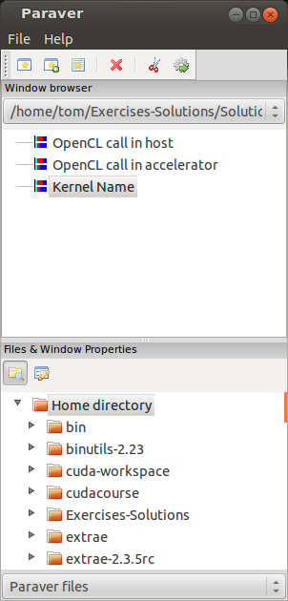
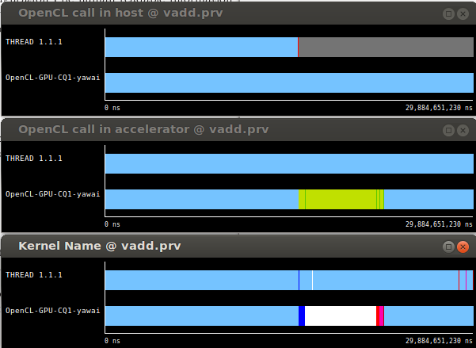
Paraver

Slide 14
Usage Tips
Show what the colours represent
Right click -> Info Panel
Zoom in to examine specific areas of interest
Highlight a section of the trace to populate the timeline window
Tabulate the data – numerical timings of API calls
Select a timeline in the Paraver main window, click on the ‘New Histogram’ icon and select OK
Powerful software – can also pick up your MPI communications
Perform calculations with the data – see the Paraver user guide

Slide 15
Platform specific profilers
More information can be obtained about your OpenCL program by profiling it using the hardware vendors dedicated profilers
OpenCL profiling can be done with Events in the API itself for specific profiling of queues and kernel calls

Slide 16
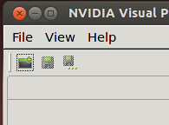
NVIDIA Visual Profiler®
This gives us information about:
Device occupancy
Memory bandwidth(between host and device)
Number of registers uses
Timeline of kernel executions and memory copies
Etc…
Start a new session:
Follow the wizard, selecting the compiled binary in the File box (you do not need to make any code or compiler modifications). You can leave the other options as the default.
The binary is then run and profiled and the results displayed.
Third party names are the property of their owners.

Slide 17
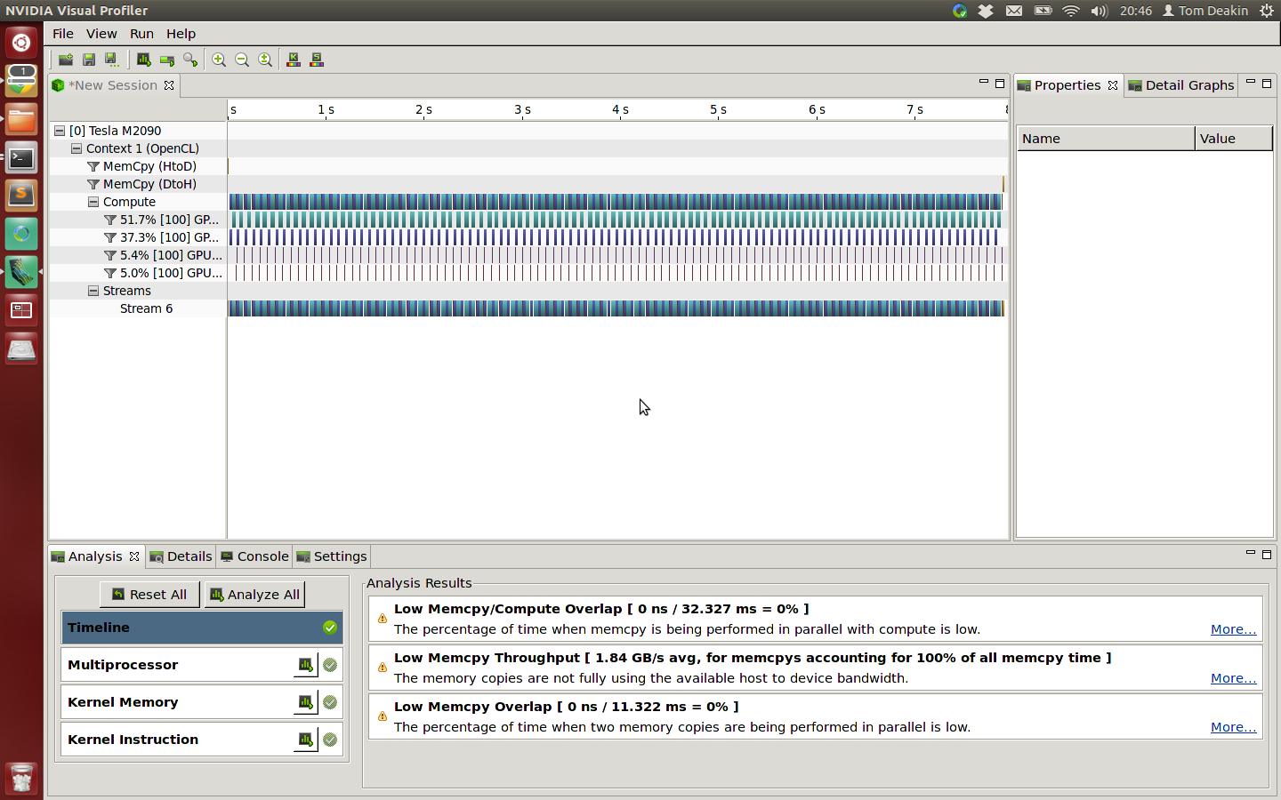
Profiling using nvvp
The timeline says what happened during the program execution:
Some things to think about optimising are displayed in the Analysis tab:
Each invocation of the kernel is pictured as a box
Kernels

Slide 18
Profiling using nvvp
The Details tab shows information for each kernel invocation and memory copy
number of registers used
work group sizes
memory throughput
amount of memory transferred
No information about which parts of the kernel are running slowly, but the figures here might give us a clue as to where to look
Best way to learn: experiment with an application yourself

Slide 19
NVIDIA® Nsight™
Visual Studio plugin
Simple tracing of API calls and enqueued commands
Visual timeline
Works with non-NVIDIA devices!
Can also profile OpenGL commands
Download here (registration required)

Slide 20
Profiling from the command line
NVIDIA® also have nvprof and 'Command Line Profiler’
nvprof available with CUDA™ 5.0 onwards, but currently lacks driver support for OpenCL profiling
The legacy command-line profiler can be invoked using environment variables:
$ export COMPUTE_PROFILE=1
$ export COMPUTE_PROFILE_LOG=<output file>
$ export COMPUTE_PROFILE_CONFIG=<config file>
Config file controls which events to collect (run nvprof --query-events for a comprehensive list)
Run your application to collect event information and then inspect output file with text editor
Can also output CSV information (COMPUTE_PROFILE_CSV=1) for inspection with a spreadsheet or import into nvvp (limited support)
Third party names are the property of their owners.

Slide 21
AMD® CodeXL
AMD provide a graphical Profiler and Debugger for AMD Radeon™ GPUs
Available for download
Can give information on:
API and kernel timings
Memory transfer information
Register use
Local memory use
Wavefront usage
Hints at limiting performance factors
Third party names are the property of their owners.

Slide 22
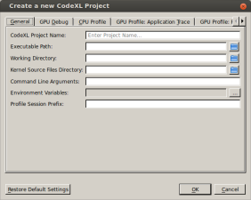
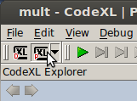
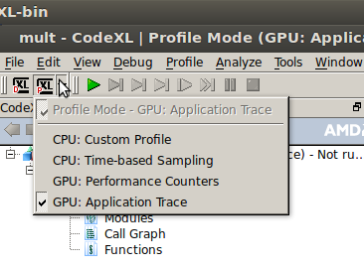
CodeXL
Create a new project, inserting the binary location in the window
Click on the Profiling button, and hit the green arrow to run your program
Select the different traces to view associated information

Slide 23
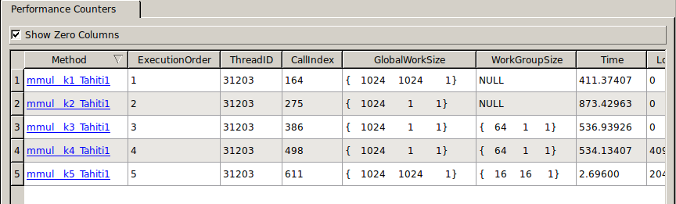
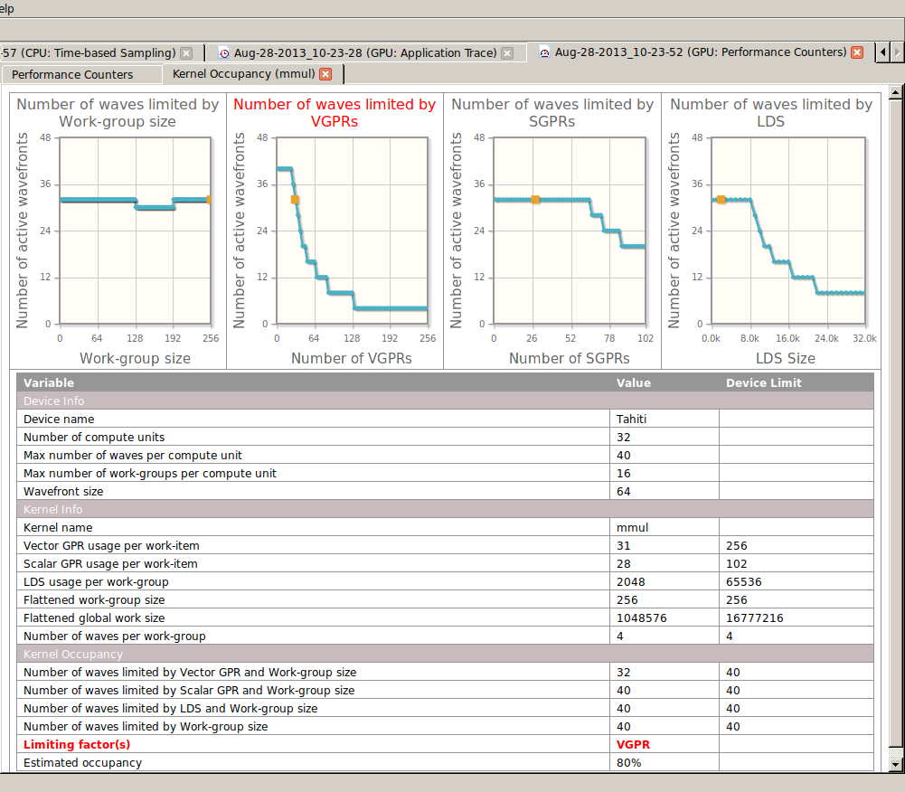
CodeXL
GPU: Performance Counters
Information on kernels including work group sizes, registers, etc.
View the kernel instruction code
Click on the kernel name in the left most column
View some graphs and hints about the kernel
Click on the Occupancy result

Slide 24
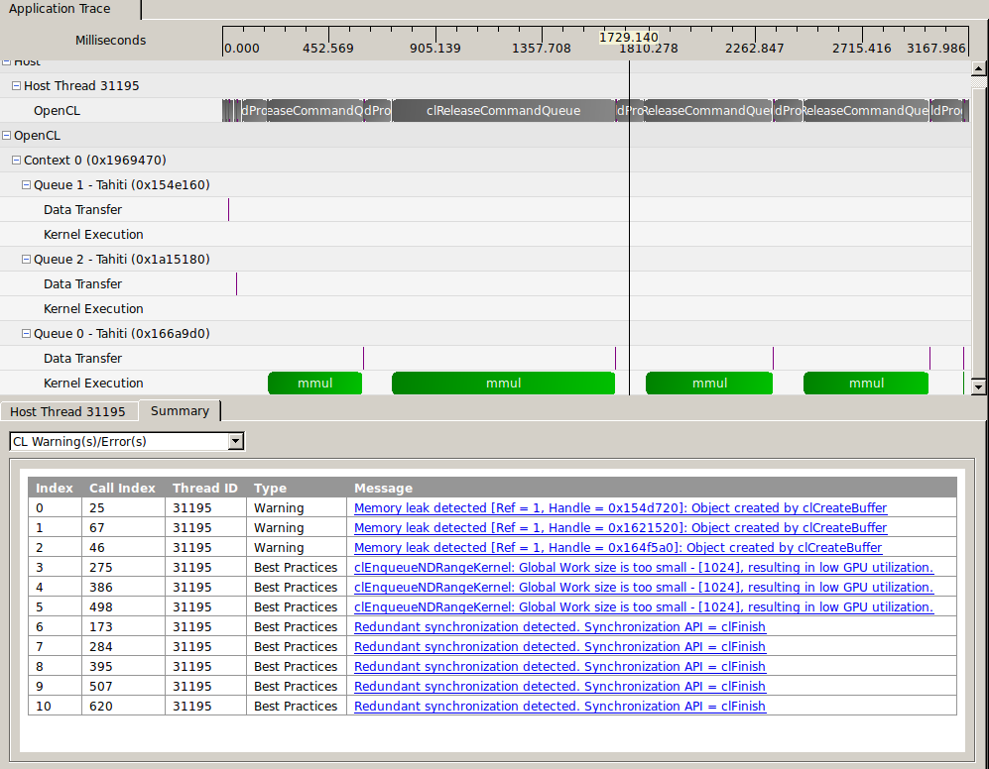
CodeXL
GPU: Application Trace
See timing information about API calls
Timings of memory movements
Timings of kernel executions

Slide 25
Intel vTune
https://software.intel.com/en-us/intel-vtune-amplifier-xe
Commercial product (30-day free trial)
Detailed analysis of OpenCL kernels running on CPUs, GPUs and Xeon Phi
Visual timelines
Hotspot analysis
Hardware counters
Lots more!
More details about profiling Intel GPUs

Slide 26
Intel Offline Compiler
ioc64 – available in the Intel OpenCL SDK
$ ioc64 -input=kernels.cl -simd=avx2
Setting target instruction set architecture to: Advanced Vector Extension 2 (AVX2)
OpenCL Intel CPU device was found!
Device name: Intel(R) Xeon(R) CPU E5-2697 v2 @ 2.70GHz
Device version: OpenCL 1.2 (Build 10002)
Device vendor: Intel(R) Corporation
Device profile: FULL_PROFILE
Compilation started
Compilation done
Linking started
Linking done
Device build started
Device build done
Kernel <mmul> was successfully vectorized (8)
Done.
mmul info:
Maximum work-group size: 4096
Compiler work-group size: (0, 0, 0)
Local memory size: 0
Preferred multiple of work-group size: 128
Minimum amount of private memory: 128
Tells you if the compiler was able to vectorize your kernels
Gives additional information about the resources that your compiled kernel requires

Slide 27
Intel OpenCL Intercept Layer
Released at IWOCL’18.
Available on GitHub: https://github.com/intel/opencl-intercept-layer
Intercepts and logs API calls.
Displays summary statistics of time in each API.
Can inject kernel source and retrieve kernel binaries.
Plugins for vTune and Chrome for timeline views.

Slide 28
Debugging OpenCL

Slide 29
Debugging OpenCL 1.1
Top tip:
Write data to a global buffer from within the kernel
result[ get_global_id(0) ] = … ;
Copy back to the host and print out from there or debug as a normal serial application
Works with any OpenCL device and platform

Slide 30
Debugging OpenCL – more tips
Check your error messages!
If you use the C++ header, you can enable Exceptions, but make sure you print out the errors.
Don’t forget, use the err_code.h from the tutorial to print out errors as strings (instead of numbers), or check in the cl.h file in the include directory of your OpenCL provider for error messages

Slide 31
printf
OpenCL 1.2* defines printf as a built-in function available within kernels
Useful to perform quick sanity checks about intermediate values
Remember that the kernel is potentially being executed by lots of work-items
Output order is undefined
Guard with if(get_global_id(0) == …) to inspect a specific work-item (adjust for 2D/3D )
* printf is also available as an extension for some 1.1 or earlier implementations

Slide 32
Debugging with GDB
GDB works with OpenCL running on the CPU with AMD® or Intel® runtimes
Useful for stepping through kernel execution, and catching some illegal memory accesses
Can be a bit fiddly to get working, and requires different setup instructions for each platform

Slide 33
Using GDB with Intel®
Ensure you select the CPU device from the Intel® platform
Enable debugging symbols and add the absolute path to the kernel source code when building the kernels:
clBuildProgram(… "–g –s /path/to/kernel.cl" …);
The symbolic name of a kernel function ‘kernel void foo(args)’ will just be foo
To set a breakpoint on kernel entry enter at the GDB prompt:
break foo
This can only be done after the kernels have been built
On Windows, this functionality is provided via a graphical user interface inside Visual Studio
Third party names are the property of their owners.

Slide 34
Using GDB with AMD®
Ensure you select the CPU device from the AMD® platform
Enable debugging symbols and turn off all optimizations when building the kernels:
clBuildProgram(… "–g –O0" …);
The symbolic name of a kernel function ‘kernel void foo(args)’ will be __OpenCL_foo_kernel
To set a breakpoint on kernel entry enter at the GDB prompt:
break __OpenCL_foo_kernel
This can only be done after the kernels have been built
AMD® recommend setting the environment variable CPU_MAX_COMPUTE_UNITS=1 to ensure deterministic kernel behaviour
Third party names are the property of their owners.

Slide 35
Debugging Tools
AMD CodeXL
Intel SDK (Visual Studio plugin)
GDB (CPU platforms)
Oclgrind
GPUVerify
printf ( from OpenCL 1.2 onwards )
Notes:
AMD CodeXL – classic debugging abilities, step through code and inspect state on AMD GPUs
Intel INDE – starter edition free, offline compiling, Visual Studio plugin with debugging
Oclgrind – Presents as an OpenCL platform, simulates your code and identifies issues
GPUVerify – Formal analysis of GPU kernels, data races and bugs
Printf – Works (almost!) everywhere, careful not to print too much.
Also mention:
Copy to host and inspect.

Slide 36
CodeXL
Provides the ability to debug OpenCL kernels running on the GPU
Step through kernel source
Inspect variables across work-items and work-groups
Display contents of buffers and images
Allows applications to be debugged on remote machines

Slide 37
Intel® INDE
Starter Edition is free to download
Contains OpenCL Code Builder (SDK)
Visual Studio plugin for debugging
Offline compiler for analysis
Usage information

Slide 38
GPUVerify
A useful tool for detecting data-races in OpenCL programs
Developed at Imperial College as part of the CARP project
Uses static analysis to try to prove that kernels are free from races
Can also detect issues with work-group divergence
More information on the GPUVerify Website
gpuverify --local_size=64,64 --num_groups=256,256 kernel.cl

Slide 39
Oclgrind
A SPIR interpreter and OpenCL simulator
Developed at the University of Bristol
Runs OpenCL kernels in a simulated environment to catch various bugs:
oclgrind ./application
Invalid memory accesses
Data-races (--data-races)
Work-group divergence
Runtime API errors (--check-api)
Also has a GDB-style interactive debugger
oclgrind –i ./application
More information on the Oclgrind Website

Slide 40
Exercise: Profiling and Debugging OpenCL programs
Goal:
To experiment with profiling and debugging tools
Procedure:
Take one of your OpenCL programs, such as matrix multiply or host<->device transfer
Run the program in the profiler and explore the results
Modify the program to change the performance in some way and observe the effect with the profiler
Repeat with other programs if you have time, such as a debugger, GPUverify, Oclgrind etc.

Slide 41
Advanced OpenCL Topics - OPTIMISATION

Slide 42
Fast Kernels
There's a tendency to overcomplicate OpenCL code
“GPUs are hard, therefore my code must be hard!”
Adding too many levels of indirection at the start is doomed to failure
Starting off with using local memory, trying to cache data yourself etc.
Modern runtimes and compilers are pretty smart!
Start simple. But once you have something working…

Slide 43
Performance portability
Obviously a very large field, but some basic concepts to keep in mind:
Don’t (over-) optimise specifically for one piece of hardware
Test on various platforms during development to make sure it actually works on different hardware
Profile (events should work everywhere)
Notes:
Quick notes about it – mention paper?

Slide 44
OpenCL Memory Hierarchy
OpenCL has 4 address spaces
Kernels are “dumb” – data movement between address spaces will not happen automatically*
However, manual use can sometimes improve performance (if you know something the compiler or runtime does not!)

Slide 45
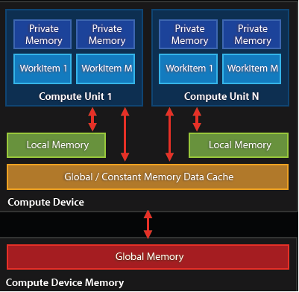
Private Memory
This is the default address space for variables defined in your kernel
Memory access time is the fastest at O(1) cycles.
But they are limited in numbers!

Slide 46
Private Memory
This is the default address space for variables defined in your kernel
Memory access time is the fastest at O(1) cycles
But they are limited in numbers!
Each variable maps to a register on the device of execution
But variables are not limited, they will be spilled into memory “somewhere” (usually global memory)
“Occupancy” must also be considered…
kernel void
calc_diff
(
global float *a,
global float *b,
global float *c
)
{
//”id” is in private memory
const int id = get_global_id(0);
c[id] = fabs(a[id] - b[id]);
}

Slide 47
Local Memory
Local memory is the next level up from private
Still reasonably fast to access at O(10) cycles
Local memory is shared between work-items inside a local work-group
Ideal use-case is when there is lots of data that gets reused amongst threads within a work-group
It can be allocated either in the host, or inline in the kernel*
When used well, can result in significant performance increases
kernel void
calc_something
(
global float *a,
global float *b,
global float *c,
//this local memory is set by the host
local float *t
)
{
//kernels can also declare local memory
local float tmp[128];
//etc.
}

Slide 48
Global Memory
This is where data you want processed will be resident, and where output data will be written to
Global memory has long access latency, but high bandwidth (> 300GB/s on high-end GPUs!)
Latency can be mitigated via coalesced accesses
It’s often better to re-compute data than store it!
size_t len = 1024*1024 * sizeof(float);
float *hostPtrA = malloc(len);
//create device buffer
cl_mem devPtrA = clCreateBuffer(
context, //pointer to context
CL_MEM_READ_WRITE,//memory flags
len, //size of buffer (bytes)
NULL, //host pointer
NULL //error code pointer
);
clEnqueueWriteBuffer(
queue, //pointer to queue
devPtrA, //host pointer
CL_FALSE, //blocking write
0, //offset into device ptr
len, //number of bytes to write
hostPtrA, //host pointer
0, NULL, NULL //event list data
);

Slide 49
Coalesced Memory Access
Coalesced memory accesses are key for high performance code.
In principle, it’s very simple, but frequently requires transposing/transforming data before using it.
Principals often apply to both SIMD CPUs and GPUs.

Slide 50
Memory access patterns
0
1
2
3
4
5
6
7
GPU Threads
0x0f4
0x0f8
0x0fc
0x100
0x104
0x108
0x10c
0x110
0x114
0x118
0x11c
0x120
0x124
0x128
64 Byte Boundary
GPU Memory
64 Byte Boundary

Slide 51
Memory access patterns
float val1 = memA[g_id];
0
1
2
3
4
5
6
7
0x0f4
0x0f8
0x0fc
0x100
0x104
0x108
0x10c
0x110
0x114
0x118
0x11c
0x120
0x124
0x128
64 Byte Boundary

Slide 52

Memory access patterns
const int c = 3;
float val2 = memA[g_id + c];
0
1
2
3
4
5
6
7
0x114
0x118
0x11c
0x120
0x124
0x128
0x12c
0x130
0x134
0x138
0x13c
0x140
0x144
0x148
64 Byte Boundary

Slide 53
Memory access patterns
float val3 = memA[3*g_id];
0
1
2
3
4
5
6
7
0x0f4
0x0f8
0x0fc
0x100
0x104
0x108
0x10c
0x110
0x114
0x118
0x11c
0x120
0x124
0x128
Strided access results in multiple
memory transactions (and
kills throughput)
64 Byte Boundary

Slide 54
Memory access patterns
const int loc =
some_strange_func(g_id);
float val4 = memA[loc];
0
1
2
3
4
5
6
7
0x0f4
0x0f8
0x0fc
0x100
0x104
0x108
0x10c
0x110
0x114
0x118
0x11c
0x120
0x124
0x128
64 Byte Boundary

Slide 55
Memory Access Coalescence
Coalesce - to combine into one
Coalesced memory accesses are key for high bandwidth
Simply, it means, if thread i accesses memory location n then thread i+1 accesses memory location n+1
In practice, it’s not quite as strict…
kernel void func(global float *memA, global float *memB)
{
int g_id = get_global_id(0);
// ideal
float val1 = memA[g_id];
// still pretty good
const int c = 3;
float val2 = memA[g_id + c];
// stride size is not so good
float val3 = memA[c*g_id];
const int loc =
some_strange_func(g_id);
// terrible!
float val4 = memA[loc];
}

Slide 56
Memory layout is critical to performance
“Structure of Arrays vs. Array of Structures” problem
Array of Structures (AoS) often more natural to code
struct Point{ float x, y, z, a; };
Point *Points;
Structure of Arrays (SoA) suits memory coalescence in vector units
struct { float *x, *y, *z, *a; } Points;
x | y | z | a | … | x | y | z | a | … | x | y | z | a | … | x | y | z | a | …
Adjacent work-items/vector-lanes like to access adjacent memory locations
x | x | x | x | … | y | y | y | y | … | z | z | z | z | … | a | a | a | a | …
Notes:
If use all the elements of a simple structure, the Intel compiler can be smart and perform this optimisation to avoid gather instructions.

Slide 57
Sub Buffers
If you have positional data, you may be tempted to create a structure with x,y,z coordinates
But when it comes to running on a GPU, this strided (AoS) access will be slower than contiguous (SoA) access
clCreateSubBuffer allows you to create a region within a pre-existing buffer, which could ease the process of converting data from AoS to SoA format

Slide 58
Constant Memory
Constant memory can be considered a store for data that never changes
Setting and updating constants in memory uses the same interface as global memory, with enqueueRead/enqueueWrite commands
The difference is how it is declared in the kernel
Some devices may have dedicated on-chip caches or data-paths for constant memory
Devices are guaranteed to support constant memory allocations of at least 64kB
Can also declare OpenCL program scope constant data, but this has to be initialized at OpenCL program compile time
kernel void calc_something(
global float *a,
global float *b,
global float *c,
// constant memory is set by the host
constant float *params
)
{
// code here
}
Notes:
Can query the maximum size of a constant memory allocation with CL_DEVICE_MAX_CONSTANT_BUFFER_SIZE
Limited number of constant memory arguments per kernel – CL_DEVICE_MAX_CONSTANT_ARGS

Slide 59
Work-groups
Work-group sizes that are a power of 2 help on most architectures. At a minimum:
8 for AVX2 CPUs
16 for Xeon Phi
32 for Nvidia
64 for AMD
May be different on different hardware
On most systems aim to run lots of work-groups.
NULL work-group size (cl::NullRange) might be good!
Notes:
Work group sizes – maybe obvious.
Padding and OpenCL 2.0 non-uniform work-groups mentioned later.

Slide 60
Work-groups
Work-group sizes that are a power of 2 help on most architectures. At a minimum:
8 for AVX2 CPUs
16 for Xeon Phi
32 for Nvidia
64 for AMD
May be different on different hardware
On most systems aim to run lots of work-groups.
NULL work-group size might be good!
Notes:
Work group sizes – maybe obvious.
Padding and OpenCL 2.0 non-uniform work-groups mentioned later.

Slide 61
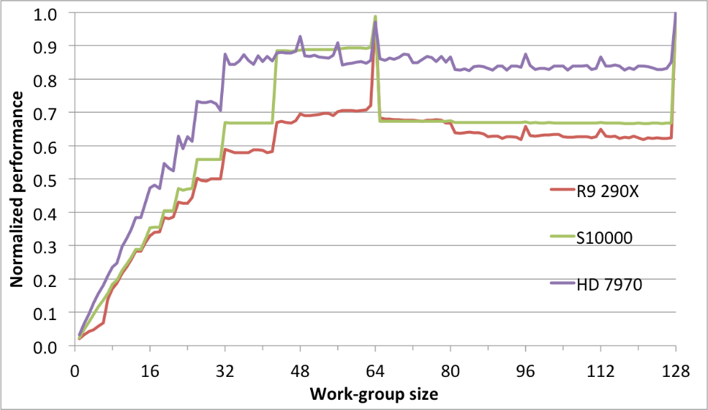
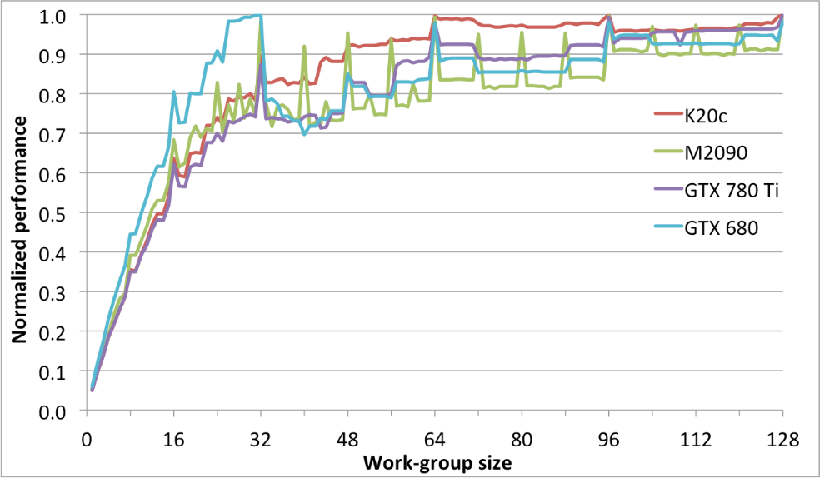
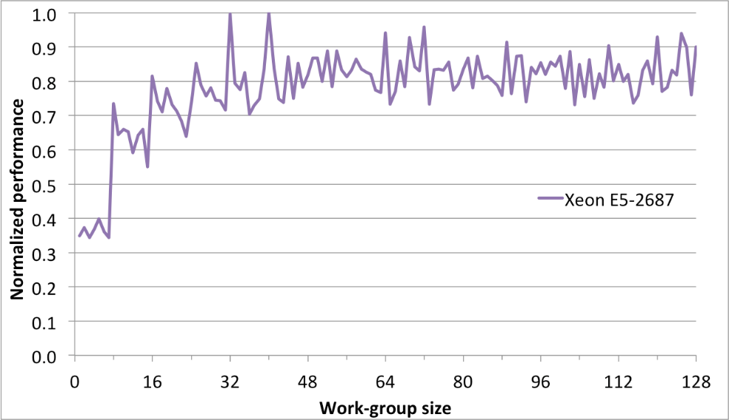
Effect of work-group sizes
Notes:
Results from our 2D lattice Boltzmann code, results from the ISC paper.
Top left is AMD, top right is Nvidia, bottom is Intel CPU.

Slide 62
Padding work-groups
OpenCL 1.x requires that the global size is exactly divisible by the work-group size
This might restrict our choice of work-group size for certain problem sizes
In the worst case, a large prime number problem would limit us to a work-group size of 1!
We can pad the global problem size to make it a multiple of our desired work-group size
This might introduce a conditional check inside the kernel
OpenCL 2.0 introduces non-uniform work-group sizes, which remove the above restriction and lets the runtime handle some of this for us
Notes:
Non-uniform work-groups in 2.0 may need some care since some work-groups may be smaller.
i.e. The get_local_size function will return different values for the ‘remainder’ work-groups.
Can use `get_enqueued_local_size` to get the size passed to clEnqueueNDRange

Slide 63
Occupancy
Number of work-groups per compute unit (CU) depends on registers and local memory size per work-group
E.g. NVIDIA’s K40 has 128 words of memory per processor element (PE), i.e. 128 registers per core; and 48KB of local memory per CU
But, multiple work-items (threads) will be scheduled on a single PE (similar to hyperthreading)
In fact, global memory latency is so high that multiple work-items per PE are a requirement for achieving a good proportion of peak performance!

Slide 64
Auto tuning
Q: How do you know what the best parameter values for your program are?
What is the best work-group size, for example?
A: Try them all! (Or a well chosen subset)
This is where auto tuning comes in
Run through different combinations of parameter values and optimize the runtime (or another measure) of your program.

Slide 65
Tuning Knobs some general issues to think about
Tiling size (work-group sizes, dimensionality etc.)
For block-based algorithms (e.g. matrix multiplication)
Different devices might run faster on different block sizes
Data layout
Array of Structures or Structure of Arrays (AoS vs. SoA)
Column or Row major
Caching and prefetching
Use of local memory or not
Extra loads and stores assist hardware cache?
Work-item / work-group data mapping
Related to data layout
Also how you parallelize the work
Operation-specific tuning
Specific hardware differences
Built-in trig / special function hardware
Double vs. float (vs. half)
From Zhang, Sinclair II and Chien: Improving Performance Portability in OpenCL Programs – ISC13

Slide 66
Auto tuning example - Flamingo
http://mistymountain.co.uk/flamingo/
Python program which compiles your code with different parameter values, and calculates the “best” combination to use
Write a simple config file, and Flamingo will run your program with different values, and returns the best combination
Remember: scale down your problem so you don’t have to wait for “bad” values (less iterations, etc.)
Notes:
Still have to expose the implementation decisions in your code though (e.g. via command-line options)

Slide 67
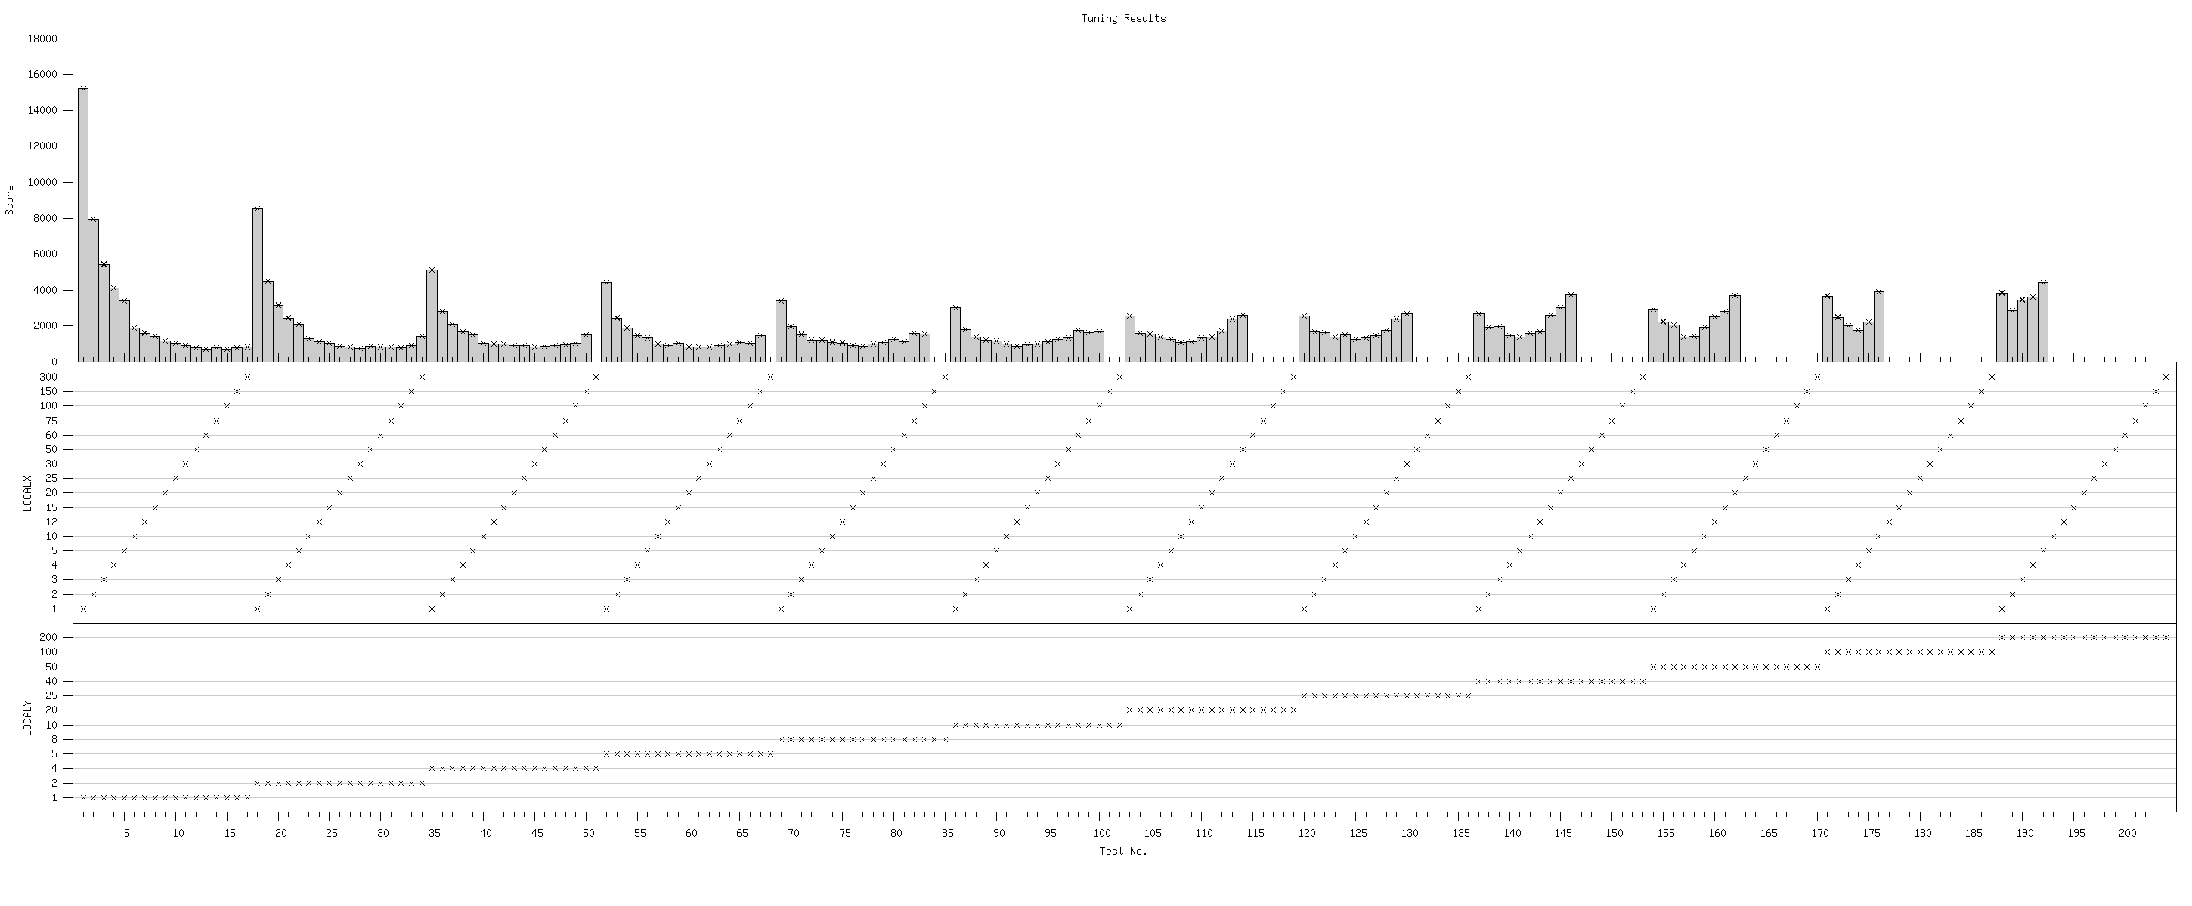
Auto tuning - Example
D2Q9 Lattice-Boltzmann
What is the best work-group size for a specific problem size (3000x2000) on a specific device (NVIDIA Tesla M2050)?
Best: 60x1
Runtimes – lower is better
X values
Y values
Collected with Flamingo (mistymountain.co.uk/flamingo)

Slide 68
Thread throttling
Barriers between memory access-heavy kernel code sections might actually speed up your code by improving the cache behaviour
Non-intuitive
Works by stopping some work-items from racing ahead and trashing the cache before all the other work-items have finished working with the current contents
Architecture dependent
Notes:
Barriers between code for better cache use etc
Architecture dependent, may not always be useful

Slide 69
Barrier example
left_flux = (xarea[THARR2D(0, 0, 1)]
* (xvel0[THARR2D(0, 0, 1)] + xvel0[THARR2D(0, 1, 1)]
+ xvel0[THARR2D(0, 0, 1)] + xvel0[THARR2D(0, 1, 1)]))
* 0.25 * dt * 0.5;
barrier(CLK_LOCAL_MEM_FENCE);
right_flux = (xarea[THARR2D(1, 0, 1)]
* (xvel0[THARR2D(1, 0, 1)] + xvel0[THARR2D(1, 1, 1)]
+ xvel0[THARR2D(1, 0, 1)] + xvel0[THARR2D(1, 1, 1)]))
* 0.25 * dt * 0.5;
barrier(CLK_LOCAL_MEM_FENCE);
bottom_flux = (yarea[THARR2D(0, 0, 0)]
* (yvel0[THARR2D(0, 0, 1)] + yvel0[THARR2D(1, 0, 1)]
+ yvel0[THARR2D(0, 0, 1)] + yvel0[THARR2D(1, 0, 1)]))
* 0.25 * dt * 0.5;
barrier(CLK_LOCAL_MEM_FENCE);
top_flux = (yarea[THARR2D(0, 1, 0)]
* (yvel0[THARR2D(0, 1, 1)] + yvel0[THARR2D(1, 1, 1)]
+ yvel0[THARR2D(0, 1, 1)] + yvel0[THARR2D(1, 1, 1)]))
* 0.25 * dt * 0.5;
Notes:
Example of the barriers which can speed up code by making a barrier between accessing different bits of memory.
From the CloverLeaf benchmark (2D structured grid code for Hydrodynamics).

Slide 70
Atomics
Fine-grained synchronisation is possible with a set of atomic functions
atomic_<op>, where <op> is one of
{add, sub, xchg, inc, dec, cmpxchg, min, max, and, or, xor}
Only applicable to integer types
Can atomically access and update a global/local memory location from multiple work-items within the same work-group without a barrier
OpenCL 2.x improves on this by inheriting the atomic types and memory model from C11
Notes:
OpenCL 2.x atomic types give you floating point atomics.
Double support with extension

Slide 71
Atomics
Can be useful to implement prefix sums, histograms and lock-free algorithms
kernel void generate_histograms(
global uchar *data,
global int *histogram)
{
int gid = get_global_id(0);
int group = get_group_id(0);
// Get pointer to start of this work-group’s histogram
global int *group_histogram = histogram + group*256;
// Get this work-item’s value
char value = data[gid];
// Increment corresponding bucket in histogram
atomic_inc(&group_histogram[value]);
}
Example: generate a per work-group histogram for uchar data

Slide 72
Vectorization
OpenCL C provides a set of vector types:
type2, type3, type4, type8 and type16
Where type is any primitive data type
Than can be convenient for representing multi-component data:
Pixels in an image (RGBA)
Atoms or points (x, y, z, mass/type)
There are also a set of built-in geometric functions for operating on these types (dot, cross, distance, length, normalize)
Notes:
All standard math functions (sqrt, sin etc) work on these vector types (component-wise)

Slide 73
Vectorization
In the past, several platforms required the use of these types in order to make use of their vector ALUs (e.g. AMD’s pre-GCN architectures and Intel’s initial CPU implementation)
This isn’t ideal: we are already exposing the data-parallelism in our code via OpenCL’s NDRange construct – we shouldn’t have to do it again!
These days, most OpenCL implementations target SIMD execution units by packing work-items into SIMD lanes – so we get the benefits of these vector ALUs for free (Intel calls this ‘implicit vectorisation’)

Slide 74
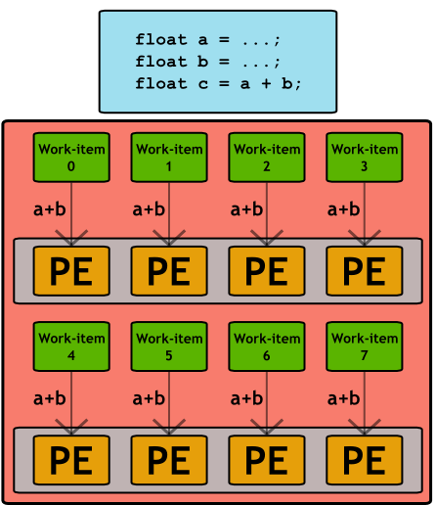
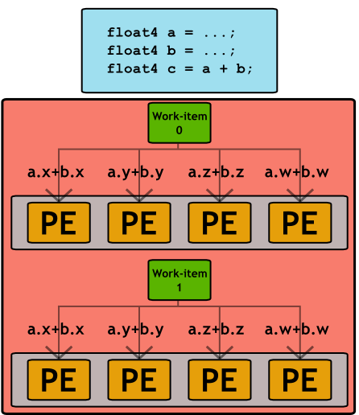
Vectorization
Implicit vectorization
Explicit vectorization

Slide 75
Vectorization
You may come across some platforms that still require explicit vectorization
As the architectures and compilers mature, we expect to see a continued shift towards simple, scalar work-items
You can query an OpenCL device to determine whether it prefers scalar or vector data types, e.g:
device.getInfo
<CL_DEVICE_PREFERRED_VECTOR_WIDTH_FLOAT>();
Notes:
This device query would return 1 on platforms that implicitly vectorize
Sometimes vectorisation helps for other reasons – e.g. increased ILP

Slide 76
Vectorization
You may come across some platforms that still require explicit vectorization
As the architectures and compilers mature, we expect to see a continued shift towards simple, scalar work-items
You can query an OpenCL device to determine whether it prefers scalar or vector data types, e.g:
clGetDeviceInfo(device, CL_DEVICE_PREFERRED_VECTOR_WIDTH_FLOAT, sizeof(cl_uint), &width, NULL);
Notes:
This device query would return 1 on platforms that implicitly vectorize
Sometimes vectorisation helps for other reasons – e.g. increased ILP

Slide 77
Branching
GPUs tend not to support speculative execution, which means that branch instructions have high latency.
Often important to avoid branching on SIMD CPUs too.
This latency can be hidden by switching to alternative work-items/work-groups, but avoiding branches where possible is often a good idea to improve performance.
When different work-items executing within the same SIMD ALU array take different paths through conditional control flow, we have divergent branches (vs. uniform branches).
We can use predication, selection and masking to convert conditional control flow into straight line code and significantly improve the performance of code that has lots of conditional branches.
Very modern HPC GPUs can sometimes cope with branchy code well.
Notes:
Branches will cause pipeline stalls if there’s no branch prediction/speculative execution

Slide 78
Single Instruction Multiple Data
Individual threads of a warp start together at the same program address
Each thread has its own instruction address counter and register state
Each thread is free to branch and execute independently
Provide the MIMD abstraction
Branch behavior
Each branch will be executed serially
Threads not following the current branch will be disabled
A warp
Time
Start
Branch1
Branch2
Branch3
Converge

Slide 79
Branching
Conditional execution
Selection and masking
// Only evaluate expression
// if condition is met
if (a > b)
{
acc += (a - b*c);
}
Corresponding PTX
setp.gt.f32 %pred, %a, %b
@!%pred bra $endif
mul.f32 %f0, %b, %c
sub.f32 %f1, %a, %f0
add.f32 %acc, %acc, %f1
$endif:
// Always evaluate expression
// and mask result
temp = (a - b*c);
mask = (a > b ? 1.f : 0.f);
acc += (mask * temp);
Corresponding PTX
mul.f32 %f0, %b, %c
sub.f32 %temp, %a, %f0
setp.gt.f32 %pred, %a, %b
selp.f32 %mask, %one, %zero, %pred
mad.f32 %acc, %mask, %temp, %acc
Notes:
Mask 0 if a <= b
Single-cycle multiply-add means we get the extra multiplication by the mask for free
No branches means there won’t be any pipeline stalls
Subtle point: more instruction level parallelism in second example: the mul and sub can be issued independently from the setp and selp on dual-issue architectures

Slide 80
Faster Math Functions
OpenCL has a large library of built-in math functions (C99 + more), which have well defined precision requirements
Some of these functions also have native variants, which drop the precision requirements in favour of performance
e.g. native_cos, native_log, native_rqsrt
There are also half_ variants of many of the math functions
These do have well-defined precision requirements
The geometric functions also have fast_ variants, e.g. fast_distance, fast_length
There are some special case functions that can improve performance, e.g.
powr(x,y)where x is >=0
pown(x,y)where y is an integer
Notes:
***no precision guarantees at all*** for native functions – need to be careful
there are also some special case functions that can give big performance improvements:
powr(x, y) where x is >=0
pown(x, y) where y is an integer

Slide 81
Half Precision
OpenCL provides a half precision data type
This can only be used as storage
(global half *)
Must be accessed with vload_half and vstore_half
If the device supports the cl_khr_fp16 extension, you can also perform arithmetic on these types, and use the built-in math functions

Slide 82
Image Types
OpenCL provides a special type of memory object for representing image data
This is an optional feature, but is supported on almost all OpenCL platforms
These are stored in global memory, but are accessed from kernels via dedicated built-in functions
Can yield significant performance improvements by taking advantage of native GPU support for manipulating textures
Automatic handling for out-of-bounds accesses
Normalizing pixel values
Interpolating between pixels
Notes:
Intel Xeon Phi is only platform we’ve come across that doesn’t support images
As well as being faster on many devices, also more convenient (bounds checking, normalization, interpolation)

Slide 83
Checking for Image Support
// Check if device supports images
cl_bool imageSupport;
device.getInfo
<CL_DEVICE_IMAGE_SUPPORT>(
&imageSupport
);
// Check maximum image dimensions
size_t maxWidth, maxHeight;
device.getInfo
<CL_DEVICE_IMAGE2D_MAX_WIDTH>(
&maxWidth
);
device.getInfo
<CL_DEVICE_IMAGE2D_MAX_HEIGHT>(
&maxHeight
);
// Get list of supported image formats
std::vector<cl::ImageFormat> formats;
context.getSupportedImageFormats(
CL_MEM_READ_WRITE,
CL_MEM_OBJECT_IMAGE2D,
&formats
);
Presence of image support can be queried with getDeviceInfo() and the CL_DEVICE_IMAGE_SUPPORT parameter
The kernel compiler will define the preprocessor macro __IMAGE_SUPPORT__=1 when building programs if images are supported
Maximum image dimensions can be queried with getDeviceInfo()
Max for 2D must be at least 8192x8192
Max for 3D must be at least 2048x2048x2048
A list of image formats supported by the target device can be queried with getSupportedImageFormats()
Notes:
OpenCL 1.2 introduced 1D images as well

Slide 84
Checking for Image Support
// Check if device supports images
cl_bool imageSupport;
clGetDeviceInfo(device,
CL_DEVICE_IMAGE_SUPPORT, sizeof(cl_bool),
&imageSupport, NULL);
// Check maximum image dimensions
size_t maxWidth, maxHeight;
clGetDeviceInfo(device,
CL_DEVICE_IMAGE2D_MAX_WIDTH, sizeof(cl_bool),
&maxWidth, NULL);
clGetDeviceInfo(device,
CL_DEVICE_IMAGE2D_MAX_HEIGHT, sizeof(cl_bool),
&maxHeight, NULL);
// Get list of supported image formats
cl_image_formats formats[32];
cl_uint num_formats;
clGetSupportedImageFormats(context,
CL_MEM_READ_WRITE,
CL_MEM_OBJECT_IMAGE2D,
32, formats, &num_formats
);
Presence of image support can be queried with clGetDeviceInfo() and the CL_DEVICE_IMAGE_SUPPORT parameter
The kernel compiler will define the preprocessor macro __IMAGE_SUPPORT__=1 when building programs if images are supported
Maximum image dimensions can be queried with clGetDeviceInfo()
Max for 2D must be at least 8192x8192
Max for 3D must be at least 2048x2048x2048
A list of image formats supported by the target device can be queried with clGetSupportedImageFormats()
Notes:
OpenCL 1.2 introduced 1D images as well

Slide 85
Image Types – Host API
cl::ImageFormat format(
CL_RGBA, // channel order
CL_UNORM_INT8 // channel data type
);
cl::Image2D d_image(
context, // context object
CL_MEM_READ_ONLY, // memory access flags
format, // image format (above)
width, // image width
height, // image height
);
cl::array<size_type, 3> origin;
origin[0] = origin[1] = origin[2] = 0;
cl::array<size_type, 3> region;
region[0] = width;
region[1] = height;
region[2] = 1;
queue.enqueueWriteImage(
d_image, // image object
CL_TRUE, // blocking read
origin, // origin of write
region, // region to write
0, // image row pitch
0, // image slice pitch (3D only)
h_image, // host data
);
Image objects are created using the Image2D and Image3D types
These functions take a cl::ImageFormat object which defines the data type and channel order for the image
Data is copied to/from the device with the enqueueWriteImage and enqueueReadImage functions
Can also copy between buffers and images
Presence of image support can be queried with getDeviceInfo and the CL_DEVICE_IMAGE_SUPPORT parameter

Slide 86
Image Types – Host API
cl_image_format format = {
// channel order
.image_channel_order = CL_RGBA,
// channel data type
.image_channel_data_type = CL_UNORM_INT8
};
cl_image_desc description;
description.image_type = CL_MEM_OBJECT_IMAGE2D;
description.image_width = width;
description.image_height = height;
d_image = clCreateImage(
context, // context object
CL_MEM_READ_ONLY, // memory access flags
format, // image format (above)
description, // image description (above)
NULL, NULL
);
size_t origin[] = {0, 0, 0};
size_t region[] = {width, height, 1};
clEnqueueWriteImage(queue,
d_image, // image object
CL_TRUE, // blocking read
origin, // origin of write
region, // region to write
0, // image row pitch
0, // image slice pitch (3D only)
h_image, // host data
0, NULL, NULL // NULL event data
);
Image objects are created using the Image2D and Image3D types
These functions take a cl_image_format which defines the data type and channel order for the image
Data is copied to/from the device with the enqueueWriteImage and enqueueReadImage functions
Can also copy between buffers and images
Presence of image support can be queried with clGetDeviceInfo and the CL_DEVICE_IMAGE_SUPPORT parameter

Slide 87
Image Formats
Data types
Channel orders
CL_SNORM_INT8
CL_SNORM_INT16
CL_UNORM_INT8
CL_UNORM_INT16
CL_UNORM_SHORT_565
CL_UNORM_SHORT_555
CL_UNORM_INT_101010
CL_SIGNED_INT8
CL_SIGNED_INT16
CL_SIGNED_INT32
CL_UNSIGNED_INT8
CL_UNSIGNED_INT16
CL_UNSIGNED_INT32
CL_HALF_FLOAT
CL_FLOAT
CL_R
CL_Rx
CL_A
CL_INTENSITY
CL_LUMINANCE
CL_RG
CL_RGx
CL_RA
CL_RGB
CL_RGBx
CL_RGBA
CL_ARGB
CL_BGRA
Notes:
Not all combinations of data-type/channel order are valid (see table in spec)
Min requirement is for CL_RGBA with the UNORM, SIGNED, UNSIGNED and *_FLOAT types, and CL_BGRA with CL_UNORM_INT8
CL_*x variants affect border color when clamping out-of-range coords – x means alpha is 0, otherwise 1
INTENSITY vs LUMINANCE – also affects border color (INTENSITY means alpha is 0, otherwise 1)

Slide 88
Image Types – Kernel
kernel void foo(
read_only image2d_t input,
write_only image2d_t output)
{
int x = get_global_id(0);
int y = get_global_id(1);
// Read a normalized pixel value
float4 color = read_imagef(
input,
(int2)(x, y)
);
...
// Write a normalized pixel value
write_imagef(
output,
(int2)(x, y),
color
);
}
Image objects are declared with special built-in types
In OpenCL 1.X, image objects can be either read_only or write_only; an image object can not be both read and written from the same kernel
Integer pixel values can be read with read_imagei/ui
Normalized floating point values can be read with read_imagef
Pixel values can be written with write_imagef
These functions operate on 4-element vectors, regardless of the image channel order
Note: these sampler-less read functions are OpenCL 1.2+ only
Notes:
OpenCL 2.0 introduced read_write attribute for images

Slide 89
Image Samplers
// Create a sampler object
cl::Sampler sampler(
context, // context objects
CL_FALSE, // normalized coordinates
CL_ADDRESS_REPEAT, // addressing mode
CL_FILTER_NEAREST, // filtering mode
);
// Pass sampler to kernel as an argument
kernel(cl::EnqueueArgs(queue, global), …, sampler, …);
kernel void foo(read_only image2d_t input,
write_only image2d_t output,
const sampler_t sampler)
{
int x = get_global_id(0);
int y = get_global_id(1);
// Read a normalized pixel value using a sampler
float4 color = read_imagef(input, sampler, (int2)(x, y));
...
}
// Alternatively, declare the sampler inside the kernel
const sampler_t sampler = CLK_NORMALIZED_COORDS_FALSE |
CLK_ADDRESS_CLAMP_TO_EDGE |
CLK_FILTER_NEAREST;
The read_image* functions can optionally use a sampler object to control how the data is read
Samplers can be created on the host (clCreateSampler) and passed as an argument (sampler_t), or declared inside the OpenCL source file as a constant value
Samplers control whether to use normalized coordinates for addressing pixels, how to deal with out-of-range coordinates (CLAMP, CLAMP_TO_EDGE, REPEAT, MIRRORED_REPEAT or NONE) and how to filter pixels values (NEAREST or LINEAR)
Notes:
Declaring the sampler inside the OpenCL program may be faster – compiler can optimize

Slide 90
Image Samplers
// Create a sampler object
sampler = clCreateSampler(
context, // context objects
CL_FALSE, // normalized coordinates
CL_ADDRESS_REPEAT, // addressing mode
CL_FILTER_NEAREST, // filtering mode
&err // error code
);
// Pass sampler to kernel as an argument
clSetKernelArg(kernel, arg_index,
sizeof(cl_sampler), sampler);
kernel void foo(read_only image2d_t input,
write_only image2d_t output,
const sampler_t sampler)
{
int x = get_global_id(0);
int y = get_global_id(1);
// Read a normalized pixel value using a sampler
float4 color = read_imagef(input, sampler, (int2)(x, y));
...
}
// Alternatively, declare the sampler inside the kernel
const sampler_t sampler = CLK_NORMALIZED_COORDS_FALSE |
CLK_ADDRESS_CLAMP_TO_EDGE |
CLK_FILTER_NEAREST;
The read_image* functions can optionally use a sampler object to control how the data is read
Samplers can be created on the host (clCreateSampler) and passed as an argument (sampler_t), or declared inside the OpenCL source file as a constant value
Samplers control whether to use normalized coordinates for addressing pixels, how to deal with out-of-range coordinates (CLAMP, CLAMP_TO_EDGE, REPEAT, MIRRORED_REPEAT or NONE) and how to filter pixels values (NEAREST or LINEAR)
Notes:
Declaring the sampler inside the OpenCL program may be faster – compiler can optimize

Slide 91
Exercise: optimisations
Try some of the more advanced optimisations on the bilateral kernel code
In particular, you should consider:
Improving the memory access coalescence
Experiment with work-group sizes
Experiment with native math functions
An example solution with all of the above applied will be provided.
Extra: Try using image types instead of buffers

Slide 92
Exercise: optimisations
Results from 3 different versions (original, meta programming, and optimised) on an NVIDIA K40:
$ ./bilateral
OpenCL took 427.7ms (13.4ms / frame)
$ ./bilateral_meta
OpenCL took 341.2ms (10.7ms / frame)
$ ./bilateral_opt
OpenCL took 59.9ms (1.9ms / frame)

Slide 93
Exercise 12
Try some of the more advanced optimisations on the N-Body kernel code
In particular, you should consider:
Experiment with work-group sizes
Caching positions in local memory (blocking)
Experiment with native math functions
An example solution with all of the above applied will be provided.

Slide 94
Exercise: image types
Start with the Bilateral example
Convert the kernel and host program to use image types
The data is RGBA, 8-bit per channel, so you can use an image format with CL_RGBA and either CL_UNSIGNED_INT8 or CL_UNORM_INT8
Use a sampler to automatically perform normalization and bounds checking
Compare the performance to the buffer version for different devices
Extra: try some other optimizations such as native functions
Tip: If verification is too slow, use --noverify flag or set verify = false

Slide 95
Exercise: image types
Results from 4 different versions (original, meta programming, optimised, and images) on an NVIDIA K40:
$ ./bilateral
OpenCL took 427.7ms (13.4ms / frame)
$ ./bilateral_meta
OpenCL took 341.2ms (10.7ms / frame)
$ ./bilateral_opt
OpenCL took 59.9ms (1.9ms / frame)
$ ./bilateral_images
OpenCL took 39.6ms (1.2ms / frame)

Slide 96
Exercise: image types
Results from 4 different versions (original, meta programming, optimised, and images) on an NVIDIA P100:
$ ./bilateral
OpenCL took 59.2ms (1.9ms / frame)
$ ./bilateral_meta
OpenCL took 56.2ms (1.8ms / frame)
$ ./bilateral_opt
OpenCL took 15.2ms (0.5ms / frame)
$ ./bilateral_images
OpenCL took 10.3ms (0.3ms / frame)

