Slide 1
Advanced OpenCL Topics - The OPENCL ECOSYSTEM

Slide 2
OpenCL 2.0
OpenCL 2.0 was ratified in Nov’13
Brings several important new features:
Shared Virtual Memory
Nested parallelism
Built-in work-group reductions
Generic address space
Pipes
C1x atomics
Specification and headers available here
Production drivers now available from Intel and AMD, with more expected to follow

Slide 3
OpenCL 2.0 Goals
Ease of use
Performance improvements
Enable new programming patterns
Well-defined execution & memory model
Improved CL / GL sharing

Slide 4
Shared Virtual Memory
In OpenCL 1.x buffer objects can only be passed as kernel arguments
Buffer object are described as a pointer to type in kernels
Restrictions
Can't pass a pointer + offset as argument value
Can't store pointers in buffer object(s)
Why?
Host and OpenCL device do not share the same virtual address space
No guarantee that the same virtual address will be used for a kernel argument across multiple enqueues

Slide 5
Shared Virtual Memory
clSVMAlloc – allocates a shared virtual memory buffer
Specify size in bytes
Specify usage information
Optional alignment value
An SVM pointer can be shared by the host and OpenCL device

Slide 6
Shared Virtual Memory
clSetKernelArgSVMPointer
SVM pointers as kernel arguments
A SVM pointer
A SVM pointer + offset
kernel void
vec_add(float *src, float *dst) {
size_t id = get_global_id(0);
dst[id] += src[id];
}
// allocating SVM pointers
cl_float *src = (cl_float *)clSVMAlloc(ctx, CL_MEM_READ_ONLY, size, 0);
cl_float *dst = (cl_float *)clSVMAlloc(ctx, CL_MEM_READ_WRITE, size, 0);
// Passing SVM pointers as arguments
clSetKernelArgSVMPointer(vec_add_kernel, 0, src);
clSetKernelArgSVMPointer(vec_add_kernel, 1, dst);
// Passing SVM pointer + offset as arguments
clSetKernelArgSVMPointer(vec_add_kernel, 0, src + offset);
clSetKernelArgSVMPointer(vec_add_kernel, 1, dst + offset);

Slide 7
Shared Virtual Memory
Three types of sharing
Coarse-grained buffer sharing
Fine-grained buffer sharing
System sharing

Slide 8
Shared Virtual Memory: Coarse & Fine Grained
SVM buffers allocated using clSVMAlloc
Coarse grained sharing
Memory consistency only guaranteed at synchronization points
Host still needs to use synchronization APIs to update data
clEnqueueSVMMap / clEnqueueSVMUnmap or event callbacks
Memory consistency is at a buffer level
Allows sharing of pointers between host and OpenCL device
Fine grained sharing
No synchronization needed between host and OpenCL device
Host and device can update data in buffer concurrently
Memory consistency using C11 atomics and synchronization operations
This is an optional feature

Slide 9
Shared Virtual Memory: System Sharing
Can directly use any pointer allocated on the host
No OpenCL APIs needed to allocate SVM buffers
Both host and OpenCL device can update data using C11 atomics and synchronization functions
This is an optional feature

Slide 10
Dynamic Parallelism
In OpenCL 1.X only the host can enqueue kernels
Iterative algorithm example:
kernel A queues kernel B
kernel B decides to queue kernel A again
Requires host-device interaction and for the host to wait for kernels to finish execution
Can use callbacks to avoid waiting for kernels to finish, but still lots of overhead with this approach
Example
Kernel A
Kernel B
done

Slide 11
Dynamic Parallelism
Enable a device to queue kernels to itself
Allow a work-item(s) to queue kernels
Uses a similar approach to how the host queues commands
Queues and events
Functions that enqueue kernels and other commands
Event and profiling functions

Slide 12
Dynamic Parallelism
Device queues
An out-of-order queue
Created by the host
Can be passed as an argument to a kernel
Default queue available
Device events
Identifies a command queued on device
User events
Device event objects cannot be used on the host and vice-versa

Slide 13
Generic Address Space
In OpenCL 1.2, function arguments that are a pointer to a type must declare the address space of the memory region they point to
There are many examples where developers want to use the same code but with pointers to different address spaces
The above example is not supported in OpenCL 1.2
This results in developers having to duplicate code
void
my_func (local int *ptr, …)
{
…
foo(ptr, …);
… }
void
my_func (global int *ptr, …)
{
…
foo(ptr, …);
… }

Slide 14
Generic Address Space
OpenCL 2.0 no longer requires an address space qualifier for arguments to a function that are a pointer to a type
Except for kernel functions
Generic address space assumed if no address space is specified
Makes it really easy to write functions without having to worry about which address space arguments point to
void my_func (int *ptr, …)
{
…
foo(ptr, …);
… }
kernel void foo(global int *g_ptr, local int *l_ptr, …)
{
…
my_func(g_ptr, …);
my_func(l_ptr, …); }

Slide 15
Generic Address Space - Casting Rules
Implicit casts allowed from named to generic address space
Explicit casts allowed from generic to named address space
Cannot cast between constant and generic address spaces
kernel void foo()
{
int *ptr;
local int *lptr;
global int *gptr;
local int val = 55;
ptr = &val; // legal (named to generic)
lptr = ptr; // illegal! (generic to named)
lptr = gptr; // illegal! (named to named)
ptr = gptr; // legal (named to generic)
lptr = (local int *)ptr;
// legal (explicit generic to named) }

Slide 16
C11 Atomics
Implements a subset of the C11 atomic and synchronization operations
Enable assignments in one work-item to be visible to others
Atomic operations
loads & stores
exchange, compare & exchange
fetch and modify (add, sub, or, xor, and, min, max)
test and set, clear
Fence operation
Atomic and Fence operations take
Memory order
Memory scope
Operations are supported for global and local memory

Slide 17
C11 Atomics
Supported atomic types:
atomic_int, atomic_uint
atomic_long, atomic_ulong
atomic_float
atomic_double
atomic_intptr_t, atomic_uintptr_t, atomic_ptrdiff_t
atomic_size_t
atomic_flag
Atomic types have same size and representation as the non-atomic types, except for atomic_flag
Atomic functions must be lock-free

Slide 18
New image features
2D image from a buffer
GPUs have dedicated and fast hardware for texture addressing and filtering
Accessing a buffer as a 2D image allows us to use this hardware
Both buffer and 2D image use the same data storage
Reading and writing to an image in a kernel
Could only read or write (not both) in v1.X
Declare images with the read_write qualifier
Use barrier between writes and reads by work-items to the image
work_group_barrier(CLK_IMAGE_MEM_FENCE)
Only sampler-less reads are supported

Slide 19
New image features
Writing to 3D images is now a core feature
New image formats
sRGB
Depth
Extended list of required image formats
Improvements to CL / GL sharing
Multi-sampled GL textures
Mip-mapped GL textures

Slide 20
Pipes
Memory objects that store data organized as a FIFO
Kernels can read from or write to a pipe object
Host can only create pipe objects

Slide 21
Pipes
Why introduce a pipe object?
Allow vendors to implement dedicated hardware to support pipes
Read from and write to a pipe without requiring atomic operations to global memory
Enable producer-consumer relationships between kernels

Slide 22
Other OpenCL 2.0 Features
Non-uniform work-group sizes
Work-group functions
broadcast, reduction, vote (any & all), prefix sum
Subgroups (expose hardware SIMD width)
Program scope (global) variables
New work-item functions to flatten nD id
get_global_linear_id, get_local_linear_id
Sharing images and events with EGL

Slide 23
OpenCL 2.1
OpenCL 2.1 was ratified in Nov’15
New Features:
Subgroups (now in core)
Low-latency device timers
Also SPIR-V:
Portable intermediate language
Enables distribution of kernels in object form
Interoperates between OpenCL and Vulkan
https://www.khronos.org/news/press/khronos-releases-opencl-2.1-and-spir-v-1.0-specifications-for-heterogeneous

Slide 24
OpenCL 2.2 (provisional)
OpenCL 2.2 provisional released in April
Expected to be finalised later in 2016
OpenCL C++ kernel language
Based on C++14 with minimal language extensions
Brings OOP and templates to kernel code
Updated to SPIR-V 1.1 to support C++
Specialization constants
https://www.khronos.org/news/press/khronos-releases-opencl-2.2-provisional-spec-opencl-c-kernel-language

Slide 25

SYCL
Single source C++ abstraction layer for OpenCL
Goal is to enable the creation of C++ libraries and frameworks that utilize OpenCL
Can utilize SPIR to target OpenCL platform
Supports ‘host-fallback’ (CPU) when no OpenCL devices available
SYCL 1.2 released May 2015
Codeplay and AMD working on implementations

Slide 26
// Host data
std::vector h_a(N), h_b(N), h_c(N, 0xDEADBEEF);
for (int i = 0; i < N; i++){
h_a[i] = rand() / (float)RAND_MAX;
h_b[i] = rand() / (float)RAND_MAX;
}
{
// Device buffers
buffer d_a(h_a), d_b(h_b), d_c(h_c);
queue myQueue;
myQueue.submit([&](handler& cgh){
// Data accessors
auto a = d_a.get_access<access::read>(cgh);
auto b = d_b.get_access<access::read>(cgh);
auto c = d_c.get_access<access::write>(cgh);
// Kernel
cgh.parallel_for<class vadd>(range<1>{N}, [=](id<1> i) {
c[i] = a[i] + b[i];
}));
});
}

Slide 27
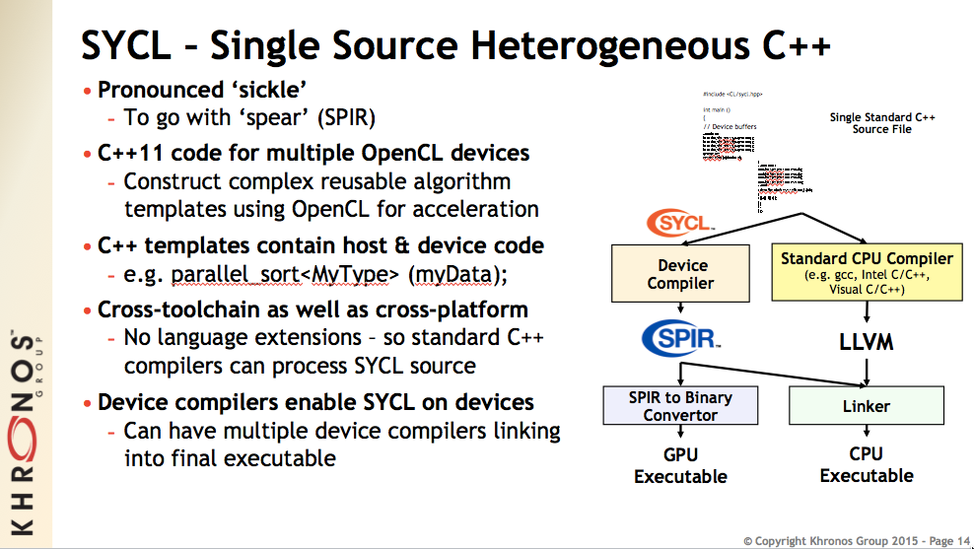

Slide 28
Libraries etc.
clFFT/clBLAS/clSPARSE/clRNG (all on github)
Been significantly improving in performance
Arrayfire v3.x now open source
Boost compute with VexCL
ViennaCL (PETSc), PARALUTION
GPU-STREAM memory bandwidth benchmark:
https://github.com/UoB-HPC/GPU-STREAM
Lots more - see the Khronos OpenCL pages: https://www.khronos.org/opencl/resources
Notes:
libraries

Slide 29
CLFORTRAN
Features
Full access to OpenCL API from Fortran applications
Pure Fortran implementation – No need for C/C++ codes or compiler support
OpenCL standard conformant, up to 1.2 *
Open Source and free for commercial use
Works with GNU Fortran, Intel Fortran and IBM XL Fortran
Needs a Fortran 2002/2003 compatible compiler
http://www.cass-hpc.com/solutions/libraries/clfortran-pure-fortran-interface-to-opencl/

Slide 30
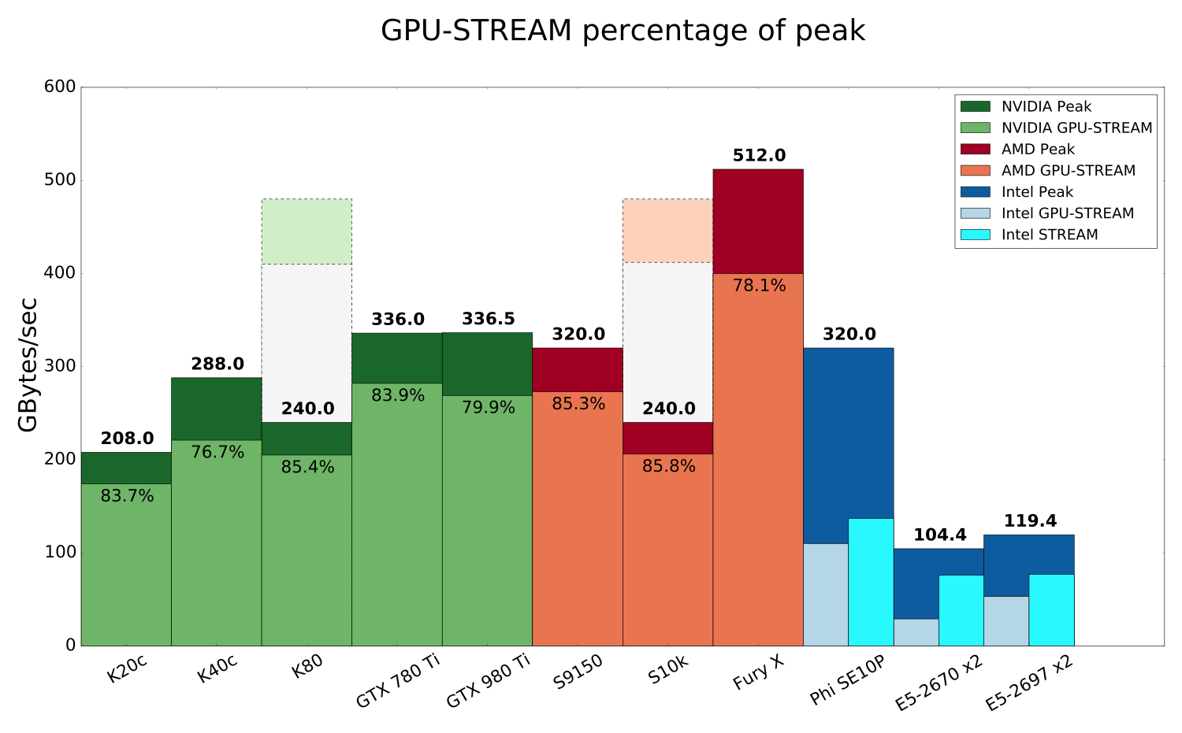

Slide 31
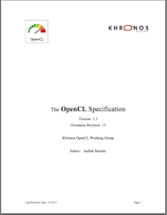
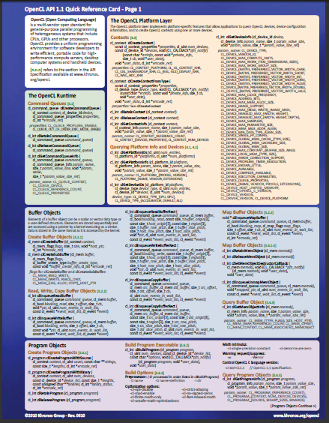
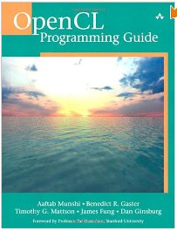

Resources: https://www.khronos.org/opencl/
The OpenCL specification
Surprisingly approachable for a spec!
https://www.khronos.org/registry/cl/
OpenCL reference card
Useful to have on your desk(top)
Available on the same page as the spec.
OpenCL Programming Guide:
Aaftab Munshi, Benedict Gaster, Timothy G. Mattson and James Fung, 2011
Heterogeneous Computing with OpenCL
Benedict Gaster, Lee Howes, David R. Kaeli, Perhaad Mistry and Dana Schaa, 2011

Slide 32
Other useful resources
Lots of OpenCL examples in the SDKs from the vendors:
AMD, Intel, Nvidia, …
The SHOC OpenCL/CUDA benchmark suite (available as source code):
https://github.com/vetter/shoc/wiki

Slide 33
OpenCL tools & run-times
Oclgrind
OpenCL/SPIR simulator & profiler
https://github.com/jrprice/Oclgrind/wiki
Portable Computing Language (POCL)
Open source implementation of the OpenCL standard using Clang/LLVM
Targets CPUs and GPUs/accelerators
http://portablecl.org

Slide 34
OpenCL Tutorials
http://handsonopencl.github.io
One of the most popular OpenCL training courses on the web
Completely open source (creative commons attribution CC BY license)
Downloaded over 8,300 times so far!
Lots of training material, examples and solutions, source code etc
Works on Linux, Windows, OSX etc.

Slide 35

Other useful resources
IWOCL annual conference
Spring each year
In North America, May 2017!
CFP opens Autumn 2016
IWOCL webpage & newsletter:
http://www.iwocl.org
http://www.iwocl.org/signup-for-updates/

Slide 36
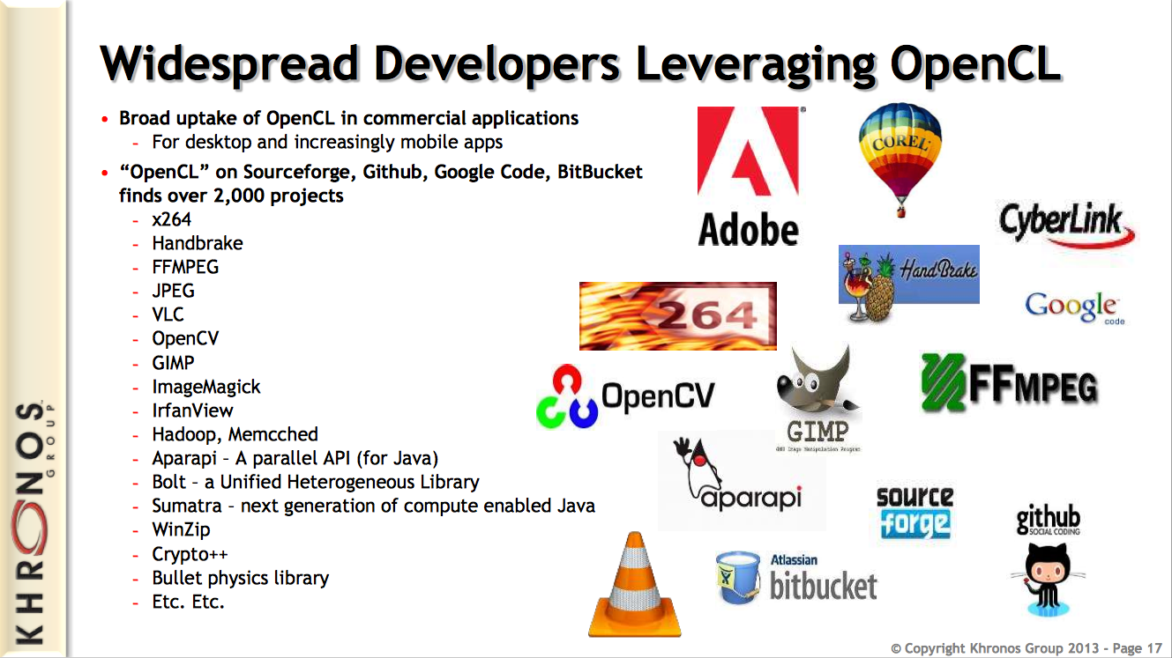

Slide 37
Links
http://streamcomputing.eu/blog/2013-06-03/the-application-areas-opencl-can-be-used/
http://lpgpu.org/wp/wp-content/uploads/2014/02/PEGPUM_2014_intel.pdf
http://hgpu.org/?tag=opencl
http://www.khronos.org/opencl/resources

Slide 38
Some Concluding remarks

Slide 39
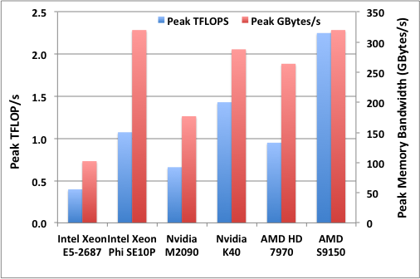
Many-core performance potential
5.7X FLOP/s speedup
3.1X memory bandwidth
16 cores of Sandy Bridge at 3.1 GHz

Slide 40
A table of interesting devices
Device | Memory size (GB) | Memory BW (STREAM GB/s) | 32-bit TFLOP/s | 64-bit TFLOP/s
AMD S9170 | 32 | 273 | 5.06 | 2.53
AMD Radeon R9 Fury X | 4 | 400 | 8.60 | 0.54
NVIDIA K40 | 12 | 221 | 2.86 | 1.43
NVIDIA K20 | 5 | 174 | 2.34 | 1.17
Intel Xeon Phi | 16 | 137 | 2.14 | 1.07
Intel Xeon E5-2698 x2 32-core | Lots | 118 | 2.36 | 1.18

Slide 41
Summary
OpenCL has increasingly widespread industrial support
OpenCL defines a platform-API/framework for heterogeneous computing, not just GPGPU or CPU-offload programming
OpenCL has the potential to deliver performance portability; but it has to be used correctly
The latest C++ and Python APIs make developing OpenCL programs much simpler than before
OpenCL is the only parallel programming standard that enables mixing task parallel and data parallel code in a single program while load balancing across ALL of the platform’s available resources.

Slide 42
Call to arms!
YOU have to tell your vendor you want OpenCL
Otherwise they'll tell you what you have to use! (And their choice usually favours them, not you)
Don't let yourself get locked in!!

Slide 43
Versions of opencl

Slide 44
OpenCL 1.0
First public release, December 2008

Slide 45
OpenCL 1.1
Released June 2010
Major new features:
Sub buffers
User events
More built-in functions
32-bit atomics become core features

Slide 46
OpenCL 1.2
Released November 2011
Major new features:
Custom devices and built-in kernels
Device partitioning
Support separate compilation and linking of programs
Greater support for OpenCL libraries

Slide 47
OpenCL 2.0
Released November 2013
Major new features:
Shared virtual memory (SVM)
Dynamic parallelism
Pipes
Built-in reductions/broadcasts
Sub-groups
"generic" address space
C11 atomics
More image support

Slide 48
Vector operations within kernels
Appendix A

Slide 49
Before we continue...
The OpenCL device compilers are good at auto-vectorising your code
Adjacent work-items may be packed to produce vectorized code
By using vector operations the compiler may not optimize as sucessfully
So think twice before you explicitly vectorize your OpenCL kernels, you might end up hurting performance!

Slide 50
Vector operations
Modern microprocessors include vector units:
Functional units that carry out operations on blocks of numbers
For example, x86 CPUs have over the years introduced MMX, SSE, and AVX instruction sets …
characterized in part by their widths (e.g. SSE operates on 128 bits at a time, AVX 256 bits etc)
To gain full performance from these processors it is important to exploit these vector units
Compilers can sometimes automatically exploit vector units.
Experience over the years has shown, however, that you all too often have to code vector operations by hand.
Example using 128 bit wide SSE:
#include "xmmintrin.h " // vector intrinsics from gcc for SSE (128 bit wide)
__m128 ramp = _mm_setr_ps(0.5, 1.5, 2.5, 3.5); // pack 4 floats into vector register
__m128 vstep = _mm_load1_ps(&step); // pack step into a vector register
__m128 xvec; = _mm_mul_ps(ramp,vstep); // multiple corresponding 32 bit
// floats and assign to xvec

Slide 51
Vector intrinsics challenges
Requires an assembly code style of programming:
Load into registers
Operate with register operands to produce values in another vector register
Non portable
Change vector instruction set (even from the same vendor) and code must be re-written. Compilers might treat them differently too
Consequences:
Very few programmers are willing to code with intrinsics
Most programs only exploit vector instructions that the compiler can automatically generate – which can be hit or miss
Most programs grossly under exploit available performance.
Solution: a high level portable vector instruction set … which is precisely what OpenCL provides.

Slide 52
Vector Types
The OpenCL C kernel programming language provides a set of vector instructions:
These are portable between different vector instruction sets
These instructions support vector lengths of 2, 4, 8, and 16 … for example:
char2, ushort4, int8, float16, double2, …
Properties of these types include:
Endian safe
Aligned at vector length
Vector operations (elementwise) and built-in functions
Remember, double (and hence vectors of double) are optional in OpenCL v1.1

Slide 53
Vector Operations
Vector literal
int4 vi0 = (int4) -7;
-7 | -7 | -7 | -7
int4 vi1 = (int4) (0, 1, 2, 3);
0 | 1 | 2 | 3
Vector components
vi0.lo = vi1.hi;
2 | 3 | -7 | -7
2 | 3 | -7 | -7
int8 v8 = (int8) (vi0, vi1.s01, vi1.odd);
0 | 1
1 | 3
2 | 3 | -7 | -7
Vector ops
0 | 1 | 2 | 3
+
vi0 += vi1;
2 | 4 | -5 | -4
vi0 = abs(vi0);
2 | 4 | 5 | 4

Slide 54
Using vector operations
You can convert a scalar loop into a vector loop using the following steps:
Based on the width of your vector instruction set and your problem, choose the number of values you can pack into a vector register (the width):
E.g. for a 128 bit wide SSE instruction set and float data (32 bit), you can pack four values (128 bits =4*32 bits) into a vector register
Unroll the loop to match your width (in our example, 4)
Set up the loop preamble and postscript. For example, if the number of loop iterations doesn’t evenly divide the width, you’ll need to cover the extra iterations in a loop postscript or pad your vectors in a preamble
Replace instructions in the body of the loop with their vector instruction counter parts

Slide 55
Vector instructions example
Scalar loop:
for (i = 0; i < 34; i++) x[i] = y[i] * y[i];
Width for a 128-bit SSE is 128/32=4
Unroll the loop, then add postscript and premable as needed:
NLP = 34+2; x[34]=x[35]=y[34]=y[35]=0.0f // preamble to zero pad
for (i = 0; i < NLP; i = i + 4) {
x[i] = y[i] * y[i]; x[i+1] = y[i+1] * y[i*1];
x[i+2] = y[i+2] * y[i*2]; x[i+3] = y[i+3] * y[i*3];
}
Replace unrolled loop with associated vector instructions:
float4 x4[DIM], y4[DIM];
// DIM set to hold 34 values extended to multiple of 4 (36)
float4 zero = {0.0f, 0.0f, 0.0f, 0.0f};
NLP = 34 % 4 + 1; // 9 values (as 34 isn’t a multiple of 4)
x4[NLP-1] = 0.0f; y4[NLP-1] = 0.0f; // zero pad arrays
for (i = 0; i < NLP; i++)
x4[i] = y4[i] * y4[i]; // actual vector operations

Slide 56
Exercise A: The vectorized Pi program
Goal:
To understand the vector instructions in the kernel programming language
Procedure:
Start with your best Pi program
Unroll the loops 4 times. Verify that the program still works
Use vector instructions in the body of the loop
Expected output:
Output result plus an estimate of the error in the result
Report the runtime and compare vectorized and scalar versions of the program
You could try running this on the CPU as well as the GPU…

Slide 57
The OpenCL event model
Appendix B

Slide 58
OpenCL Events
An event is an object that communicates the status of commands in OpenCL … legal values for an event:
CL_QUEUED: command has been enqueued.
CL_SUBMITTED: command has been submitted to the compute device
CL_RUNNING: compute device is executing the command
CL_COMPLETE: command has completed
ERROR_CODE: a negative value indicates an error condition occurred.
Can query the value of an event from the host … for example to track the progress of a command.
Examples:
CL_EVENT_CONTEXT
CL_EVENT_COMMAND_EXECUTION_STATUS
CL_EVENT_COMMAND_TYPE
cl_int clGetEventInfo (
cl_event event, cl_event_info param_name,
size_t param_value_size, void *param_value,
size_t *param_value_size_ret)

Slide 59
Generating and consuming events
Consider the command to enqueue a kernel. The last three arguments optionally expose events (NULL otherwise).
cl_int clEnqueueNDRangeKernel (
cl_command_queue command_queue,
cl_kernel kernel,
cl_uint work_dim,
const size_t *global_work_offset,
const size_t *global_work_size,
const size_t *local_work_size,
cl_uint num_events_in_wait_list,
const cl_event *event_wait_list,
cl_event *event)
Number of events this command is waiting to complete before executing
Array of pointers to the events being waited upon … Command queue and events must share a context.
Pointer to an event object generated by this command

Slide 60
Event: basic event usage
Events can be used to impose order constraints on kernel execution.
Very useful with out-of-order queues.
cl_event k_events[2];
err = clEnqueueNDRangeKernel(commands, kernel1, 1,
NULL, &global, &local, 0, NULL, &k_events[0]);
err = clEnqueueNDRangeKernel(commands, kernel2, 1,
NULL, &global, &local, 0, NULL, &k_events[1]);
err = clEnqueueNDRangeKernel(commands, kernel3, 1,
NULL, &global, &local, 2, k_events, NULL);
Enqueue two kernels that expose events
Wait to execute until two previous events complete

Slide 61
OpenCL synchronization: queues & events
Events connect command invocations. Can be used to synchronize executions inside out-of-order queues or between queues
Example: 2 queues with 2 devices
Kernel 2 starts before the results from Kernel 1 are ready
Kernel 2 waits for an event from Kernel 1 and does not start until the results are ready
Enqueue Kernel 2
Enqueue Kernel 2
Enqueue Kernel 1
Enqueue Kernel 1
CPU
CPU
Kernel 2
Kernel 2
GPU
GPU
Kernel 1
Kernel 1
Time
Time

Slide 62

Why Events? Won’t a barrier do?
A barrier defines a synchronization point … commands following a barrier wait to execute until all prior enqueued commands complete
cl_int clEnqueueBarrier(cl_command_queue queue)
Events provide fine grained control … this can really matter with an out-of-order queue.
Events work between commands in the different queues … as long as they share a context
Events convey more information than a barrier … provide info on state of a command, not just whether it’s complete or not.
GPU
CPU
Queue
Queue
Event
Context

Slide 63
Barriers between queues: clEnqueueBarrier doesn’t work
1st Command Queue
2nd Command Queue
clEnqueueNDRangeKernel()
clEnqueueWriteBuffer()
clEnqueueWriteBuffer()
clEnqueueNDRangeKernel()
clEnqueueReadBuffer()
clEnqueueReadBuffer()
clEnqueueWriteBuffer()
clEnqueueNDRangeKernel()
clEnqueueReadBuffer()
clEnqueueNDRangeKernel()
clEnqueueWriteBuffer()
clEnqueueWriteBuffer()
clEnqueueNDRangeKernel()
clEnqueueReadBuffer()
clEnqueueReadBuffer()
clEnqueueWriteBuffer()
clEnqueueNDRangeKernel()
clEnqueueReadBuffer()
clEnqueueBarrier()
clEnqueueBarrier()
clEnqueueNDRangeKernel()
clEnqueueWriteBuffer()
clEnqueueWriteBuffer()
clEnqueueReadBuffer()
clEnqueueReadBuffer()
clEnqueueWriteBuffer()
clEnqueueNDRangeKernel()
clEnqueueReadBuffer() clEnqueueNDRangeKernel()
clEnqueueNDRangeKernel()
clEnqueueWriteBuffer()
clEnqueueWriteBuffer()
clEnqueueReadBuffer()
clEnqueueReadBuffer()
clEnqueueWriteBuffer()
clEnqueueNDRangeKernel()
clEnqueueReadBuffer() clEnqueueNDRangeKernel()

Slide 64
Barriers between queues: this works!
1st Command Queue
2nd Command Queue
clEnqueueNDRangeKernel()
clEnqueueWriteBuffer()
clEnqueueWriteBuffer()
clEnqueueNDRangeKernel()
clEnqueueReadBuffer()
clEnqueueReadBuffer()
clEnqueueWriteBuffer()
clEnqueueNDRangeKernel()
clEnqueueReadBuffer()
clEnqueueNDRangeKernel()
clEnqueueWriteBuffer()
clEnqueueWriteBuffer()
clEnqueueNDRangeKernel()
clEnqueueReadBuffer()
clEnqueueReadBuffer()
clEnqueueWriteBuffer()
clEnqueueNDRangeKernel()
clEnqueueReadBuffer()
clEnqueueBarrier()
clEnqueueWaitForEvent(event)
clEnqueueMarker(event)
clEnqueueNDRangeKernel()
clEnqueueWriteBuffer()
clEnqueueWriteBuffer()
clEnqueueReadBuffer()
clEnqueueReadBuffer()
clEnqueueWriteBuffer()
clEnqueueNDRangeKernel()
clEnqueueReadBuffer() clEnqueueNDRangeKernel()
clEnqueueNDRangeKernel()
clEnqueueWriteBuffer()
clEnqueueWriteBuffer()
clEnqueueReadBuffer()
clEnqueueReadBuffer()
clEnqueueWriteBuffer()
clEnqueueNDRangeKernel()
clEnqueueReadBuffer() clEnqueueNDRangeKernel()

Slide 65
Host generated events influencing execution of commands: User events
“user code” running on a host thread can generate event objects
cl_event clCreateUserEvent(cl_context context, cl_int *errcode_ret)
Created with value CL_SUBMITTED.
It’s just another event to enqueued commands.
Can set the event to one of the legal event values
cl_int clSetUserEventStatus(cl_event event, cl_int execution_status)
Example use case: Queue up block of commands that wait on user input to finalize state of memory objects before proceeding.

Slide 66
Command generated events influencing execution of host code
A thread running on the host can pause waiting on a list of events to complete. This can be done with the function:
cl_int clWaitForEvents(
cl_uint num_events,
const cl_event *event_list)
Example use case: Host code waiting for an event to complete before extracting information from the event.
Number of events to wait on
An array of pointers to event object

Slide 67
Profiling with Events
OpenCL is a performance oriented language … Hence performance analysis is an essential part of OpenCL programming.
The OpenCL specification defines a portable way to collect profiling data.
Can be used with most commands placed on the command queue … includes:
Commands to read, write, map or copy memory objects
Commands to enqueue kernels, tasks, and native kernels
Commands to Acquire or Release OpenGL objects
Profiling works by turning an event into an opaque object to hold timing data.

Slide 68
Using the Profiling interface
Profiling is enabled when a queue is created with the CL_QUEUE_PROFILING_ENABLE flag set.
When profiling is enabled, the following function is used to extract the timing data
Profiling data to query (see next slide)
cl_int clGetEventProfilingInfo(
cl_event event,
cl_profiling_info param_name,
size_t param_value_size,
void *param_value,
size_t *param_value_size_ret)
Expected and actual size of profiling data.
Pointer to memory to hold results

Slide 69
cl_profiling_info values
CL_PROFILING_COMMAND_QUEUED
the device time in nanoseconds when the command is enqueued in a command-queue by the host. (cl_ulong)
CL_PROFILING_COMMAND_SUBMIT
the device time in nanoseconds when the command is submitted to compute device. (cl_ulong)
CL_PROFILING_COMMAND_START
the device time in nanoseconds when the command starts execution on the device. (cl_ulong)
CL_PROFILING_COMMAND_END
the device time in nanoseconds when the command has finished execution on the device. (cl_ulong)

Slide 70
Profiling Examples
cl_event prof_event;
cl_command_queue comm;
comm = clCreateCommandQueue(
context, device_id,
CL_QUEUE_PROFILING_ENABLE,
&err);
err = clEnqueueNDRangeKernel(
comm, kernel,
nd, NULL, global, NULL,
0, NULL, prof_event);
clFinish(comm);
err = clWaitForEvents(1, &prof_event );
cl_ulong start_time, end_time;
size_t return_bytes;
err = clGetEventProfilingInfo(
prof_event,
CL_PROFILING_COMMAND_QUEUED,
sizeof(cl_ulong),
&start_time,
&return_bytes);
err = clGetEventProfilingInfo(
prof_event,
CL_PROFILING_COMMAND_END,
sizeof(cl_ulong),
&end_time,
&return_bytes);
run_time =(double)(end_time - start_time);

Slide 71
Events inside Kernels … Async. copy
// A, B, C kernel args … global buffers.
// Bwrk is a local buffer
for(k=0;k<Pdim;k++)
Awrk[k] = A[i*Ndim+k];
for(j=0;j<Mdim;j++){
event_t ev_cp = async_work_group_copy(
(__local float*) Bwrk, (__global float*) B,
(size_t) Pdim, (event_t) 0);
wait_group_events(1, &ev_cp);
for(k=0, tmp= 0.0;k<Pdim;k++)
tmp += Awrk[k] * Bwrk[k];
C[i*Ndim+j] = tmp;
}
Compute a row of C = A * B
1 A col.per work-item
Work group shares rows of B
Start an async. copy for row of B returning an event to track progress.
Wait for async. copy to complete before proceeding.
Compute element of C using A from private memory and B from local memory.

Slide 72
Events and the C++ interface (for profiling)
Enqueue the kernel with a returned event
Event event =
vadd(
EnqueueArgs(commands,NDRange(count), NDRange(local)),
a_in, b_in, c_out, count);
What for the command attached to the event to complete
event.wait();
Extract timing data from the event:
cl_ulong ev_start_time =
event.getProfilingInfo<CL_PROFILING_COMMAND_START>();
cl_ulong ev_end_time =
event.getProfilingInfo<CL_PROFILING_COMMAND_END>();

Slide 73
C++ for C Programmers
Appendix C

Slide 74
C++ for C programmers
This Appendix shows and highlights some of the basic features and principles of C++.
It is intended for the working C programmer.
The C++ standards:
ISO/ANSI Standard 1998 (revision 2003)
ISO/ANSI Standard 2011 (aka C++0x or C++11)

Slide 75
Comments, includes, and variable definitions
Single line comments:
// this is a C++ comment
C includes are prefixed with “c”:
#include <cstdio>
IO from keyboard and to console
#include <iosteam>
int a;
std::cin >> a; // input integer to ‘a’
std::cout << a; // outputs ‘a’ to console

Slide 76
Namespaces
Definitions and variables can be scoped with namespaces.
:: is used to dereference.
Using namespace opens names space into current scope.
Default namespace is std.
#include <iostream> // definitions in std namespace
namespace foo {
int id(int x) { return x; }
};
int x = foo::id(10);
using namespace std;
cout << x; // no need to prefix with std::

Slide 77
References in C++ … a safer way to do pointers
References are non-null pointers. Since they can’t be NULL, you don’t have to check for NULL value all the time (as you do with C)
For example, in C we need to write:
int foo(int * x) {
if (x != NULL) return *x;
else return 0;
}
In C++ we could write:
int foo(int & x) {
return x;
}
Note that in both cases the memory address of x is passed (i.e. by reference) and not the value!

Slide 78
New/Delete Memory allocation
C++ provides safe(r) memory allocation
new and delete operator are defined for each type, including user defined types. No need to multiple by sizeof(type) as in C.
int * x = new int;
delete x;
For multi element allocation (i.e. arrays) we must use delete[].
int * array = new int[100];
delete[] array;

Slide 79
Overloading
C++ allows functions to have the same name but with different argument types.
int add(int x, int y)
{
return x+y;
}
float add(float x, float y)
{
return x+y;
}
// call the float version of add
float f = add(10.4f, 5.0f);
// call the int version of add
int i = add(100,20);

Slide 80
Classes (and structs)
C++ classes are an extension of C structs (and unions) that can functions (called member functions) as well as data.
class Vector {
private:
int x_, y_, z_ ;
public:
Vector (int x, int y, int z) : x_(x), y_(y), z_(z) {} // constructor
~Vector // destructor
{
cout << “vector destructor”;
}
int getX() const { return x_; } // access member function
…
};
The keyword “const” can be applied to member functions such as getX() to state that the particular member function will not modify the internal state of the object, i.e it will not cause any visual effects to someone owning a pointer to the said object. This allows for the compiler to report errors if this is not the case, better static analysis, and to optimize uses of the object , i.e. promote it to a register or set of registers.

Slide 81
More information about constructors
Consider the constructor from the previous slide …
Vector (int x, int y, int z): x_(x), y_(y), z_(z) {}
C++ member data local to a class (or struct) can be initialized using the noation
: data_name(initializer_name), ...
Consider the following two semantically equivalent structs in which the constructor sets the data member x_ to the input value x:
Case B must use a temporary to read the value of x, while this is not so for Case A. This is due to C’s definition of local stack allocation.
This turns out to be very import in C++11 with its memory model which states that an object is said to exist once inside the body of the constructor and hence thread safety becomes an issue, this is not the case for the constructor initalization list (case A). This means that safe double locking and similar idioms can be implemented using this approach.
A
struct Foo
{
int x_;
Foo(int x) : x_(x) {}
}
B
struct Foo
{
int x_;
Foo(int x) { x_ = x; }
}

Slide 82
Classes (and structs) continued
Consider the following block where we construct an object (the vector “v”), use it and then reach the end of the block
{
Vector v(10,20,30);
// vector {x_ = 10, y_ = 20 , z_ = 30}
// use v
} // at this point v’s destructor would be called!
Note that at the end of the block, v is no longer accessible and hence can be destroyed. At this point, the destructor for v is called.

Slide 83
Classes (and structs) continued
There is a lot more to classes, e.g. inheritance but it is all based on this basic notion.
The previous examples adds no additional data or overhead to a traditional C struct, it has just improved software composibility.

Slide 84
Function objects
Function application operator can be overloaded to define functor classes
struct Functor
{
int operator() (int x) { return x*x; }
};
// create an object of type Functor
Functor f();
int value = f(10); // call the operator()

Slide 85
Template functions
Don’t want to write the same function many times for different types?
Templates allow functions to be parameterized with a type(s).
template<typename T>
T add(T x, T y) { return x+y; }
float f = add<float>(10.4f, 5.0f); // float version
int i = add<int>(100,20); // int version
You can use the templatized type, T, inside the template function

Slide 86
Template classes
Don’t want to write the same class many times for different types?
Templates allow class to be parameterized with a type(s) too.
template <typename T>
class Square
{
T operator() (T x) { return x*x; }
};
Square<int> f_int();
int value = f_int(10);

Slide 87
C++11 defines a function template
C++ function objects can be stored in the templated class std::function. The following header defines the class std::function
#include <functional>
We can define a C++ function object (e.g. functor) and then store it in the tempated class std::function
struct Functor
{
int operator() (int x) { return x*x; }
};
std::function<int (int)> square(Functor());

Slide 88
C++ function template: example 1
The header <functional> just defines the template std::function. This can be used to warp standard functions or function objects, e.g.:
int foo(int x) { return x; } // standard function
std::function<int (int)> foo_wrapper(foo);
struct Foo // function object
{
void operator()(int x) {return x;}
};
std::function<int (int)> foo_functor(Foo());
foo_functor and foo_wrapper are basically the same but one is using a standard C like function, while the other is using a function object

Slide 89
C++ function template: example 2
What is the point of function objects? Well they can of course contain local state, which functions cannot, they can also contain member functions and so on. A silly example might be:
struct Foo // function object
{
int y_;
Foo() : y_(100) {}
void operator()(int x) { return x+100; }
};
std::function<int (int)> add100(Foo());
// function that adds 100 to its argument

Slide 90
Python for C programmers
Appendix D

Slide 91
Python 101
Python is an interpreted language, and so doesn’t need to be compiled
Python is often used as a language to glue other parts of your application together – with OpenCL this is great as the host code is fast to write and the heavy computation is done on your accelerator
Run your code as:
python file.py
No curly braces – indent consistently to define blocks of code
Print to stdout with print – it will try it’s best to format variables:
print ‘a =‘, a, ‘and b =‘, b

Slide 92
Comments, variables and includes
A comment is prefixed with the hash
# this is a comment
Initilize variables as you go – no need for a type
N = 1024
x = 5.23
my_string = 'hello world'
Use single or double quotes for strings
'this is the same'
"as this"
"no need to escape 'opposite' quotes!"
Also use three quotes ''' or """ for multiline strings without escaping anything!
Include additional modules and libraries with
import sys

Slide 93
Conditionals
if n == 1:
print ‘n was 1’
elif n == 2 or n == 3:
print ‘n was 2 or 3’
else:
print ‘n was’, n

Slide 94
Loops
# loop from 0 to 1023
for i in range(1024):
print i
# iterate through an array
for x in my_array:
x += 1
# same as the first one
while i < 1024:
print i
i += 1

Slide 95
Functions and classes
Define a function with the def keyword
def func(arg):
You don’t specify the types or return arguments
you just return what you like
Define a class with the class keyword
class name:
Classes contain function definitions and variables
These are both called attributes

Slide 96
More about classes
There is a lot more about classes e.g. inheritance
Python is an object-oriented language
A small example from the python tutorial:
class Complex:
def __init__(self, realpart, imagpart):
self.r = realpart
self.i = imagpart
Initilize an instance of the class with:
x = Complex(3.0, -4.5)

Slide 97
Python has functional programming elements
Filter
filter(function, sequence)
Returns a list from sequence which function returns true
Map
map(function, sequence)
Applies the function to each element in the sequence
Reduce
reduce(function, sequence)
Applies binary function with first two in sequence, then with the result with third, etc.

Slide 98
Python has functional programming elements
List comprehensions
squares = [x*x for x in range(10)]
# squares = [0, 1, 4, 9, 16, etc]
Zip
zip(list1, list2)
Creates a list of tuples, where the ith tuple consists of the ith elements of each list
Generators
Lazy generation of lists
Either:
Replace [] with () in list comprehensions to use as expression, i.e. to pass to another function
Use the yield keyword instead of return in a function which builds and returns a list

Slide 99
Further information:
There is lots more to python, this is just a flavor of the language to help you understand the syntax in this course
The official python tutorial is much more complete:
http://docs.python.org/2/tutorial/index.html
The python docs are really good too
http://docs.python.org/2/library/index.html

Slide 100
Porting CUDA to OpenCL
Appending E

Slide 101
Introduction to OpenCL
If you have CUDA code, you’ve already done the hard work!
I.e. working out how to split up the problem to run effectively on a many-core device
Switching between CUDA and OpenCL is mainly changing the host code syntax
Apart from indexing and naming conventions in the kernel code (simple to change!)

Slide 102
Memory Hierarchy Terminology
CUDA
OpenCL
Local – within a thread
Private – within a work-item
Shared – shared between threads in a thread block
Local – shared between work-items in a work-group
Constant – a cache for constant memory
Constant – a cache for constant memory
Device – shared between all thread blocks
Global – shared between all work-groups

Slide 103
Allocating and copying memory
 | CUDA C | OpenCL C
Allocate | float* d_x; cudaMalloc(&d_x, sizeof(float)*size); | cl_mem d_x = clCreateBuffer(context, CL_MEM_READ_WRITE, sizeof(float)*size, NULL, NULL);
Host to Device | cudaMemcpy(d_x, h_x, sizeof(float)*size, cudaMemcpyHostToDevice); | clEnqueueWriteBuffer(queue, d_x, CL_TRUE, 0, sizeof(float)*size, h_x, 0, NULL, NULL);
Device to Host | cudaMemcpy(h_x, d_x, sizeof(float)*size, cudaMemcpyDeviceToHost); | clEnqueueReadBuffer(queue, d_x, CL_TRUE, 0, sizeof(float)*size, h_x, 0, NULL, NULL);

Slide 104
Allocating and copying memory
 | CUDA C | OpenCL C++
Allocate | float* d_x; cudaMalloc(&d_x, sizeof(float)*size); | cl::Buffer d_x(begin(h_x), end(h_x), true);
Host to Device | cudaMemcpy(d_x, h_x, sizeof(float)*size, cudaMemcpyHostToDevice); | cl::copy(begin(h_x), end(h_x), d_x);
Device to Host | cudaMemcpy(h_x, d_x, sizeof(float)*size, cudaMemcpyDeviceToHost); | cl::copy(d_x, begin(h_x), end(h_x));

Slide 105
Declaring dynamic local/shared memory
CUDA C
OpenCL C++
Define an array in the kernel source as extern
__shared__ int array[];
When executing the kernel, specify the third parameter as size in bytes of shared memory
func<<<num_blocks,
num_threads_per_block,
shared_mem_size>>>(args);
Have the kernel accept a local array as an argument
__kernel void func(
__local int *array)
{}
Define a local memory kernel kernel argument of the right size
cl::LocalSpaceArg localmem =
cl::Local(shared_mem_size);
Pass the argument to the kernel invocation
func(EnqueueArgs(…),localmem);

Slide 106
Declaring dynamic local/shared memory
CUDA C
OpenCL C
Define an array in the kernel source as extern
__shared__ int array[];
When executing the kernel, specify the third parameter as size in bytes of shared memory
func<<<num_blocks,
num_threads_per_block,
shared_mem_size>>>(args);
Have the kernel accept a local array as an argument
__kernel void func(
__local int *array) {}
Specify the size by setting the kernel argument
clSetKernelArg(kernel, 0,
sizeof(int)*num_elements,
NULL);

Slide 107
Dividing up the work
Problem size
CUDA
OpenCL
Thread
Work-item
Thread block
Work-group
To enqueue the kernel
CUDA – specify the number of thread blocks and threads per block
OpenCL – specify the problem size and (optionally) number of work-items per work-group

Slide 108
Enqueue a kernel (C)
CUDA C
OpenCL C
dim3 threads_per_block(30,20);
dim3 num_blocks(10,10);
kernel<<<num_blocks,
threads_per_block>>>();
const size_t global[2] =
{300, 200};
const size_t local[2] =
{30, 20};
clEnqueueNDRangeKernel(
queue, &kernel,
2, 0, &global, &local,
0, NULL, NULL);

Slide 109
Enqueue a kernel (C++)
CUDA C
OpenCL C++
dim3 threads_per_block(30,20);
dim3 num_blocks(10,10);
kernel<<<num_blocks,
threads_per_block>>>(…);
const cl::NDRange global(300, 200);
const cl::NDRange local(30, 20);
kernel(
EnqueueArgs(global, local),
…);

Slide 110
Indexing work
CUDA
OpenCL
gridDim
blockIdx
blockDim
gridDim * blockDim
threadIdx
blockIdx * blockdim + threadIdx
get_num_groups()
get_group_id()
get_local_size()
get_global_size()
get_local_id()
get_global_id()

Slide 111
Differences in kernels
Where do you find the kernel?
OpenCL - either a string (const char *), or read from a file
CUDA – a function in the host code
Denoting a kernel
OpenCL - __kernel
CUDA - __global__
When are my kernels compiled?
OpenCL – at runtime
CUDA – with compilation of host code

Slide 112
Host code
By default, CUDA initializes the GPU automatically
If you needed anything more complicated (multi-device etc.) you must do so manually
OpenCL always requires explicit device initialization
It runs not just on NVIDIA® GPUs and so you must tell it which device(s) to use
Third party names are the property of their owners.

Slide 113
Thread Synchronization
CUDA | OpenCL
__syncthreads() | barrier()
__threadfenceblock() | mem_fence( CLK_GLOBAL_MEM_FENCE | CLK_LOCAL_MEM_FENCE)
No equivalent | read_mem_fence()
No equivalent | write_mem_fence()
__threadfence() | Finish one kernel and start another

Slide 114
Translation from CUDA to OpenCL
CUDA | OpenCL
GPU | Device (CPU, GPU etc.)
Multiprocessor | Compute Unit, or CU
Scalar or CUDA core | Processing Element, or PE
Global or Device Memory | Global Memory
Shared Memory (per block) | Local Memory (per work-group)
Local Memory (registers) | Private Memory
Thread Block | Work-group
Thread | Work-item
Warp | Subgroups (v2.0 onwards)
Grid | NDRange

Slide 115
More information
http://developer.amd.com/Resources/hc/OpenCLZone/programming/pages/portingcudatoopencl.aspx

Slide 116
Exercise B: Porting CUDA to OpenCL
Goal:
To port the provided CUDA/serial C program to OpenCL
Procedure:
Examine the CUDA kernel and identify which parts need changing
Change them to the OpenCL equivalents
Examine the Host code and port the commands to the OpenCL equivalents
Expected output:
The OpenCL and CUDA programs should produce the same output – check this!

