Slide 1
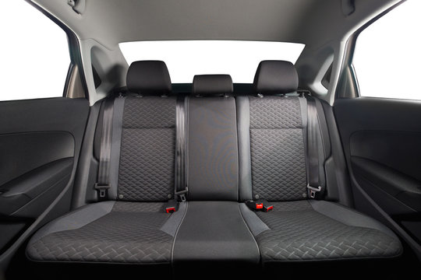
No signal
lots of movement
potential from outside
can’t distract driver with noise
or light at night
motion sickness
possibly noisy outside the car
possibly radio/music/podcast playing

