Slide 1
(URS101B)
Planning of the Built Environment: Current Planning Practice and Contemporary Planning Issues
Lecture 1: Introduction

Slide 2
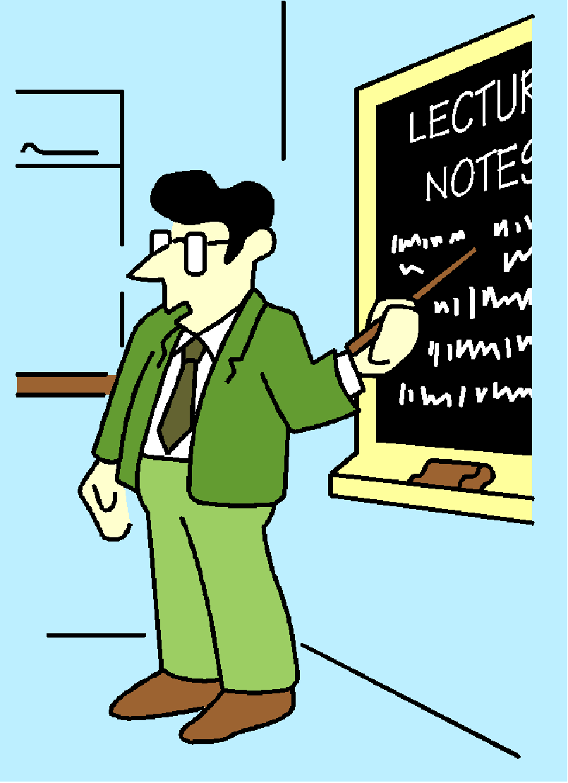
Structure of Session
Introduction
What is planning?
What is the module all about?
Module organisation
Planning System and Reform

Slide 3

Purpose of Session
Introduce the module and links to the previous module
To understand the purpose of planning
To consider recent proposals for change

Slide 4
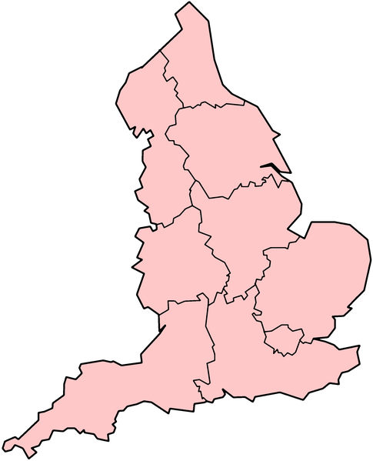
Introduction: Context
England:
  50.5 million population (84% of UK total)
80% of people live in the urban areas
On less than 10% of the land
Highly urbanised

Slide 5
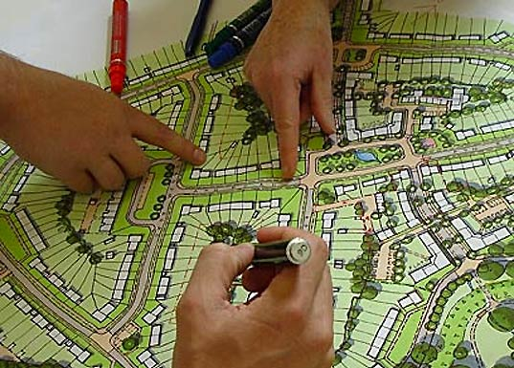
What is Planning?
Long history
Future shape of towns, cities and countryside
Controlling land use in the public interest
Determines what gets built where
Creating better places to live

Slide 6
What is planning?
“Planning is about how we plan for, and make decisions about, the future of our cities, towns and countryside “ (The Planning Portal)
http://www.planningportal.gov.uk/
“Planning is about where stuff goes” (TCPA)
http://www.tcpa.org.uk/data/files/your_place_your_plan.pdf
Notes:
Very generic definition

Slide 7

What is planning?
“The planning system is a vital enabler in securing the long-term well-being of our local communities through sustainable development” (TCPA, 2010,2)

Slide 8
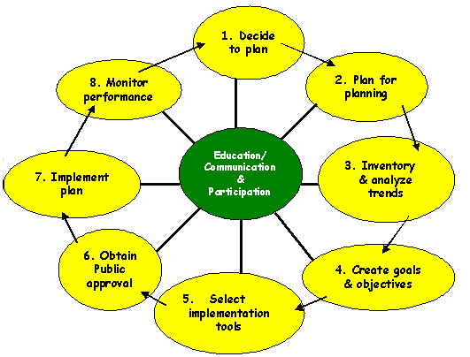
What is Planning?
Future orientated
Primarily a public sector activity
Physical, spatial focus
Regulatory and interventionist
Movement towards a desired end

Slide 9

A balancing act
Planning has been defined as a balancing act between physical, social and economic factors
And between public interest and private interest
Notes:
In many ways planning is a balancing act between private interests on the one hand and the public interest on the other

Slide 10
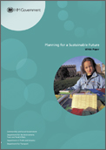
Importance of Planning
Planning is fundamental to quality of people’s lives
Contributes towards economic development and national prosperity
Protects natural and historic environment
Provides key infrastructure
Promotes sustainable development
Planning White Paper 2007

Slide 11

Module Objectives
To have acquired an understanding of the nature and operation of the planning system
To be aware of key issues in the urban and rural environment
To have extended your knowledge of how planning impacts on the environment
To have an appreciation of the role of planning in shaping the built environment

Slide 12
Module Organisation
Practical and policy orientated
  Introduction, Planning Theory, Planning Practice, Key Issues in Planning and Revision and Evaluation
Practitioner perspective
Questions and discussion welcome
Assessment - 2 hour examination in May - 3 questions out of 8
Semester 2 work only

Slide 13
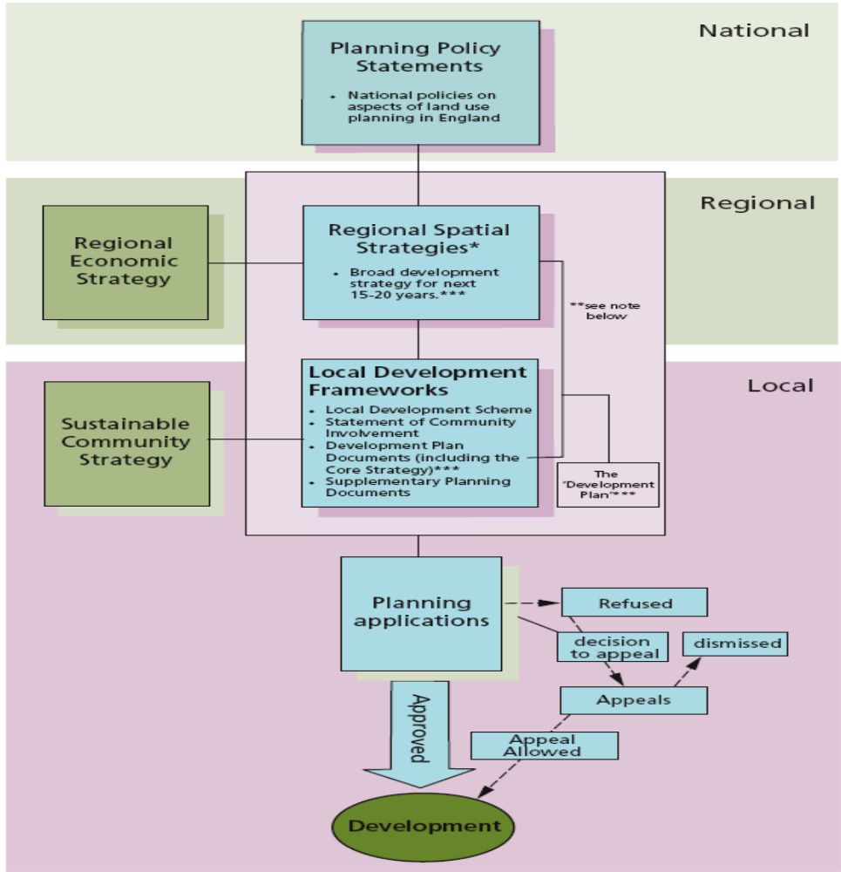
The
English Planning System (Pre 2011)
Source: Planning White Paper (2007) Executive Summary

Slide 14
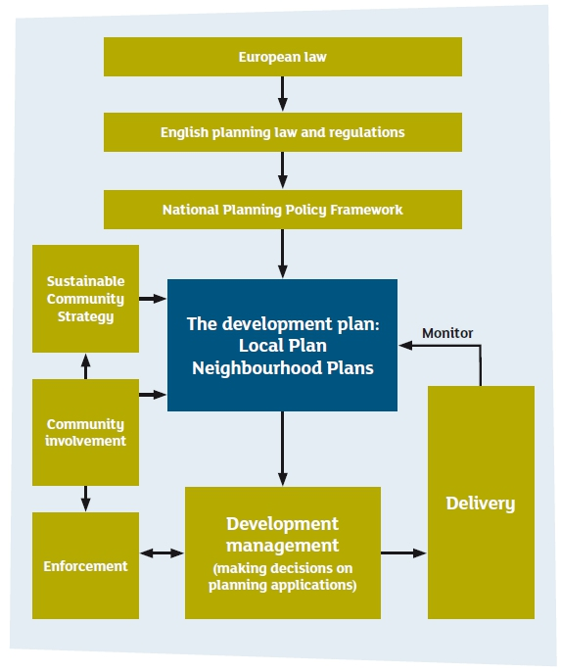
The New English Planning System (post 2011) http://www.planninghelp.org.uk/improve-where-you-live/how-your-council-makes-planning-decisions/key-components-of-the-planning-system

Slide 15
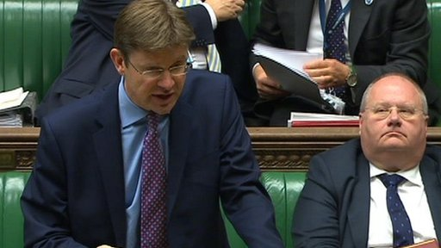

Road to Reform
Planning Green Paper 2001
Planning and Compulsory Purchase Act 2004
Barker Review 2006
Planning White Paper 2007
Planning Act 2008
Localism Act 2011

Slide 16
Planning System Reform
simplify complex development plans
increase speed of plan production
simplify development control
better engagement with the community
culture change - positive role
Planning Green Paper “Planning - Delivering Fundamental Reform” December 2001

Slide 17

Planning and Compulsory Purchase Act 2004
Main provisions:
PPG Notes PPS and
Good Practice Guides
Structure Plans abolished
RPG RSS
Flexible local plan policy LDF
Development control streamlined
Wider compulsory purchase powers

Slide 18
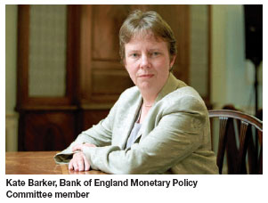
Kate Barker Review of Planning 2006
Streamlining policy and process
Update national policy on planning for economic development
Introduce new system for dealing with major infrastructure projects
Promote positive planning culture
More risk-based and proportionate approach to regulation

Slide 19

Planning White Paper 2007
Planning must be responsive to longer term challenges
Must be streamlined, efficient and predictable
Full and fair opportunities for public consultation and community engagement
Transparent and accountable
Undertaken at the right level

Slide 20
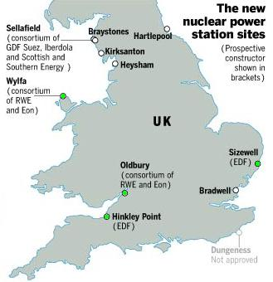
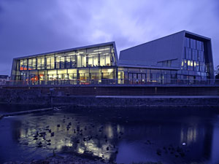
2008 Planning Act

Slide 21

Open Source Planning Green Paper (2010)
“Broken” planning system
Open source democracy
Neighbourhood involvement
Sustainable development
Abolition of RSSs

Slide 22

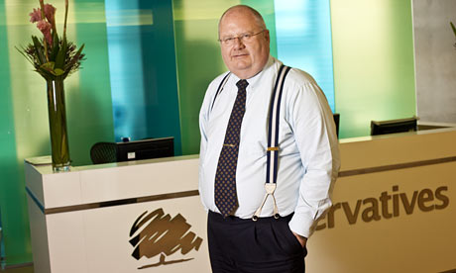
Coalition Government
2010
Two key goals:
    Deficit reduction
    Smaller state
Key themes
  Big Society
  Localism
  Major Planning Reform

Slide 23




Bonfire of the Quangos

Slide 24
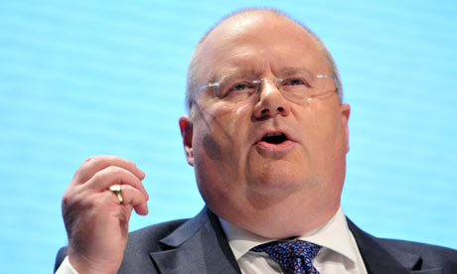
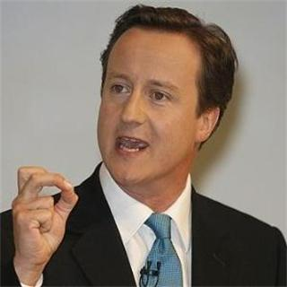
Tory Party Views on Planning
City Planning Offices are “bastions of communism”
(Pickles)
“Enemies of enterprise” (Cameron)
“Let’s get the Planners off our backs”

Slide 25
Major Planning Reforms in Localism Act 2011
Abolition of RSSs
Duty to Co-operate
Neighbourhood planning
Community right to build
Developer consultation
Strengthening enforcement rules
Reforming CIL
Reforming way local plans are made
Abolition of IPC
Directly elected mayors
Community right to bid (assets of community value)

Slide 26

National Planning Policy Framework
New system based on PPSs and PPGs
Light touch – minimal guidance
New style bottom-up local plans
Sits alongside National Policy Statements
Statutory document

Slide 27
National Planning Policy Framework
Key features:
  Fewer rules
  Presumption in favour of sustainable development
  Local plan – central
  Supports an economic growth agenda
  Duty to co-operate
  Targets replaced with incentives
  Neighbourhood planning

Slide 28

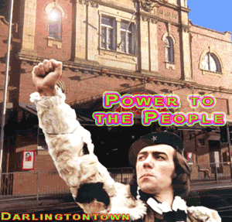
Neighbourhood Planning

Slide 29
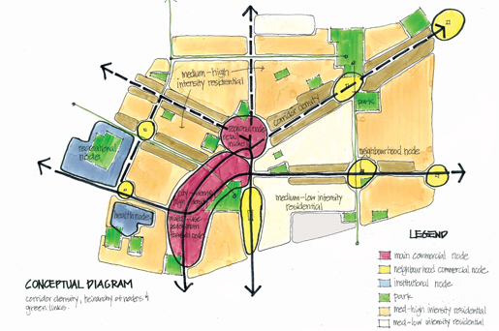
Neighbourhood planning
Core of the decentralisation, Big Society, localism agenda
Community-led
Power to community:
  To determine where they want development
  To have a say on urban design
  To grant planning permission for new development they support
Voluntary

Slide 30
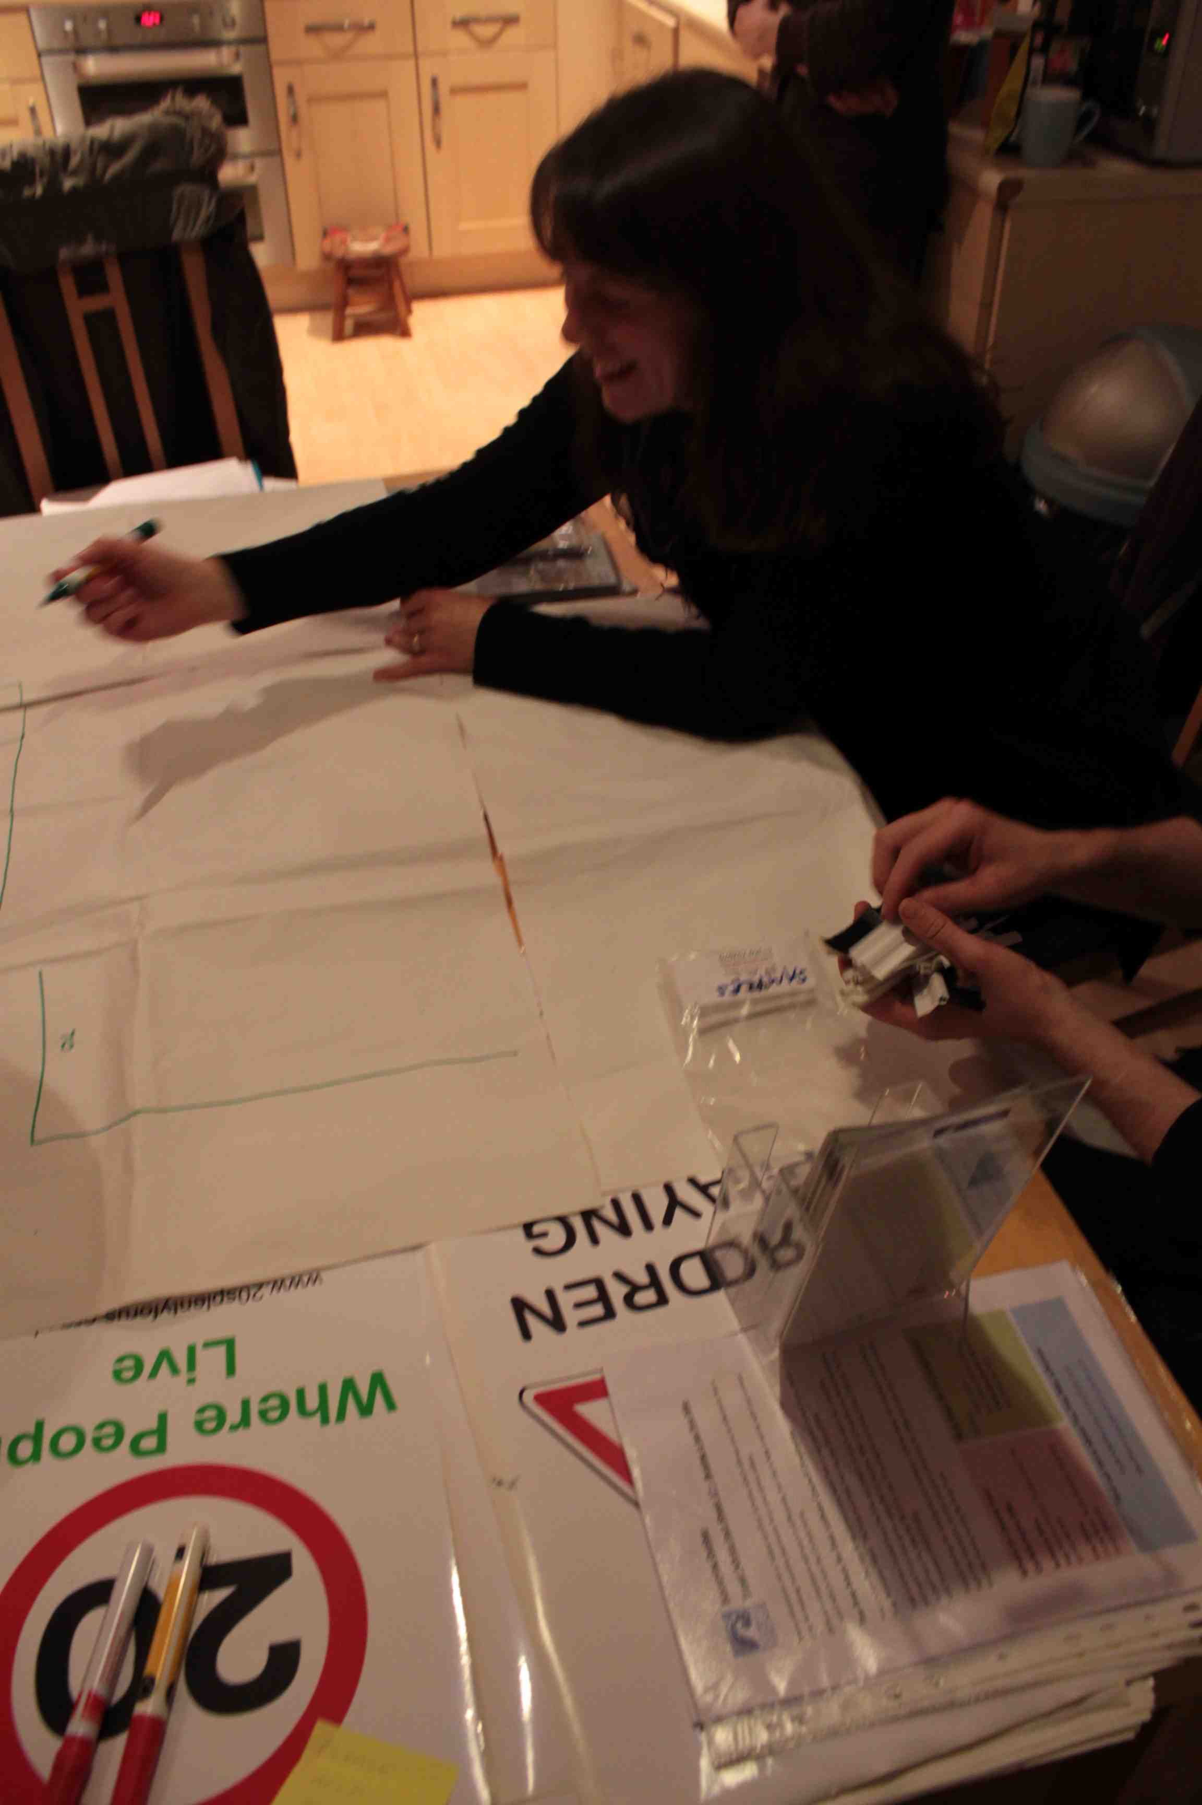
Neighbourhood Planning Process
Define the neighbourhood
Prepare the plan
Get it checked independently
Hold a referendum
Adopt the plan

Slide 31
Summary
Link with last semester work
Considered what is planning?
Introduced module content and organisation
Current legislation and recent proposals for change
Planning in the Government spotlight – election year
Provides useful background for rest of sessions

