Slide 1

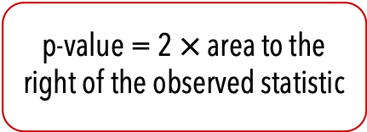

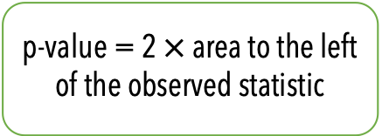
Start
What type of test?
Left-tailed
Two-tailed
Right-tailed
Is the observed statistic to the right or left of the centre?
Left
Right
p-value = area to the left of the observed statistic
p-value = 2 $×$ area to the left of the observed statistic
p-value = 2 $×$ area to the right of the observed statistic
p-value = area to the right of the observed statistic
p-value
p-value = 2 $×$ this area
p-value = 2 $×$ this area
p-value
observed statistic
observed statistic
observed statistic
observed statistic

