Slide 1

Workshop on Numerical Simulation
    Mohammed Alsubeihi, Kimiya Ramezani
    Department of Chemical Engineering, The University of Manchester, United Kingdom
    22/10/2025

Slide 2
Please note that the lecture day, time, and location for next week are different than the usual ones

Slide 3
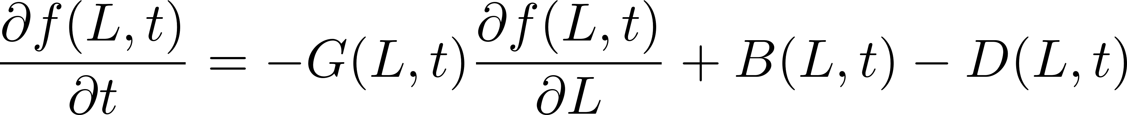
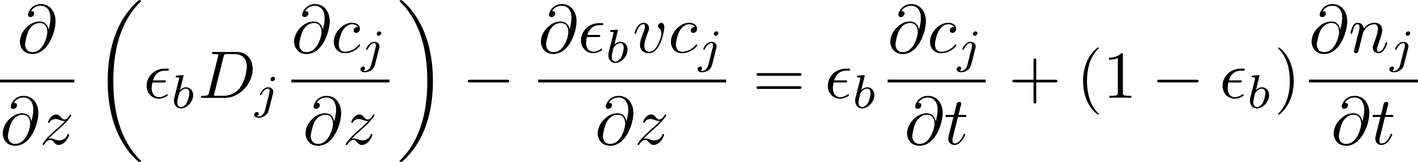
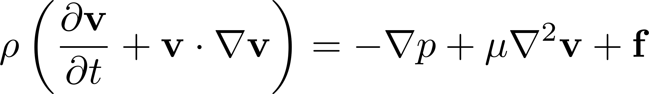
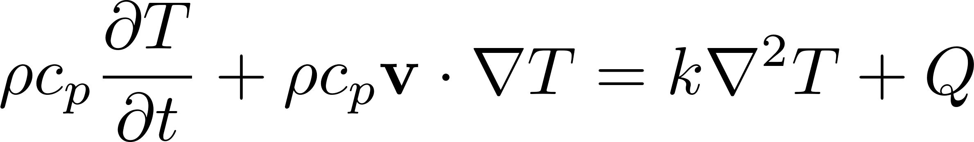
Introduction
Common equations in chemical Engineering
Population Balance Equation
Adsorption Mass Balance Equation
Navier-Stokes Equation
Heat Balance Equation
In chemical engineering, we deal with partial differential equations (PDE) that do not have an analytical solution
KR and MA
Workshop on Numerical Simulation
22/10/2025
Notes:
Presentation in 2 parts

Slide 4
Introduction
Common equations in chemical Engineering
Population Balance Equation
Adsorption Mass Balance Equation
Navier-Stokes Equation
Heat Balance Equation
In chemical engineering, we deal with partial differential equations (PDE) that do not have an analytical solution
The PDEs can be converted to ODEs using numerical approximations.
KR and MA
Workshop on Numerical Simulation
22/10/2025
Notes:
Presentation in 2 parts

Slide 5
Coursework
Advanced separation processes
Modeling the adsorption of Nitrogen on the selected adsorbents
Adsorption Mass Balance Equation (week 4)
Obtaining the isotherm of N₂ and O₂ on the selected adsorbents (week 2)
Science of formulation
Modeling the crystallization of the selected materials
Population Balance Equation (week 4)
Obtaining the growth and nucleation rate (week 2)
KR and MA
Workshop on Numerical Simulation
22/10/2025
Notes:
Presentation in 2 parts

Slide 6




Advection equation
A fluid enters an empty unpacked pipe at a constant velocity of 2 $m s^{−1}$​. The pipe length is 30 $m$. The solute is transported solely by advection (no diffusion or reaction). The inlet solute concentration increases linearly for the first 5 seconds at a rate of $2 mol m^{−3} s^{−1}$; after 5 seconds it remains constant.
Obtain the concentration distribution over time.
$$L=30 m$$
$$u_{in}=2m s^{−1}$$
$$c_{out}$$
$$c_{in}$$
Copy the question from Canvas
Paste it on to the LLM of your choice
Copy and run the solution on Google Colab
Explain the solution from the LLM and the results you get from running the code
KR and MA
Workshop on Numerical Simulation
22/10/2025
Notes:
Presentation in 2 parts

Slide 7
Advection equation
A fluid enters an empty unpacked pipe at a constant velocity of 2 $m s^{−1}$​. The pipe length is 30 $m$. The solute is transported solely by advection (no diffusion or reaction). The inlet solute concentration increases linearly for the first 5 seconds at a rate of $2 mol m^{−3} s^{−1}$; after 5 seconds it remains constant.
Obtain the concentration distribution over time.
$$L=30 m$$
$$u_{in}=2m s^{−1}$$
$$c_{out}$$
$$c_{in}$$
What do we need to get a model?
KR and MA
Workshop on Numerical Simulation
22/10/2025
Notes:
Presentation in 2 parts

Slide 8

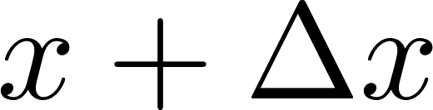
Deriving the equation
A fluid enters an empty unpacked pipe at a constant velocity of 2 $m s^{−1}$​. The pipe length is 30 $m$. The solute is transported solely by advection (no diffusion or reaction). The inlet solute concentration increases linearly for the first 5 seconds at a rate of
$2 mol m^{−3} s^{−1}$; after 5 seconds it remains constant.
Obtain the concentration distribution over time.
$$L=30 m$$
$$u_{in}=2m s^{−1}$$
$$c_{out}$$
$$c_{in}$$
CV
Accumulation= In - Out
KR and MA
Workshop on Numerical Simulation
22/10/2025
Notes:
Presentation in 2 parts

Slide 9
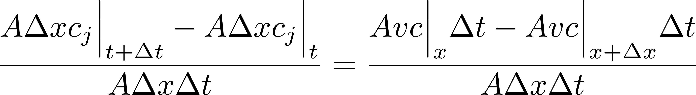
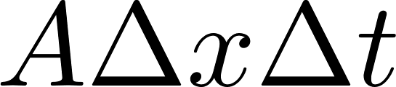
Deriving the equation
A fluid enters an empty unpacked pipe at a constant velocity of 2 $m s^{−1}$​. The pipe length is 30 $m$. The solute is transported solely by advection (no diffusion or reaction). The inlet solute concentration increases linearly for the first 5 seconds at a rate
$2 mol m^{−3} s^{−1}$; after 5 seconds it remains constant.
Obtain the concentration distribution over time.
$$L=30 m$$
$$u_{in}=2m s^{−1}$$
$$c_{out}$$
$$c_{in}$$
CV
Accumulation= In - Out
Dividing the two sides by
KR and MA
Workshop on Numerical Simulation
22/10/2025
Notes:
Presentation in 2 parts

Slide 10
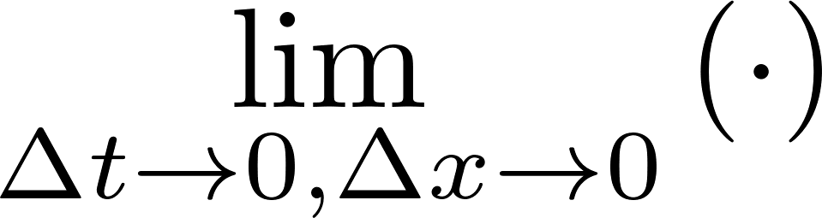
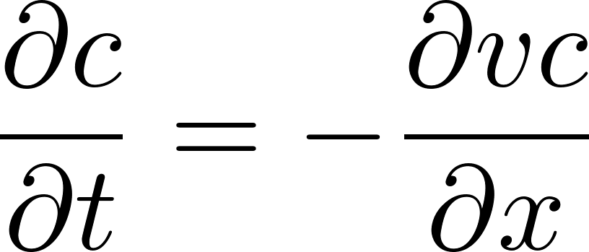
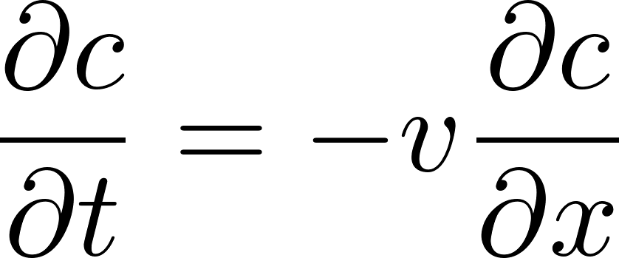
Deriving the equation
A fluid enters an empty unpacked pipe at a constant velocity of 2 $m s^{−1}$​. The pipe length is 30 $m$. The solute is transported solely by advection (no diffusion or reaction). The inlet solute concentration increases linearly for the first 5 seconds at a rate
$2 mol m^{−3} s^{−1}$; after 5 seconds it remains constant.
Obtain the concentration distribution over time.
$$L=30 m$$
$$u_{in}=2m s^{−1}$$
$$c_{out}$$
$$c_{in}$$
CV
Accumulation= In - Out
Dividing the two sides by
Constant velocity
KR and MA
Workshop on Numerical Simulation
22/10/2025
Notes:
Presentation in 2 parts

Slide 11
Deriving the equation
A fluid enters an empty unpacked pipe at a constant velocity of 2 $m s^{−1}$​. The pipe length is 30 $m$. The solute is transported solely by advection (no diffusion or reaction). The inlet solute concentration increases linearly for the first 5 seconds at a rate
$2 mol m^{−3} s^{−1}$; after 5 seconds it remains constant.
Obtain the concentration distribution over time.
$$L=30 m$$
$$u_{in}=2m s^{−1}$$
$$c_{out}$$
$$c_{in}$$
CV
Accumulation= In - Out
What do you need to solve the partial differential equation?
Dividing the two sides by
Constant velocity
KR and MA
Workshop on Numerical Simulation
22/10/2025
Notes:
Presentation in 2 parts

Slide 12
Deriving the equation
A fluid enters an empty unpacked pipe at a constant velocity of 2 $m s^{−1}$​. The pipe length is 30 $m$. The solute is transported solely by advection (no diffusion or reaction). The inlet solute concentration increases linearly for the first 5 seconds at a rate
$2 mol m^{−3} s^{−1}$; after 5 seconds it remains constant.
Obtain the concentration distribution over time.
$$L=30 m$$
$$u_{in}=2m s^{−1}$$
$$c_{out}$$
$$c_{in}$$
CV
In total, how many initial and boundary conditions do you need?
KR and MA
Workshop on Numerical Simulation
22/10/2025
Notes:
Presentation in 2 parts

Slide 13



Initial and Boundary Conditions
A fluid enters an empty unpacked pipe at a constant velocity of 2 $m s^{−1}$​. The pipe length is 30 $m$. The solute is transported solely by advection (no diffusion or reaction). The inlet solute concentration increases linearly for the first 5 seconds at a rate
$2 mol m^{−3} s^{−1}$; after 5 seconds it remains constant.
Obtain the concentration distribution over time.
$$L=30 m$$
$$u_{in}=2m s^{−1}$$
$$c_{out}$$
$$c_{in}$$
Initial condition
Initial state of concentration in the pipe
$${c(t=0,x)}_{}=0 mol m^{−3}$$
$$t=0$$
KR and MA
Workshop on Numerical Simulation
22/10/2025
Notes:
Presentation in 2 parts

Slide 14



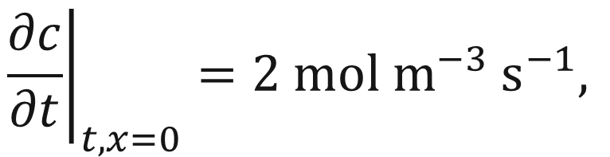
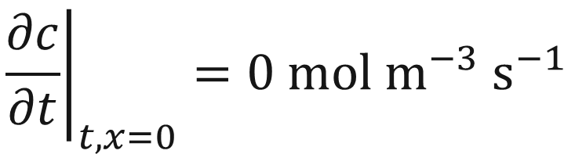

Initial and Boundary Conditions
A fluid enters an empty unpacked pipe at a constant velocity of 2 $m s^{−1}$​. The pipe length is 30 $m$. The solute is transported solely by advection (no diffusion or reaction). The inlet solute concentration increases linearly for the first 5 seconds at a rate
$2 mol m^{−3} s^{−1}$; after 5 seconds it remains constant.
Obtain the concentration distribution over time.
$$L=30 m$$
$$u_{in}=2m s^{−1}$$
$$c_{out}$$
$$c_{in}$$
Initial condition
Initial state of concentration in the pipe
$${c(t=0,x)}_{}=0 mol m^{−3}$$
$$t=0$$
$${\left.\frac{∂c}{∂t}\right|}_{t,x=0}=2 mol m^{−3} s^{−1},$$
$$t<5$$
Inlet boundary condition
Boundary conditions
$$x=0$$
$${\left.\frac{∂c}{∂t}\right|}_{t,x=0}=0 mol m^{−3} s^{−1}$$
$$t≥5$$
Outlet boundary condition
$$x=L$$
KR and MA
Workshop on Numerical Simulation
22/10/2025
Notes:
Presentation in 2 parts

Slide 15
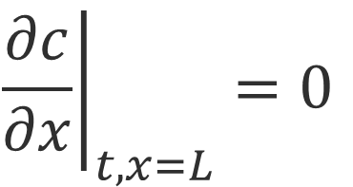
Initial and Boundary Conditions
A fluid enters an empty unpacked pipe at a constant velocity of 2 $m s^{−1}$​. The pipe length is 30 $m$. The solute is transported solely by advection (no diffusion or reaction). The inlet solute concentration increases linearly for the first 5 seconds at a rate
$2 mol m^{−3} s^{−1}$; after 5 seconds it remains constant.
Obtain the concentration distribution over time.
$$L=30 m$$
$$u_{in}=2m s^{−1}$$
$$c_{out}$$
$$c_{in}$$
Initial condition
Initial state of concentration in the pipe
$${c(t=0,x)}_{}=0 mol m^{−3}$$
$$t=0$$
$${\left.\frac{∂c}{∂t}\right|}_{t,x=0}=2 mol m^{−3} s^{−1},$$
$$t<5$$
Inlet boundary condition
Boundary conditions
$$x=0$$
$${\left.\frac{∂c}{∂t}\right|}_{t,x=0}=0 mol m^{−3} s^{−1}$$
$$t≥5$$
Outlet boundary condition
$${\left.\frac{∂c}{∂x}\right|}_{t,x=L}=0$$
Outlet concentration is the same as the last cell
$$x=L$$
KR and MA
Workshop on Numerical Simulation
22/10/2025
Notes:
Presentation in 2 parts

Slide 16
Complete section 1 in the notebook
    (~10 minutes)

Slide 17
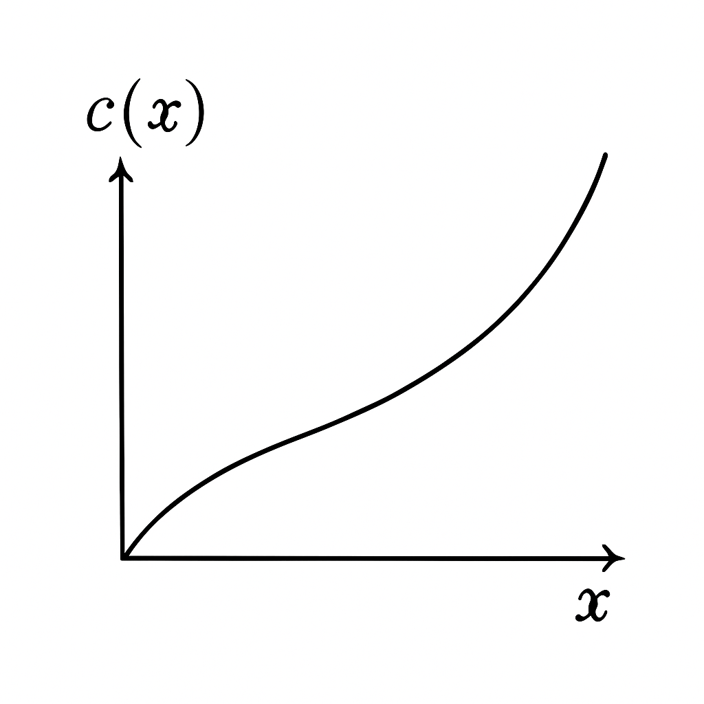





Converting PDE to ODE
PDE
$$c(x)$$
True
slope
$$x_{i−1}$$
$$x_{i}$$
$$x_{i+1}$$
$$x$$
KR and MA
Workshop on Numerical Simulation
22/10/2025
Back
Notes:
Presentation in 2 parts

Slide 18



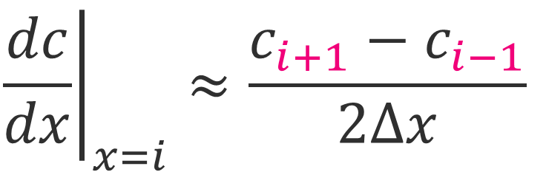

Converting PDE to ODE
Central difference
$${\left.\frac{dc}{dx}\right|}_{x=i}≈\frac{c_{i+1}−c_{i−1}}{2∆x}$$
PDE
$$c(x)$$
Approximated
slope
True
slope
$$x_{i−1}$$
$$x_{i}$$
$$x_{i+1}$$
$$x$$
$$∆x$$
$$∆x$$
KR and MA
Workshop on Numerical Simulation
22/10/2025
Notes:
Presentation in 2 parts

Slide 19

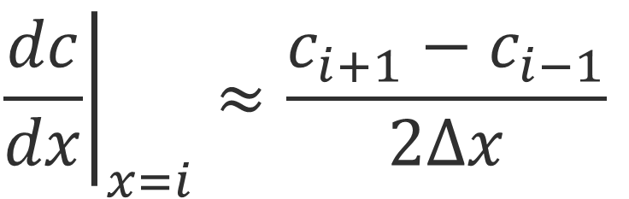
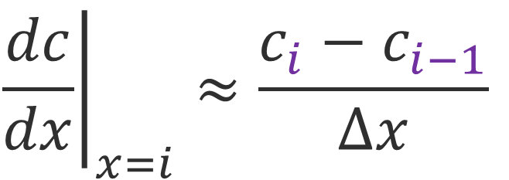

Converting PDE to ODE
Central difference
Backward difference
$${\left.\frac{dc}{dx}\right|}_{x=i}≈\frac{c_{i+1}−c_{i−1}}{2∆x}$$
$${\left.\frac{dc}{dx}\right|}_{x=i}≈\frac{c_{i}−c_{i−1}}{∆x}$$
PDE
$$c(x)$$
True
slope
Approximated
slope
$$x_{i−1}$$
$$x_{i}$$
$$x_{i+1}$$
$$x$$
$$∆x$$
KR and MA
Workshop on Numerical Simulation
22/10/2025
Notes:
Presentation in 2 parts

Slide 20
Converting PDE to ODE
Central difference
Backward difference
$${\left.\frac{dc}{dx}\right|}_{x=i}≈\frac{c_{i+1}−c_{i−1}}{2∆x}$$
$${\left.\frac{dc}{dx}\right|}_{x=i}≈\frac{c_{i}−c_{i−1}}{∆x}$$
PDE
$$c(x)$$
True
slope
Approximated
slope
$$x_{i−1}$$
$$x_{i}$$
$$x_{i+1}$$
$$x$$
$$∆x$$
Would you prefer a smaller or larger Δx?
KR and MA
Workshop on Numerical Simulation
22/10/2025
Notes:
Presentation in 2 parts

Slide 21


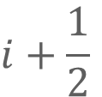
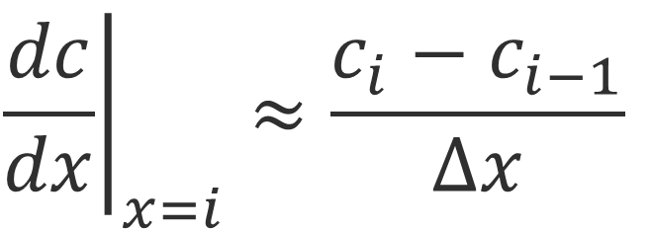


Converting PDE to ODE
Central difference
Backward difference
$${\left.\frac{dc}{dx}\right|}_{x=i}≈\frac{c_{i+1}−c_{i−1}}{2∆x}$$
$${\left.\frac{dc}{dx}\right|}_{x=i}≈\frac{c_{i}−c_{i−1}}{∆x}$$
PDE
Discretize the spatial domain but keep the time domain continuous
$$c(x)$$
$$L$$
$$≈$$
i=0
i=1
i=2
i=n-2
i=n-1
i=n
True
slope
Approximated
slope
$$≈$$
$$i+\frac{1}{2}$$
$$x_{i−1}$$
$$x_{i}$$
$$x_{i+1}$$
$$x$$
$$∆x$$
$$∆x$$
KR and MA
Workshop on Numerical Simulation
22/10/2025
Notes:
Presentation in 2 parts

Slide 22

Converting PDE to ODE
Central difference
Backward difference
$${\left.\frac{dc}{dx}\right|}_{x=i}≈\frac{c_{i+1}−c_{i−1}}{2∆x}$$
$${\left.\frac{dc}{dx}\right|}_{x=i}≈\frac{c_{i}−c_{i−1}}{∆x}$$
PDE
Discretize the spatial domain but keep the time domain continuous
$$c(x)$$
$$L$$
$$≈$$
i=0
i=1
i=2
i=n-2
i=n-1
i=n
True
slope
Approximated
slope
$$≈$$
$$i+\frac{1}{2}$$
$$x_{i−1}$$
$$x_{i}$$
$$x_{i+1}$$
$$x$$
$$∆x$$
$$∆x$$
Initial condition
$${c(t=0,x)}_{}=0 mol m^{−3}$$
KR and MA
Workshop on Numerical Simulation
22/10/2025
Back
Notes:
Presentation in 2 parts

Slide 23
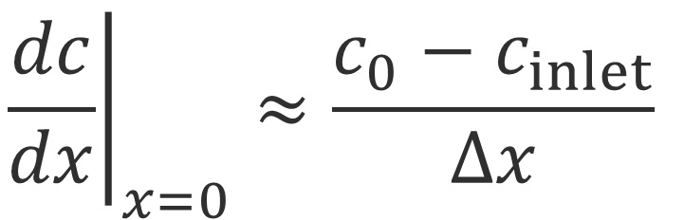
Converting PDE to ODE
Central difference
Backward difference
$${\left.\frac{dc}{dx}\right|}_{x=i}≈\frac{c_{i+1}−c_{i−1}}{2∆x}$$
$${\left.\frac{dc}{dx}\right|}_{x=i}≈\frac{c_{i}−c_{i−1}}{∆x}$$
PDE
Discretize the spatial domain but keep the time domain continuous
$$c(x)$$
$$L$$
$$≈$$
inlet
i=0
i=1
i=2
i=n-2
i=n-1
i=n
True
slope
Approximated
slope
$$≈$$
$$i+\frac{1}{2}$$
$$x_{i−1}$$
$$x_{i}$$
$$x_{i+1}$$
$$x$$
$$∆x$$
$$∆x$$
Initial condition
$${c(t=0,x)}_{}=0 mol m^{−3}$$
$${\left.\frac{dc}{dx}\right|}_{x=0}≈\frac{c_{0}−c_{inlet}}{∆x}$$
Inlet boundary condition
KR and MA
Workshop on Numerical Simulation
22/10/2025
Notes:
Presentation in 2 parts

Slide 24
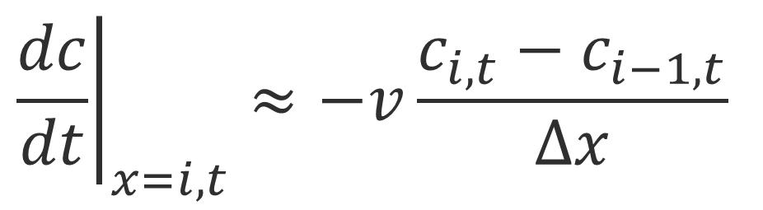
Converting PDE to ODE
Central difference
Backward difference
$${\left.\frac{dc}{dx}\right|}_{x=i}≈\frac{c_{i+1}−c_{i−1}}{2∆x}$$
$${\left.\frac{dc}{dx}\right|}_{x=i}≈\frac{c_{i}−c_{i−1}}{∆x}$$
PDE
Discretize the spatial domain but keep the time domain continuous
$$c(x)$$
$$L$$
$$≈$$
inlet
i=0
i=1
i=2
i=n-2
i=n-1
i=n
True
slope
Approximated
slope
$$≈$$
$$i+\frac{1}{2}$$
$$x_{i−1}$$
$$x_{i}$$
$$x_{i+1}$$
$$x$$
$$∆x$$
$$∆x$$
ODE
solved by ode solver
Initial condition
$${c(t=0,x)}_{}=0 mol m^{−3}$$
$${\left.\frac{dc}{dx}\right|}_{x=0}≈\frac{c_{0}−c_{inlet}}{∆x}$$
$${\left.\frac{dc}{dt}\right|}_{x=i, t}≈−v\frac{c_{i,t}−c_{i−1,t}}{∆x}$$
Inlet boundary condition
KR and MA
Workshop on Numerical Simulation
22/10/2025
Notes:
Presentation in 2 parts

Slide 25
Converting PDE to ODE
Central difference
Backward difference
$${\left.\frac{dc}{dx}\right|}_{x=i}≈\frac{c_{i+1}−c_{i−1}}{2∆x}$$
$${\left.\frac{dc}{dx}\right|}_{x=i}≈\frac{c_{i}−c_{i−1}}{∆x}$$
PDE
Discretize the spatial domain but keep the time domain continuous
$$c(x)$$
$$L$$
$$≈$$
inlet
i=0
i=1
i=2
i=n-2
i=n-1
i=n
True
slope
1
Approximated
slope
$$≈$$
$$i+\frac{1}{2}$$
4
Import solve_ivp from scipy.integrate and choose a method to solve the ode
$$x_{i−1}$$
$$x_{i}$$
$$x_{i+1}$$
$$x$$
$$∆x$$
$$∆x$$
ODE
solved by ode solver
2
Initial condition
$${c(t=0,x)}_{}=0 mol m^{−3}$$
$${\left.\frac{dc}{dx}\right|}_{x=0}≈\frac{c_{0}−c_{inlet}}{∆x}$$
$${\left.\frac{dc}{dt}\right|}_{x=i, t}≈−v\frac{c_{i,t}−c_{i−1,t}}{∆x}$$
3
Inlet boundary condition
KR and MA
Workshop on Numerical Simulation
22/10/2025
Notes:
Presentation in 2 parts

Slide 26

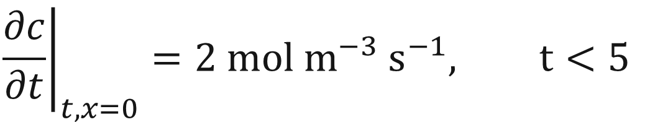



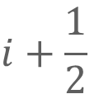
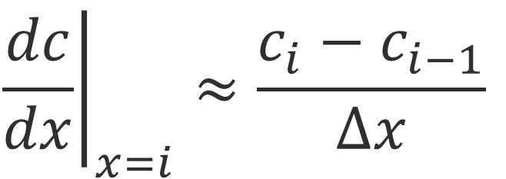


Converting PDE to ODE
PDE
Discretize the spatial domain but keep the time domain continuous
$$L$$
$$≈$$
inlet
i=0
i=1
i=2
i=n-2
i=n-1
i=n
$$≈$$
$$i+\frac{1}{2}$$
$$∆x$$
Finite Difference Approximation
Central difference
Backward difference
Inlet boundary condition
$${\left.\frac{dc}{dx}\right|}_{x=i}≈\frac{c_{i+1}−c_{i−1}}{2∆x}$$
$${\left.\frac{dc}{dx}\right|}_{x=i}≈\frac{c_{i}−c_{i−1}}{∆x}$$
$${\left.\frac{dc}{dx}\right|}_{x=0}≈\frac{c_{0}−c_{inlet}}{∆x}$$
$${\left.\frac{∂c}{∂t}\right|}_{t,x=0}=2 mol m^{−3} s^{−1}, t<5$$
KR and MA
Workshop on Numerical Simulation
22/10/2025
Notes:
Presentation in 2 parts

Slide 27
Complete section 2.1 in the notebook
    (~5 minutes)

Slide 28
Break
    (~10 minutes)

Slide 29
Complete section 2.2 in the notebook
    (~15 minutes)

Slide 30
Complete section 3 in the notebook
    (~10 minutes)

Slide 31
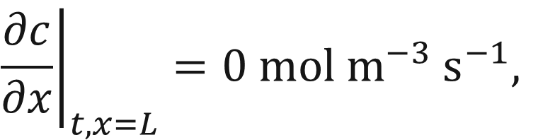
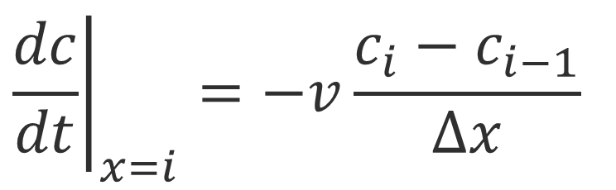


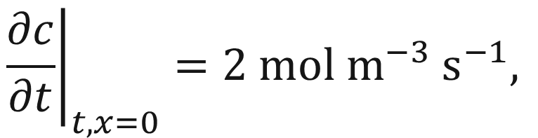
Summary
A fluid enters an empty unpacked pipe at a constant velocity of 2 $m s^{−1}$​. The pipe length is 30 $m$. The solute is transported solely by advection (no diffusion or reaction). The inlet solute concentration increases linearly for the first 5 seconds at a rate
$2 mol m^{−3} s^{−1}$; after 5 seconds it remains constant.
[40461/60461] - How would you solve an adsorption model?
1- Derive the equation
2- Determine the initial and boundary conditions
$${c(t=0,x)}_{}=0 mol m^{−3}$$
$${\left.\frac{∂c}{∂t}\right|}_{t,x=0}=2 mol m^{−3} s^{−1},$$
$$t<5$$
$${\left.\frac{∂c}{∂x}\right|}_{t,x=L}=0 mol m^{−3} s^{−1},$$
$$t≥5$$
3- Discretize the spatial domain and solve the spatial domain using the finite difference method
0de15s or
solve_ivp
$${\left.\frac{dc}{dt}\right|}_{x=i}=−v\frac{c_{i}−c_{i−1}}{∆x}$$
finite difference approximation
KR and MA
Workshop on Numerical Simulation
22/10/2025
Notes:
Presentation in 2 parts

Slide 32
Summary
A fluid enters an empty unpacked pipe at a constant velocity of 2 $m s^{−1}$​. The pipe length is 30 $m$. The solute is transported solely by advection (no diffusion or reaction). The inlet solute concentration increases linearly for the first 5 seconds at a rate
$2 mol m^{−3} s^{−1}$; after 5 seconds it remains constant.
[40461/60461] - How would you solve an adsorption model?
1- Derive the equation
$${c(t=0,x)}_{}=0 mol m^{−3}$$
[40441/60441] - How would you solve a crystallization model?
2- Determine the initial and boundary conditions
$${\left.\frac{∂c}{∂t}\right|}_{t,x=0}=2 mol m^{−3} s^{−1},$$
$$t<5$$
$${\left.\frac{∂c}{∂x}\right|}_{t,x=L}=0 mol m^{−3} s^{−1},$$
$$t≥5$$
3- Discretize the spatial domain and solve the spatial domain using the finite difference method
0de15s or
solve_ivp
$${\left.\frac{dc}{dt}\right|}_{x=i}=−v\frac{c_{i}−c_{i−1}}{∆x}$$
finite difference approximation
KR and MA
Workshop on Numerical Simulation
22/10/2025
Notes:
Presentation in 2 parts

Slide 33
Break
    (~10 minutes)

Slide 34
Workshop Hackathon
    Goal: use your model to perform a sensitivity analysis on any variable of your choice
    Time limit: 50 minutes
    Deliverables:
    1 slide containing a single figure summarizing your findings
    1-minute presentation explaining what you learned
    Assessment: Ashwin and GTAs
    A small prize🤩

