Slide 1
Hack-A-Bot 2026
HACK-A-BOT 2026
Google Slides theme deck built from the documented site palette and visual board.
Dark canvas
Cool-neutral frame
Red interaction accent
Import this PPTX into Google Slides, then keep it as a starter deck or use it as the theme source for a new presentation.

Slide 2
Theme Principles
Theme Source Deck
Dark technical base with cool-gray structure.
High-contrast type for headings, agendas, and scorecards.
Red reserved for action states, emphasis, and key data points.
Borders and glows stay subtle so content remains primary.

Slide 3
Event Structure
03
Use this layout for agenda breaks, tracks, judging phases, and sponsor sections.

Slide 4
Tracks and Deliverables
Tracks
Deliverables
AI assistants
Automation tools
Student workflows
Team operations
Demo-ready prototype
Pitch narrative
Judging summary
Deployment next step

Slide 5
Presentation Blocks
48
12
6
Teams
Hours
Judges
Use for metrics, counts, or deadlines.
Use for metrics, counts, or deadlines.
Use for metrics, counts, or deadlines.

Slide 6
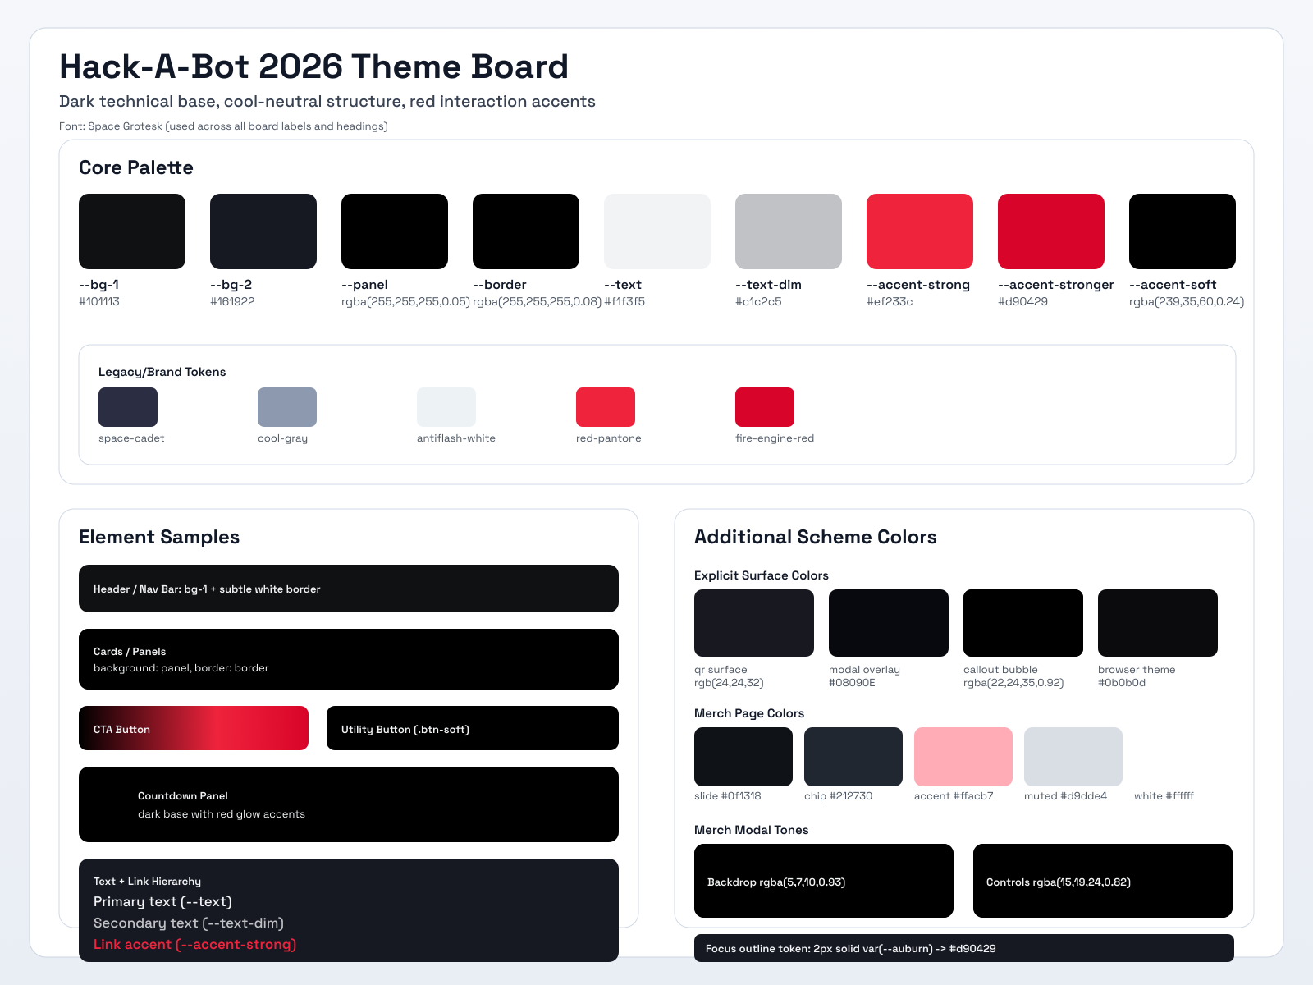
Palette Reference
Core colors taken from the documented site theme.
Canvas
Section
#101113
#161922
Text
Secondary
#F1F3F5
#C1C2C5
Accent
Hover
#EF233C
#D90429
Cool gray
Neutral
#8D99AE
#EDF2F4

