Slide 1
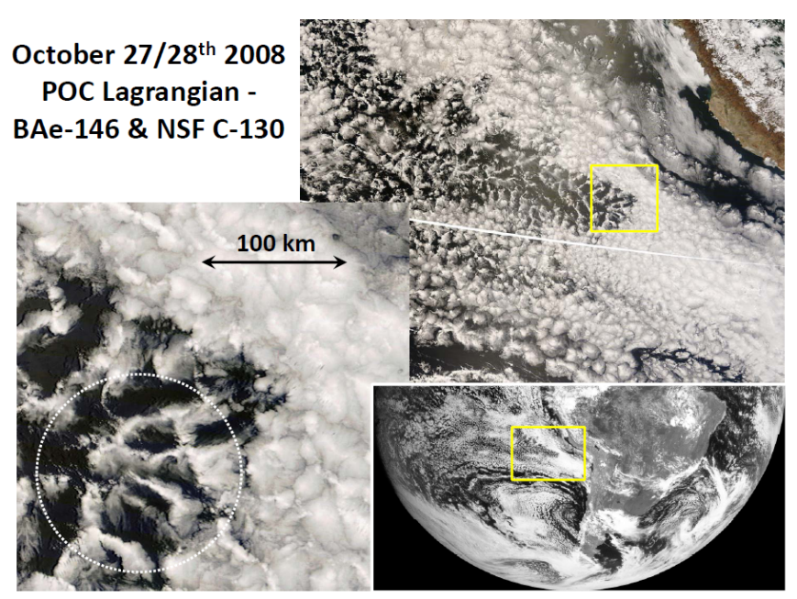
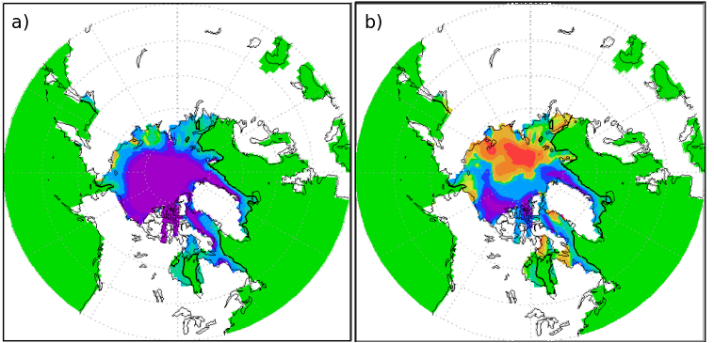
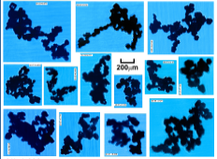

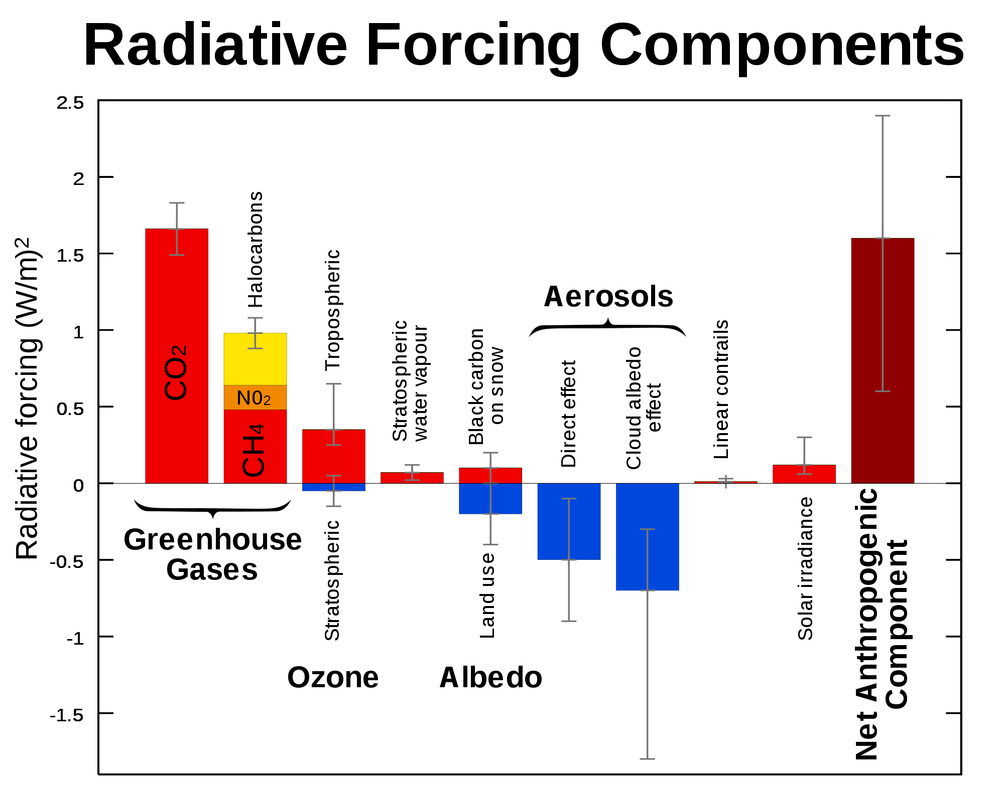
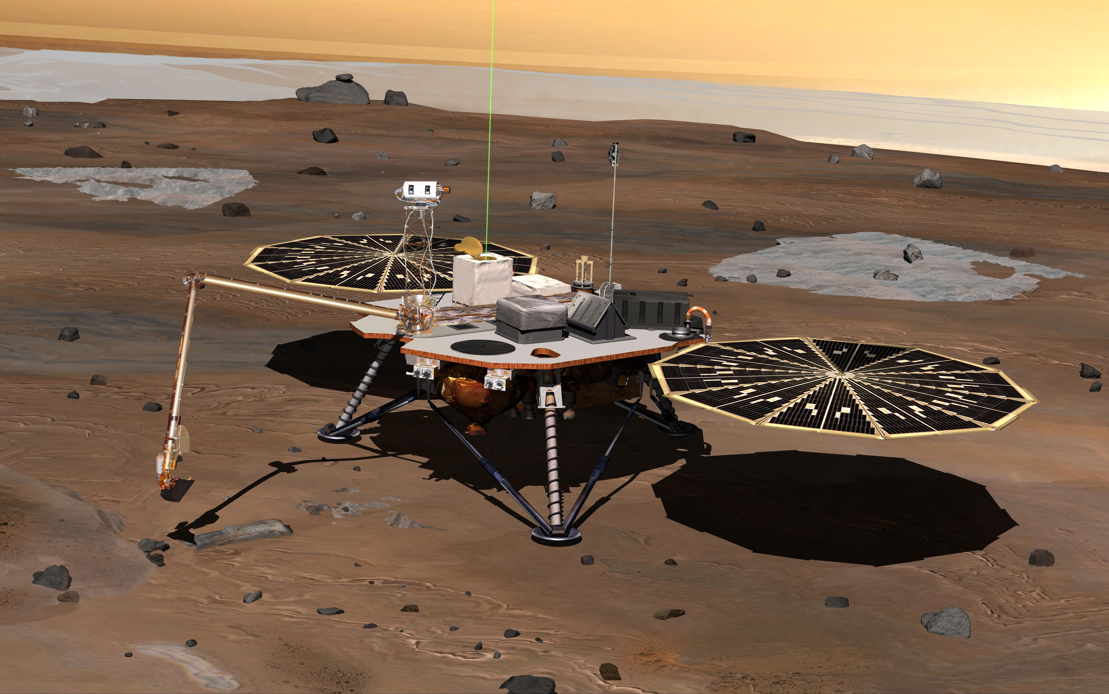
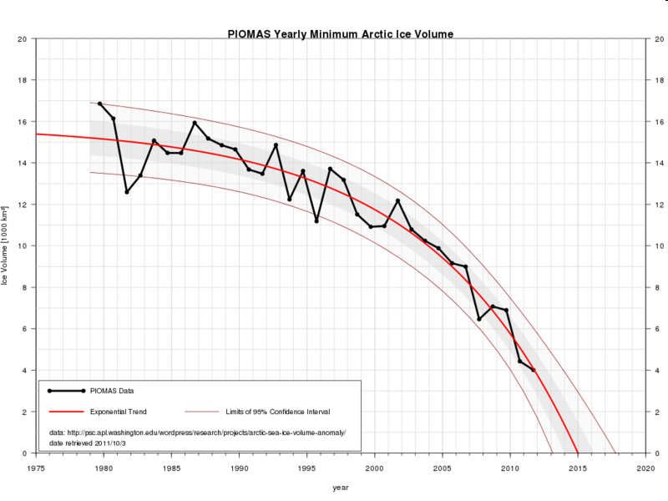
EART20170 data analysis lecture 1: intro to stats and data
Dr Paul Connolly

Slide 2
Outline: Statistics and data
Blackboard and materials
Definitions
Types of data
Common sense approach and attention to detail
Investigations and sampling techniques / problems
Describing and understanding data with histograms and x-y plots
Practical

Slide 3
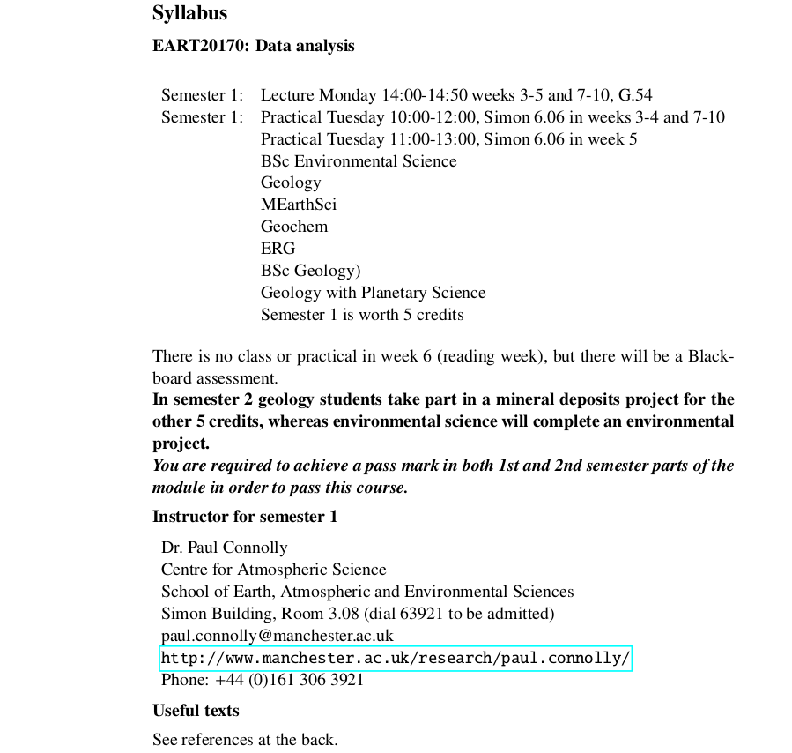

Slide 4

There are two assessments for this week!

Slide 5
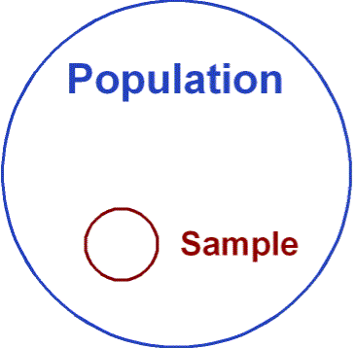
Definitions
Population
  The complete collection of all elements (scores, people, measurements and so on) to be studied; the collection is complete in that it includes all subjects to be studied.
Sample
  Sub-collection of members selected from a population.
Census
  Collection of data from every member of a population (difficult or impossible)

Slide 6
Dealing with data
The subject of statistics is largely about using sample data to make inferences (or generalisations) about an entire population.
Sample data must be collected in an appropriate way, such as through a process of random selection.
  E.g. you could have a biased sample (e.g. traffic survey during rush hour)
  Survey of people with an axe to grind
If sample data are not collected in an appropriate way the data may be useless so that not about of statistical torturing can salvage them.

Slide 7
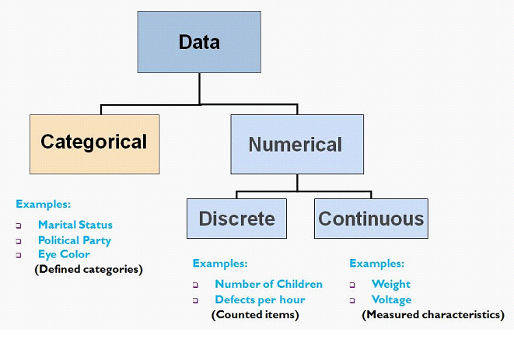
Thinking about your data
(common sense really)
Numerical data
  Numbers representing counts or measurements. E.g. sizes of cloud drops, grain size, pollution amounts.
Qualitative (or categorical) data
  Can be separated into different categories. E.g. genders of academics department
http://rchsbowman.wordpress.com/2009/08/12/

Slide 8
Thinking about your data
(common sense really)
Numerical data can be:
  Discrete data (e.g. number of ice crystals in a cloud).
  Continuous data (e.g. the CO₂ concentration in the atmosphere).
http://rchsbowman.wordpress.com/2009/08/12/

Slide 9
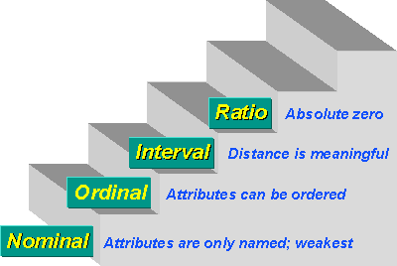
4 Levels of measurement
(I’ve yet to use this in any investigations!)
Nominal level of measurement
  Data that consist of names, labels or categories (cannot be ranked).
  E.g. survey responses (yes or no).
Ordinal level of measurement
  Can be ranked, but differences between data can not be determined.
  E.g. Course grades, or Moh’s hardness scale.
http://www.socialresearchmethods.net/kb/measlevl.php

Slide 10
4 Levels of measurement
(I’ve yet to use this in any investigations!)
Interval level of measurement
  Like the ordinal scale can be ranked AND differences are meaningful. However, no natural zero starting point.
  E.g. years 1000, 2000, 1776 etc.
  Temperature on Celsius scale
Ratio level of measurement
  Like the interval scale, but with a natural zero
  Temperature on Kelvin scale.
  Price of text books.

Slide 11
Planning an investigation and working with data
(a common sense approach)
Success when planning investigations or working with data often requires more common sense than mathematical expertise.
  No point in using a statistical procedure for the sake of it
  Good to know about them as sometimes people try to blind you with statistics!
It also requires attention to detail

Slide 12
Common sense # 1 bad samples
Voluntary response sample (or self selected sample)
  One in which the respondents themselves decide whether to be included.
  E.g. a survey asking whether people believe in human induced global warming.
  In this case, valid conclusion can be made only about the specific group of people who agree to take part.

Slide 13
Common sense #2 small samples
Example: associating increased pollution with mortality by measuring one day of PM10 in a city.
Conclusions should not be based on samples that are far too small because you may sample extremes and assume they are typical.

Slide 14
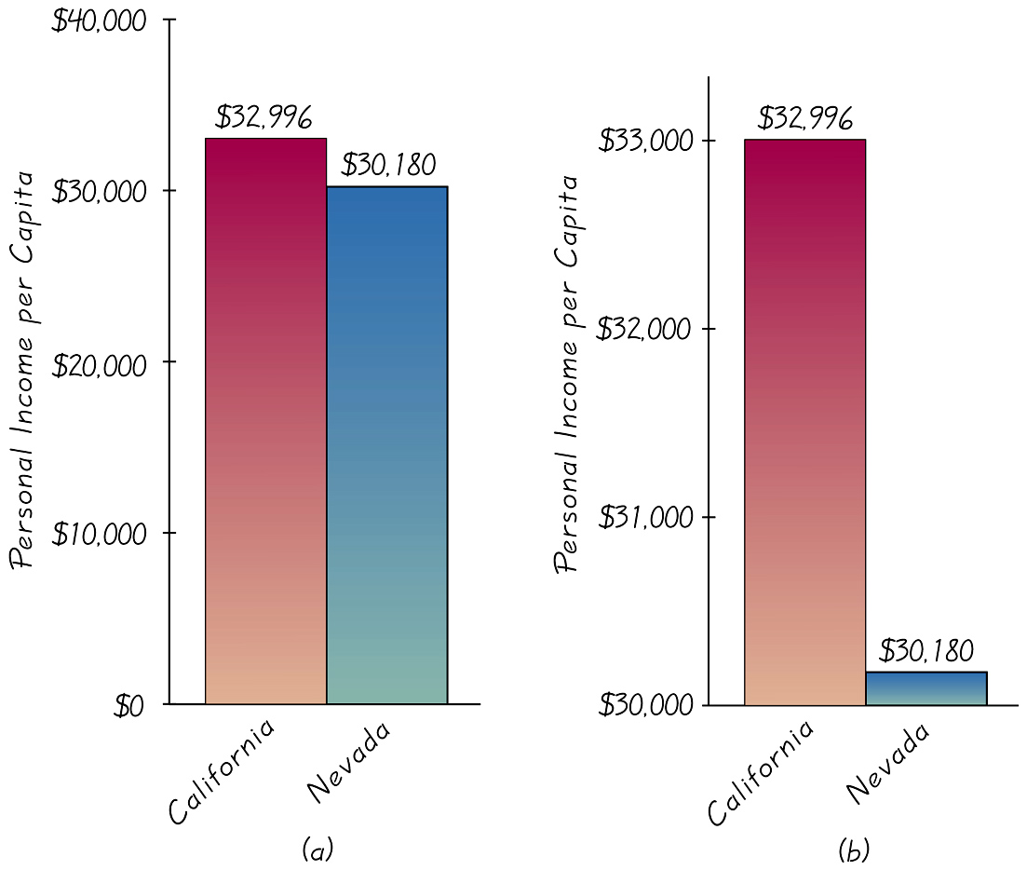
Common sense # 3 graphs
Notes:
Note the scale!

Slide 15
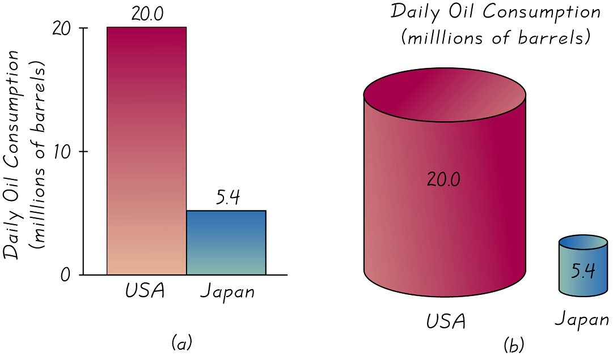
Common sense #4 pictographs
They accentuate the difference by extending both the height and width.

Slide 16
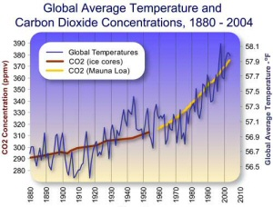
Other misuses of statistics
Correlation is not equal to causality
  E.g. CO₂ vs temperature.
  Most murderers have eaten pickles. Therefore, pickles cause murders.
  Virus `link’ to childhood obesity (BBC september 2010). But maybe obese people are more susceptible to virus?
Precise numbers.
  E.g. pollution or temperature increased by 65.7142857 %
  But the instrumental precision isn’t that good.
http://www.norcalblogs.com/watts/2007/01/2006_hottest_year_on_record_so.html
Notes:
Virus link to causing weight gain.

Slide 17
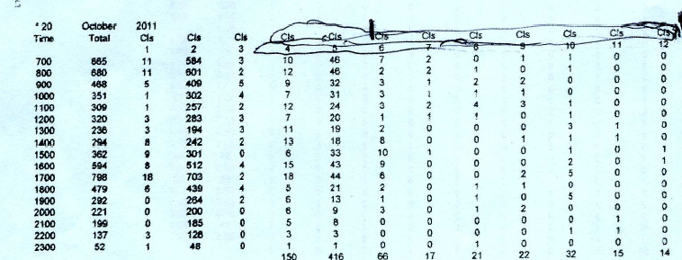
Attention to detail I…
Traffic data used as evidence by a traffic consultant in a recent Public Inquiry

Slide 18
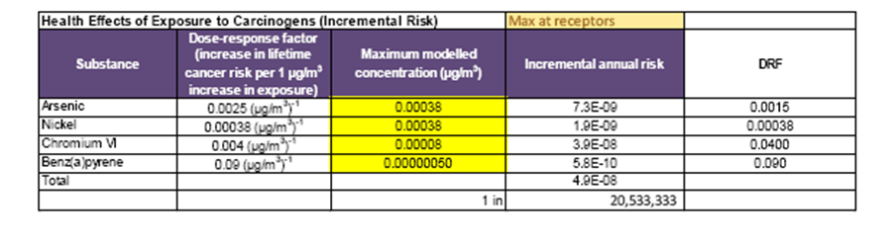
Attention to detail II…
Air quality modelling used as proof to determine health impacts of an incinerator at a recent Public Inquiry…
The Inspector quashed the development!
However, they are appealing to the high court

Slide 19
Types of investigations
(important to get this right!)
Observational study
  Observing and measuring specific characteristics without attempting to modify the subjects being studied.
Experiment
  Apply some treatment and then observe its effects on the subjects; (subjects in experiments are called experimental units).
  E.g. dope cloud drops with volcanic ash in a cloud chamber experiment observe the effects on the cloud

Slide 20
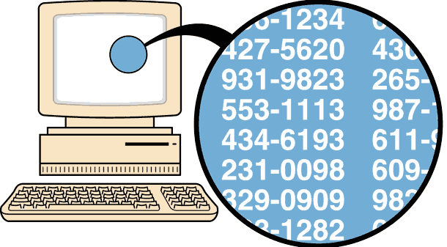
Random (unbiased) sampling
(true random sampling is very difficult to do in practice)
Selection so that each individual member has an equal chance of being selected
  (e.g. respond to a question in a survey)
  or rainfall data over UK (lots of data, every 15 minutes), sample randomly, not biased to times of day, etc – what times would you sample?
  Look at boreholes or samples in detail, which ones would you choose?
  Choose years to analyse wind data – which years?

Slide 21
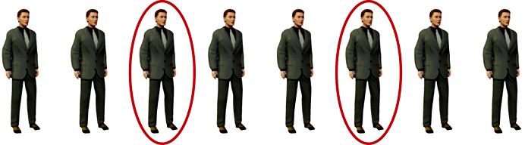
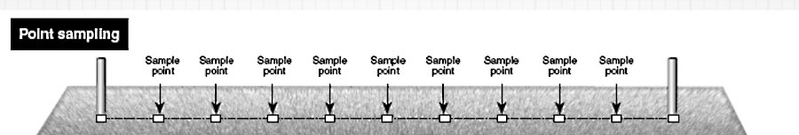
Systematic sampling
(reasonable compromise, good design)
Select some starting point and then select every k th element in the population
For example this could be every 5th ice core sample to be taken to the lab for analysis.

Slide 22
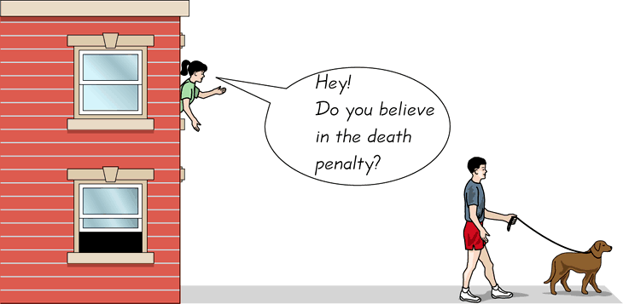
Convenience sampling
(little statistical validity, poor design)
Use results that are easy to get

Slide 23
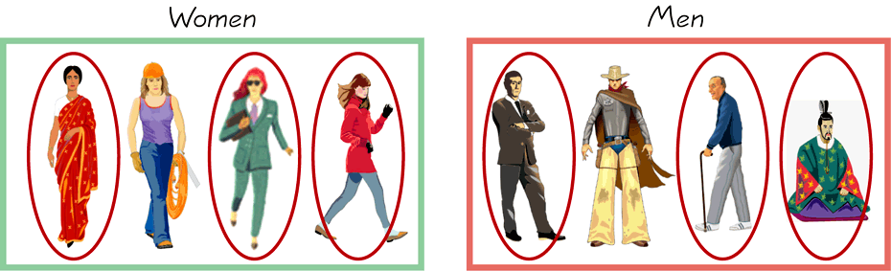
Stratified sampling
(if you wanted to compare groups)
Subdivide the population into at least two different subgroups that share the same characteristics and then draw a sample from each subgroup
  E.g. Men vs Women
  Cumulus vs stratocumulus (in terms of say precipitation rate)
  Are x different or to same as y?

Slide 24
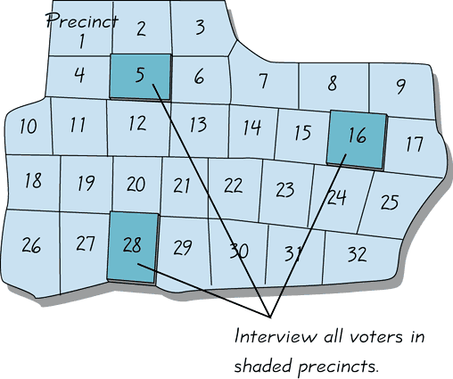
Cluster sampling never really used myself – seems pretty rubbish to me
Divide the population into section (or clusters); randomly select some of those clusters; choose all members from selected clusters.

Slide 25
Errors in investigations
Sampling error (hard to remove)
  The difference between a sample result and the true population result; such an error results from chance sample fluctuations (e.g. heights in class)
Non sampling error
  Sample data incorrectly collected, recorded or analysed.
  E.g. sampled heights of people in class starting at the back of the room (taller people may go to the back of the room?)

Slide 26
Summarising and describing data using histograms and scatter plots

Slide 27
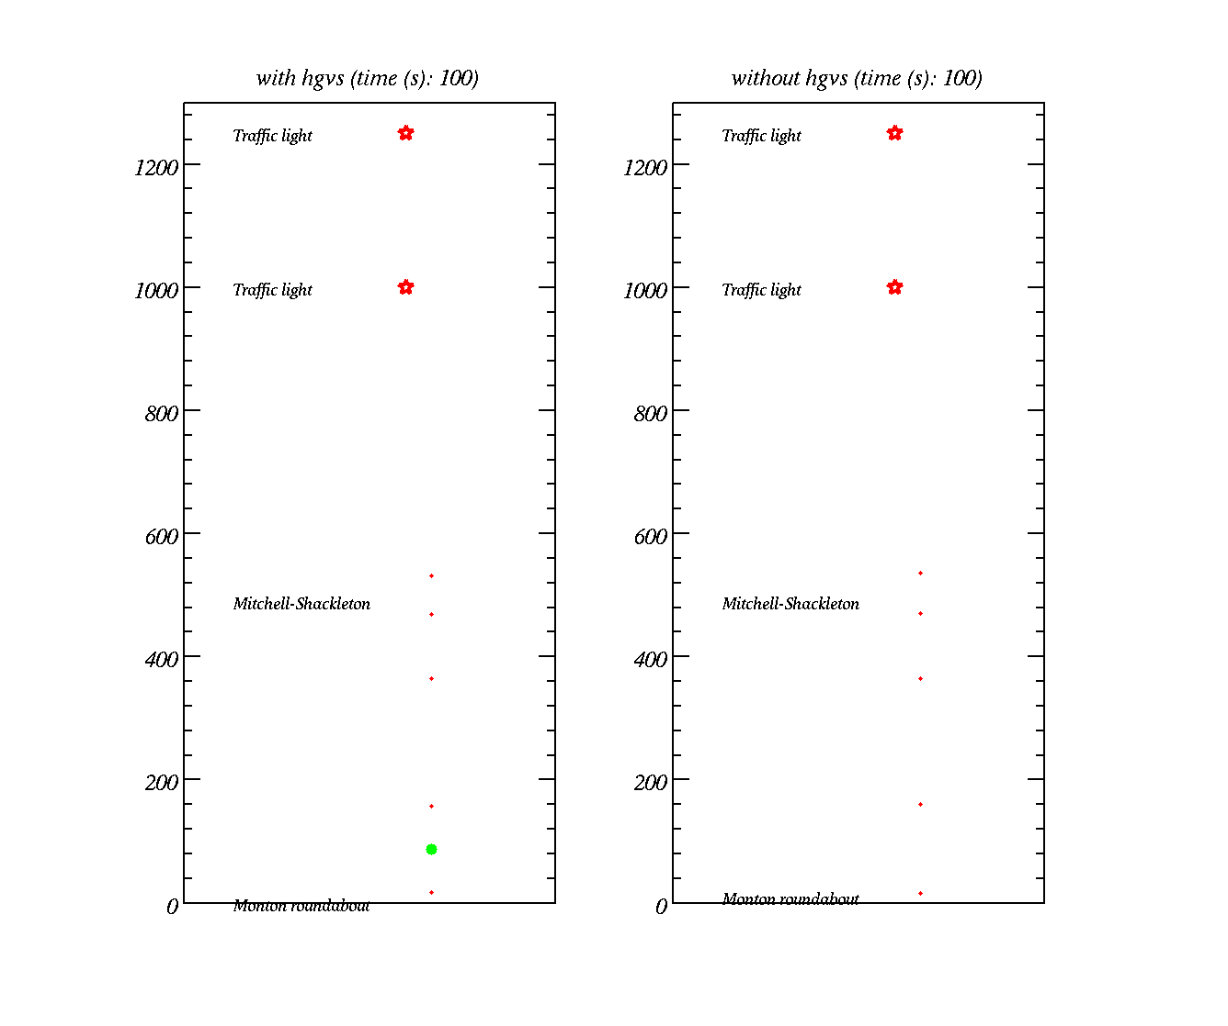
Modelling the flow of traffic
Traffic lights
Cars – red dots
HGVs – green dots
Distance along road (m)

Slide 28
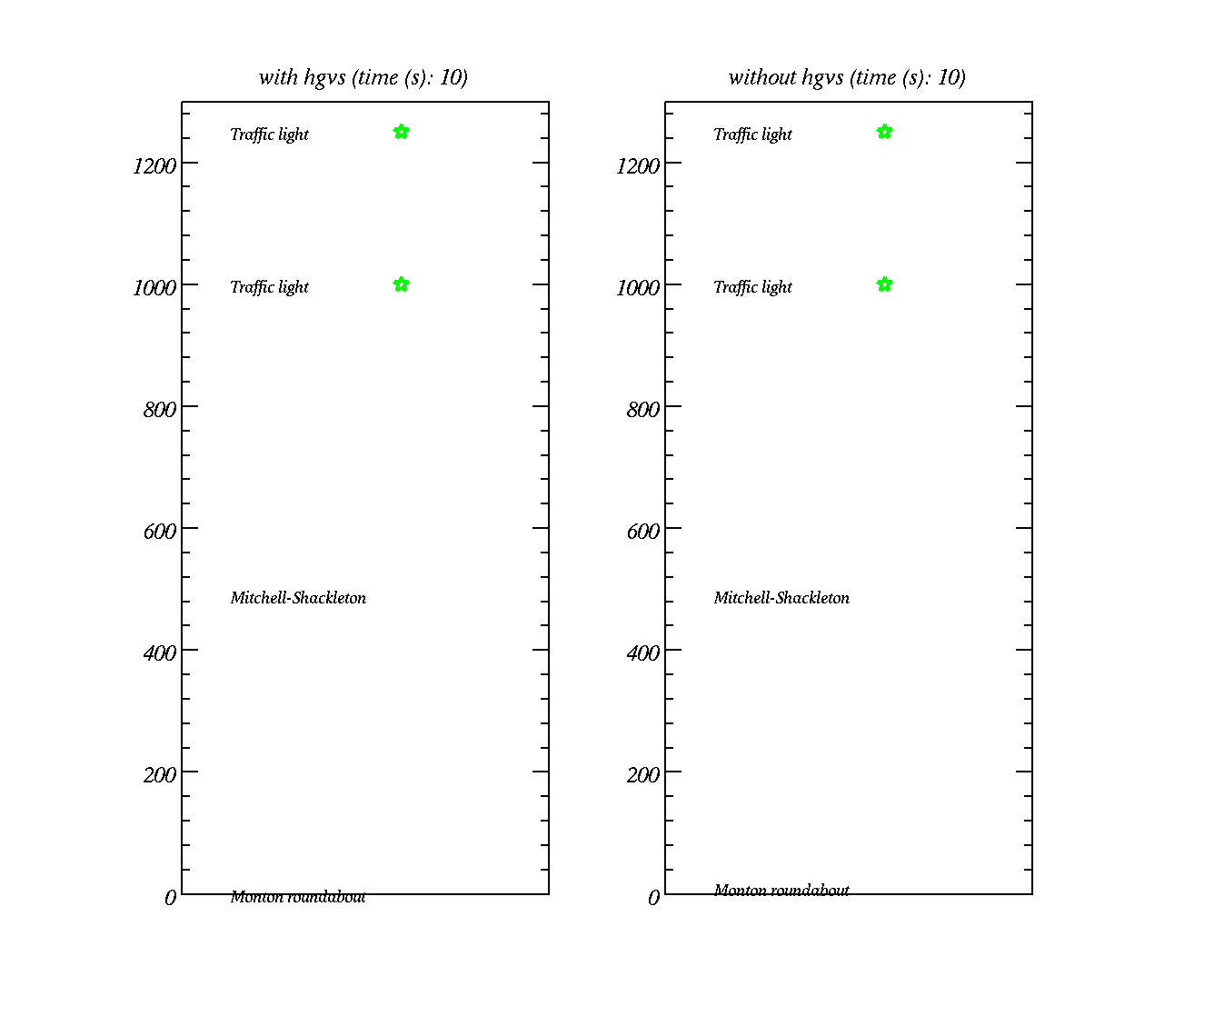
Modelling the flow of traffic
Traffic lights
Do HGVs have an impact on the time it takes for cars to travel down a road?
Cars – red dots
HGVs – green dots
Distance along road (m)

Slide 29
Important! When creating histograms
Create `bins’ to put numerical data into. These should have lower and upper edges
However, the histogram itself is plotted using the bin `mid-points’
Excel doesn’t do this by default – see YouTube videos on practical and in Blackboard
Time it takes for cars to travel down road
156.4547
144.9886
133.8906
129.1142
166.9715
136.7672
126.2964
120.1236
112.3065
108.1506
167.2900
155.0425
…

Slide 30
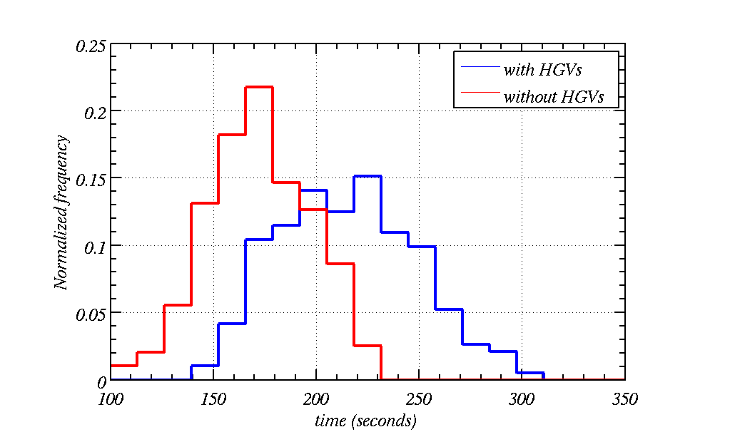
Histogram of time-taken to drive down Road 1 HGV every 6 minutes
Mode – most common value
Mode – most common value
Positively skewed
Negatively skewed
Fraction of vehicles
Much shorter mode times when there are no HGVs (165 seconds on average)
Much longer mode times when there are HGVs (210 seconds on average)
Notes:
22 % take between 165 and 180 seconds
Cars:
1. 4 m/s%2
2. 8 m/s^2
HGVs:
Braking 6 m/s^2
Accelerating: 2 m/s^2

Slide 31
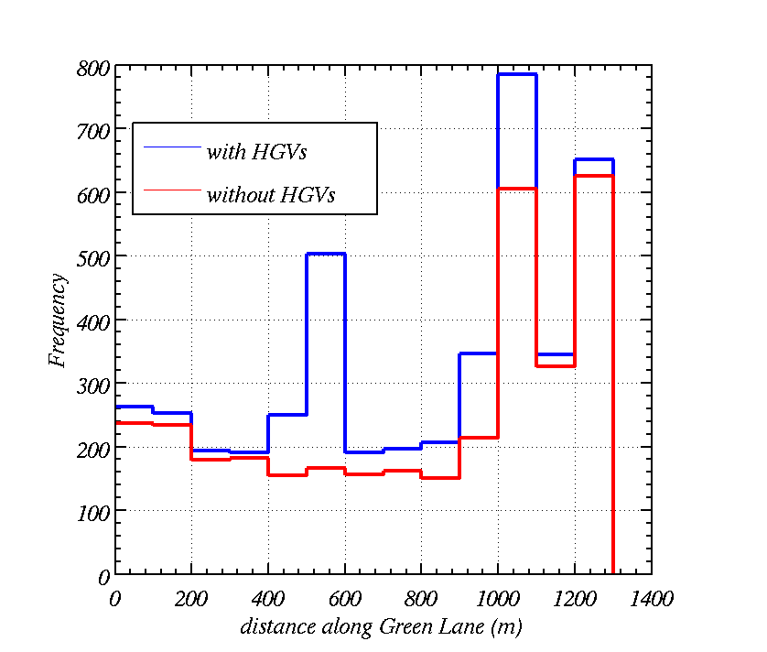
Histogram of clustering along Road
Even causes higher densities at the traffic lights
Bi-modal
Number of vehicles per 100 m of road per hour
tri-modal
Clusters build up at the site and traffic density / frequency is higher everywhere.
Traffic density is higher at the roundabout

Slide 32
What if the HGVs come at a rate of 1 a minute?
(a reasonable worse case scenario)

Slide 33
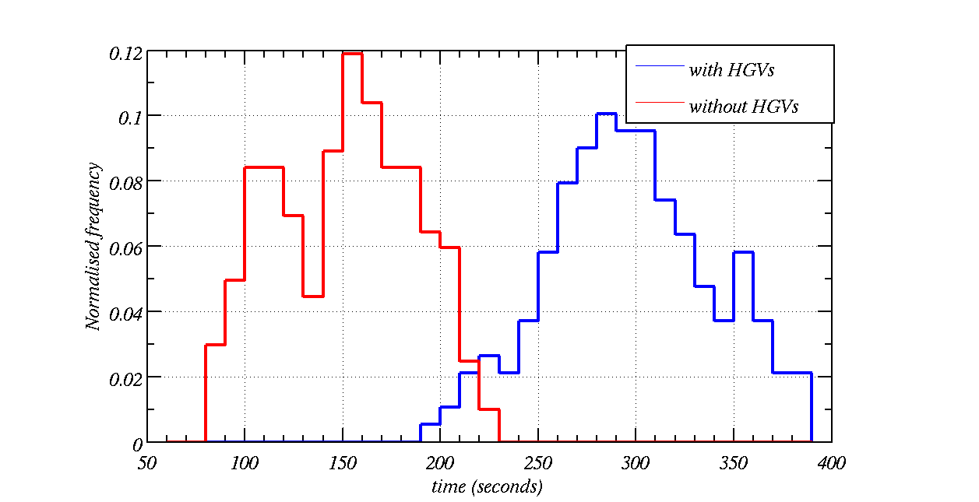
Histogram of time-taken to drive down Road (HGV every minute)
HGVs effectively double the time taken to drive down Road (290s on average)
Negatively skewed
Fraction of vehicles
Much shorter times when there are no HGVs (150 seconds on average)
Notes:
12 % take between 160 and 170 seconds

Slide 34
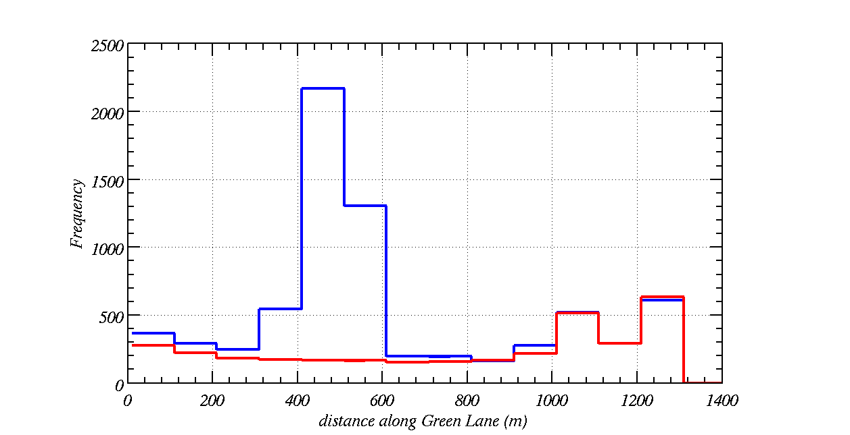
Histogram of clustering along Road (HGV every minute)
Number of vehicles per 100 m of road per hour
Clusters build up at the site and traffic density / frequency is higher.
Traffic density is higher at the roundabout

Slide 35
Cars and HGVs affect the sound level, L(dBA)
Cars are 60 dB(A) at 10 m.
HGVs are 84 dB(A) at 15 m.
Therefore the HGVs will increase the sound level at houses
HGVs can cause clustering of traffic, which can increase or decrease the sound level – this effect is not generally included in noise assessment.
Sound level is important planning criteria

Slide 36
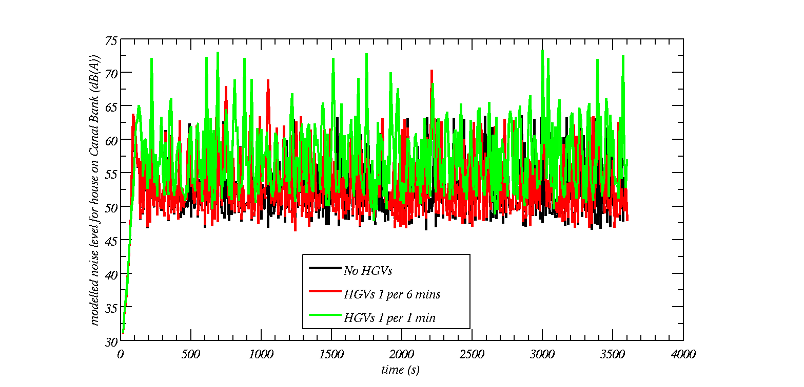
Traffic modelling with steady flow along road
(sound data over lap with each other)
L10 = 64.0 dB(A)
L10 = 61.7 dB(A)
L10 = 60.7 dB(A)
Notes:
Error bars show LAeq (horizontal line), LA10 (top) and LA90 (bottom)

Slide 37
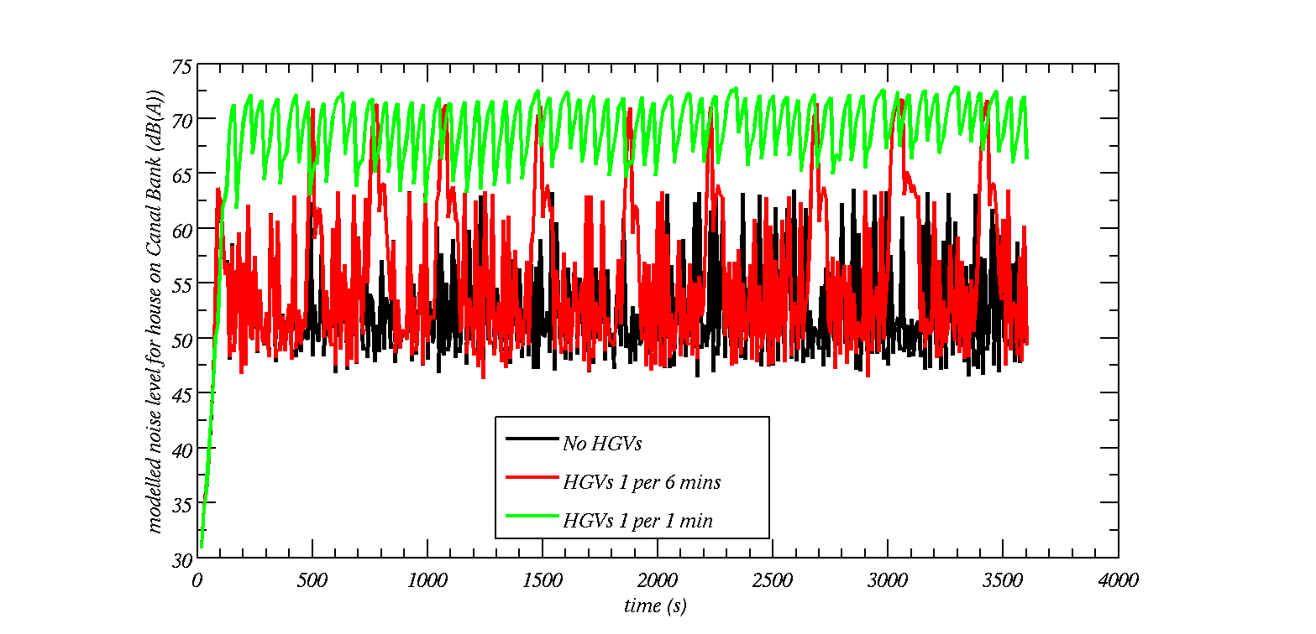
Traffic modelling with HGVs slowing
(sound levels do not over lap each other)
L10 = 72.1 dB(A)
L10 = 63.9 dB(A)
L10 = 60.7 dB(A)
Notes:
Error bars show LAeq (horizontal line), LA10 (top) and LA90 (bottom)

Slide 38
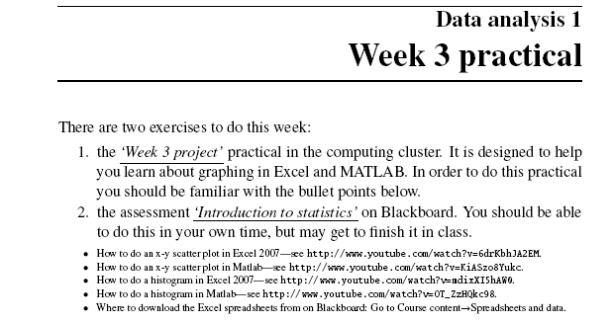
We will meet you in the Simon building room 6.06 computing practical tomorrow at 10.
Please log on to Blackboard and download the practical01.pdf
Please bring some head phones if you want to listen to the YouTube videos

Slide 39
Summary
Types of data
Common sense, attention to detail
Investigations / planning, etc.
Histograms, x-y plots
Practicals

