Slide 1
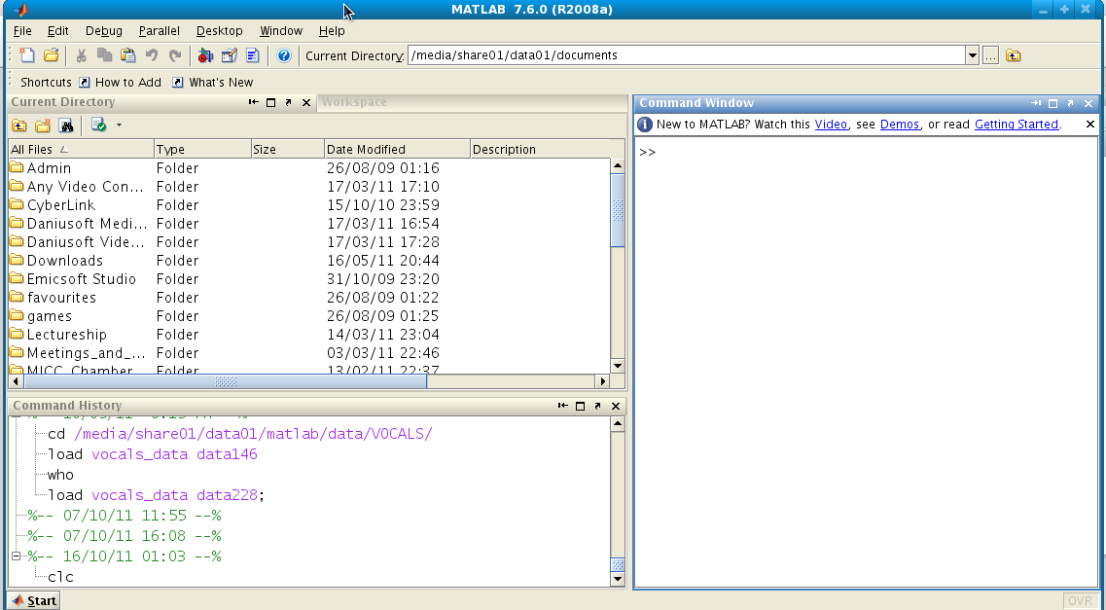
Command history
Current directory window
Command window
Current directory bar

