Slide 1
EART10160: Scientific problem solving
Introduction
Assessment
Typical week in this class
Syllabus / other handouts
Website / Blackboard
  http://tinyurl.com/ybeht4co
Course is run by Dr Paul Connolly (Atmospheric Sciences)
(and demonstrators)

Slide 2
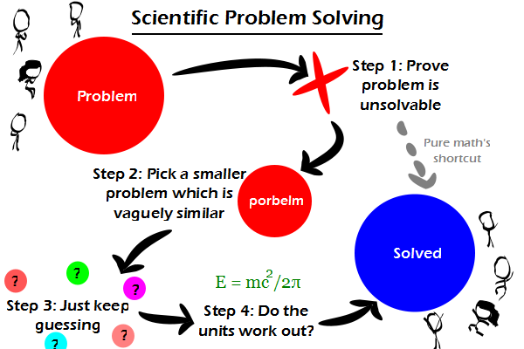
http://comicjk.com/770

Slide 3
Why do numerical science?
Geology, or Environmental Science are not just qualitative science (describing fossils, or how pollution affects organisms).
Like all true science they are quantitative.
Usually trying to predict what will happen in the future or happened in the past.

Slide 4
Why do numerical science 2
Makes you more employable:
  What are the main skills you look for, or would be looking for in potential employees?
  “Standard degree level skills e.g. numeracy, team working, presentation” Robert Finney BP.
  Do you look for a reasonably high level of mathematics or quantitative skills in potential graduate employees?
  “Yes as a means to demonstrate general numeracy and also to enable both calculation of emissions, discharges, conversion into appropriate units, etc and impact modelling.” Shaun Robinson, Environment Agency
  “we are looking for people who can `do stuff’, numerically”, Paul Field, Met Office

Slide 5
Points to take note of
Use your critical faculty
  e.g. mass of a lake 100m diameter, if you calculate that it weighs 50-80 kg, think does that make sense?
  Does it fit in with what I know already?
Converting units.
  Learn how to do it and you will do well.
Bottom line is you can all develop simple mathematical models of real situations and use these to predict future or past
  E.g. if you are employed by an oil company and work out 1x10⁹ (1E9) barrels of oil and after expensive drilling they only extract 1x10⁶ (1E6) you probably wont be employed for very long.

Slide 6
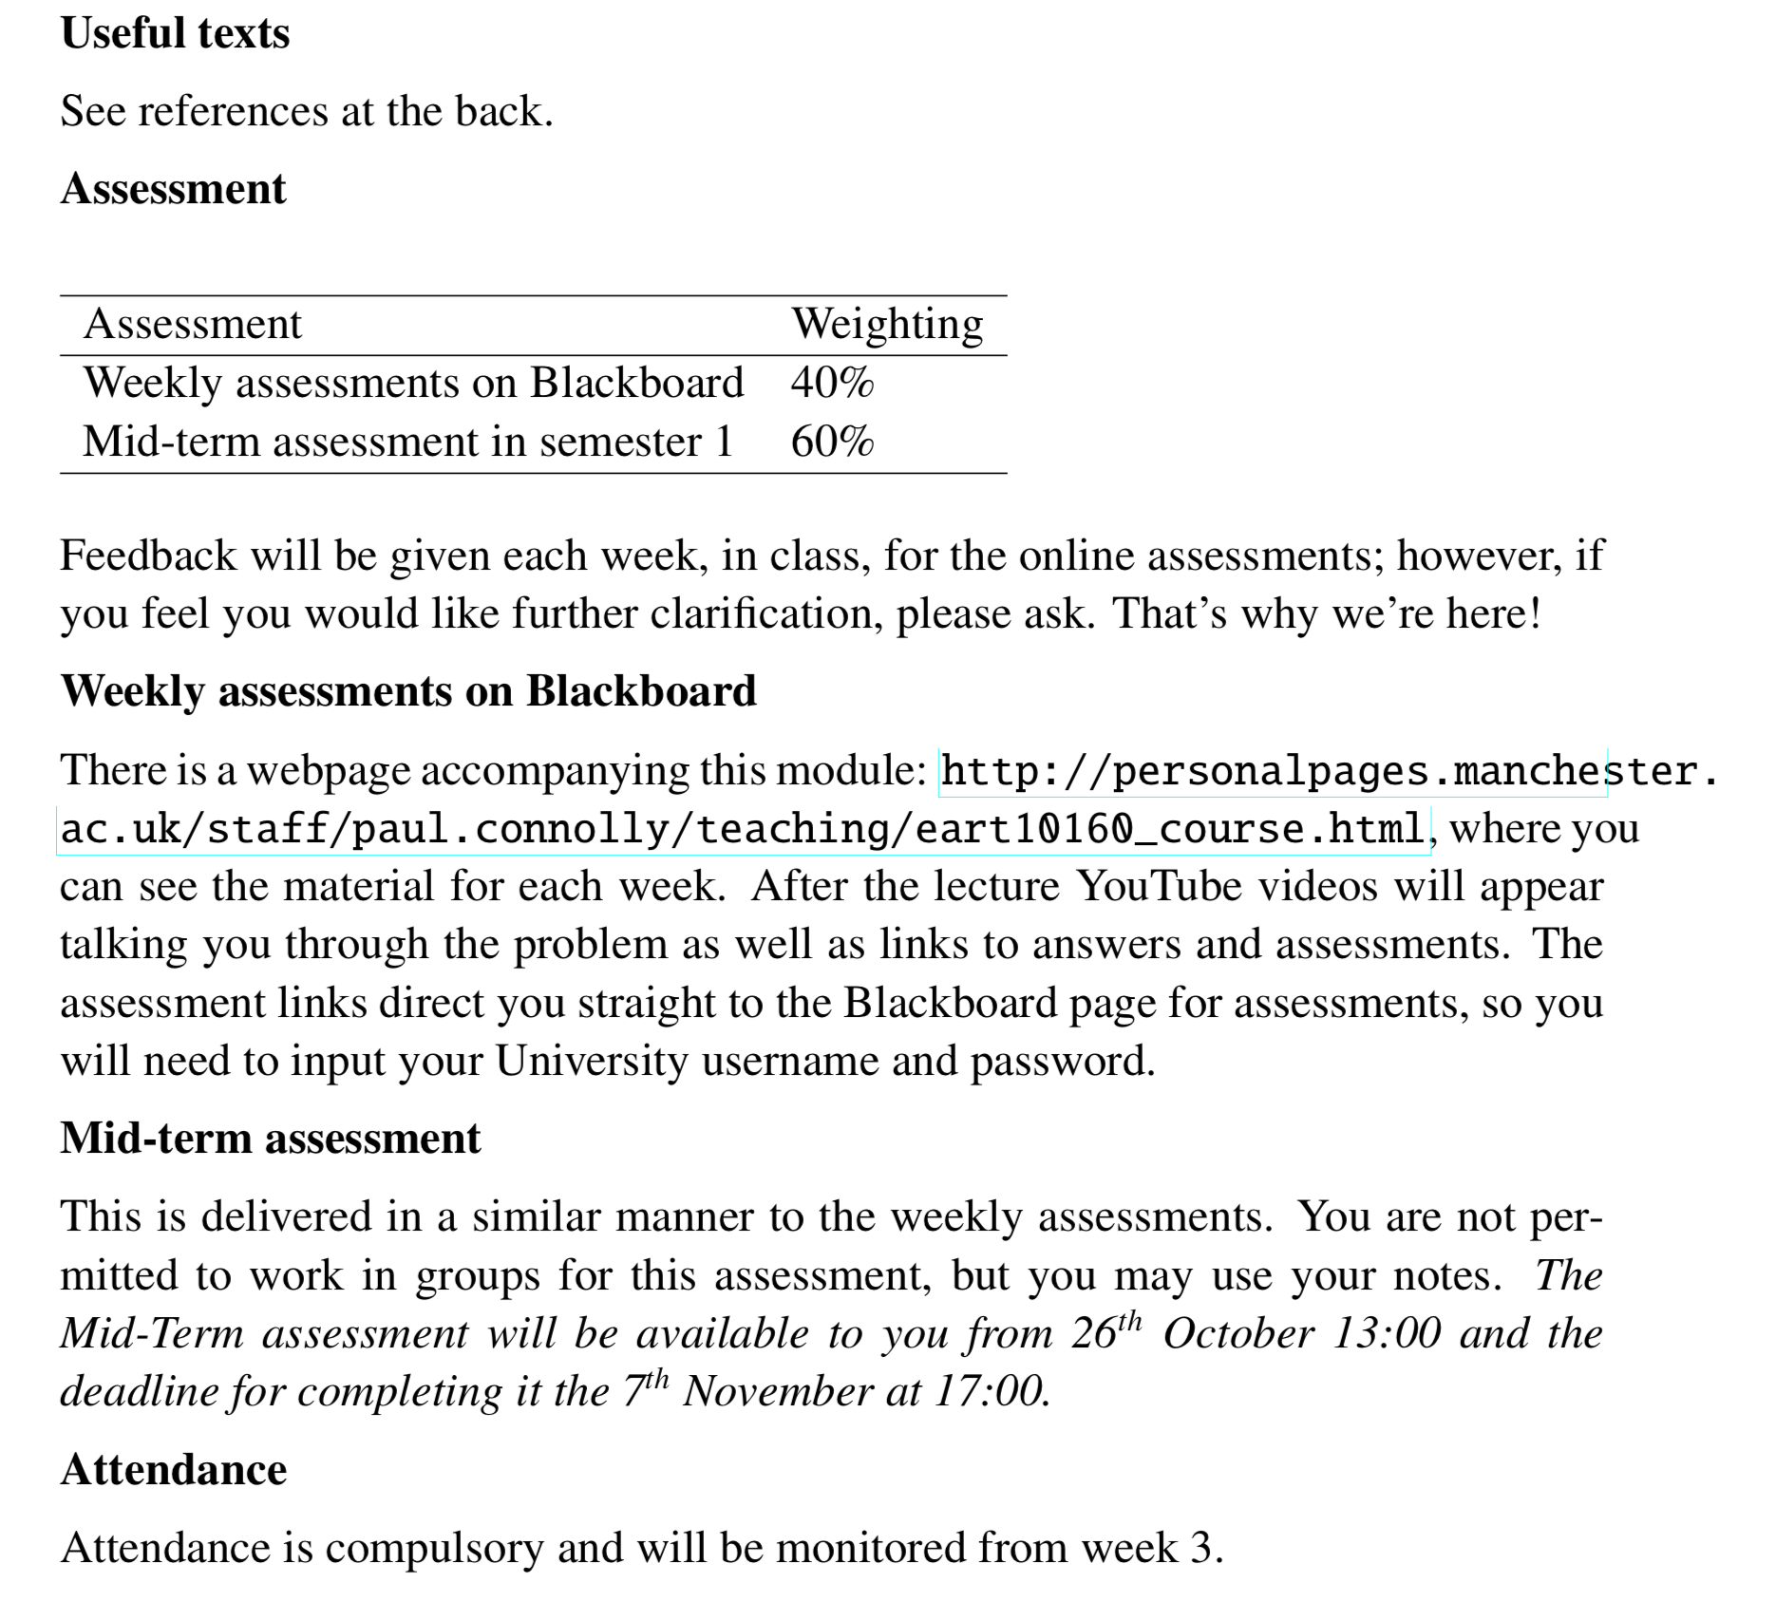
Assessment
There is no January exam

Slide 7
What if I fail?
We hope you wont!
As with everything worthwhile there are 3 key ingredients for success:
  Inherent Ability
  Motivation
    Those who have ability and the motivation to apply it
    Those who have the ability and no motivation
    Those who lack ability but have great motivation (=success)
    Those who lack ability and aren’t motivated. You enrolled on a degree at a high ranking University, so you must be motivated!
  Direction
    (we will direct you to resources that are useful, etc.)

Slide 8
What if I fail?
…but if you do fail you will be given a re-sit which will be capped at 40%.

Slide 9
Typical week
Sign register – attendance is monitored! From week 3.
Background information in lecture:
  You may want to take notes, most of the information is in the handouts, but notes / annotations are useful
Present with problem / practical exercises
  Talk to your fellow students about the problem and how you think you would go about solving it.
Solve the problem and additional problems as directed.
  Those wanting further help with Mathematics we will offer help in the second part of class on parts of the Maths that we feel are relevant to the problem.
Homework – read around subject (as directed), do Blackboard exercises.
In week 6 (see date in Syllabus) there will be a mid-term assessment (also on Blackboard**).
*Trial this term: email reminders about dates.
Notes:
Go through Blackboard.
You will get a password to start the mid-term upon attending week 5’s class

Slide 10
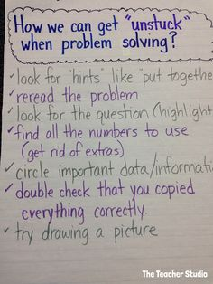

Slide 11
A typical problem...

Slide 12
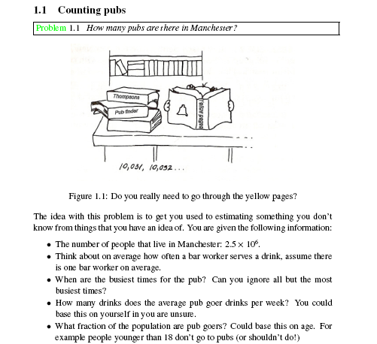

Slide 14
EART10160: Scientific problem solving today’s class
Introduce concepts and problem: measuring molecules.
Gets us thinking about molecules, atoms and geometry (after a long layoff!)
To get started on the relevant maths look at the supplementary problems
  Specifically on converting units and distances between things
Take any questions about access to Blackboard / previous problem
Talk in groups ~6-7 about problem and solve it.
Solve `related problems’ questions
  Important one is `related problems, q2’.

Slide 15
Talk about
Prefixes for numbers
Periodic table
  I won’t talk about (ionic, covalent) bonding today, we will cover that in week 5. But information in appendix C2 if interested.
Atoms, atomic mass, molecular mass, moles.
Avogadro's number

Slide 16
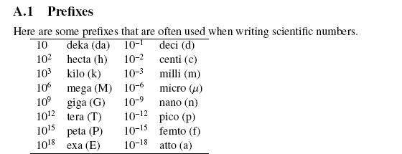
Some example prefixes
Wavelength of green light: 4 E-7 m. How many nanometres?
Solar constant: ~1300 W m⁻². How many kW m⁻²?
Size of a cloud drop 1E-5 m. How many micro-metres?
Energy consumption in the UK: 6E11 W. How many TW?
Mass of earth: 6E24 kg. How many exa grams? (tricky)
Mass of hydrogen atom: 1.66E-27 kg. How many atto grams? (tricky)
400
1.3
10
0.6
6E9
1.66E-6
Notes:
4E-7 m -> divide by 1E-9 m / nm to get number of nano metres: 4E-7 m / 1E-9 = 400 nm
1300 W / m^2 -> divide by 1E3 W/kW to get number of kW /m^2: 1300/1000 = 1.3 kW /m^2
1E-5 m -> divide by 1E-6 m / micrometres to get number of micro metres: 1E-5/1E-6 = 10 micrometres.
6E11 W -> divide by 1E12 W / TW to get number of terra watts: 6E11/1E12=0.6 TW
6.0E24 kg -> multiply by 1000 g / kg and divide by 1E18 grams / exa grams: 6.4E24 kg * 1000 g/kg /(1E18 grams / exa grams)=6E 9 Eg
1.66E-27 kg ->multiply by 1000 g/kg and divide by 1E-18 grams / attogram: 1.66E-27*1000/1E-18=1.66E-6 attograms.

Slide 17
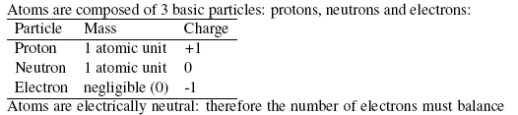
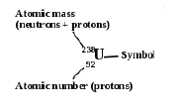
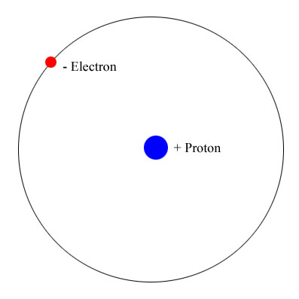

Atoms, hydrogen and Periodic Table
Hydrogen is the simplest atom
We can’t just add another proton as positive charges repel – we have to add some glue
Size ~ 1E-10 m = 1 Å
Notes:
And nucleus is 1E-15 m! a factor of 5 smaller. For example 10,000 m run vs 10 cm!
Periodic Table…
Note that your period table may show the atomic mass and the atomic number slightly differently (just be aware)
In fact it has the atomic number above and mass number below!

Slide 18
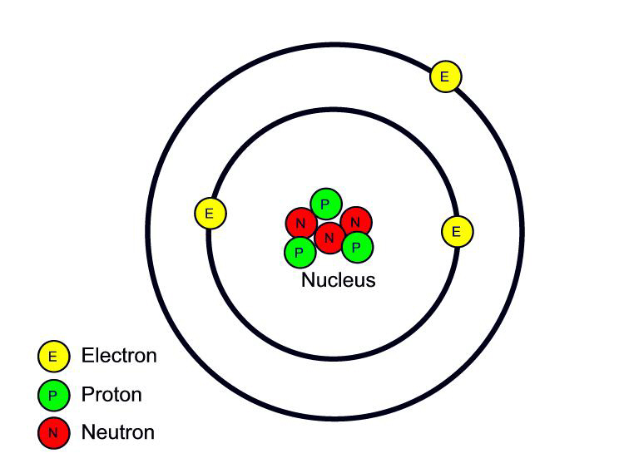
Shell model of atom, part I
(neutrons help to bind the nucleus together)
Electrons hardly have any mass compared to protons and neutrons, which both have mass 1.66x10⁻²⁷ kg
Electrons have mass 9.1x10⁻³¹ kg
Say we get rid of a neutron (e.g. fire high energy neutron at it to knock one out) – what happens? What element is it now?
Which element is this atom?
Size ~ 1.52E-10 m = 1.52 Å
Notes:
Ask which element – lithium
Ask which element now: Lithium isotope

Slide 19
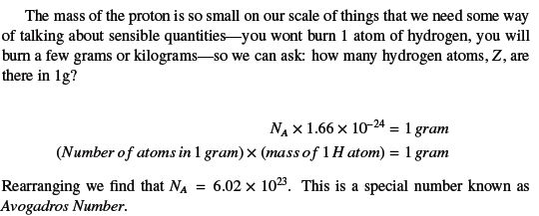
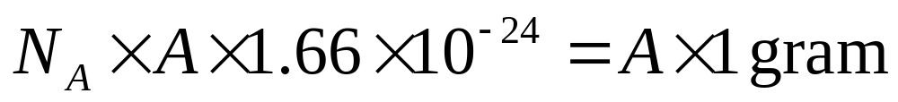
Avogadro’s number
This scales with mass number, A:
`Atomic mass’ (mass of 1 mole of an element)
So `A’ grams of every element contains Avogadros’ number of atoms. Which leads to the concept of atomic weight:.

Slide 20
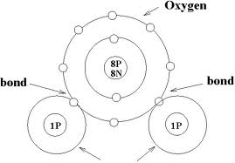
Molecular mass
The concept of atomic mass extends to molecules too.
Sum of mass nos, means add up the atomic masses of all atoms in molecule
`Molecular mass’ (mass of 1 mole of an substance)
So `sum of mass no’ grams of every molecule contains Avogadros’ number of molecules.
Notes:
There will be slight differences due to binding energies (physics tells us this, i.e. E=mc^2),; however, these quantities are small

Slide 21
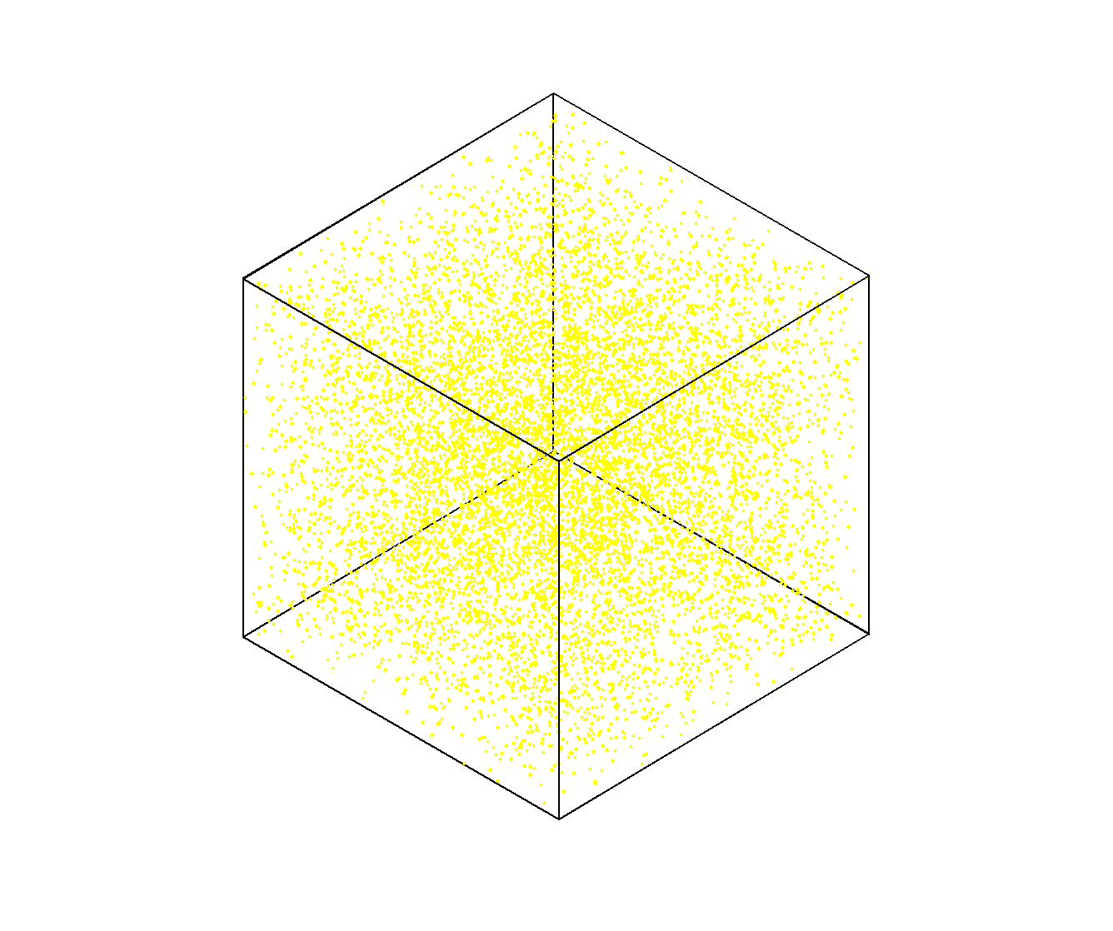
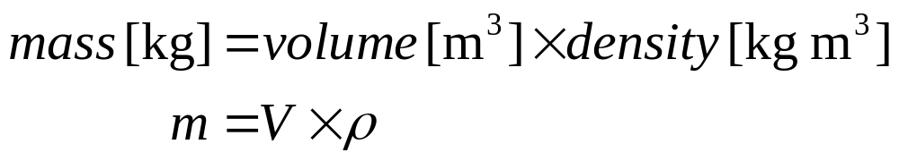
Avogadro’s number
(in ‘related problems 2’)
Know how many atoms / molecules there are per unit mass of a substance
How can we work out the number of atoms / molecules per unit volume?
?
If you know how many atoms (or molecules) there are per unit volume [#m⁻³], how can you calculate the average distance between atoms (or molecules) [m]?

Slide 22
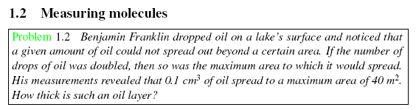

Problem: How thick is a layer of oil?

Slide 23
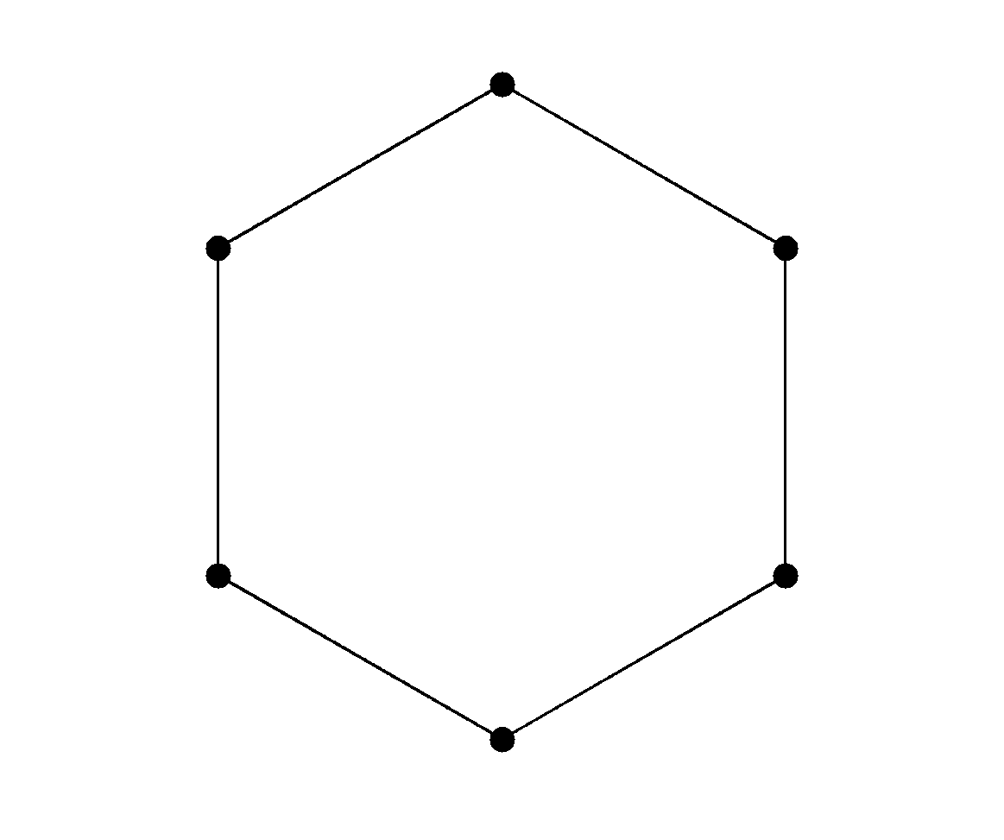
The `Graphene’ question
Distance between carbon atoms, t ?
0.5xt
sqrt(3)/2xt

Slide 24
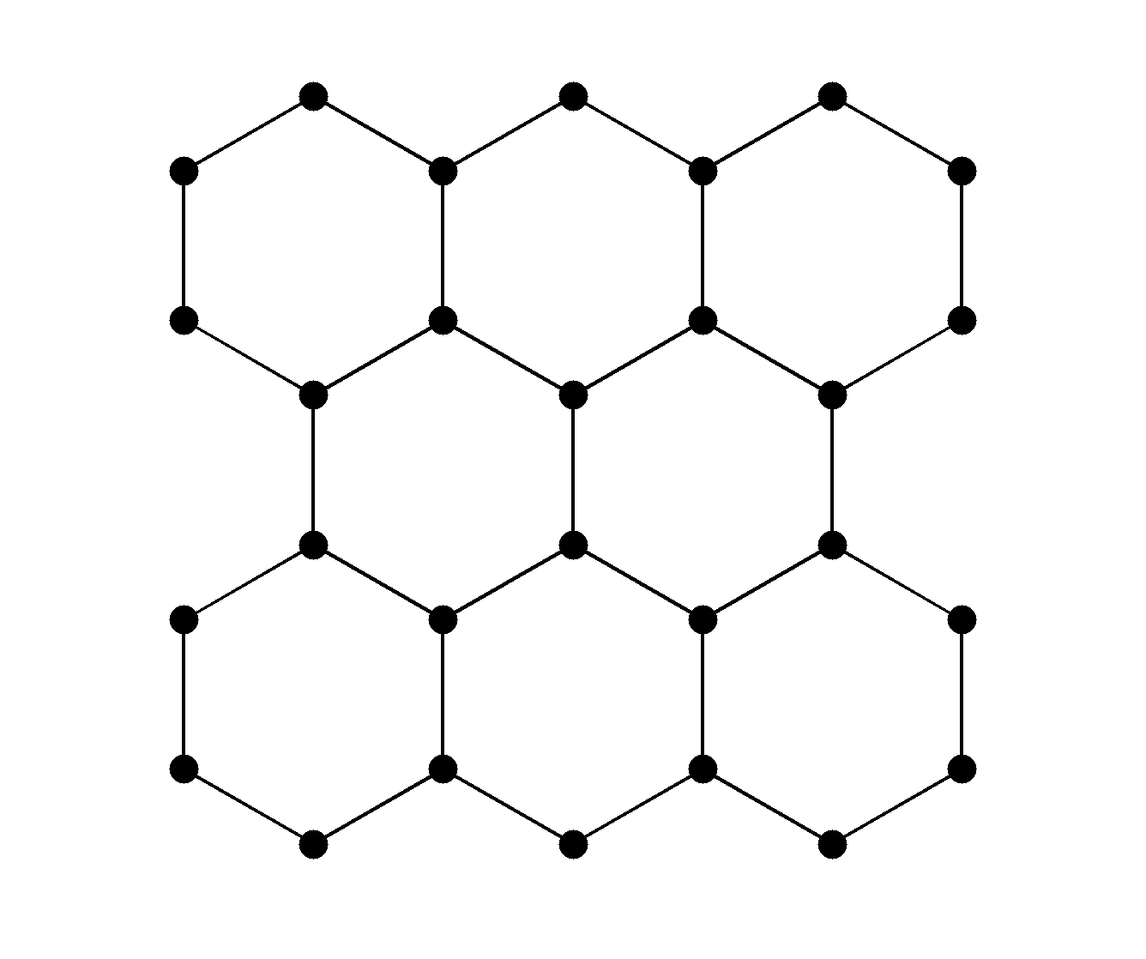
The `Graphene’ question
Graphene is 2-D with 1.299 m² mg⁻¹ and carbon is 12 g mol⁻¹
Count the atoms within a square area
Calculate the area
Height = ?
What is the distance between atoms, t?
Length = ?

Slide 25
Today / in week
First do supplementary material
Then attempt main problem
Then related questions.
In the week do the Blackboard assessment as mentioned in handout.
Next: see you in Williamson G12-G16 just before 10:00 for the practical.

Slide 26
