Slide 1
EART10160: today’s class
Questions about last week? Auto. Emails? YouTube videos?
How much of our energy use can be provided by renewables?
Some background on Net Primary Productivity
  What it is
  How it is measured /estimated
Heat and Energy
  Equivalence of heat and energy
Do supplementary material
Do main problems on `Greens we eat’

Slide 2
Primary production
The production of organic compounds from atmospheric or aquatic carbon dioxide.
May occur through photosynthesis, using light as a source of energy, or chemosynthesis, using the oxidation or reduction of chemical compounds as energy.
Almost all life on earth is directly or indirectly reliant on primary production. The organisms responsible for primary production are known as primary producers or autotrophs, and form the base of the food chain.
In terrestrial eco-regions, these are plants, while in aquatic eco-regions it is algae.
Primary production is either as net or gross, the former accounting for losses to processes such as cellular respiration, the latter not.
Net Primary Productivity can be thought of as the mass of carbon that is converted to biomass.
Notes:
Wikipedia

Slide 3
Overview
Primary production is the production of chemical energy in organic compounds by living organisms. The main source of this energy is sunlight but a minute fraction of primary production is driven by lithotrophic organisms using the chemical energy of inorganic molecules
Regardless of its source, this energy is used to synthesize complex organic molecules from simpler inorganic compounds such as carbon dioxide (CO₂) and water (H₂O). The following two equations are simplified representations of photosynthesis (top) and (one form of) chemosynthesis (bottom):
  CO₂ + H₂O + light -> CH₂O + O₂
  CO₂ + O₂ + 4 H₂S -> CH₂O + 4 S + 3 H₂O
In both cases, the end point is reduced carbohydrate (CH₂O), typically molecules such as glucose (C₆H₁₂O₆)or other sugars. These relatively simple molecules may be then used to further synthesise more complicated molecules, including proteins, complex carbohydrates, lipids, and nucleic acids, or be respired to perform work (energy).
Notes:
Wikipedia
There is a clue in the first point `minute’ – ie. they should ignore it.

Slide 4
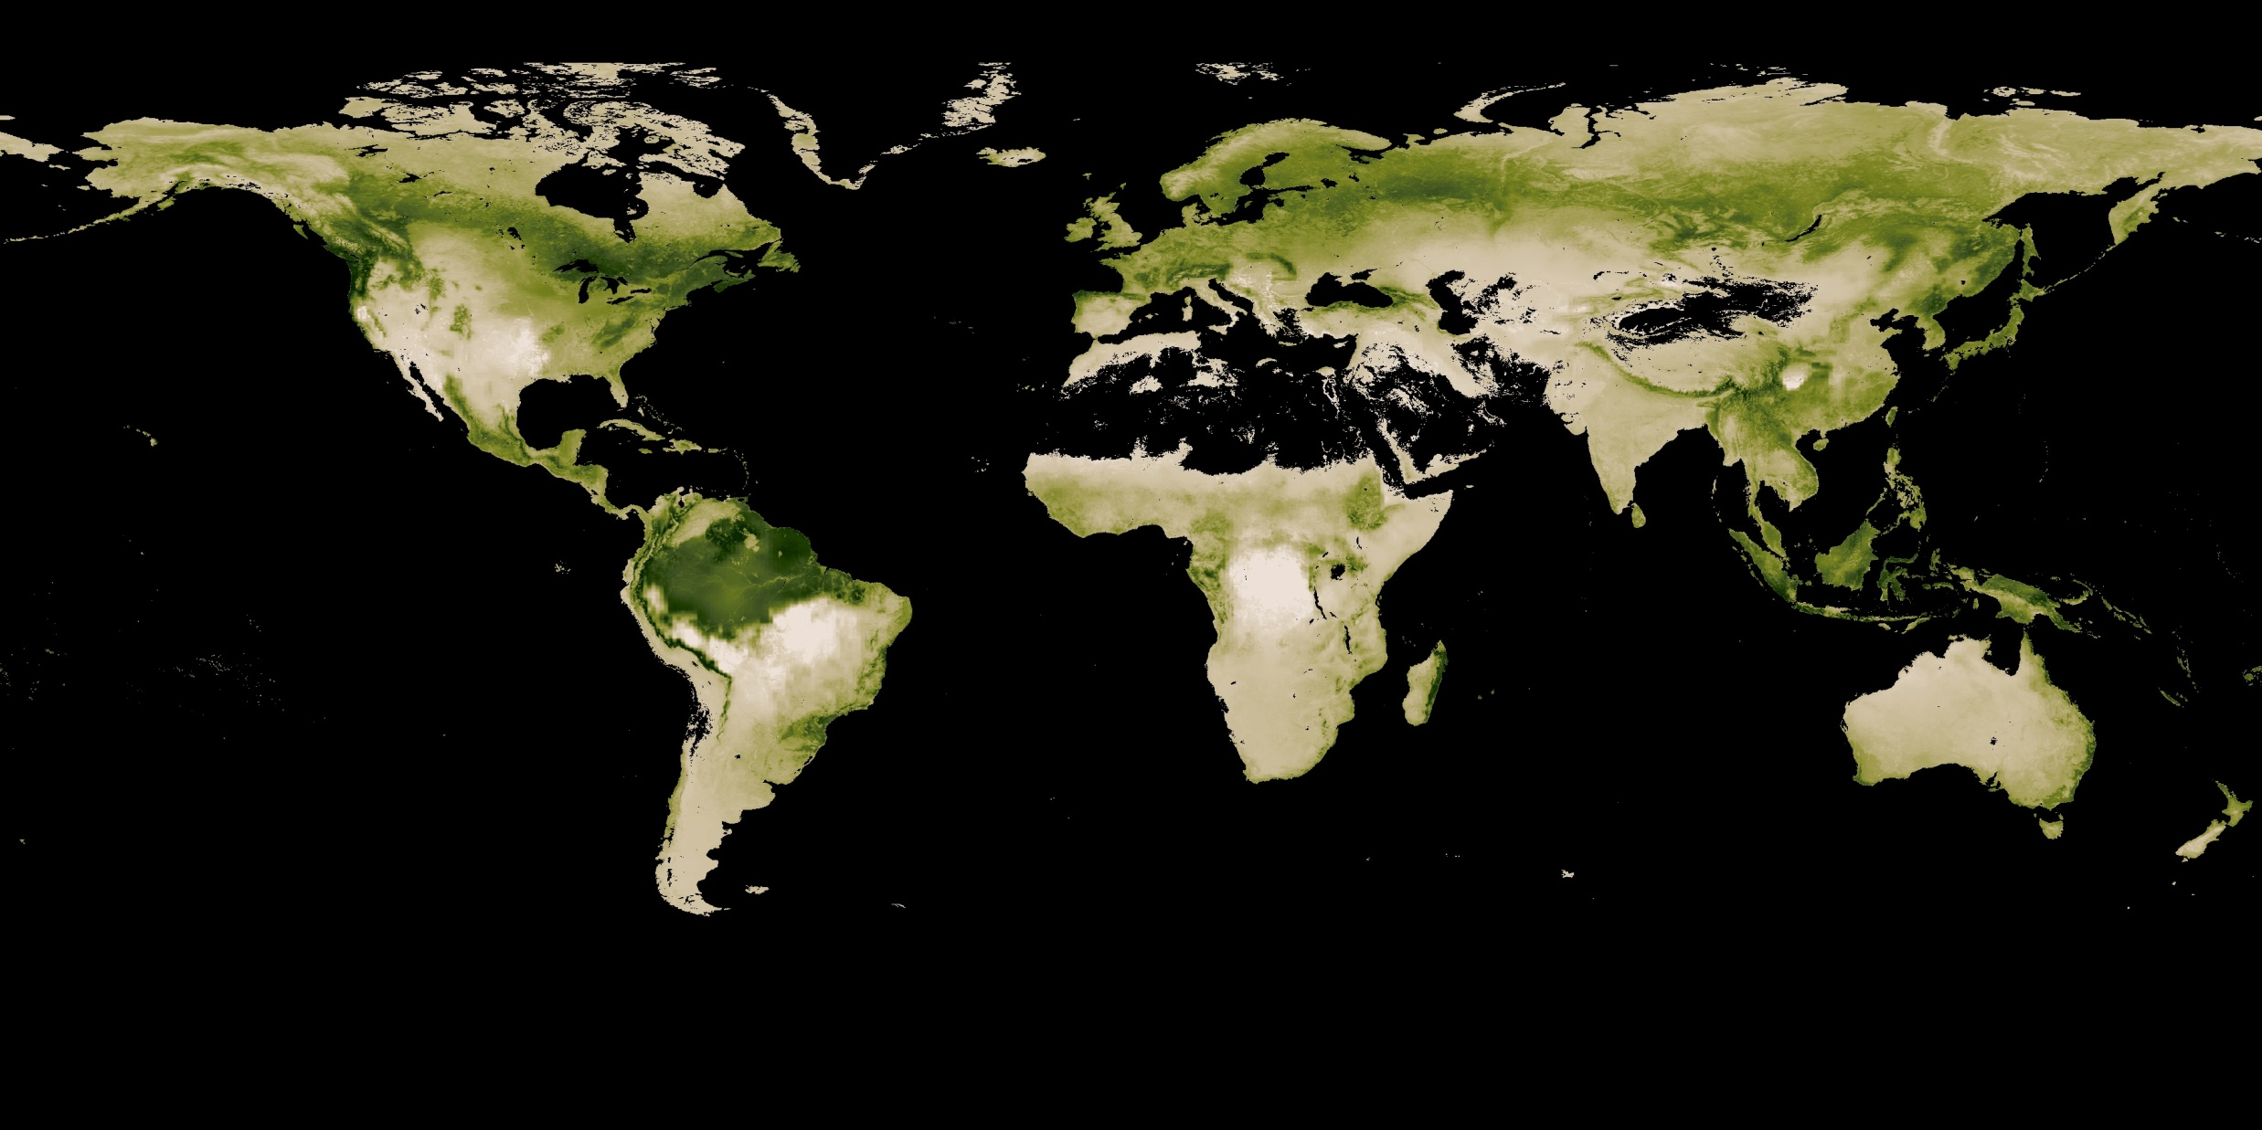
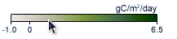
Net primary productivity for August 2011
Notes:
This particular retrieval neglects the oceans, which are also a significant source.

Slide 5
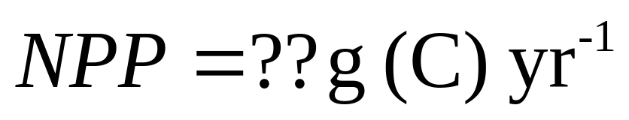
Important point
Think of it as the amount of Carbon that goes into plant growth / biomass each year.
It does not equal the mass of the plants growing per year...why?

Slide 6
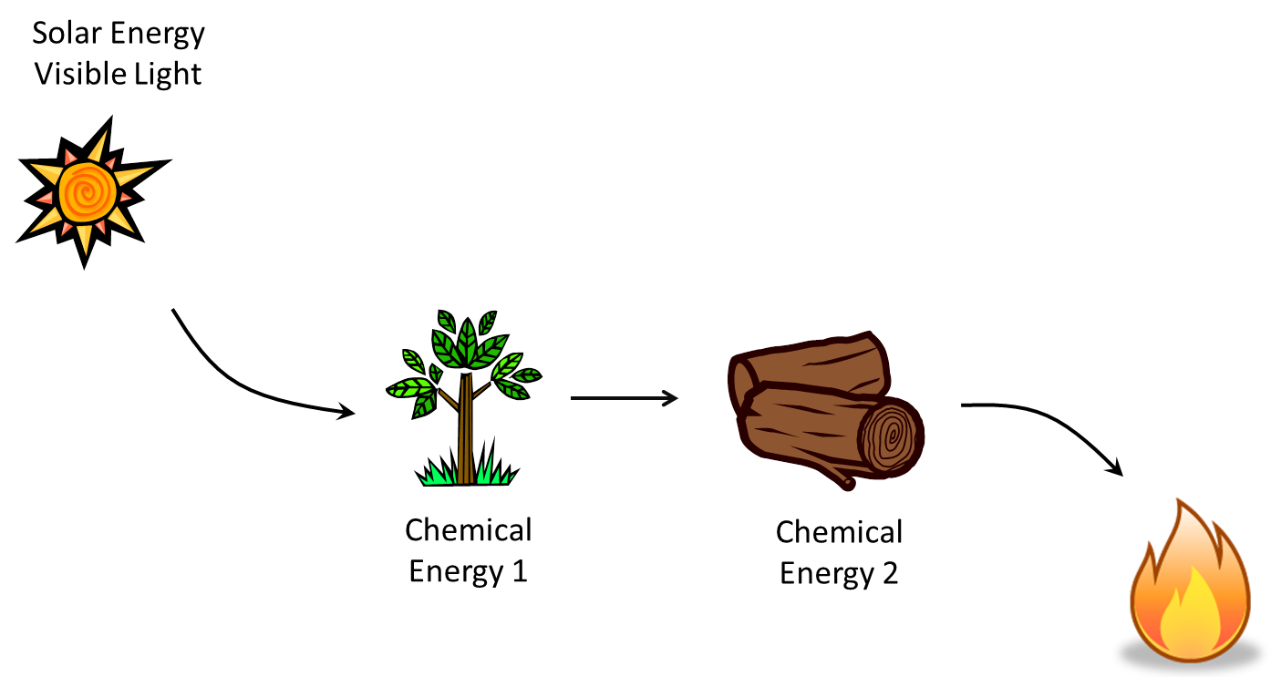
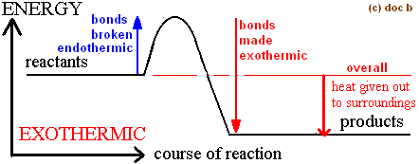
Heat content of the fuel:
Joules per gram.

Slide 7
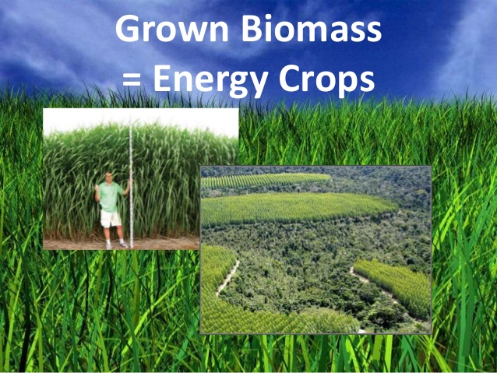
Grown Biomass= Energy for power generation
Grown Biomass= Energy for food?

Slide 8
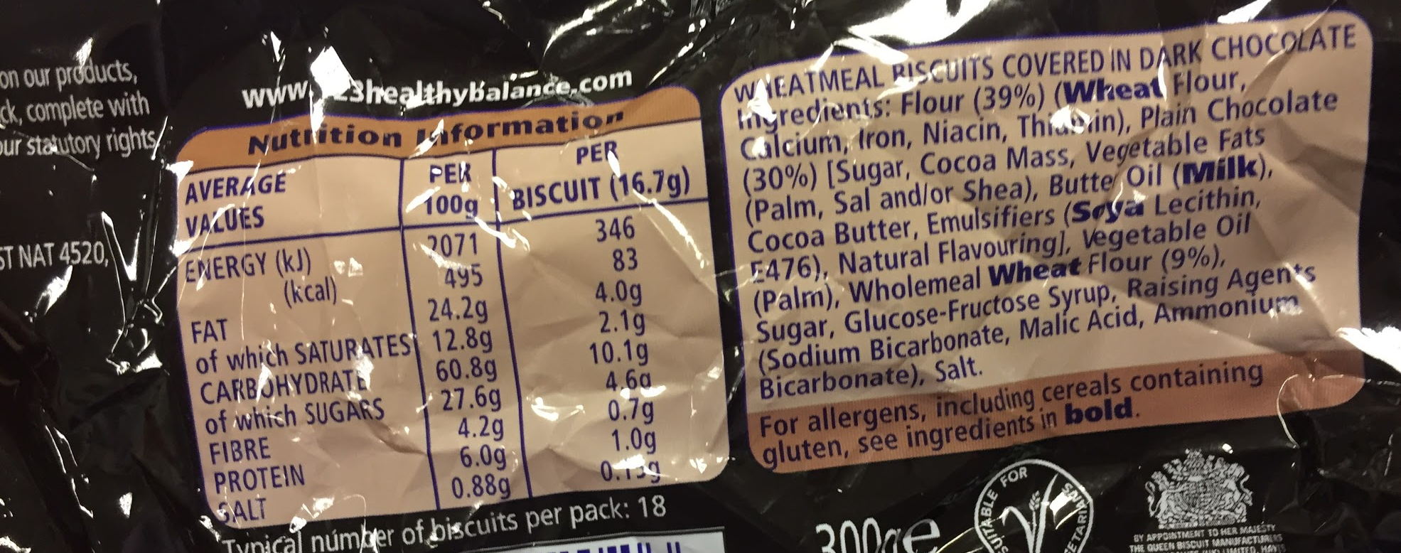
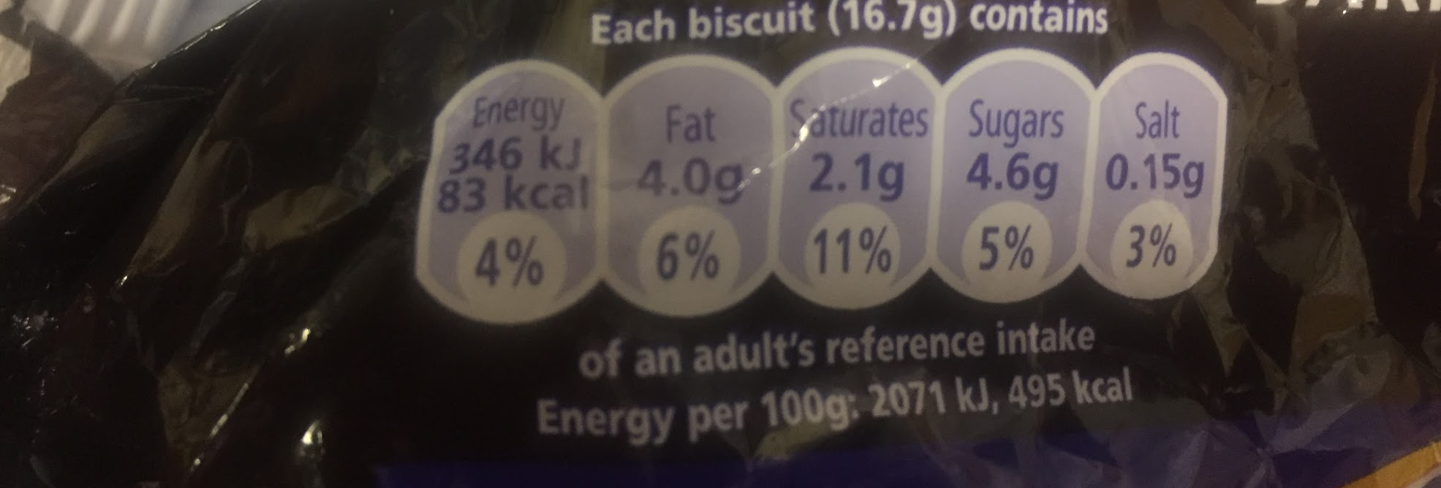

Slide 9
Energy is often quantified by its calorific content (e.g. Food).
calorie (cal): amount of heat needed to raise the temperature of 1 gram of water 1 degree Celsius.
Calorie (kcal): amount of heat needed to raise the temperature of 1 kilogram of water 1 degree Celsius.
calorie = 4.18 joules of energy / heat
This heat content can be used to fuel our activity, keep us warm, or used to make another form of energy (e.g. Electricity).
Notes:
Look at a sweet wrapper

Slide 10
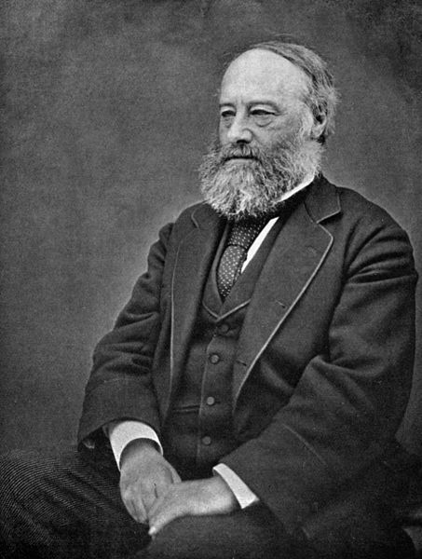
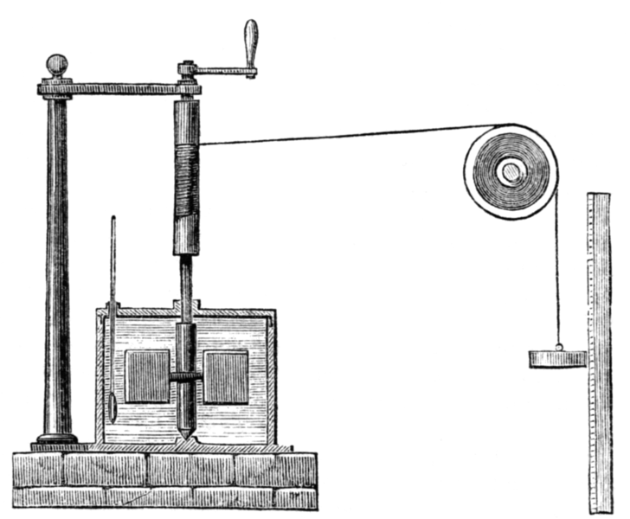
Heat and Energy equivalence
Paper in 1845 (led to the law of conservation of energy):
Joule’s apparatus that demonstrated a falling weight converting potential energy, =mgh, into viscous heating of water, =mcδT
James Prescott Joule, 1818-1888
Famous physicist and brewer, born in Salford.
I conceive that this theory ... is opposed to the recognised principles of philosophy because it leads to the conclusion that [energy] may be destroyed by an improper disposition of the apparatus: Thus Mr Clapeyron draws the inference that 'the temperature of the fire being 1000 °C to 2000 °C higher than that of the boiler there is an enormous loss of [energy] in the passage of the heat from the furnace to the boiler.' Believing that the power to destroy belongs to The Creator alone I affirm ... that any theory which, when carried out, demands the annihilation of force, is necessarily erroneous.
Notes:
Salford brewer could measure temperature extremely accurately.
So Calories derived from burning food = calories used for energy = calories used to generate electricity and so on.

Slide 11
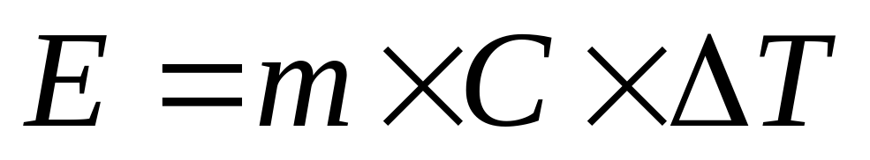
Energy required to raise the temperature of a substance
Each substance has its own heat capacity
The term ΔT is the change in temperature
m is the mass
C:specific heat capacity (=4180 J kg⁻¹ K⁻¹ for water)
Notes:
Look at a sweet wrapper

Slide 12
Example – Joule’s experiment
Mass of 1 kg on string is 1.0 m above ground.
  How much potential energy is there (answer in joules)?
  If the mass then falls to the ground and drives paddles in water, mass 0.5 kg, what would the rise in temperature be? (note that heat capacity of water is 4180 joules per kg, per degC
Notes:
PE=~5 joules
Equate to mCdT
0.005 degC

Slide 13
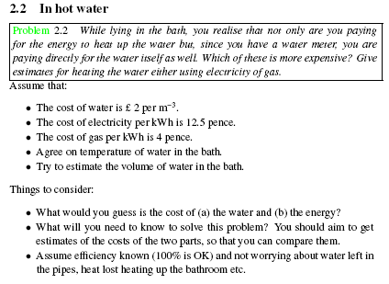
Another example:

Slide 14
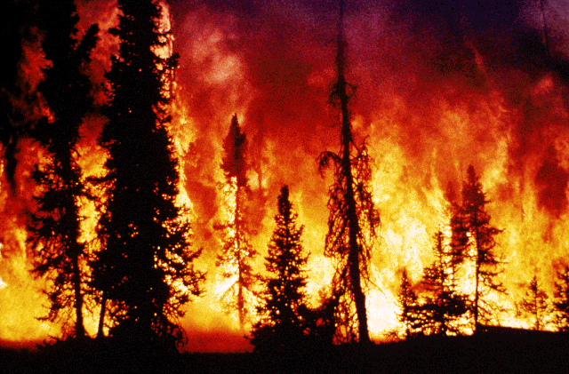
Greens we eat: one question what fraction of earth’s plants need to be burned each year to meet energy demands?
(practice with topics below)
Further practice with chemistry: Stochiometry – i.e. ratios of different elements, Avogadro’s number
Energy – do we need fossil fuels?
Fractions and simplifying fractions

Slide 15
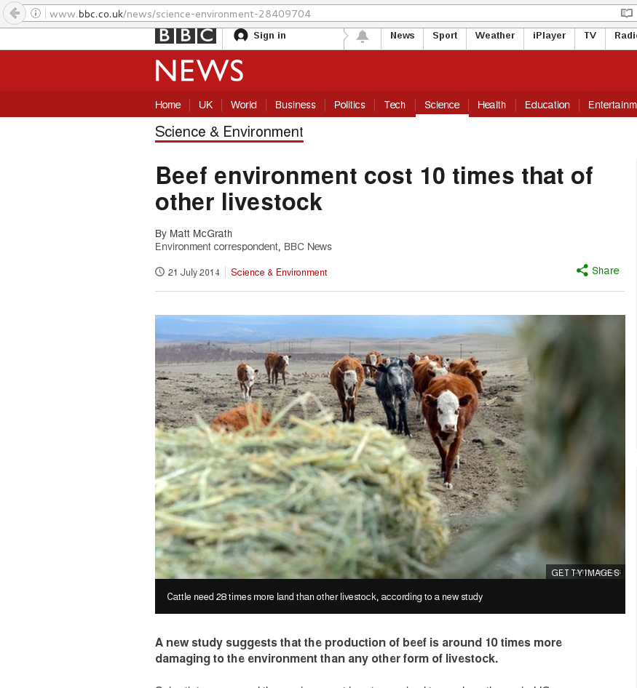

Slide 16
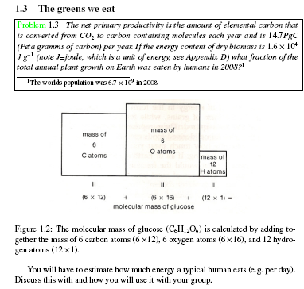

Slide 17
Today / in week
First do supplementary material
Then attempt main problem
Then related questions.
In the week do the Blackboard assessment as mentioned in handout.

Slide 19
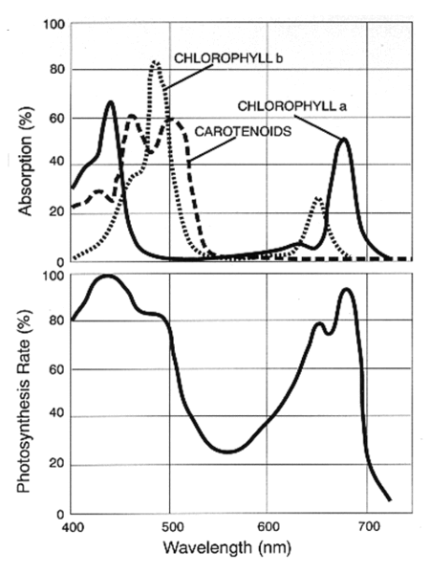
How can we estimate global Primary Production?
Well, plants absorb radiation from the sun
A surface covered completely by plants will absorb visible radiation of different wavelengths.
This can be related to the photosynthesis rate, which can therefore be used to estimate NPP
It is more difficult to estimate sub-surface primary production, why?
How do you think we estimate NPP globally?
Notes:
We know they must absorb light, because photosynthesis requires light.

Slide 20
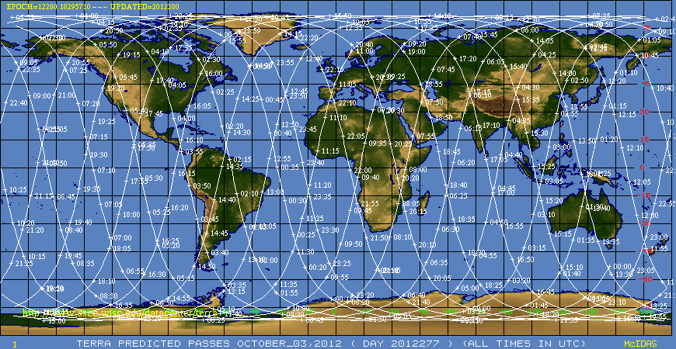
To get a global picture scientists use
Polar orbiting satellite
Polar orbiting satellite

Slide 21
A word on statistics we will talk more about statistics later (2nd half of semester)
Polar orbiting satellites do not observe all or the earths surface at any one time, so scientists use statistics to estimate what the total would be.
They calculate absorption statistics of the observed surface (and assume the areas that are missed are similar to the observations).
  Kind of like if you were doing a traffic survey (e.g. count traffic for an hour at different times of day for 1 week and scale it up)
They perform a `retrieval’ (or calculation) of the primary productivity by looking at how much visible radiation is reflected back over certain areas

Slide 22
Data analysis: calculating the global total
Mean: add up all numbers and divide by number of observations
  E.g. mean of 5, 10, 5, 2.5 and 7.5 is 6
Calculating the global mean
  Satellite data are normally supplied on a lat-long grid
  Can’t just take the mean at all points on a lat, long grid because a degree of longitude is less distance at high latitudes than low latitudes. Learn about how to deal with this on the computers.

