Slide 1

Today you will need to know about Pythagoras’ theorem and trig ratios
Consequently before you start the problem, you may want to review:
And you can try this weeks additional problems before you start
The two main problems:
Which uses trigonometry / Pythagoras for a geometrical problem
Which uses trigonometry for looking at diffraction of X-rays from crystals
Which uses Pythagoras to calculate the sum of a scalar (pressure) – need to know a little bit about logs – Foundation maths support pack

Slide 2
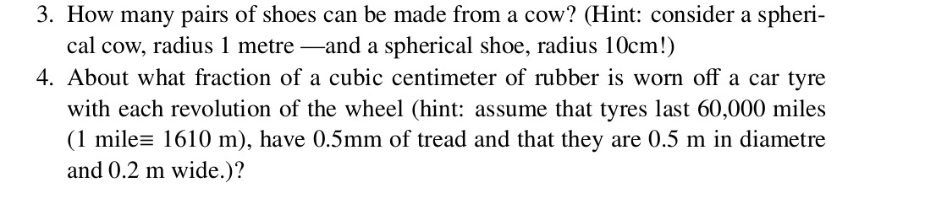
First some worked problems

Slide 3
Structural geology
Structural geology is the study of the three-dimensional distribution of rock units with respect to their deformational histories.
Today we will look at a seam of gold, which is a plane of rock high in Au.
Examples of planes:
  Bedding, cleavage, joint surfaces, fault planes, fold axial planes, quarry faces
Geologists will measure some of these properties using a COMPASS-CLINOMETER, which you will have seen
Notes:
Bedding at different orientations: bedding
Rock that breaks of and slides down (like a normal fault): Cleavage and joint surfaces
Slip etc, Fault plane
Fold in rock – fold axial plane

Slide 4
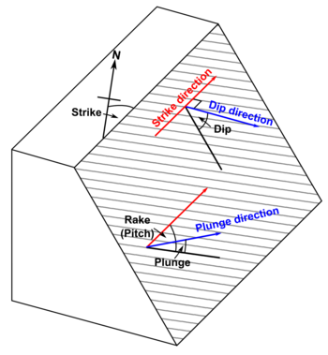
Geometries: Measurement conventions
The inclination of a planar structure in geology is measured by strike and dip.
  The strike is the line of intersection between the planar feature and a horizontal plane, taken according to the right hand convention,
  the dip is the magnitude of the inclination, below horizontal, at right angles to strike.
  For example; striking 25 degrees East of North, dipping 45 degrees Southeast, recorded as N25E,45SE.
Alternatively, dip and dip direction may be used as this is absolute. Dip direction is measured in 360 degrees, generally clockwise from North. For example, a dip of 45 degrees towards 115 degrees from north, recorded as 45/115.
http://en.wikipedia.org/wiki/Structural_geology
Notes:
Lineations are measured in terms of dip and dip direction, if possible. Often lineations occur expressed on a planar surface and can be difficult to measure directly. In this case, the lineation may be measured from the horizontal as a rake or pitch upon the surface.
Rake is measured by placing a protractor flat on the planar surface, with the flat edge horizontal and measuring the angle of the lineation clockwise from horizontal. The orientation of the lineation can then be calculated from the rake and strike-dip information of the plane it was measured from, using a stereographic projection.

Slide 5
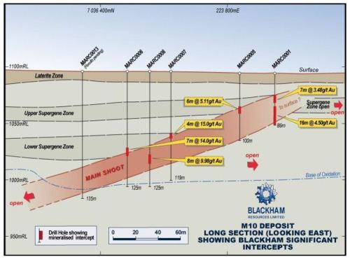
Gold seam at Matilda, Australia (April 2012)
http://www.resourcesroadhouse.com.au/_blog/Resources_Roadhouse/post/Blackham_fires_up_new_drilling_program_at_Matilda/

Slide 6
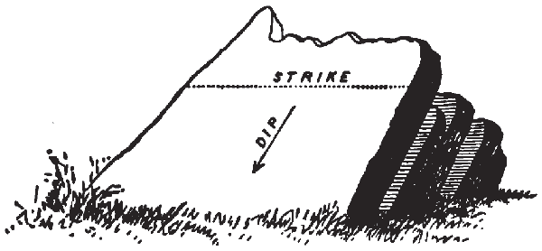
Some times the seam will protrude out of the ground

Slide 7
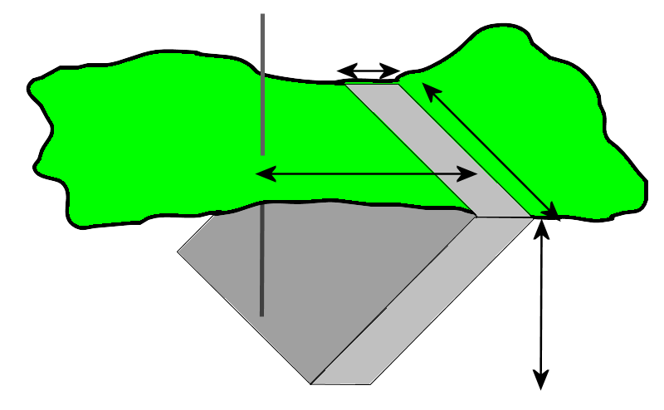
Lets model this as an idealised Gold seam with plunge=dip
Drill hole
1.8 m
15 m
30 m
8 m
Those of you comfortable with Maths can solve this problem without the distance from centre of seam to bore hole (30 m).

Slide 8
Maths knowledge required today
Pythagorean theorem
Radians and degrees
Trig ratios.
These concepts come up in many, many, many areas of science. They are used in simple problems and difficult problems too, because they are so fundamental!
Today’s problem will be fairly simple, but look at some more difficult examples...

Slide 9
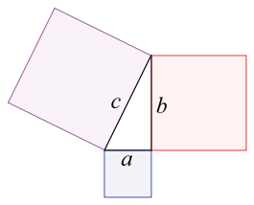
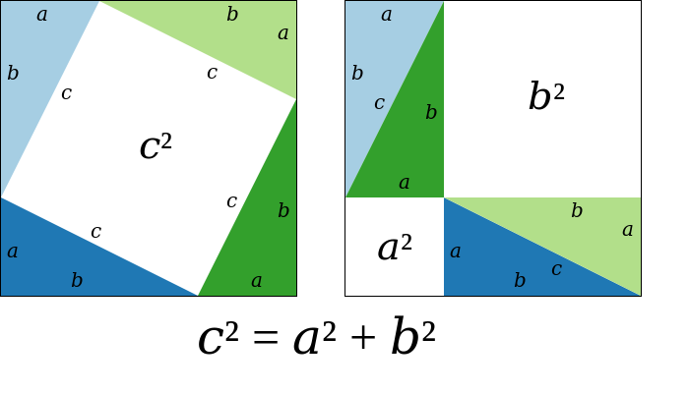
Pythagorean theorem
“The square of the hypotenuse (the side opposite the right angle) is equal to the sum of the squares of the other two sides”
Notes:
Fundamental! Used in many places, it is surprising! That is why we are practicing today.

Slide 10
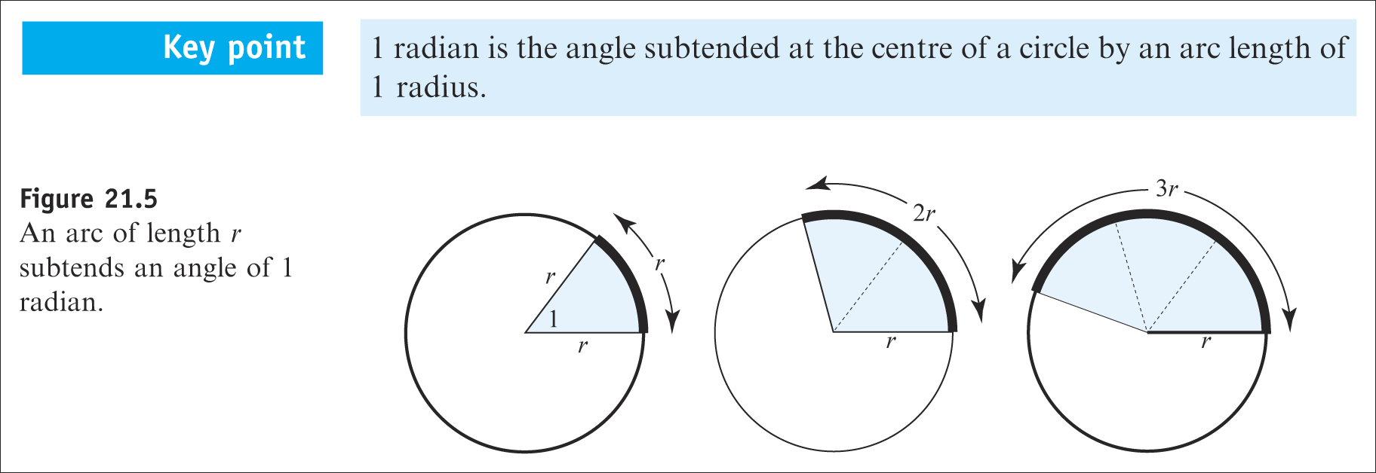
Radians and degrees

Slide 11
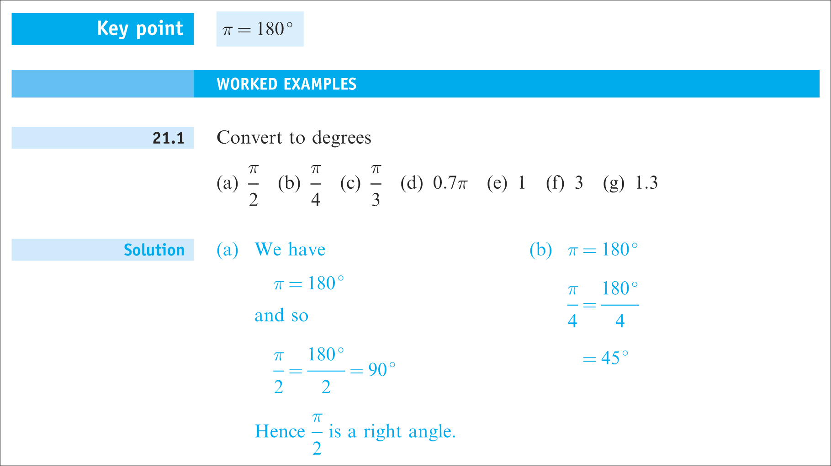

Slide 12
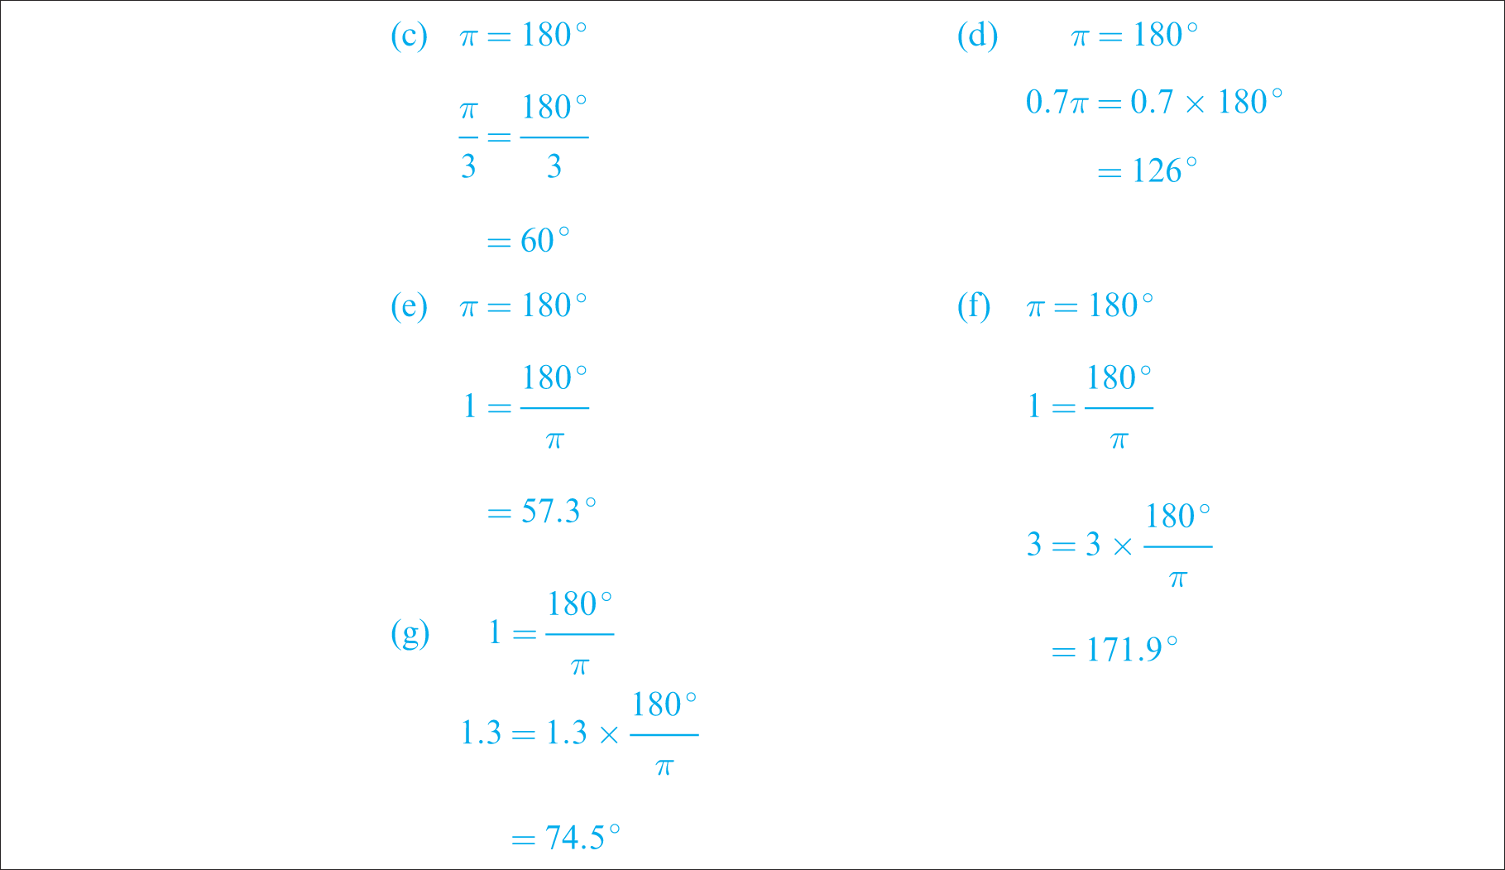
Continued

Slide 13
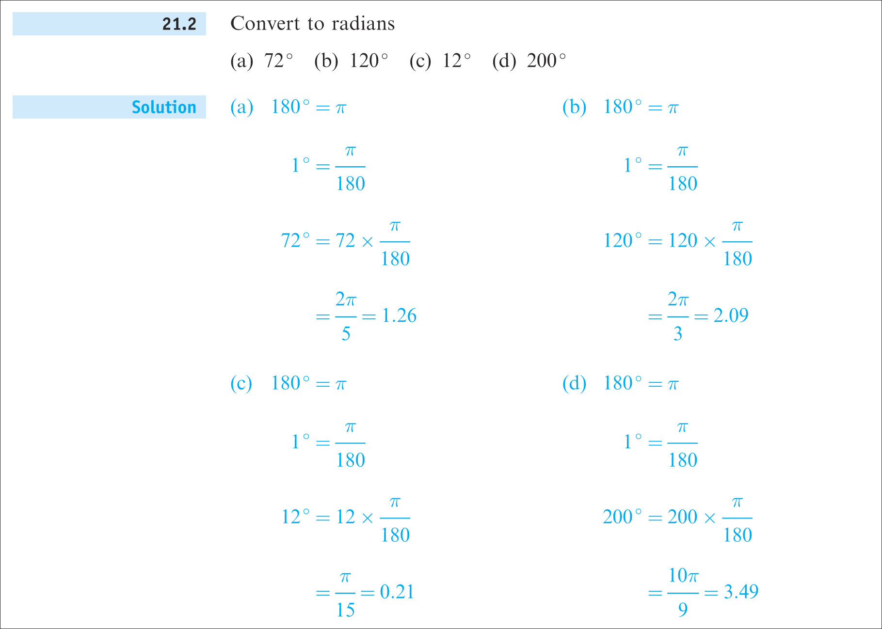
Continued

Slide 14
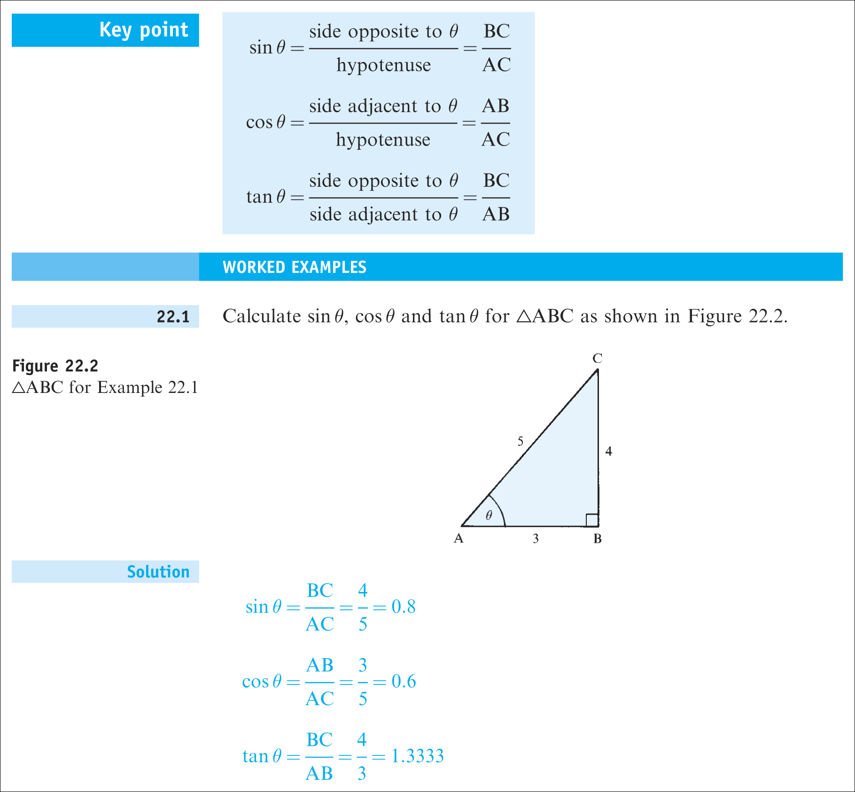
Trigonometric ratios

Slide 15
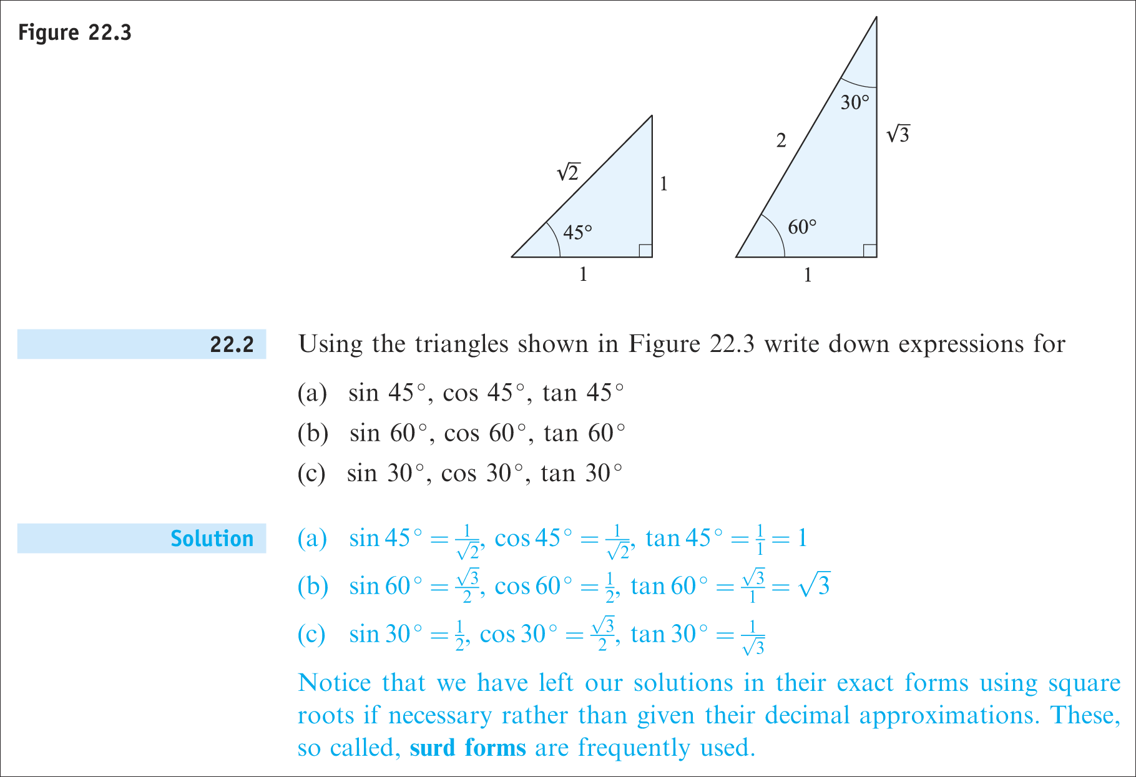
Continued

Slide 16
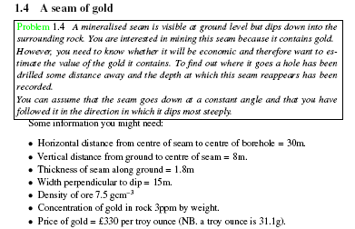

Slide 17
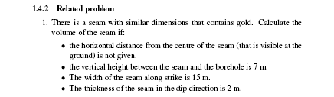

Slide 18
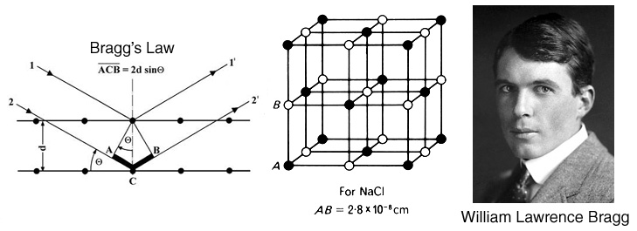
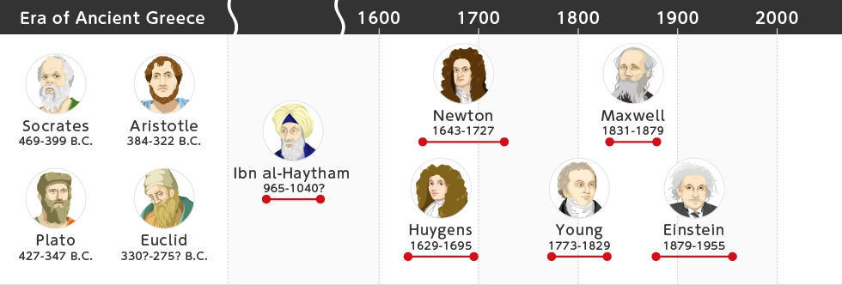
Father William Henry Bragg shared the Nobel prize for physics in 1915, "for their services in the analysis of crystal structure by means of X-rays".
Langworthy professor of physics at Manchester 1919 - 1937
Still widely believed that light was a “wave” (a disturbance in the electro-magnetic field).
http://photonterrace.net/en/photon/history/

Slide 19
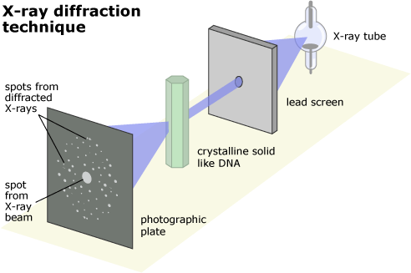
Visual of how X-Ray diffraction works © King's College Archives; Wilkins-Gosling

Slide 20
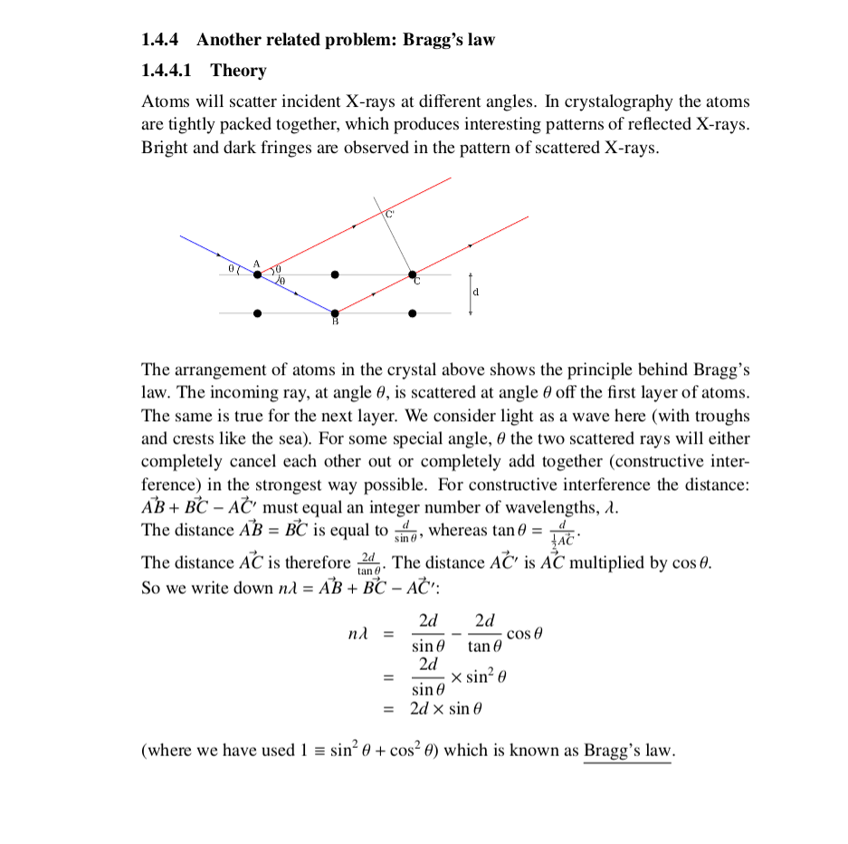
Notes:
Go through this carefully!

Slide 21
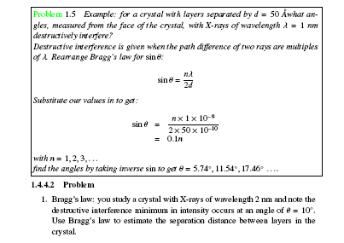
Notes:
For them to try.

Slide 22
Today
Problems on trig and Pythagoras’ theorem
Main problem on gold seam
Bragg’s law
If time try the sound pressure levels – not needed!
Homework:
  Seam of Gold
  Angles, solutions of triangles and trig

Slide 24
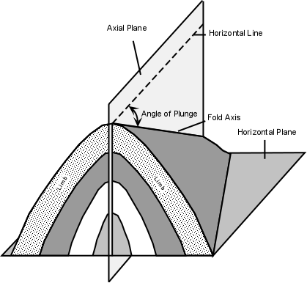
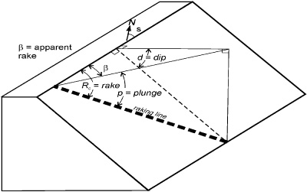
Another example, showing plunge better
Lineations
http://serc.carleton.edu/NAGTWorkshops/structure/computer_resources.html
http://earthsci.org/education/teacher/basicgeol/deform/deform.html
See (even try at home?):
http://www.fault-analysis-group.ucd.ie/papermodels/models/strike_dip.html

Slide 25
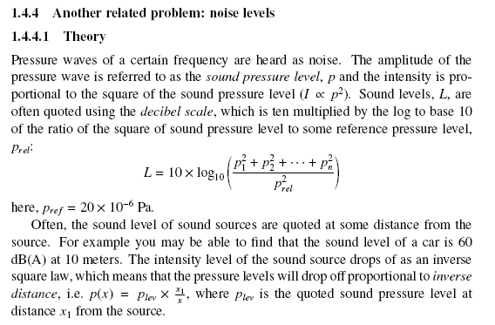

Slide 26
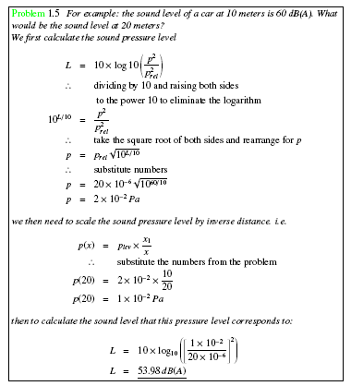

Slide 27
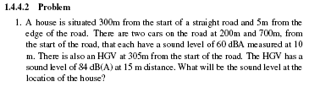
Cars and HGVs noise levels
Cars are 60 dB(A) at 10 m.
HGVs are 84 dB(A) at 15 m.
The house is 5 m off the road side.

