Slide 1
Altering the atmosphere by burning fossil fuels
You have two weeks to complete assessments. Try them after the practical, if you are stuck ask about them the following week.
Altering atmosphere by burning fossil fuels
Next week – Acid Mine Drainage
Reading week
Then start of module 2 – stats and data analysis.

Slide 2
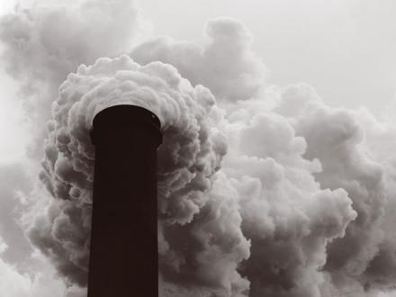
we will learn about burning fossil fuels creates pollutants and CO₂, which contribute to global warming

Slide 3
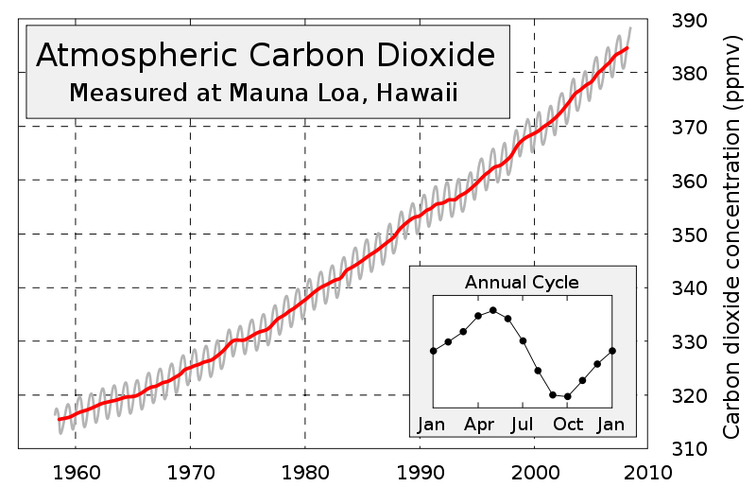
Think about how much the CO₂ concentration has increased over time (gradient)
385-365=20 ppm
10 years

Slide 4
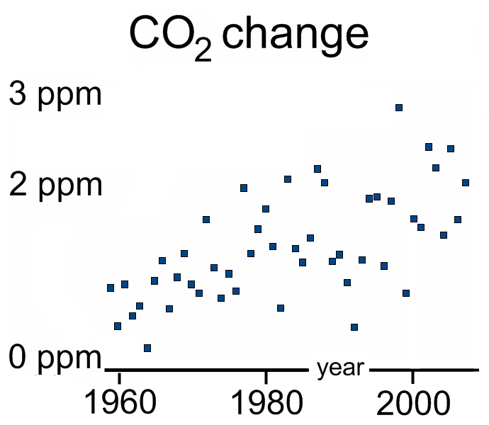
per year

Slide 5
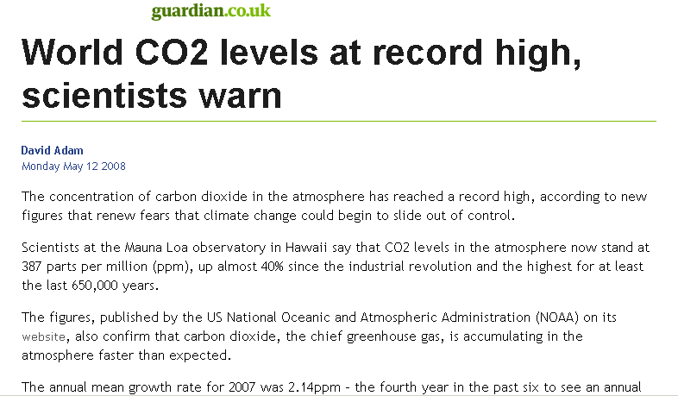

Slide 6
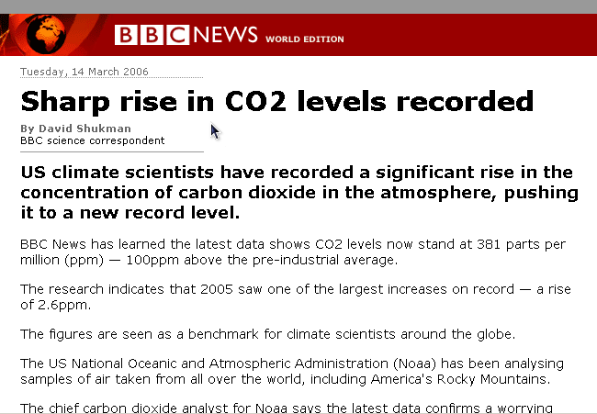

Slide 7
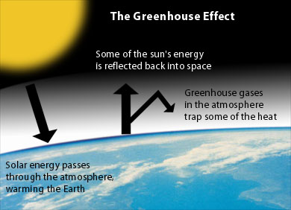
(e.g. by clouds)
www.environmentalsociety.ca/issues/climate/international-issues.html
Notes:
Write albedo=energy reflected/energy incident on board

Slide 8
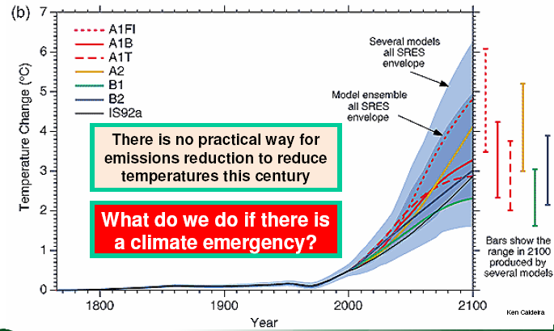
Climate predictions show temperatures to increase throughout this century
Different predictions of temperature change
Many interacting factors, clouds, greenhouse gases, etc
For a basic description of the processes (not needed, but interesting?) see:
http://personalpages.manchester.ac.uk/staff/paul.connolly/teaching/climatesim/index.html

Slide 9
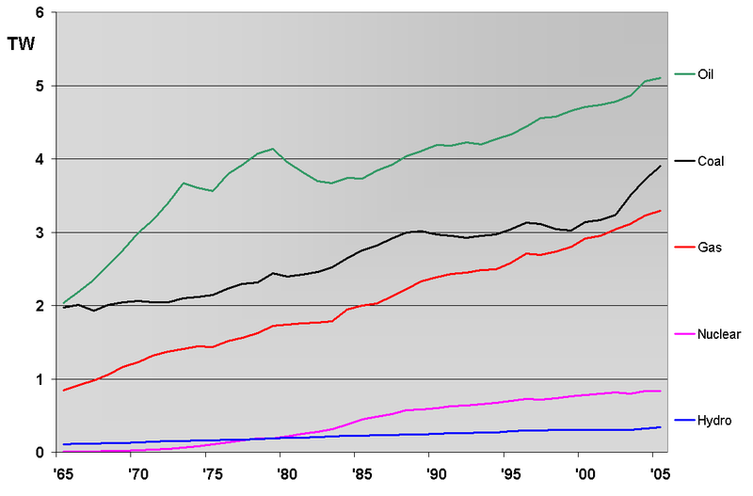
We can work out how much CO2 was made from fossil fuels by considering the global power consumption
TW (Terra watt)
This example problem is from 1985-7
Year
Notes:
Terra watt is a unit of power. We talked about energy, power in this instance is the rate of energy being used. P=delta E/ delta t. Show how to convert it.

Slide 10
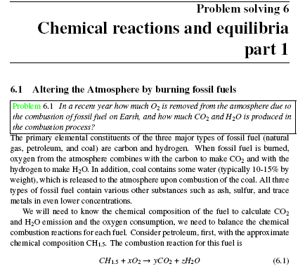
How much CO₂ is made by burning these fuels?
How does this affect the atmospheric CO₂ concentration?
Notes:
Talk through finding x, y and z on board. Explain they are molar stochiometric constants (i.e. they can be scaled up).

Slide 11
Burning hydrocarbons
CH₄ + 2O₂ → CO₂ + 2H₂O
C₂H₆ +3.5O₂ → 2CO₂ + 3 H₂O
C₃H₈ +5O₂ → 3 CO₂ + 4 H₂O
The number of CO2 moles has to balance the length of the carbon chain i.e. n
The number of water molecules is determined by balancing the hydrogens i.e. (2n+2)/2
If n is the length of the carbon chain, the number of hydrogens is 2n+2
The number of molecular oxygens must balance with the oxygen on the right, i.e. n+(2n+2)/4

Slide 12
CO2 concentrations

Slide 13
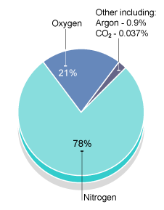
Composition of atmosphere by moles
What is ppmv? Totally misleading (unfortunately we’re stuck with it)
Each gas exerts a partial pressure p_{i}
The ideal gas law holds for each gas:
p_{i}V=N_{i}RT
The total pressure is the sum of partial pressures:
p=p₁+p₂+p₃+…+p_{N}
Take the ratio p_{i}/p for gases occupying the same volume, V, at same temperature, T:
p_{i}/p=N_{i}/N
Ppmv is the molar ratio times by 1x10⁶
It should be called moles per million!
R=8.314 J K⁻¹ mol⁻¹
T=temperature
P=pressure
V=volume

Slide 14
Today / this week
Do supplementary material (additional problems on ppmv / mixing ratio)
Do main problems: and 1 & 2 (don’t need to do 3&4)
Homework: Blackboard exercises
  Altering the Atmosphere
  Factorising / simplifying fractions

Slide 16
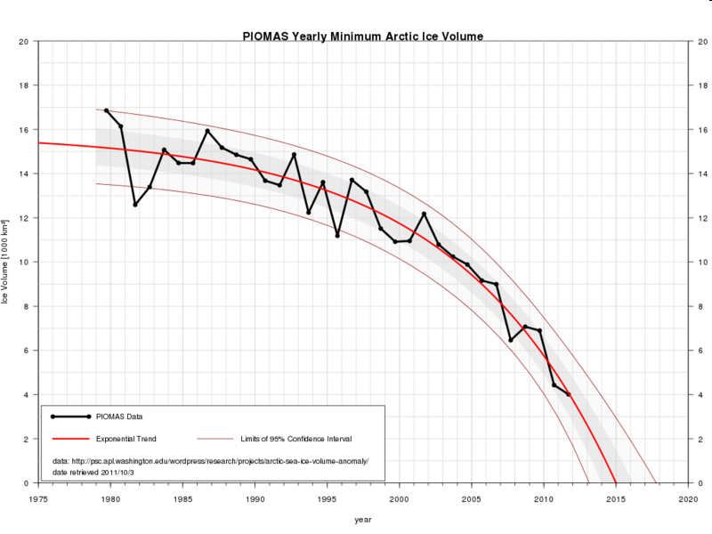
Decline of the Arctic sea ice happening fast
The ice minimum may be zero by 2015!
Ice volume (1000 km³)
So what:
Well, melting sea ice could switch off the gulf stream and make it colder in the UK
Could have also been responsible for the miserable summer and winter snow over the last few years.

