Slide 1
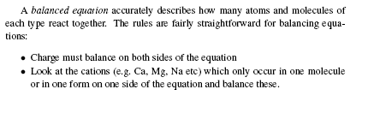
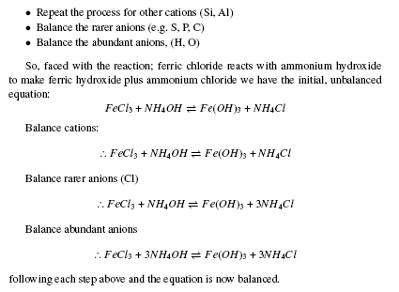
More practice balancing equations
(see appendices)

Slide 2
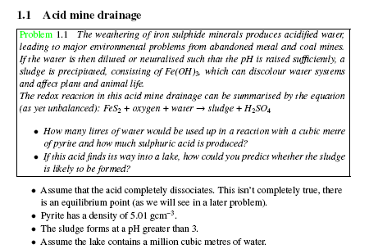
Assume we are working with 1 cubic metre of pyrite

Slide 3
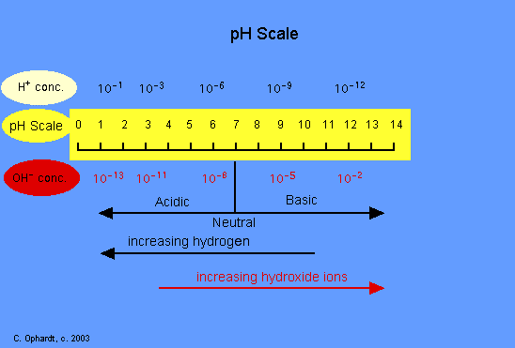

Slide 4
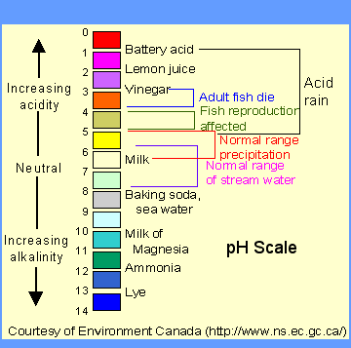
Another related question: do the fish in the lake die?

Slide 5
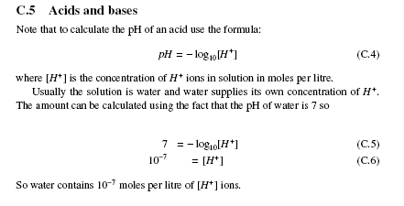
Quantitative bit: pH scale
(see your appendices)
You will need to calculate pH. Note the square brackets are concentration in moles per litre of water.
Practice manipulating logs with the supplementary sheet.

Slide 6
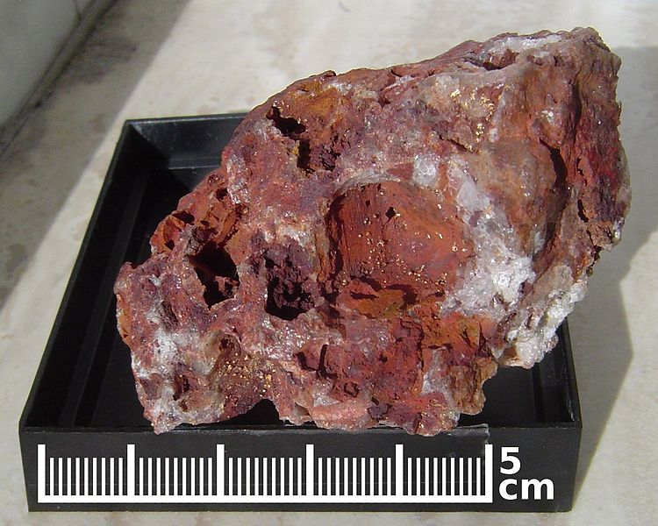
Pyrite
Pyrite exposed to the atmosphere during mining and excavation reacts with oxygen and water to form sulphate (sulphuric acid), resulting in acid mine drainage. This acidity results from the action of Acidithiobacillus bacteria, which generate their energy by oxidizing ferrous iron (Fe2+) to ferric iron (Fe3+) using oxygen. This oxidation is required so that the reaction
The ferric iron in turn attacks the pyrite to produce ferrous iron and sulphate. This continues until the pyrite is depleted.
Why does bacteria oxidize iron? See http://www.youtube.com/watch?v=jS9jAZJiBRg

Slide 7
Bonding (see appendix C2)
Electrons in the atom can be though to orbit in `shells’. This is because certain numbers of electrons are more stable than others. These numbers are 2, 10, 18, 26. So we can think of complete `shells’ having 2, 8, 8, 8 numbers of electrons in them.
Bonding occurs because atoms try to configure themselves to have a stable electron configuration.
.
.
.
e.g. Lithium has 3 electrons in the first shell; fluorine has in the second shell. They can both obtain `stable’ configurations if an electron is transferred from lithium to fluorine.
.
.
.
Li
.
F
.
.
.
.
.
.
.
.
-
.
+
.
.
Li
F
Since both lithium and fluorine are now ions they can bond because of electrostatic interaction: an ionic bond.
.
.

Slide 8
Bonding (see appendix C2)
It is more difficult for the complete transfer of electrons for atoms in the middle of the period table.
Take oxygen for instance; it has 6 electrons in it’s outer shell
.
.
Oxygen needs 2 more electrons to form a stable electron configuration / shell.
It can most easily do this by forming another type of bond: a covalent bond, in which it shares electrons with another oxygen.
.
.
O
.
.
.
.
.
.
.
.
Thus both oxygen’s can form a more stable configuration by `sharing’ two electrons we say that the bond in molecular oxygen is a covalent bond.
O
.
.
O
.
.
.
.

Slide 9
Iron oxidation number / ionic bonding
Iron(II) disulphide can be thought of as being bonded either ionic or covalent.
  Sulphur atoms gain 1 electron to become S⁻ ions. Two S⁻ can then form an ionic bond with Fe²⁺.
  OR because sulphur is group 6 (6 electrons in outer shell) it can share an electron with another sulphur and each sulphur can share an electron with iron(II).
OH ion:
  oxygen is group 6 element and has 6 electrons in outer shell.
  Forms a covalent bond with two hydrogens to form water. OH ion has one less hydrogen. So OH⁻ (1 minus charge).
  Three OH⁻ can form ionic / covalent bond with Fe³⁺ similar to iron disulphide.

Slide 10
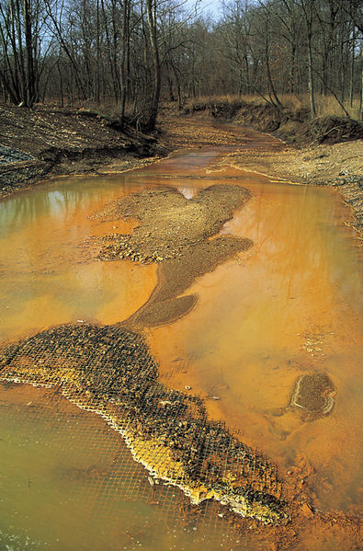

Slide 11
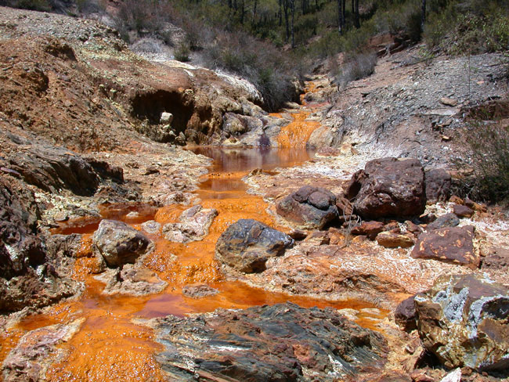
Tinto river in Spain

Slide 12
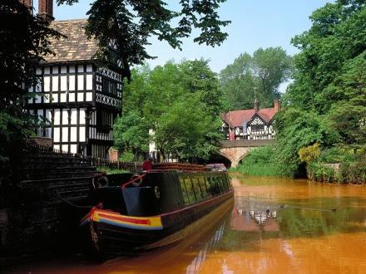
The world famous Bridgewater canal…

Slide 13
Assume we are working with 1 cubic metre of pyrite
The degree to which H₂SO₄ dissociates depends on how acidic it gets. As two estimates assume it either dissociates into H⁺ and HSO₄⁻ and then 2H⁺ and SO₄²⁻

Slide 14
Logarithms refresher

Slide 15
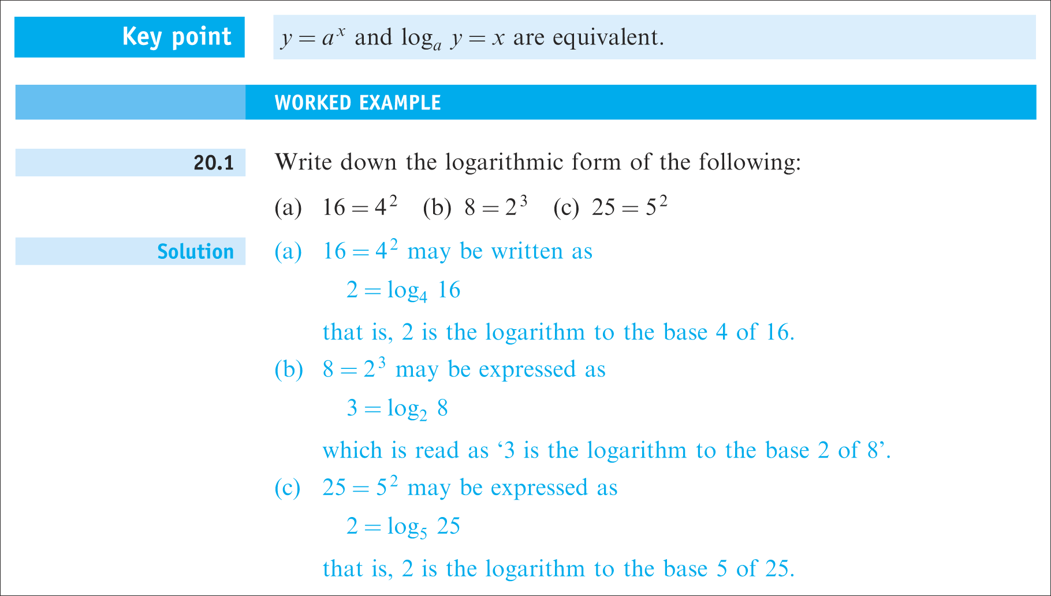

Slide 16
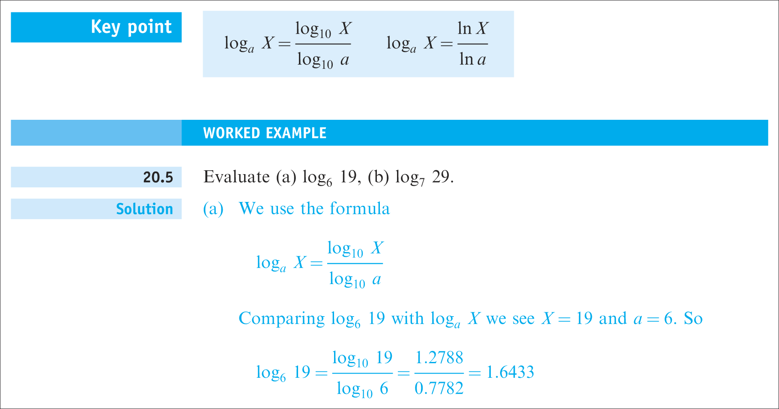

Slide 17
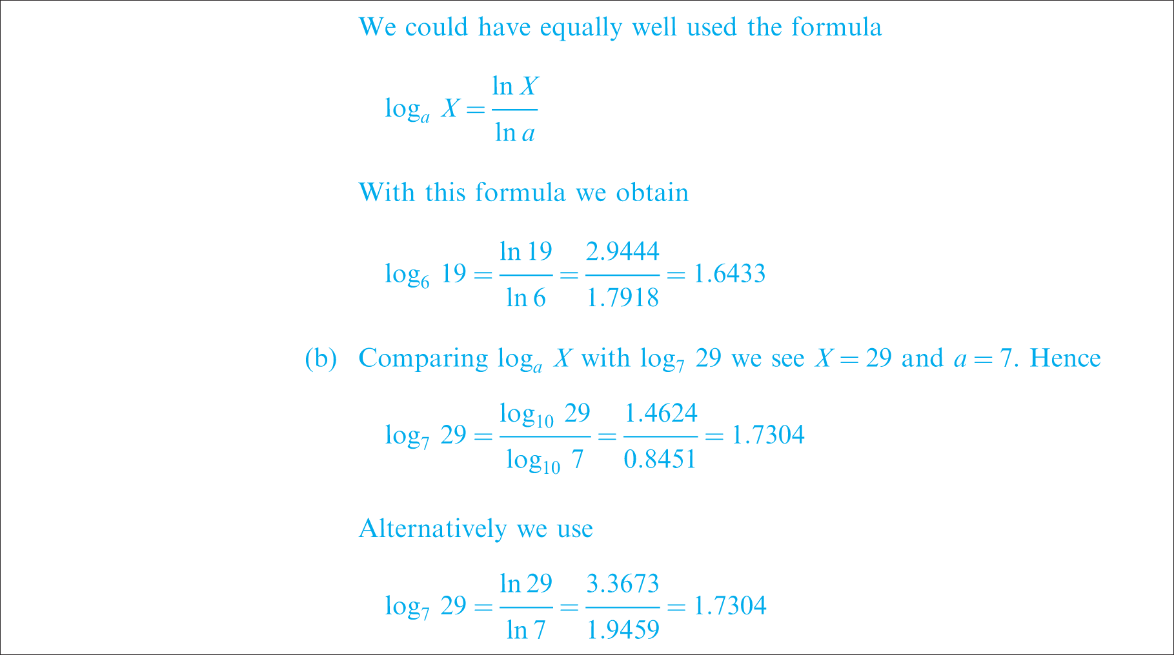
Continued

Slide 19
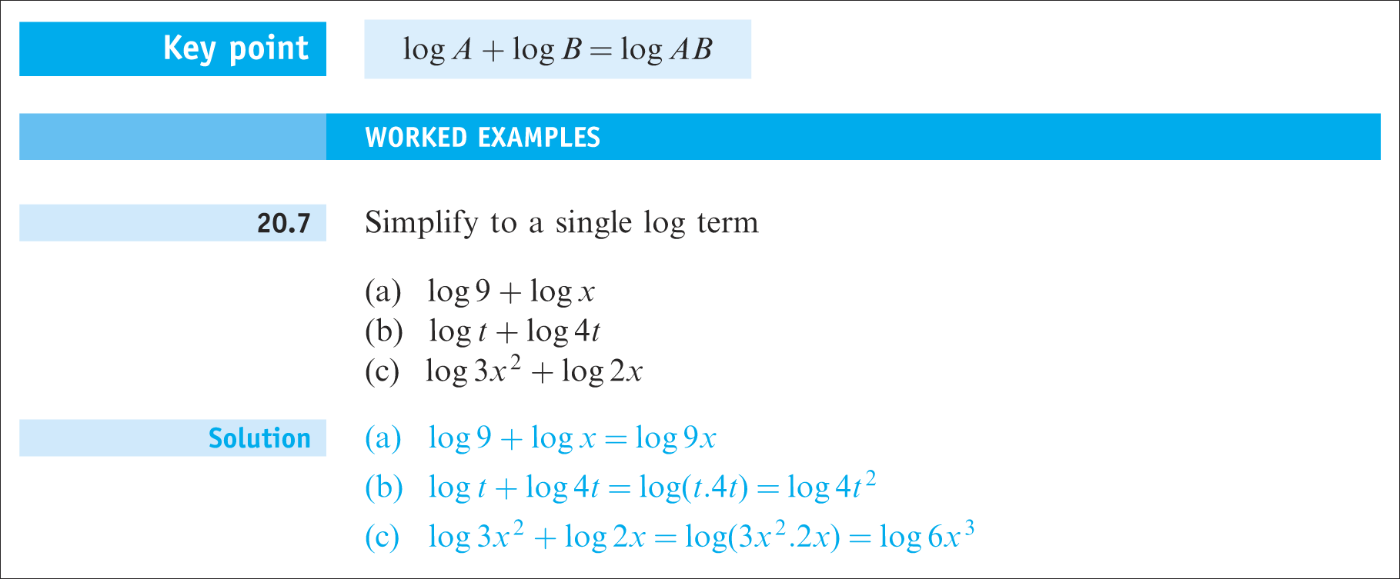

Slide 20
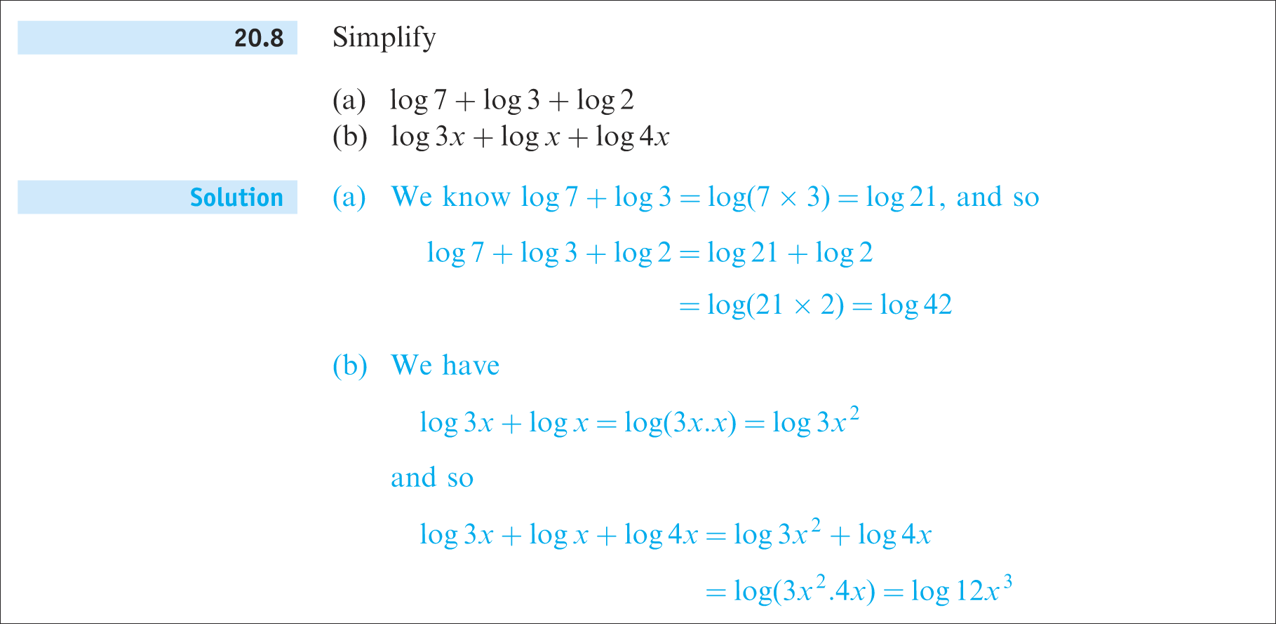
Continued

Slide 21
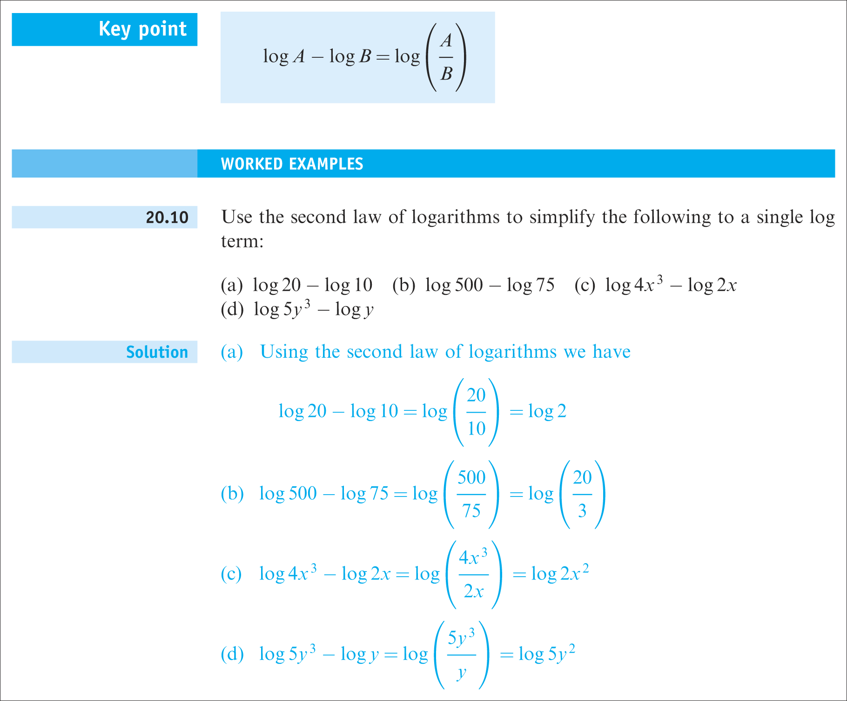

Slide 22
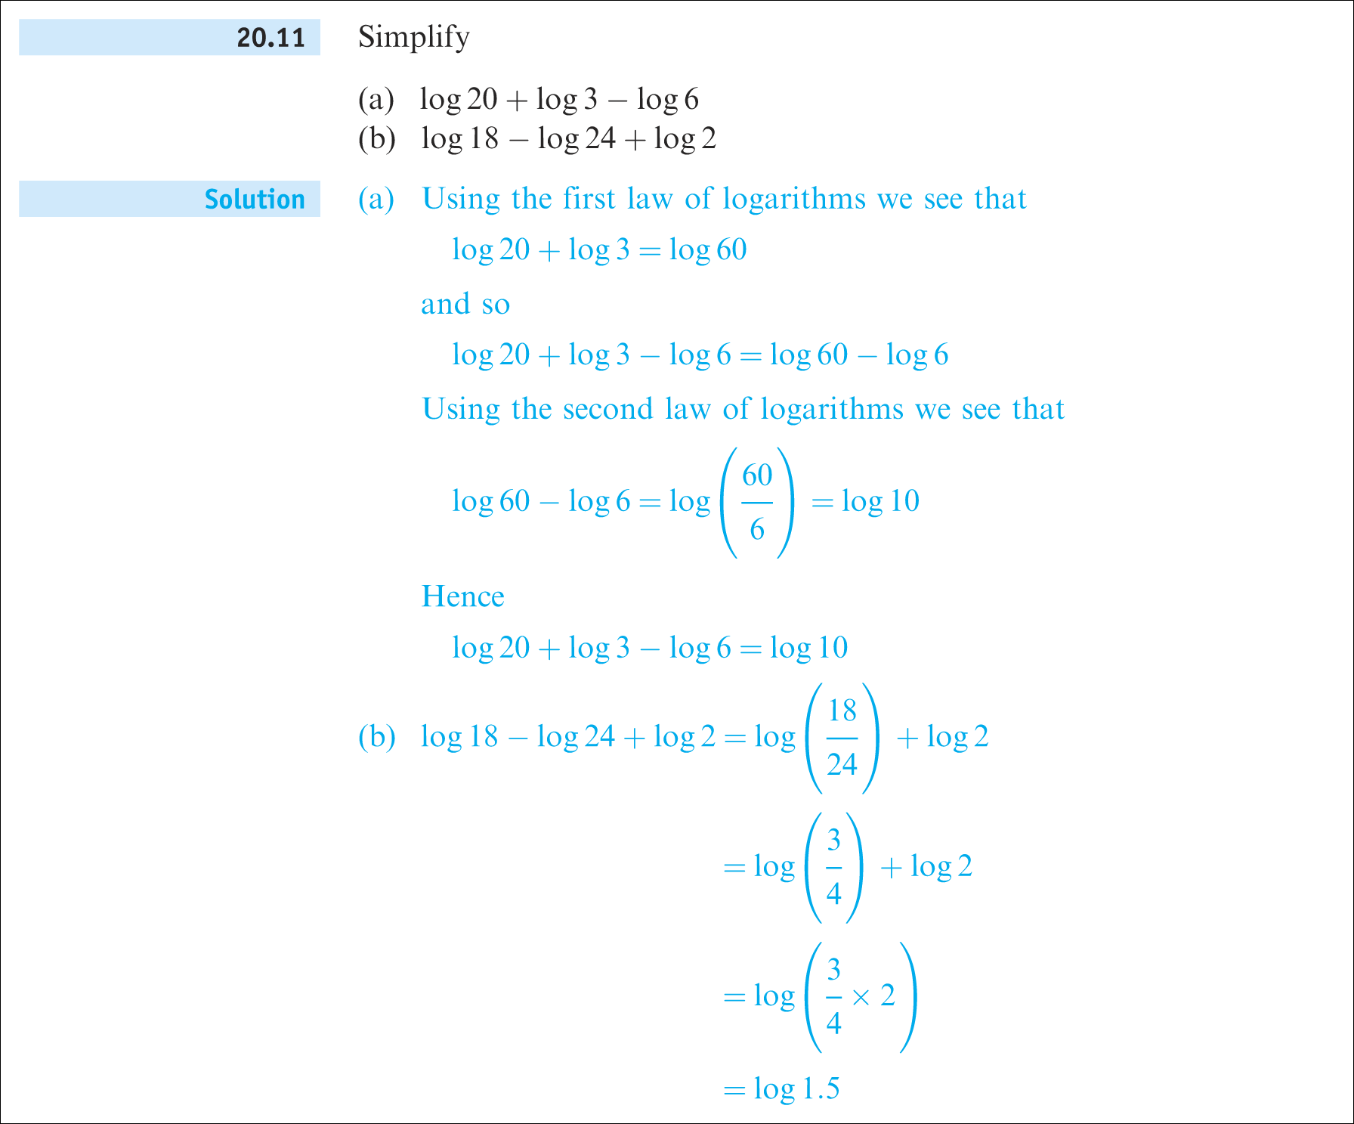
Continued

Slide 23
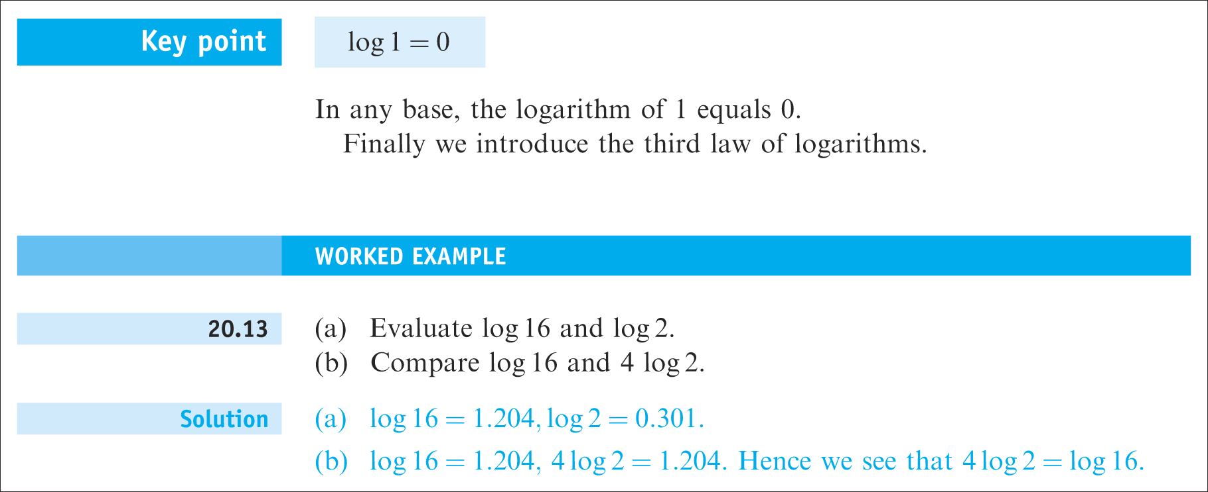

Slide 24
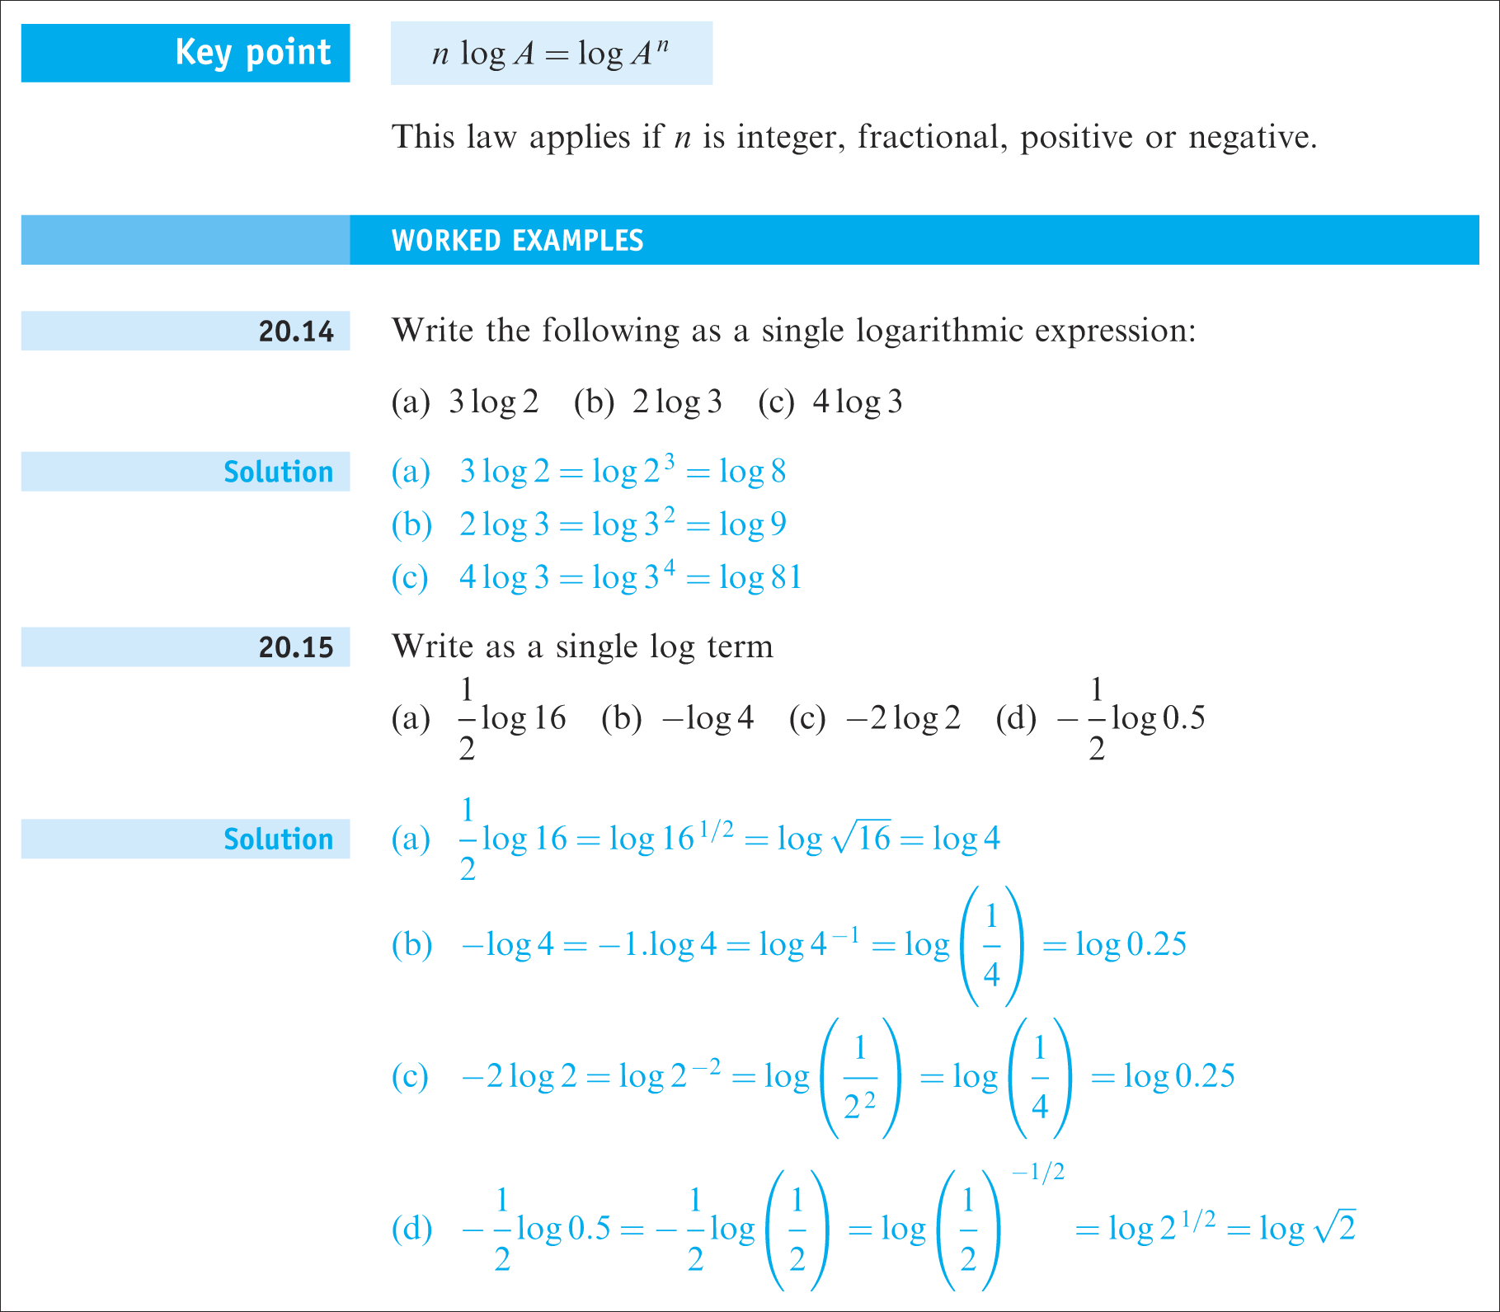

Slide 25
The constant e

Slide 26
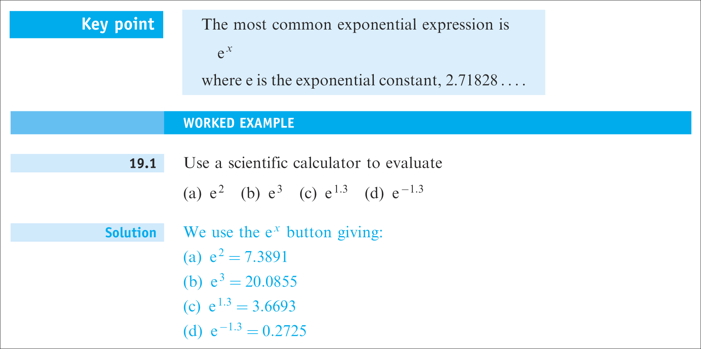

Slide 27
Today and this week
Work through supplementary sheet on exponentials and logs
Work through Acid mine drainage problems
In the week there are two assessments:
  Acid mine drainage
  Exponentials and logarithms

