Slide 1
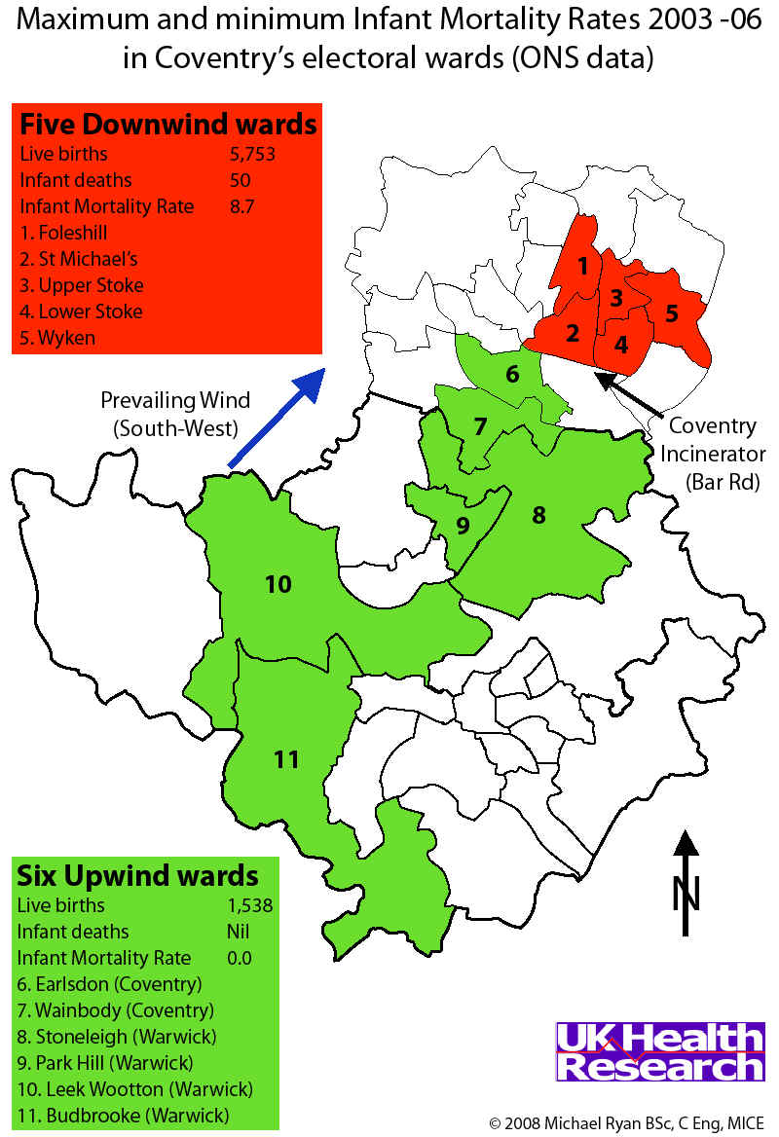
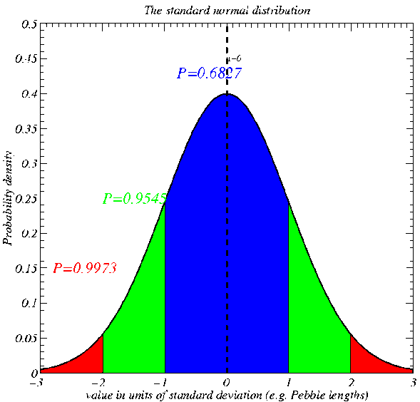
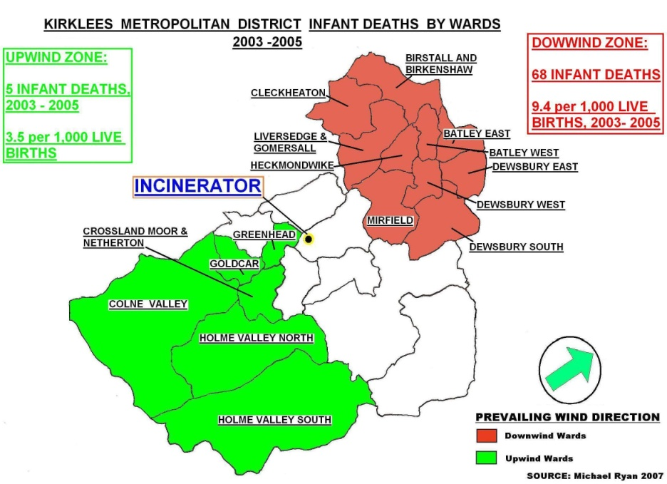
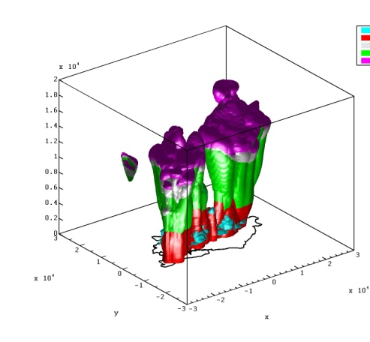
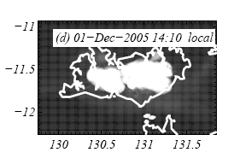
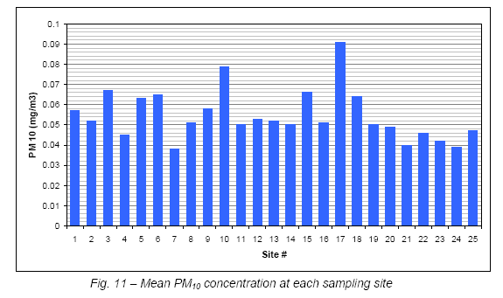
EART10160 data analysis lecture 3: hypothesis testing about a proportion or a mean
Dr Paul Connolly

Slide 2
Intended learning outcomes
Know how to formulate and test a hypothesis about a population mean from sample data
Have an appreciation why it works!
There are many examples, a few could be…

Slide 3
Examples of hypotheses to be tested
Is the ratio of male:female students 50:50?
Is the gold content in a seam above 5 ppm?
Do atmospheric aerosol particles increase or decrease the chances of rain?
Does it rain more at the weekend than during the week?

Slide 4
Definition
Hypothesis: A testable statement on the basis of limited evidence as a starting point for further investigation.
Null hypothesis: A type of hypothesis used in statistics that proposes that no statistical significance exists in a set of given observations.
Alternate hypothesis: the opposite to the null hypothesis

Slide 5
All hypothesis tests in this course:
State the null and alternate hypotheses:
  E.g. H₀: μ=0, H₁: μ>0
  Or, H₀: p=0.5, H₁: p≠0.5
  Or, H₀: ρ=0, H₁: ρ≠0
Calculate a statistic (to be defined): something that if null hypothesis is true is distributed according to a theoretical distribution.
Calculate a critical value from the theoretical distribution.
Assess which is largest: statistic or critical value and
Accept the null if statistic < critical value or reject the null (and hence accept the alternate) if statistic > critical value.
You can also calculate a p-value for the hypothesis test which is the probability to the left of the calculated statistic (e.g. the p-value is 0.0001).
I’ve noticed that many journals in the biological sciences do quote p-values for their tests. It is useful because it allows the reader to assign their own significance level and make their own judgement.

Slide 6

What statistics shall we calculate from our data? I
Statisticians have found that if you take a random sample, size N, from a population of which a proportion p answer `yes’ to a question and ask that sample the same question, the statistic:
p=population proportion saying either yes or no (depends on convention).
q=population proportion saying the opposite to p
p̂ =sample proportion saying either yes or no
z will be:
Distributed according to a standard normal distribution (if the data are drawn from the same population).
Therefore, if we calculate a value of z from our data that is large, we can say it is unusual.

Slide 7
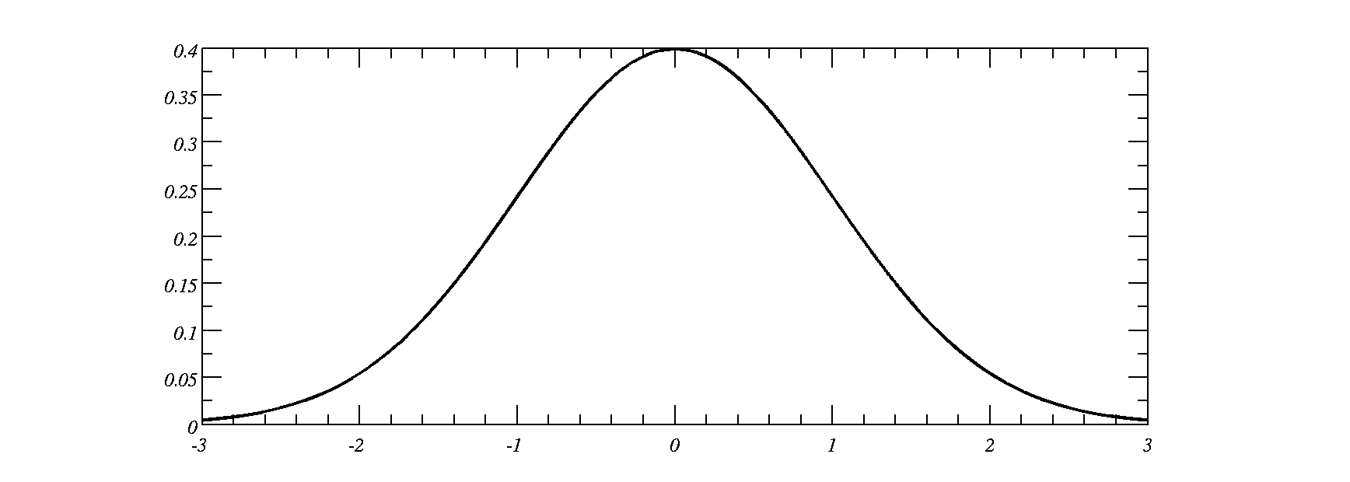
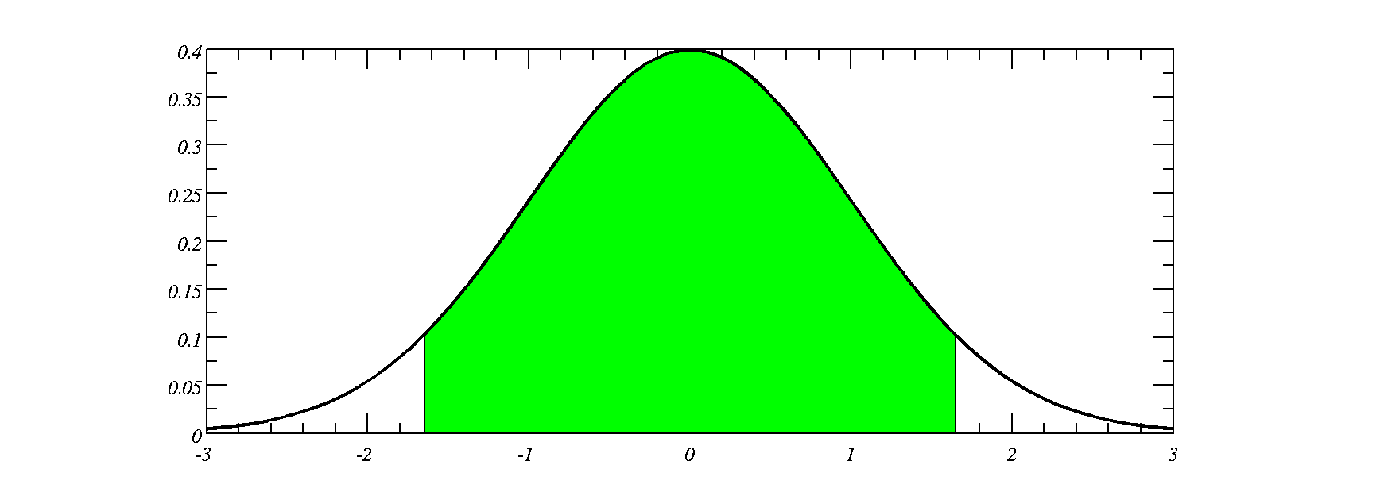
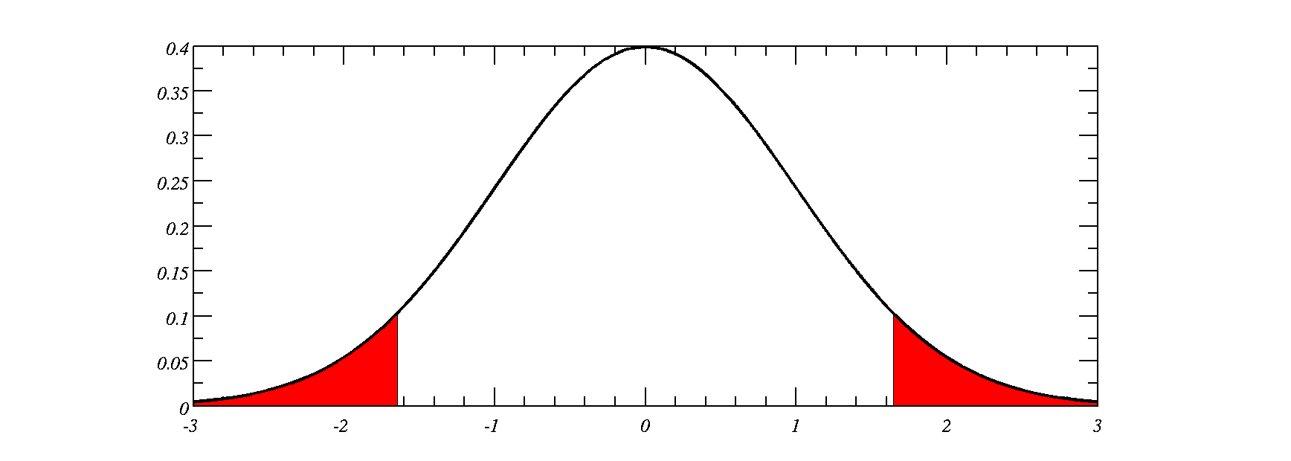
Confidence levels and significance levels
Usually we want to be confident that the statement we make is correct. Unfortunately you can never be 100% confident in anything.
10% chance that the value is in this region
5% in each `tail’.
We call this a 10% significance level
Select a value at random, 90% chance within these bounds.
Thus 90% confidence level
Critical value is the point where the x-axis goes into the red region
Therefore significance level, α=1-confidence level

Slide 8
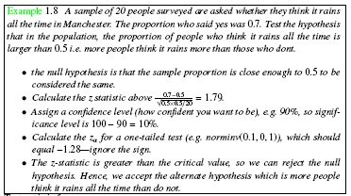
Example: proportions
What is the p-value?
normcdf(-1.79,0,1)=0.037

Slide 9
Coventry

Slide 10

Kirklees
Is the average mortality rate statistically different to the UK average 5.33 in 1000 (for the same period)?
http://en.wikipedia.org/wiki/List_of_countries_by_infant_mortality_rate#UN_United_Kingdom

Slide 11
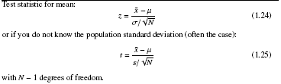
What statistics shall we calculate from our data? II
Statisticians have found that if you take a random sample, size N, from a population with mean, μ, and calculate:
z will be:
  Distributed according to a normal distribution
t will be
  Distributed according to a Student-t distribution (because the sample standard deviation is usually lower than the population; hence, t will usually be larger than z)
Therefore, if we calculate a value that has a large value of z or t, we can say it is unusual.

Slide 12
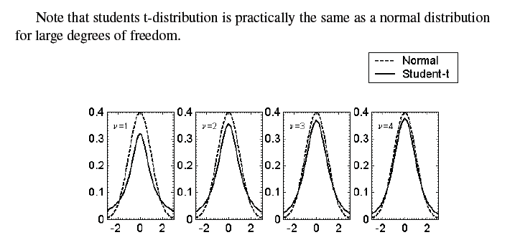
Student’s t-distribution
Used when you don’t know population standard deviation. Nearly always!
Note the t-distribution is a bit broader than the normal distribution because the sample standard deviation usually underestimates the population standard deviation, so t tends to be bigger than z
Symmetrical, tends towards normal distribution for high ν, but broader at low ν

Slide 13
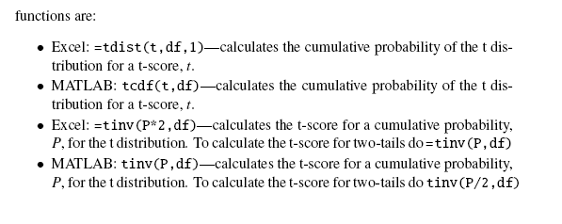
To calculate these using computer
MATLABer’s rejoice! tinv is used the same way as norminv.
Exceller’s: oh dear, by default tinv gives you the t-value for the two-tailed probability, so if you multiply P by two it gives one tailed.

Slide 14
Excel vs Matlab sampling distributions
To calculate the distance from the mean for the normal distribution:
  norminv(P,μ,σ) [ Matlab]
  NORMINV(P,μ,σ) [ Excel ]
To calculate the cumulative probability for a distance from the mean for the normal distribution:
  normcdf(z,μ,σ) [ Matlab ]
  NORMDIST(z,μ,σ, 1) [Excel ]
To calculate the distance from the mean for the t-distribution
  tinv(P,ν) [ Matlab ]
  TINV(2xP,ν) [ Excel ]
To calculate the cumulative probability for a distance from 0 for the t-distribution
  tcdf(t,ν) [ Matlab ]
  TDIST(t,ν,1) [ Excel ]
Note that Excel doesn’t have negative values of t either!
Notes:
Draw a distribution and talk about how you can sample using these functions.

Slide 15
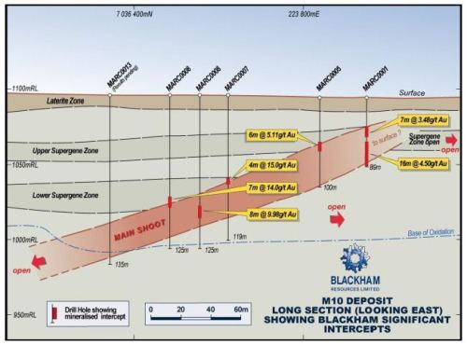
Gold seam at Matilda, Australia (April 2012)
http://www.resourcesroadhouse.com.au/_blog/Resources_Roadhouse/post/Blackham_fires_up_new_drilling_program_at_Matilda/

Slide 16
Gold seam at Matilda, Australia (April 2012)
Mining company only want to mine the gold if weight percent is above 5 ppm.
Is the mean gold content in the seam greater than 5ppm? Choose a 0.05 significance level.
H₀: the gold weight percent is equal to 5 ppm.
H₁: the gold weight percent is larger than 5 ppm.
Spot measurements are
  5.11, 15.14, 9.98, 3.48, 4.50 ppm
  Sample mean=8.68
  Standard deviation=5.04
  t= (8.68-5)/(5.04/sqrt(5))=1.63
  Excel: =tinv(0.05*2,5-1)… 2.78
  Matlab: tinv(0.05,5-1) … -2.78 (ignore sign)
Cannot reject null hypothesis that gold weight percent is equal to 5 ppm.
Note the difference between MATLAB and Excel

Slide 17
One-tailed and two-tailed tests
Usually when testing hypotheses about a mean we can have either one or two-tailed tests.
Two-tailed test is if we are testing if something is significantly different to something else (e.g. as we did with confidence intervals last week)
  We had a lower confidence limit and an upper.
One-tailed test is if we are testing if something is significantly larger or smaller than something else.
Important as it affects the probability you put into the `norminv’, (or `tinv’) functions in Excel or MATLAB.
Notes:
Draw a distribution and talk about how you can sample using these functions.

Slide 18
Two-tailed test
Test whether a sample mean or proportion is significantly different than a population mean or proportion at the 10% significance level
Area in each tail is 0.05, so area of both is 0.10.
Critical region
Critical value (read off on x-axis – or use output of norminv(α/2), or tinv(α/2)) [tinv(α) in Excel]

Slide 19
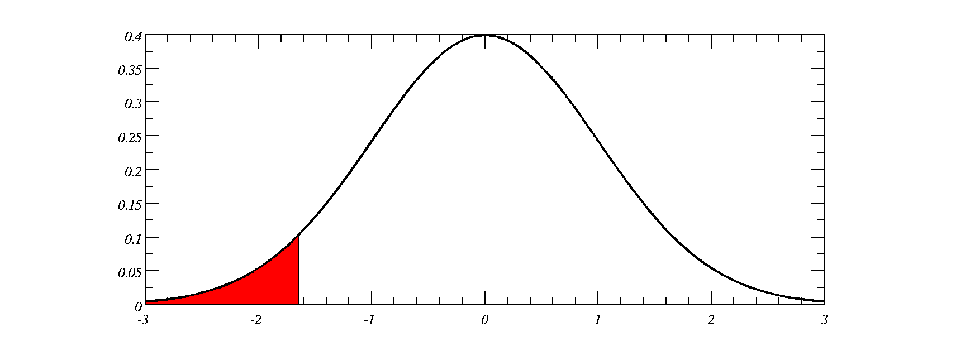
One tailed test
Test whether a sample mean or proportion is significantly smaller or larger (symmetric so doesn’t matter) than a population mean or proportion at the 5% significance level
Area in tail is 0.05, so significance level is 0.05.
Critical region
Critical value (read off on x-axis – or use output of norminv(α), or tinv(α)) [tinv(α*2) in Excel.]

Slide 20
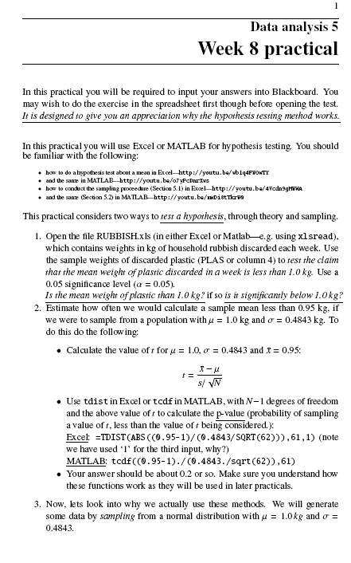
The practical this week
The aim of the practical is to give an appreciation of why hypothesis testing works and give you some practice in applying the methods discussed.

Slide 21
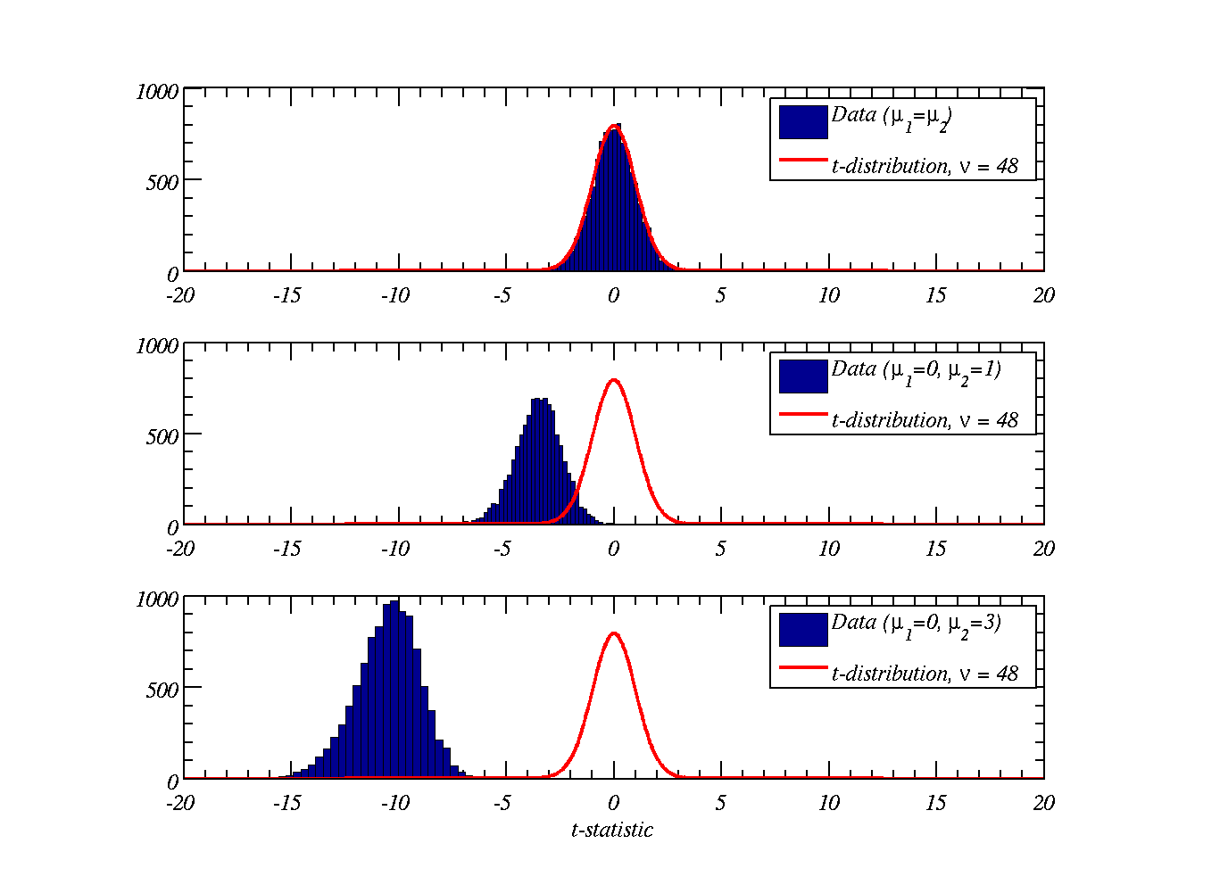
Why we use these methods
Null: If sample comes from a distribution with same mean: good chance of being close to zero
Borderline: If sample comes from different distribution – we don’t get a t-distribution and little chance of being close to zero. But say ~5% of the time it could be close to zero.
Alternate: If sample comes from a vastly different distribution – practically no chance of overlapping
Notes:
Overlapping distributions

Slide 22
Additional slides

Slide 23
Example of one and two-tailed test
Test whether a sample mean (of size 10) is significantly larger than the population mean at the 0.01 level of significance
  Excel: tinv(0.01/2,9)
  MATLAB: tinv(0.01,9)
Test whether a sample proportion (of size 20) is significantly different from a population proportion at the 0.05 level of significance
  Excel: tinv(0.05,19)
  MATLAB: tinv(0.05/2,19)

Slide 24
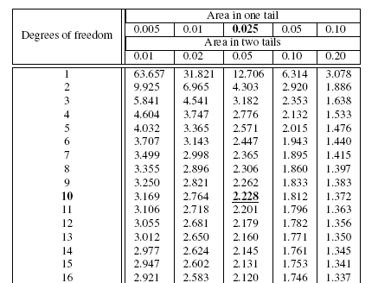
How far from 0 is a certain sig level?
Call this the t-value, like z-value for normal distribution
`t-values’
Significance levels

Slide 25

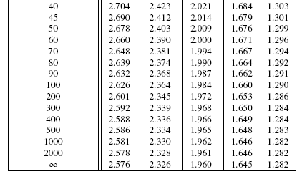
T-distribution at high ν…

Slide 26
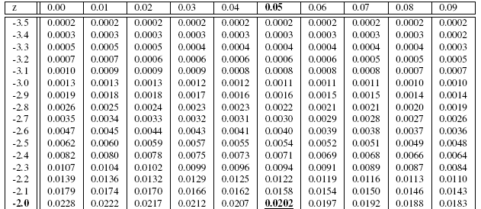
Similar to the normal distribution table
`z-values’
One-tailed significance levels

