Slide 1
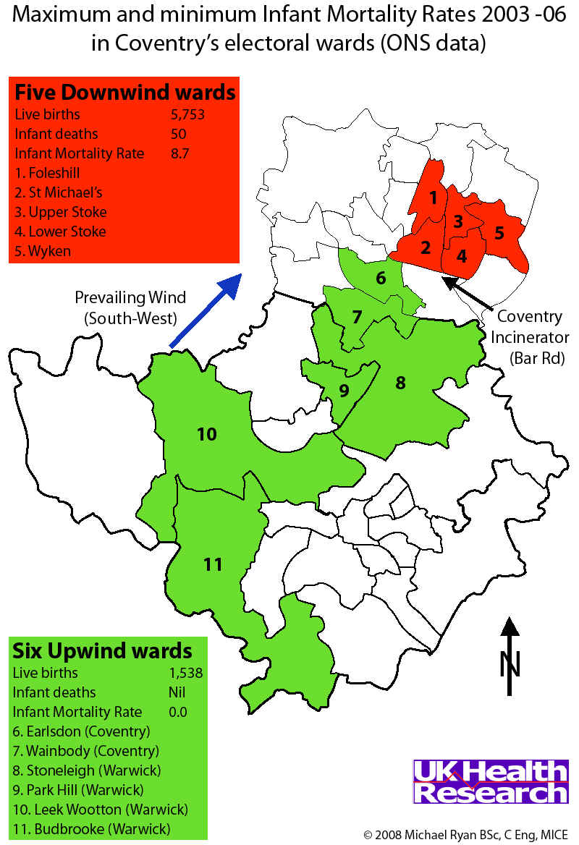
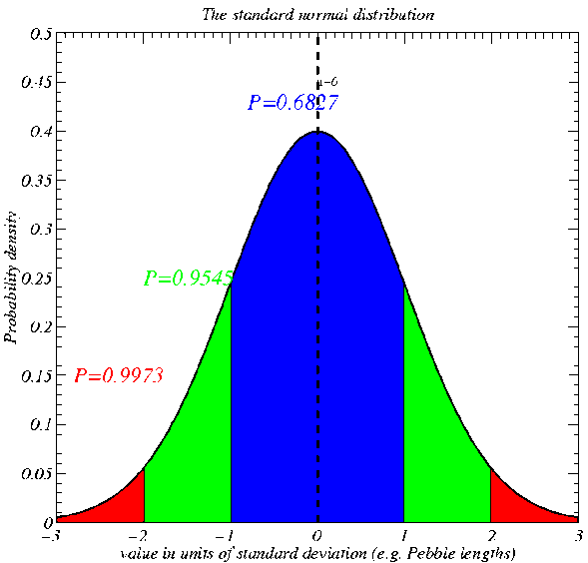
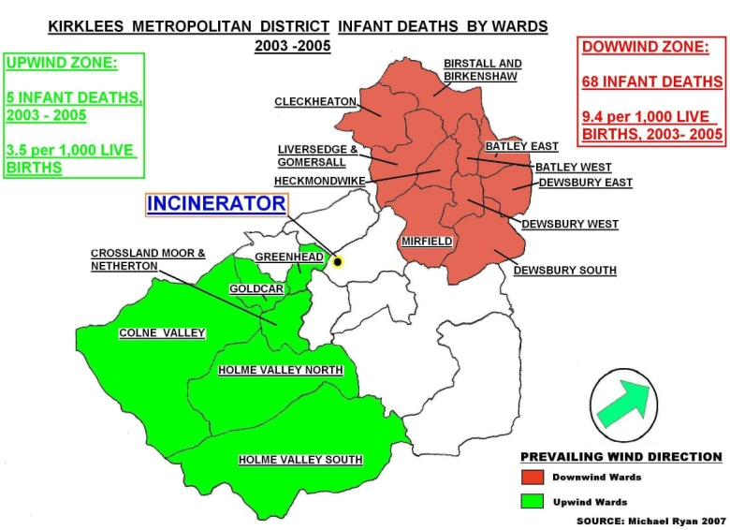
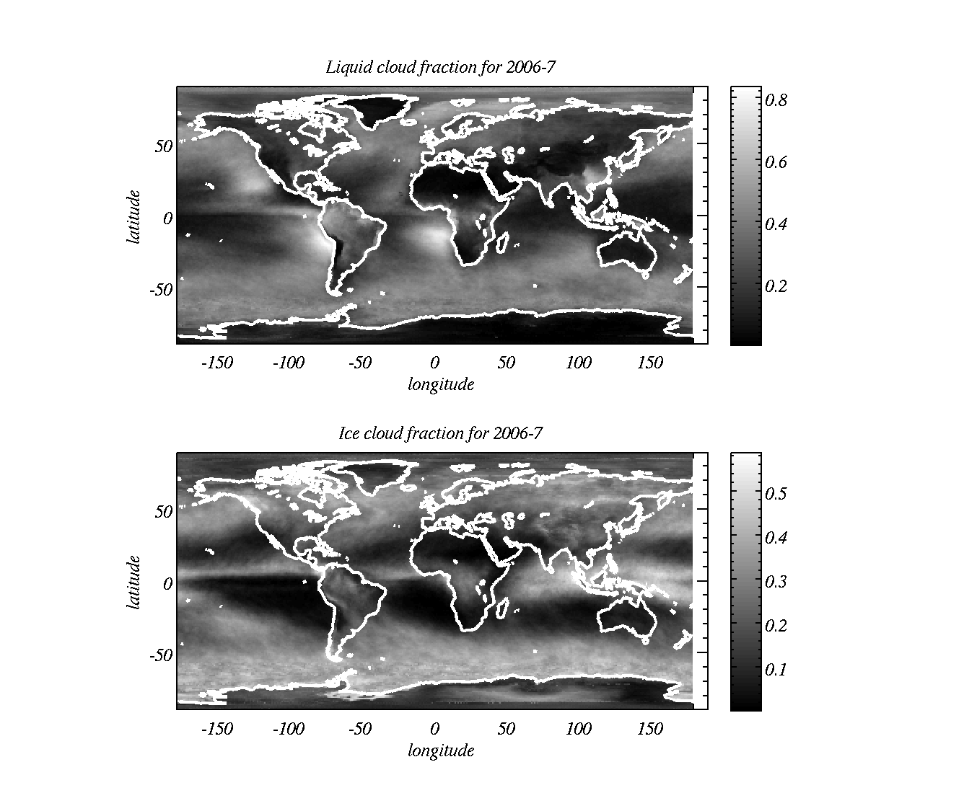
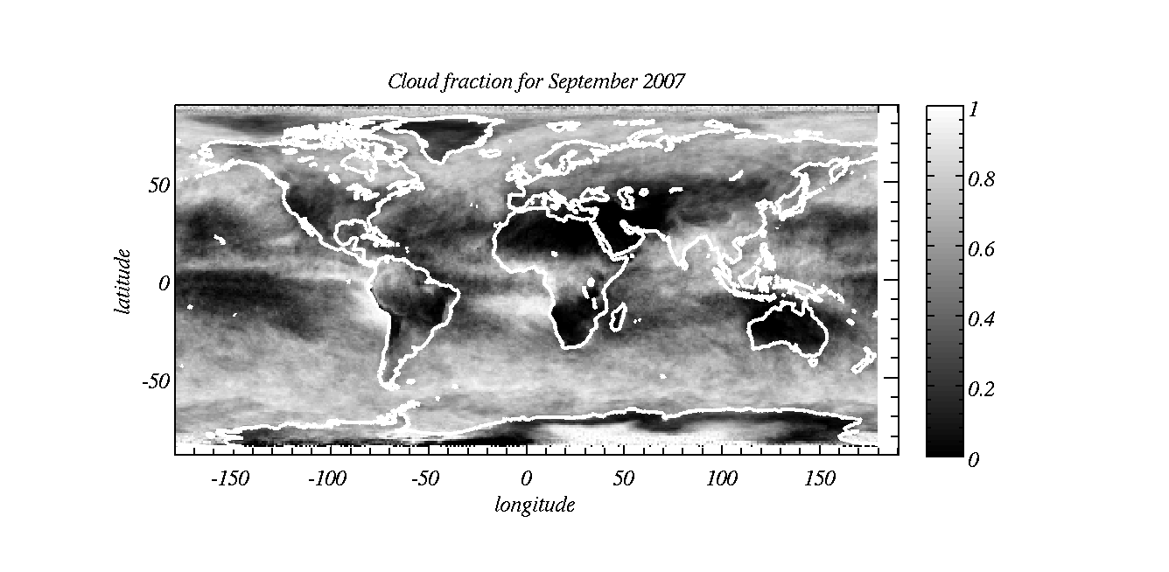
EART10160 data analysis lecture 4: hypothesis testing about two means / proportions
Dr Paul Connolly

Slide 2
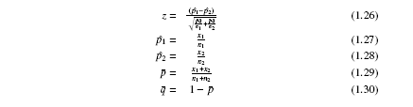
Why does this kind of hypothesis testing work? (I)
If you take a random sample, size n₁, from a population of which a proportion p₁ answer `yes’ to a question to calculate p̂₁, then repeat the process for sample n₂, to calculate p̂_{2.} you will find that p̂₁ and p̂_{2.} are in general not equal. Statisticians have found, if this process is repeated many times, the statistic, z:
p̂₁ =sample proportion 1 saying either yes or no (depends on convention).
p̂₂ =sample proportion 2 saying either yes or no (depends on convention).
p=total proportion saying either yes or no from both samples
q=sample proportion saying the opposite to p from both samples
will be:
  Distributed according to a standard normal distribution (if the data are drawn from the same population).
Therefore, if we calculate a value of z from our data that is large, we can say it is unusual.

Slide 3
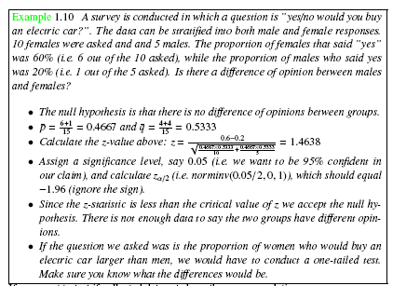
Example: proportions (consumer opinions)
Notes:
E.g. difference between Environmental Science and Geology students (are they different animals?)

Slide 4
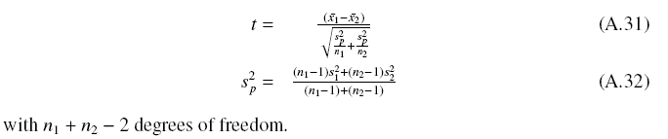
Why does this kind of hypothesis testing work? (II)
Statisticians have found that if you take two independent random samples, size n₁, n₂, from a population with mean μ and calculate
it will be:
  Distributed according to a Student t distribution if they are from the same distribution.
Therefore, if we calculate a value that has a large value of t, we can say it is unusual.

Slide 5
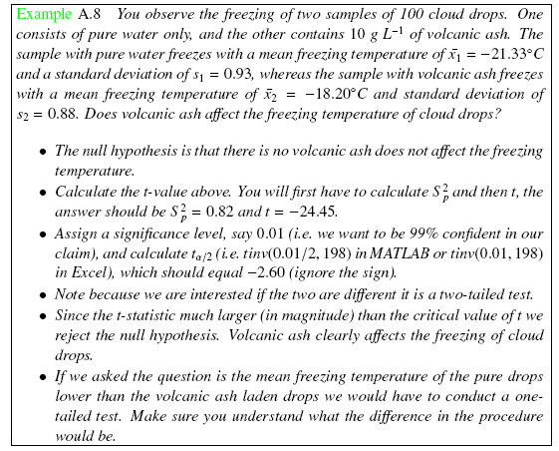
Example: population mean (differences between two groups)
Notes:
E.g. does volcanic ash affect the freezing of cloud drops?

Slide 6
One-tailed and two-tailed tests
Usually when testing hypotheses using two samples we can have either one or two-tailed tests.
Two tailed test is if we are testing if something is significantly different to something else (e.g. as we did last week)
  E.g. the data in sample 1 have a mean that is significantly different (higher or lower) than the data in sample 2.
  The mortality rate downwind of incinerators is significantly different (higher or lower) than the rate upwind.
One-tailed test is if we are testing if something is significantly larger or smaller than something else.
  E.g. the mortality rate downwind of incinerators is significantly higher than the mortality rate upwind of incinerators.
Important as it affects the probability you put into the `norminv’, (or `tinv’) functions in Excel or MATLAB.

Slide 7
IMPORTANT: Reiterated from last week!
Those using Excel or MATLAB:
  E.g. calculate the critical value of z for a 1 tailed 5% significance level:
  norminv gives the distance away from the mean for the input probability so norminv(0.05,0,1)
  E.g. calculate the critical value of z for a 2 tailed 5% significance level:
  norminv gives the distance away from the mean for the input probability, there are two lots of 0.025 either side so norminv(0.025,0,1)
Those using Excel (t-distribution)
  E.g. calculate the critical value of t for a 1 tailed 5% significance level:
  For Excel: tinv gives the distance away from the mean for a two tailed input probability so multiply the probability by two: tinv(0.05*2,df);
Those using MATLAB (t-distribution)
  E.g. calculate the critical value of t for a 1 tailed 5% significance level:
  For MATLAB: tinv gives the distance away from the mean for a one-tailed input probability so don’t divide probability by two: tinv(0.05,df); ignore sign

Slide 8
Example of one and two-tailed test
Degrees of freedom:
  Testing about a population mean: N-1
  Testing about two population means: N1+N2-2
Test whether a sample mean (of size 10) is significantly larger than the sample mean of size 20 at the 0.01 level of significance (10+20-2 degrees of freedom)
  Excel: tinv(0.01*2,28)
  MATLAB: tinv(0.01,28) [ignore sign]
Test whether a sample proportion (of size 20) is significantly different from a sample (of size 10) proportion at the 0.05 level of significance
  Excel: norminv(0.05/2,0,1)
  MATLAB: norminv(0.05/2,0,1) (and ignore the sign!)

Slide 9
This weeks practical:
(cloud fraction data from satellite)
One month of data from the MODIS sensor (NASA)

Slide 10
This weeks practical
Is most of the planet covered by clouds?
  What do you think?
  We could try and test the hypothesis that students think it is greater than 50 : 50
Are most clouds made from liquid or ice?
Is it more cloudy during an El-Nino year than a non El-Nino year?
  What is El-Nino?

Slide 11
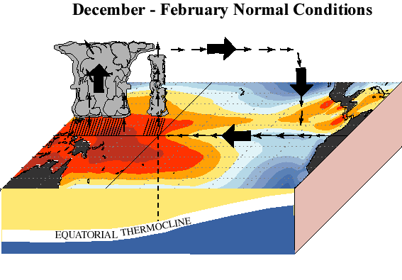
The Walker Circulation:
Climate and Energy EART30362 lecture 8B-9
Notes:
Ocean surface temperatures across the tropical Pacific contribute significantly to the observed patterns of tropical rainfall and tropical thunderstorm activity. The heaviest rainfall is typically observed across Indonesia and the western tropical Pacific, and least rainfall is normally found across the eastern equatorial Pacific.
The mean patterns of sea surface temperature and equatorial rainfall are accompanied by low level easterly winds (east- to- west flow) and upper level westerly winds across the tropical Pacific. Over the western tropical Pacific and Indonesia this wind pattern is associated with low air pressure and ascending motion, while over the eastern Pacific it is accompanied by high pressure and descending motion. Collectively, these conditions reflect the equatorial Walker Circulation, which is a primary large-scale circulation feature across the Pacific.
The subsurface ocean structure is characterized by a deep layer of warm water in the western tropical Pacific, and by a comparatively shallow layer of warm water in the eastern Pacific. This warm water is separated from the cold, deep ocean waters by the oceanic thermocline, which is normally deepest in the west and slopes upward toward the surface farther east. The resulting east-west variations in mean upper-ocean temperatures result in east-west variations in sea level height, which is higher in the west than in the east.

Slide 12
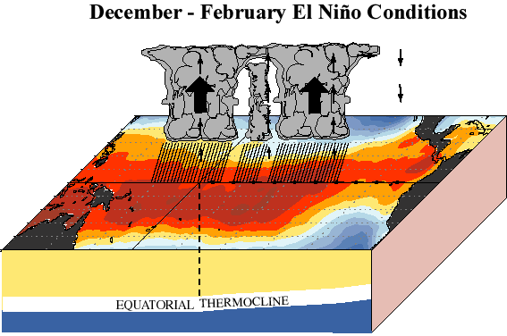
Changes to the Walker Circulation During El Nino:
Reduced surface wind speeds: weakened Walker circulation
Reduced upper level wind speeds, weakened Walker Circulation
Higher sea surface height in E Pacific
Deeper layer of warm water, deeper thermocline in eastern Pacific
Reduced or zero thermocline gradient across Pacific

Slide 13
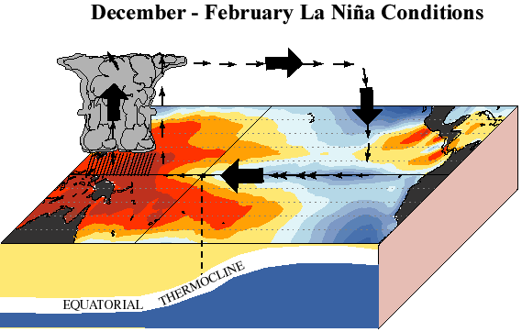
Changes to the Walker Circulation during La Niña:
Increased upper level wind speeds, enhanced Walker Circulation
Increased surface wind speeds: enhanced Walker circulation
Lower sea surface height in E Pacific
Shallow layer of warm water, shallow thermocline in eastern Pacific
Enhanced thermocline gradient across Pacific
Nutrient rich water close to surface

Slide 14
Liquid clouds are predominant on west coast of Chile, US and South Africa.
  In regions of high pressure
  Learn about why high pressure results in little high cloud, but low cloud in Meteorology course (EART30551).
Ice clouds predominant over the Indonesian tropical warm pool
H
H
H

Slide 15
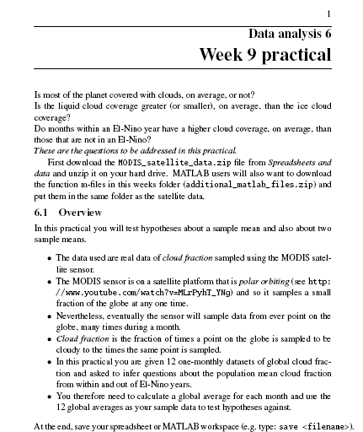
The practical this week
The aim of the practical is to give practice with dealing with a large dataset and using it to test interesting? Hypotheses.

Slide 17
Coventry
Last week we asked whether mortality rate downwind was significantly higher than the population.
What if we just wanted to ask whether the two groups of people are different? Doesn’t prove that the incinerator makes them different, but that they are different (or not!)

Slide 18
Definition (recap)
Hypothesis: A testable statement on the basis of limited evidence as a starting point for further investigation.
Null hypothesis: A type of hypothesis used in statistics that proposes that no statistical significance exists in a set of given observations.
Alternate hypothesis: the opposite to the null hypothesis

