Slide 1
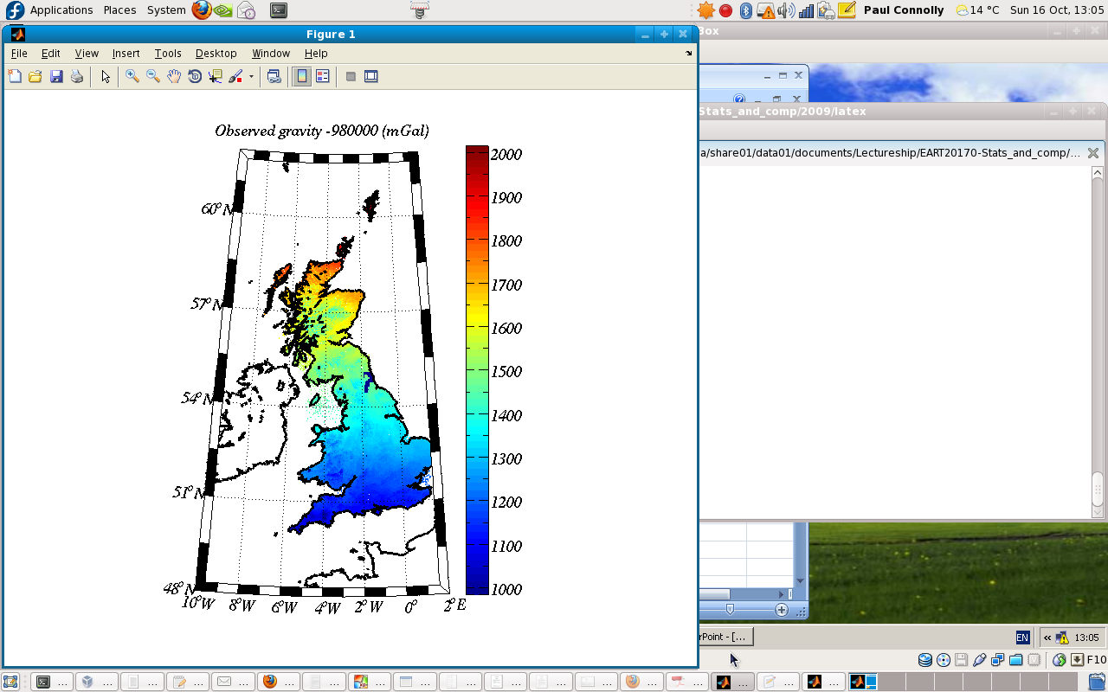
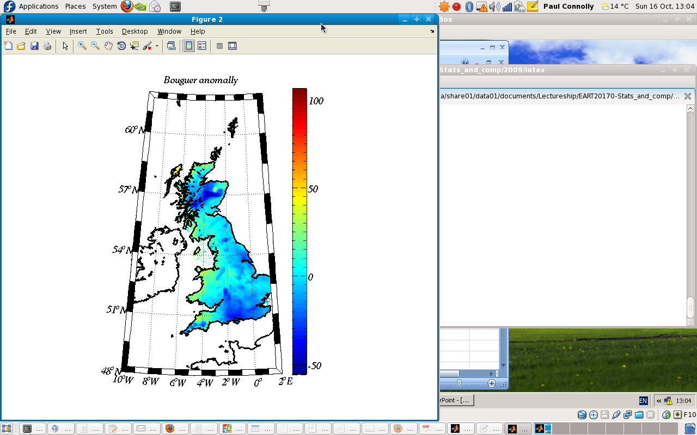
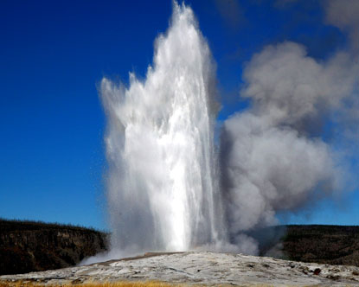
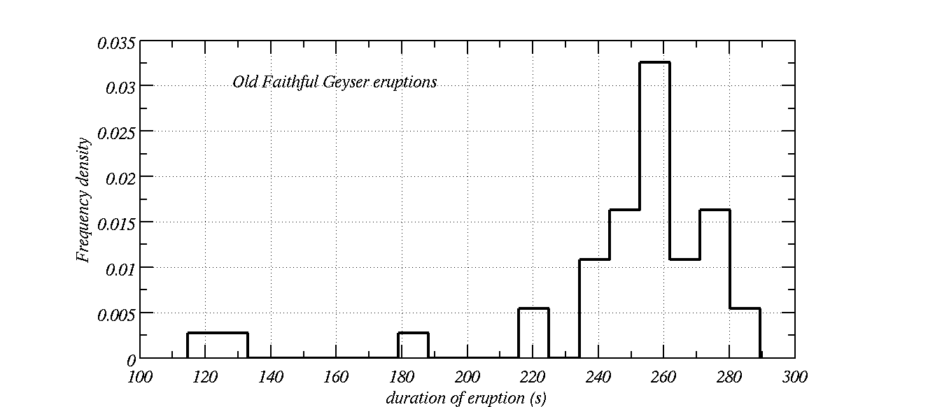
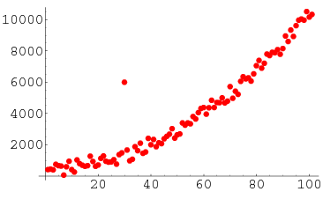
EART20170 data analysis lecture 2: descriptive stats and outliers
Dr Paul Connolly

Slide 2
Frequency tables and histograms
A frequency histogram is a plot of binned data using the bin mid-points and the frequency in the bin as x and y values respectively.
Excel doesn’t do this by default…
  It uses upper bin edges.
  So bin upper edges need to be shifted before plotted
Why is Excel is a pain!

Slide 3
Overview this week
Descriptive statistics (4 boring slides, sorry!):
  Mean, Median, Mode
  Standard deviation, variance, standard error, range.
Outliers:
  Spotting them in histograms
  Definition using `z-score’
Rare values:
  Determined using `z-score’
Visual comparison of histograms

Slide 4

Definition: Mean, page 8 notes
x_{i}= values in a list
- means to sum all values
N = number of data points in a list (sample size).
Excel:
=AVERAGE(A1:A10) (see table page 45 of notes)
MATLAB:
mean(dat) (see table page 45 of notes)

Slide 5
Definition: Median and Mode
Median: half way point in a ranked list of numbers.
  Excel: `=median(A1:A10)’ (see table page 45 of notes)
  MATLAB: `median(dat)’ (see table page 45 of notes)
Mode: most frequent value (the highest point in a histogram)
  Excel: `=mode(A1:A10)’ (see table page 45 of notes)
  MATLAB: `mode(dat)’ (see table page 45 of notes)

Slide 6

Definition: Standard deviation, page 9 notes
x_{i}= values in a list
- means to sum all values
N = number of data points in a list.
Normally:
68.3% of data lies within 1 standard deviation of the mean
95.5% of data lies within 2 “
99.9% of data lies within 3 “
Excel
`=STDEV(A1:A10)’ (see table page 45 of notes)
MATLAB
`std(dat)’ (see table page 45 of notes)

Slide 7

Definition: z-score
If you don’t know the population mean,μ, just use the sample mean.
This tells us how many standard deviations away from the mean a value is.
Remember that normally:
68.3% of data lies within 1 standard deviation of the mean
95.5% of data lies within 2 “
99.9% of data lies within 3 “

Slide 8
Old faithful geyser: determining outliers

Slide 9
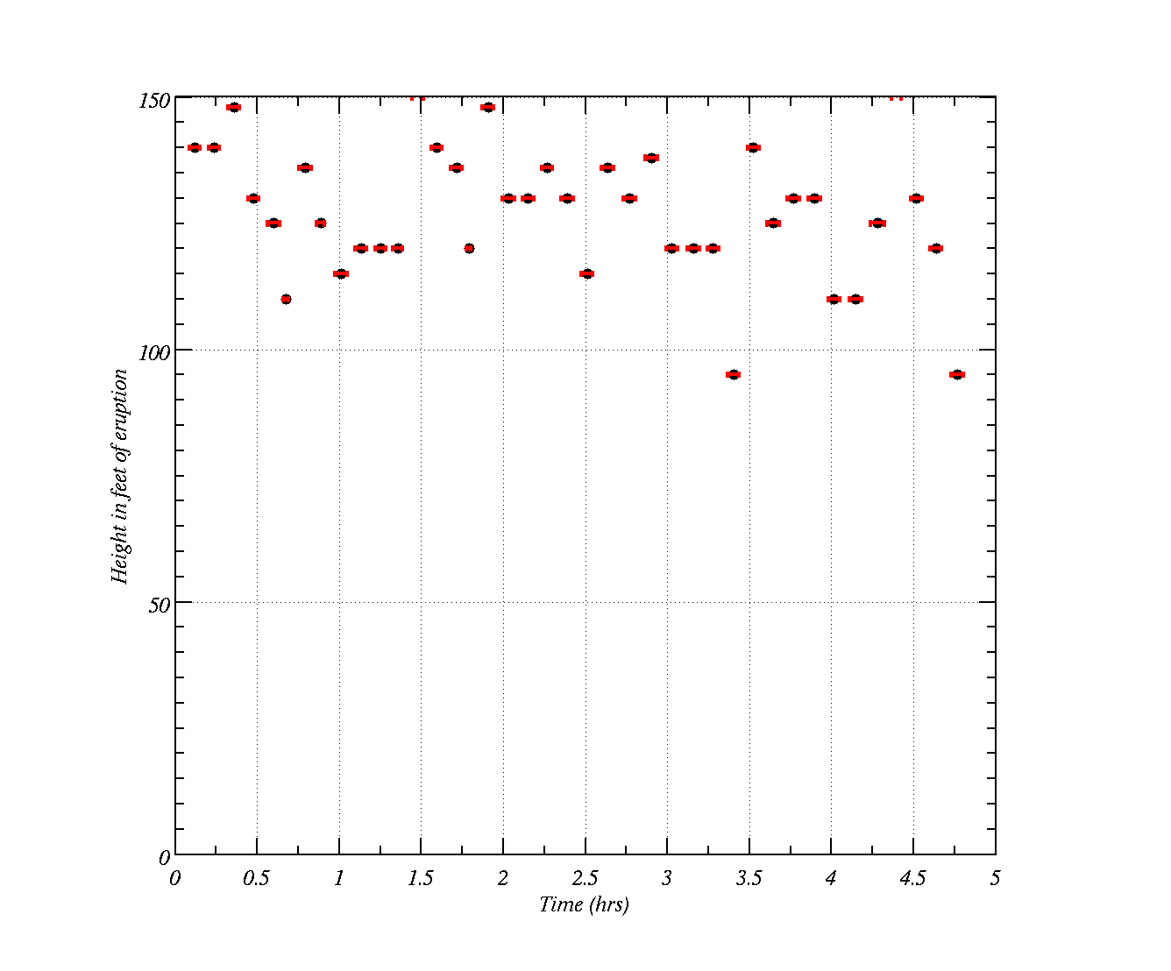
See OLDFAITH.xls

Slide 10
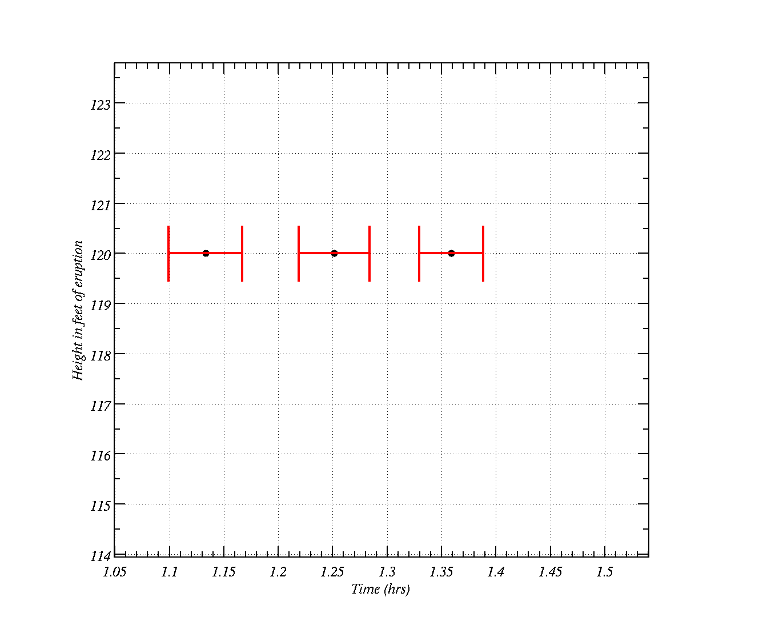
See OLDFAITH.xls
Duration of eruption

Slide 11
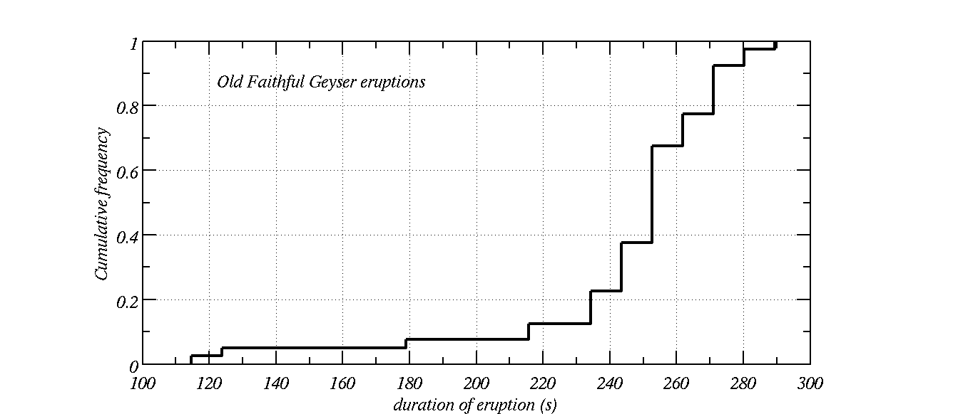
Frequency density:
  Frequency divided by the sum of the total, divided by the bin width
  Area under the curve=1
Cumulative Frequency:
  Cumulative sum of frequency histogram (from the left) divided by the total.
  Max value of curve=1
What value is 90% of the data less than (or 10% of the data larger than)?

Slide 12
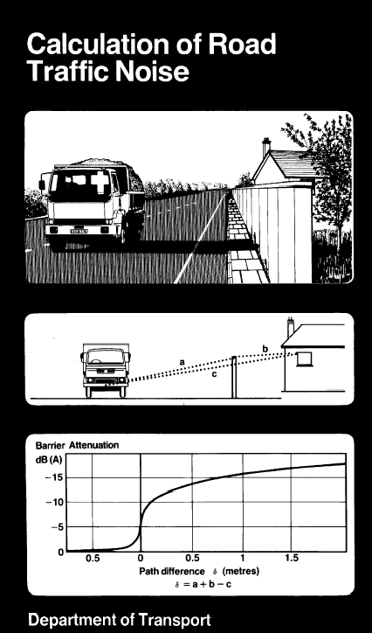
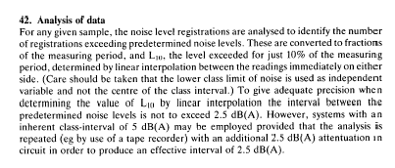
Page 29 says
The wording is atrocious! (and probably purposely written so that lay people do not understand it.)
In other words, just produce a cumulative frequency plot and find the sound level corresponding to cumulative frequency=0.9

Slide 13
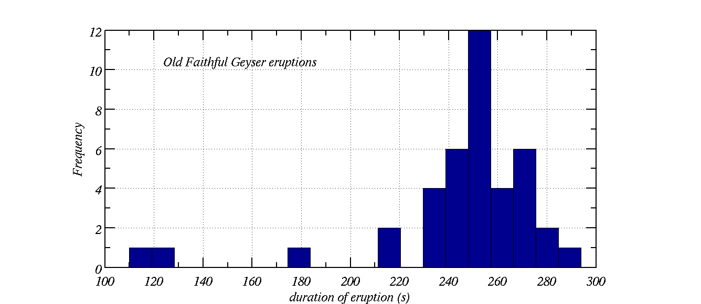
How can we tell whether the duration of eruptions of old faithful is changing or unusual?
How do we quantitatively say that these are unusual?
The histogram is asymmetric
Visually, they are separated from the main `mode’
Could also calculate the z-score for the list of data.

Slide 14
Rare values are not the same as outliers, but statistically can be determined in a similar way (e.g. calculating the z-score)…

Slide 15
Geophysics: gravity anomalies
Gravity: more mass = higher attraction.
BGS measure the observed gravity in units of mGal (1x10⁻⁵ m s⁻²)
Tell you about the geology of the UK.

Slide 16
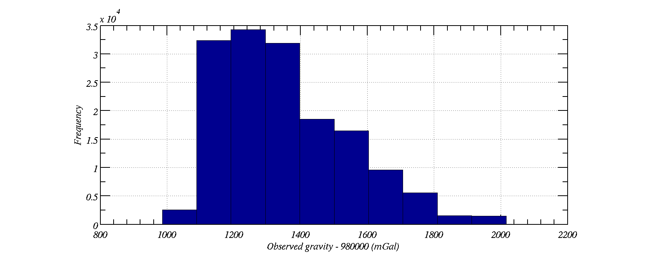
Histogram of observed gravity over the UK
Positively skewed
i.e. every so often it is higher than most of the values
The positive skew makes observed gravity difficult to analyse statistically.

Slide 17
Geophysics: the Bouguer anomaly
Difference between expected value of gravity and actual.
  +ve anomaly means there is less gravity than expected
  and vice-versa.
Tells you about how dense the underlying surface is.
i.e. if there is a large oil field or meteorite below the surface.

Slide 18
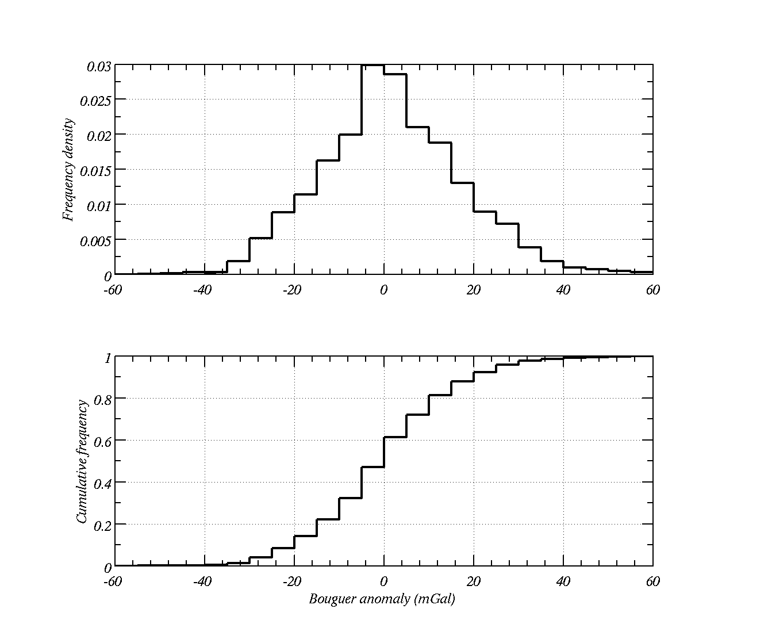
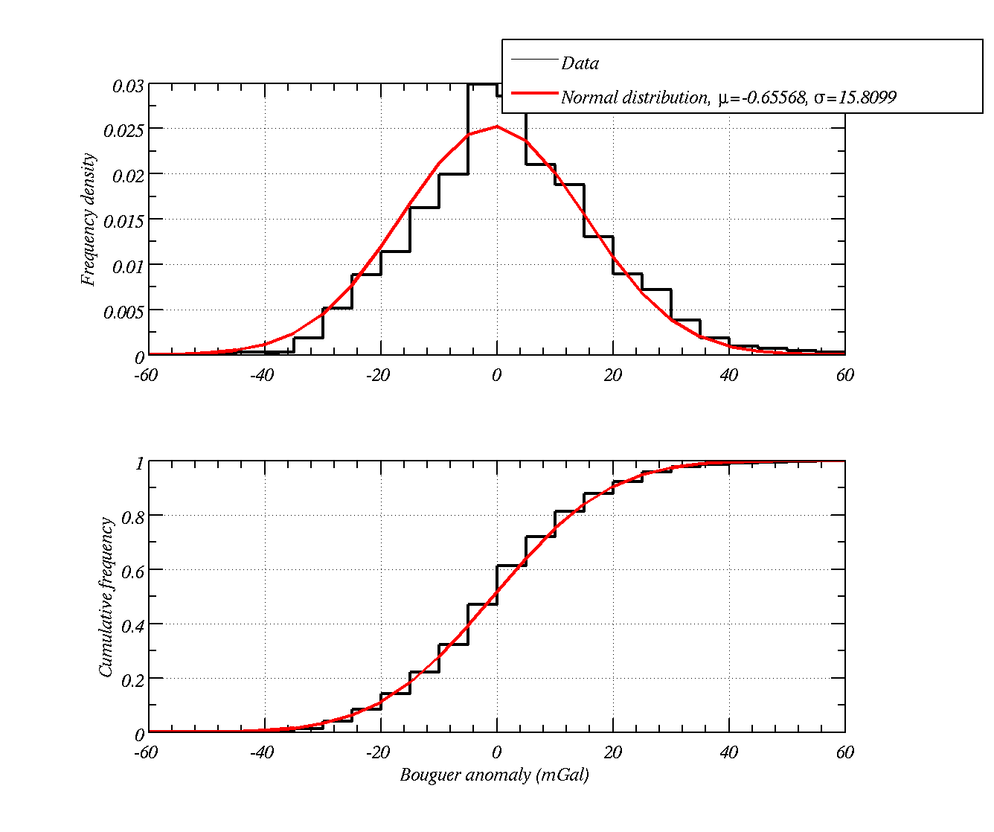
It turns out that distribution Bouguer anomaly over the UK almost symmetrical. It is normally distributed this makes it much easier to analyse in the context of this course (next practical). There are no obvious outliers in the histogram.
Although there are no obvious outliers you will be asked whether a value is unusual. In this context we are asking whether a value is rare

Slide 19
Comparing histograms to say whether datasets are similar (or not)

Slide 20
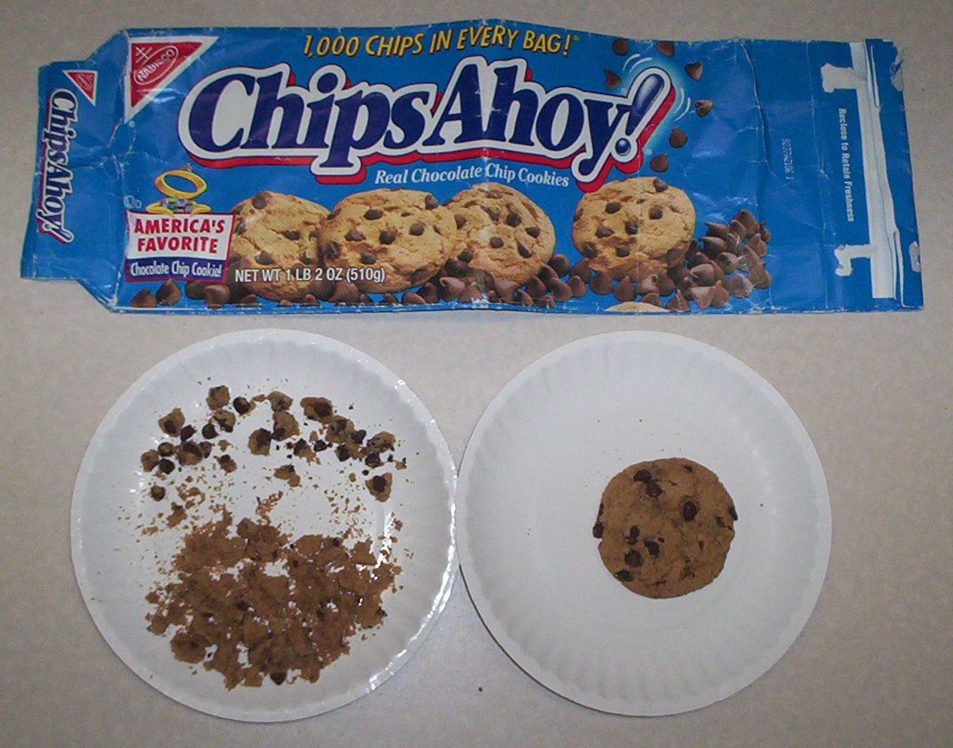
Do brand-name biscuits have more chocolate chips than the supermarkets brand?

Slide 21
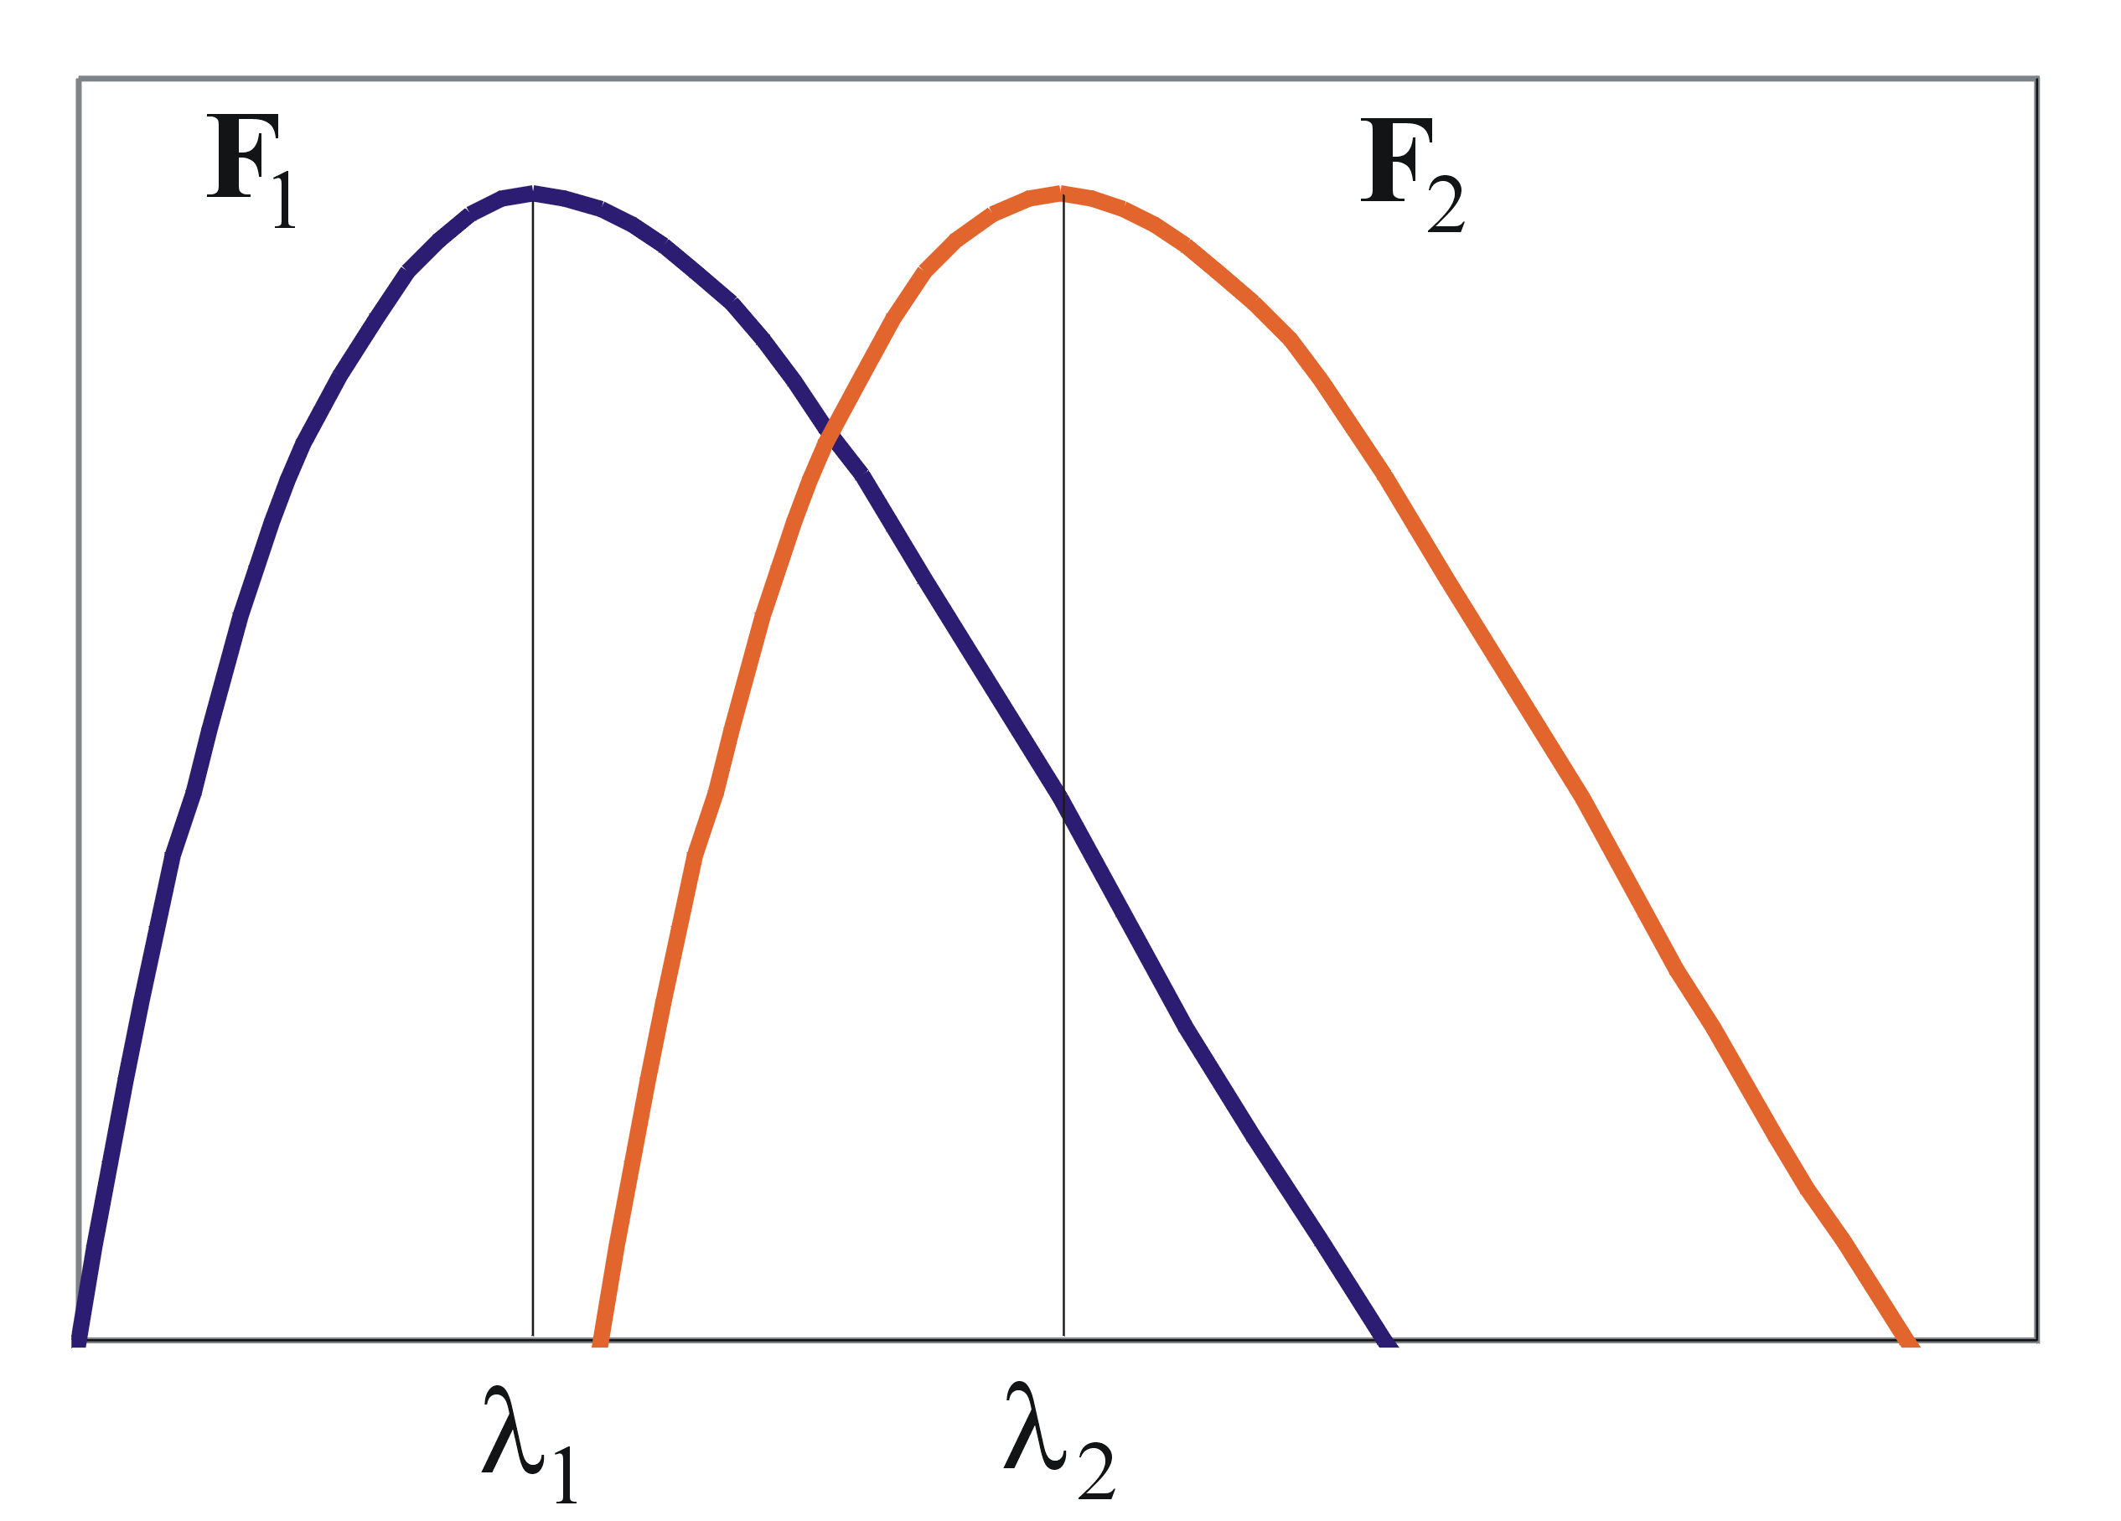
Your population data might look like:
Store brand
Name brand
Can you say that the
name brand has more chips?
Can you say that the
name brand has more chips?
How certain are you?
Number of biscuits
Number of chocolate chips per biscuit

Slide 22
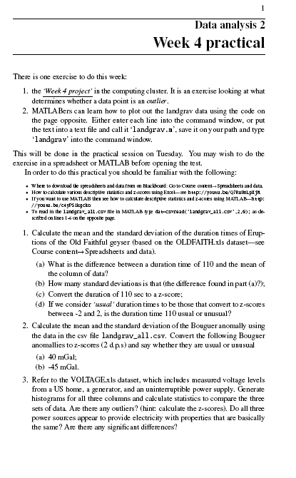
Either do in Excel or MATLAB (help will be on hand)
YouTube tutorials
Spreadsheets and data.

Slide 23
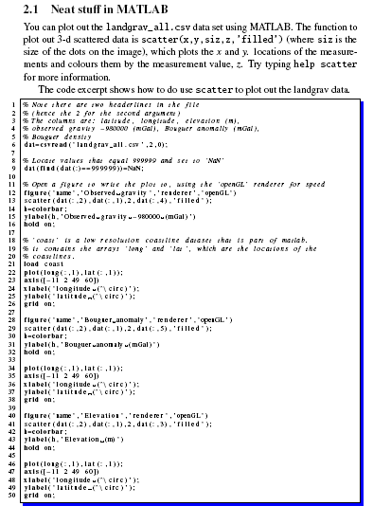
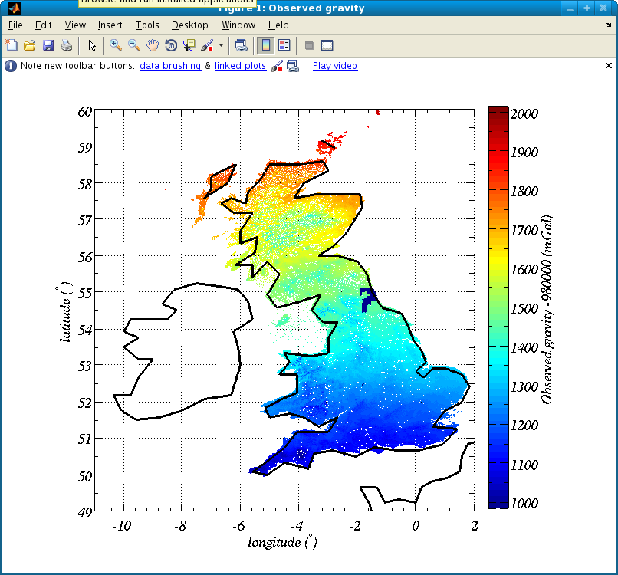
MATLABers, if you want to learn how to plot out the landgrav data from BGS see second page
`scatter’ function deals with ungridded 2-d spatial data
We will also learn how to deal with gridded data.
I would not know how to do this in Excel.

Slide 24
Week 4 practical
You are given several datasets and asked to say whether different values are usual or un-usual.
  Use the z-score to say how many standard deviations from the mean the values are. Larger than 2 standard deviations are un-usual.
You are asked to look at a cumulative frequency distribution and comment on it.
You are asked to create several histograms – practice, practice, practice.
You are asked to compare different histograms of VOLTAGES to say whether different datasets are different.
  Look to see how much of the histograms over-lap with each other and how different the modes, and variations are.

